Slide 1
2024 NFHS Softball Rules PowerPoint
Rules changes
Major Editorial Changes
Points of Emphasis

Slide 2
about the NFHS

Slide 3

nfhs
NFHS (located in Indianapolis, IN – Est. 1920):
  National leader and advocate for
  high school athletics and
  performing arts programs.
  Serves 51 state associations, 19,500
  high schools and 12 million student
  participants.
  Writes playing rules for 17 high school
  sports for boys and girls.
  Offers online education courses for high school coaches,
  officials, parents, students and others.
  Ensures that students have opportunity to enjoy healthy participation, achievement and good sportsmanship in education-based athletics.
Notes:
The NFHS is the national leader and advocate for high school athletics and performing arts programs. Services of the NFHS reach more than 19,000 high schools and 12 million participants throughout the eight NFHS sections across the U.S.
A significant responsibility of the NFHS is the commitment to writing quality playing rules for 17 high school sports for boys and girls, in addition to providing educational resources for high school coaches, officials, parents and students.
It is the vision of the NFHS to help prepare tomorrow’s leaders for the next level of life through the many program offerings in education-based athletics and activities.

Slide 4








NFHS Rules Review Committee
The NFHS Rules Review Committee is chaired by the chief operating officer and composed of all rules editors. After each committee concludes its deliberations and has adopted its recommended changes for the subsequent year, such revisions will be evaluated by the Rules Review Committee.
Davis Whitfield
Chief Operating Officer
Lindsey Atkinson
Basketball, Girls Lacrosse and Volleyball
Bob Colgate
Football and Sports
Medicine
Sandy Searcy
Softball, Swimming & Diving and Water Polo
Elliot Hopkins
Baseball and Wrestling
Julie Cochran
Cross Country, Gymnastics, Field Hockey, Soccer and
Track & Field
James Weaver
Boys Lacrosse
and Spirit
Dan Schuster
Ice Hockey
Notes:
All rules committee recommended rules changes are vetted through the NFHS Rules Review Committee before advancing to the NFHS Board of Directors for final action. The committee, as you see, is comprised of all NFHS Director of Sports and chaired by the NFHS Chief Operating Officer.

Slide 5
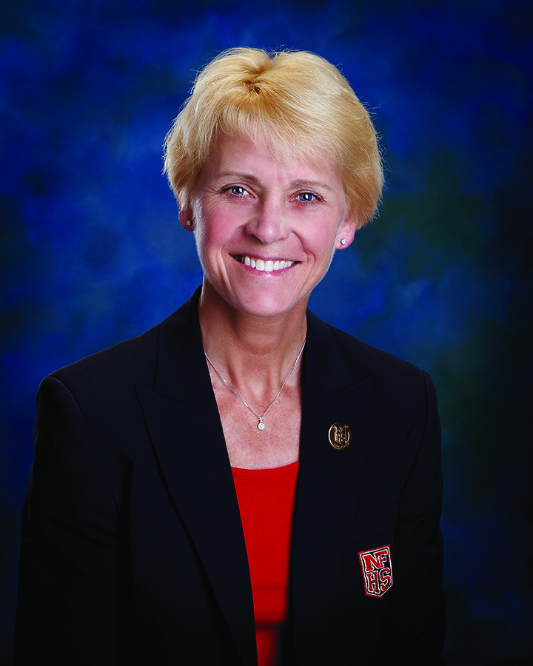
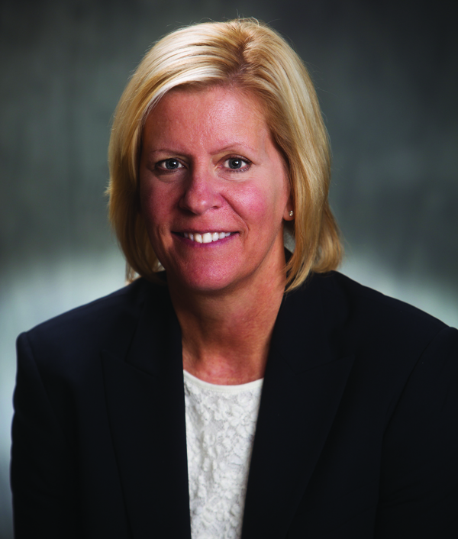
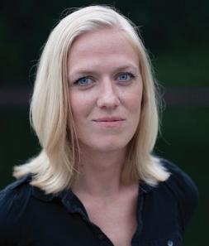



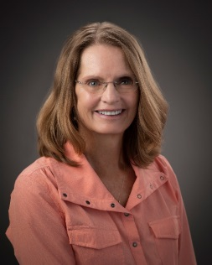
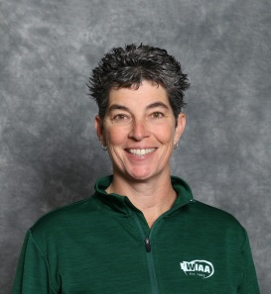
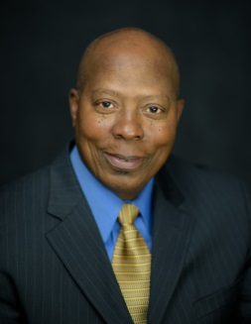
NFHS Rules Committee
Dr. Karissa Niehoff
NFHS
Publisher
Sandy Searcy
NFHS
Editor
Andi Osters
Michigan
Chair - 2026
Dennis Crowe
Maine
Section 1 - 2024
Sarah Bridenbaugh
Kentucky
Section 2 - 2025
Michelle Yeater
South Carolina
Section 3 - 2026
Cathy Creighton
Iowa
Section 4 - 2023
Diane Smith
Kansas
Section 5 - 2024
Steve Roberts
Arkansas
Section 6 - 2025
Laura Traeger
Nevada
Section 7 - 2026
Kelly Foster
Oregon
Section 8 - 2023
BJ Kuntz
NFHS Coaches Association - 2025
Michiael Shannon
NFHS Officials
Association - 2026
Notes:
Photos of the 2023 NFHS Softball Rules Committee members include the representation of eight sections, the NFHS Officials Association, the NFHS Coaches Association, and Rules Committee Chair.

Slide 6












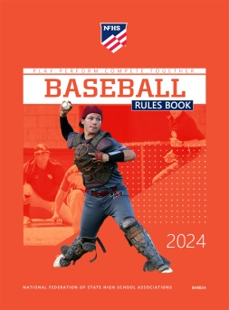
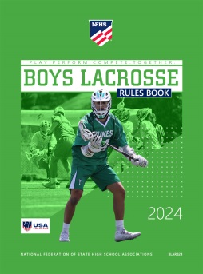
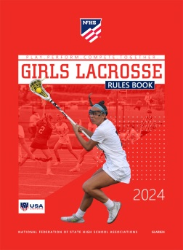



Nfhs
The NFHS writes playing rules for 17 sports
for boys and girls at the high school level.
  Publishes 4 million pieces of materials annually.
Notes:
The NFHS writes playing rules for 17 sports, publishes High School Today (HST) along with several other key publications totaling over four million pieces annually.

Slide 7

NEW NFHS AllAccess – Website
AllAccess is the New NFHS Digital Publications Platform that includes:
  Rules Publications
  High School Today Magazine
  Policy Debate Quarterlies
  Other NFHS Digital Publications
Website organized for associations and individuals to assign books and manage purchases
Visit www.allaccess.nfhs.org

Slide 8
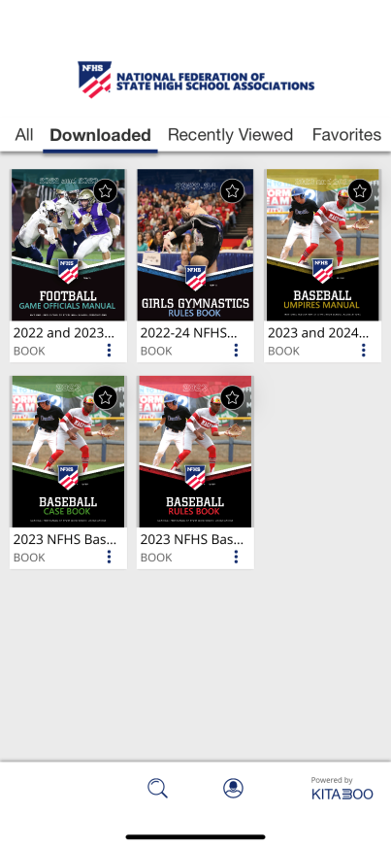


NEW NFHS AllAccess – Mobile App
Access Via Website or Mobile App:
View available publications for sale
View publications assigned to you
Download books for offline viewing
Read publications as an e-book
  Book features include:
    Table of contents
    Highlighting text
    Creating ‘sticky notes’ on pages
    Searching for terms
    Mark-up pen feature
    Viewing highlights and notes on data page
Available on App Store and Google Play

Slide 9
Guidelines for Schools and state associations for consideration of accommodations
Request of Accommodation by School
State Association Review
Written Determination from State Association
Competition with Approval of Accommodation
Notes:
To assist state associations in working with schools for the inclusion of students with disabilities the following guide prepared by the NFHS Task Force on the Inclusion of Students with Disabilities is being provided for your review.
Following these guidelines will assist in the individual student assessment by the student and the school.
When requesting a possible accommodation, coaches should work with their school and the state association as early as possible in the sport season.
Contest officials shall defer decisions on rule accommodations to the respective state association.
This information serves as a guide. Each state association may develop its own process.

Slide 10
2024 nfhs softball RULES CHANGES

Slide 11
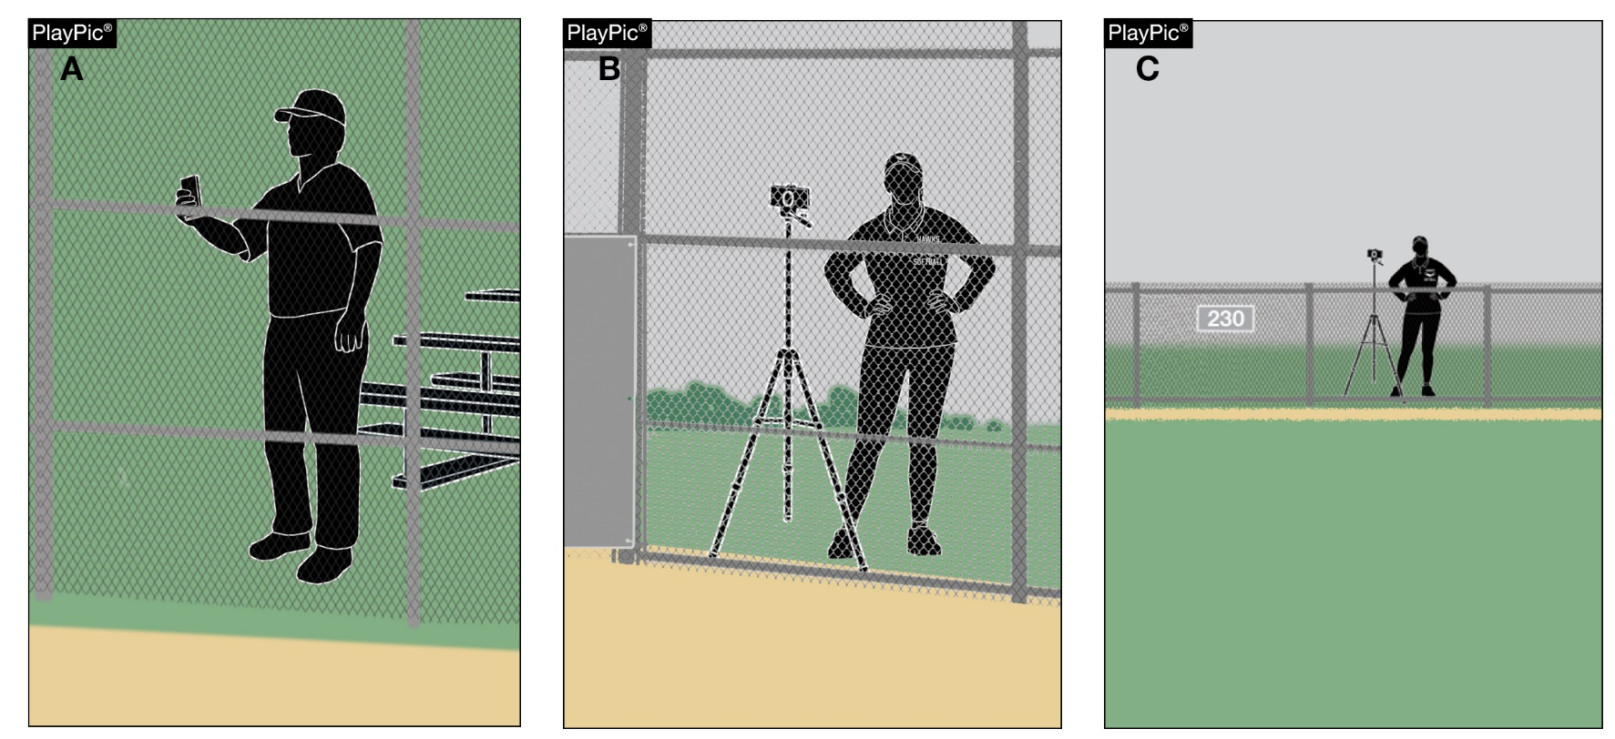
Other equipment
1-8-6
Electronic information may be transmitted to the dugout from anywhere outside of live ball area. However, electronic devices used for coaching purposes may only be utilized in the dugout.
Notes:
Rule 1-8-6: Electronic information may be transmitted to the dugout from anywhere outside of live ball area. However, electronic devices used for coaching purposes may only be utilized in the dugout.
Rationale: The rule change reflects current technology and still requires that electronic devices used for coaching purposes may only be used in the dugout but does not stipulate where the video is recorded or how it is transmitted.
Comments: The rule edit continues to require that electronic devices for coaching purposes can only be used in the dugout but does not require that the information originate from the dugout. The electronic information may be transmitted to the dugout from anywhere outside of live ball area.

Slide 12
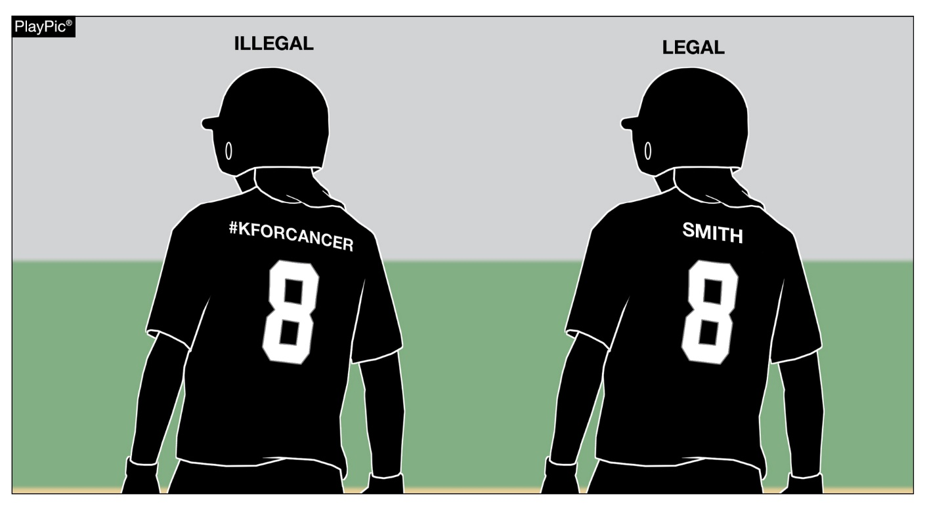
Uniforms, player equipment
3-2-3
Beginning January 1, 2027, uniforms may only bear a single manufacturer’s logo, school name, school logo, mascot and/or the participant’s name. Advertisements, messages, team slogans, etc., will no longer be permitted.
Notes:
Rule 3-2-3: Beginning January 1, 2027, uniforms may only bear a single manufacturer’s logo, school name, school logo, mascot and/or the participant’s name. Advertisements, messages, team slogans, etc., will no longer be permitted.
Rationale: Consistent language has been established for NFHS sports that describe what information is permitted on the uniform. A player’s name, school name, school nickname, school mascot and/or the school logo may be placed on the uniform.
Comments: Beginning January 1, 2027, uniforms may only bear a single manufacturer's logo, school name, school logo, mascot and/or the participant's name. Advertisements, messages, team slogans, etc., will no longer be allowed.

Slide 13
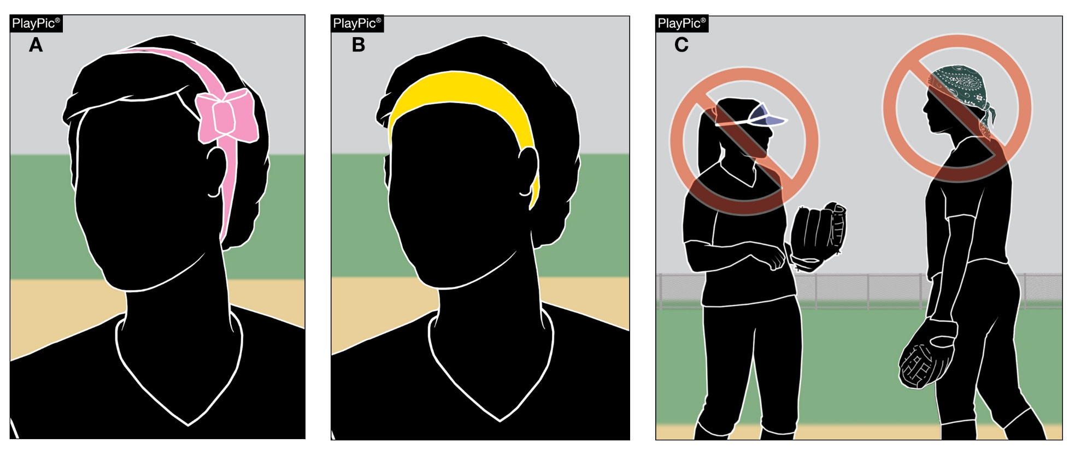
Uniforms, player equipment
3-2-5
There is no longer a color restriction for headbands and ribbons. However, plastic visors and bandanas are still illegal.
Notes:
Rule 3-2-5: There is no longer a color restriction for headbands and ribbons. However, plastic visors and bandanas are still illegal.
Rationale: Adds consistency amongst headwear requirements for other NFHS sports.
Comments: Headbands and ribbons are no longer restricted under the uniform rules. Headbands and ribbons may be any color or design.

Slide 14
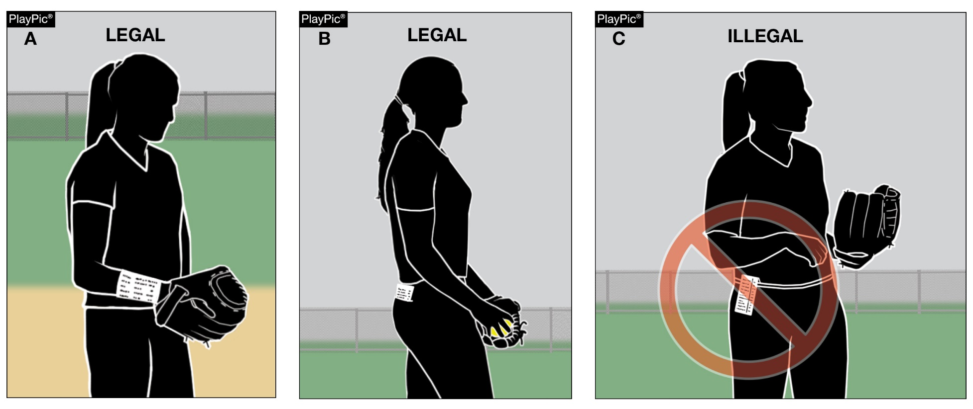
Uniforms, player equipment
3-2-7
A wristband with a playbook/playcard may only be worn on a player’s wrist or arm or kept in the back pocket. It may not be worn on the belt. If a pitcher wears one, it must be on the non-pitching arm.
Notes:
Rule 3-2-7: A wristband with a playbook/playcard may only be worn on a player’s wrist or arm or kept in the back pocket. It may not be worn on the belt. If a pitcher wears one, it must be on the non-pitching arm.
Rationale: Clarifies where this equipment can be worn. This change will prohibit wristbands from being worn on the belt. It remains legal for players to keep the wristband with a playbook/playcard in their back pocket.
Comments: If worn, a player’s wristband with a playbook/playcard must be worn on the player’s wrist or arm. If worn by the pitcher, the wristband with a playbook/playcard must be worn on the non-pitching wrist or arm. It remains legal for players to keep the wristband with a playbook/playcard in their back pocket.

Slide 15
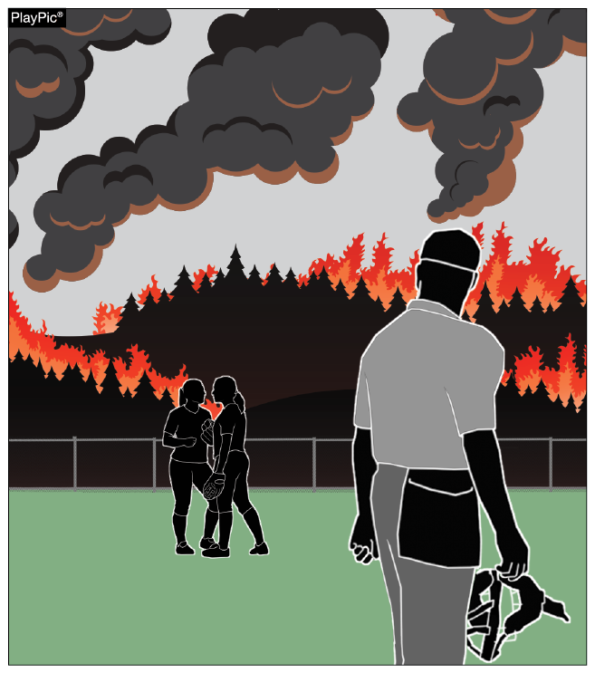
Ending a game, plate umpire
4-2-7 & 10-2-3e, h
The umpire may call (end) a game if playing conditions around the facility become unacceptable to safely continue the game.
Notes:
Rules 4-2-7 & 10-2-3e, h: The umpire may call (end) a game if playing conditions around the facility become unacceptable to safely continue the game.
Rationale: Provides rule justification when an umpire ends a contest due to unacceptable playing conditions to continue play in addition to weather.
Comments: The umpire may call (end) a game if conditions in or around the facility become unacceptable to safely continue the game.

Slide 16
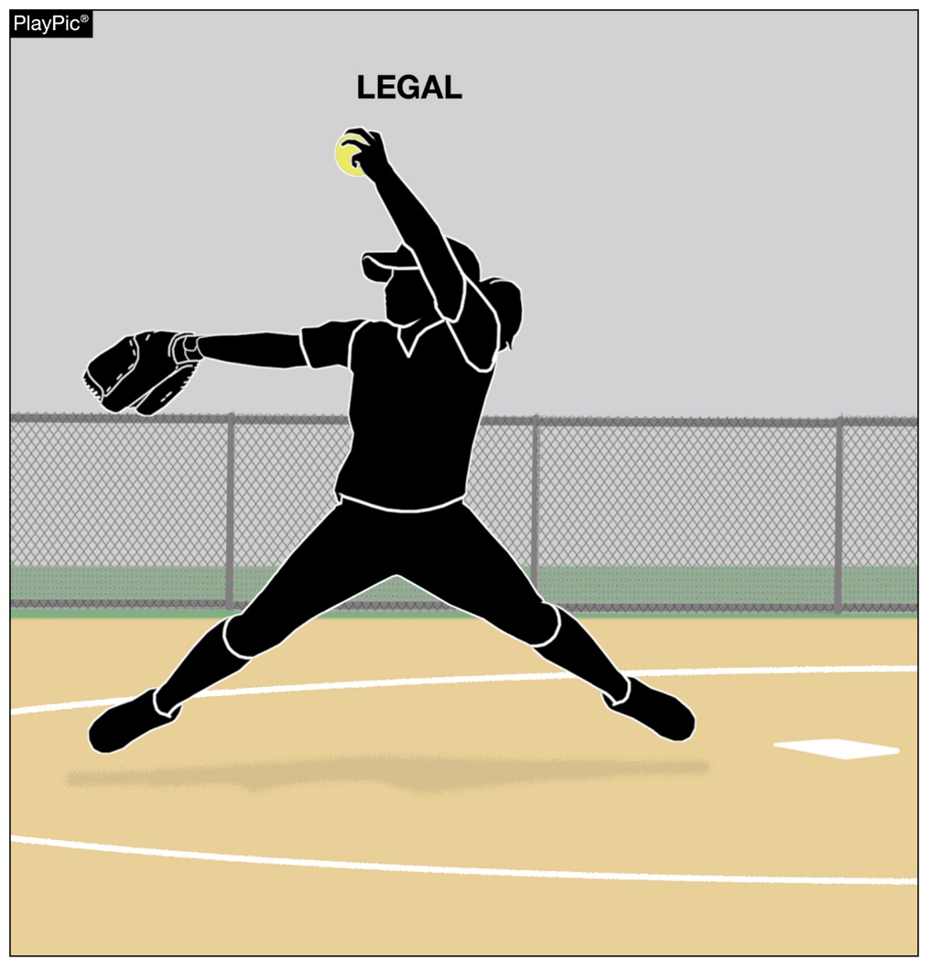
Pitching regulations (f.p.)
6-1-2c & 2-47
The pitcher may now have both feet off the ground at the same time as long as both feet remain with the 24-inch width of the pitching plate and the pitcher does not replant the pivot foot.
A replant of the pivot foot occurs when the pitcher pushes off the playing surface from anywhere other than the pitcher’s plate prior to the act of delivering the pitch.
Notes:
Rules 6-1-2c & 2-47: The pitcher may now have both feet off the ground at the same time as long as both feet remain with the 24-inch width of the pitching plate and the pitcher does not replant the pivot foot. A replant of the pivot foot occurs when the pitcher pushes off the playing surface from anywhere other than the pitcher’s plate prior to the act of delivering the pitch.
Rationale: The rule change permits both feet to disengage from the playing surface while delivering a pitch. The addition of Rule 2-47 defines that a replant of the pivot foot occurs when the pitcher pushes off the playing surface from anywhere other than the pitcher’s plate prior to the act of delivering the pitch.
Comments: The pitcher may now have both feet off the ground at the same time as long as both feet remain within the 24-inch width of the pitcher’s plate and the pitcher does not replant the pivot foot. A definition for the replant was added.

Slide 17
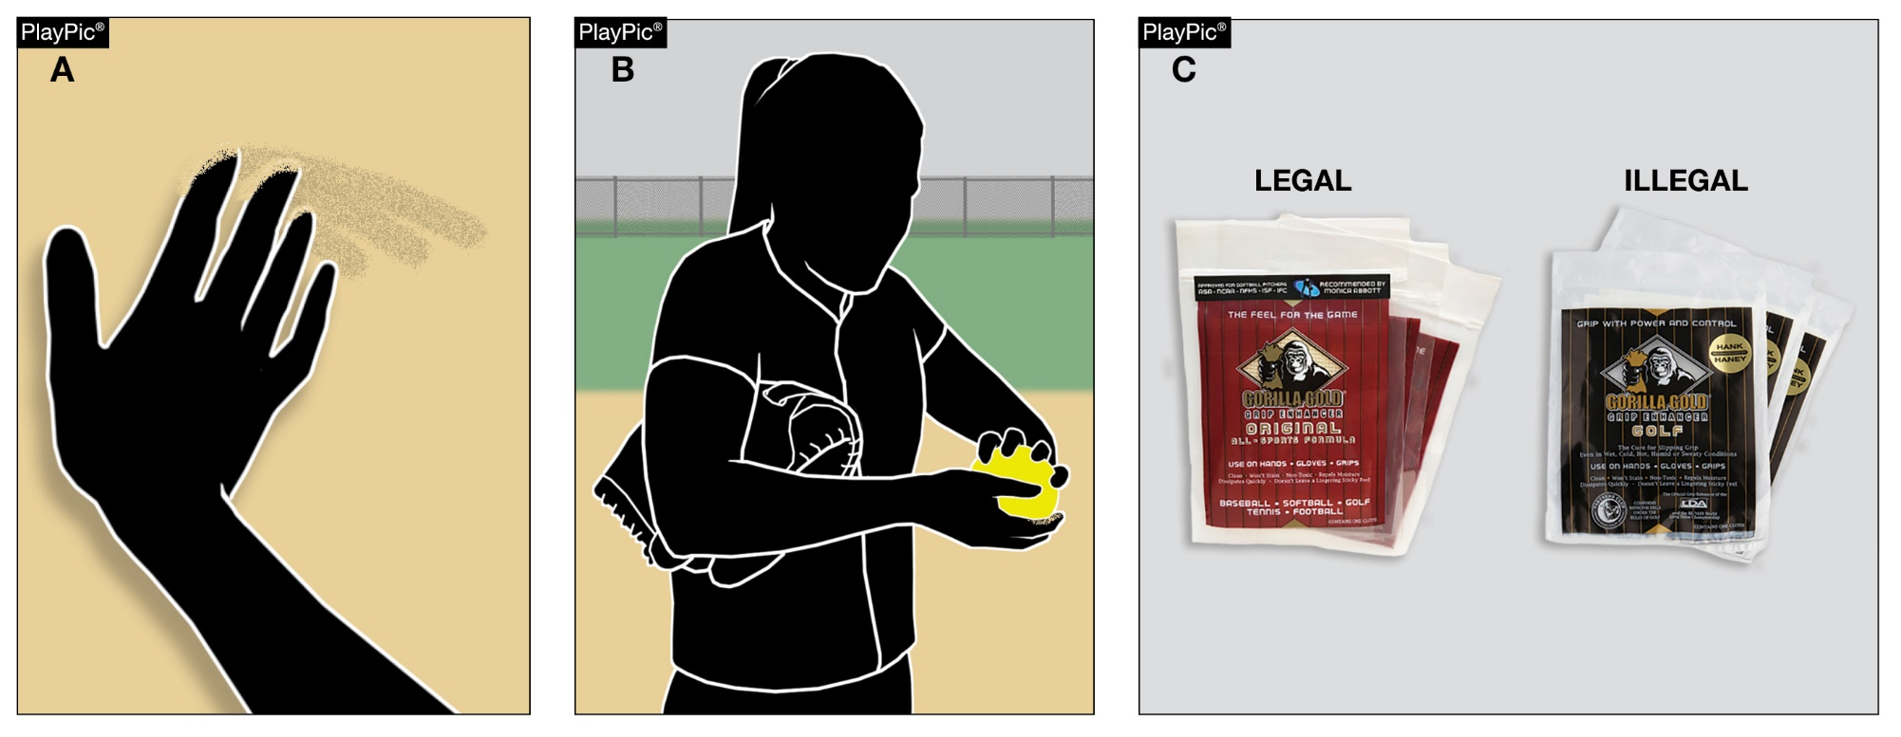
Infractions by pitcher (f.P.)
6-2-2
Pitchers may only use dirt, powdered rosin or comparable drying agents that are listed on the USA Softball’s certified equipment webpage to dry the hand.
Notes:
Rule 6-2-2: Pitchers may only use dirt, powdered rosin or comparable drying agents that are listed on the USA Softball’s certified equipment webpage to dry the hand.
Rationale: Clarifies the difference between tape and other non-approved substances on the pitching hand or fingers versus the use of approved substances under the supervision and control of the umpire.
Comments: Pitchers shall only use dirt, powdered rosin or comparable drying agents that are listed on the USA Softball’s certified equipment webpage to dry the hand.

Slide 18
2024 nfhs softball editorial CHANGES

Slide 19
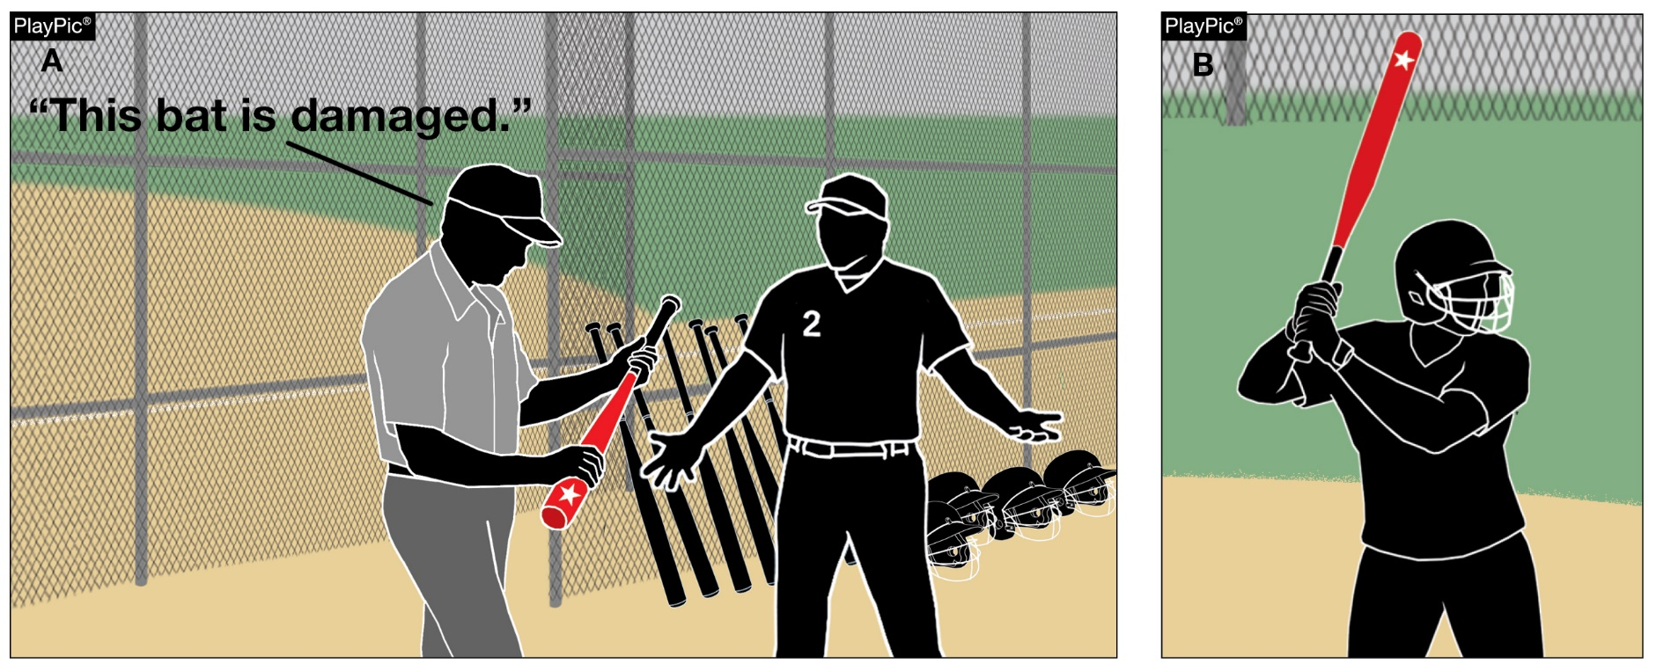
Bats
1-5-1c & 2-4-3
“It needs to be
removed
from the
game.”
Adds the words “when initially detected” to clarify what occurs when a damaged bat is initially discovered in the game.
Notes:
Rules 1-5-1c & 2-4-3: Adds the words “when initially detected” to clarify what occurs when a damaged bat is initially discovered in the game.
Rationale: Clarifies what occurs when a damaged bat is initially discovered in a game.

Slide 20
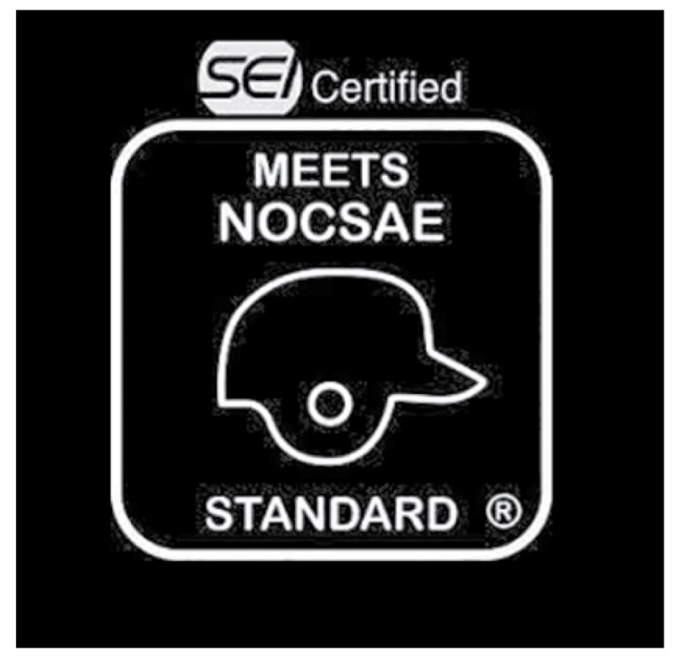
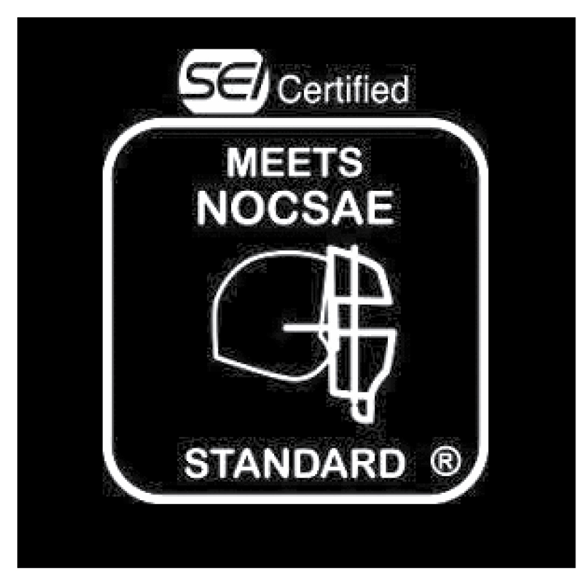
Batting and catchers helmets
1-6-1 & 1-7-1
Rule 1-6-1: Updates the current stamp used by NOCSAE for approved batting helmets.
Rule 1-7-1: Updates the current stamp used by NOCSAE for approved catcher’s helmets.
Notes:
Rule 1-6-1: Updates the current stamp used by NOCSAE for approved batting helmets.
Rationale: The NOCSAE stamp (Figure 1-8) and legible exterior warning label on helmets, which is mandatory for each batter, on-deck batter, players/students in the coach's boxes, runners and retired runners, was updated several years ago. The current stamp should be included in the rules book.
Rule 1-7-1: Updates the current stamp used by NOCSAE for approved catcher’s helmets.
Rationale: The catcher shall wear a catcher's helmet and mask combination that meets the NOCSAE standard at the time of manufacture. The helmet shall bear the permanent NOCSAE seal. The NOCSAE stamp (Figure 1-9) was updated several years ago, and the current stamp should be included in the rules book.

Slide 21
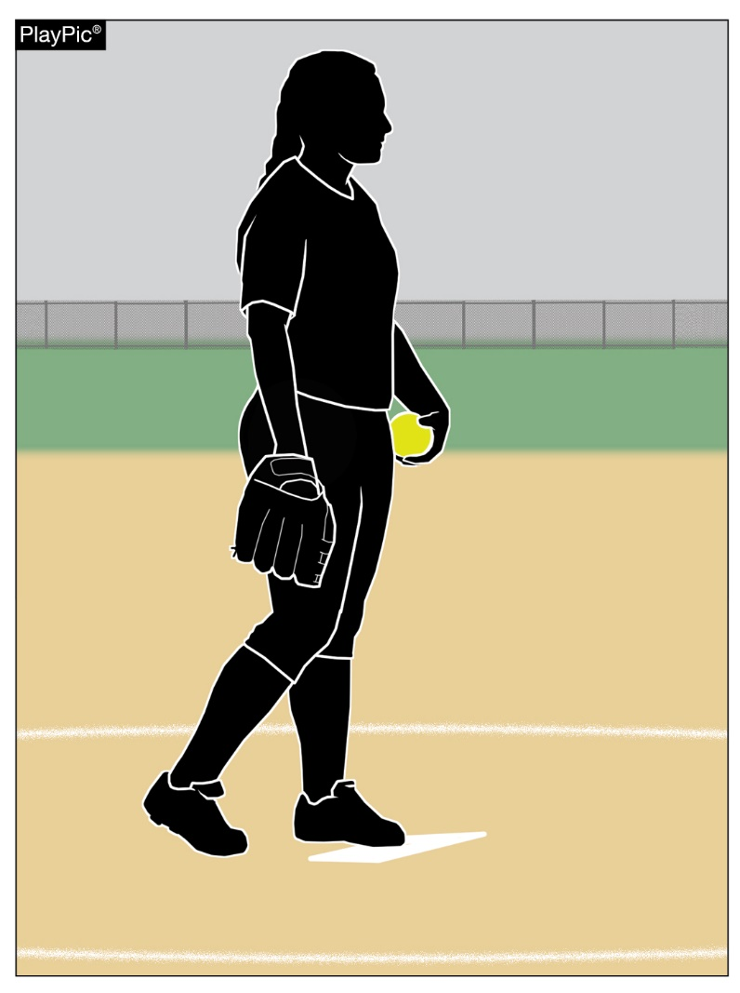
Pitching regulations (f.p.)
6-1-1b
text
Adds the wording “in contact with the pitcher’s plate” to clarify where the pitcher is required to take (or simulate taking) a signal from the catcher.
Notes:
Rule 6-1-1b: Adds the wording “in contact with the pitcher’s plate” to clarify where the pitcher is required to take (or simulate taking) a signal from the catcher.
Rationale: The change will eliminate the decision whether F1 did or did not simulate taking a signal from the catcher. This also is consistent with the Case Book play 6.1.1, Situation B on page 42 of the NFHS Softball Case Book.

Slide 22
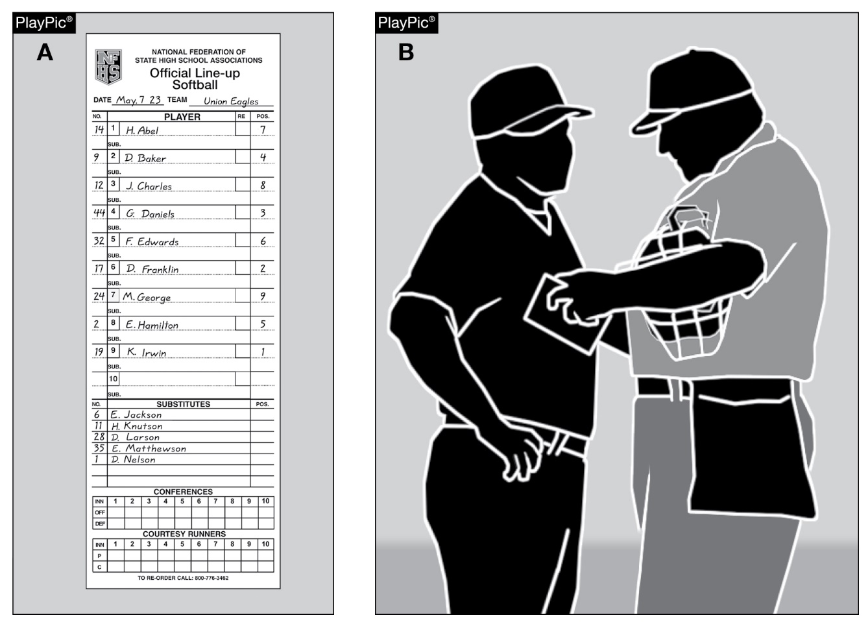
Position and batting order
7-1-2 penalty 2
text
Changes the formatting in the penalty to clarify the effects of when an improper batter becomes a runner or is put out and the defensive team appeals to the umpire before the next pitch.
Notes:
Rule 7-1-2 PENALTY 2: Changes the formatting in the penalty to clarify the effects of when an improper batter becomes a runner or is put out and the defensive team appeals to the umpire before the next pitch.
Rationale: Formatting of this penalty clarifies the effects of when an improper batter becomes a runner or is put out and the defensive team appeals to the umpire.

Slide 23
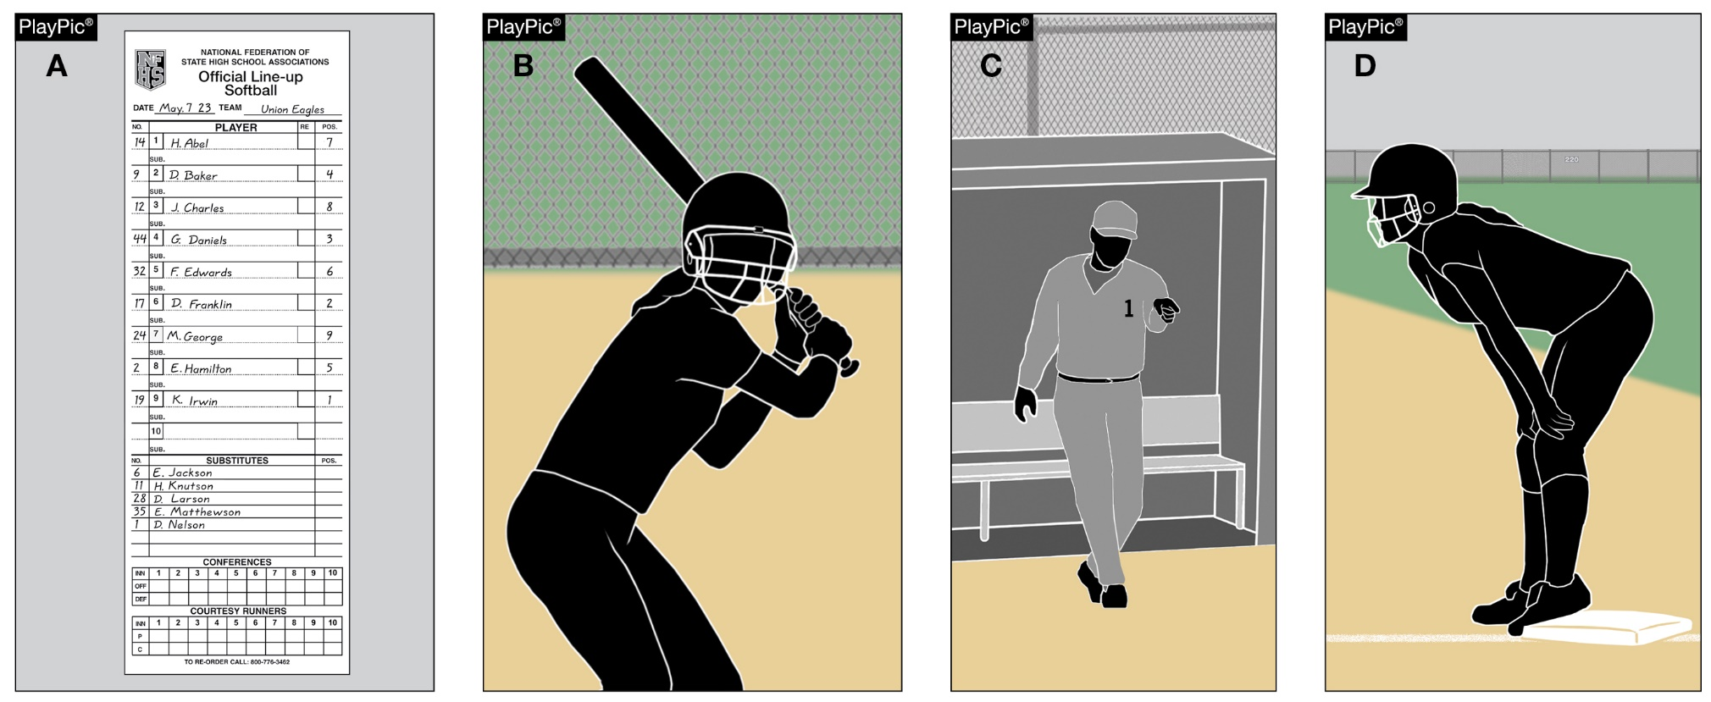
Position and batting order
7-1-2 penalty 3
text
Formats the penalty to clarify the effect for when an improper batter has completed their turn at bat and no appeal has been made before the next pitch.
Notes:
Rule 7-1-2 PENALTY 3: Formats the penalty to clarify the effect for when an improper batter has completed their turn at bat and no appeal has been made before the next pitch.
Rationale: Formatting of this penalty clarifies the effect when an improper batter has completed their turn at bat and no appeal has been made.

Slide 24
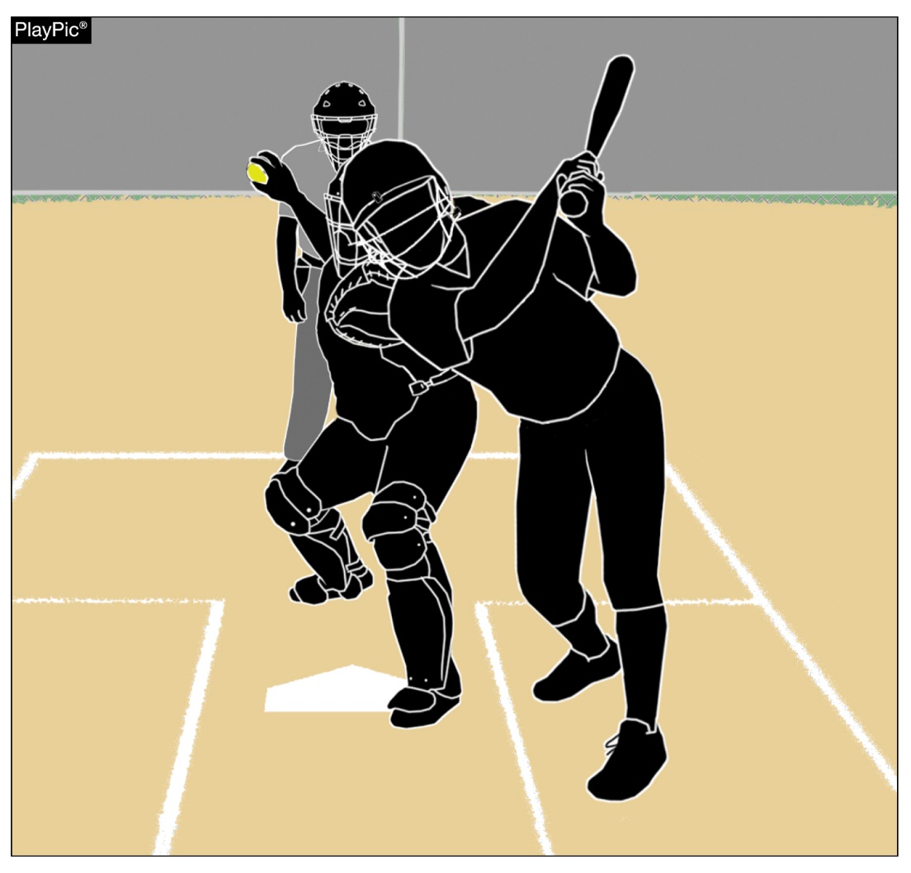
Batter is out
7-4-4
text
Formats the rule to clarify the various ways the batter can interfere with the catcher’s fielding or throwing.
Notes:
Rule 7-4-4: Formats the rule to clarify the various ways the batter can interfere with the catcher’s fielding or throwing.
Rationale: Formatting the rule more clearly defines the actions of the batter that would constitute interference with the catcher's fielding or throwing.

Slide 25
2024 nfhs softball points of emphasis

Slide 26
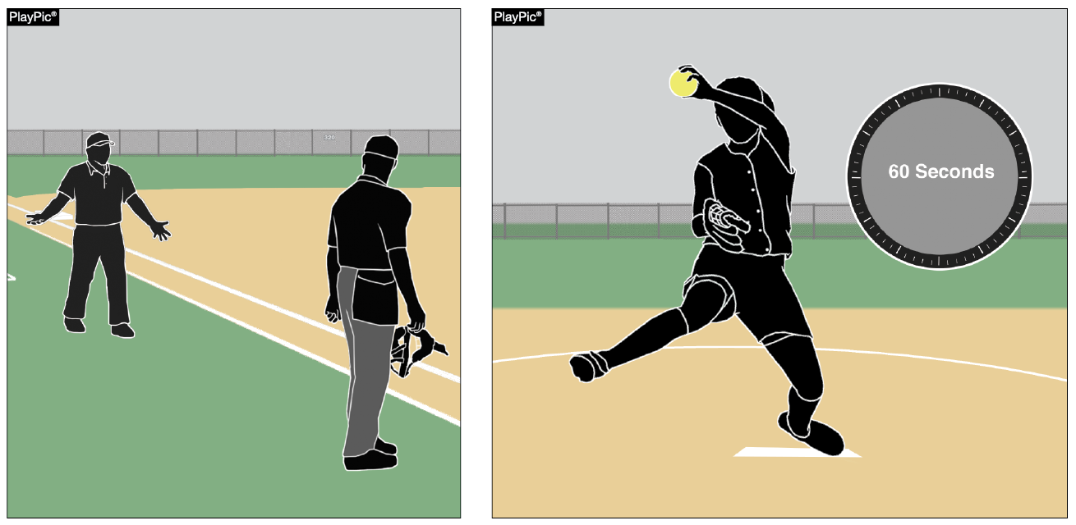
Game management
Umpire and coach communication should be conversational, not confrontational.
Professionalism should be followed by coaches and umpires to maintain a successful working relationship.
Although umpires are not there to “rush” players, one of their responsibilities is to help maintain a good flow of the game.
Notes:
GAME MANAGEMENT:
Coach and umpire communication should be conversational, not confrontational.
There must be a mutual respect for each other and a professionalism that is followed by both coaches and umpires to maintain the working relationship that is imperative to have a successful game.
Last year, there was a point of emphasis about the 60 seconds between innings. Although umpires are not there to “rush” players, one of the responsibilities of an umpire is to help maintain a good flow of the game. This can be done without being overly aggressive.
Game Management
Coach and umpire communication should be conversational, not confrontational. Passion for their team is often the root of fiery responses from coaches about plays or rulings that they felt went against their team. As an umpire, it is important to balance an understanding of the passion coaches hold for their teams and the sporting expectations of education-based athletics. There has to be a mutual respect for each other and a professionalism that is followed by both coaches and umpires to maintain the working relationship that is imperative to have a successful game. Listening to understand a coach’s issue so you can properly respond to their concerns is a huge part of defusing the situation. Maintaining a calm demeanor when speaking to the coach also often helps to lower the temperature of the conversation and assists in having a more meaningful discussion. Another helpful tool for the umpire is utilizing rule book terminology to help keep discussions on topic and achieve resolution more quickly.
Another key aspect of game management is managing the flow of the game. Last year NFHS had a point of emphasis about the 60 seconds between innings. Although umpires are not there to “rush” players, one of the responsibilities of an umpire is to help maintain a good flow of the game. This can be done without being overly aggressive, often just a simple “here we go” or “let’s get ready to play red” is all the encouragement that a team needs to know that it is time to get back to playing. Utilizing these simple reminders during each half-inning as well as during charged conferences can help make sure a good game flow is maintained.

Slide 27

Unacceptable conditions
Umpire jurisdiction is limited to the confines of the field of play. Issues outside of the field of play such as spectator behavior is monitored and controlled by event management. Absent a designated event manager, the home team’s head coach assumes this responsibility. However, if conditions become unacceptable for play due to spectator conduct, umpires have the authority to call (end) the contest.
In addition to spectator behavior, other external conditions could result in the umpire having to call (end) the contest. For example, at the start of a game, a wildfire might be a safe distance with winds carrying the smoke away from the field. If these conditions change and result in conditions becoming unacceptable for play, it may result in an umpire having to call (end) the game.
Notes:
UNACCEPTABLE CONDITIONS:
Umpire jurisdiction is limited to the confines of the field of play. Issues outside of the field of play such as spectator behavior is monitored and controlled by event management. Absent a designated event manager, the home team’s head coach assumes this responsibility. However, if conditions become unacceptable for play due to spectator conduct, umpires have the authority to call (end) the contest.
In addition to spectator behavior, other external conditions could result in the umpire having to call (end) the contest. For example, at the start of a game, a wildfire might be a safe distance with winds carrying the smoke away from the field. If these conditions change and result in conditions becoming unacceptable for play, it may result in an umpire having to call (end) the game.
Unacceptable Conditions
Umpire jurisdiction is limited to the confines of the field of play. Items outside of the field of play, like spectator behavior, is monitored and controlled by event management. Absent a designated event manager, the home team’s head coach assumes this responsibility. Most spectator behavior never reaches a level that would be considered dangerous or severe enough to cause a concern for participant safety. However, if conditions become unacceptable for play due to spectator conduct, umpires have the authority to call (end) the contest. Again, this is a very rare occurrence and all attempts should be made to have event management control the situation prior to ending a contest.
In addition to spectator behavior, other external conditions could result in the umpire having to call (end) the contest. For example, at the start of a game, a wildfire might be a safe distance with winds carrying the smoke away from the field. If these conditions change and result in conditions becoming unacceptable for play, it may result in an umpire having to call (end) the game.

Slide 28
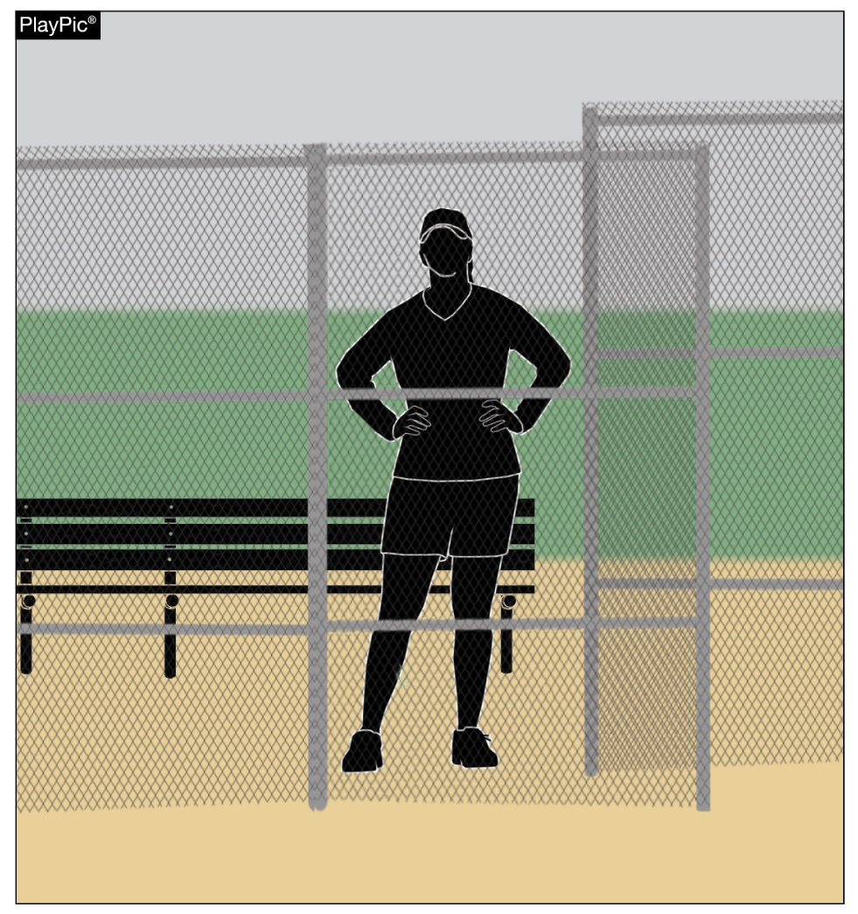
Unreported vs. illegal substitutions
An illegal substitute is a player who is ineligible to occupy a position in the lineup. This can occur when a player:
Enters or re-enters the game without eligibility to do so (illegal re-entry).
Re-enters the game in the wrong position in the batting order.
Is the (F.P.) FLEX and enters the game as a batter or runner in a different position in the batting order than the DP.
Violates the courtesy runner rule.
All of these violations result in an illegal substitution and the offender is restricted to the bench/dugout for the first offense.
In contrast to an illegal substitute, an unreported substitute is a
player that could legally occupy the position they are in the lineup but has simply failed to report that they are entering the game. The first offense results in a team warning.
Notes:
UNREPORTED VS. ILLEGAL SUBSTITUTIONS:
An illegal substitute is a player who is ineligible to occupy a position in the lineup. This can occur when a player:
Enters or re-enters the game without eligibility to do so (illegal re-entry).
Re-enters the game in the wrong position in the batting order.
Is the (F.P.) FLEX and enters the game as a batter or runner in a different position in the batting order than the DP.
Violates the courtesy runner rule.
All of these violations result in an illegal substitution and the offender is restricted to the bench/dugout for the first offense. Additional penalties for offensive violations are defined in rule 3-4-2 and defensive violations are detailed in rule 3-4-3.
In contrast to an illegal substitute, an unreported substitute is a player that could legally occupy the position they are in the lineup but has simply failed to report that they are entering the game. The first offense results in a team warning.
In contrast to an illegal substitute, an unreported substitute is a player that could legally occupy the position they are in the lineup but has simply failed to report that they are entering the game. All substitutions and courtesy runners are required to be reported to the plate umpire upon entering the game. When a player enters the game unreported, a warning is issued to the head coach. Any subsequent violation results in both the head coach and player being restricted to the dugout for the remainder of the game.

Slide 29
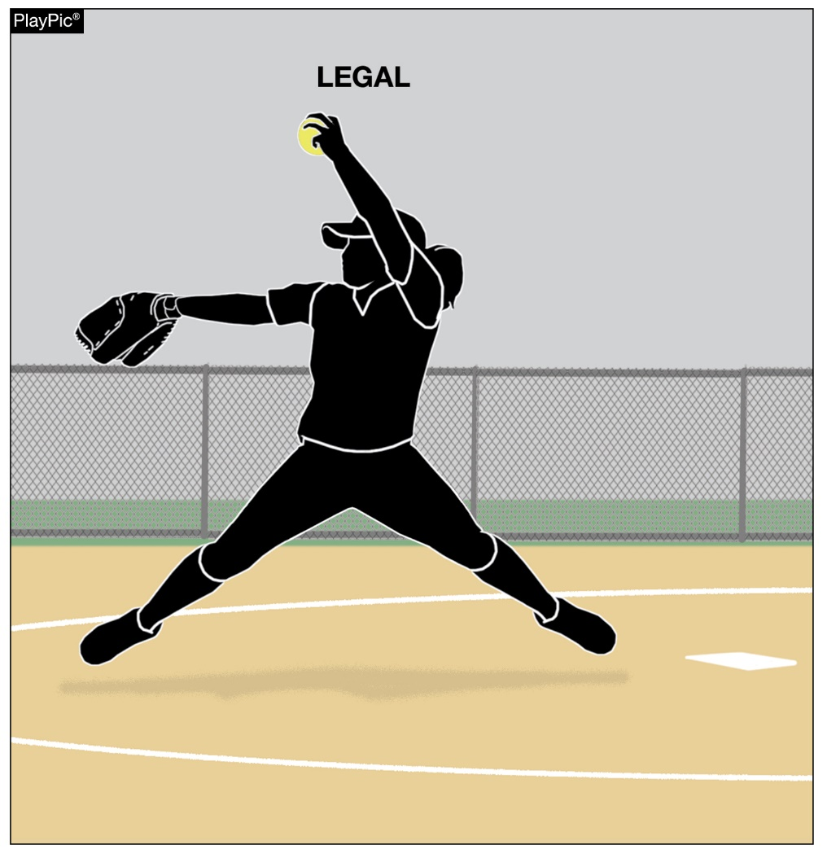
Pitching mechanics: replant
A replant prior to the delivery would result in an illegal pitch.
It is an illegal action if the pitcher slides their foot forward
past the pitching plate pushing off to start their movement from a position in front of the pitching plate (no part of their foot is still in contact with or over the pitching plate).
“Closing the hip,” is pushing with the pivot foot while delivering the pitch. Depending on the pitching style, the pitcher will either bring their pivot foot forward to square up toward the batter or they will tuck the pivot foot behind the non-pivot foot. This push is during the act of delivering the pitch and is legal.
Notes:
PITCHING MECHANICS: REPLANT:
The allowance for both feet to disengage from the playing surface while delivering a pitch has increased the concern about pitching mechanics involving a replant of the pivot foot. A replant prior to the delivery would result in an illegal pitch.
It is an illegal action if the pitcher slides their foot forward past the pitching plate pushing off to start their movement from a position in front of the pitching plate (no part of their foot is still in contact with or over the pitching plate).
Another common action, often referred to as “closing the hip,” is pushing with the pivot foot while delivering the pitch. Depending on the pitching style, the pitcher will either bring their pivot foot forward to square up toward the batter or they will tuck the pivot foot behind the non-pivot foot. This push is during the act of delivering the pitch and is legal.
Pitching Mechanics: Replant
The allowance for both feet to disengage from the playing surface while delivering a pitch has increased the concern about pitching mechanics involving a replant of the pivot foot. A replant during the delivery would result in an illegal pitch. To help assist in enforcement of this rule, a new definition of replant was created. Rule 2-47 now defines that a replant of the pivot foot occurs when the pitcher pushes off the playing surface from anywhere other than the pitcher’s plate prior to the act of delivering the pitch. With this definition in mind, it is an illegal action if the pitcher slides the foot forward past the pitching plate pushing off to start their movement from a position in front of the pitching plate (no part of their foot is still in contact with or over the pitching plate). Another common action, often referred to as “closing the hip,” is pushing with the pivot foot while delivering the pitch. Depending on the pitching style, the pitcher will either bring the pivot foot forward to square up toward the batter or the pitcher will tuck the pivot foot behind the non-pivot foot. This push is during the act of delivering the pitch and is legal.

Slide 30
NFHS OFFICIALS Education

Slide 31





OFFICIALS EDUCATION
Content remains free of charge
TEACHING
AIDS
RULES
CHANGES
DIAGRAMS
VIDEO
LIBRARY
OFFICIALS
COURSES
Notes:
Sport-Specific Officiating courses are offered in several sports. They are ideal for new officials and those in the first few years of officiating. These courses introduce officials to the mechanics and techniques used in the sport and provide specific information on an area within that sport. Individuals can complete a course within 30-45 minutes. These courses are free to all officials and prospective officials.
“Interscholastic Officiating” is a general course on sports officiating, and it is free to all officials and prospective officials. This course provides an introduction to skills and concepts used as an official. Several topics are covered such as: basics of becoming and staying an official, science of officiating, art of officiating, how to combine these skills for successful officiating.
Video clips are made available to NFHS Officials Association members. The video is clipped on specific topics and provides the rules references as well as dialogue on the topic.
The courses and videos are offered at www.NFHSLearn.com .
Courses Available:
Officiating Football
Officiating Volleyball – Ball Handling
Officiating Volleyball – Alignment
Officiating Volleyball – E-Whistle
Officiating Basketball
Officiating Basketball – Three-Person Mechanics
Officiating Basketball - Pre-Game Conference
Soccer – Fouls and Misconduct
Soccer – Offside
Soccer - Pre-Game Conference
Swimming and Diving
Officiating Wrestling
Umpiring Softball
Officiating Field Hockey
Officiating Track and Field
Future Courses to be Considered:
Umpiring Baseball
Umpiring Softball – 2 Person Mechanics
Communication Among Officials and Coaches

Slide 32



Future Developments:
Auto Assign
Mobil Assign
Customized Game and Travel Fees
Mass Update Capabilities
Integrated Playoff Financial Reporting
Improvements:
Invoicing
Updated Financial Reporting
Playoff and Tournament Bracketing
Eligibility Tracking Notifications
NFHS Learn Integration
Coming Fall 2023:
NFHS Exam Center
New Team App
New Form Builder
Year Two Accomplishments
16
194,810
$29M
States
Registering
Officials
Contests
Assigned
Payments
Sent to
Officials
100% FREE to your state as a NFHS-Member Benefit.
Notes:
NFHS CENTER FOR OFFICIALS SERVICES (COS)
Your Complete Solution for Officials Management and More:
Registration
Assignment
Payment
Testing
Background Checks
For More Information on the NFHS – Center for Officials Services (COS) Contact:
Dana Pappas, Director of Officiating Services, dpappas@nfhs.org
Also If You’re Interested in Eligibility and Monitoring Requirements Contact
the Folks at Dragonfly:
Kirk Miller, Dragonfly, kirk@dragonflyathletics.com
Brandon Wallace, Dragonfly, brandon@dragonflyathletics.com

Slide 33
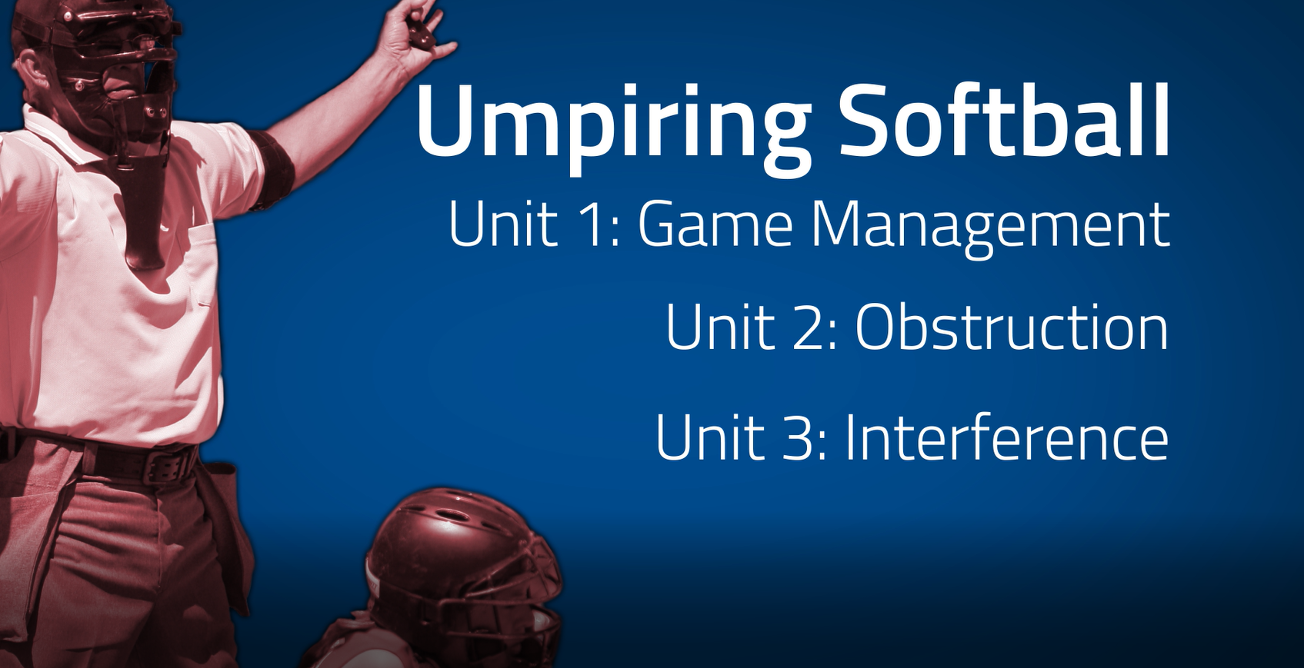
www.nfhs.org
Notes:
UMPIRING SOFTBALL
In partnership with USA Softball, the NFHS has developed the first in a line of educational softball courses. This first course addresses game management as well as obstruction and interference.

Slide 34
NFHS Learning Center

Slide 35

Notes:
The NFHS Learning Center is the home to more than 90 online professional development courses for everyone within the interscholastic community - coaches, students, officials, parents, administrators, and individuals within performing arts programs. More than 60 courses are available for free.
The NFHS is an Accredited Institution and has delivered more than 15 million courses on its NFHS Learning Center platform since its inception in 2007. In receiving national accreditation by Cognia, the NFHS has upheld itself to rigorous standards that focus on productive learning environments, equitable resource allocation that meet the needs of learners, and effective leadership.
The NFHS Learning Center features its flagship coaching course, “Fundamentals of Coaching,” as well as several health and safety courses that have been completed by millions of individuals, such as “Concussion in Sports,” “Heat Illness Prevention,” “Sudden Cardiac Arrest” and “Protecting Students from Abuse.” The NFHS Learning Center offers several national credentials that can be earned by individuals who complete specific NFHS courses. Through the School Honor Roll Program, schools can earn a physical banner to hang in their school.
To learn more and start your professional development journey, please visit the NFHS Learning Center at NFHSLearn.com.

Slide 36
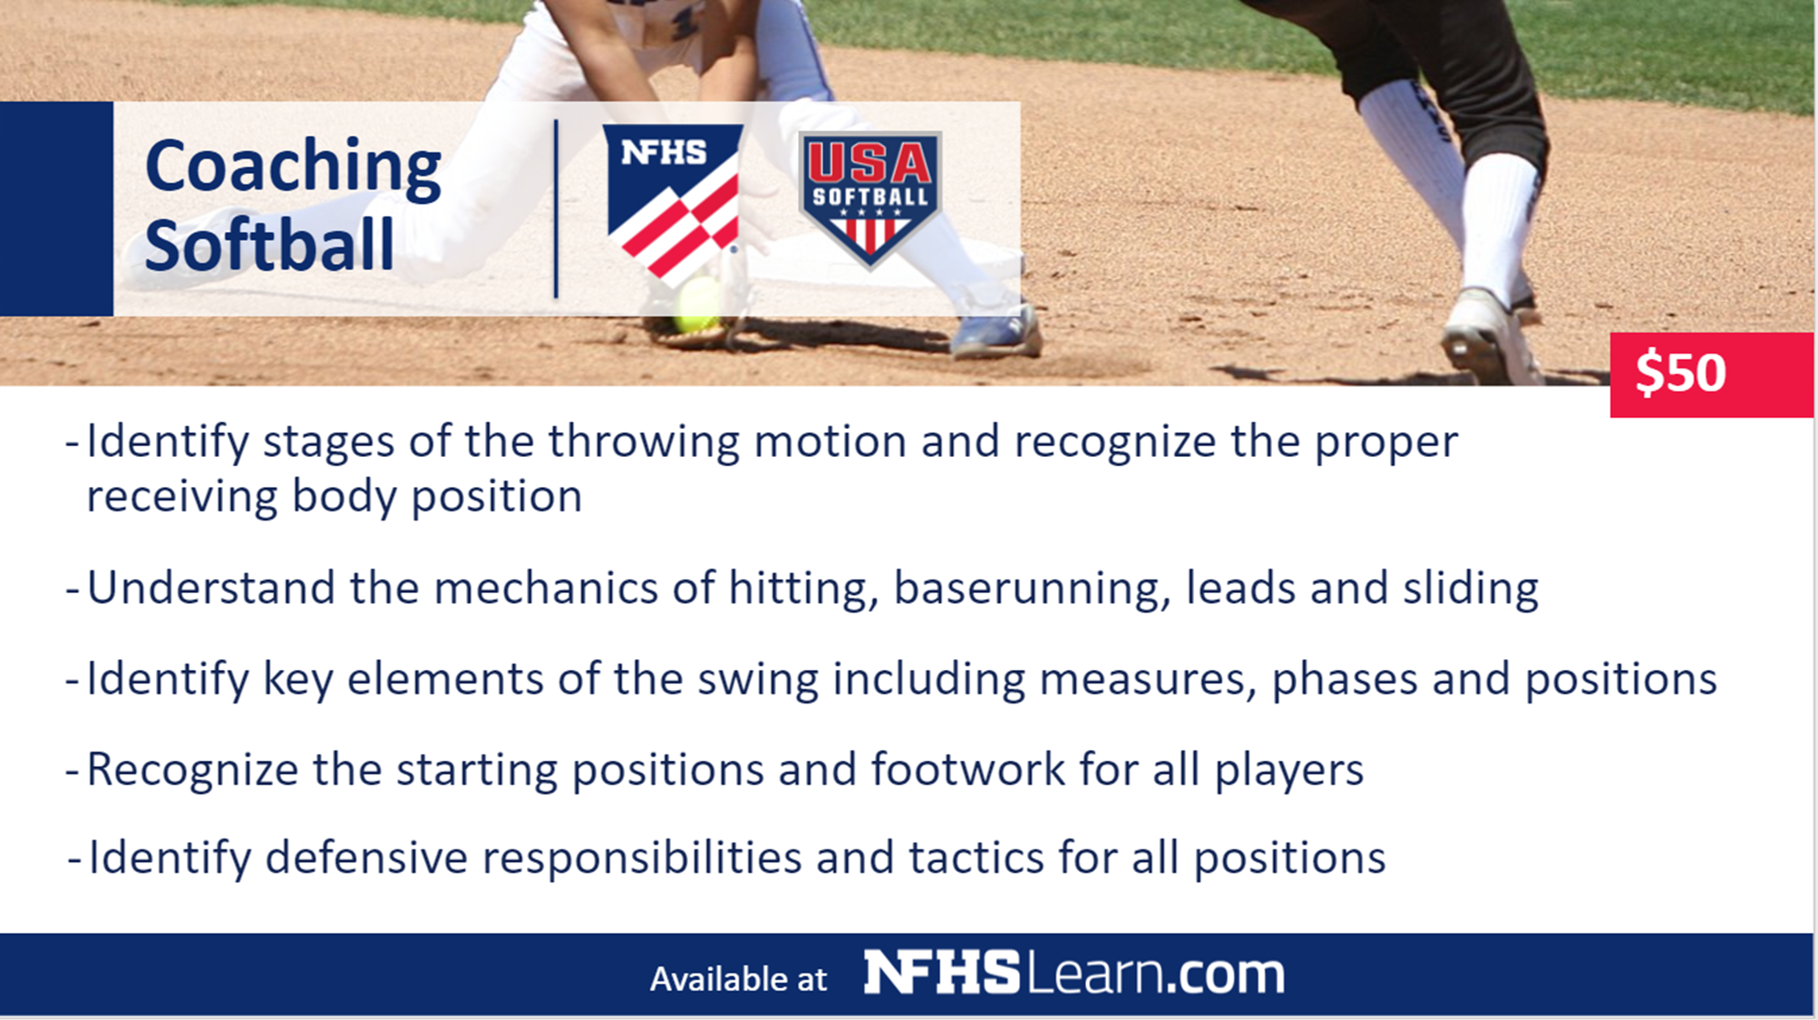



Coaching Softball
$50
Identify stages of the throwing motion and recognize the
proper receiving body position
Understand the mechanics of hitting, baserunning, leads and sliding
Identify key elements of the swing including phases and positions
Recognize the starting positions and footwork for all players
Identify defensive responsibilities and tactics for all positions
Available at
Notes:
The NFHS partnered with USA Softball to present the online Coaching Softball course. Go to www.nfhslearn.com to view the trailer, description and outline for this course, and encourage your coaches to sign-up today!

Slide 37
NFHS Network

Slide 38


NFHS Network
By 2025, every high school sporting event in America will be streamed live.
The NFHS Network will be
THE DESTINATION for fans
to view these broadcasts.
Covering 27 different sports and activities.
www.NFHSnetwork.com
Notes:
The NFHS Network is the leader in streaming Live and On Demand high school sports.
Partnered with the National Federation of State High School Associations, 45 high school state athletic/activities associations, and PlayOn! Sports, the NFHS Network is a joint venture created to provide fans with the ability to stream high school sports on any device, from wherever they are.
All NFHS Network events are available to watch online at www.NFHSnetwork.com and through the NFHS Network Live App for iOS and Android. Follow us on Facebook, Twitter, Instagram, and YouTube.
Watching high school sports and events has never been easier.
The NFHS Network’s goal to broadcast live all 2 million high school sporting events by 2025.
The NFHS Network covers 27 different regular season and postseason sports, as well as other high school activities, celebrating the accomplishments of students-athletes, student broadcasters, and high schools across the country.

Slide 39


Over 1 million events this year…
Notes:
The NFHS Network will broadcast over 150,000 live events this year. If your school is not a member of the NFHS Network School Broadcast Program, please contact us at Mark.Koski@NFHSnetwork.com

Slide 40
2024 nfhs softball resources

Slide 41




nfhs softball resources
NFHS Rules Books, Case Books
and other softball resources can be ordered:
  online at www.nfhs.com or
  by calling 1-800-776-3462
Notes:
NFHS SOFTBALL PUBLICATIONS
The NFHS softball publications are available to order online or by using the toll-free number.

Slide 42

Thank You
National Federation of State High School Associations
PO Box 690 | Indianapolis, IN 46206
Phone: 317-972-6900 | Fax: 317.822.5700
www.nfhs.org | www.nfhslearn.com | www.nfhsnetwork.com

