Slide 1
2024-25 NFHS VOLLEYBALL rules PowerPoint
Rules Changes
Editorial Changes
Points of Emphasis

Slide 2

Sponsor Slide
remove this text and place artwork centered here

Slide 3
About The NFHS

Slide 4

National Federation of
State High School Associations
NFHS (located in Indianapolis, IN – Est. 1920):
  National leader and advocate for
  high school athletics and
  performing arts programs.
  Serves 51 state associations, 19,500
  high schools and 12 million student
  participants.
  Writes playing rules for 17 high school
  sports for boys and girls.
  Offers online education courses for high school coaches,
  officials, parents, students and others.
  Ensures that students have opportunity to enjoy healthy participation, achievement and good sportsmanship in education-based athletics.
Notes:
NFHS (located in Indianapolis, IN – Est. 1920):
National leader and advocate for
high school athletics and
performing arts programs.
Serves 51 state associations, 19,500
high schools and 12 million student
participants.
Writes playing rules for 17 high school
sports for boys and girls.
Offers online education courses for high school coaches,
officials, parents, students and others.
Ensures that students have opportunity to enjoy healthy participation, achievement and good sportsmanship in education-based athletics.

Slide 5




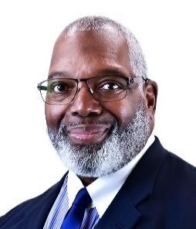

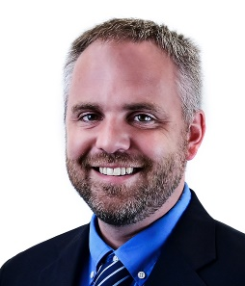

NFHS Rules Review Committee
The NFHS Rules Review Committee is chaired by the chief operating officer and composed of all rules editors. After each committee concludes its deliberations and has adopted its recommended changes for the subsequent year, such revisions will be evaluated by the Rules Review Committee.
Davis Whitfield
Chief Operating Officer
Lindsey Atkinson
Basketball, Girls Lacrosse and Volleyball
Bob Colgate
Football and Sports
Medicine
Sandy Searcy
Softball, Swimming & Diving and Water Polo
Elliot Hopkins
Baseball and Wrestling
Julie Cochran
Cross Country, Gymnastics, Field Hockey, Soccer and
Track & Field
James Weaver
Boys Lacrosse
and Spirit
Dan Schuster
Ice Hockey
Notes:
The NFHS Rules Review Committee is chaired by the chief operating officer and composed of all rules editors.
After each committee concludes its deliberations and has adopted its recommended changes for the subsequent year, such revisions will be evaluated by the Rules Review Committee.

Slide 6
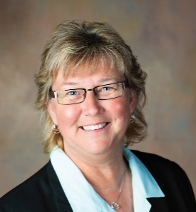
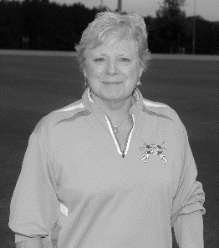
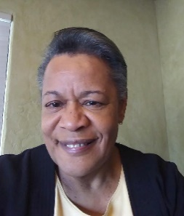
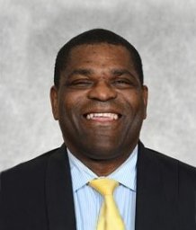


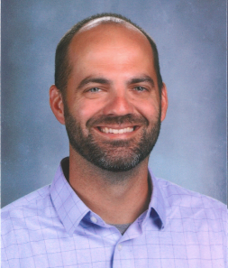
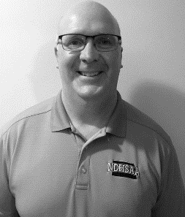
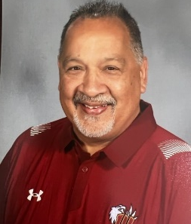
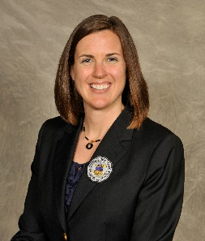
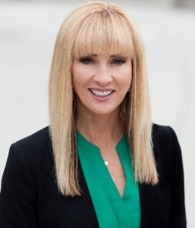

NFHS Volleyball RULES COMMITTEE
Jo Auch
Pierre, SD
Chair - 2024
Paula Kirkland
Roebuck, SC
Coaches – 2024
Nora Carter
Albuquerque, NM
Officials - 2026
Derryk Sellers
Robbinsville, NJ
Section 1 - 2026
Emily Mason
Columbus, OH
Section 2 - 2026
Rhonda Dreibelbis
Chapel Hill, NC
Section 3 - 2027
Ben Van Wyk
West Des Moines, IA
Section 4 - 2024
Kevin Morast
Valley City, ND
Section 5 - 2024
Mike Espinosa
Blue Springs, MO
Section 5 - 2027
Bethany Brookens
Aurora, CO
Section 6 - 2027
Jan Whittaker
Midvale, UT
Section 7 - 2026
Sandi Wagner
Anchorage, AK
Section 8 - 2025
Notes:
The 2024 Volleyball Rules Committee is comprised of a chair, representatives from the NFHS Coaches Association and the NFHS Officials Association, and representatives from each of the eight NFHS sections.

Slide 7



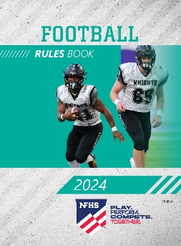
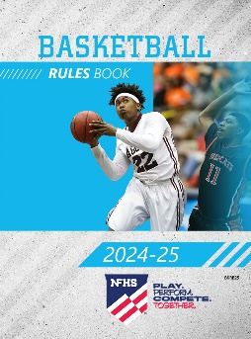
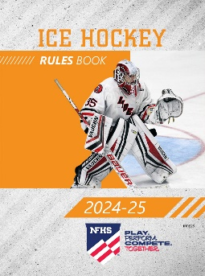
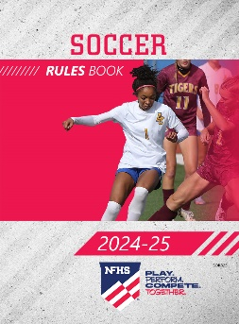
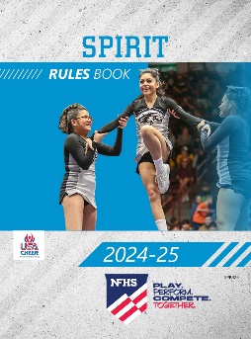
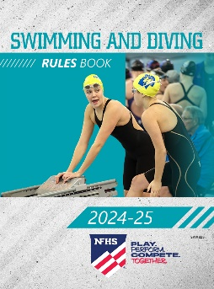

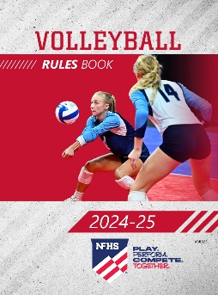
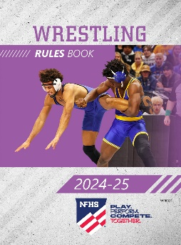
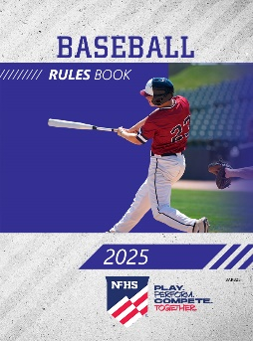
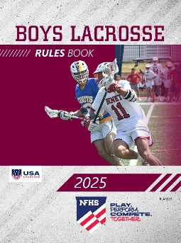
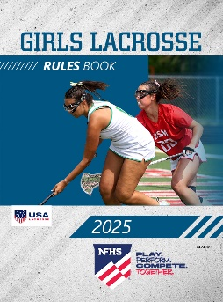
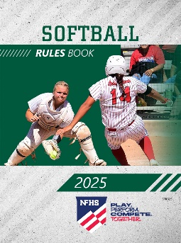

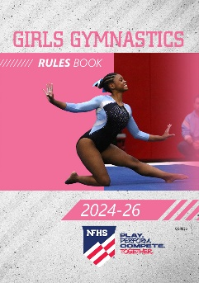
NFHS Publications
The NFHS writes playing rules for 17 sports
for boys and girls at the high school level.
  Publishes 4 million pieces of materials annually.
Notes:
The NFHS writes playing rules for 17 sports for boys and girls at the high school level.
Publishes 4 million pieces of materials annually.

Slide 8

NFHS AllAccess – Website
AllAccess is the NFHS Digital Publications Platform that includes:
  Rules Publications
  High School Today Magazine
  Policy Debate Quarterlies
  Other NFHS Digital Publications
Website organized for associations and individuals to assign books and manage purchases
Visit https://allaccess.nfhs.org
Notes:
AllAccess is the NFHS Digital Publications Platform that includes:
Rules Publications
High School Today Magazine
Policy Debate Quarterlies
Other NFHS Digital Publications
Website organized for associations and individuals to assign books and manage purchases
Visit https://allaccess.nfhs.org

Slide 9
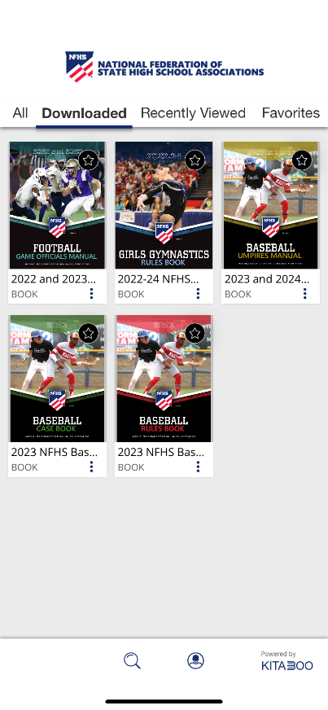


NFHS AllAccess – Mobile App
Access Via Website or Mobile App:
View available publications for sale
View publications assigned to you
Download books for offline viewing
Read publications as an e-book
Available on App Store and Google Play
Notes:
Access Via Website or Mobile App:
View available publications for sale
View publications assigned to you
Download books for offline viewing
Read publications as an e-book
Available on App Store and Google Play

Slide 10
2024-25 NFHS volleyball
Rules Changes

Slide 11
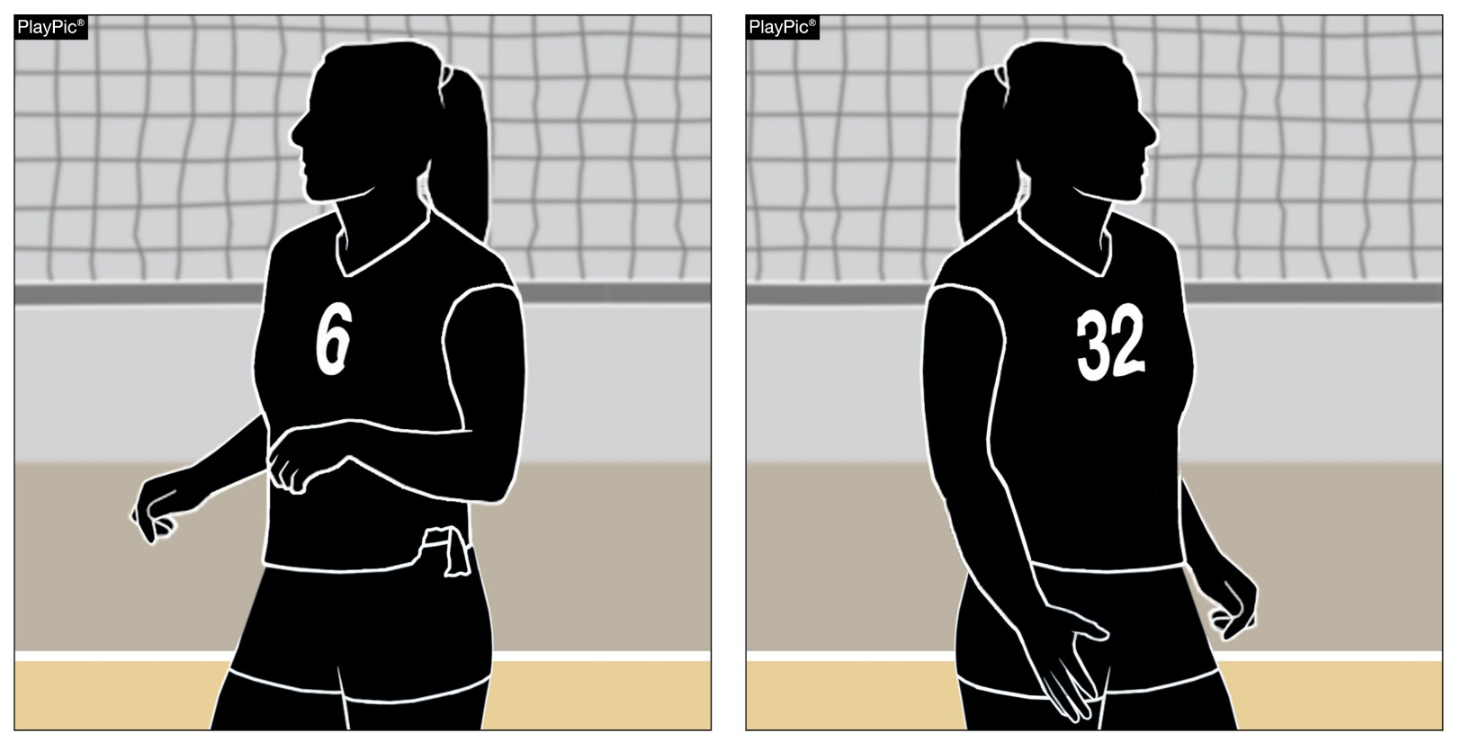
Legal uniform
4-2-3 NOTE (NEW), 7-1-1 NOTE
A player may change uniform numbers without penalty when a uniform is damaged, in addition to when a uniform has blood on it.
Notes:
A player may change uniform numbers without penalty when a uniform is damaged, in addition to when a uniform has blood on it.
Rationale: Adds language to Rule 4: Uniforms regarding the proper procedure for a legal uniform number change and expands to include a damaged unform as a legal reason for changing a uniform number. Aligns language in Rules 4 and 7.

Slide 12
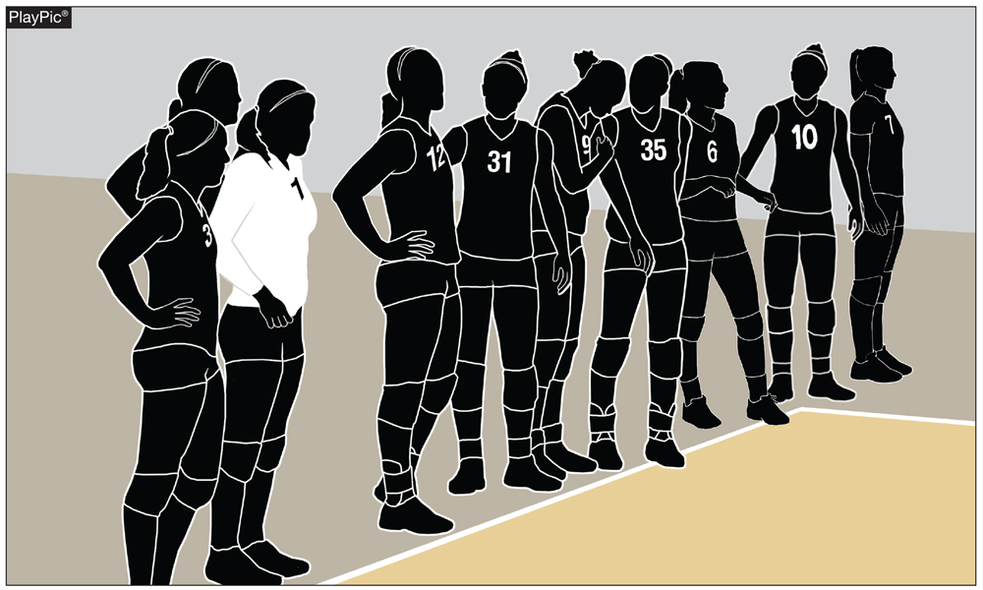
First referee responsibilities
5-4-3c(1)
All players on the roster, not just starting players, may stand on their respective end lines prior to the first set.
Notes:
All players on the roster, not just starting players, may stand on their respective end lines prior to the first set.
Rationale: Allows the inclusion of all players to participate in the prematch announcements.

Slide 13
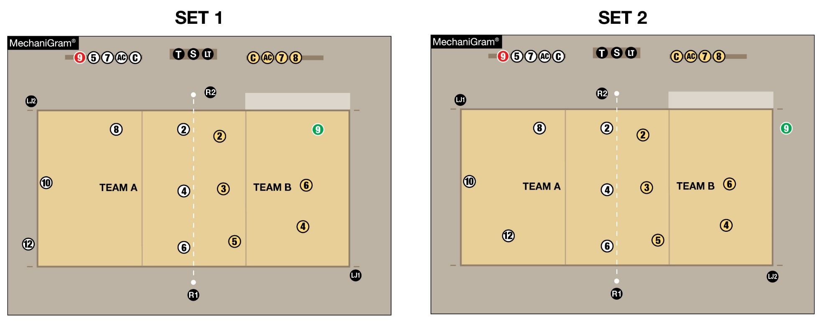
Line judge responsibilities
5-9-2b note (NEW), State Association adoption chart
Line judges will switch sides of the court between sets when, by state association adoption, teams remain on the same benches throughout the match.
Notes:
Line judges will switch sides of the court between sets when, by state association adoption, teams remain on the same benches throughout the match.
Rationale: Aligns with the original intent of the rule allowing line judges to alternate between each set to promote fair officiating.

Slide 14
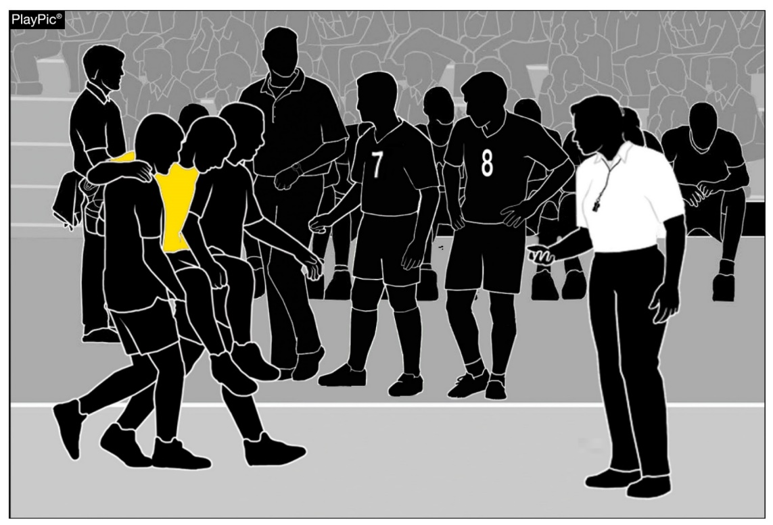
injury
11-4-1b
Teams may substitute during an injury time-out for the libero replacement if the libero is injured or ill.
  In the PlayPic, the libero in yellow is injured and cannot continue.
  The libero replacement, No. 8, must enter as the replacement.
  Next, the head coach may request a substitution (No. 7 for No. 8).
Teams no longer must wait until the next completed rally to make the substitution.
No other substitutions may take place at this time as play resumes with a replay.
Notes:
Teams may substitute during an injury time-out for the libero replacement if the libero is injured or ill.
In the PlayPic, the libero in yellow is injured and cannot continue.
The libero replacement, No. 8, must enter as the replacement.
Next, the head coach may request a substitution (No. 7 for No. 8).
Teams no longer must wait until the next completed rally to make the substitution.
No other substitutions may take place at this time as play resumes with a replay.
Rationale: Allows teams to substitute a player immediately for the replacement player who may be playing out of position due to the injury to the libero.

Slide 15
2024-25 NFHS Volleyball
Editorial Changes

Slide 16
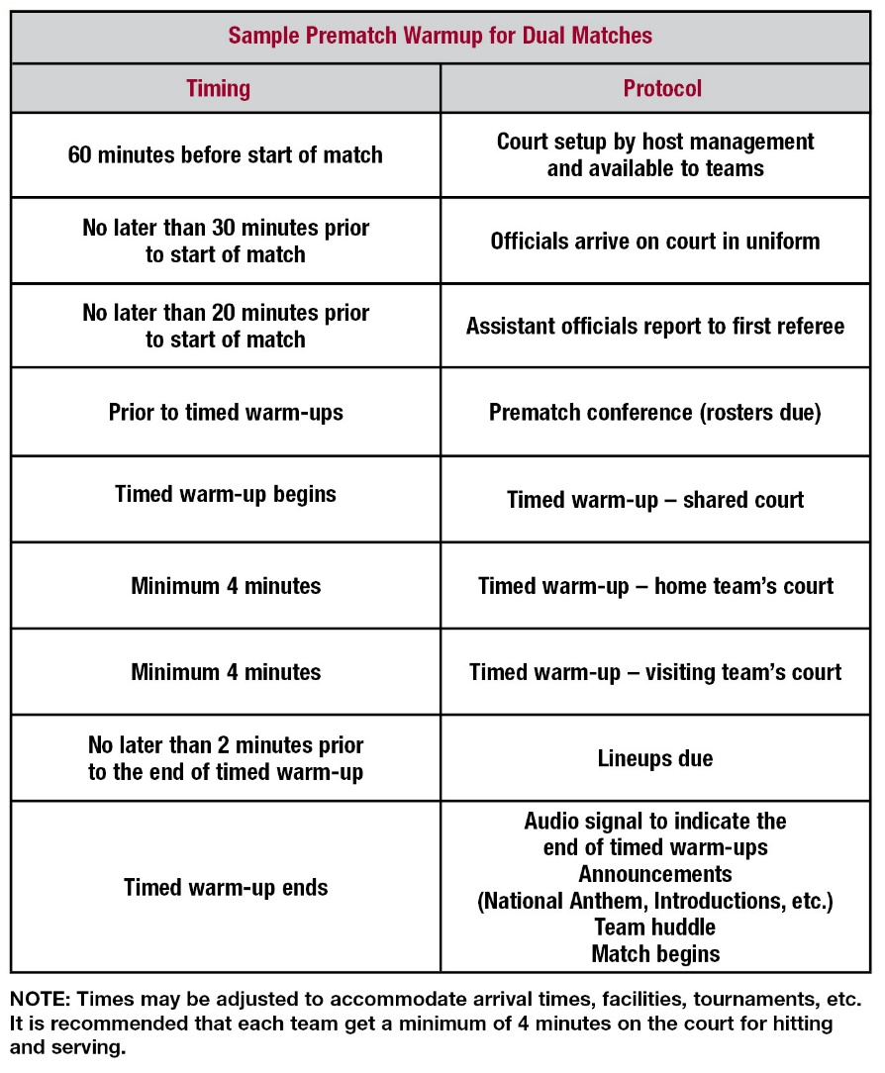
Suggested prematch protocols
Suggested Prematch Protocols:
  The competition court should be set up and available at least one hour before the first scheduled match.
  A timed warm-up period for each team should be predetermined. The timed warm-up period will vary depending on facility and format of matches.
    During shared warm-up, players may not intentionally or cause balls to intentionally enter the opponent’s court.
    When one team has exclusive use of the court, the other team should be at its bench or off the playable area. Teams can utilize an auxiliary gym or the area behind the team bench if adequate space is available.
  Announcements – teams on their endlines for player introductions, national anthem, shaking hands, etc.
Notes:
The NFHS rules governing prematch procedures can be found in Rule 1-6. It is recommended that state associations adopt prematch protocols including warm-up procedures similar to the examples provided.
Suggested Prematch Protocols:
The competition court should be set up and available at least one hour before the first scheduled match.
A timed warm-up period for each team should be predetermined. The timed warm-up period will vary depending on facility and format of matches.
During shared warm-up, players may not intentionally or cause balls to intentionally enter the opponent’s court.
When one team has exclusive use of the court the other team should be at its bench or off the playable area. Teams can utilize an auxiliary gym or the area behind the team bench if adequate space is available.
Announcements – teams on their endlines for player introductions, national anthem, shaking hands, etc.

Slide 17
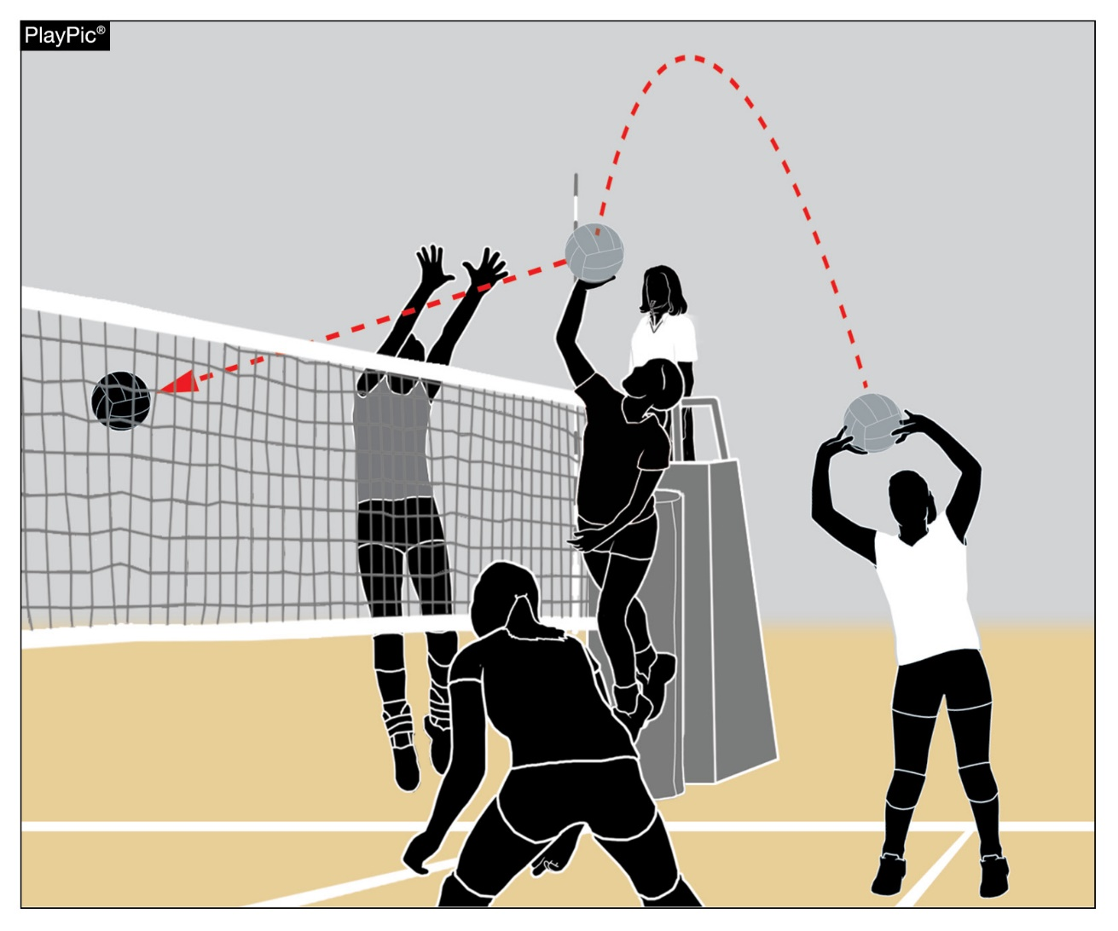
Player actions
9-5-1a(2), 9-5-1a(4), 9-5-1b(4), 9-5-6b
The term “overhead” has been changed to “overhand” throughout Rule 9, Section 5 – Player Actions to align with other volleyball rules codes’ descriptions that focus on hand placement.
Notes:
The term “overhead” has been changed to “overhand” throughout Rule 9, Section 5 – Player Actions to align with other volleyball rules codes’ descriptions that focus on hand placement.

Slide 18
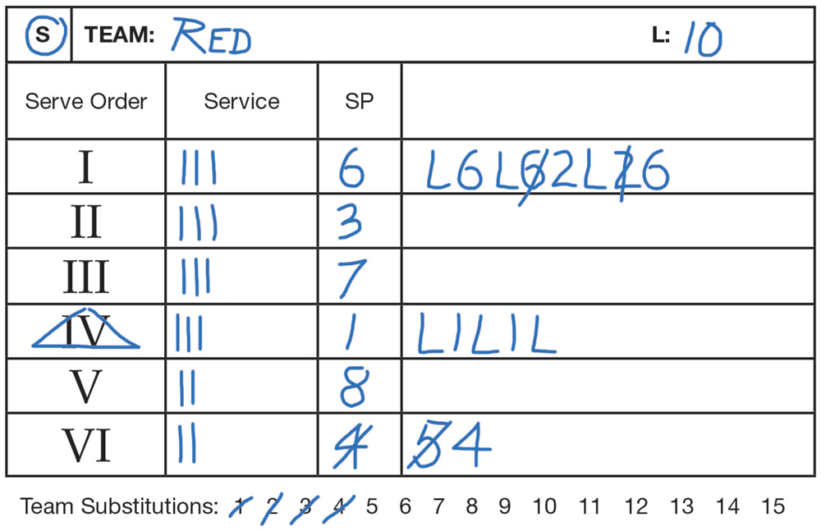
Instructions for Libero Tracker
It is no longer acceptable to cross off the libero or the replacement player’s number on the tracking sheet when there is a libero replacement.
The libero tracker will only cross off the number of the replacement when a substitute enters the set.
This helps keep the tracking sheet legible and avoids confusion when trying to count the number of substitutions a team has used in a set.
Notes:
It is no longer acceptable to cross off the libero or the replacement player’s number on the tracking sheet when there is a libero replacement.
The libero tracker will only cross off the number of the replacement when a substitute enters the set.
This helps keep the tracking sheet legible and avoids confusion when trying to count the number of substitutions a team has used in a set.

Slide 19
Editorial Changes
a. A medical-alert shall be taped to the body and the alert may be visible.
b. Religious medals or other religious items shall be taped to the body and worn under the uniform.
New 6. Mirror the second referee's signal for time-out and substitution.
(Reorganized items 3-24)
No participant, team personnel, coach or contest official shall use any form of alcohol or tobacco, or be under the influence of (i.e., impaired by) a controlled or illicit substance(s), beginning with arrival at the competition site until departure following the completion of the match.
4-1-7a,b
5-4-3c(3 thru 24)
12 NOTES 1

Slide 20
2024-25 NFHS Volleyball
Other Changes

Slide 21
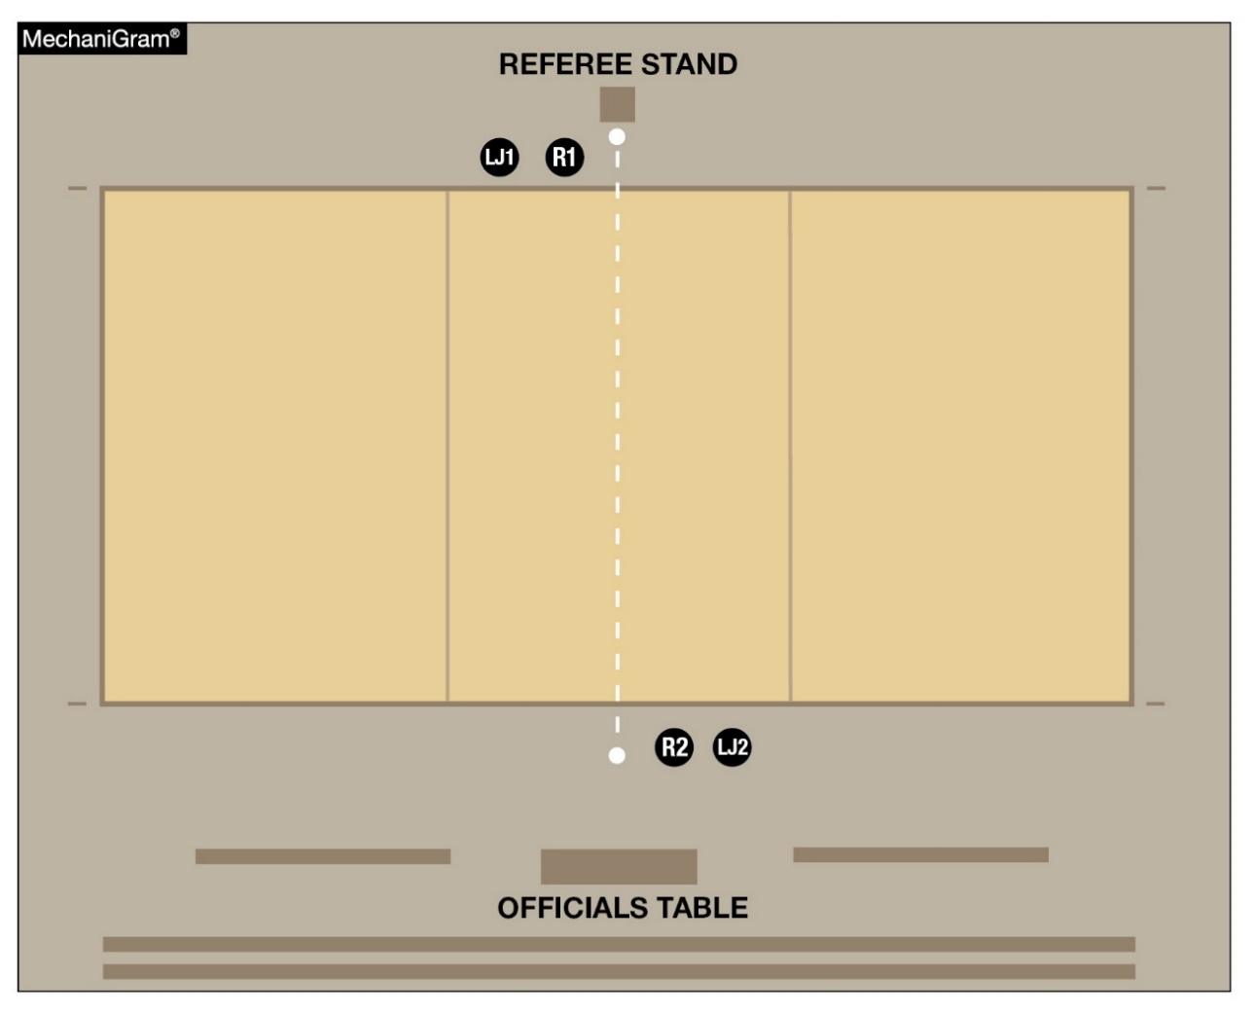
Officials Manual – Introductions and national anthem protocol
At the end of the timed warm-up, the first referee and the LJ1 will walk across the court while the second referee and LJ2 will remain tableside for introductions and the national anthem.
Notes:
At the end of the timed warm-up, the first referee and the LJ1 will walk across the court while the second referee and LJ2 will remain tableside for introductions and the national anthem.
Rationale: Allows the R2 and LJ2 to remain on their side of the court and avoid officials walking back and forth across the court before the match.

Slide 22
2024-25 NFHS volleyball
Points of Emphasis

Slide 23
Ball Handling
The goal for players is to master ball control; for officials, it is a goal to maintain a consistent level of ball handling from set to set and from match to match.
Coaches play a role in the consistency equation with their methods of training, the expectations placed on their players, and the desired level of allowance by the officials.
The goal when officiating ball handling is to increase the continuation of play when judging second ball contacts that are directed to a teammate.
Notes:
The goal for players is to master ball control; for officials, it is a goal to maintain a consistent level of ball handling from set to set and from match to match.
Coaches play a role in the consistency equation with their methods of training, the expectations placed on their players, and the desired level of allowance by the officials.
The goal when officiating ball handling is to increase the continuation of play when judging second ball contacts that are directed to a teammate.

Slide 24
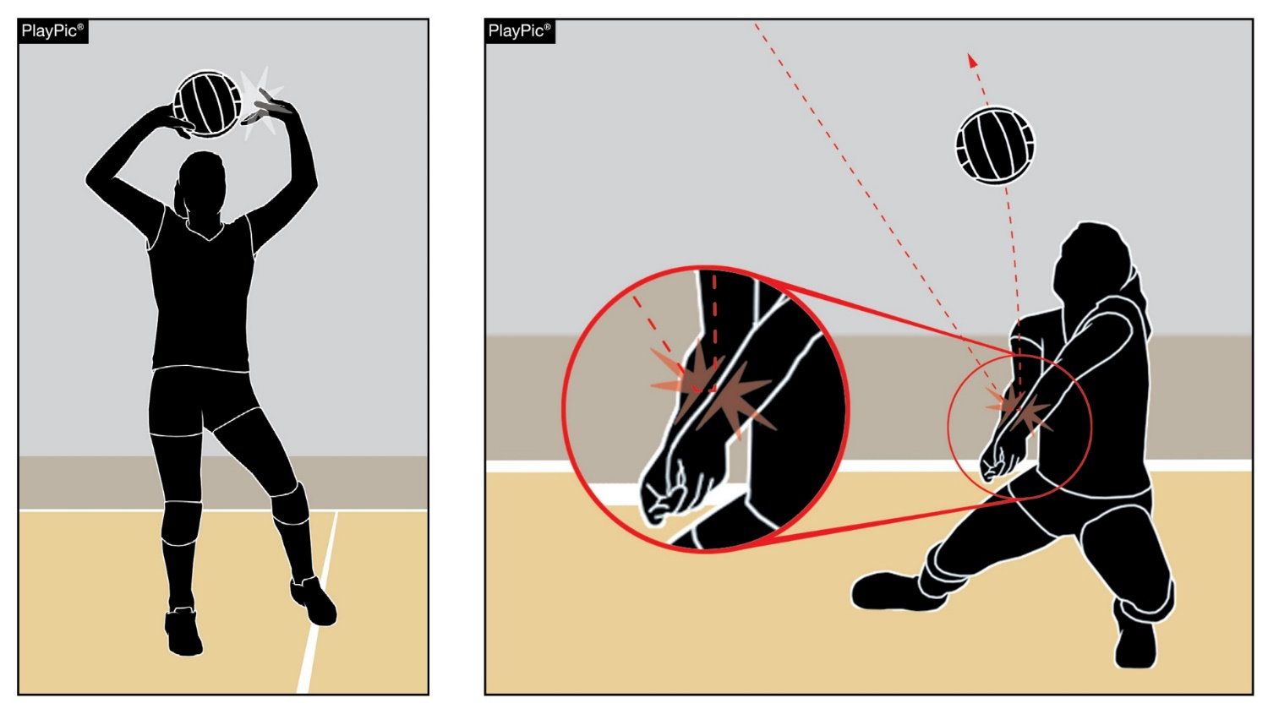
Ball handling
A player in good position must play the ball without discernible double contact.
Less severe judgment is applied to a contact by a player who makes a challenging or spectacular play while maintaining a legal play.
Mishandled balls resulting in a blatant fault should still be called, regardless of the challenging or spectacular nature of the play.
Multiple contacts on a third ball must be whistled.
Notes:
A player in good position must play the ball without discernible double contact.
Less severe judgment is applied to a contact by a player who makes a challenging or spectacular play while maintaining a legal play.
Mishandled balls resulting in a blatant fault should still be called, regardless of the challenging or spectacular nature of the play.
Multiple contacts on a third ball must be whistled.

Slide 25
Ball Handling
Prolonged Contact
  The rule states that the ball is not allowed to come to rest or involve prolonged contact.
  The fact that the contact is an underhand action or done with an open hand is not an automatic call.
  Players can legally take a stab at the ball to keep the ball alive as they pursue an errant contact from their teammate.
  A whistle should accompany prolonged contact.
Notes:
Prolonged Contact
The rule states that the ball is not allowed to come to rest or involve prolonged contact.
The fact that the contact is an underhand action or done with an open hand is not an automatic call.
Players can legally take a stab at the ball to keep the ball alive as they pursue an errant contact from their teammate.
A whistle should accompany prolonged contact.

Slide 26
Ball handling
Power Tip and Setter Dump
  Players are utilizing the setter dump effectively, while attackers are tipping the ball deeper into their opponent’s court and tipping with more power.
  Officials must determine where the ball contact was initiated in relation to the body and judge how long the player continued the action while in contact with the ball.
Notes:
Power Tip and Setter Dump
Players are utilizing the setter dump effectively, while attackers are tipping the ball deeper into their opponent’s court and tipping with more power.
Officials must determine where the ball contact was initiated in relation to the body and judge how long the player continued the action while in contact with the ball.

Slide 27
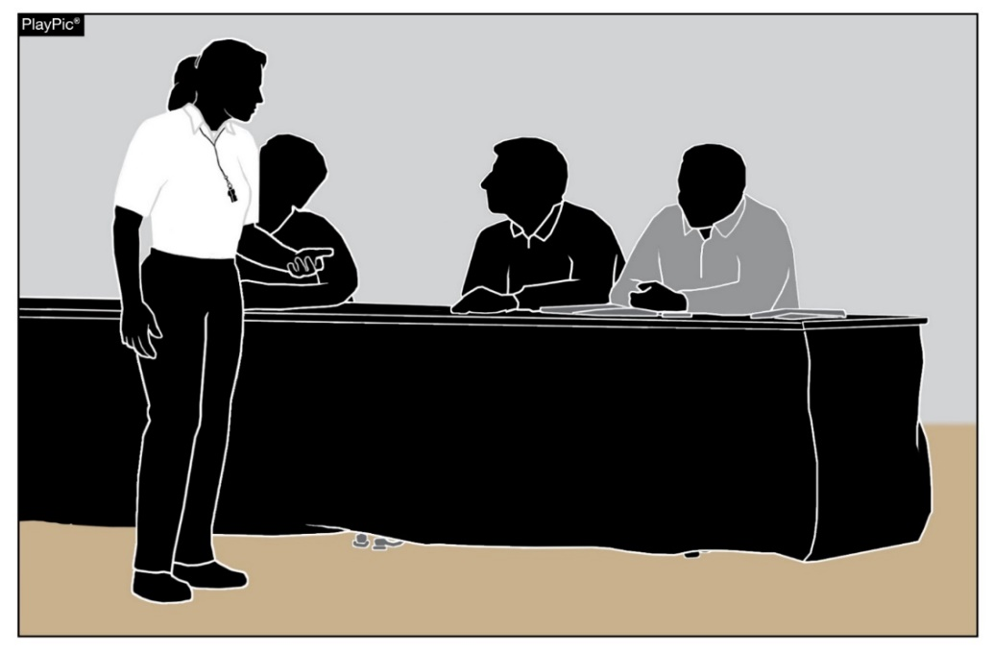
Scoring best practices
The scoring crew is an integral part of the officiating team. The scorer must:
Arrive no later than 20 minutes before match time.
Complete the match information in the scorebook/scoresheet or an electronic scoring device.
Accept the team rosters and lineups and record the lineups.
Secure each team’s lineup by placing them upside down on the table.
Collaborate with the R2 to ensure each team’s lineup is correct on the R2’s lineup card and verify teams are in correct starting positions on the court prior to each set.
Establish a routine with the assistant scorer for handling substitutions and libero replacements.
Ensure readiness to the R2 after each substitution.
Use contrasting colors to indicate full rounds of service.
Notify the R2 if there are any scoring issues.
Communicate with the R2 during time-outs and between sets.
Notes:
The scoring crew is an integral part of the officiating team. The scorer must:
Arrive no later than 20 minutes before match time.
Complete the match information in the scorebook/scoresheet or an electronic scoring device.
Accept the team rosters and lineups and record the lineups.
Secure each team’s lineup by placing them upside down on the table.
Collaborate with the R2 to ensure each team’s lineup is correct on the R2’s lineup card and verify teams are in correct starting positions on the court prior to each set.
Establish a routine with the assistant scorer for handling substitutions and libero replacements.
Ensure readiness to the R2 after each substitution.
Use contrasting colors to indicate full rounds of service.
Notify the R2 if there are any scoring issues.
Communicate with the R2 during time-outs and between sets.

Slide 28
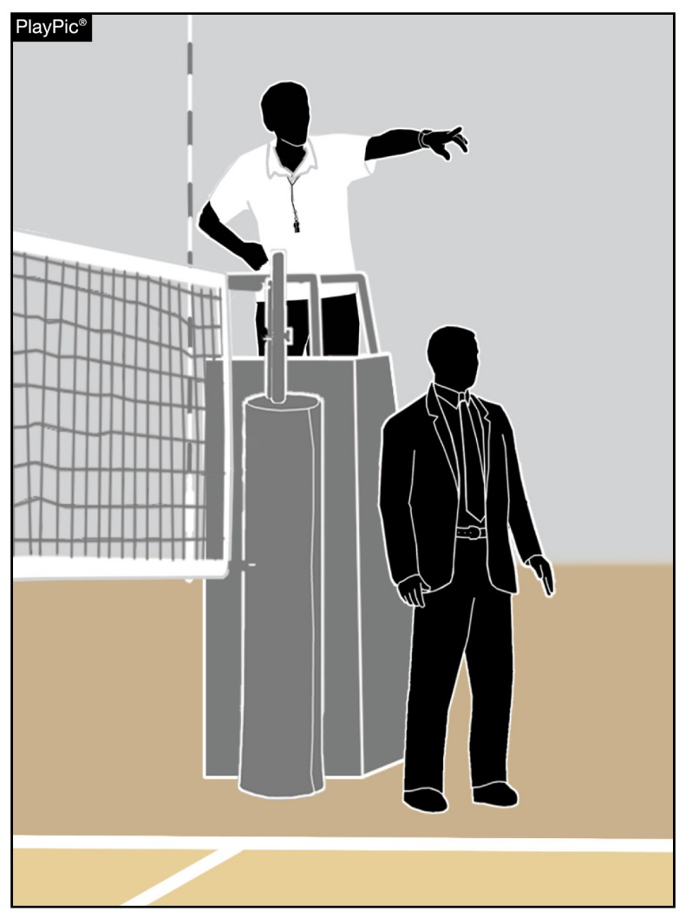
Host management best practices
The designated administrator on site should introduce themselves to the officials upon arrival at the facility and show them to their locker rooms. Officials and coaches should be able to quickly identify host management should any issues arise. Host management should:
Ensure the facility is set up properly one hour before the match.
Ensure the net system is at the correct height and is padded.
Ensure the referee stand is secure and padded.
Assist in ensuring teams from both sides do not encircle the entire court.
Be available throughout the match.
Post signage for home/visitor and/or student section. Allow fans to stand, but not on the playing surface.
Ensure that any unsporting conduct by spectators is not tolerated. It needs to be immediately addressed.
Collaborate with officials to suspend play for fan issues, if necessary.
Notes:
The designated administrator on site should introduce themselves to the officials upon arrival at the facility and show them to their locker rooms. Officials and coaches should be able to quickly identify host management should any issues arise. Host management should:
Ensure the facility is set up properly one hour before the match.
Ensure the net system is at the correct height and is padded.
Ensure the referee stand is secure and padded.
Assist in ensuring teams from both sides do not encircle the entire court.
Be available throughout the match.
Post signage for home/visitor and/or student section. Allow fans to stand, but not on the playing surface.
Ensure that any unsporting conduct by spectators is not tolerated. It needs to be immediately addressed.
Collaborate with officials to suspend play for fan issues, if necessary.

Slide 29
NFHS Authentication Mark Update

Slide 30



NFHS Authenticating Mark update
Specifications
Do not use the NFHS Authenticating Mark without prior written approval from the NFHS.
This mark is for use of licensees only.
Minimum size
  Inflatable Balls - 2 ½" (Basketball, Football, Soccer, Volleyball, and Water Polo)
  Non-Inflatable Balls - 1 ¼" (Baseball, Field Hockey, Ice Hockey Puck, Lacrosse, and Softball)
  On a ball or puck, the NFHS logo may be smaller than manufacturer’s logo, but should be placed in proximity to the manufacturer’s name for easy identification. Allow enough space around the logo so it can be easily recognized as distinct and separate.
  Reproduce the logo only from the vector artwork provided here or on Direct Licensing Hub. Do not copy, scan art electronically or use as a template to redraw the symbol.
Note: If sizing or specifications do not work well in your particular design situation, contactK12 Licensing.
Current Logos
New Logo
Notes:
Current and New Logos are both permissible for competition.

Slide 31
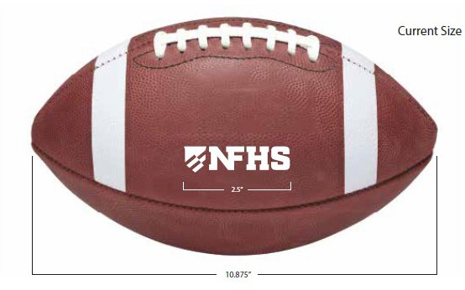
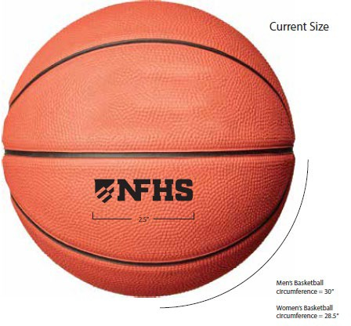
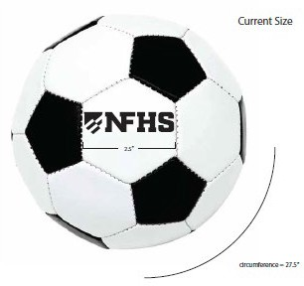
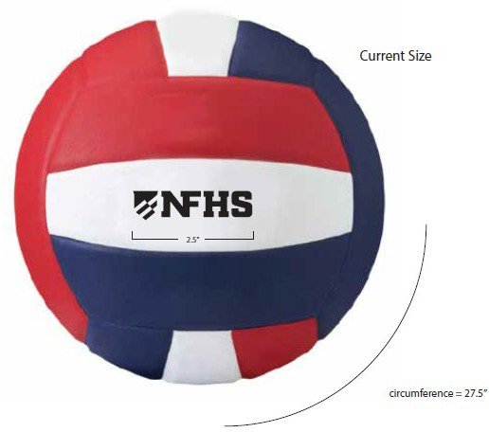
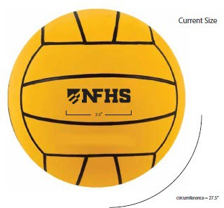
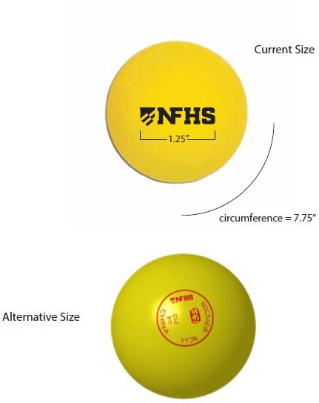
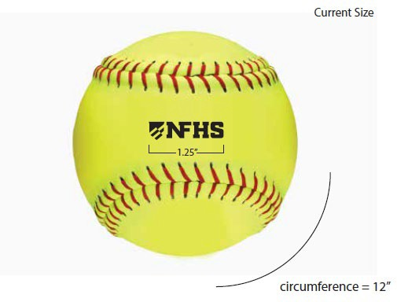
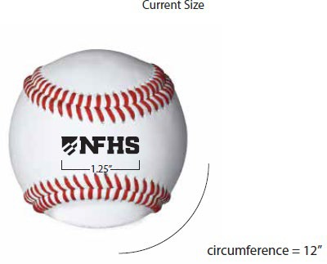
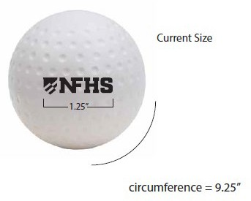
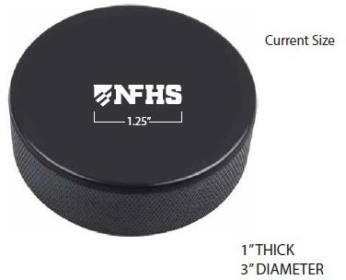
NFHS Authenticating Mark update
A current list of NFHS authenticated products can be found at www.nfhs.org, Resources, Authenticating Mark.
Notes:
A current list of NFHS authenticated products can be found at www.nfhs.org, Resources, Authenticating Mark.

Slide 32
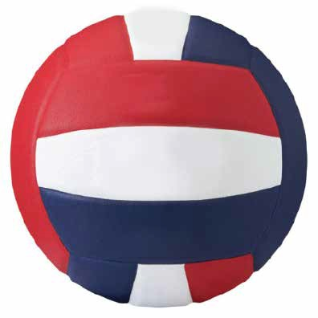


Volleyball
Old Size
Current Size
OR
1.25”
2.5”
circumference = 26”
circumference = 27.5”
Notes:
Both marks are compliant for competition.
Manufacturers must begin using the new NFHS Authenticating Mark with all new products.

Slide 33
NFHS OFFICIALS Education

Slide 34

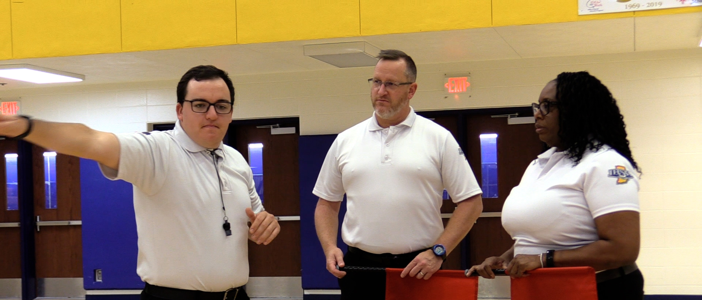

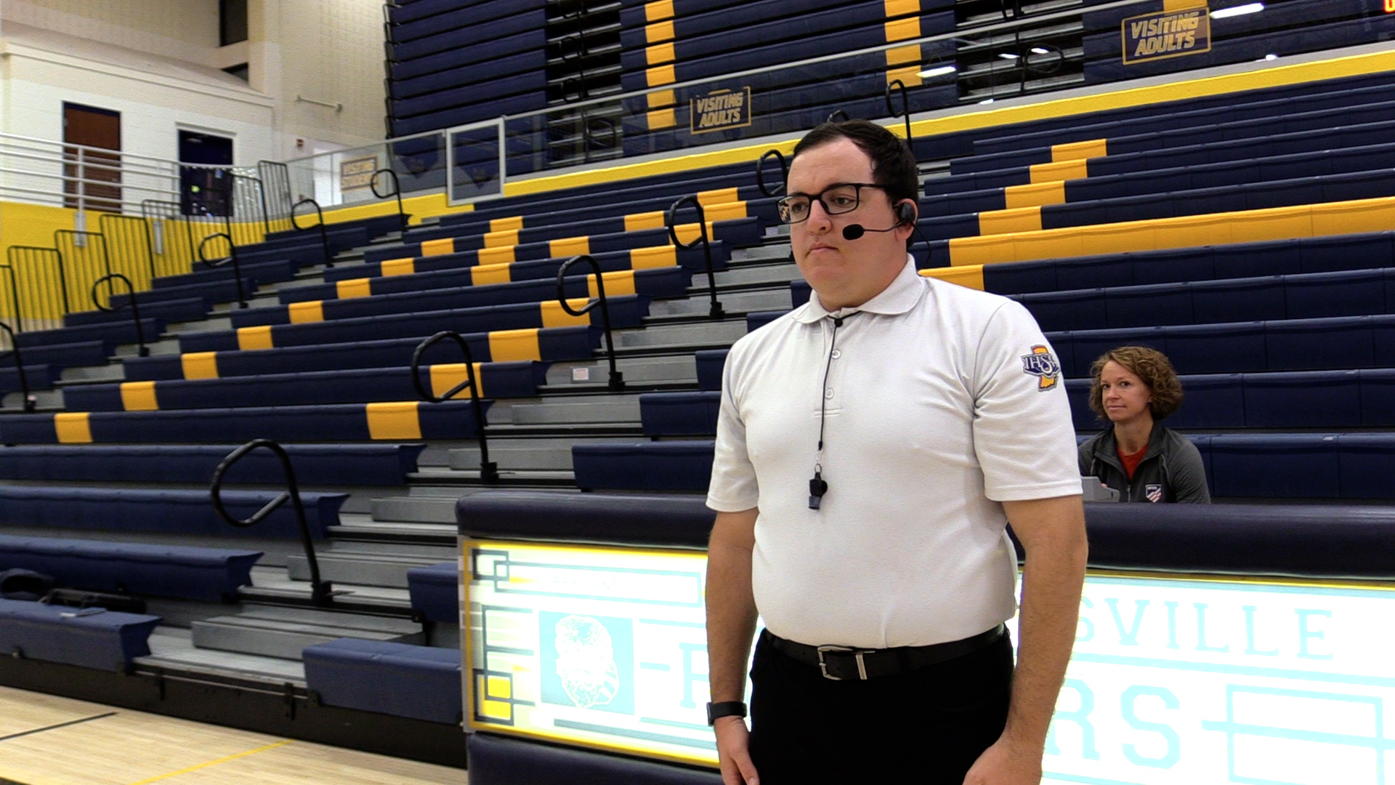
LINE JUDGE TRAINING
Electronic headset TRAINING
NEW OFFICIATING VIDEOS!
The NFHS will be releasing two new officials’ training videos for the 2024 season:
Basic Signals and Fundamentals of Line Judging
Recommended Best Practices for the Use of Electronic Headsets
Notes:
The NFHS will be releasing two new officials’ training videos for the 2024 season:
Basic Signals and Fundamentals of Line Judging
Recommended Best Practices for the Use of Electronic Headsets

Slide 35

All things officiating in one place!
The all-in-one, cloud-based NFHS Center for Officials Services (COS) connects everyone associated with officiating. The COS handles registration, assignments, testing, payments, and a host of other features and integrations that consolidate all officiating needs into a single, modern solution. Free to all NFHS state associations, local associations, and assigner groups.
20+
Member States
300,000+
Officials
7,000+
Schools
Notes:
The NFHS Network is the leader in streaming Live and On Demand high school sports.
Partnered with the National Federation of State High School Associations, 45 high school state athletic/activities associations, and PlayOn! Sports, the NFHS Network is a joint venture created to provide fans with the ability to stream high school sports on any device, from wherever they are.
All NFHS Network events are available to watch online at www.NFHSnetwork.com and through the NFHS Network Live App for iOS and Android. Follow us on Facebook, Twitter, Instagram, and YouTube.
Watching high school sports and events has never been easier.
The NFHS Network’s goal to broadcast live all 2 million high school sporting events by 2025.
The NFHS Network covers 27 different regular season and postseason sports, as well as other high school activities, celebrating the accomplishments of students-athletes, student broadcasters, and high schools across the country.

Slide 36
COS Continued Improvements
Over 200 Updates and New Features in the Past 12 Months!
  COMING SOON
    Exam Center Improvements
    Streamlined Registrations and Onboarding
    Expanded Reporting Capabilities for States
    Event/Clinic Registration and Attendance Tracking
  Reciprocity
    In-State/Out-of-State
  Watch for Many More Updates from NFHS!
Notes:
The NFHS Network is the leader in streaming Live and On Demand high school sports.
Partnered with the National Federation of State High School Associations, 45 high school state athletic/activities associations, and PlayOn! Sports, the NFHS Network is a joint venture created to provide fans with the ability to stream high school sports on any device, from wherever they are.
All NFHS Network events are available to watch online at www.NFHSnetwork.com and through the NFHS Network Live App for iOS and Android. Follow us on Facebook, Twitter, Instagram, and YouTube.
Watching high school sports and events has never been easier.
The NFHS Network’s goal to broadcast live all 2 million high school sporting events by 2025.
The NFHS Network covers 27 different regular season and postseason sports, as well as other high school activities, celebrating the accomplishments of students-athletes, student broadcasters, and high schools across the country.

Slide 37
NFHS Learning Center

Slide 38

Notes:
The NFHS Learning Center is the home to more than 90 online professional development courses for everyone within the interscholastic community - coaches, students, officials, parents, administrators, and individuals within performing arts programs. More than 60 courses are available for free.
The NFHS is an Accredited Institution and has delivered more than 15 million courses on its NFHS Learning Center platform since its inception in 2007. In receiving national accreditation by Cognia, the NFHS has upheld itself to rigorous standards that focus on productive learning environments, equitable resource allocation that meet the needs of learners, and effective leadership.
The NFHS Learning Center features its flagship coaching course, “Fundamentals of Coaching,” as well as several health and safety courses that have been completed by millions of individuals, such as “Concussion in Sports,” “Heat Illness Prevention,” “Sudden Cardiac Arrest” and “Protecting Students from Abuse.” The NFHS Learning Center offers several national credentials that can be earned by individuals who complete specific NFHS courses. Through the School Honor Roll Program, schools can earn a physical banner to hang in their school.
To learn more and start your professional development journey, please visit the NFHS Learning Center at NFHSLearn.com.

Slide 39

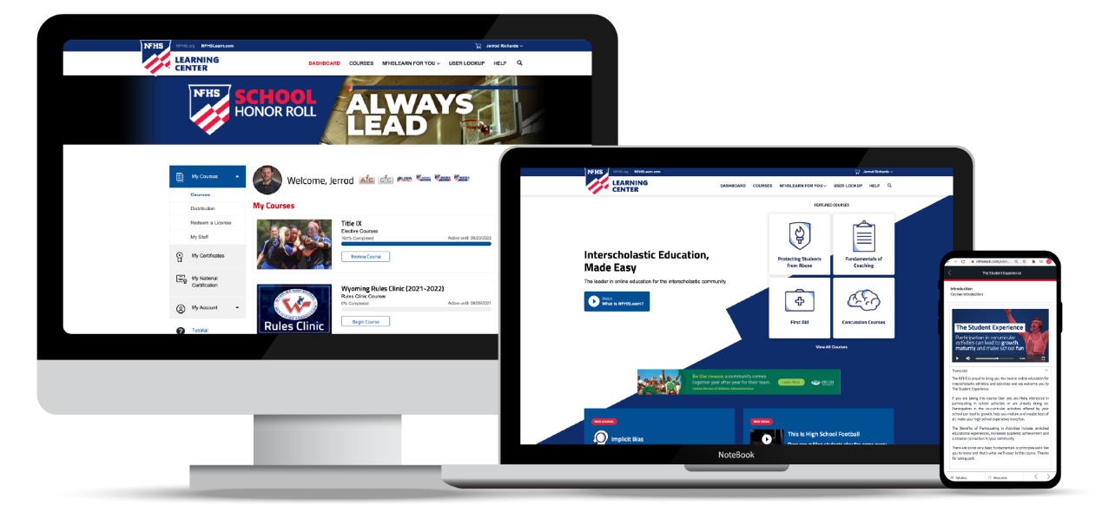
Over 21 million courses delivered!
Concussion in Sports – 7.2M+
Heat Illness Prevention – 2.2M+
Sudden Cardiac Arrest – 2.4M+
Concussion for Students – 1.2M+
The Collapsed Student (2020) – 67,550+
CPR & AED Training (2023) – 9,300+
Sportsmanship – 1M+
Fundamentals of Coaching – 928,000+
First Aid, Health and Safety – 418,000+
Bullying, Hazing and Inappropriate Behaviors – 425,000+
Student Mental Health and Suicide Prevention – 250,000+
Protecting Students from Abuse – 250,000+
Implicit Bias (2021) – 96,000+

Slide 40
NFHS Network

Slide 41


NFHS Network
By 2025, every high school sporting event in America will be streamed live.
The NFHS Network will be
THE DESTINATION for fans
to view these broadcasts.
27 Different Sports and Activities
www.NFHSnetwork.com
Notes:
The NFHS Network is the leader in streaming Live and On Demand high school sports.
Partnered with the National Federation of State High School Associations, 45 high school state athletic/activities associations, and PlayOn! Sports, the NFHS Network is a joint venture created to provide fans with the ability to stream high school sports on any device, from wherever they are.
All NFHS Network events are available to watch online at www.NFHSnetwork.com and through the NFHS Network Live App for iOS and Android. Follow us on Facebook, Twitter, Instagram, and YouTube.
Watching high school sports and events has never been easier.
The NFHS Network’s goal to broadcast live all 2 million high school sporting events by 2025.
The NFHS Network covers 27 different regular season and postseason sports, as well as other high school activities, celebrating the accomplishments of students-athletes, student broadcasters, and high schools across the country.

Slide 42


Over 1 million events this year…
Notes:
The NFHS Network will broadcast over 150,000 live events this year. If your school is not a member of the NFHS Network School Broadcast Program, please contact us at Mark.Koski@NFHSnetwork.com

Slide 43

Thank You
National Federation of State High School Associations
PO Box 690 | Indianapolis, IN 46206
Phone: 317-972-6900
www.nfhs.org | www.nfhslearn.com | www.nfhsnetwork.com

