Slide 1
2024-25 NFHS soccer Rules PowerPoint

Slide 2

National Federation of
State High School Associations
NFHS (located in Indianapolis, IN – Est. 1920):
  National leader and advocate for
  high school athletics and
  performing arts programs.
  Serves 51 state associations, 19,500
  high schools and 12 million student
  participants.
  Writes playing rules for 17 high school
  sports for boys and girls.
  Offers online education courses for high school coaches,
  officials, parents, students and others.
  Ensures that students have opportunity to enjoy healthy participation, achievement and good sportsmanship in education-based athletics.
Notes:
The NFHS is the national leader and advocate for high school athletics and performing arts programs. Services of the NFHS reach more than 19,500 high schools and 12 million participants throughout the eight NFHS sections across the U.S.
A significant responsibility of the NFHS is the commitment to writing quality playing rules for 17 high school sports for boys and girls, in addition to providing educational resources for high school coaches, officials, parents and students.
It is the vision of the NFHS to help prepare tomorrow’s leaders for the next level of life through the many program offerings in education-based athletics and activities.

Slide 3








NFHS Rules Review Committee
The NFHS Rules Review Committee is chaired by the chief operating officer and composed of all rules editors. After each committee concludes its deliberations and has adopted its recommended changes for the subsequent year, such revisions will be evaluated by the Rules Review Committee.
Davis Whitfield
Chief Operating Officer
Lindsey Atkinson
Basketball, Girls Lacrosse and Volleyball
Bob Colgate
Football and Sports
Medicine
Sandy Searcy
Softball, Swimming & Diving and Water Polo
Elliot Hopkins
Baseball and Wrestling
Julie Cochran
Cross Country, Gymnastics, Field Hockey, Soccer and
Track & Field
James Weaver
Boys Lacrosse
and Spirit
Dan Schuster
Ice Hockey
Notes:
The rules writing process is multi-tiered. Each year, specific committee meets to deliberate rules proposals submitted by state associations and committee members. After each committee concludes its deliberations and has adopted its recommended changes for the subsequent year, proposals are sent to the Rules Review Committee, who then evaluates the proposals and then forwards the to the NFHS Board of Directors for their consideration. The NFHS Rules Review Committee is chaired by the chief operating officer and consists of all NFHS rules editors

Slide 4
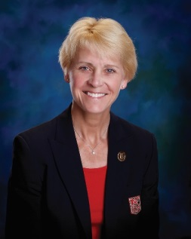




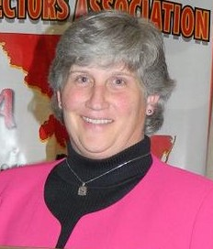

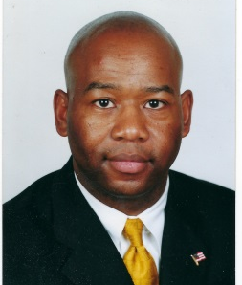




NFHS Rules Committee
Dr. Karissa Niehoff
NFHS
Publisher
Julie Cochran
NFHS
Editor
Gibby Reynolds
Wilsonville, OR
Chair - 2027
Brianna Hines
Woodbridge, VA
Coaches- 2026
Teri Connor
Allenwood, NJ
Officials - 2027
Mike Andrew
Binghamton, NY
Section 1- 2024
Marianne Shultz
Abingdon, MD
Section 2- 2026
Marvin Chou
Montgomery, AL
Section 3- 2025
Roger Morton
Greensboro, NC
Section 3 - 2027
Beth Sauser
Bloomington, IL
Section 4 -2026
Saul Hernandez
Dodge City, KS
Section 5- 2025
Joey Walters
North Little Rock, AR
Section 6- 2024
Joe Oberndorfer
Las Vegas, NV
Section 7 -2027
Julie Hammons
Boise, ID
Section 8- 2025
Notes:
The 2024 Soccer Rules committee members. Representation of eight sections, the NFHS Officials Association, the NFHS Coaches Association, and Rules Committee Chair.

Slide 5


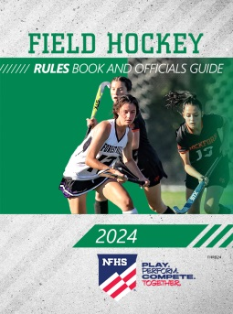
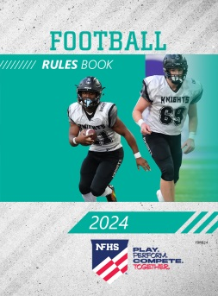
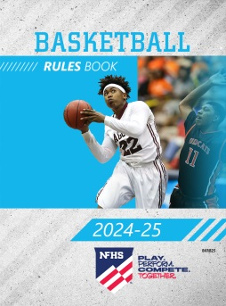
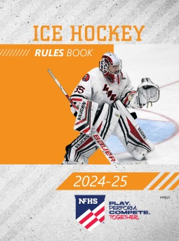
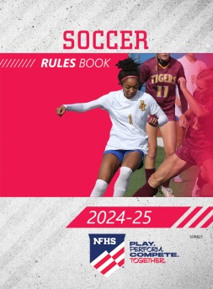
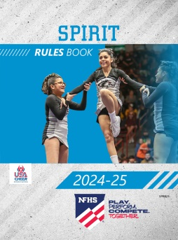
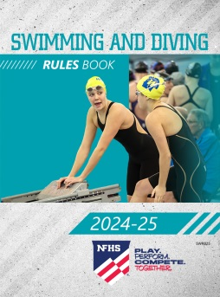

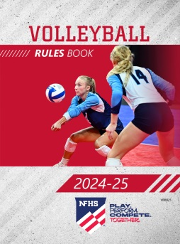
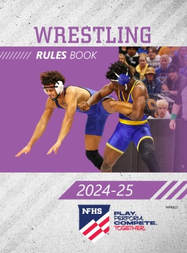
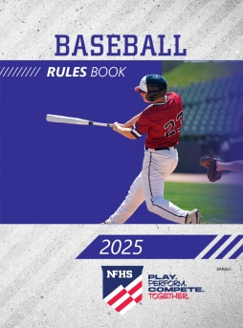
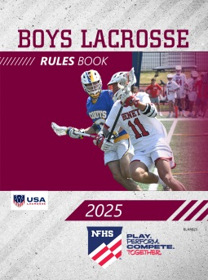
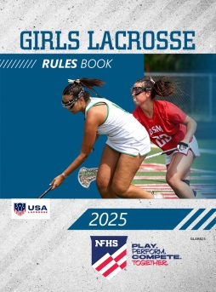
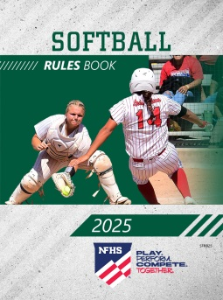

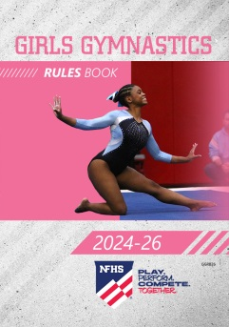
NFHS Publications
The NFHS writes playing rules for 17 sports
for boys and girls at the high school level.
  Publishes 4 million pieces of materials annually.
Notes:
The NFHS writes playing rules for 17 sports for boys and girls at the high school level and publishes 4 million pieces of materials annually.

Slide 6

NFHS AllAccess – Website
AllAccess is the NFHS Digital Publications Platform that includes:
  Rules Publications
  High School Today Magazine
  Policy Debate Quarterlies
  Other NFHS Digital Publications
Website organized for associations and individuals to assign books and manage purchases
Visit https://allaccess.nfhs.org
Notes:
AllAccess is the New NFHS Digital Publications Platform that includes:
Rules Publications
High School Today Magazine
Policy Debate Quarterlies
Other NFHS Digital Publications
Website organized for associations and individuals to assign books and manage purchases
Visit www.allaccess.nfhs.org

Slide 7
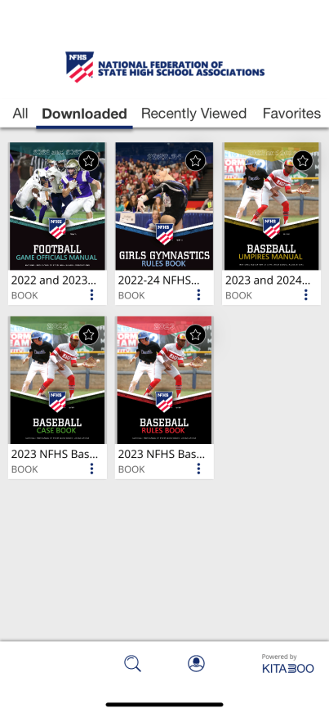


NFHS AllAccess – Mobile App
Access Via Website or Mobile App:
View available publications for sale
View publications assigned to you
Download books for offline viewing
Read publications as an e-book
Available on App Store and Google Play
Notes:
Access Via Website or Mobile App:
View available publications for sale
View publications assigned to you
Download books for offline viewing
Read publications as an e-book
Book features include:
Table of contents
Highlighting text
Creating ‘sticky notes’ on pages
Searching for terms
Mark-up pen feature
Viewing highlights and notes on data page
Available on App Store and Google Play

Slide 8
Rules changes

Slide 9
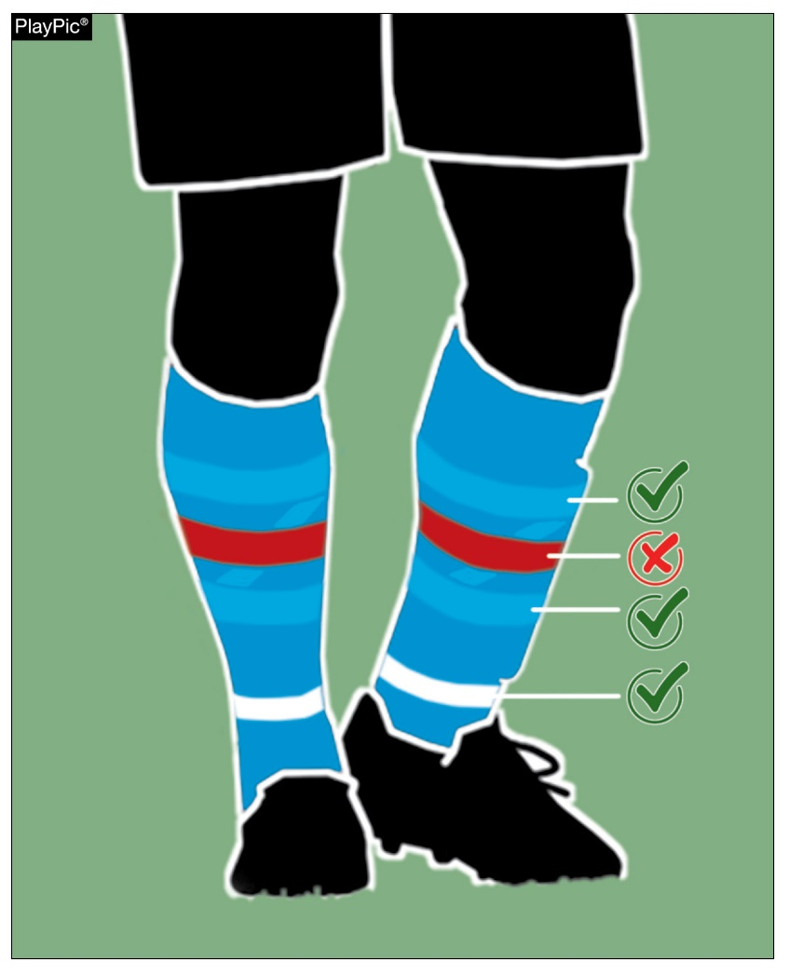
Required Uniform
4-1-4d
If tape or a similar material (stays/straps) is applied externally to the socks above the ankle, it shall be a similar color as that part of the sock to which it is applied.
Below the ankle, tape or similar material may be any color.
Notes:
Rationale: Athletes have the flexibility to modify socks within the existing regulations. Frequently, they remove the foot of one sock to layer another underneath, enhancing comfort or grip inside their shoes and fastening the top sock around the ankle. Any tape or similar material used above the ankle must match the sock's color, while at or below the ankle, any color is allowed. Referees are no longer required to oversee socks below the ankle.

Slide 10

FOULS AND Misconduct
Rule 12
The rule on Fouls and Misconduct has been revised to eliminate duplicate language and improve usability. Sections have been rearranged to enhance ease of reference. Red card offenses have been ordered by relative level of severity.
Notes:
Rationale: The Fouls and Misconduct rule has been revised to eliminate duplicate language and improve usability. The main changes involve reorganizing the existing rule for clarity. Sections have been rearranged to enhance ease of reference, and a new section addressing Stopping a Promising Attack (SPA) has been included. Certain general language in the rule has been modified to align with other rules codes. Section 6, Ejections, provides an ordered list of offenses by severity to allow associations more flexibility for determining post-game sanctions for misconduct. Additionally, an article has been added to clarify that all necessary conditions must be met for DOGSO (Denial of an Obvious Goal-Scoring Opportunity) to be applicable.

Slide 11
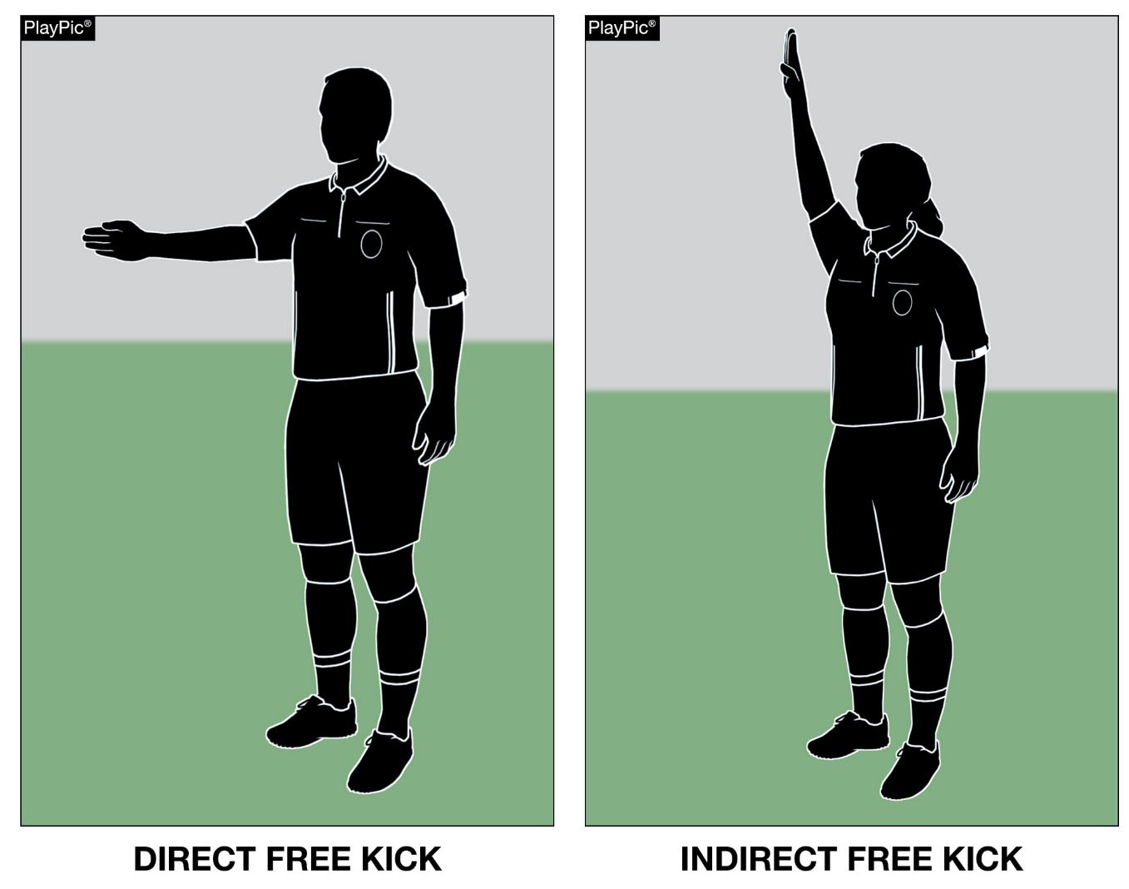
Fouls and Misconduct
Rule 12
Direct and Indirect free kick fouls have their own sections now in the rules.
Notes:
Rationale: Breaking the Direct and indirect Fouls into separate sections enhances ease of reference and logically groups fouls with similar characteristics.

Slide 12
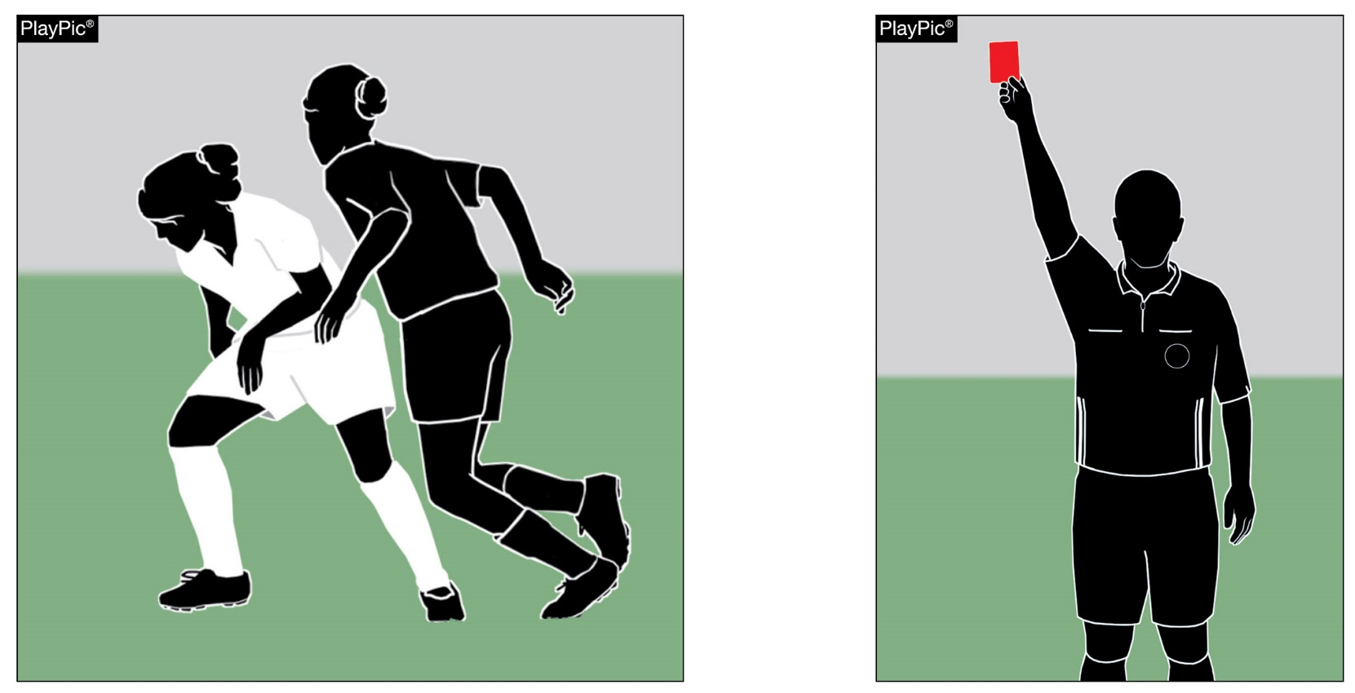
Fouls and Misconduct
Rule 12
Terminology Changes
Wording was updated to reflect national terminology.
The term “obstruction” has been replaced by the term “impeding.”
The term “disqualification” has been replaced by the term “ejection.”
Notes:
Rationale: General language has been modified to align with other rules codes for officials working at different levels.

Slide 13
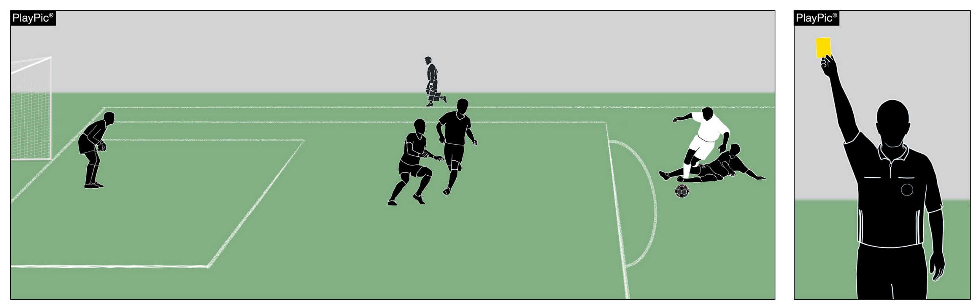
Fouls and Misconduct
Rule 12
Rule 12 now includes the criteria for Stopping a Promising Attack (SPA) in Section 8.
Notes:
Rationale: A new section addressing the considerations for a promising attack serves as a crucial clarification in the rules, specifically addressing what was previously referred to as “tactical fouls”.
While the considerations are clear for obvious goal-scoring opportunities, promising attacks may be more difficult to recognize.
The new section assists officials in identifying plays where an attacking opportunity with clear potential has been halted through a foul.
Slide Note: One of the DOGSO criteria is missing in this PlayPic. There are too many defenders between the carless foul and the goal. While the offender has not denied an obvious goal-scoring opportunity, they should be cautioned for stopping a promising attack.

Slide 14
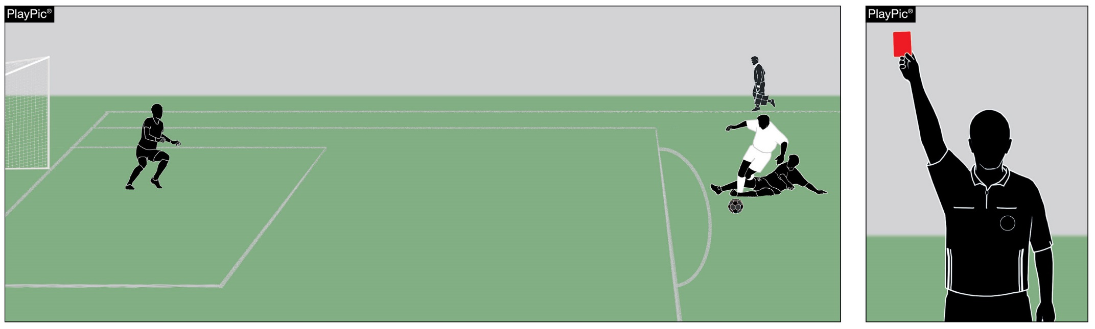
Fouls and Misconduct
Rule 12
Article 4 in 12-8 provides guidance that all elements must be satisfied for obvious goal-scoring opportunities:
Distance between the offense and the goal,
General direction of play,
Likelihood of keeping control of the ball,
Location and number of defenders.
Notes:
Rationale: An article was added to clarify that all necessary conditions must be met for DOGSO to be applicable.
Slide Note: Unlike the previous slide, this PlayPic shows all four considerations are met and warrant the offender’s ejection for denying an obvious goal-scoring opportunity

Slide 15
Editorial changes

Slide 16
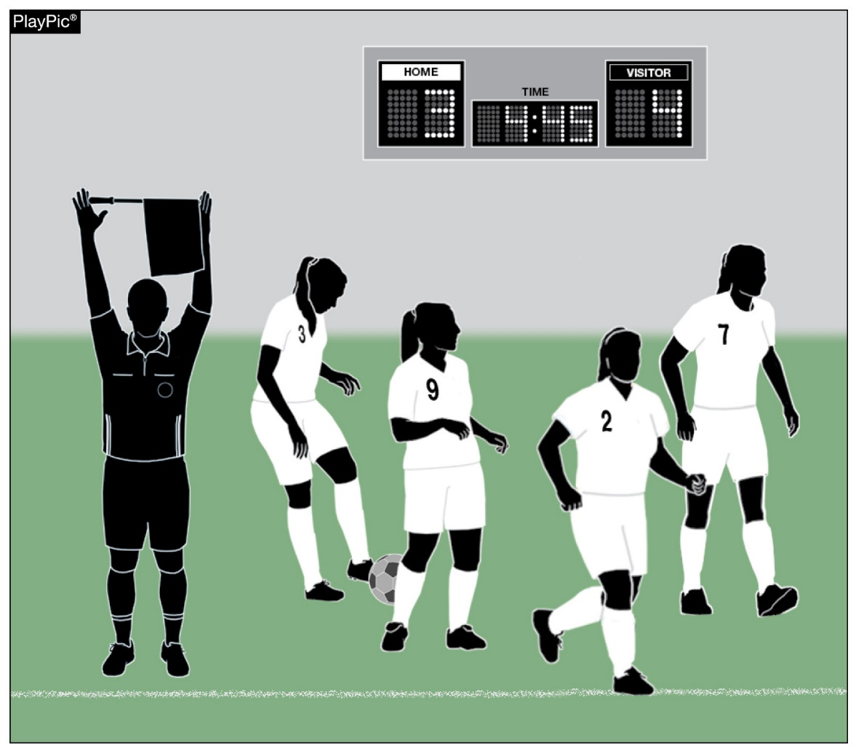
Time – Out and In
7-4-3
The clock shall be stopped when a substitute by the team in the lead is beckoned onto the field in the final five minutes of regulation or overtime.
Notes:
Notes: This is not a rules change this year, but a clarification that the language that was in 3-4-3 has been removed so now all language is in 7-4-3.

Slide 17
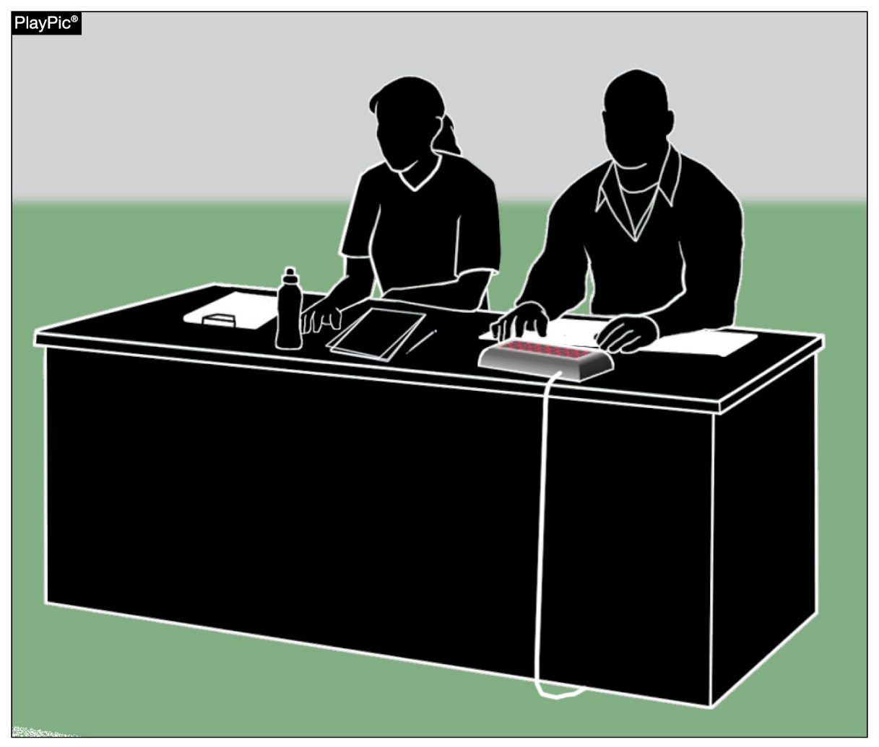
Timer
6-2-3
The official timer shall start or stop the timing device as per 7-4 when signaled to do so by the referee.
This change removes a duplicate reference to timer duties.
Notes:
Removed duplicate description of when the clock Is to start and stop and consolidates all articles within the book.

Slide 18

Misconduct
12-5-1f15, 5-1-2
Amended language related to prohibition of players, coaches, bench personnel or officials related to the use of alcohol, tobacco or controlled or illicit substance(s) for non-medicinal purposes beginning with arrival at the competition site until departure following the completion of the contest.
Notes:
Notes: This editorial change brings language in line with all NFHS Rules Books.

Slide 19
Points of emphasis

Slide 20
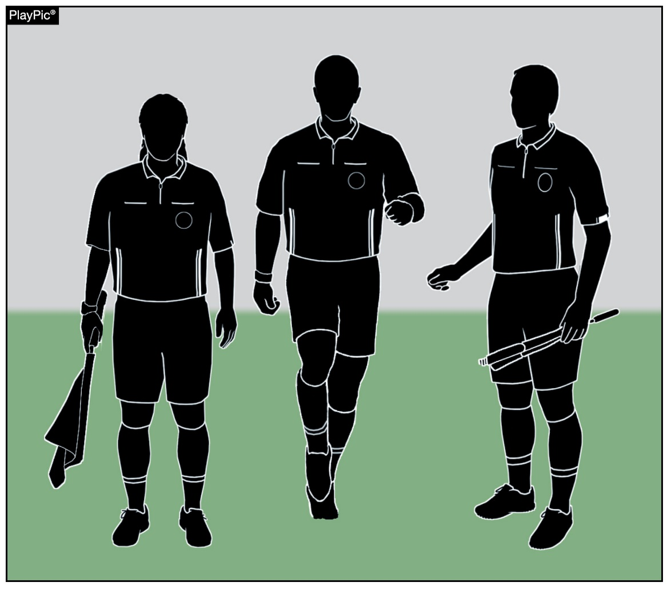
Official’s Toolbox for Game Management
Referees have a variety of skills, techniques and strategies within their “toolbox” to effectively officiate a match and maintain control over players, coaches and the game environment.
Notes:
A referee's "toolbox" for game management consists of various skills, techniques, and strategies they can employ to effectively officiate a match and maintain control over the players, coaches and game environment.
By utilizing these tools effectively while managing emotions and remaining calm and composed, referees can promote fair play, ensure player safety, and contribute to a positive and enjoyable experience for everyone involved in the game.

Slide 21
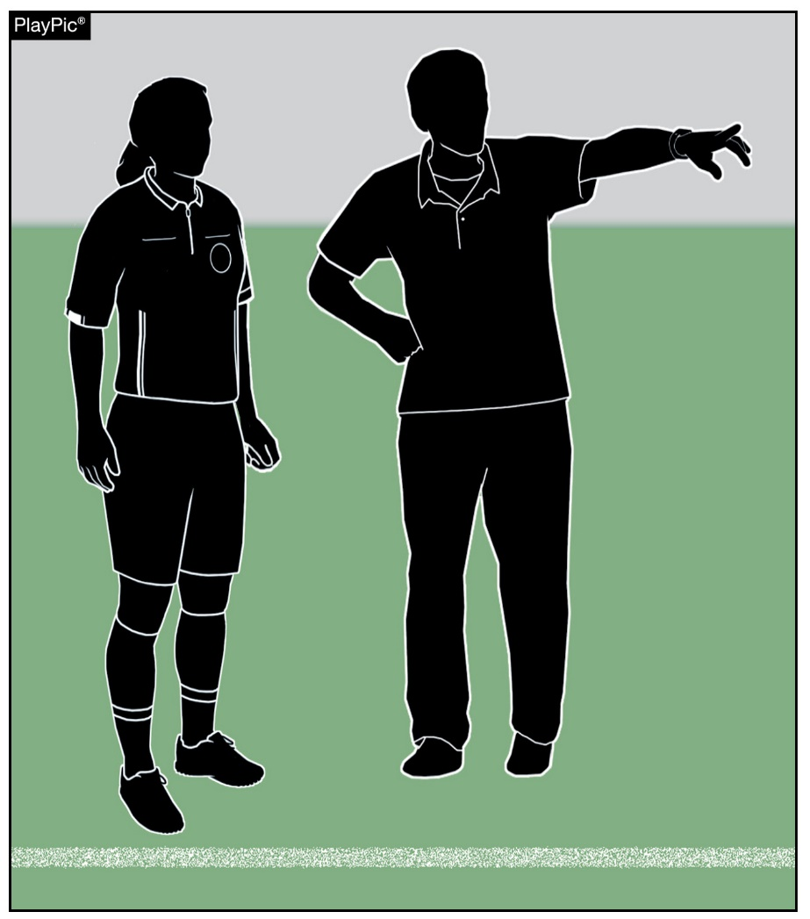
Official’s Toolbox for Game Management
These tools include:
Communication – Using verbal and non-verbal cues to convey decision, instructions, warnings and working with game site administration to facilitate a positive game environment.
Game control – Using authority to manage the tempo and flow of the game, intervening to calm tensions, prevent conflicts and address unsporting behavior.

Slide 22
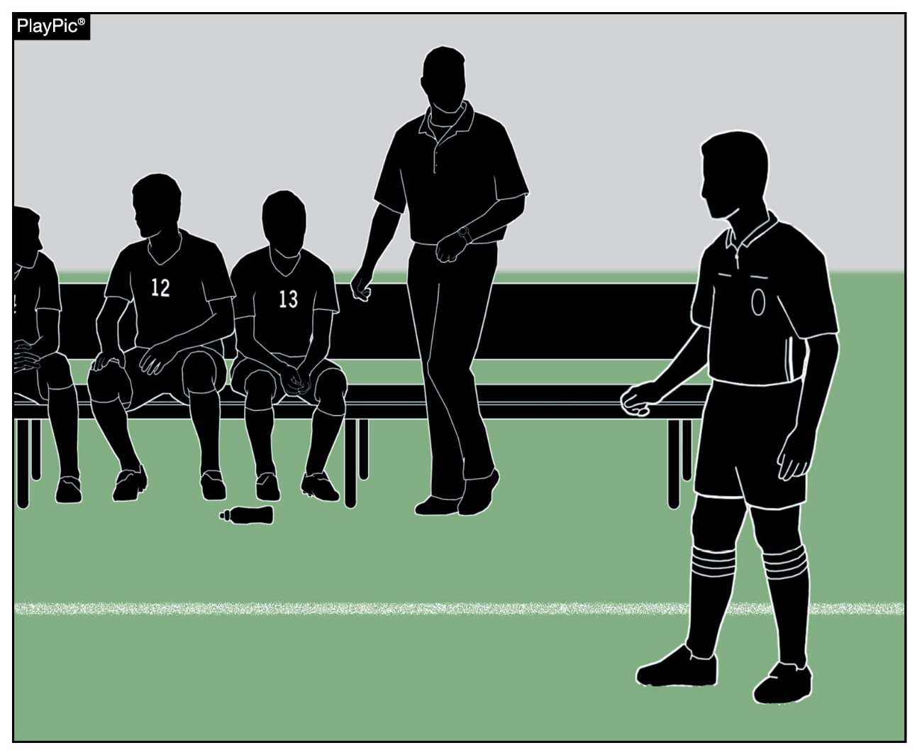
Official’s Toolbox for Game Management
Development – With the explanation of misconduct, both coaches and officials should approach interactions with respect and maintain professionalism.
Adaptability – Referees must adapt to changing circumstances and adjust their officiating style based on the level of play, the behavior of players and unexpected developments during the match.

Slide 23
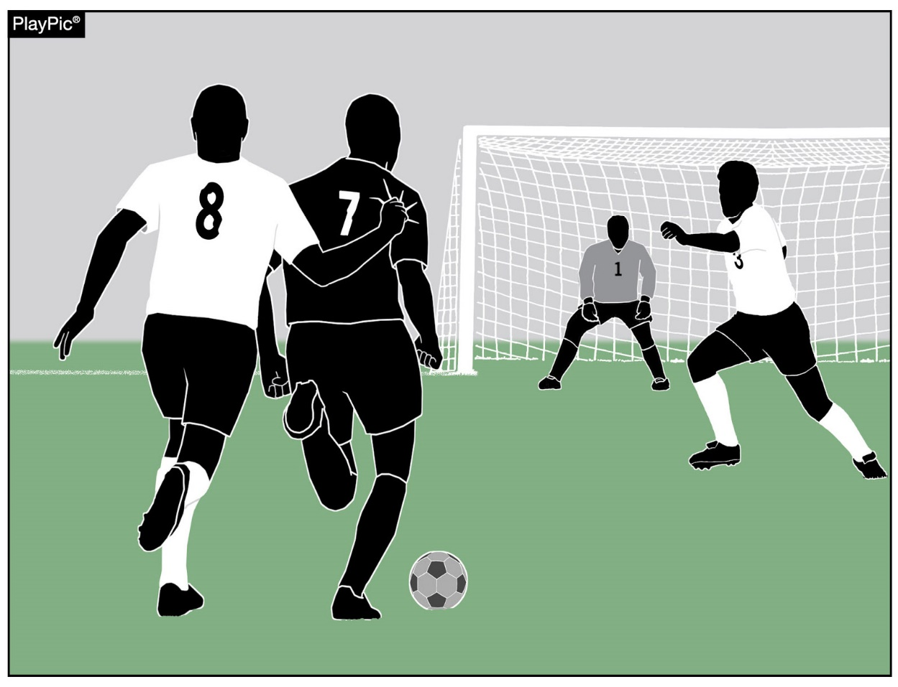
Stopping a promising Attack
The strategy of tactically fouling with the aim to interrupt the attacking team’s progress without necessarily denying an obvious goal-scoring opportunity is a form of misconduct.
Rule 12 highlights the importance of discerning the nature of these types of tactical offenses for consistent and fair officiating.
Notes:
The inclusion of the considerations for a promising attack serves as a crucial clarification in the rules, specifically addressing what was previously referred to as “tactical fouls”. While the considerations are clear for obvious goal-scoring opportunities, promising attacks may be more difficult to recognize.

Slide 24
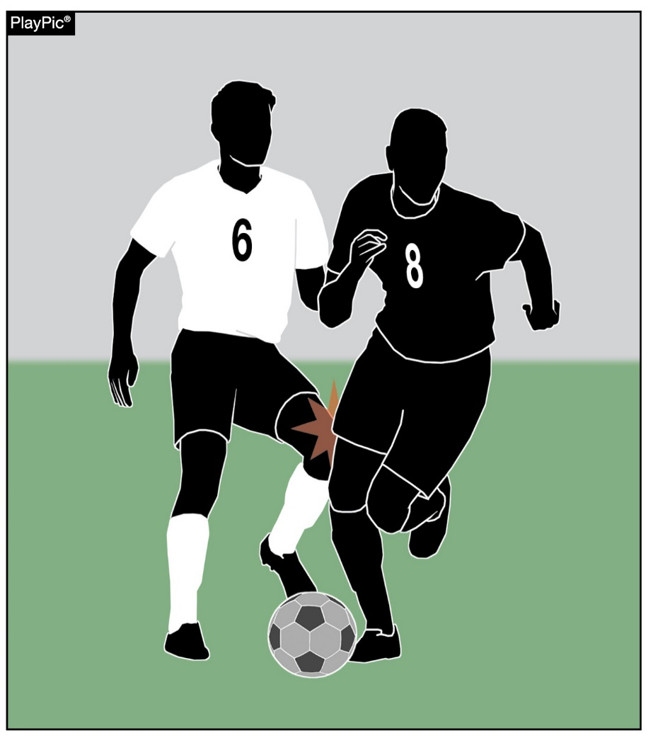
Stopping a promising Attack
Fouls that stop a promising attack (SPA)
might not be severe in nature,
but the offense’s impact on the attacking team’s potential needs to be recognized and dealt with accordingly.
Officials need to understand
to understand the nuanced dynamics of play,
maintain a tactical awareness of the phase of play, and
recognize SPA incidents.

Slide 25
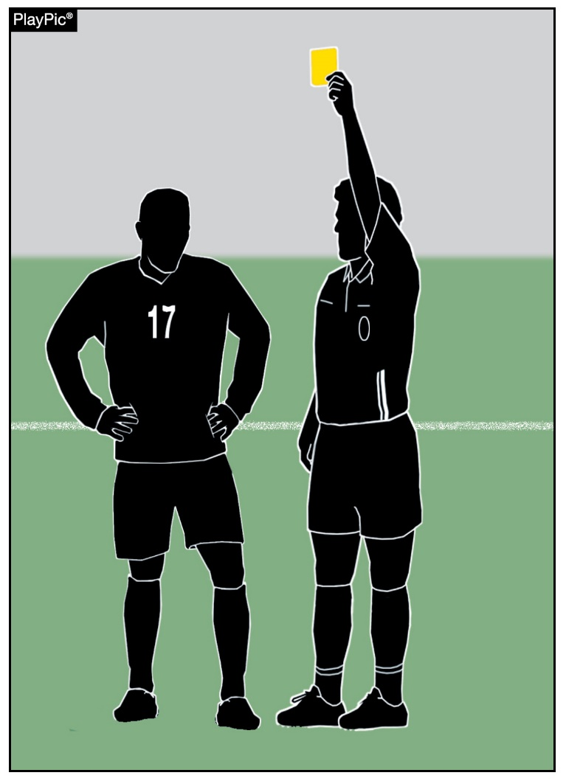
Stopping a promising Attack
Referees are tasked with evaluating multiple factors to determine the promise of an attack, encompassing elements like:
Player positioning,
Ball control,
Defensive presence,
Team’s pace.
Any foul disrupting a promising attack is considered misconduct, warranting a caution and a yellow card for the offending player.

Slide 26
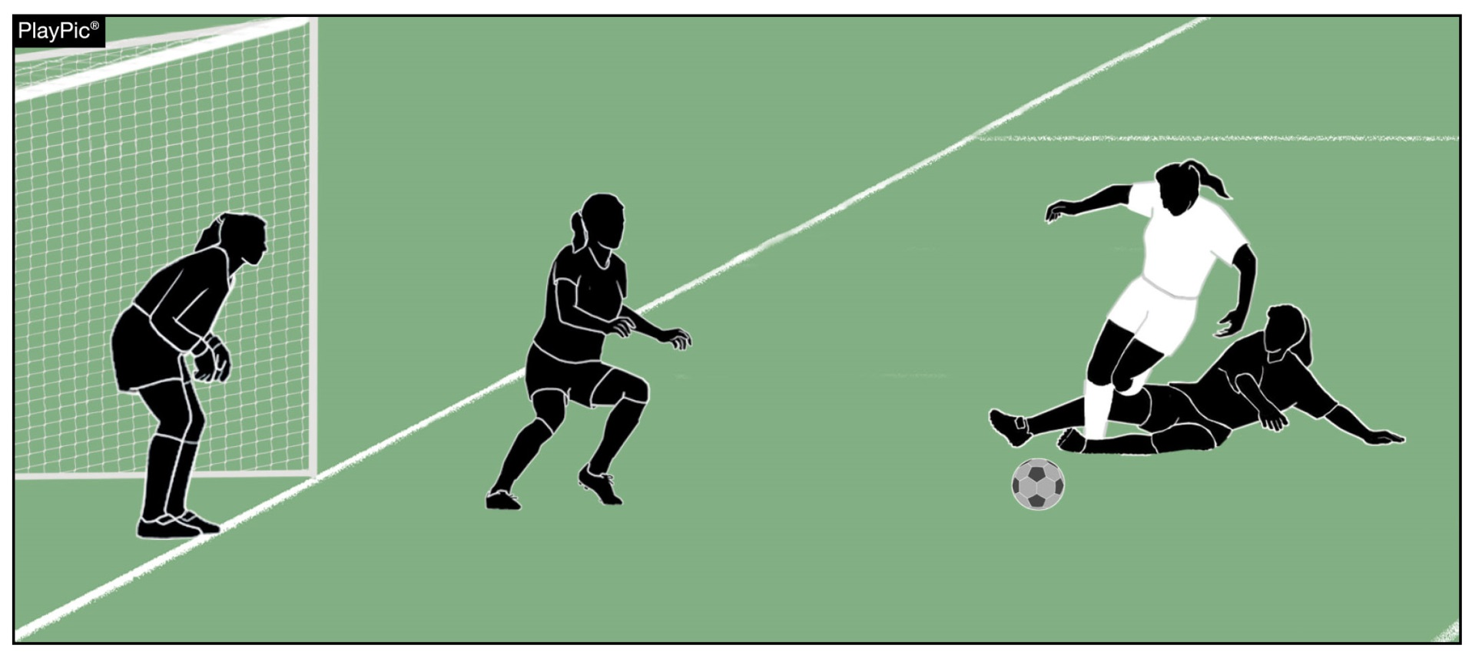
Stopping a promising Attack
If SPA occurs within the offender’s penalty area, and the foul is an attempt to play the ball, the player is not cautioned if the referee awards a penalty kick.
Notes:
Notes: In this PlayPic, the defender attempted to play the ball, but carelessly tripped the opponent in the penalty area. This is a foul that stops a promising attack. The official awards a penalty kick and the offender is not cautioned (yellow card).

Slide 27
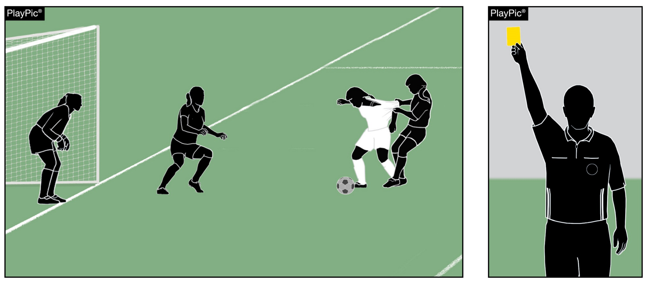
Stopping a promising Attack
In other SPA circumstances inside the penalty area (e.g., holding, pulling, pushing, no possibility to play the ball, etc.) the offending player must be cautioned.
Notes:
Notes: In this PlayPic, the defender did not attempt to play the ball in the penalty area., Tthis is a foul that stops a promising attack. and The official awards a penalty kick and the offender is cautioned (a yellow card).

Slide 28
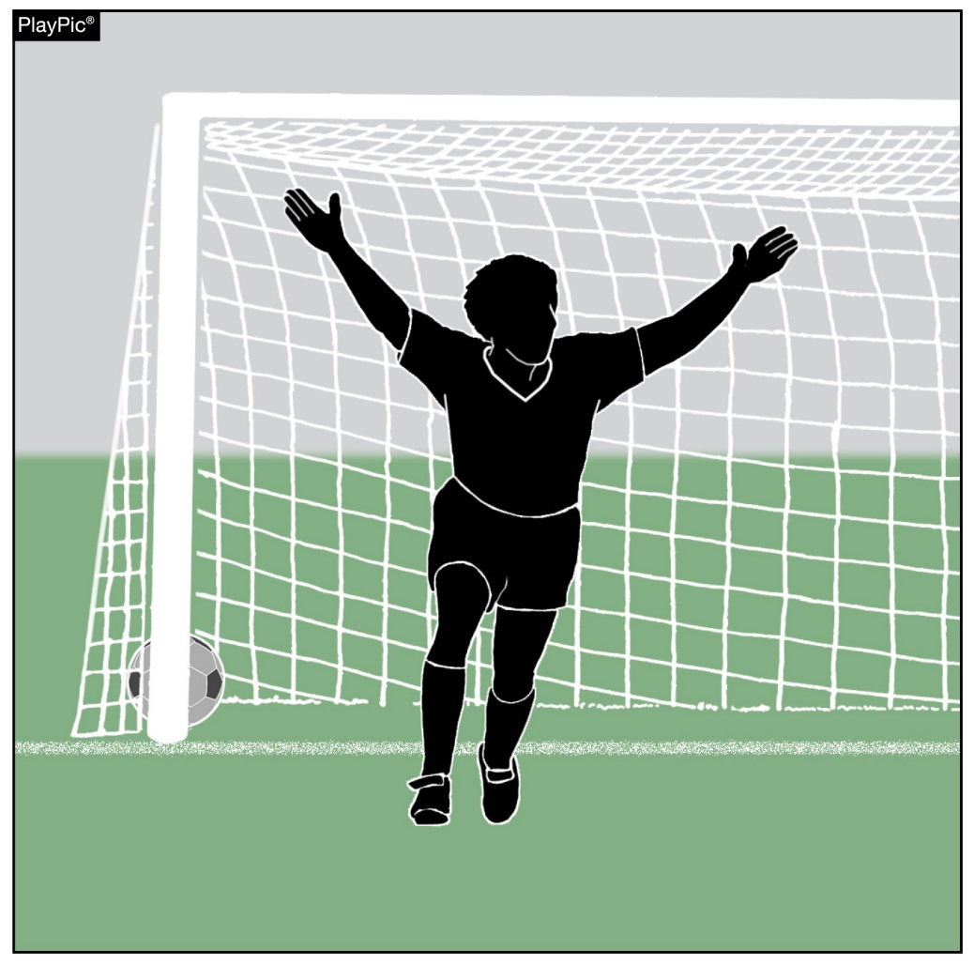
After a Goal
After a goal is scored, officials must stay alert. In addition to administrative tasks, officials must be vigilant for any signs of tension or potential misconduct and address issues promptly to prevent situations from escalating.
Key aspects include:
Officials need to work as a team to determine if the goal was, in fact, scored properly.
Identifying and addressing any unsporting actions or misconduct.

Slide 29
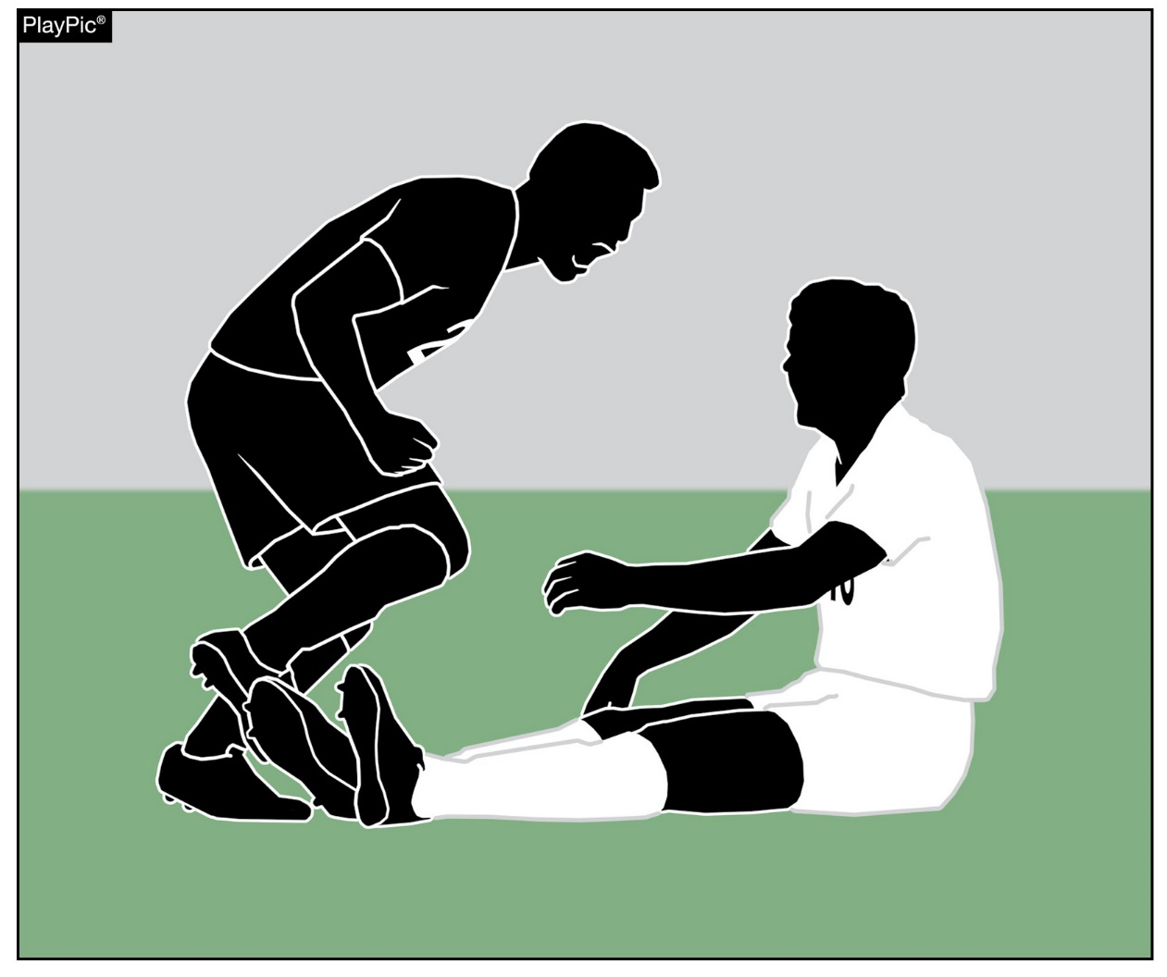
After a Goal
The officiating crew must monitor players for excessive or inappropriate behavior, such as taunting, or potential confrontations, dissent or other provocative actions.
Notes:
Notes: Observing players' reactions and behaviors after the goal is important to identify and address any unsporting actions or misconduct. This includes potential confrontations, dissent, or provocative actions. If the team that scored is behind, they may try to quickly retrieve the ball from the goal or grab it out of an opponent’s hands. The defense that was setting an offside trap may swarm around the assistant referee to argue about a non-call. These can be volatile situations and proactive officials will intervene quickly to make their presence known. Officials should encourage attackers to return to their side of the field promptly or remind defenders the decisions of the officiating crew must be respected before their actions rise to misconduct. When behavior crosses the line, officials must recognize it and deal with it firmly and according to the rules.

Slide 30
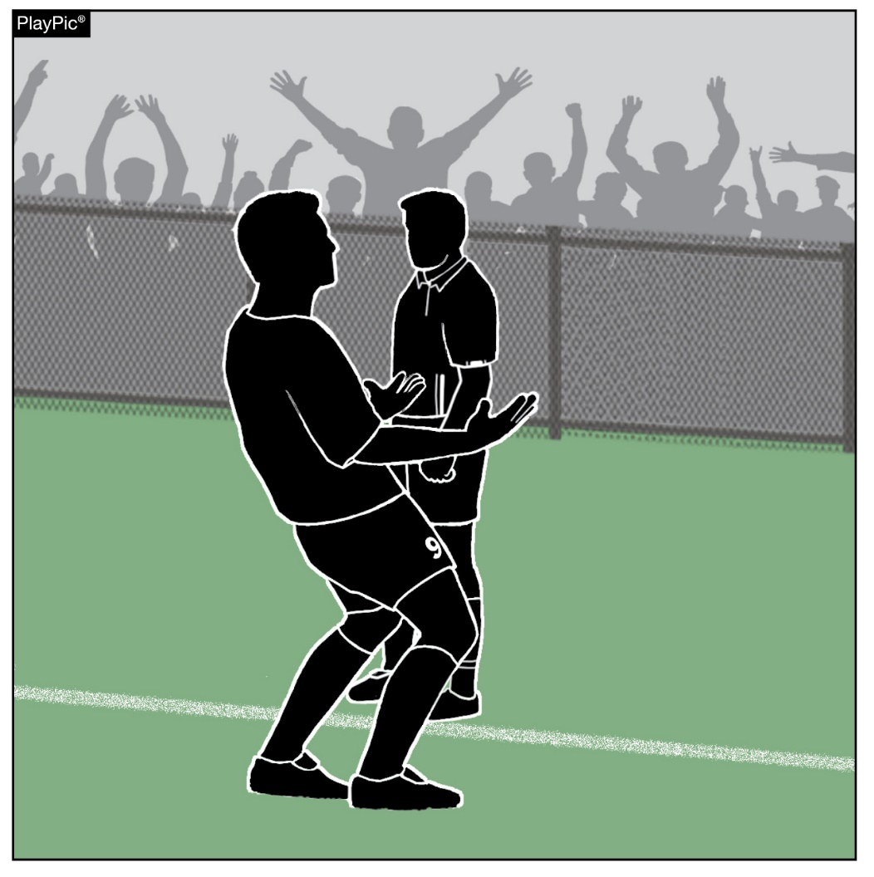
After a Goal
Officials should focus on the players, recognize situations that could lead to conflicts, be present and proactive in their responses, and deal with misconduct appropriately.

Slide 31
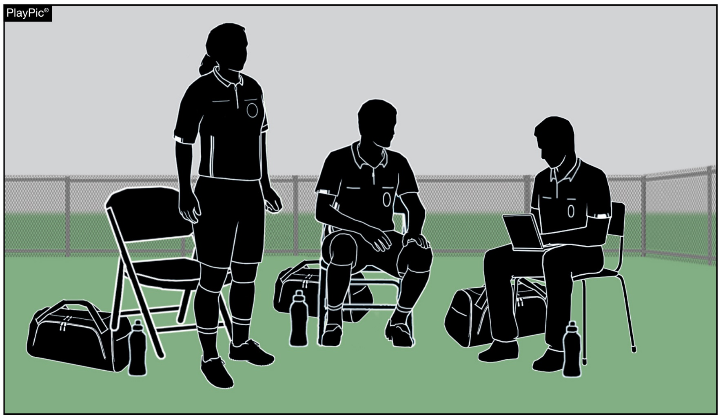
AFTER a goal
The crew should cover record keeping and beckoning in substitutes in their pre-game discussions.
Notes:
Notes: A recommended good practice: in the officials’ pregame discussion is to review amongst the officiating crew the expected record keeping procedures after a goal to prevent all officials from looking at their books at the same time. A prepared and proactive officiating crew plans for success by having least one official observing the field of play while another records the event.

Slide 32
NFHS OFFICIALS Education

Slide 33
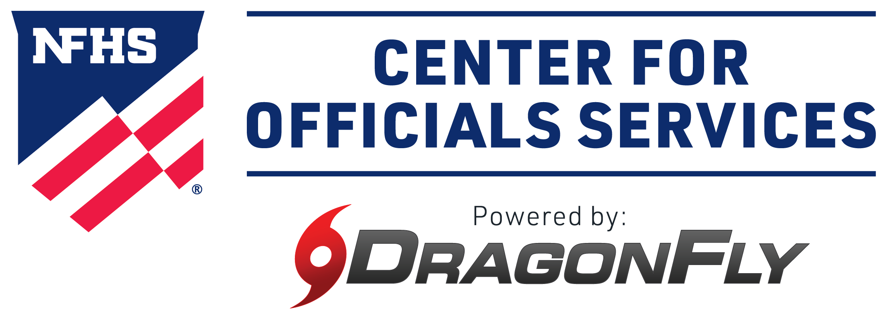
All things officiating in one place!
The all-in-one, cloud-based NFHS Center for Officials Services (COS) connects everyone associated with officiating. The COS handles registration, assignments, testing, payments, and a host of other features and integrations that consolidate all officiating needs into a single, modern solution. Free to all NFHS state associations, local associations, and assigner groups.
20+
Member States
300,000+
Officials
7,000+
Schools
Notes:
The NFHS Network is the leader in streaming Live and On Demand high school sports.
Partnered with the National Federation of State High School Associations, 45 high school state athletic/activities associations, and PlayOn! Sports, the NFHS Network is a joint venture created to provide fans with the ability to stream high school sports on any device, from wherever they are.
All NFHS Network events are available to watch online at www.NFHSnetwork.com and through the NFHS Network Live App for iOS and Android. Follow us on Facebook, Twitter, Instagram, and YouTube.
Watching high school sports and events has never been easier.
The NFHS Network’s goal to broadcast live all 2 million high school sporting events by 2025.
The NFHS Network covers 27 different regular season and postseason sports, as well as other high school activities, celebrating the accomplishments of students-athletes, student broadcasters, and high schools across the country.

Slide 34
COS Continued Improvements
Over 200 Updates and New Features in the Past 12 Months!
  COMING SOON
    Exam Center Improvements
    Streamlined Registrations and Onboarding
    Expanded Reporting Capabilities for States
    Event/Clinic Registration and Attendance Tracking
  Reciprocity
    In-State/Out-of-State
  Watch for Many More Updates from NFHS!
Notes:
The NFHS Network is the leader in streaming Live and On Demand high school sports.
Partnered with the National Federation of State High School Associations, 45 high school state athletic/activities associations, and PlayOn! Sports, the NFHS Network is a joint venture created to provide fans with the ability to stream high school sports on any device, from wherever they are.
All NFHS Network events are available to watch online at www.NFHSnetwork.com and through the NFHS Network Live App for iOS and Android. Follow us on Facebook, Twitter, Instagram, and YouTube.
Watching high school sports and events has never been easier.
The NFHS Network’s goal to broadcast live all 2 million high school sporting events by 2025.
The NFHS Network covers 27 different regular season and postseason sports, as well as other high school activities, celebrating the accomplishments of students-athletes, student broadcasters, and high schools across the country.

Slide 35
NFHS Learning Center

Slide 36

Notes:
The NFHS Learning Center is the home to more than 90 online professional development courses for everyone within the interscholastic community - coaches, students, officials, parents, administrators, and individuals within performing arts programs. More than 60 courses are available for free.
The NFHS is an Accredited Institution and has delivered more than 15 million courses on its NFHS Learning Center platform since its inception in 2007. In receiving national accreditation by Cognia, the NFHS has upheld itself to rigorous standards that focus on productive learning environments, equitable resource allocation that meet the needs of learners, and effective leadership.
The NFHS Learning Center features its flagship coaching course, “Fundamentals of Coaching,” as well as several health and safety courses that have been completed by millions of individuals, such as “Concussion in Sports,” “Heat Illness Prevention,” “Sudden Cardiac Arrest” and “Protecting Students from Abuse.” The NFHS Learning Center offers several national credentials that can be earned by individuals who complete specific NFHS courses. Through the School Honor Roll Program, schools can earn a physical banner to hang in their school.
To learn more and start your professional development journey, please visit the NFHS Learning Center at NFHSLearn.com.

Slide 37

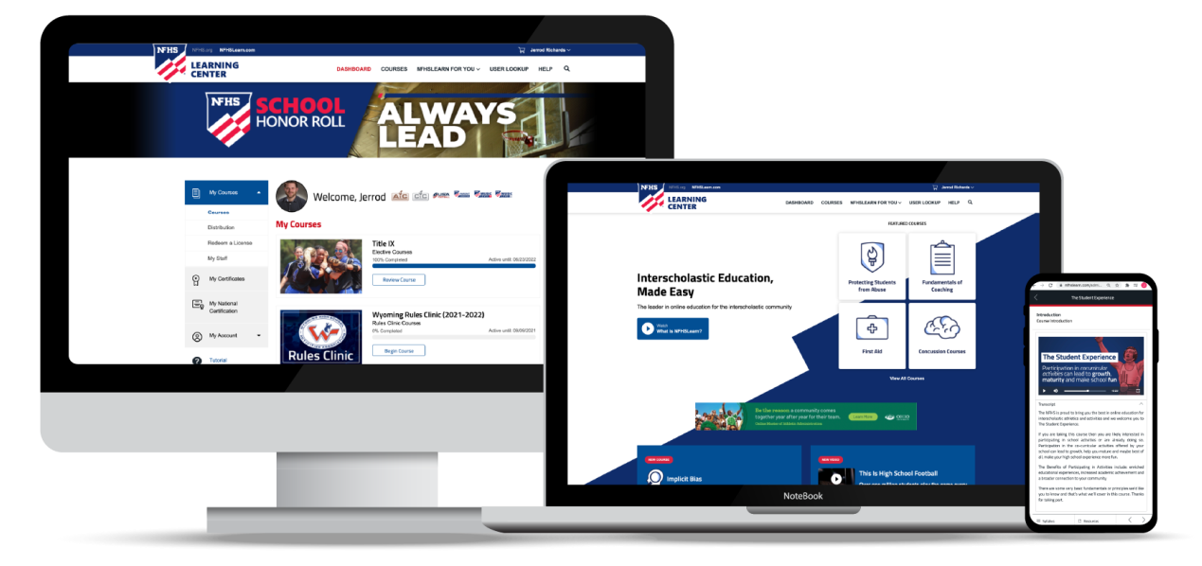
Over 21 million courses delivered!
Concussion in Sports – 7.2M+
Heat Illness Prevention – 2.2M+
Sudden Cardiac Arrest – 2.4M+
Concussion for Students – 1.2M+
The Collapsed Student (2020) – 67,550+
CPR & AED Training (2023) – 9,300+
Sportsmanship – 1M+
Fundamentals of Coaching – 928,000+
First Aid, Health and Safety – 418,000+
Bullying, Hazing and Inappropriate Behaviors – 425,000+
Student Mental Health and Suicide Prevention – 250,000+
Protecting Students from Abuse – 250,000+
Implicit Bias (2021) – 96,000+

Slide 38
NFHS Network

Slide 39


NFHS Network
By 2025, every high school sporting event in America will be streamed live.
The NFHS Network will be
THE DESTINATION for fans
to view these broadcasts.
27 Different Sports and Activities
www.NFHSnetwork.com
Notes:
The NFHS Network is the leader in streaming Live and On Demand high school sports.
Partnered with the National Federation of State High School Associations, 45 high school state athletic/activities associations, and PlayOn! Sports, the NFHS Network is a joint venture created to provide fans with the ability to stream high school sports on any device, from wherever they are.
All NFHS Network events are available to watch online at www.NFHSnetwork.com and through the NFHS Network Live App for iOS and Android. Follow us on Facebook, Twitter, Instagram, and YouTube.
Watching high school sports and events has never been easier.
The NFHS Network’s goal to broadcast live all 2 million high school sporting events by 2025.
The NFHS Network covers 27 different regular season and postseason sports, as well as other high school activities, celebrating the accomplishments of students-athletes, student broadcasters, and high schools across the country.

Slide 40


Over 1 million events this year…
Notes:
The NFHS Network will broadcast over 150,000 live events this year. If your school is not a member of the NFHS Network School Broadcast Program, please contact us at Mark.Koski@NFHSnetwork.com

Slide 41
Nfhs Authentication Mark Update

Slide 42



NFHS Authenticating Mark update
Specifications
Do not use the NFHS Authenticating Mark without prior written approval from the NFHS.
This mark is for use of licensees only.
Minimum size
  Inflatable Balls - 2 ½" (Basketball, Football, Soccer, Volleyball, and Water Polo)
  Non-Inflatable Balls - 1 ¼" (Baseball, Field Hockey, Ice Hockey Puck, Lacrosse, and Softball)
  On a ball or puck, the NFHS logo may be smaller than manufacturer’s logo, but should be placed in proximity to the manufacturer’s name for easy identification. Allow enough space around the logo so it can be easily recognized as distinct and separate.
  Reproduce the logo only from the vector artwork provided here or on Direct Licensing Hub. Do not copy, scan art electronically or use as a template to redraw the symbol.
Note: If sizing or specifications do not work well in your design situation, contactK12 Licensing.
Current Logos
New Logo

Slide 43
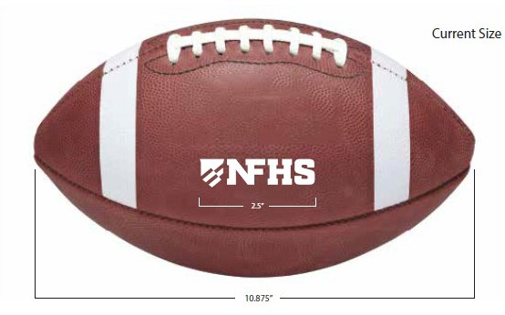
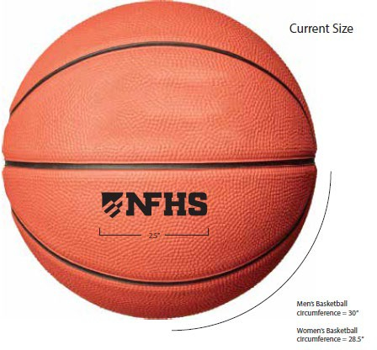
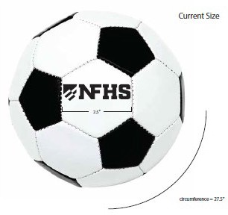
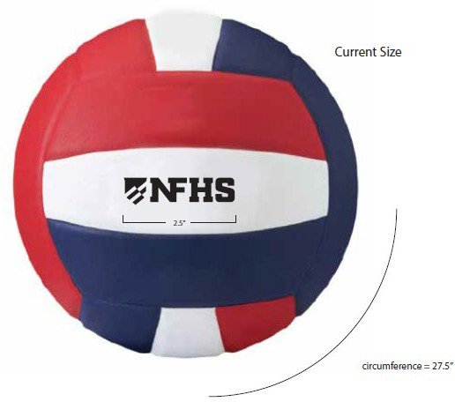
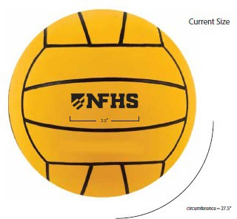
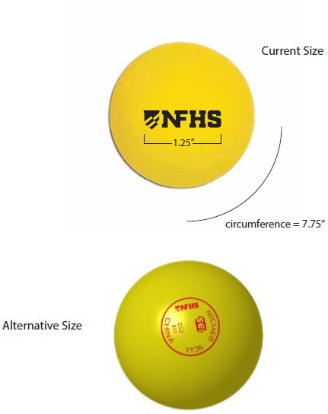
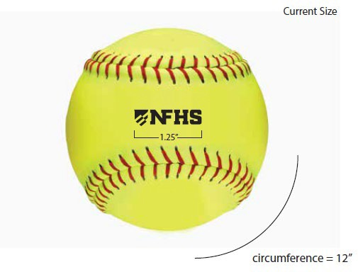
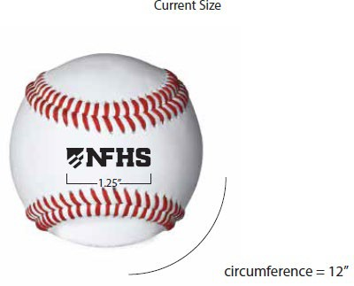
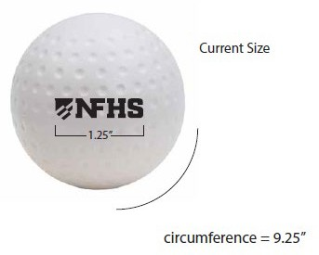
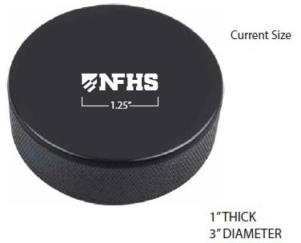
NFHS Authenticating Mark update
A current list of NFHS authenticated products can be found at www.nfhs.org, Resources, Authenticating Mark.

Slide 44



soccer
Old Size
Current Size
OR
1.25”
2.5”
circumference = 27.5”
circumference = 27.5”

Slide 45

Thank You
National Federation of State High School Associations
PO Box 690 | Indianapolis, IN 46206
Phone: 317-972-6900
www.nfhs.org | www.nfhslearn.com | www.nfhsnetwork.com

