Slide 1
2023-24 NFHS Volleyball Rules PowerPoint
Rules Changes
Editorial Changes
Points of Emphasis

Slide 2




OFFICIAL VOLLEYBALL PARTNER OF THE
NATIONAL FEDERATION OF STATE HIGH SCHOOL ASSOCIATIONS

Slide 3
National federation of state high school associations (NFHS)

Slide 4

National Federation of
State High School Associations
NFHS (located in Indianapolis, IN – Est. 1920):
  National leader and advocate for
  high school athletics and
  performing arts programs.
  Serves 51 state associations, 19,500
  high schools and 12 million student
  participants.
  Writes playing rules for 17 high school
  sports for boys and girls.
  Offers online education courses for high school coaches,
  officials, parents, students and others.
  Ensures that students have opportunity to enjoy healthy participation, achievement and good sportsmanship in education-based athletics.

Slide 5






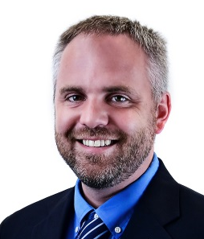

NFHS Rules Review Committee
The NFHS Rules Review Committee is chaired by the chief operating officer and composed of all rules editors. After each committee concludes its deliberations and has adopted its recommended changes for the subsequent year, such revisions will be evaluated by the Rules Review Committee.
Davis Whitfield
Chief Operating Officer
Lindsey Atkinson
Basketball, Girls Lacrosse and Volleyball
Bob Colgate
Football and Sports
Medicine
Sandy Searcy
Softball, Swimming & Diving and Water Polo
Elliot Hopkins
Baseball and Wrestling
Julie Cochran
Cross Country, Gymnastics, Field Hockey, Soccer and
Track & Field
James Weaver
Boys Lacrosse
and Spirit
Dan Schuster
Ice Hockey

Slide 6
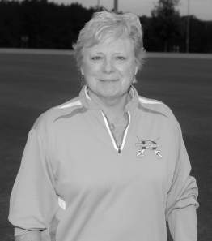
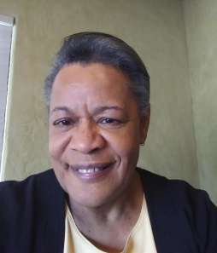
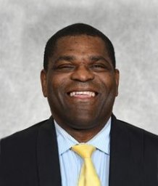
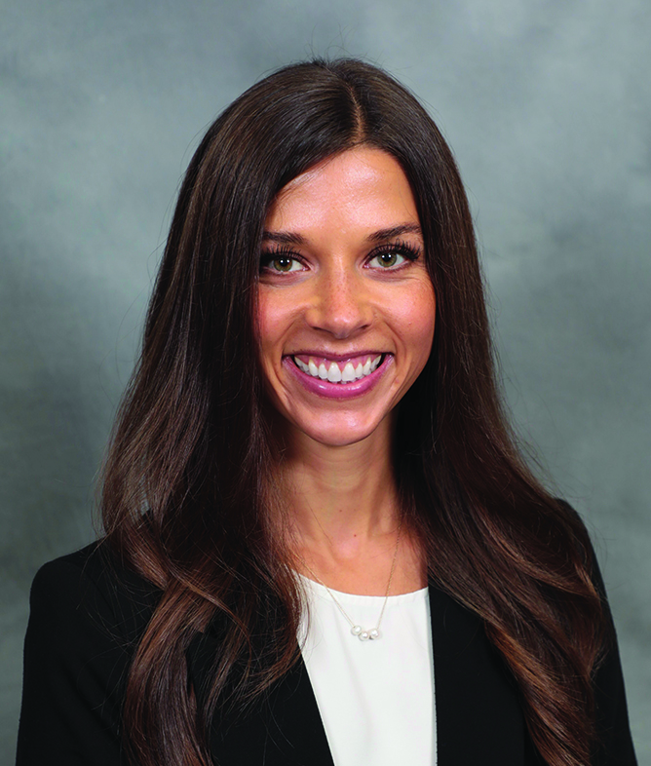
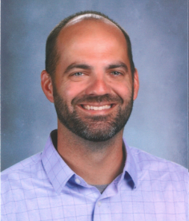
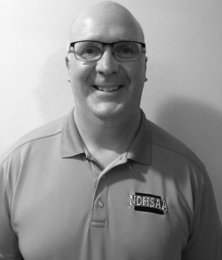
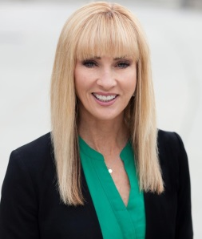
NFHS Rules Committee
Jo Auch
Pierre, SD
Chair - 2024
Paula Kirkland
Roebuck, SC
Coaches - 2024
Nora Carter
Albuquerque, NM
Officials - 2026
Derryk Sellers
Robbinsville, NJ
Section 1 - 2026
Emily Mason
Columbus, OH
Section 2 - 2025
Kimberly Haywood
Greenville, SC
Section 3 - 2023
Ben Van Wyk
West Des Moines, IA
Section 4 - 2024
Kevin Morast
Valley City, ND
Section 5 - 2024
Nick Lasker
North Little Rock, AR
Section 6 - 2023
Jan Whittaker
Midvale, UT
Section 7 - 2026
Sandi Wagner
Anchorage, AK
Section 8 - 2025

Slide 7



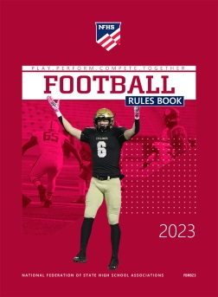








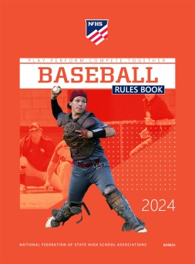
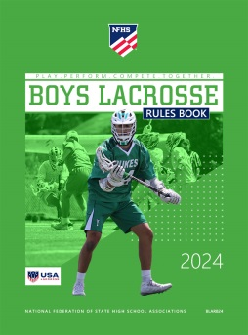
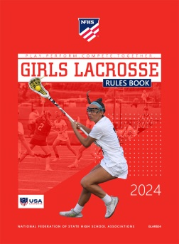



National Federation of
State High School Associations
The NFHS writes playing rules for 17 sports
for boys and girls at the high school level.
  Publishes 4 million pieces of materials annually.

Slide 8
2023-24 NFHS Volleyball
Rules Changes

Slide 9
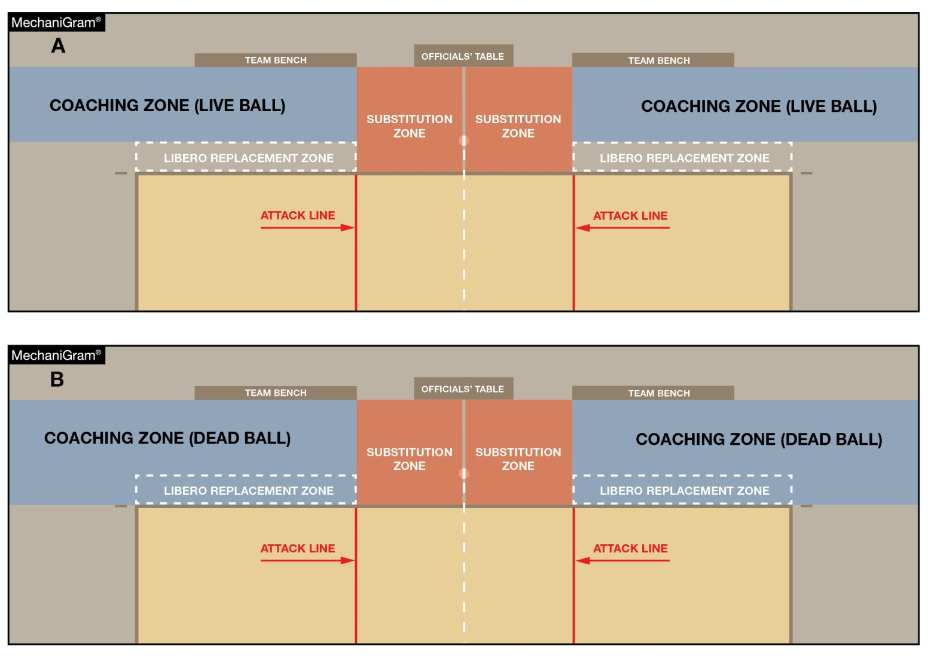
THE COURT AND MARKINGS
2-1-9 (NEW) & 12-2-5
A new Coaching Zone has been established to clearly identify the area in which coaches are allowed to stand.
This area is defined by the libero replacement zone extending beyond the end line and sideline extended.
Head coaches must maintain a distance of at least 6 feet from the sideline during live-ball situations (MechaniGram A) and may approach the sideline during dead-ball situations (MechaniGram B).
Notes:
A new Coaching Zone has been established to clearly identify the area in which coaches are allowed to stand.
This area is defined by the libero replacement zone extending beyond the end line and sideline extended.
Head coaches must maintain a distance of at least 6 feet from the sideline during live-ball situations (MechaniGram A) and may approach the sideline during dead-ball situations (MechaniGram B).
Rationale: Defines and clarifies the area in which coaches may stand.

Slide 10
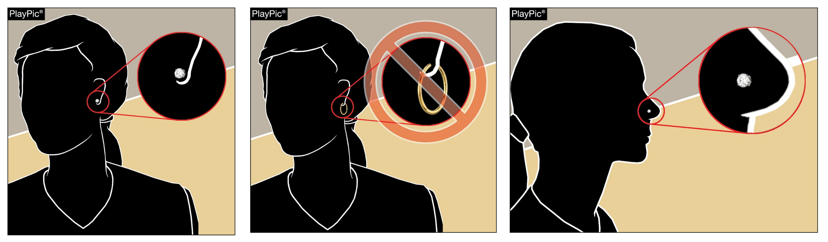
Equipment and accessories
4-1-7
Small, secured stud or post jewelry may be worn above the chin.
No jewelry is permitted below the chin.
Notes:
Small, secured stud or post jewelry may be worn above the chin.
No jewelry is permitted below the chin.
Rationale: Allows limited use of jewelry above the chin keeping with current trends of other NFHS and volleyball rules codes.

Slide 11

Equipment and accessories
4-1-7
String bracelets, commemorative bracelets and body jewelry are considered jewelry and are not permitted.
Taping over jewelry is not permitted.
  Exceptions remain for religious and medical alert medals
Notes:
String bracelets, commemorative bracelets and body jewelry are considered jewelry and are not permitted.
Taping over jewelry is not permitted.
Exceptions remain for religious and medical alert medals
Rationale: Allows limited use of jewelry above the chin keeping with current trends of other NFHS and volleyball rules codes.

Slide 12
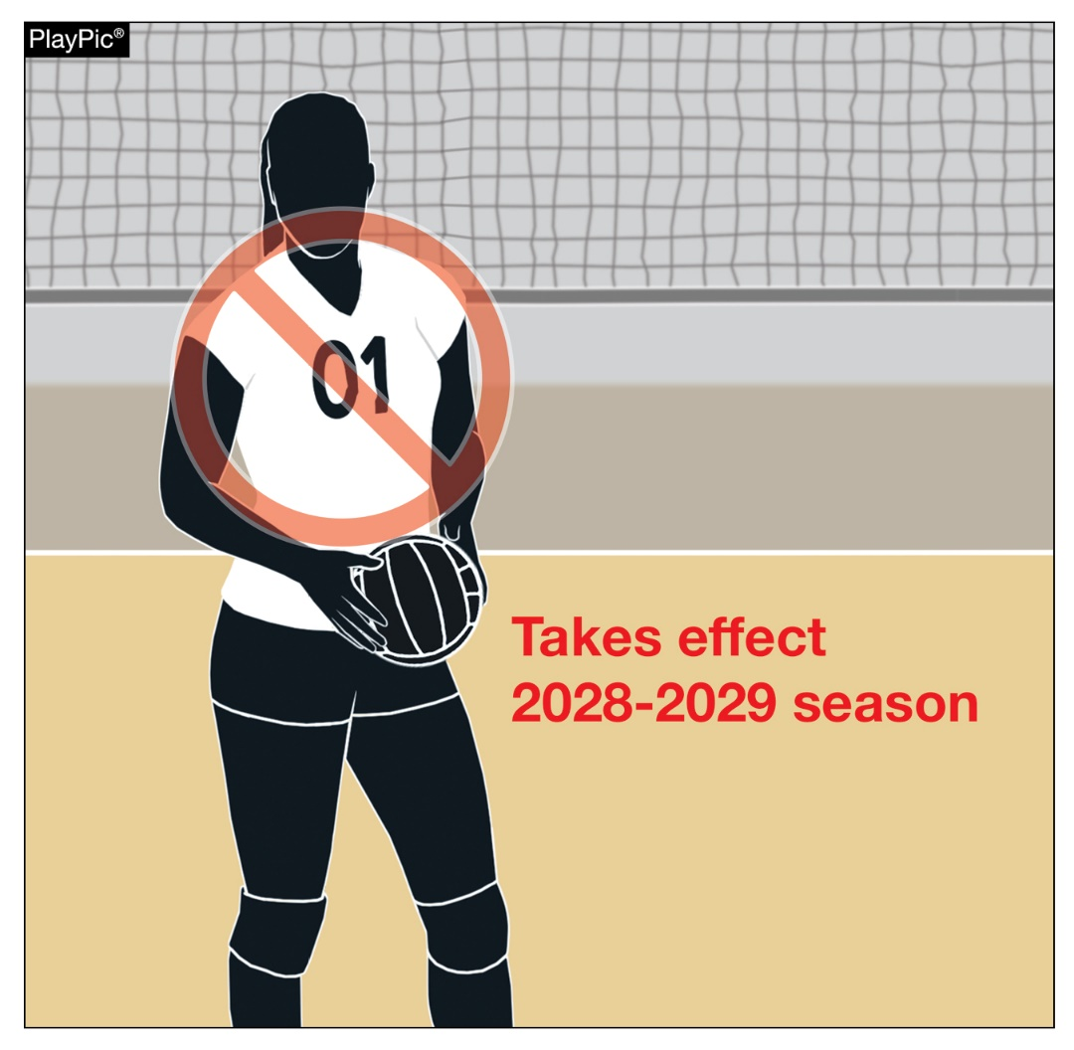
Legal uniform
4-2-4b
Numbers with a leading zero (01, 02, 03, etc.) will be non-compliant beginning in 2028.
Legal uniforms must be numbered 0-99.
Notes:
Numbers with a leading zero (01, 02, 03, etc.) will be non-compliant beginning in 2028.
Legal uniforms must be numbered 0-99.
Rationale: Clarifies legal numbers and eliminates confusion when signaling while aligning with other rules codes.

Slide 13
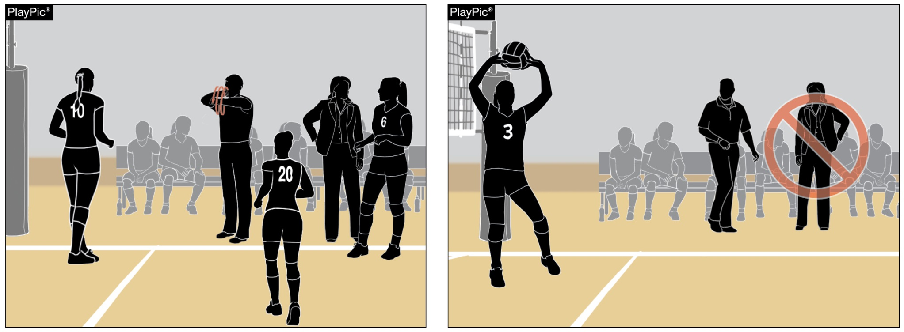
conduct
5-5-3b(11), 12-2-6
Dead Ball
Live Ball
One assistant coach may stand within the coaching zone to provide instruction during dead-ball situations only.
The assistant coach who stands may change throughout the match – only one can stand at a time.
Notes:
One assistant coach may stand within the coaching zone to provide instruction during dead-ball situations only.
The assistant coach who stands may change throughout the match – only one can stand at a time.
Rationale: Allows an assistant coach to stand and coach during dead-ball situations in addition to the head coach. This allows for assistant coaches to provide position- or situation-specific coaching.

Slide 14
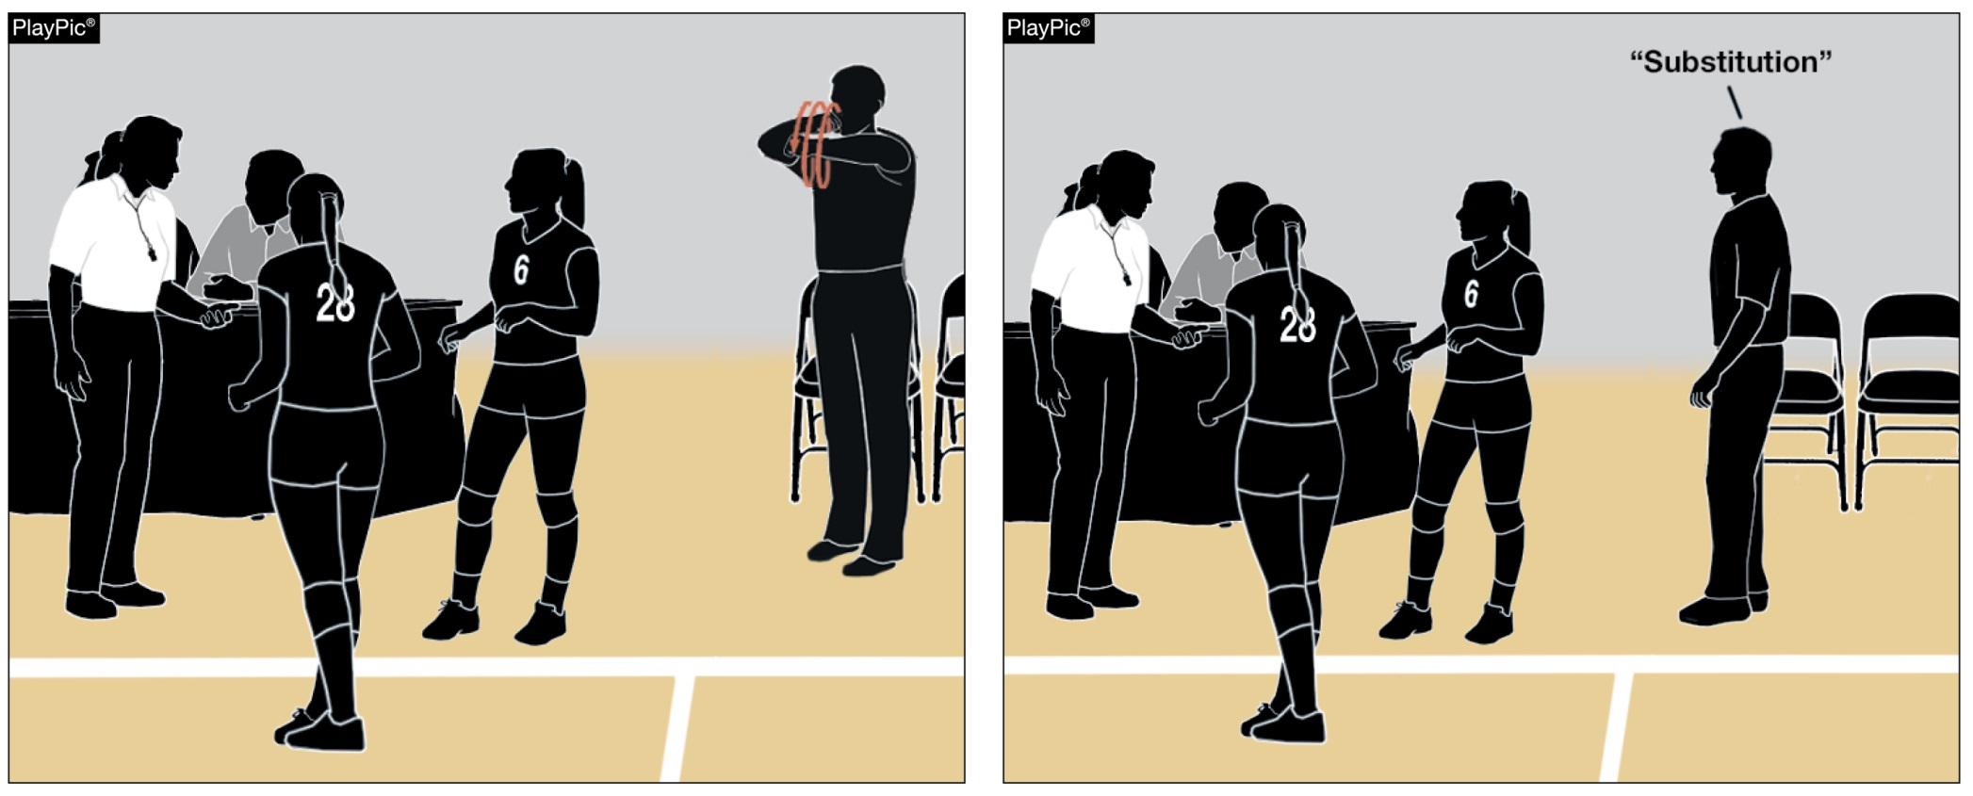
Procedure for substitution
10-2-1
The head coach may signal or verbally request a substitution.
Notes:
The head coach may signal or verbally request a substitution.
Rationale: Creates consistency by allowing either a verbal or non-verbal signal for as substitution.

Slide 15
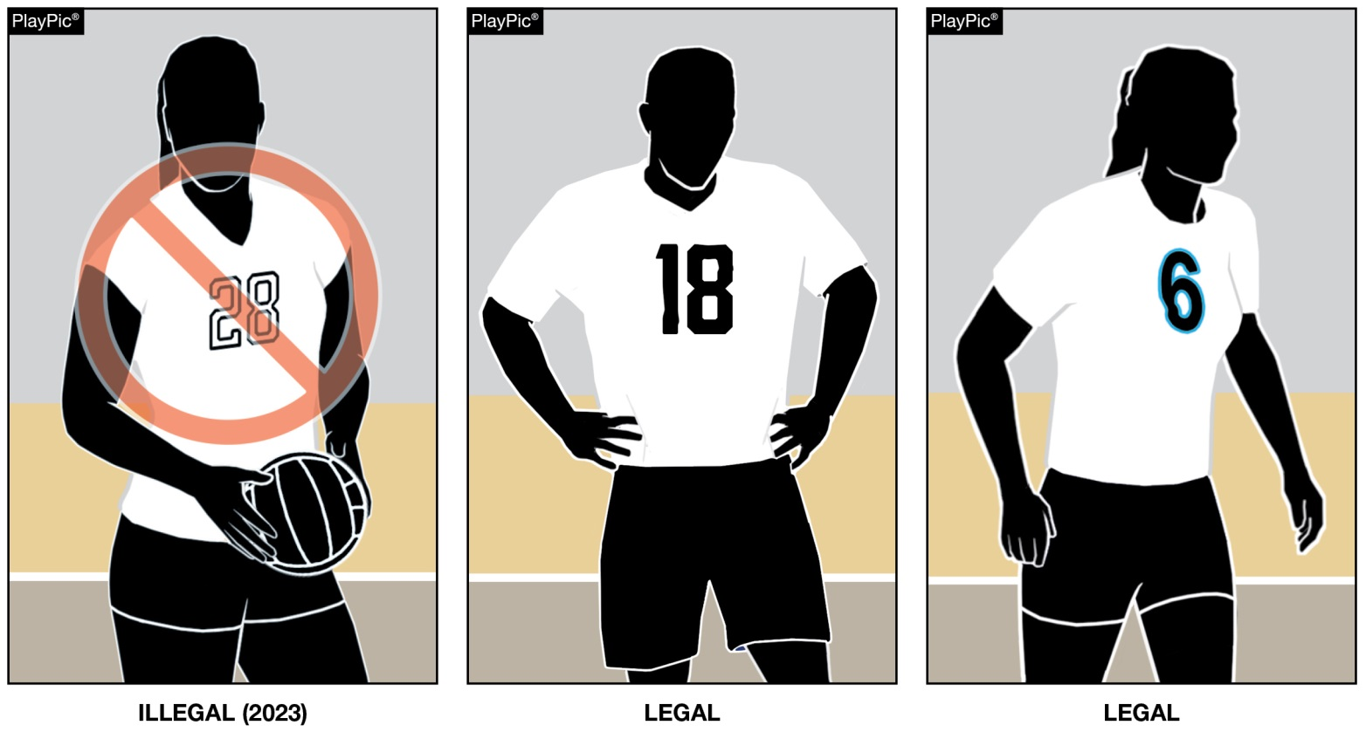
4-2-4c legal uniform
Beginning with the 2023 season, the body of the uniform number must clearly contrast with the uniform top regardless of the border/trim.
Notes:
Beginning with the 2023 season, the body of the uniform number must clearly contrast with the uniform top regardless of the border/trim.
Rationale: This change was approved in 2019 to allow officials and scorers to easily identify uniform numbers and align with other rules codes.

Slide 16
2023-24 NFHS Volleyball
Editorial Change

Slide 17
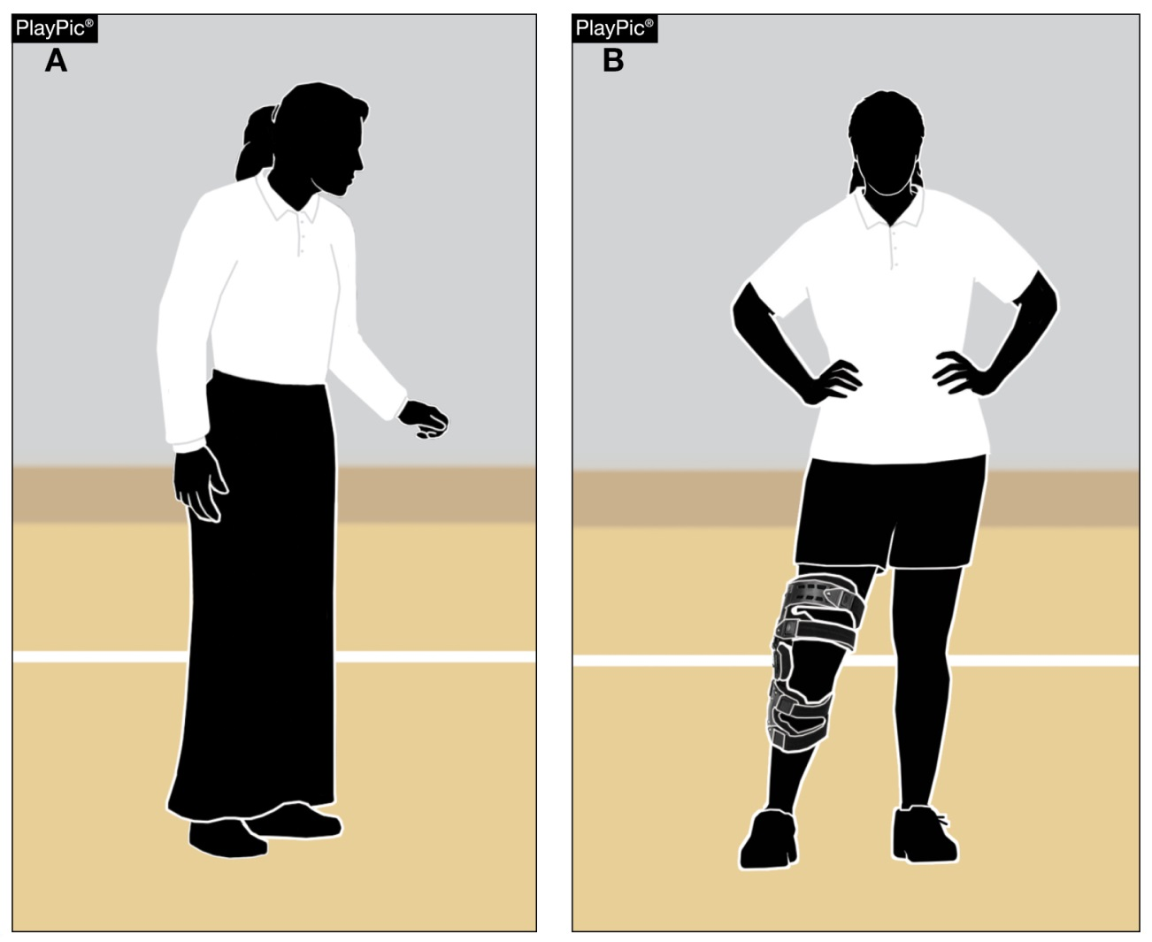
5-3-1 note (new) officials uniform accommodations
Officials uniform accommodations may be made for religious and medical reasons while adhering to the established colors in items (a) and (b).
Notes:
Officials uniform accommodations may be made for religious and medical reasons while adhering to the established colors in items (a) and (b).

Slide 18
Editorial Changes
2-1-1, 2-1-3, 2-1-4, 2-1-5,
2-1-6, 3-1-1, 3-1-2, 3-5
5-5-3b(10), 9-1-1,
10-2-7a(1)
10-2-1
Added “or” before the metric measurement to clarify that either measurement is legal.
Added appropriate reference to the new “coaching zone.”
Eliminated clerical error that a captain could request a substitution.

Slide 19
2023-24 NFHS Volleyball
Points of Emphasis

Slide 20
Using the lineup card effectively
The lineup card is a tool to assist the second referee and is used to:
  Record starting lineups; and
  Verify each team’s lineup at the start of each set.
The second referee can also use the lineup card to:
  Record substitutions;
  Record time-outs used by each team;
  Identify players (circle the back-row setter); and/or
  Record yellow/red cards.
Notes:
The lineup card is a tool to assist the second referee and is used to:
Record starting lineups; and
Verify each team’s lineup at the start of each set.
The second referee can also use the lineup card to:
Record substitutions;
Record time-outs used by each team;
Identify players (circle the back-row setter); and/or
Record yellow/red cards.

Slide 21
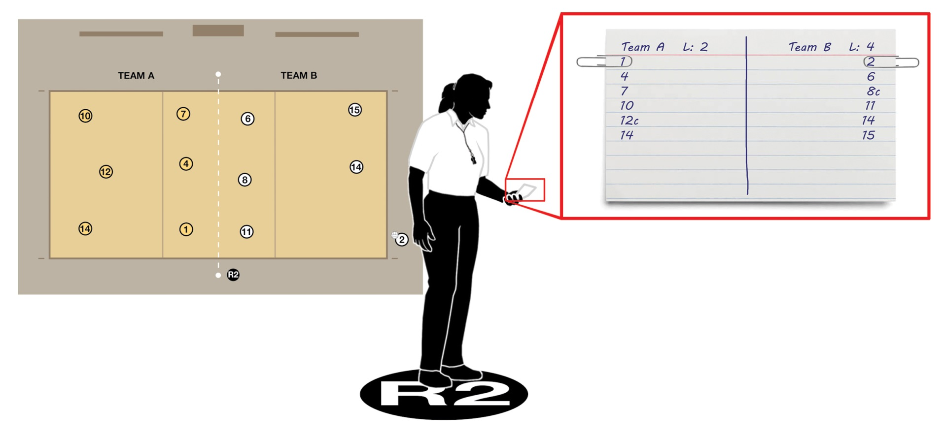
Using the lineup card effectively:
Starting Play
Second referees should use or create a succinct lineup card for checking the teams’ starting positions prior to each set.
Notes:
Second referees should use or create a succinct lineup card for checking the teams’ starting positions prior to each set.

Slide 22
Using the lineup card effectively:
Starting Play
Once the lineups have been checked, the captain has been identified, the libero (if used) has been authorized by the second referee to enter, the game ball has been retrieved from the officials’ table and tossed to the first server, the second referee should:
  Place the lineup card and writing utensil in a pocket;
  Take the ready position on the receiving team’s side;
  Face the court with shoulders parallel;
  Make eye contact with the first referee; and
  Signal “ready” by extending the arm farthest from the net toward the first referee.
Notes:
Once the lineups have been checked, the captain has been identified, the libero (if used) has been authorized by the second referee to enter, the game ball has been retrieved from the officials’ table and tossed to the first server, the second referee should:
Place the lineup card and writing utensil in a pocket;
Take the ready position on the receiving team’s side;
Face the court with shoulders parallel;
Make eye contact with the first referee; and
Signal “ready” by extending the arm farthest from the net toward the first referee.

Slide 23
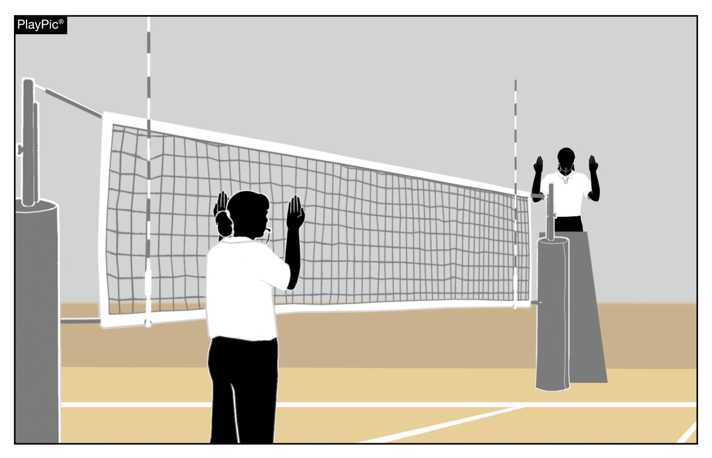
Using the lineup card effectively:
During the Set
During play, second referees should keep lineup cards in their pocket in order to properly mimic their partner’s signals.
Second referees should refrain from signaling with a lineup card or pencil in hand.
During substitutions, if recording on the lineup card, quickly take the card out, note the changes and put the card back in a pocket.
Refrain from giving the court back to the first referee until the lineup card and pencil are put away.
Notes:
During play, second referees should keep lineup cards in their pocket in order to properly mimic their partner’s signals.
Second referees should refrain from signaling with a lineup card or pencil in hand.
During substitutions, if recording on the lineup card, quickly take the card out, note the changes and put the card back in a pocket.
Refrain from giving the court back to the first referee until the lineup card and pencil are put away.

Slide 24
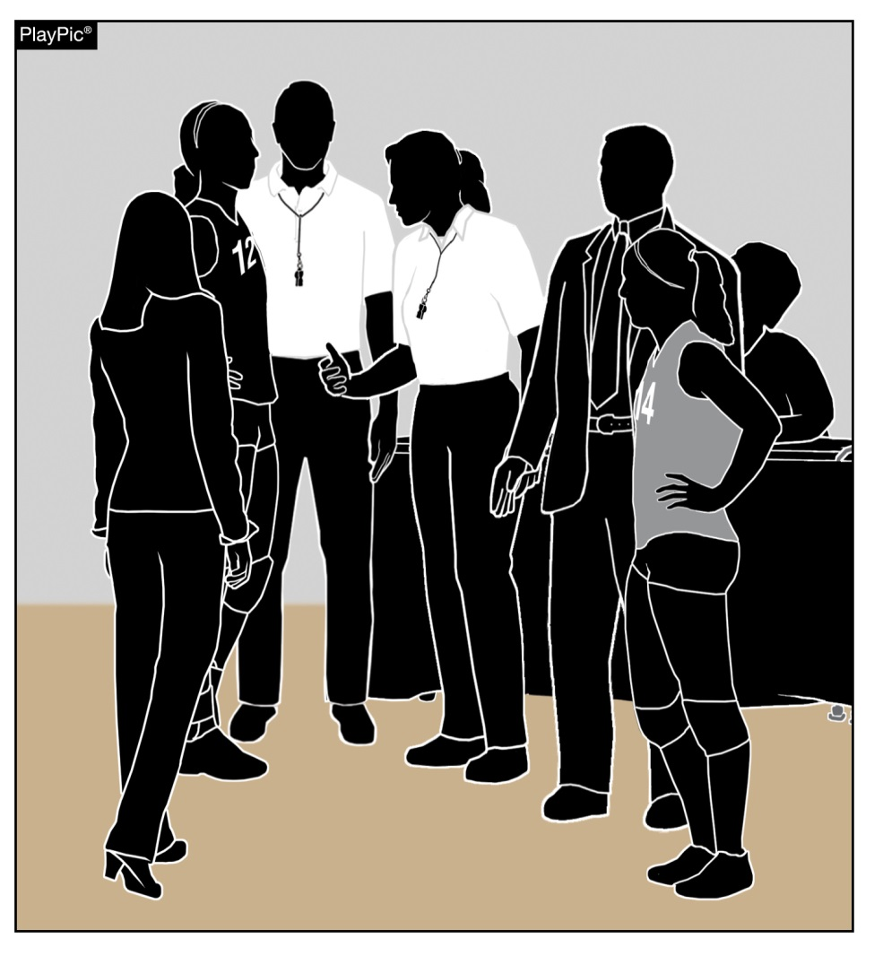
Coaching Zone privileges
The pre-match conference provides an opportunity for the officials to identify the head coach of each team for the current match.
During the pre-match conference, officials should remind head coaches that only one assistant coach at a time may stand during a dead ball.
Notes:
The pre-match conference provides an opportunity for the officials to identify the head coach of each team for the current match.
During the pre-match conference, officials should remind head coaches that only one assistant coach at a time may stand during a dead ball.

Slide 25
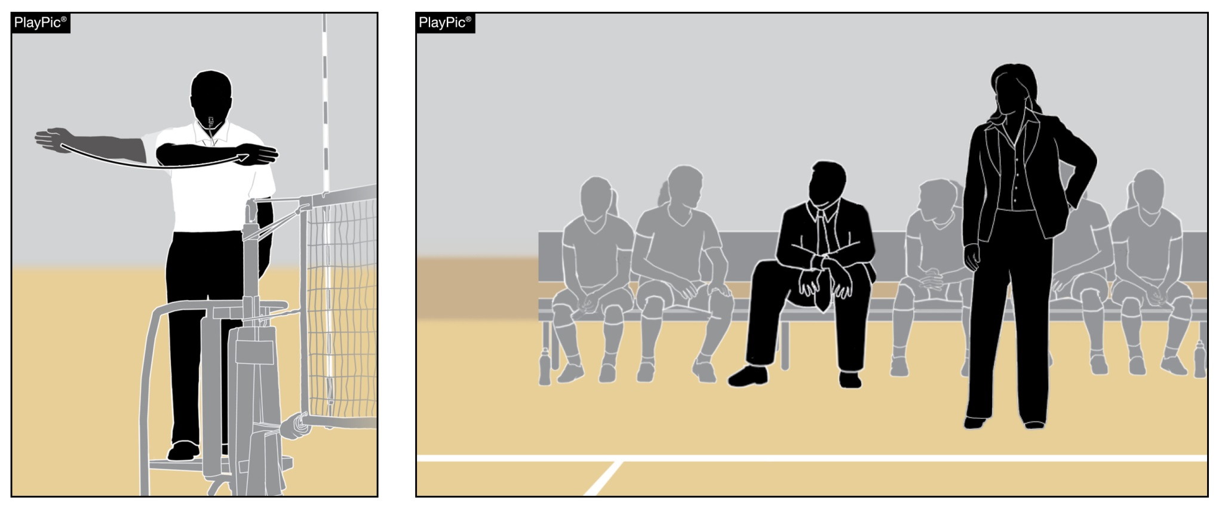
Coaching Zone privileges
Once the first referee extends an arm for the authorization of serve, the assistant coach must return to the bench and may not stand again until the next dead ball.
Notes:
Once the first referee extends an arm for the authorization of serve, the assistant coach must return to the bench and may not stand again until the next dead ball.

Slide 26
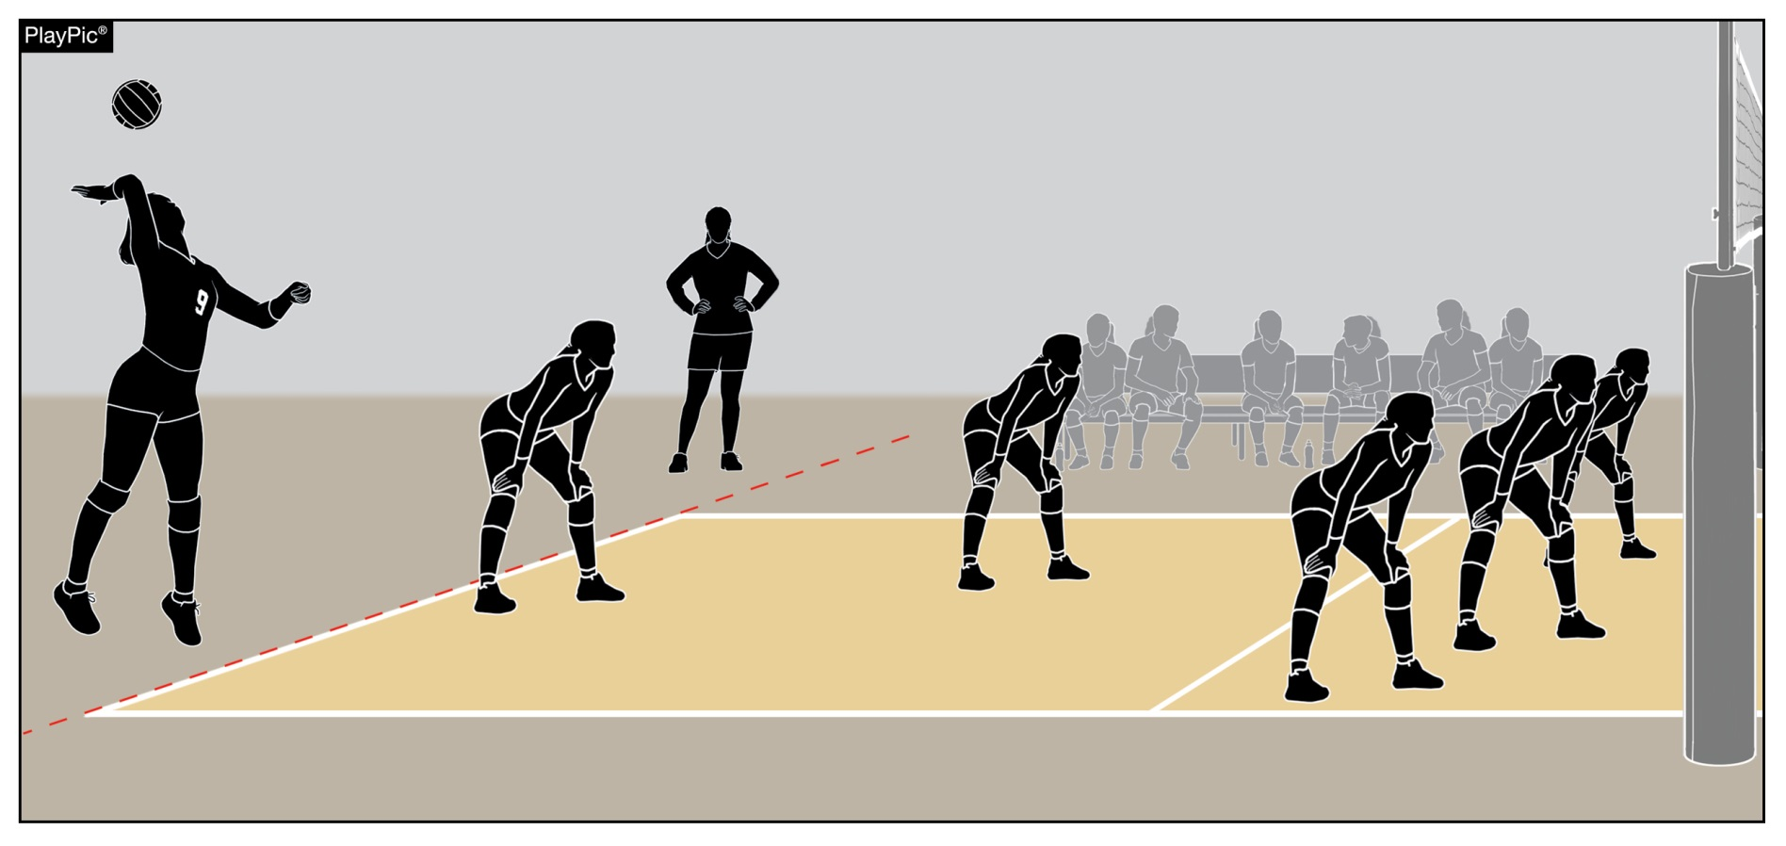
Coaching Zone privileges
The head coach may stand and coach beyond the libero replacement zone. However, the coach must remain six feet off the court during play and may not cross the sideline extended during dead-ball situations.
Notes:
The head coach may stand and coach beyond the libero replacement zone. However, the coach must remain six feet off the court during play and may not cross the sideline extended during dead-ball situations.

Slide 27
Coaching Zone privileges
Assistant coaches may not address officials, except to:
  Review the accuracy of the score,
  Verify the number of time-outs used by their team,
  Verify the number of substitutions used by their team, or
  Verify the proper server for the opponent.
Abuse of these privileges will result in:
  Yellow Conduct Card (warning) for first minor offense;
  Red Conduct Card (penalty) for first serious or second minor offense and loss of rally/point is awarded to opponent.
Notes:
Assistant coaches may not address officials, except to:
Review the accuracy of the score,
Verify the number of time-outs used by their team,
Verify the number of substitutions used by their team, or
Verify the proper server for the opponent.
Abuse of these privileges will result in:
Yellow Conduct Card (warning) for first minor offense;
Red Conduct Card (penalty) for first serious or second minor offense and loss of rally/point is awarded to opponent.

Slide 28
NFHS OFFICIALS Education

Slide 29





OFFICIALS EDUCATION
Content remains free of charge
TEACHING
AIDS
RULES
CHANGES
DIAGRAMS
VIDEO
LIBRARY
OFFICIALS
COURSES
Notes:
Sport-Specific Officiating courses are offered in several sports. They are ideal for new officials and those in the first few years of officiating. These courses introduce officials to the mechanics and techniques used in the sport and provide specific information on an area within that sport. Individuals can complete a course within 30-45 minutes. These courses are free to all officials and prospective officials.
“Interscholastic Officiating” is a general course on sports officiating, and it is free to all officials and prospective officials. This course provides an introduction to skills and concepts used as an official. Several topics are covered such as: basics of becoming and staying an official, science of officiating, art of officiating, how to combine these skills for successful officiating.
Video clips are made available to NFHS Officials Association members. The video is clipped on specific topics and provides the rules references as well as dialogue on the topic.
The courses and videos are offered at www.NFHSLearn.com .
Courses Available:
Officiating Football
Officiating Volleyball – Ball Handling
Officiating Volleyball – Alignment
Officiating Volleyball – E-Whistle
Officiating Basketball
Officiating Basketball – Three-Person Mechanics
Officiating Basketball - Pre-Game Conference
Soccer – Fouls and Misconduct
Soccer – Offside
Soccer - Pre-Game Conference
Swimming and Diving
Officiating Wrestling
Umpiring Softball
Officiating Field Hockey
Officiating Track and Field
Future Courses to be Considered:
Umpiring Baseball
Umpiring Softball – 2 Person Mechanics
Communication Among Officials and Coaches

Slide 30



Future Developments:
Auto Assign
Mobil Assign
Customized Game and Travel Fees
Mass Update Capabilities
Integrated Playoff Financial Reporting
Improvements:
Invoicing
Updated Financial Reporting
Playoff and Tournament Bracketing
Eligibility Tracking Notifications
NFHS Learn Integration
Coming Fall 2023:
NFHS Exam Center
New Team App
New Form Builder
Year Two Accomplishments
16
194,810
$29M
States
Registering
Officials
Contests
Assigned
Payments
Sent to
Officials
100% FREE to your state as a NFHS-Member Benefit.
Notes:
NFHS CENTER FOR OFFICIALS SERVICES (COS)
Your Complete Solution for Officials Management and More:
Registration
Assignment
Payment
Testing
Background Checks
For More Information on the NFHS – Center for Officials Services (COS) Contact:
Dana Pappas, Director of Officiating Services, dpappas@nfhs.org
Also If You’re Interested in Eligibility and Monitoring Requirements Contact
the Folks at Dragonfly:
Kirk Miller, Dragonfly, kirk@dragonflyathletics.com
Brandon Wallace, Dragonfly, brandon@dragonflyathletics.com

Slide 31
NFHS Learning Center

Slide 32

Notes:
The NFHS Learning Center is the home to more than 90 online professional development courses for everyone within the interscholastic community - coaches, students, officials, parents, administrators, and individuals within performing arts programs. More than 60 courses are available for free.
The NFHS is an Accredited Institution and has delivered more than 15 million courses on its NFHS Learning Center platform since its inception in 2007. In receiving national accreditation by Cognia, the NFHS has upheld itself to rigorous standards that focus on productive learning environments, equitable resource allocation that meet the needs of learners, and effective leadership.
The NFHS Learning Center features its flagship coaching course, “Fundamentals of Coaching,” as well as several health and safety courses that have been completed by millions of individuals, such as “Concussion in Sports,” “Heat Illness Prevention,” “Sudden Cardiac Arrest” and “Protecting Students from Abuse.” The NFHS Learning Center offers several national credentials that can be earned by individuals who complete specific NFHS courses. Through the School Honor Roll Program, schools can earn a physical banner to hang in their school.
To learn more and start your professional development journey, please visit the NFHS Learning Center at NFHSLearn.com.

Slide 33
NFHS Network

Slide 34


NFHS Network
By 2025, every high school sporting event in America will be streamed live.
The NFHS Network will be
THE DESTINATION for fans
to view these broadcasts.
27 Different Sports and Activities
www.NFHSnetwork.com
Notes:
The NFHS Network is the leader in streaming Live and On Demand high school sports.
Partnered with the National Federation of State High School Associations, 45 high school state athletic/activities associations, and PlayOn! Sports, the NFHS Network is a joint venture created to provide fans with the ability to stream high school sports on any device, from wherever they are.
All NFHS Network events are available to watch online at www.NFHSnetwork.com and through the NFHS Network Live App for iOS and Android. Follow us on Facebook, Twitter, Instagram, and YouTube.
Watching high school sports and events has never been easier.
The NFHS Network’s goal to broadcast live all 2 million high school sporting events by 2025.
The NFHS Network covers 27 different regular season and postseason sports, as well as other high school activities, celebrating the accomplishments of students-athletes, student broadcasters, and high schools across the country.

Slide 35


Over 1 million events this year…
Notes:
The NFHS Network will broadcast over 150,000 live events this year. If your school is not a member of the NFHS Network School Broadcast Program, please contact us at Mark.Koski@NFHSnetwork.com

Slide 36

Thank You
National Federation of State High School Associations
PO Box 690 | Indianapolis, IN 46206
Phone: 317-972-6900 | Fax: 317.822.5700
www.nfhs.org | www.nfhslearn.com | www.nfhsnetwork.com

