Slide 1
2023-24 NFHS WRESTLING RULE INTERPRETATION POWERPOINT
B. Elliot Hopkins, MLD, CAA
Director of Sports, Sanctioning and Student Services

Slide 2
Important facts and dates
2021-22 Participation Results
  Wrestling (6th largest) 231,874 (boys)[down from 2018-19 {247,441]
  Girls’: 31,654 (up from 2018-19)
In-Person Interpretation Meeting Dates
  September 19-20, 2023
Mid-Season Webinar Date
  January 5, 2024
Rule Change Proposal Submission Dates
  Open Date: June 1, 2024
  Close Date: March 1, 2024
Rules Committee Date
  April 1-3, 2024

Slide 3

National Federation of
State High School Associations
NFHS (located in Indianapolis, IN – Est. 1920):
  National leader and advocate for
  high school athletics and
  performing arts programs.
  Serves 51 state associations, 19,500
  high schools and 12 million student
  participants.
  Writes playing rules for 17 high school
  sports for boys and girls.
  Offers online education courses for high school coaches,
  officials, parents, students and others.
  Ensures that students have opportunity to enjoy healthy participation, achievement and good sportsmanship in education-based athletics.
Notes:
The NFHS is the national leader and advocate for high school athletics and performing arts programs. Services of the NFHS reach more than 19,000 high schools and 12 million participants throughout the 8 NFHS sections across the U.S.
A significant responsibility of the NFHS is the commitment to writing quality playing rules for 17 high school sports for boys and girls, in addition to providing educational resources for high school coaches, officials, parents and students.

Slide 4








NFHS Rules Review Committee
The NFHS Rules Review Committee is chaired by the chief operating officer and composed of all rules editors. After each committee concludes its deliberations and has adopted its recommended changes for the subsequent year, such revisions will be evaluated by the Rules Review Committee.
Davis Whitfield
Chief Operating Officer
Lindsey Atkinson
Basketball, Girls Lacrosse and Volleyball
Bob Colgate
Football and Sports
Medicine
Sandy Searcy
Softball, Swimming & Diving and Water Polo
Elliot Hopkins
Baseball and Wrestling
Julie Cochran
Cross Country, Gymnastics, Field Hockey, Soccer and
Track & Field
James Weaver
Boys Lacrosse
and Spirit
Dan Schuster
Ice Hockey

Slide 5







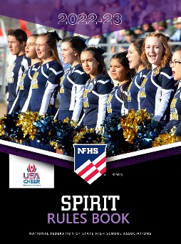


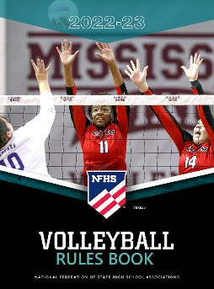







National Federation of
State High School Associations
The NFHS writes playing rules for 17 sports
for boys and girls at the high school level.
  Publishes 4 million pieces of materials annually.
Notes:
The NFHS writes playing rules for 17 sports, publishes High School Today (HST) along with several other key publications totaling over 4 million pieces annually.

Slide 6
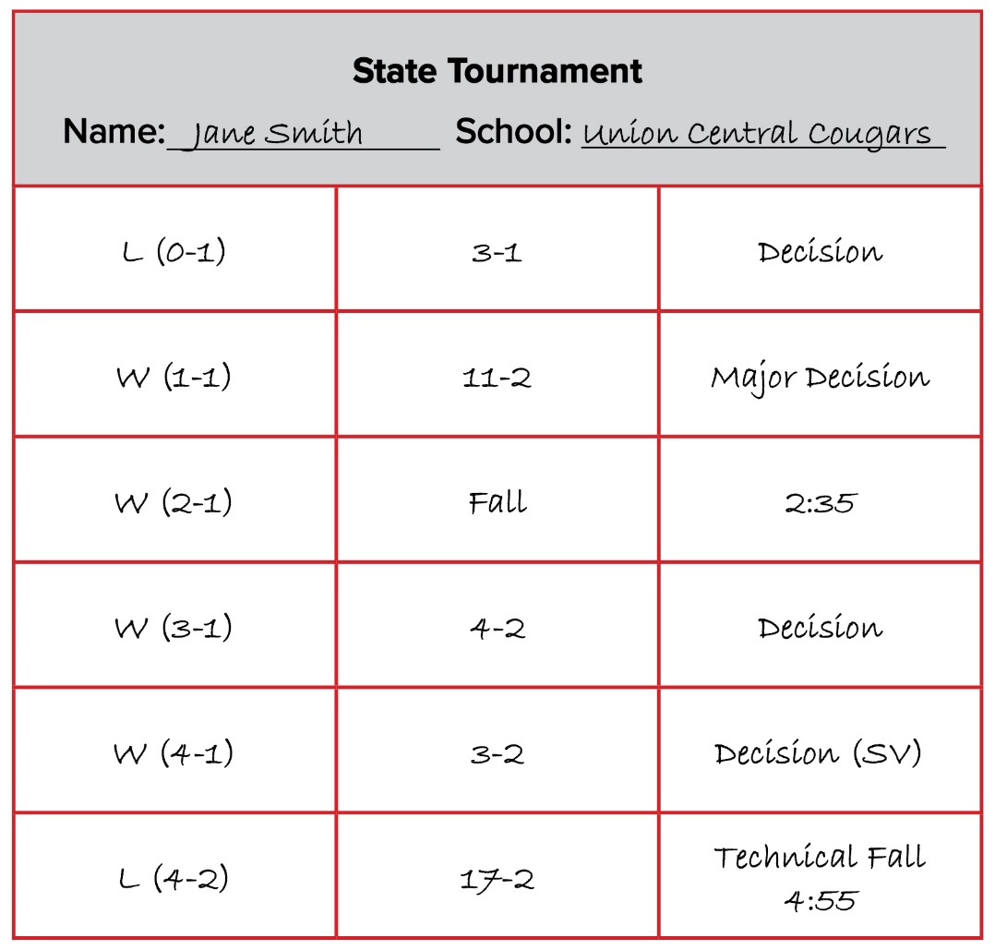
representation rule 1-4-3

Slide 7
representation rule 1-4-3
ART. 3. . . No wrestler shall represent the school in more than one weight class in any meet or wrestle in more than six matches (championship or consolation), excluding forfeits in any one day of competition. Exception: No wrestler shall wrestle in more than six matches (championship or consolation), excluding forfeits in any one day of a tournament conducted by the state high school association for qualification to the state high school championships or the championships themselves.

Slide 8
representation rule 1-4-3
Rationale:
Experiments were conducted by state associations during the 2022-23 school year to allow six matches in post-season events, and there was no reported increase of injuries. Allowing six matches during the regular season events is a normal progression and will be monitored throughout the season.

Slide 9
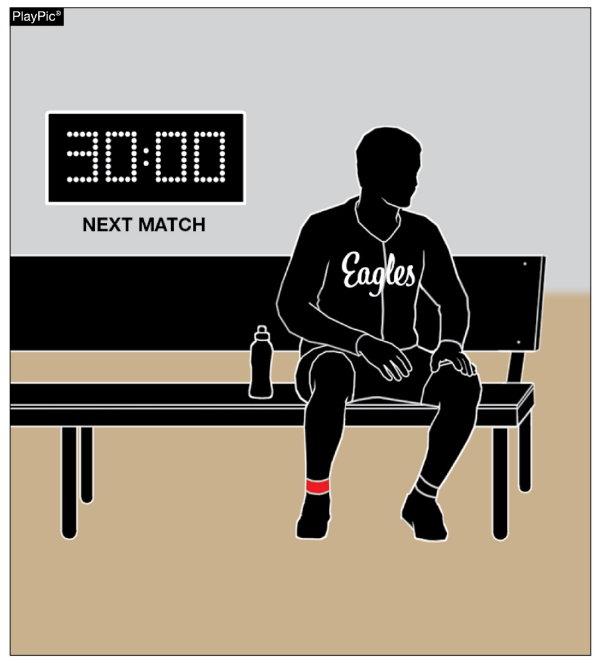
representation rule 1-4-4

Slide 10
representation rule 1-4-4
ART. 4 . . . No contestant shall wrestle in two consecutive matches with less than a 45-minute 30-minute rest between matches. The conclusion time of each match shall be recorded.
Rationale:
There was no peer-reviewed data to suggest any additional risk for using a 30-minute rest/recovery time between matches.

Slide 11
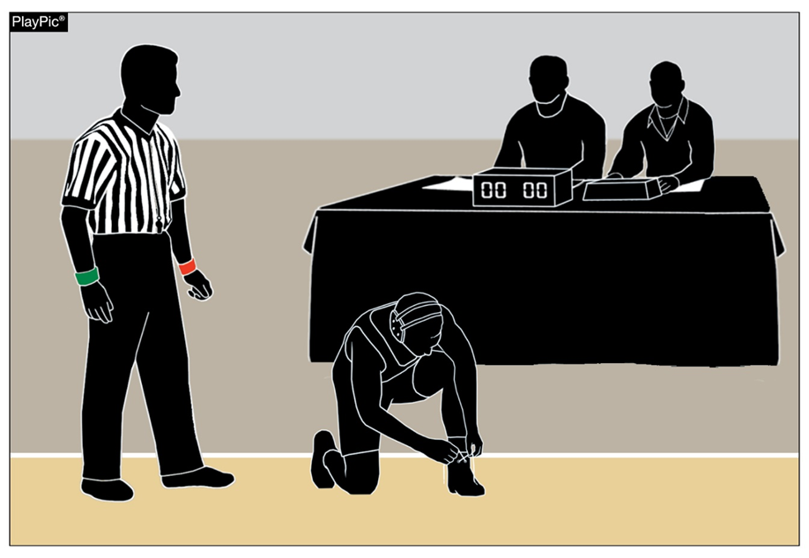
Representation limited competition rule 1-4-7 (new)

Slide 12
representation rule 1-4-7 (new)
ART. 7 . . . No contestant shall wrestle in more than 10 matches in a two-consecutive day period.
Rationale:
The rule to allow 6 matches per day was intended for meet management on one-day tournaments and is not to allow more matches in a season.

Slide 13
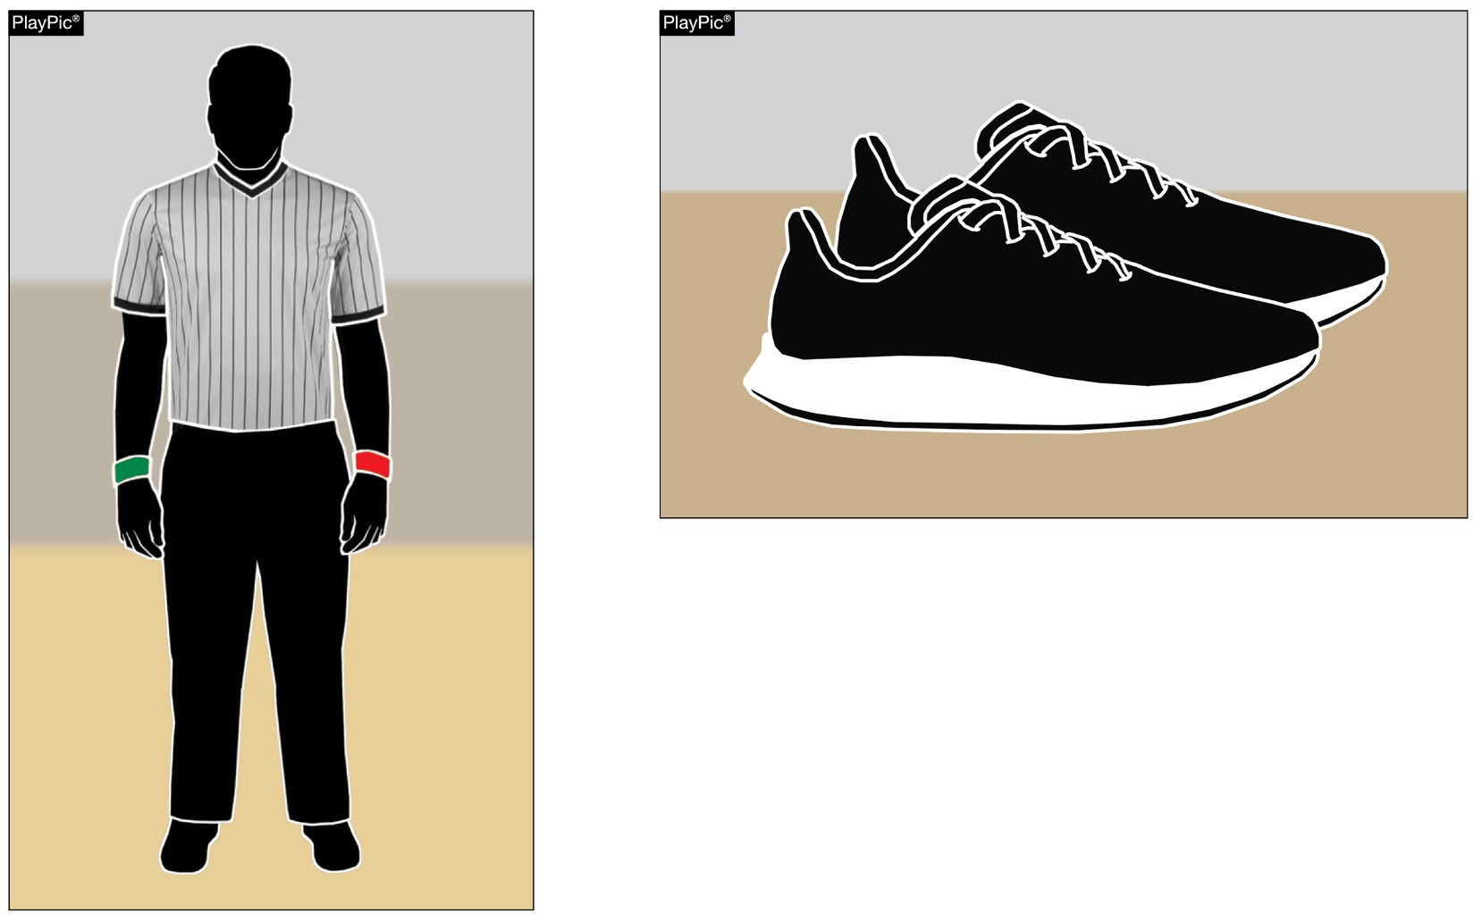
Referee’s uniform rule 3-1-1

Slide 14
Referee rule 3-1-1
ART. 1 . . . The referee’s uniform consists of a short-sleeved knit shirt, with alternating black and white 1-inch stripes; or gray with black pinstripes, or an event provided shirt common to all referees at that event, full-length black trousers, black belt (if trousers have belt loops), black socks and black wrestling/gym shoes without colored highlights. Shoes with white or gray trim are allowed.

Slide 15
Referee rule 3-1-1
The referee shall be neatly attired and have other accessories, including a colored disk, a black lanyard and black whistle, red and green armbands, and a kit to conduct the random draw. The red armband shall be worn on the left wrist and the green armband on the right wrist.
Rationale:
Allowing the referee's shoes to have trim gives them more options and opportunity to find more comfortable shoes and does not hinder the appearance of the official.

Slide 16
SECTION 1 Wrestlers' UNIFORM rule 4-1-1a and 4-1-1b
A legal uniform consists of:
a one-piece singlet cut no lower in the back or front than the level of the armpits and under the arms no lower than one-half the distance between the armpit and belt line. A suitable undergarment, which completely covers the buttocks and groin area, shall be worn under a one-piece singlet.

Slide 17
SECTION 1 Wrestlers' UNIFORM rule 4-1-1a and 4-1-1b
Any other undergarment worn under the one-piece singlet which extends beyond the inseam shall be tight-fitting and shall not extend below the knee. The one-piece singlet may be worn with full-length form-fitted tights with stirrups. The one-piece singlet shall be school-issued.

Slide 18
SECTION 1 Wrestlers' UNIFORM rule 4-1-1a and 4-1-1b
NOTE: Female contestants wearing a one-piece singlet shall wear a sports bra that completely covers their breasts and minimizes the risk of exposure. Compression shirts worn underneath a one-piece singlet are permitted but not required for female contestants unless needed to ensure complete coverage.
b. compression shorts or shorts designed for wrestling shall have a minimum 4-inch inseam that shall not extend below the knee; shorts designed for wrestling shall have an elastic waistband and a drawstring that is not exposed.

Slide 19
SECTION 1 Wrestlers' UNIFORM rule 4-1-1a and 4-1-1b
Compression shorts or shorts designed for wrestling shall not have exposed drawstrings, belt loops, zippers, snaps, button or pockets. A suitable undergarment, which completely covers the buttocks and groin area shall be worn under shorts designed for wrestling and compression shorts. Shorts designed for wrestling may be worn over the singlet.

Slide 20
SECTION 1 Wrestlers' UNIFORM rule 4-1-1a and 4-1-1b
Compression shorts or shorts designed for wrestling may be worn with a form-fitted compression shirt. Compression shorts or shorts designed for wrestling shall be school-issued. Compression shorts or shorts designed for wrestling may be worn with full-length form-fitted tights.
c. Remains the same.
Rationale:
For consistency, either uniform style is available for full-length form-fitted tights usage.

Slide 21
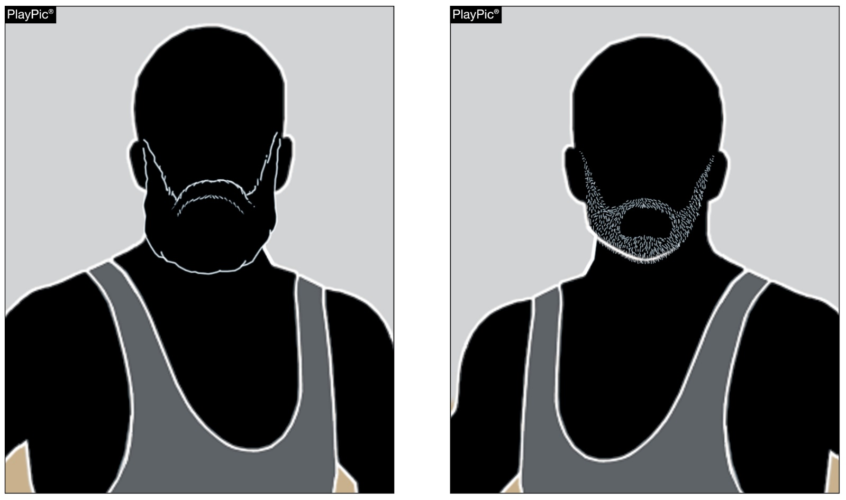
SECTION 2 WRESTLERS’ APPEARANCE AND HEALTH rule 4-2-1

Slide 22
SECTION 2 WRESTLERS’ APPEARANCE AND HEALTH rule 4-2-1
Facial hair is permissible. Trimmed to a length so that the skin is visible for skin checks is allowed. Facial hair that does not allow for skin a check to be performed, as determined by the referee or a designated, on-site appropriate health care professional overseeing the skin checks, shall be immediately trimmed to within the guidelines. A wrestler may not compete until the facial hair is trimmed and the skin check is completed. Hair control devices and other adornments in the hair that are securely fastened and do not present an increased risk to the wrestler or the opponent are allowed.

Slide 23
SECTION 2 WRESTLERS’ APPEARANCE AND HEALTH rule 4-2-1
A wrestler's hair may be contained in a legal hair cover. The legal hair cover, if worn, shall be attached to the ear guards. A bandanna is not considered a legal hair cover. The legal hair cover must be of a solid material and be nonabrasive. The wrestler opting to wear a legal hair cover must wear it to the weigh-in procedure and be checked for grooming with it on. The legal hair cover must be removed prior to the wrestler stepping on the scale to be weighed. If a referee is not present at weigh-ins, the hair cover must be checked by the meet referee upon arrival at the site.

Slide 24
SECTION 2 WRESTLERS’ APPEARANCE AND HEALTH rule 4-2-1
Wrestlers that do not meet the requirement shall wear a face mask. All legal hair covers and face masks will be considered as special equipment.
Rationale:
It is important to be cognizant about skin disease and keeping all involved safe. If there are any questionable areas on or around the face, we would inquire with the wrestler about a physician’s note or get input from the on-site approved health-care professional (AHCP) if one is present.

Slide 25
SECTION 2 WRESTLERS’ APPEARANCE AND HEALTH rule 4-2-1
Rationale:
If there is no on-site AHCP and no note, then we would deny the wrestler the opportunity to compete. The length of the facial hair does not have any influence on the referee’s decision.

Slide 26
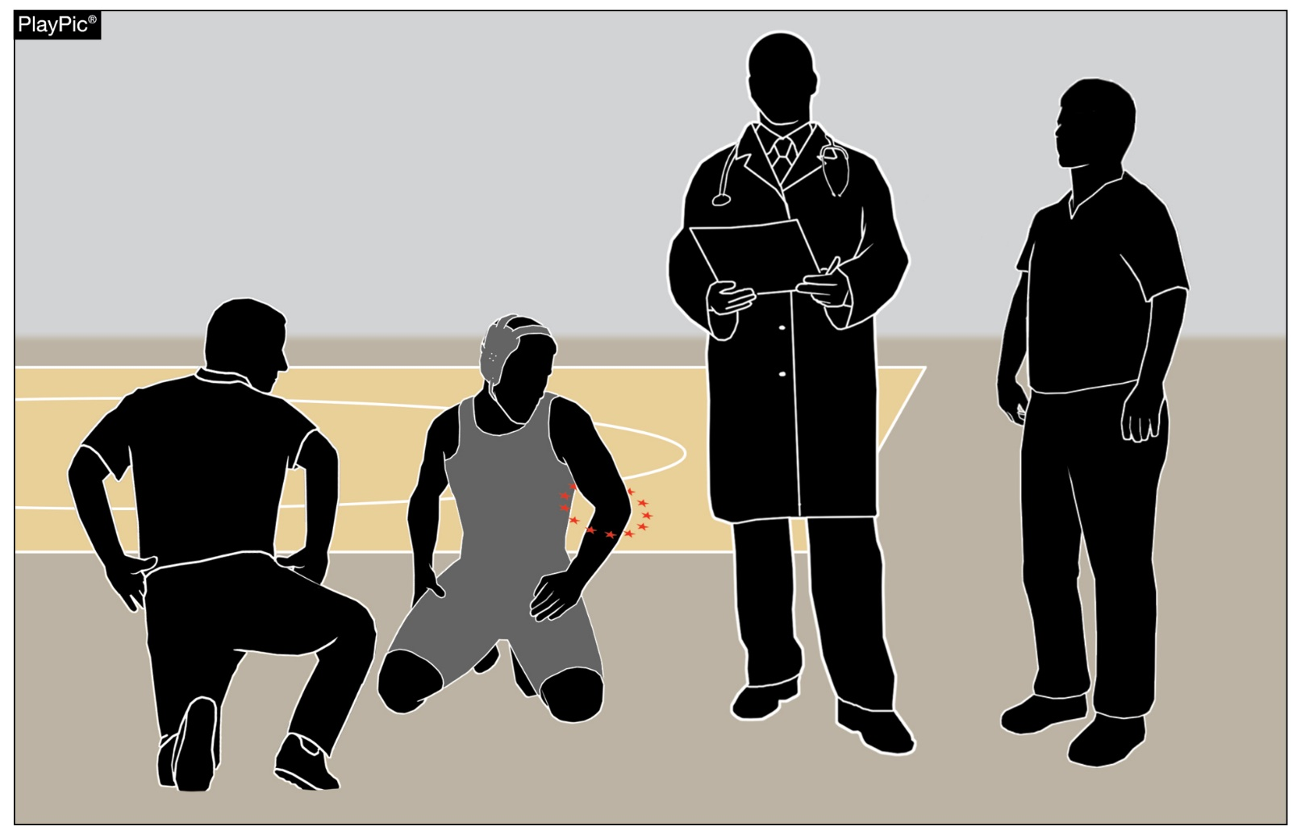
Forfeits/medical forfeits/entries rules 5-13, 10-2-4, 10-2-5
AHCP
COACH
TOURNAMENT DIRECTOR

Slide 27
SECTION 13 forfeit/medical forfeit rule 5-13
It shall be considered a forfeit when the opponent, for any reason fails to appear for a match. In order to receive a forfeit the wrestler shall be dressed in a legal wrestling uniform and appear on the mat. It shall be considered a medical forfeit when the opponent fails to appear for a match due to injury or illness that occurred during the tournament. This determination will be made by the Tournament Director.

Slide 28
SECTION 13 forfeit/medical forfeit rule 5-13
Rationale:
The term medical forfeit accurately describes that the forfeit was due to injury or illness that occurred during the tournament. A medical forfeit would not count against the wrestler's record.

Slide 29
SECTION 2 entries (forfeit/medical forfeit) rule 10-2-4
ART. 4 . . . In case of injury or illness after verification of entries, the tournament director, in consultation with the designated, on-site meet, appropriate health-care professional(s) and the coach of the injured or ill contestant, shall determine the contestant's ability to continue. Extenuating circumstances concerning the injury or illness as it relates to default, or forfeit or medical forfeit for scoring purposes, shall be considered by the tournament director.

Slide 30
SECTION 2 entries (forfeit/medical forfeit) rule 10-2-4
Rationale:
By using a medical forfeit, it will accurately define that the wrestler was not able to report to the match due to injury or illness. Like regular forfeits the wrestler would not take a loss on their record.

Slide 31
SECTION 2 entries (forfeit/medical forfeit) rule 10-2-5
ART. 5 . . . A forfeit shall eliminate a contestant from further competition in a tournament, except when the forfeit is deemed a medical forfeit because of an injury or illness which occurred during the tournament.

Slide 32
SECTION 2 entries (forfeit/medical forfeit) rule 10-2-5
Rationale:
There is confusion when choosing an injury default versus a forfeit in tournament situations. Rule 5-7 defines a default when one of the competitors is unable to continue wrestling for any reason. Rule 5-13 defines a forfeit when the opponent, for any reason, fails to appear for a match. Using medical forfeit versus an injury default will accurately define when a wrestler shows a loss on their record. A default counts as a loss a medical forfeit does not.

Slide 33
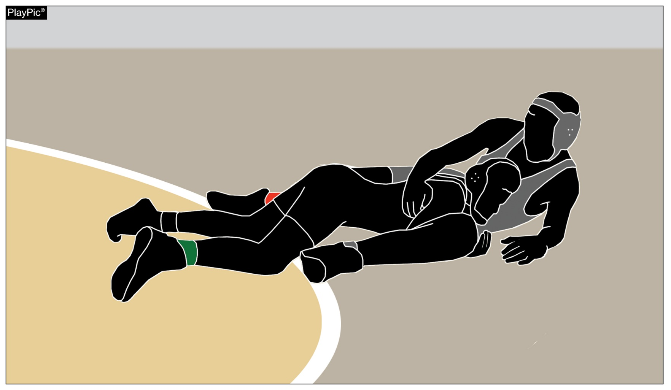
Section 15 Supporting points rule 5-15-2a

Slide 34
SECTION 15 inbounds rule 5-15-2a
a. When down on the mat, the usual points of support are:
1. the knee(s)
2. the side of the thigh
3. the buttocks
4. the hand(s)
5. the head
6. foot/feet

Slide 35
SECTION 15 inbounds rule 5-15-2a
Rationale:
Feet are regularly supporting the wrestler’s weight during the match while on the mat. We allow a wrestler’s feet to be considered supporting points while in a near-fall situation. By adding it to the list of usual supporting points on the mat it will provide clarity and consistency for the wrestlers, coaches and officials.

Slide 36
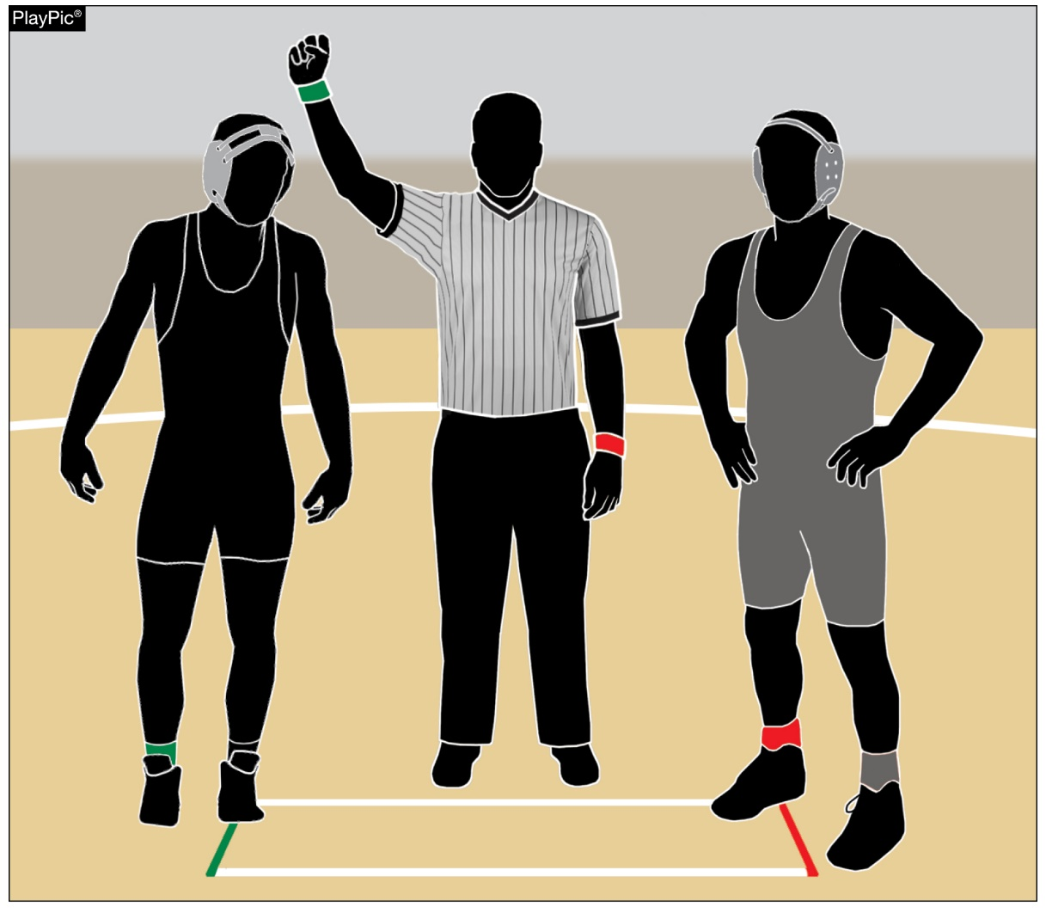
End-of-match procedure rule 6-5-2

Slide 37
SECTION 5 END-OF-MATCH PROCEDURE rule 6-5-2
ART. 2 . . . The wrestlers shall shake hands and the referee shall declare the winner by raising the winning wrestler’s hand or raise the color wristband of the winning wrestler on their (referee’s) arm or have the winning wrestler raise their own arm. wrestler's hand.

Slide 38
SECTION 5 END-OF-MATCH PROCEDURE rule 6-5-2
Rationale:
Wrestling remains the only sport where it is required for the official to touch the student athlete as part of the post match/game procedure. There truly is no need for adult officials to contact the student athletes unless the health and safety of the athlete is in jeopardy. During the pandemic we adopted a number of protocols to help avoid the transmission of the disease, one of those was to no longer raise the hand of the wrestler, rather raise the color wristband of the wrestler who won, this was very successful and widely appreciated by officials. This is end of match procedure would still indicate the winner and alleviate the requirement of the official from touching the athlete.

Slide 39
Points of emphasis

Slide 40
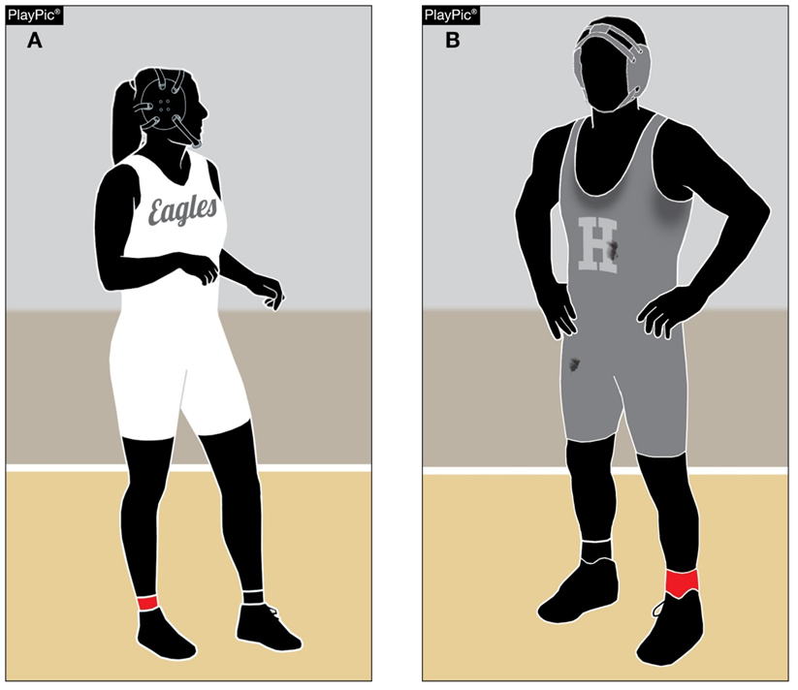
Uniform appearance

Slide 41
Uniform decorum
The proper use of a uniform is paramount in high school wrestling. Cleanliness, color selection, fit and style all go into what constitutes the proper decorum of use by the wrestler. A dirty, poorly sized, unbecoming colored uniform is an impediment that interferes with wrestling.
We cannot afford for the wrestler’s attention to be distracted from the business at hand...to wrestle! Keeping the uniform washed and clean reduces risks of transmitting skin disease which protects the opponent, referee and provides comfort for the wearer.

Slide 42
Uniform decorum
When looking to purchase new or replacement uniforms, consider your color selection and placement. Today’s youth do not want to be placed in a situation where a white or light uniform (top or bottom) when wet reveals more of their body than they are comfortable in having exposed.
They can become easily embarrassed and self-conscious. With cellphones ever present and everything and/or everybody possibly being the next social media post that goes viral, we want to do our best in avoiding any unfortunate situations.

Slide 43
Uniform decorum
Similarly, it is imperative that a uniform (singlet or two-piece) should be issued to a student that best fits their size, weight and gender. It is disconcerting to have a wrestler wearing a stretched out uniform while wrestling and the back of their uniform is touching the mat during competition.
The referee has no other option but to award a fall to their opponent. Whereas, a properly fitted uniform would not have placed the wrestler in jeopardy.

Slide 44
Uniform decorum
With an increase of over 30,000 girls entering our sport this last school year and more are expected to join our ranks this year, girls being issued a boy’s uniform is no longer practical or reasonable.
Obviously, boys and girls have different anatomies and require different types of uniforms. It is highly recommended that girls are issued girls’ cut singlets/two-piece uniforms. The design of the girls’ cut style uniforms reduces the risk of exposure during wrestling competition.

Slide 45
Uniform decorum
We cannot expect a girl to perform her best if she has to be concerned whether her uniform will support her while she is competing. A sports bra and suitable undergarment that completely covers the groin and buttocks are not just items of modern-day convenience.
They are significant in high school wrestling because they are part of the uniform. Proper fit and sizing (to minimize the risk of exposure) should be considered when the female wrestler is on her feet or in various positions during competition.

Slide 46
Uniform decorum
Coaches and parents/guardians have a collaborative role in helping the wrestler to maintain their modesty with proper fitting undergarments and allow them to compete at their optimum best!
While we are not suggesting a wholesale overhaul of your uniform stock. We are asking you to inspect what you have and if it is financially (or when your school’s uniform rotation occurs) feasible replace your inventory with newer and properly fitting uniforms designed for all the wrestlers on your team. It will encourage the morale and confidence of your wrestlers.

Slide 47
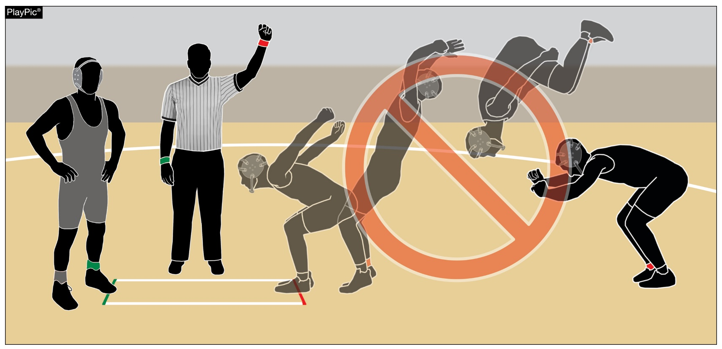
Excessive celebrations

Slide 48
Excessive celebration
Wrestling consists of two similar sized athletes using their skill, technique, strength and catalogue of moves to control and dominate their opponent. One wrestler always has to win and the other unfortunately will be the loser during that match. We are observing that some of the celebrations have become excessive and over the top.
We appreciate the exuberance of a young person winning and their success is a sense of accomplishment and pride, but not at the expense of their opponent. Embarrassing the opponent does not add to their win.

Slide 49
Excessive celebration
It tarnishes the sport that they have dedicated themselves to and have found success in. High school sports and other activities exist to lift students up, not demean or tear them down. The goal is to treat everyone fairly and treat each other with respect. Any actions, taunts, speech or harassment that is insulting, demeaning or hurtful will and should not be tolerated.
Good sports win with humility, lose with grace and do both with dignity. It takes the efforts of everyone every day to ensure that sportsmanship remains one of the top priorities in education-based activity programs.

Slide 50
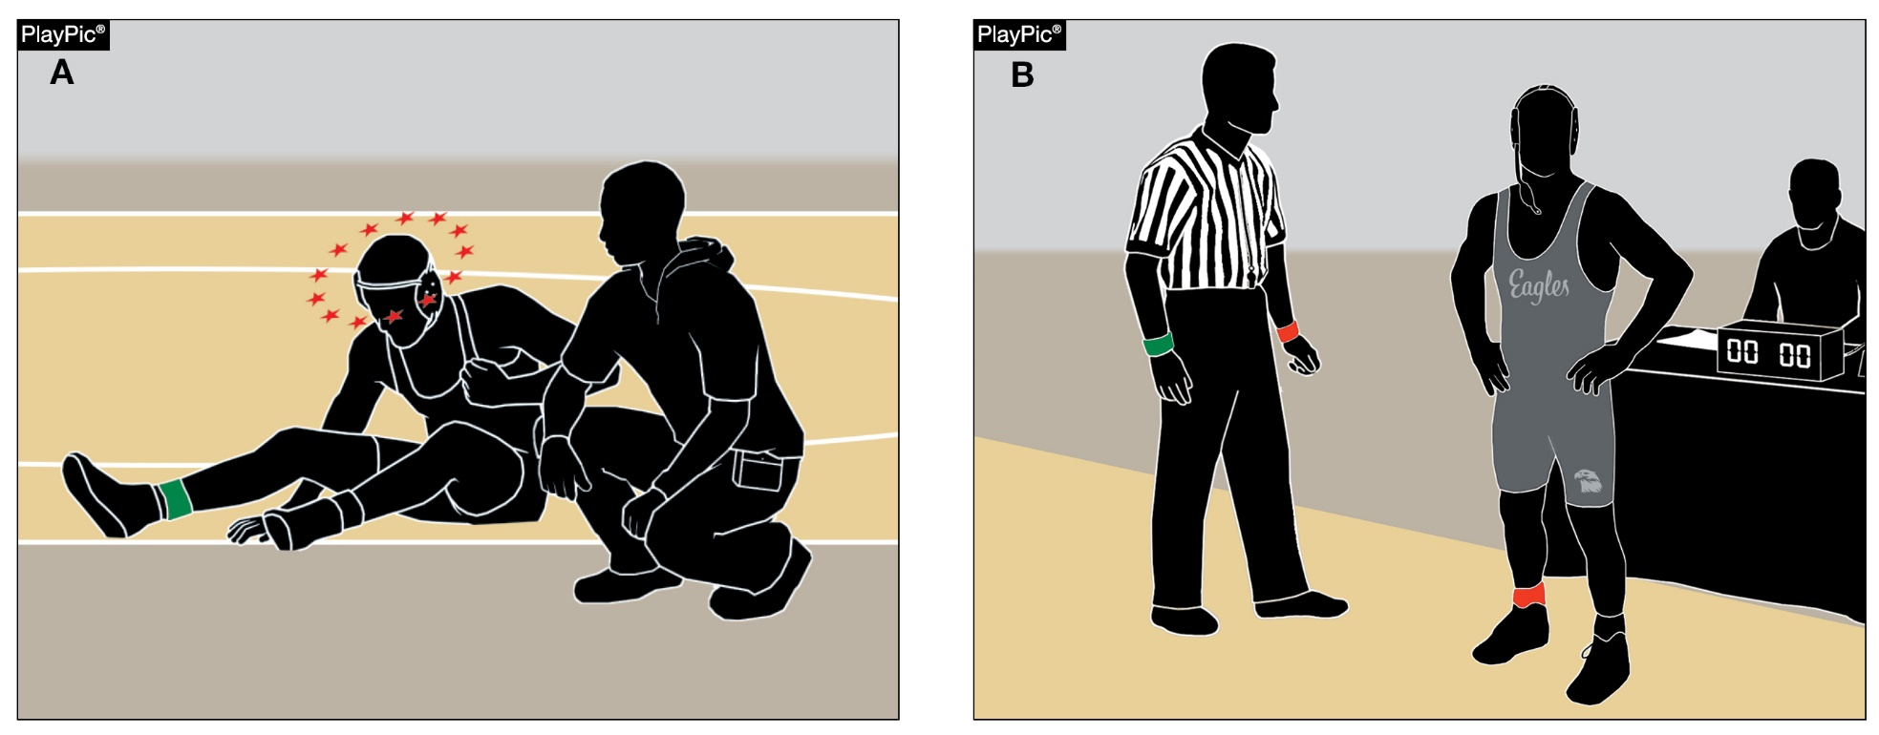
Default vs forfeit

Slide 51
Default vs. forfeit
In the purest and simplest form, a default is awarded when a wrestler is unable to continue wrestling for any reason. The match has started and they cannot continue to wrestle anywhere during the match. The opponent wins and the defaulting wrestler receives the loss.

Slide 52
Default vs. forfeit
A forfeit is when an opponent fails to appear for a match for any reason. With the new rule change, a medical forfeit is now an option. The caveat is that the forfeiting wrestler cannot wrestle due to an injury or illness that occurred during the tournament. The wrestler remains in the tournament if possible (moving down to the consolation bracket) and does not take a loss on their record.
This entire transaction is determined by the tournament director after consultation with the on-site appropriate health-care professional and the coach of the injured or ill contestant. Both actions cease wrestling for different reasons and have unique consequences.

Slide 53
Concealment of a communicable skin condition
With our new facial hair rule allowing beards of varying thicknesses and lengths, paying particular attention to more visible skin issues is as important as ever. Covering a communicable skin disease with either make-up or other methods is in direct conflict with our rules of fairness and risk minimization.
Concealing or hiding a communicable skin disease is unsporting behavior and in violation of the NFHS Communicable Disease Procedures and makes the wrestler ineligible to participate per rule.

Slide 54

Guidelines for Schools and state associations for consideration of accommodations
Notes:
To assist state associations in working with schools for the inclusion of students with disabilities, the following guide prepared by the NFHS Task Force on the Inclusion of Students with Disabilities is being provided for your review.
Following these guidelines will assist in the individual student assessment by the student and the school.
When requesting a possible accommodation, coaches should work with their school and the state association as early as possible in the sport season.
Contest officials shall defer decisions on rule accommodations to the respective state association.
This information serves as a guide. Each state association may develop its own process.

Slide 55
NFHS OFFICIALS Education

Slide 56





OFFICIALS EDUCATION
Content remains free of charge
TEACHING
AIDS
RULES
CHANGES
DIAGRAMS
VIDEO
LIBRARY
OFFICIALS
COURSES
Notes:
Sport-Specific Officiating courses are offered in several sports. They are ideal for new officials and those in the first few years of officiating. These courses introduce officials to the mechanics and techniques used in the sport and provide specific information on an area within that sport. Individuals can complete a course within 30-45 minutes. These courses are free to all officials and prospective officials.
“Interscholastic Officiating” is a general course on sports officiating, and it is free to all officials and prospective officials. This course provides an introduction to skills and concepts used as an official. Several topics are covered such as: basics of becoming and staying an official, science of officiating, art of officiating, how to combine these skills for successful officiating.
Video clips are made available to NFHS Officials Association members. The video is clipped on specific topics and provides the rules references as well as dialogue on the topic.
The courses and videos are offered at www.NFHSLearn.com .
Courses Available:
Officiating Football
Officiating Volleyball – Ball Handling
Officiating Volleyball – Alignment
Officiating Volleyball – E-Whistle
Officiating Basketball
Officiating Basketball – Three-Person Mechanics
Officiating Basketball - Pre-Game Conference
Soccer – Fouls and Misconduct
Soccer – Offside
Soccer - Pre-Game Conference
Swimming and Diving
Officiating Wrestling
Umpiring Softball
Officiating Field Hockey
Officiating Track and Field
Future Courses to be Considered:
Umpiring Baseball
Umpiring Softball – 2 Person Mechanics
Communication Among Officials and Coaches

Slide 57


Future Developments
Improved Schedule View
Year Two Accomplishments
Auto-Assign
Years of Service
14
121,508
$9.2M
Enhanced Payment Capabilities
States
Registering
Officials
Contests
Assigned
Payments
Sent to
Officials
100% FREE to your state as a NFHS-Member Benefit.
Notes:
NFHS CENTER FOR OFFICIALS SERVICES (COS)
Your Complete Solution for Officials Management and More:
Registration
Assignment
Payment
Testing
Background Checks
For More Information on the NFHS – Center for Officials Services (COS) Contact:
Dana Pappas, Director of Officiating Services, dpappas@nfhs.org
Also If You’re Interested in Eligibility and Monitoring Requirements Contact
the Folks at Dragonfly:
Kirk Miller, Dragonfly, kirk@dragonflyathletics.com
Brandon Wallace, Dragonfly, brandon@dragonflyathletics.com

Slide 58
NFHS Learning Center

Slide 59

Notes:
The NFHS Learning Center is the home to more than 90 online professional development courses for everyone within the interscholastic community - coaches, students, officials, parents, administrators, and individuals within performing arts programs. More than 60 courses are available for free.
The NFHS is an Accredited Institution and has delivered more than 15 million courses on its NFHS Learning Center platform since its inception in 2007. In receiving national accreditation by Cognia, the NFHS has upheld itself to rigorous standards that focus on productive learning environments, equitable resource allocation that meet the needs of learners, and effective leadership.
The NFHS Learning Center features its flagship coaching course, “Fundamentals of Coaching,” as well as several health and safety courses that have been completed by millions of individuals, such as “Concussion in Sports,” “Heat Illness Prevention,” “Sudden Cardiac Arrest” and “Protecting Students from Abuse.” The NFHS Learning Center offers several national credentials that can be earned by individuals who complete specific NFHS courses. Through the School Honor Roll Program, schools can earn a physical banner to hang in their school.
To learn more and start your professional development journey, please visit the NFHS Learning Center at NFHSLearn.com.

Slide 60
NFHS Network

Slide 61


NFHS Network
By 2025, every high school sporting event in America will be streamed live.
The NFHS Network will be
THE DESTINATION for fans
to view these broadcasts.
27 Different Sports and Activities
www.NFHSnetwork.com
Notes:
The NFHS Network is the leader in streaming Live and On Demand high school sports.
Partnered with the National Federation of State High School Associations, 45 high school state athletic/activities associations, and PlayOn! Sports, the NFHS Network is a joint venture created to provide fans with the ability to stream high school sports on any device, from wherever they are.
All NFHS Network events are available to watch online at www.NFHSnetwork.com and through the NFHS Network Live App for iOS and Android. Follow us on Facebook, Twitter, Instagram, and YouTube.
Watching high school sports and events has never been easier.
The NFHS Network’s goal to broadcast live all 2 million high school sporting events by 2025.
The NFHS Network covers 27 different regular season and postseason sports, as well as other high school activities, celebrating the accomplishments of students-athletes, student broadcasters, and high schools across the country.

Slide 62

Over 1 million events this year…
Notes:
The NFHS Network will broadcast over 150,000 live events this year. If your school is not a member of the NFHS Network School Broadcast Program, please contact us at Mark.Koski@NFHSnetwork.com

Slide 63

Thank You
National Federation of State High School Associations
PO Box 690 | Indianapolis, IN 46206
Phone: 317-972-6900 | Fax: 317.822.5700
www.nfhs.org | www.nfhslearn.com | www.nfhsnetwork.com

