Slide 1
2024 NFHS Track and Field and cross country PowerPoint
Rules Changes
Major Editorial Changes
Points of Emphasis

Slide 2

National Federation of
State High School Associations
NFHS (located in Indianapolis, IN – Est. 1920):
  National leader and advocate for
  high school athletics and
  performing arts programs.
  Serves 51 state associations, 19,500
  high schools and 12 million student
  participants.
  Writes playing rules for 17 high school
  sports for boys and girls.
  Offers online education courses for high school coaches,
  officials, parents, students and others.
  Ensures that students have opportunity to enjoy healthy participation, achievement and good sportsmanship in education-based athletics.

Slide 3


















National Federation of
State High School Associations
The NFHS writes playing rules for 17 sports
for boys and girls at the high school level.
  Publishes 4 million pieces of materials annually.

Slide 4

NEW NFHS AllAccess – Website
AllAccess is the New NFHS Digital Publications Platform that includes:
  Rules Publications
  High School Today Magazine
  Policy Debate Quarterlies
  Other NFHS Digital Publications
Website organized for associations and individuals to assign books and manage purchases
Visit www.allaccess.nfhs.org
Notes:
www.allaccess.nfhs.org/help – will access videos

Slide 5



NEW NFHS AllAccess – Mobile App
Access Via Website or Mobile App:
View available publications for sale
View publications assigned to you
Download books for offline viewing
Read publications as an e-book
  Book features include:
    Table of contents
    Highlighting text
    Creating ‘sticky notes’ on pages
    Searching for terms
    Mark-up pen feature
    Viewing highlights and notes on data page
Available on App Store and Google Play

Slide 6






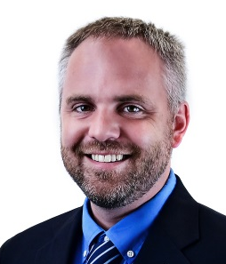

NFHS Rules Review Committee
The NFHS Rules Review Committee is chaired by the chief operating officer and composed of all rules editors. After each committee concludes its deliberations and has adopted its recommended changes for the subsequent year, such revisions will be evaluated by the Rules Review Committee.
Davis Whitfield
Chief Operating Officer
Lindsey Atkinson
Basketball, Girls Lacrosse and Volleyball
Bob Colgate
Football and Sports
Medicine
Sandy Searcy
Softball, Swimming & Diving and Water Polo
Elliot Hopkins
Baseball and Wrestling
Julie Cochran
Cross Country, Gymnastics, Field Hockey, Soccer and
Track & Field
James Weaver
Boys Lacrosse
and Spirit
Dan Schuster
Ice Hockey

Slide 7
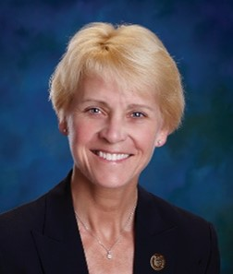



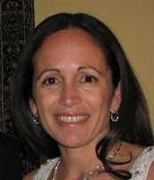

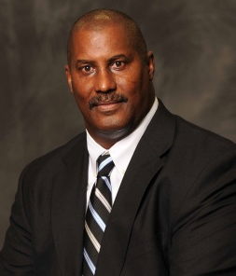
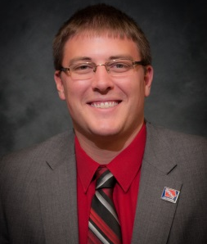
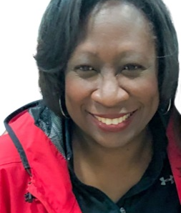
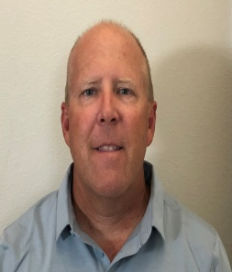
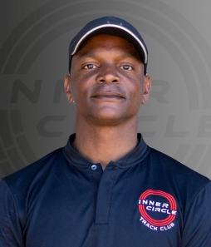
NFHS Track and field Rules Committee
Dr. Karissa Niehoff
NFHS
Publisher
Julie Cochran
NFHS
Editor
Cody Inglis
East Lansing, MI
Chair - 2023
Sheree Beaumont
Louisville, KY
Coaches - 2026
Thomas McTaggart
Sloatsburg, NY
Officials - 2024
Yvonne Grimes
Sandy Hook, CT
Section 1 - 2024
Tia Clemmons
Upper Marlboro, MD
Section 2 - 2025
Lonnie Tillman
Clinton, MS
Section 3 - 2026
Jared Chizek
Boone, IA
Section 4 - 2023
Roberta McWoods
St. Louis, MO
Section 5 - 2024
Mike Whaley
Oklahoma City, OK
Section 6 - 2023
Brian Weaver
Clovis, CA
Section 7 - 2025
Hashim Hall
Tigard, OR
Section 8 - 2026

Slide 8
2024 nfhs Track and field and cross country RULES CHANGES

Slide 9
3-8-1 finish judges and timers/fat
Removed the requirement of two appointed officials to operate the FAT timing system.
  Now a small meet could utilize one individual to operate the FAT timing system and evaluate the finish line pictures.
  Each meet should utilize the number of officials that specific meet needs to operate the FAT timing system.
Notes:
SECTION 8 FINISH JUDGES AND TIMERS/FULLY AUTOMATIC TIMING
ART. 1 . . . When fully automatic timing (FAT) is used, there shall be a minimum of two appointed officials an appointed timing official(s) whose duties shall be to operate the automatic timing system and evaluate finish line pictures/video: The timing official shall be responsible for the operation of finish timing devices and for the evaluation, interpretation of the official picture/video and determine the finish place and times.
Rationale:
As technology continues to evolve, current FAT systems do not require separate operators and evaluators. Games Committees may set requirements for each meet on the number of timing officials.

Slide 10
4-2-1 nOTE PARTICIPATION AND ENTRY LIMITATIONS
State Associations may adopt different participation limitations, not to exceed six events.
  Offers flexibility to states to determine number of events best suited to the student athletes in their state.
Notes:
SECTION 2 PARTICIPATION AND ENTRY LIMITATIONS
ART. 1. . . A competitor shall not compete in more than four events, including relays.
NOTE: State Associations may adopt different participation limitations within their state.
Rationale:
The participation and entry limitation rule should be by state association adoption. Each state should be allowed to determine the number of events best suited for their state and their student athletes as long as it is no more than four running events.

Slide 11

5-3-1 track markings
Track staggers are dependent on the geometry of each individual track and a competent surveyor should determine the lane staggers.
  Examples of a competent surveyor such as: land surveyor, professional engineer, certified track builder, or experienced track striper
9-4-1 Indoor Track Markings is also affected by this change.
Notes:
SECTION 3 TRACK MARKINGS
ART. 1 . . . When races are run in lanes around a turn or turns, the starting lines shall be staggered so that each competitor will run the same distance. Staggered markings are dependent on the geometry of each individual track.
NOTE: A competent surveyor such as, but not limited to, a registered land surveyor, professional engineer, certified track builder or experienced track striper should determine the lane staggers. The staggers are not the same for races run entirely in lanes and the races that use a break line.
Rationale:
Track staggers are dependent on the geometry of each individual track and a competent surveyor should determine the lane staggers.

Slide 12
5-7-4 c,d and NOTE (NEW) The start
Changes made to the definition of a false start and how it should be consistently officiated.
Starting violations which constitute a false start include:
Failure to comply with the starter's commands.
Having any part of the body in contact with the starting line or running surface beyond the line, when the starting device is fired.
If a runner leaves their mark with a hand or foot after the “set” command but before the starting device is fired.
If a runner leaves their mark with a forward motion without the starting device being fired.
Failure to place starting blocks within the respective competitor’s lane.
Repeated use of disconcerting acts.
PENALTY: A competitor who commits a false start shall be disqualified.
NOTE: Extraneous motion before the device is fired does not necessarily require a false start be charged unless the criteria listed in the rule above are met. If the starter thinks the movement creates a situation of unfairness to any of the competitors, they may cancel the start with the command “Stand Up” or if the device has been fired, recall the race as an unsteady or unfair start and redo the start procedure.
OTHER RULES AFFECTED: 8-4-4 NOTE 2 (NEW)
Notes:
SECTION 7 THE START
ART. 4 . . . Starting violations which constitute a false start include:
a. Failure to comply with the starter's commands.
b. Having any part of the body in contact with the starting line or running surface beyond the line, when the starting device is fired.
c. Failure to remain motionless after assuming the set position prior to the starting device being fired. If a runner leaves their mark with a hand or foot after the “set” command but before the starting device is fired.
d. If a runner leaves their mark with a forward motion without the starting device being fired.
d. e. Failure to place starting blocks within the respective competitor’s lane.
e. f. Repeated use of disconcerting acts.
PENALTY: A competitor who commits a false start shall be disqualified.
NOTE: Extraneous motion before the device is fired does not necessarily require a false start be charged unless the criteria listed in the rule above are met. If the starter thinks the movement creates a situation of unfairness to any of the competitors, they may cancel the start with the command “Stand Up” or if the device has been fired, recall the race as an unsteady or unfair start and redo the start procedure.
OTHER RULES AFFECTED: 8-4-4 NOTE 2 (NEW)
Rationale: Language removed that the athlete remain motionless after assuming set position. The change makes it clearer as to the definition of a false start and how it should be consistently officiated.

Slide 13
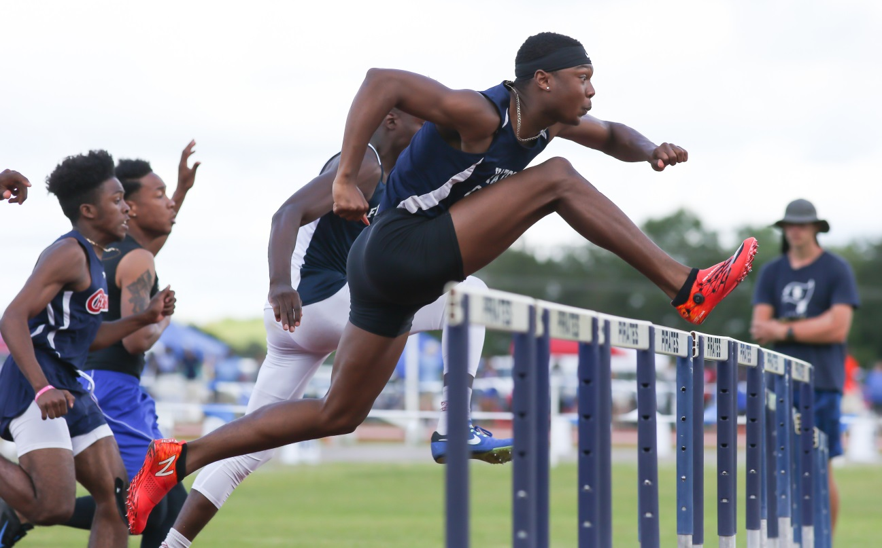
5-14-1 Hurdling infractions
ART. 1. . It is an infraction if a competitor:
a. Does not attempt to clear each hurdle.
b. Knocks down or displaces any hurdle by hand.
c. Advances or trails a leg or foot along the side of and below the height of the hurdle gate.
d. Runs over a hurdle not in the assigned lane.
e. Runs around a hurdle.
f. Interferes with another hurdler.
PENALTY: Disqualification from the event.
Notes:
SECTION 14 HURDLING INFRACTIONS
ART. 1. . It is an infraction if a competitor:
a. Does not attempt to clear each hurdle.
b. Knocks down or displaces any hurdle by hand.
c. Advances or trails a leg or foot along the side of and below the height of the hurdle gate.
d. Runs over a hurdle not in the assigned lane.
e. Runs around a hurdle.
f. Interferes with another hurdler.
PENALTY: Disqualification from the event.
Rationale:
The definition of hurdling does not fit under infraction. The addition of displacement of any hurdle by hand was also added to give guidance to officials when ruling on infractions.

Slide 14
6-2-2d (NEW) General Rules for field events
Guidance was added for how to handle a competitor entering late in a competition.
d. In the high jump and pole vault, one minute shall be allowed for the first trial of a competitor first entering the competition. (at any height of entry)
Notes:
SECTION 2 GENERAL RULES FOR FIELD EVENTS
ART. 2 . . . d. In the high jump and pole vault, one minute shall be allowed for the first trial of a competitor first entering the competition. (at any height of entry)
e. When a single competitor who has won the competition remains in the high jump or pole vault, the allowed time for a trial shall be five minutes.
Rationale:
This clarifies how the rule is to be interpreted and adds additional support to the official’s decisions.

Slide 15
6-3-2b (NEW) Breaking ties
Rules were added to offer guidance to officials when dealing with competitors withdrawing from competition or jump-off. (b) If all competitors eligible for a jump-off withdraw from the competition before the jump-off begins or at a height change, those competitors shall tie for first place, and any team points shall be added together and divided equally between the tying competitors.
Notes:
SECTION 3 BREAKING TIES
ART. 2 When there is a tie at any distance or height of a field event, places and points scored shall be awarded as follows:
b. For places determined by height:
4. If the tie remains after applying (1) and (2) and:
(a) It concerns first place, the competitors tying shall make one more
attempt at the height at which they failed. If no decision is reached,
the bar shall be lowered in increments of 1 inch (2 cm) in the high
jump and 3 inches (7 cm) in the pole vault. If two or more of the
tying contestants cleared the height, the bar shall be raised by
intervals of 1 inch (2 cm) in the high jump and 3 inches (7 cm) in the
pole vault. Each competitor shall attempt one trial at each height
until a winner is determined.
(b) If all competitors eligible for a jump-off withdraw from the competition before the jumpoff begins or at a height
change, those competitors shall tie for first place, and any team points shall be added together and divided
equally between the tying competitors.
(b c) The tie concerns any place other than first, the competitors shall be awarded the same place.
Rationale: Current rule is silent regarding two or more tied competitors withdrawing from the competition/jump-off at the same time. The addition offers guidance to officials in these given situations.

Slide 16
6-3-2B NOTES (new) breaking ties cont.
The new note explains that an athlete withdrawing from a jump-off concedes the higher place but does not negate their performance in the event nor is it unsporting to simply withdraw in this scenario. The addition of the new note helps explain how to officiate these scenarios.
NOTES:
3. A competitor withdrawing from a jump-off shall concede any opportunity for a higher placing in the event, but the withdrawal shall not negate a competitor’s performance in that event up to the point of withdrawal. Withdrawing from a jump-off is not unsporting conduct. [4-6-1]
Notes:
NOTES:
1. If the height which the tied competitors last attempted is not the same, because of a passed height by one or more of the remaining competitors, the bar shall be lowered to the lowest height last attempted by any of the remaining competitors to begin the jump-off.
2. No passed heights shall be permitted in the jump-offs.
3. A competitor withdrawing from a jump-off shall concede any opportunity for a higher placing in the event, but the withdrawal shall not negate a competitor’s performance in that event up to the point of withdrawal. Withdrawing from a jump-off is not unsporting conduct. [4-6-1]
Rationale: The new note explains that an athlete withdrawing from a jump-off concedes the higher place but does not negate their performance in the event nor is it unsporting to simply withdraw in this scenario. The not addition of the new note helps explain how to officiate these scenarios.

Slide 17
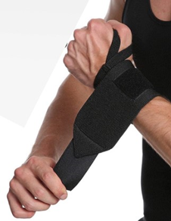
6-4-1, 6-5-1, 6-6-1 THROWS
The rule change permits athletes to apply tape to their fingers provided that the fingers are not taped together, and all fingers can move independently.
The change also permits a wrist wrap provided there are no artificial aids within the wrap such as hard plastic pieces to keep the wrist stiff.
LEGAL
Notes:
SECTION 4 SHOT PUT, SECTION 5 DISCUS THROW, SECTION 6 JAVELIN THROW
ART. 1… Taping of any part of the throwing hand or fingers shall not be permitted unless there is an open wound that must be protected by tape. Taping of the wrist is permissible. Tape may be used on the hand and fingers provided that no two fingers are taped together. The tape may be continuous and connect to the wrist, but all fingers must be able to move independently. A wrist wrap used in lieu of tape is acceptable and is not considered an artificial aid. Gloves are not permitted; however, a support belt may be worn. No harness or mechanical device attached to the hand or arm shall be used.
Rationale: The rules change permits athletes to apply tape to their fingers as long as they are not taped together and all fingers can move independently. The change also permits a wrist wrap as long as there are no artificial aids with in the wrap such as hard plastic pieces to keep the wrist stiff.

Slide 18
8-1 COURSE LAyout
The COURSE section was reorganized for ease of use when
setting up a Cross Country course.
ART. 1 . . . Course Length: no change
ART. 2 . . . Course Layout:
  Turns and guidelines should be marked on the ground with a material which is not injurious to the eyes or skin.
  The course should be at least 3 feet (1 meter) wide at its narrowest place.
1. No narrow section should be longer than 10 feet (3 meters) long.
c. The course surface may range from grass, dirt, asphalt or other materials.
    No ground obstructions which might cause tripping, turned ankles, etc., are permitted.
d. No overhead objects such as tree branches lower than 8 feet above the ground are permitted.
e. A straightaway at the beginning of the course of at least 100 meters before any significant turns is required.
Notes:
Rationale: Clarifies the course layout for ease of use and reorganizes the rule. Section 5 on XC Teams was broken into articles to increase ease of use of the rule.
ART. 1 . . . Course Length: The cross country course shall be 2,500 to 5,000 meters (1.5 to 3.1 miles) in length as determined by the meet director or games committee. Measurement shall be along the shortest possible route a runner may take on the prescribed course.
ART. 2 . . . Course Layout:
a. Turns and guidelines should be marked on the ground with a material which is not injurious to the eyes or skin.
b. The course should be at least 3 feet (1 meter) wide at its narrowest place.
1. No narrow section should be longer than 10 feet (3 meters) long.
c. The course surface may range from grass, dirt, asphalt, or other materials.
1. No ground obstructions which might cause tripping, turned ankles, etc.
d. No overhead objects such as tree branches lower than 8 feet above the ground.
e. A straightaway of at least 100 meters before any significant turns.

Slide 19
8-1 COURSE Markings
ART. 3 . . . Course Markings: The course shall be clearly marked using natural or artificial markers.
a. The boundary markers shall be continuous through the entire length of the course clearly designating both the inside and outside boundaries.
b. The course markings could be a single-wide line, dashed line or boundary lines, both inside and outside, marked with a material which is not injurious to the eyes or skin.
NOTE: If a single-wide line is used, it may or may not mark the shortest possible route a runner may take. If used on turns, the course should utilize other methods of markings,
natural boundaries or boundary markers to assist the runner in identifying the course route.
c. Flags, caution tape, rope or other type of material are permitted along the course.
1. Signs and directional flags shall be at least 6 feet above the ground and visible for 100 feet (30 meters).
2. Small survey flags or cones at least 12 inches (30 cm) high of the appropriate color may be used in lieu of painted line or survey chalk.
d. In case of a discrepancy in the course markings, directional flag markings take
precedence over any other course markings.
FLAG DESIGNATIONS WERE MOVED TO THIS ARTICLE
Notes:
Rationale: Clarifies the course layout for ease of use and reorganizes the rule. Section 5 on XC Teams was broken into articles to increase ease of use of the rule.
ART. 3 . . . Course Markings: The course shall be clearly marked using natural or artificial boundary markers.
a. The boundary markers shall be continuous throughout the entire length of the course clearly designating both the inside and outside boundaries.
b. A single wide line, dashed line or boundary lines, both inside and outside, marked with a material which is not injurious to the eyes or skin;
NOTE: If a single wide line is used it may or may not mark the shortest
possible route a runner may take. , If used on turns, the course should
utilize other methods of markings, natural boundaries or boundary
markers listed on the following page to assist the runner in identifying the
course route.
c. Flags, caution tape, rope or other type of material along the course.
1. Signs and directional flags shall be at least 6 feet above the ground and
visible for 100 feet (30 meters).
2. Small survey flags or cones at least 12 inches (30 cm) high of the
appropriate color may be used in lieu of painted lines or survey chalk.
d. ART. 2 . . . In case of a discrepancy in the course markings, directional flag markings take precedence over any other course markings.
NOTE: If a single wide line is used, it may or may not mark the shortest possible route that a runner may take.
FLAG DESIGNATIONS
A red flag indicates a turn to the left. Runners must stay on the right side of the flag.
A yellow flag indicates a turn to the right. Runners must stay on the left side of the flag.
A blue flag indicates a course straight ahead. Runners may run on either side of the flag.

Slide 20
8-1 COURSE
The Start Area:
  Recommendation that lane positions or boxes be numbered from left to right facing the running area.
The Finish Area:
  The finish line should be indicated by some type of flags, cones, or other finish indicators.
  A finish chute recommended for all races not using transponder (chip) system
  A finish corral should be used for all races that use transponder (chip) system
Notes:
Rationale: Clarifies the course layout for ease of use and reorganizes the rule. Section 5 on XC Teams was broken into articles to increase ease of use of the rule.
ART. 4 . . . The Start Area
a. A 2-inch wide starting line marked at the beginning of a lengthy straight- away, wide enough to accommodate all teams, i.e., a width of the number of teams multiplied by 6 feet.
b. It is recommended that lane positions or boxes be numbered from left to right facing the running area.
ART. 5 . . . The Finish Area
a. The finish line should be indicated by some type of flags, cones, or other finish line indicators.
b. A straightaway of at least 150 yards (137 meters) ending in a rope funnel with a mouth 15 feet wide.
c. The finish line should be at the mouth of the finish corral or chute. Approximately 15 to 25 feet from the chute.
1. A finish chute is recommended for all races that do not use the
transponder (chip) system to help with meet administration and provide
accuracy and fairness to the competitors.
2. A finish coral to help with meet administration should be used for all
raced that use a transponder (chip) system
NOTE: The funnel should narrow to a rope chute about 30 inches
wide and at least 100 feet long.
d. The stakes supporting the ropes should be solid enough to permit taut ropes, and the stakes and ropes near the finish line should be well-padded. See diagrams of chutes (Figures 16 and 17)

Slide 21
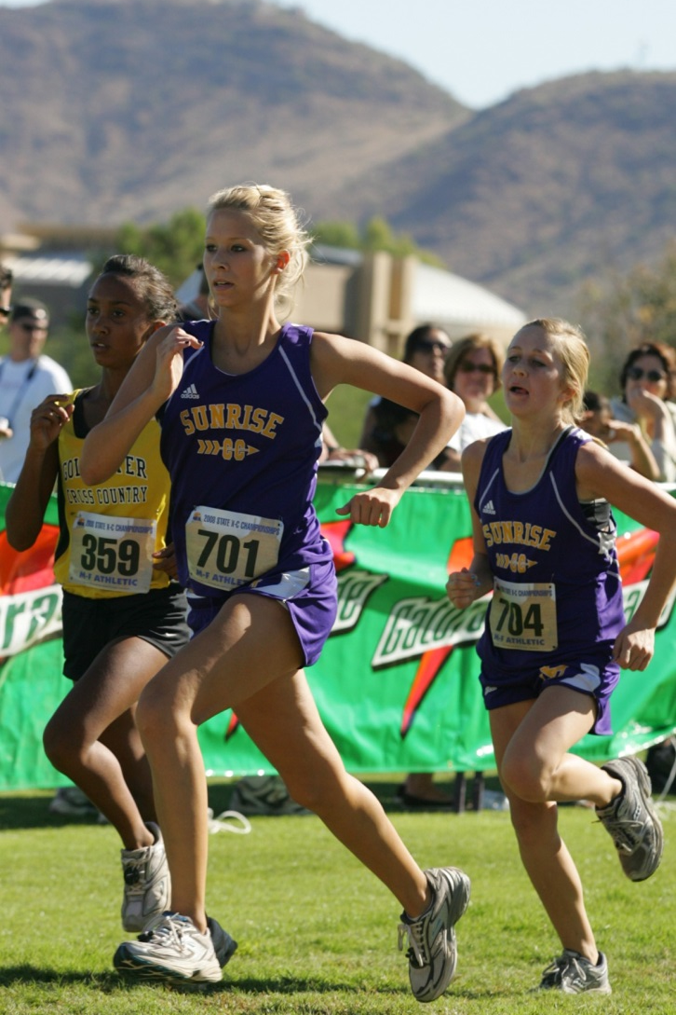
8-5-3 (NEW) teams
Section 5 was broken into articles for ease of use. ART. 3 was added new.
ART. 3. . . All members of a scoring team must follow all competitor and uniform rules. (4-3-1 thru 3)
Notes:
Rationale: Section 5 on XC Teams was broken into articles to increase ease of use of the rule.

Slide 22
9-6-1 (NEW) indoor relays
Offered clarification as to when to utilize the 30m exchange zone on an indoor track.
Relays with legs of 200 meters or less, each exchange zone in which the incoming competitor is running 200 meters or less in lanes will be 30 meters long on a 200 meter track. Tracks smaller than 200 meters may use a 20 meter exchange zone.
Notes:
SECTION 6 INDOOR RELAYS
ART. 1. . . Relays with legs of 200 meters or less, each exchange zone in which the incoming competitor is running 200 meters or less in lanes will be 30 meters long on a 200 meter track. Tracks smaller than 200 meters may use a 20 meter exchange zone.
Remaining sections re-numbered
Rationale: Offers guidance on the relay exchange zone for indoor track and field.

Slide 23
2024 nfhs Track and field and cross country editorial changes

Slide 24
4-2-1 participation and entry limitations
SECTION 2 PARTICIPATION AND ENTRY LIMITATIONS
ART. 1 . . . A competitor shall not compete in more than four events, including relays.
Contestant may officially participate in:
Four individual events | No relays allowed.
Three individual events | May be listed on any number of relays but compete in only one relay.
Two individual events | May be listed on any number of relays but compete in only two relays.
One individual event | May be listed on any number of relays but compete in only three relays.
Zero individual events | May be listed on four any number of relays but compete in only one relay.
Notes:
Rationale: To create consistency amongst all entries on the relay cards.

Slide 25
4-6-5 disqualification and conduct
Rewording of providing and receiving assistance.
ART. 5… It is an unfair act when a competitor receives any assistance. Assistance includes:
g. A downed competitor who receives assistance from another competitor, coach, official, or spectator to finish the race shall be disqualified. The individual providing the assistance shall not be disqualified for assisting a downed runner unless the assisting individual or their team gains an advantage.
Notes:
NOTE: Every attempt should be made for the appropriate health-care professionals to make these decisions as to assistance. A competitor who provides assistance to an injured, or ill competitor should not be disqualified if neither the individual competitor providing the assistance nor the competitor's team gains an advantage as a result of providing the assistance.

Slide 26
5-9-2 infractions for all races
Clarifies the 2022 rule change which allows the meet referee the option to create an additional preliminary heat for the offended competitor/team without automatically having to advance the competitor/team to the next round.
ART 2… If interference occurs in a preliminary heat, the referee may allow the offended competitor or relay team to start in a subsequent heat in the same round of heats if a lane is available. If a lane is not available, the meet referee may add a heat in that preliminary round or in the next round of heats, the same as if the offended competitor or relay team had won a place.
Notes:
Rationale: Clarifies that the 2022 rule change allows the meet referee the option to create an additional preliminary heat for the offended
competitor/team without automatically having to advance the competitor/team to the next round.

Slide 27
2024 nfhs Track and field and cross country Points of emphasis

Slide 28
Fair starts
It is the starter’s responsibility to ensure a fair and legal start.
The interval between the set command and the firing of the starting device should be approximately two seconds.
After giving the order “Set” if any competitor is in motion the starter shall not fire the device.
  Firing too soon doesn’t allow athletes to get ready and firing the device too slow create a situation of unfairness.
Notes:
It is the starter’s responsibility to ensure a fair and legal start and anticipate problems. The interval between the set command and the firing of the starting device should be approximately two seconds. After a starter gives the order “Set” if any competitor is in motion, the starter shall not fire the starting device. Firing the starting device too soon doesn’t allow athletes to get ready and firing the starting device too slow also creates a situation of unfairness.

Slide 29
Fair starts
Starters may for any reason cancel a start by directing competitors to “Stand Up”.
Examples a starter may cancel in races with legs of less than 800 meters.
Noise at the start line;
Starting block problem;
Obstruction on the track;
Slow athlete getting set;
Misfire of starting pistol;
Hands on the line; or
Extraneous movement after the set command.
Notes:
Starters may for any reason cancel a start by directing all competitors to “Stand Up”. The following are some of the reasons that a starter may cancel a start in races with legs of less than 800 meters:
Noise at the start line,
Starting block problem,
Obstruction on the track,
Slow athlete getting set,
Misfire of starting pistol,
Hands on the line,
Extraneous movement after the set command.

Slide 30
Fair starts
In Distance races the following are some of the reasons that a starter could halt or recall the start.
  Runners not steady;
  Toes on the line;
  Failure to come to the line in a timely manner;
  Impeding a position of another athlete; or
  Fall during first 100 meters due to contact.
Notes:
In Distance races the following are some of the reasons that a starter could halt or recall the start.
Runners not steady,
Toes on the line,
Failure to come to the line in a timely manner,
Impeding a position of another athlete,
Fall during first 100 meters due to contact.

Slide 31
Sportsmanship
Sportsmanship rules help officials, parents, coaches, and student-athletes develop and reinforce values that apply to the development of the whole person. Respect for others, honesty, fair play, learning, and understanding the rules are critical life skills that, when practiced, will enhance any individual’s character. The absence of good sportsmanship jeopardizes one of the fundamental principles of participation in education-based athletics and complicates the team-building process. A sportsmanship priority is keeping winning and losing in perspective. Understanding that losing with dignity is an important lesson, everyone must learn and practice. A collaborative, working relationship should be a priority between officials, game administration, coaches, and student-athletes to promote good sportsmanship during a track meet. This includes treating people with respect and using appropriate language, actions, and language that build people up and values each person.
It is critical to remember that winning means you were the best version of yourself that day. The beauty of track and field is that one constantly tests themself against one’s best time, height, or distance. Continual improvement is a hallmark of successful student-athletes, programs, teams, and coaches. This improvement also involves positive sporting behavior, a fundamental ingredient of education-based high school sports.
Notes:
Sportsmanship rules help officials, parents, coaches, and student-athletes develop and reinforce values that apply to the development of the whole person. Respect for others, honesty, fair play, learning, and understanding the rules are critical life skills that, when practiced, will enhance any individual’s character. The absence of good sportsmanship jeopardizes one of the fundamental principles of participation in education-based athletics and complicates the team-building process. A sportsmanship priority is keeping winning and losing in perspective. Understanding that losing with dignity is an important lesson, everyone must learn and practice. A collaborative, working relationship should be a priority between officials, game administration, coaches, and student-athletes to promote good sportsmanship during a track meet. This includes treating people with respect and using appropriate language, actions, and language that build people up and values each person.
It is critical to remember that winning means you were the best version of yourself that day. The beauty of track and field is that one constantly tests themself against one’s best time, height, or distance. Continual improvement is a hallmark of successful student-athletes, programs, teams, and coaches. This improvement also involves positive sporting behavior, a fundamental ingredient of education-based high school sports.

Slide 32
Cross country safety
Training for Cross Country is unique in that there are so many options afforded to the runner(s) to accomplish their workouts.
Not being limited to the track allows the runners access to parks, city streets, highways and country roads. However, each of these options creates safety concerns that all runners and coaches should keep in mind.
Workouts and runs should be fun, relaxing, carefree experiences. But an increase in pedestrian deaths in the United States, as well as eight reported running-related motor vehicle crashes resulting in nine deaths and two disabling injuries among middle school and high school cross country and track and field runners between 2011 and 2021 shows a continual need for point of emphasis.
Notes:
Training for Cross Country is unique in that there are so many options afforded to the runner(s) to accomplish their workouts. Not being limited to the track allows the runners access to parks, city streets, highways and country roads. However, each of these options creates safety concerns that all runners and coaches should keep in mind. Workouts and runs should be fun, relaxing, carefree experiences. Sadly, the need for runner safety tips is evidenced by a dramatic increase in pedestrian deaths in the United States, as well as eight reported running-related motor vehicle crashes resulting in nine deaths and two disabling injuries among middle school and high school cross country and track and field runners between 2011 and 2021.
It is critical that administrators, coaches and athletes promote and practice safety and risk minimization strategies as Cross Country runners share the road with vehicles and drivers that have become increasingly distracted on the roads. Some key safety measures that can be promoted by school coaches and others to their Cross Country runners include:
Using sidewalks when available or run facing traffic.
Stay alert and avoid wearing headphones and using electronic devices, including cell phones.
Crossing roads at crosswalks and intersections, when available. If not, cross at a well-lit location.
Avoid running when it is dark. If it is dark, wear bright, reflective materials and/or use a flashlight or head lamp.
Follow the rules of the road.
Avoid running along eastbound roads at sunrise or along westbound roads at sunset.
Provide a safety orientation for first-year runners
Run in pairs
Never run against traffic lights
Avoid running in higher traffic speed areas
Run during lower traffic times if running along a road
Avoid loitering along the road before and after runs
Coaches need to plan when developing a road route where stop lights, routes, and heavy traffic exist. Educating the athletes on where to go for safety in case of weather, emergency situations and hydration stops is crucial to athlete safety.

Slide 33
Cross country safety cont.
Everyone should promote and practice safety and risk minimization strategies as Cross Country runners share the road with vehicles and drivers that have become increasingly distracted on the roads.
Coaches need to plan when developing a road route where stop lights, routes, and heavy traffic exist. Educating the athletes on where to go for safety in case of weather, emergency situations and hydration stops is crucial to athlete safety.
Some key safety measures include:
Using sidewalks when available or run facing traffic.
Stay alert and avoid wearing headphones and using electronic devices, including cell phones.
Crossing roads at crosswalks and intersections, when available. If not, cross at a well-lit location.
Avoid running when it is dark. If it is dark, wear bright, reflective materials and/or use a flashlight or head lamp.
Notes:
It is critical that administrators, coaches and athletes promote and practice safety and risk minimization strategies as Cross Country runners share the road with vehicles and drivers that have become increasingly distracted on the roads. Some key safety measures that can be promoted by school coaches and others to their Cross Country runners include:
Using sidewalks when available or run facing traffic.
Stay alert and avoid wearing headphones and using electronic devices, including cell phones.
Crossing roads at crosswalks and intersections, when available. If not, cross at a well-lit location.
Avoid running when it is dark. If it is dark, wear bright, reflective materials and/or use a flashlight or head lamp.
Follow the rules of the road.
Avoid running along eastbound roads at sunrise or along westbound roads at sunset.
Provide a safety orientation for first-year runners
Run in pairs
Never run against traffic lights
Avoid running in higher traffic speed areas
Run during lower traffic times if running along a road
Avoid loitering along the road before and after runs
Coaches need to plan when developing a road route where stop lights, routes, and heavy traffic exist. Educating the athletes on where to go for safety in case of weather, emergency situations and hydration stops is crucial to athlete safety.

Slide 34
Cross country safety cont.
Some key safety measures continued
Follow the rules of the road.
Avoid running along eastbound roads at sunrise or along westbound roads at sunset.
Provide a safety orientation for first-year runners
Run in pairs
Never run against traffic lights
Avoid running in higher traffic speed areas
Run during lower traffic times if running along a road
Avoid loitering along the road before and after runs
Notes:
It is critical that administrators, coaches and athletes promote and practice safety and risk minimization strategies as Cross Country runners share the road with vehicles and drivers that have become increasingly distracted on the roads. Some key safety measures that can be promoted by school coaches and others to their Cross Country runners include:
Using sidewalks when available or run facing traffic.
Stay alert and avoid wearing headphones and using electronic devices, including cell phones.
Crossing roads at crosswalks and intersections, when available. If not, cross at a well-lit location.
Avoid running when it is dark. If it is dark, wear bright, reflective materials and/or use a flashlight or head lamp.
Follow the rules of the road.
Avoid running along eastbound roads at sunrise or along westbound roads at sunset.
Provide a safety orientation for first-year runners
Run in pairs
Never run against traffic lights
Avoid running in higher traffic speed areas
Run during lower traffic times if running along a road
Avoid loitering along the road before and after runs
Coaches need to plan when developing a road route where stop lights, routes, and heavy traffic exist. Educating the athletes on where to go for safety in case of weather, emergency situations and hydration stops is crucial to athlete safety.

Slide 35
NFHS OFFICIALS Education

Slide 36





OFFICIALS EDUCATION
Content remains free of charge
TEACHING
AIDS
RULES
CHANGES
DIAGRAMS
VIDEO
LIBRARY
OFFICIALS
COURSES
Notes:
Sport-Specific Officiating courses are offered in several sports. They are ideal for new officials and those in the first few years of officiating. These courses introduce officials to the mechanics and techniques used in the sport and provide specific information on an area within that sport. Individuals can complete a course within 30-45 minutes. These courses are free to all officials and prospective officials.
“Interscholastic Officiating” is a general course on sports officiating, and it is free to all officials and prospective officials. This course provides an introduction to skills and concepts used as an official. Several topics are covered such as: basics of becoming and staying an official, science of officiating, art of officiating, how to combine these skills for successful officiating.
Video clips are made available to NFHS Officials Association members. The video is clipped on specific topics and provides the rules references as well as dialogue on the topic.
The courses and videos are offered at www.NFHSLearn.com .
Courses Available:
Officiating Football
Officiating Volleyball – Ball Handling
Officiating Volleyball – Alignment
Officiating Volleyball – E-Whistle
Officiating Basketball
Officiating Basketball – Three-Person Mechanics
Officiating Basketball - Pre-Game Conference
Soccer – Fouls and Misconduct
Soccer – Offside
Soccer - Pre-Game Conference
Swimming and Diving
Officiating Wrestling
Umpiring Softball
Officiating Field Hockey
Officiating Track and Field
Future Courses to be Considered:
Umpiring Baseball
Umpiring Softball – 2 Person Mechanics
Communication Among Officials and Coaches

Slide 37



Future Developments:
Auto Assign
Mobil Assign
Customized Game and Travel Fees
Mass Update Capabilities
Integrated Playoff Financial Reporting
Improvements:
Invoicing
Updated Financial Reporting
Playoff and Tournament Bracketing
Eligibility Tracking Notifications
NFHS Learn Integration
Coming Fall 2023:
NFHS Exam Center
New Team App
New Form Builder
Year Two Accomplishments
16
194,810
$29M
States
Registering
Officials
Contests
Assigned
Payments
Sent to
Officials
100% FREE to your state as a NFHS-Member Benefit.
Notes:
NFHS CENTER FOR OFFICIALS SERVICES (COS)
Your Complete Solution for Officials Management and More:
Registration
Assignment
Payment
Testing
Background Checks
For More Information on the NFHS – Center for Officials Services (COS) Contact:
Dana Pappas, Director of Officiating Services, dpappas@nfhs.org
Also If You’re Interested in Eligibility and Monitoring Requirements Contact
the Folks at Dragonfly:
Kirk Miller, Dragonfly, kirk@dragonflyathletics.com
Brandon Wallace, Dragonfly, brandon@dragonflyathletics.com

Slide 38
NFHS Learning Center

Slide 39

Notes:
The NFHS Learning Center is the home to more than 90 online professional development courses for everyone within the interscholastic community - coaches, students, officials, parents, administrators, and individuals within performing arts programs. More than 60 courses are available for free.
The NFHS is an Accredited Institution and has delivered more than 15 million courses on its NFHS Learning Center platform since its inception in 2007. In receiving national accreditation by Cognia, the NFHS has upheld itself to rigorous standards that focus on productive learning environments, equitable resource allocation that meet the needs of learners, and effective leadership.
The NFHS Learning Center features its flagship coaching course, “Fundamentals of Coaching,” as well as several health and safety courses that have been completed by millions of individuals, such as “Concussion in Sports,” “Heat Illness Prevention,” “Sudden Cardiac Arrest” and “Protecting Students from Abuse.” The NFHS Learning Center offers several national credentials that can be earned by individuals who complete specific NFHS courses. Through the School Honor Roll Program, schools can earn a physical banner to hang in their school.
To learn more and start your professional development journey, please visit the NFHS Learning Center at NFHSLearn.com.

Slide 40
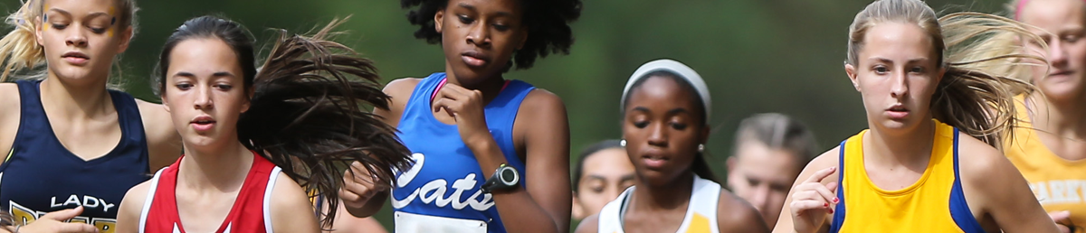


Coaching Cross Country
Course Objectives
Units
Explain the cycles of the season and how to develop training plans based on them
Illustrate drills using video of student-athletes
Identify common Cross Country injuries and ways to prevent them
Introduce the concepts of Team Dynamics and explain how they affect a team’s performance and experience
Provide an overview of goal-setting and mental toughness
- Training Plan
- Goal Setting and Mental Toughness
- Team Dynamics
- Tapering Principles
- Common Injuries and Prevention
- Ancillary Training Activities
- Training Environments
COST $35
Available at nfhslearn.com!
Notes:
[REVISED 9-2-2020]
More:
Unlimited access to course & resources for one year from date of purchase

Slide 41
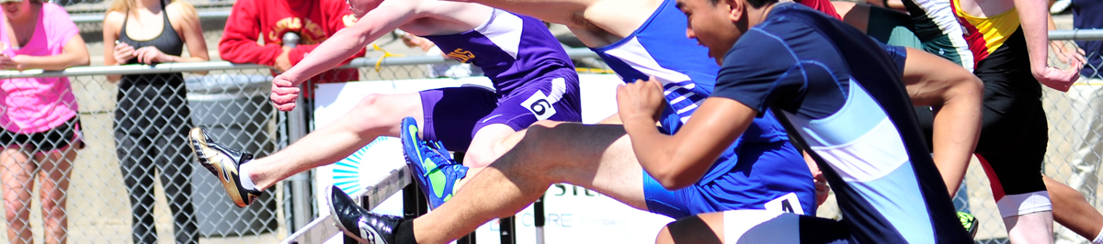
Coaching Track and Field
Course Objectives
Units
Display fundamentals of running, jumping and throwing
Highlight the importance of sound mechanics in teaching basic skills
Identify key points of a skill
Utilize video demonstrations to teach verbal cutes to use when coaching athletes
Running
Jumping
Throwing
$75|$10 discount with USA Track and Field Membership
Available at nfhslearn.com!
Notes:
[REVISED 9-2-2020]
More:
Unlimited access to course & resources for one year from date of purchase

Slide 42
NFHS Network

Slide 43


NFHS Network
By 2025, every high school sporting event in America will be streamed live.
The NFHS Network will be
THE DESTINATION for fans
to view these broadcasts.
27 Different Sports and Activities
www.NFHSnetwork.com
Notes:
The NFHS Network is the leader in streaming Live and On Demand high school sports.
Partnered with the National Federation of State High School Associations, 45 high school state athletic/activities associations, and PlayOn! Sports, the NFHS Network is a joint venture created to provide fans with the ability to stream high school sports on any device, from wherever they are.
All NFHS Network events are available to watch online at www.NFHSnetwork.com and through the NFHS Network Live App for iOS and Android. Follow us on Facebook, Twitter, Instagram, and YouTube.
Watching high school sports and events has never been easier.
The NFHS Network’s goal to broadcast live all 2 million high school sporting events by 2025.
The NFHS Network covers 27 different regular season and postseason sports, as well as other high school activities, celebrating the accomplishments of students-athletes, student broadcasters, and high schools across the country.

Slide 44


Over 1 million events this year…
Notes:
The NFHS Network will broadcast over 150,000 live events this year. If your school is not a member of the NFHS Network School Broadcast Program, please contact us at Mark.Koski@NFHSnetwork.com

Slide 45

Thank You
National Federation of State High School Associations
PO Box 690 | Indianapolis, IN 46206
Phone: 317-972-6900 | Fax: 317.822.5700
www.nfhs.org | www.nfhslearn.com | www.nfhsnetwork.com

