Slide 1
2023-24 NFHS Swimming and diving Rules PowerPoint
Rules Changes
Major Editorial Changes
Points of Emphasis

Slide 2
National federation of state high school associations (NFHS)

Slide 3

National Federation of
State High School Associations
NFHS (located in Indianapolis, IN – Est. 1920):
  National leader and advocate for
  high school athletics and
  performing arts programs.
  Serves 51 state associations, 19,500
  high schools and 12 million student
  participants.
  Writes playing rules for 17 high school
  sports for boys and girls.
  Offers online education courses for high school coaches,
  officials, parents, students and others.
  Ensures that students have opportunity to enjoy healthy participation, achievement and good sportsmanship in education-based athletics.
Notes:
The NFHS is the national leader and advocate for high school athletics and performing arts programs. Services of the NFHS reach more than 19,500 high schools and 12 million participants throughout the eight NFHS sections across the U.S.
A significant responsibility of the NFHS is the commitment to writing quality playing rules for 17 high school sports for boys and girls, in addition to providing educational resources for high school coaches, officials, parents and students.
It is the vision of the NFHS to help prepare tomorrow’s leaders for the next level of life through the many program offerings in education-based athletics and activities.

Slide 4








NFHS Rules Review Committee
The NFHS Rules Review Committee is chaired by the chief operating officer and composed of all rules editors. After each committee concludes its deliberations and has adopted its recommended changes for the subsequent year, such revisions will be evaluated by the Rules Review Committee.
Davis Whitfield
Chief Operating Officer
Lindsey Atkinson
Basketball, Girls Lacrosse and Volleyball
Bob Colgate
Football and Sports
Medicine
Sandy Searcy
Softball, Swimming & Diving and Water Polo
Elliot Hopkins
Baseball and Wrestling
Julie Cochran
Cross Country, Gymnastics, Field Hockey, Soccer and
Track & Field
James Weaver
Boys Lacrosse
and Spirit
Dan Schuster
Ice Hockey
Notes:
All rules committee recommended rules changes are vetted through the NFHS Rules Review Committee before advancing to the NFHS Board of Directors for final action. The committee, as you see, is comprised of all NFHS Director of Sports and chaired by the NFHS Chief Operating Officer.

Slide 5





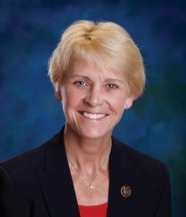


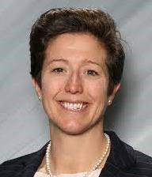
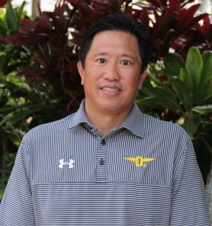

NFHS Rules Committee
Dr. Karissa Niehoff
NFHS
Publisher
Sandy Searcy
NFHS
Editor
Rod Garman
Topeka, KS
Chair - 2026
Bob Ouellette
Manchester, NH
Section 1 - 2023
Chris Bley
Joppa, MD
Section 2 - 2026
Danielle Hogle
Gainesville, FL
Section 3 - 2025
Jason Eslinger
West Des Moines, IA
Section 4 - 2024
Samarah Hadley
Orono, MN
Section 5 - 2026
Monica Abelein
Lakewood, CO
Section 6 - 2023
Erin Coy
Gilbert, AZ
Section 7 - 2024
K.T. Emerson
Wilsonville, OR
Section 8 - 2025
Kenny Chew
Honolulu, HI
Coaches - 2025
Joe Plack
Deerfield, IL
Officials - 2024
Notes:
Photos of the 2023 NFHS Swimming and Diving Rules Committee members include the representation of eight sections, the NFHS Officials Association, the NFHS Coaches Association, and Rules Committee Chair.

Slide 6


















National Federation of
State High School Associations
The NFHS writes playing rules for 17 sports
for boys and girls at the high school level.
  Publishes 4 million pieces of materials annually.
Notes:
The NFHS writes playing rules for 17 sports, publishes High School Today (HST) along with several other key publications totaling over four million pieces annually.

Slide 7

NEW NFHS AllAccess – Website
AllAccess is the New NFHS Digital Publications Platform that includes:
  Rules Publications
  High School Today Magazine
  Policy Debate Quarterlies
  Other NFHS Digital Publications
Website organized for associations and individuals to assign books and manage purchases
Visit www.allaccess.nfhs.org
Notes:
AllAccess is the New NFHS Digital Publications Platform that includes:
Rules Publications
High School Today Magazine
Policy Debate Quarterlies
Other NFHS Digital Publications
Website organized for associations and individuals to assign books and manage purchases
Visit www.allaccess.nfhs.org

Slide 8



NEW NFHS AllAccess – Mobile App
Access Via Website or Mobile App:
View available publications for sale
View publications assigned to you
Download books for offline viewing
Read publications as an e-book
  Book features include:
    Table of contents
    Highlighting text
    Creating ‘sticky notes’ on pages
    Searching for terms
    Mark-up pen feature
    Viewing highlights and notes on data page
Available on App Store and Google Play
Notes:
Access Via Website or Mobile App:
View available publications for sale
View publications assigned to you
Download books for offline viewing
Read publications as an e-book
Book features include:
Table of contents
Highlighting text
Creating ‘sticky notes’ on pages
Searching for terms
Mark-up pen feature
Viewing highlights and notes on data page
Available on App Store and Google Play

Slide 9
2023-24 nfhs swimming and diving RULES CHANGES

Slide 10
Uniforms
Section 3 Note
Moved NOTE addressing accommodations to the beginning of
Rule 3-3 Uniforms;
Added language specifying suit constructions rules which cannot be waived:
suit must be constructed of a woven/knit textile material,
suit must be permeable 100% to air and water,
suit must not aid speed, buoyancy or body compression.
Notes:
Rule 3-3 NOTE:
Moved NOTE addressing accommodations to the beginning of Rule 3-3 Uniforms;
Added language specifying suit constructions rules which cannot be waived:
suit must be constructed of a woven/knit textile material,
suit must be permeable 100% to air and water,
suit must not aid speed, buoyancy or body compression.
Rationale: Moving the NOTE to the beginning of Rule 3-3 will make it clear that the NOTE applies to all articles in this section. The need for accommodation does not solely apply to Article 6. There are situations where Article 2 may be necessarily waived due to conflicts with the participant and state law, and state associations should be permitted to permit an accommodation provided there is no competitive advantage gained.
Comments: Moving the note to the beginning of the section will make it clear this provision applies to all articles in Section 3. Requests to state associations for waivers of Rule 3-3 are driven by a wide range of motivations, including the need for additional physical support and desire for additional body coverage. Some suit design parameters can be waived while others cannot be altered without creating a competitive advantage for the athlete.

Slide 11
Guidelines for Schools and state associations for consideration of accommodations
Request of Accommodation by School
State Association Review
Written Determination from State Association
Competition with Approval of Accommodation
Notes:
To assist state associations in working with schools for the inclusion of students with disabilities the following guide prepared by the NFHS Task Force on the Inclusion of Students with Disabilities is being provided for your review.
Following these guidelines will assist in the individual student assessment by the student and the school.
When requesting a possible accommodation, coaches should work with their school and the state association as early as possible in the sport season.
Contest officials shall defer decisions on rule accommodations to the respective state association.
This information serves as a guide. Each state association may develop its own process.

Slide 12
Accommodations appendix B
Modifications for the blind and visually impaired may include:
  Starts
  Turns and finishes
  Relay takeoffs
  Modifications for the deaf and hard-of-hearing may include:
  Starts
  Strobe light location
  Reseeding
Notes:
Accommodations - Appendix B
A student with a physical or cognitive disability requesting a specific accommodation(s) in the start, strokes, turns, etc. who does not require equipment, must seek approval from the state high school athletic/activities association, which may be authorized, providing the accommodation(s) does not fundamentally alter the sport and/or no advantage is gained. Written authorization from the state association should include what accommodations the referee should make for the swimmer.
Modifications for the blind and visually impaired may include:
Starts – With an audible starting system, no modification is usually required for a blind or visually impaired swimmer. A swimmer may, however, require assistance getting to and on the block, or into the water if an in-water start is used.
Turns and finishes – A blind or visually impaired swimmer may be permitted to have a personal assistant (tappers who use poles with soft-tipped ends to tap the swimmer as notification of turns and the finish). Sounding devices shall not be used as the devices may cause confusion for other swimmers. It is the swimmer’s responsibility to provide the tapper(s), who shall be positioned within the confines of the swimmer’s lane at the ends of the pool.
Relay takeoffs – A physical touch may be required to signal the relay swimmer when the teammate has touched the wall. The specific method may be tailored to the swimmer’s preference so long as it does not aid the swimmer’s takeoff or interfere with the timing system.
Modifications for the deaf and hard-of-hearing may include:
Starts – Deaf and hard-of-hearing swimmers require a visual starting signal, i.e., a strobe light and/or starter’s arm signals. The modification may include the referee reassigning lanes within the swimmer’s heat, i.e., exchanging one lane for another, so that the strobe light or starter’s arm signal can more clearly be seen by the deaf or hard-of- hearing swimmer. Standard starter’s arm signals are shown in Figures 1 and 2. A false start rope may be required in the event of a recall.
Strobe light location – The referee, or a designee, shall advise the swimmer and the coach as to the location of the strobe light and the light should be located where the swimmers can clearly see it for the start. For backstroke starts, the light should be positioned so that the swimmers don’t have to turn their heads to look backward.
Reseeding is permitted.

Slide 13

Accommodations
Modifications that do not require state association approval:
  Wearing of full body coverage for religious reasons:
The suit must meet the requirements of
Rule 3-3-4b(1-3);
Questions about a specific suit must be addressed by
the state association after the meet.
Notes:
Modifications that do not require state association approval:
Wearing of full body coverage for religious reasons:
The suit must meet the requirements of Rule 3-3-4b(1-3);
Questions about a specific suit must be addressed by the state association after the meet.
Rationale: Eliminates the need for state association authorization of suits providing full body coverage. Added language allows for freedom of religion without creating a competitive advantage for the athlete. Suits worn for religious reasons must adhere to all provisions of Rule 3-3-4b, with one exception: the suit may include a fastening system.

Slide 14
Accommodations
Modifications that do require state association approval:
  Wearing of additional attire (beyond the single suit) for purposes of bodily support or modesty, not religious in nature;
  Use of devices to assist a disabled swimmer (e.g., tap pole for notifying blind swimmer of approach to a turn);
  Use of artificial devices to replace a missing limb or extremity;
  Use of tape of any kind is permitted only for medical necessities and requires letter from certified medical professional. (3-3-5d)
Notes:
Accommodations requiring State Association approval: this should be done in writing and presented to the meet referee prior to the start of competition, but retained by the coach for future meets –
Wearing of additional attire (beyond the single suit) for purposes of bodily support or modesty, not religious in nature;
Use of devices to assist a disabled swimmer (e.g., tap pole for notifying blind swimmer of approach to a turn);
Use of artificial devices to replace a missing limb or extremity;
Use of tape of any kind is permitted only for medical necessities and requires letter from certified medical professional. (3-3-5d)

Slide 15
Uniforms
3-3-2
Removed language specifying a competitor must compete in a
suit that is of decent appearance;
Eliminates the subjectivity of “decent appearance” for an
official when making an illegal suit determination;
Officials are responsible for adjudicating:
waist to knee coverage or shoulder to knee coverage
  single suit
  coverage
Notes:
Rule 3-3-2:
Removed language specifying a competitor must compete in a suit that is of decent appearance;
Eliminates the subjectivity of “decent appearance” for an official when making an illegal suit determination
Officials are responsible for adjudicating:
waist to knee coverage or shoulder to knee coverage
single suit
coverage
Rationale: Eliminates the subjectivity of “decent appearance” for an official when making an illegal suit determination. Removing the sentence in the rule specifying that a competitor shall only be able to compete in a suit that is of decent appearance requires an official to make a subjective judgement on the decency of a suit.
Comments: The concept of “decent appearance” is highly subjective. Removing the sentence in the rule, which specifies that a competitor shall only be able to compete in a suit that is of decent appearance, eliminates the subjectivity of “decent appearance” for an official when making an illegal suit determination. Officials are reminded to notify the coach, not the athlete, of any concerns about suit coverage.

Slide 16
Starts & finishes
8-1-3d, PENALTY 2, 8-1-6 PENALTY
Requires a written record for dual confirmation of a false start;
Aligns with requirement of a written record for dual confirmation of a relay takeoff during a championship meet;
Provides an additional level of accountability.
Notes:
Rule 8-1-3d PENALTY 2, 8-1-6 PENALTY:
Requires a written record for dual confirmation of a false start;
Aligns with requirement of a written record for dual confirmation of a relay takeoff during a championship meet;
Provides an additional level of accountability..
Rationale: The change aligns language with the current requirement that when dual confirmation is used in championship meets, the relay takeoff judges are required to report in writing any violations to the referee.
Comments: The requirement of a written record for dual confirmation of a false start is consistent with the already existing requirement for relay takeoff violations. The change provides an additional level of accountability. Adopting this new requirement will closely align it with the current requirement that, when dual confirmation is used, the officials are required to report in writing any violations to the referee. The requirement of a written record for dual confirmation of a false start is consistent with the already-existing requirement for relay takeoff violations (Rule 4-6-3c).

Slide 17
Form of individual events
8-2-1g BACKSTROKE
Removes language requiring some part of the body be at or
above the surface during the backstroke finish;
Once some part of the swimmer’s head has passed the final 5-yard/5-meter mark immediately prior to reaching for the backstroke finish, the swimmer may now be completely submerged and continue propulsive movements until touching the wall.
Notes:
Rule 8-2-1g:
Removes language requiring some part of the body be at or above the surface during the backstroke finish;
Once some part of the swimmer’s head has passed the final 5-yard/5-meter mark immediately prior to reaching for the backstroke finish, the swimmer may now be completely submerged and continue propulsive movements until touching the wall.
Rationale: The change aligns with national trends, allows the official to concentrate on the backstroke finish (wall touch), and may prevent lunging at the wall which reduces risk.
Comments: Removing the language about some part of the body at or above the surface may prevent lunging immediately prior to the finish, which reduces risk. The change aligns with national trends and allows the official to concentrate on the backstroke finish. The backstroke flags are positioned at the 5-yard mark in 25-yard pools and at the 5-meter mark in 25-meter facilities and shall be used as the point where the swimmer may resubmerge once their head is at or beyond this mark.

Slide 18
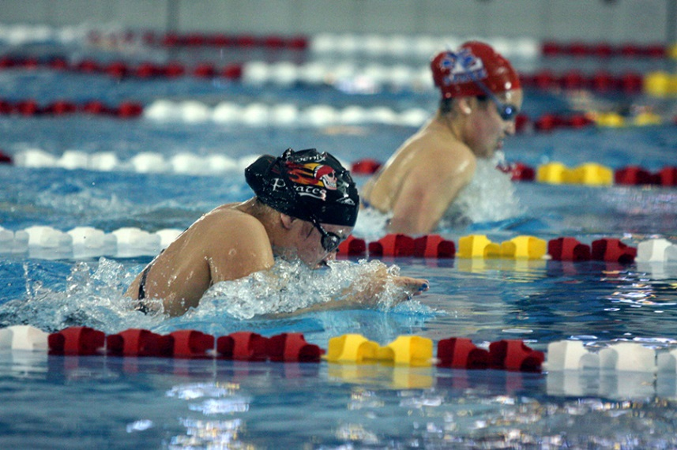
Form of individual events
8-2-2d BREASTSTROKE
Removed language prohibiting sculling after the initial pull-out following the start or turn;
There is no competitive advantage;
Difficult to observe.
Notes:
Former Rule 8-2-2d:
Removed language prohibiting sculling after the initial pull-out following the start or turn;
There is no competitive advantage
Difficult to observe
Rationale: Change provides clarity, consistency, and alignment with national trends and do not provide a competitive advantage. Sculling does not provide a competitive advantage. The benefits of hand moment at the end of the initial pull-down are minimal, and likely non-existent. It is extremely difficult to detect as well. The remaining breaststroke rules have been re-lettered.

Slide 19
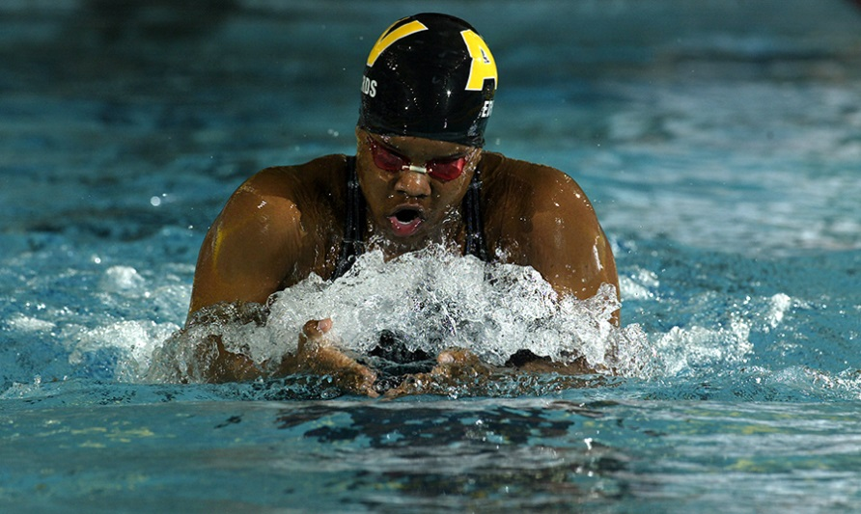
Form of individual events
8-2-2d BREASTSTROKE PULLOUT
The requirement of arms moving in the same horizontal plane was eliminated;
Will permit swimmer to begin pullout without being perfectly level on the breast;
Difficult to observe by officials.
Notes:
Rule 8-2-2d:
The requirement of arms moving in the same horizontal plane was eliminated;
Will permit swimmer to begin pullout without being perfectly level on the breast;
Difficult to observe by officials.
Rationale: World Aquatics has removed this requirement from international standards of swimming competition as well as USA Swimming. High school swimming should not hold swimmers to a more difficult standard. The specific effect of this change will now permit the swimmer to begin his/her pullout without being perfectly level on the breast, which has always been a very difficult thing to observe. It is difficult to discern any competitive advantage in permitting an earlier pull-out; this change will likely create minimal advantage, if any at all.
Comments: Changes provide clarity, consistency and alignment with national trends and do not provide a competitive advantage. The rule now requires the arms and legs to move simultaneously but does not require the arms and legs to be in the same horizontal plane. The specific effect of this change will now permit swimmers to begin their pullout without being perfectly level on the breast.

Slide 20
Form of individual events
8-2-2e BREASTSTROKE KICK
The legs no longer need to be in the same horizontal plane during the kick.
Language addressing flexion and extension of the knee during the kick was removed.
While vertical movement created by knee flexion/extension will still be prohibited, so are all other vertical movements regardless of their origin.
Notes:
Rule 8-2-2e:
The legs no longer need to be in the same horizontal plane during the kick.
Language addressing flexion and extension of the knee during the kick was removed.
While vertical movement created by knee flexion/extension will still be prohibited, so are all other vertical movements regardless of their origin.
Rationale: Removal of the phrase addressing knee flexion and extension during the kick creates more clarity for officials.
Comments: Vertical movement created by knee flexion/extension would still be prohibited. Officials are not limited to penalize only knee flexion/extension, but vertical movement regardless of the source is prohibited. Officials will need to carefully differentiate between prohibited vertical movements and natural body undulation.

Slide 21
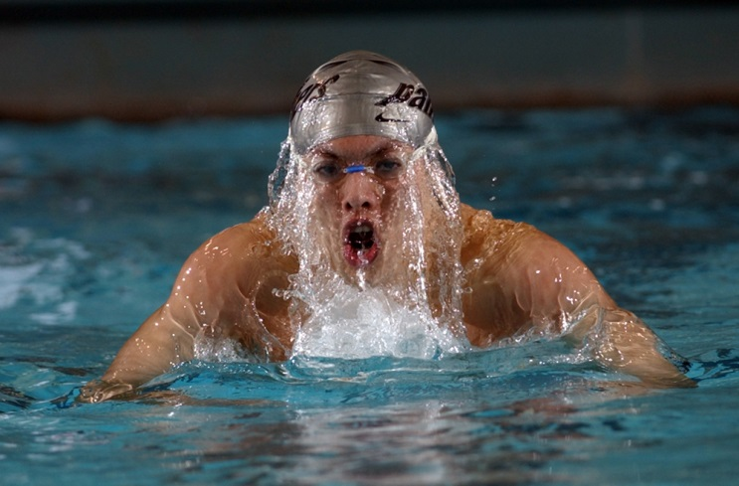
Form of individual events
8-2-2f,g BREASTSTROKE TURN AND FINISH
The turn requires a simultaneous touch with separated hands not necessarily on the same plane at, above, or below the water surface.
The finish requires a simultaneous touch with separated hands not necessarily on the same plane at, above, or below the water surface.
Notes:
Rule 8-2-2f, g:
The turn requires a simultaneous touch with separated hands not necessarily on the same plane at, above, or below the water surface.
The finish requires a simultaneous touch with separated hands not necessarily on the same plane at, above, or below the water surface.
Rationale: NFHS Breaststroke rules now requires separation of the hands during the touch at turns and finishes.
Comments: Changes provide clarity, consistency and alignment with national trends and do not provide a competitive advantage. Separation of the hands during the touch at turns and finish is now required. This revision maintains the appropriate consistency for touches/finishes with the butterfly rules.

Slide 22
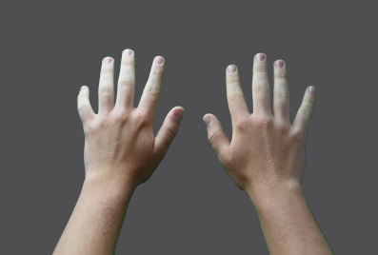



Form of individual events
8-2-2f,g BREASTSTROKE TURN AND FINISH
Separated Hands – Separated means that hands cannot be stacked one on top of the other. It is not necessary to see space between the hands. Incidental contact at the fingers is not a concern.
Legal
Not Legal
Notes:
Separated Hands – Separated means that hands cannot be stacked one on top of the other. It is not necessary to see space between the hands. Incidental contact at the fingers is not a concern.

Slide 23
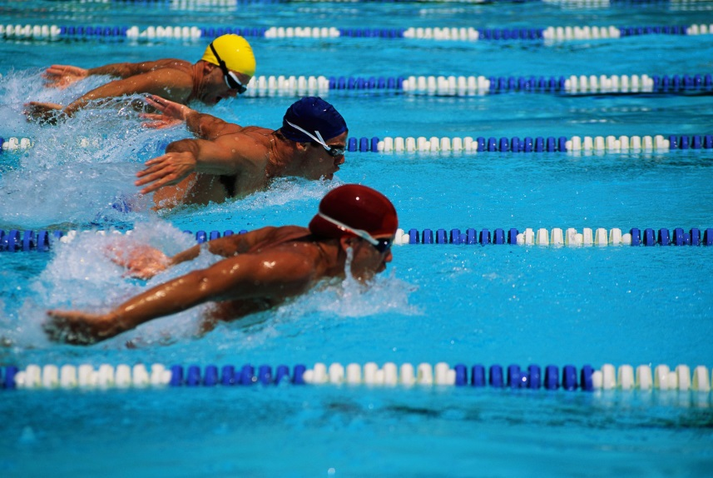
Form of individual events
8-2-3c BUTTERFLY
The requirement of arms moving in the same horizontal plane was eliminated;
Will permit swimmer to begin the stroke without being perfectly level on the breast;
Difficult to observe.
Notes:
Rule 8-2-3c:
The requirement of arms moving in the same horizontal plane was eliminated;
Will permit swimmer to begin the stroke without being perfectly level on the breast;
Difficult to observe.
Rationale: Changes provide clarity, consistency, and alignment with national trends and do not provide a competitive advantage. The specific effect of this change will now permit the swimmer to begin his/her pullout without being perfectly level on the breast, which has always been a very difficult thing to observe. It is difficult to discern any competitive advantage in permitting an earlier pull-out; this change will likely create minimal advantage, if any at all.
Comments: Changes provide clarity, consistency and alignment with national trends and do not provide a competitive advantage. This revision maintains the appropriate consistency for touches/finishes with the breaststroke.

Slide 24
Form of individual events
8-2-3e, g BUTTERFLY TURN AND FINISH
The turn requires a simultaneous touch with separated hands not necessarily on the same plane at, above, or below the water surface.
The finish requires a simultaneous touch with separated hands not necessarily on the same plane at, above, or below the water surface.
Notes:
Rule 8-2-3e, g:
The turn requires a simultaneous touch with separated hands not necessarily on the same plane at, above, or below the water surface.
The finish requires a simultaneous touch with separated hands not necessarily on the same plane at, above, or below the water surface.
Rationale: NFHS Butterfly rules now requires separation of the hands during the touch at turns and finishes.
Comments: Changes provide clarity, consistency and alignment with national trends and do not provide a competitive advantage. Separation of the hands during the touch at turns and finish is now required. This revision maintains the appropriate consistency for touches/finishes with the breaststroke.

Slide 25
choice of dives
9-5 diving table
The following dives were eliminated from the NFHS Diving Table:
104A Forward 2ss (straight);
304A Reverse 2ss (straight);
402A Inward 1ss (straight);
Removal of these dives is a risk minimization measure.
Notes:
Rule 9-5 Diving Table:
The following dives were eliminated from the NFHS Diving Table:
104A Forward 2ss (straight)
304A Reverse 2ss (straight)
402A Inward 1ss (straight)
Removal of these dives is a risk minimization measure
Rationale: When each dive is performed slightly short of vertical, the diver’s head may be precariously close to the diving board. The risk of hitting the board in these cases is far greater than other dives on the table.
Comments: Risk minimization for the athlete is emphasized with the removal of these three dives in the straight position. When each dive is performed slightly short of vertical, the diver’s head may be precariously close to the diving board. The risk of hitting the board in these cases is far greater than any other dive on the chart. Simply stated, the risk of doing these dives outweighs the benefits of doing them. For these dives the risk of hitting the board is far greater than any other dive on the chart. The 204A has already been removed for the same reason. Specifically, when a 104A is slightly short of vertical it places the diver’s head precariously close to the diving board. Additionally, a slightly off balance 304A causes a diver to pull back into the board far more than any other dive in the reverse category, and a 402A done a little too close creates a much higher risk of hitting the board than any other dive in the Inward category. These dives in the tuck and/or pike positions are still permitted.

Slide 26
Awarding points
9-7-4c (NEW)
A dive is unsatisfactory if, in the referee's opinion the diver’s
head is unsafely close to the diving board during the dive;
The diving referee shall be seated in direct line with the end of
the diving board;
The determination is made as the diver’s head passes through
the plane of the diving board.
Notes:
Rule 9-7-4c:
A dive is unsatisfactory if, in the referee's opinion the diver’s head is unsafely close to the diving board during the dive;
The diving referee shall be seated in direct line with the end of the diving board;
The determination is made as the diver’s head passes through the plane of the diving board.
Rationale: Minimizes the risk factor of the diver performing the dive in a way that brings the diver’s head too close to the board. A dive that is performed with the diver’s head unsafely close to the board is (at least) equally important as a diver touching the board with their hands or feet. This change is consistent with rules written for other rules codes.
Comments: Addition of this element provides the diving referee with a sanction that is imposed to encourage diver safety and minimize the risk factor of the diver performing the dive in a way that brings the diver’s head too close to the board (within 6 inches). A dive that is performed with the diver’s head unsafely close to the board is at least equally important as a diver touching the board with their hands or feet. In keeping with national trends, NFHS rules focus on preventing the diver’s head from coming too close to the board. The diving referee will be responsible for making the call and will instruct judges to score a maximum of two points. The diving referee shall be seated in line with the end of the board to have an accurate line of site for judging this new requirement.

Slide 27
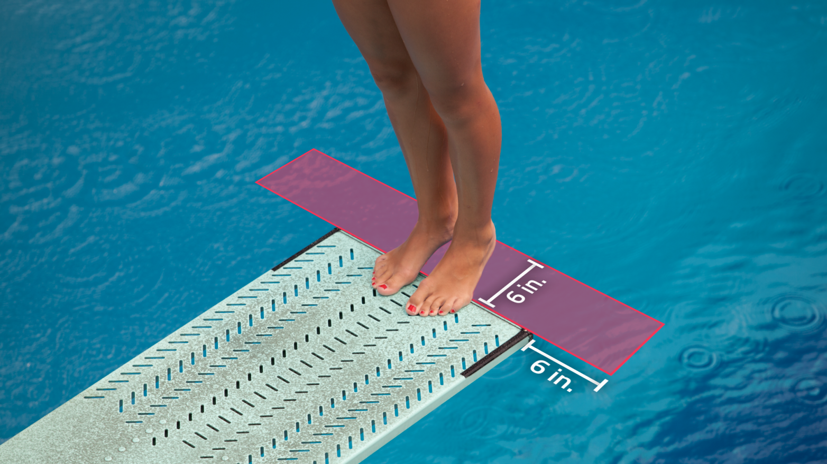
Awarding points
9-7-4c
Notes:
Rule 9-7-4c:
Rationale: The diving referee shall be the judge of whether the diver’s head is within six inches of the end or the sides of the diving board. The determination is made as the diver’s head passes through the plane of the diving board. If the diver’s head is within the six-inch zone, the diving referee will instruct judges to score a maximum of two points. The diving referee shall be seated in line with the end of the board to have an accurate line of sight for judging this new requirement. The addition of this element provides the diving referee with a sanction that is imposed to encourage diver safety and minimize the risk factor of the diver performing the dive in a way that brings the diver’s head too close to the board.

Slide 28
2023-24 nfhs swimming and diving major editorial CHANGES

Slide 29
Pool markings
2-4-2, Table 2-1
Pool Markings Before January 1, 2023 After January 1, 2023
Width of line on pool bottom | 10 to 12 inches (25 to 30.48 cm.) | 8 to 12 inches (.20 to .30 cm.)
Length of cross line | 36 inches (.9144 m.) | 3 feet 4 inches (1.0 m.)
Line terminates from end wall Length of end wall targets below water | 60 to 80 inches (1.5 to 2.0 m.) 3 feet 6 inches (1.0668 m.) | 6 feet 7 inches (2.0 m.) Minimum of 3 feet 4 inches (1.0 m.) below water
Notes:
Rule 2-4-2, Table 2-1
Pool Markings Before January 1, 2023 After January 1, 2023
Width of line on 10 to 12 inches (25 to 30.48 cm.) 8 to 12 inches (.20 to .30 cm.)
pool bottom
Length of cross line 36 inches (.9144 m.) 3 feet 4 inches (1.0 m.)
Line terminates from 60 to 80 inches (1.5 to 2.0 m.) 6 feet 7 inches (2.0 m.)
end wall
Length of end wall 3 feet 6 inches (1.0668 m.) Minimum of 3 feet 4 inches (1.0 m.)
targets below water below water
Rationale: Updated language to clarify changes to pool markings instituted in the previous year. A reminder: this applies to new construction after January 1, 2023. Any refurbishment that involves removal or refreshing of the existing pool markings requires that the new dimensions be employed when the pool is re-marked. These dimensions are now common to all swimming rule codes.

Slide 30
seeding
5-2-1, 5-2-2
ART. 1 . . . In preliminary heats, or finals which have no preliminaries, the time to be considered for purposes of seeding shall be the best competitive time for each swimmer as listed on the entry card and submitted to the meet committee (championship meets) or referee (other meets).
ART. 2 . . . In races which require qualifying, the time to be considered for the purposes of seeding shall be the best time made during qualifying races.
Notes:
Rule 5-2-1, 5-2-2
ART. 1 . . . In preliminary heats, or finals which have no preliminaries, the time to be considered for purposes of seeding shall be the best competitive time for each swimmer as listed on the entry card and submitted to the meet committee (championship meets) or referee (other meets).
ART. 2 . . . In races which require qualifying, the time to be considered for the purposes of seeding shall be the best time made during qualifying races.
Rationale: These changes are clarifying edits only.

Slide 31
Lane and heat assignments
5-3-6
ART. 6 . . . In preliminary races, the final three heats shall consist of the fastest seeded competitors with the fastest in the last heat, the second fastest in the next to last heat, the third fastest in the second to last heat, the fourth fastest in the last heat, and so on. If more than three heats are needed, the assignment in additional
heats is determined as in timed final events. For example, the following plan shall operate when there are 32 swimmers in six lanes for preliminaries.
Notes:
ART. 6 . . . In preliminary races, the final three heats shall consist of the fastest seeded competitors with the fastest in the last heat, the second fastest in the next to last heat, the third fastest in the second to last heat, the fourth fastest in the last heat, and so on. If more than three heats are needed, the assignment in additional heats is determined as in timed final events. For example, the following plan shall operate when there are 32 swimmers in six lanes for preliminaries.
Rationale: These changes are clarifying edits only.

Slide 32
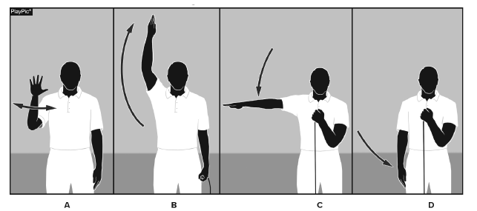
Appendix B
FIGURE 1 – FORWARD START
A. Twist hand at chin level – short whistles;
B. Arm overhead – long whistle – swimmer steps onto starting block;
C. Arm moves to shoulder level – signal to “take your mark”;
D. Arm moves to side of body – starting signal;
Notes:
Rationale: The words “long whistle” was omitted from the rules book in the previous year.

Slide 33
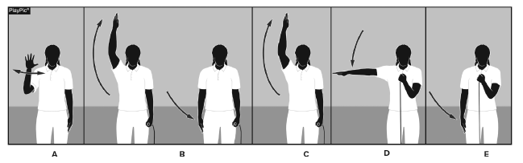
Appendix B
FIGURE 2 – BACKSTROKE START
A. Twist hand at chin level – short whistles;
B. Arm overhead – long whistle – swimmer enters water; drop arm to
side while swimmer enters water;
C. Arm overhead – swimmer returns to backstroke start position;
D. Arm moves to shoulder level – signal to “take your mark;”
E. Arm moves to side of body – starting signal.
Notes:
Rationale: The words “long whistle” was omitted from the rules book in the previous year.

Slide 34
2023-24 nfhs swimming and diving points of emphasis

Slide 35
Risk minimization
The NFHS serves as the national authority on competition rules while promoting fair play and seeks to minimize risk of injury for student participants.
On an ongoing basis, the rules committee assesses and minimizes risks, to the extent consistent with the sound traditions of the sport.
Changes related to risk minimization included the backstroke finish, the diving table, and the establishment of a penalty for a diver’s head being too close to the board.
Notes:
The NFHS serves as the national authority on competition rules while promoting fair play and seeks to minimize risk of injury for student participants in education-based high school athletic and activity programs. On an ongoing basis, the rules committee assesses and minimizes risks, to the extent consistent with the sound traditions of the sport. This year, specifically, rules related to risk minimization on the backstroke finish, the diving table, and establishing a penalty for a diver’s head being too close to the board, were carefully considered and addressed.

Slide 36
National trends
The NFHS Swimming and Diving Rules Committee consistently monitors national trends having to do with technical rules, technology, and behavior.
The committee is cognizant of the philosophy of the NFHS membership, the health and safety of the competitor and financial considerations that may present a competitive advantage, while also preserving/protecting the important values of education-based athletics, good citizenship, and personal responsibility.
This year the uses of electronic devices and backstroke ledges was a specific focus of the Swimming and Diving Rules Committee.
Notes:
The NFHS Swimming and Diving Rules Committee consistently monitors national trends having to do with technical rules, technology, and behavior. The committee remains cognizant of the philosophy of the NFHS membership, the health and safety of the competitor, as well as financial considerations that may present a competitive advantage, while also preserving/protecting the important values of education-based athletics, good citizenship, and personal responsibility.
Electronic devices may currently be used to record a competitor’s performance, as well as used as a coaching aid, but not while the athlete is swimming or diving in competition. The information may be presented to the athlete prior to the next race or dive, or for review afterwards. Devices which transmit information to athletes during competition are not allowed.

Slide 37
Participant and spectator unsporting conduct
The 2023 NFHS Swimming and Diving Questionnaire revealed a dramatic increase of negative behavior on the pool deck.
Under Rule 3-6-1, unsporting conduct includes making insulting or derogatory remarks, gestures or acts including taunting, attempting to influence, showing disgust, or interfering with an official.
Rule 3-6-2 addresses unacceptable conduct, specifically profanity, whether or not directed at someone or any action which could bring discredit to the individual or school.
Notes:
The 2023 NFHS Swimming and Diving Questionnaire revealed a dramatic increase of profanity on the deck. Coaches and competitors are reminded of rule provisions prohibiting this kind of behavior. Under Rule 3-6-1, unsporting conduct includes, but is not limited to, making insulting or derogatory remarks, gestures or acts including taunting, trying to influence, showing disgust, or interfering with an official. The meet referee always retains the authority under Rule 3-6-1 to disqualify a competitor for any act the referee deems as unsporting conduct. Per Rule 3-6-2, unacceptable conduct includes, but is not limited to, the use of profanity whether it is directed at another person, or any action which could discredit the individual or the individual’s high school. Team personnel shall be disqualified from that event or the next event in which the competitor is entered, whichever is appropriate.

Slide 38
designated areas for photographers
Guidelines for photographer access should be clearly defined prior to the swimming and diving event.
It is recommended that state associations and event hosts consider the areas, and specifically the angles, for photography of swimmers that they consider appropriate/inappropriate and set reasonable guidelines.
Photographers should not be located directly behind the starting blocks.
Athletes with cell phones should be instructed photos behind the starting blocks are not permitted.
Notes:
Guidelines for photographer access should be clearly defined prior to the swimming and diving event. It is recommended that state associations and event hosts consider the areas, and specifically the angles, for photography of swimmers that they consider appropriate/inappropriate and set reasonable guidelines. Due to swimmer attire and the starting positions in the sport, media access in the starting area may not be appropriate. If a designated media area is used, it should be established before the meet begins. It may be more appropriate for photographers to be limited to areas adjacent to the starting area (starting area is defined as that behind the blocks). When there is not a designated area for press/media or others, photographers can be limited to taking photos from the side and/or the turning end of the competition pool. Athletes with cell phones should be instructed photos behind the starting blocks are not permitted.

Slide 39
NFHS OFFICIALS Education

Slide 40





OFFICIALS EDUCATION
Content remains free of charge
TEACHING
AIDS
RULES
CHANGES
DIAGRAMS
VIDEO
LIBRARY
OFFICIALS
COURSES
Notes:
Sport-Specific Officiating courses are offered in several sports. They are ideal for new officials and those in the first few years of officiating. These courses introduce officials to the mechanics and techniques used in the sport and provide specific information on an area within that sport. Individuals can complete a course within 30-45 minutes. These courses are free to all officials and prospective officials.
“Interscholastic Officiating” is a general course on sports officiating, and it is free to all officials and prospective officials. This course provides an introduction to skills and concepts used as an official. Several topics are covered such as: basics of becoming and staying an official, science of officiating, art of officiating, how to combine these skills for successful officiating.
Video clips are made available to NFHS Officials Association members. The video is clipped on specific topics and provides the rules references as well as dialogue on the topic.
The courses and videos are offered at www.NFHSLearn.com.
Courses Available:
Officiating Football
Officiating Volleyball – Ball Handling
Officiating Volleyball – Alignment
Officiating Volleyball – E-Whistle
Officiating Basketball
Officiating Basketball – Three-Person Mechanics
Officiating Basketball – Pre-Game Conference
Soccer – Fouls and Misconduct
Soccer – Offside
Soccer – Pre-Game Conference
Swimming and Diving
Officiating Wrestling
Umpiring Softball
Officiating Field Hockey
Officiating Track and Field
Future Courses to be Considered:
Umpiring Baseball
Communication Among Officials and Coaches

Slide 41



Future Developments:
Auto Assign
Mobil Assign
Customized Game and Travel Fees
Mass Update Capabilities
Integrated Playoff Financial Reporting
Improvements:
Invoicing
Updated Financial Reporting
Playoff and Tournament Bracketing
Eligibility Tracking Notifications
NFHS Learn Integration
Coming Fall 2023:
NFHS Exam Center
New Team App
New Form Builder
Year Three Accomplishments
16
194,810
$29M
States
Registering
Officials
Contests
Assigned
Payments
Sent to
Officials
100% FREE to your state as a NFHS-Member Benefit.
Notes:
NFHS CENTER FOR OFFICIALS SERVICES (COS)
Your complete solution for officials management and more:
Registration
Assignment
Payment
Testing
Background Checks
For more information on the NFHS – Center for Officials Services (COS) contact:
Dana Pappas, Director of Officiating Services, dpappas@nfhs.org
Also, If you’re interested in eligibility and monitoring requirements contact
the Dragonfly:
Kirk Miller, Dragonfly, kirk@dragonflyathletics.com
Brandon Wallace, Dragonfly, brandon@dragonflyathletics.com

Slide 42

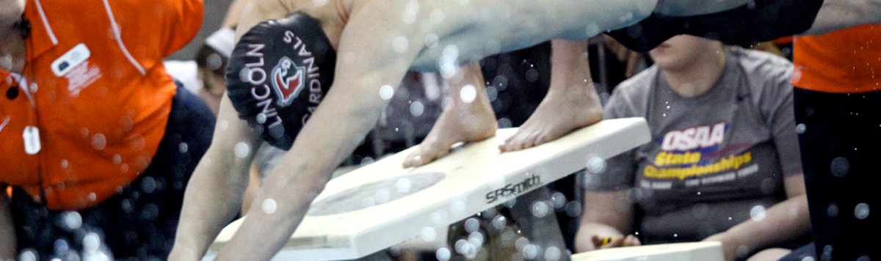



Officiating Swimming & Diving
Course Objectives
Units
Understand the roles of professionalism, rules knowledge, and communication and how they help ensure a fair meet.
Know how to consistently identify swimming violations in each type of event.
Learn the elements of a proper dive and how to score dives appropriately.
Elements of Professional Development
Officiating Swimming
Officiating Diving
Judging Practicum
Unlimited access to course for 1 year from the date of purchase
Approved by NFHS for 3 course clock hours
Notes:
Officiating Swimming and Diving is a course developed by the NFHS in conjunction with the National Interscholastic Swim Coaches Association (NISCA) and USA Diving. This course defines the elements of professional development and the fundamentals of officiating strokes and turns. The course also explores officiating and judging diving and provides a judging practicum that includes feedback of submitted scores. Officials may select either the swimming track, the diving track, or both, depending on rules required by their state association.
More:
- Unlimited access to course & resources for one year from date of purchase
- Use as an elective to fulfill AIC or CIC certification requirements

Slide 43
NFHS Learning Center

Slide 44

Notes:
The NFHS Learning Center is the home to more than 90 online professional development courses for everyone within the interscholastic community - coaches, students, officials, parents, administrators, and individuals within performing arts programs. More than 60 courses are available for free.

Slide 45

Over 17.8 million courses delivered!
Concussion in Sports – 7M
Heat Illness Prevention – 2.1M+
Sudden Cardiac Arrest – 2.2M+
The Collapsed Athlete (2020) – 51,000+
Concussion for Students – 1.1M+
Implicit Bias (2021) – 90,000+
Fundamentals of Coaching – 900,000+
First Aid, Health and Safety – 400,000+
Protecting Students from Abuse – 220,000+
Student Mental Health and Suicide Prevention – 227,000+
Bullying, Hazing and Inappropriate Behaviors – 400,000+
Appearance & Performance Enhancing Drugs and Substances – 118,000+
COVID-19 for Coaches and Administrators – 360,000+

Slide 46
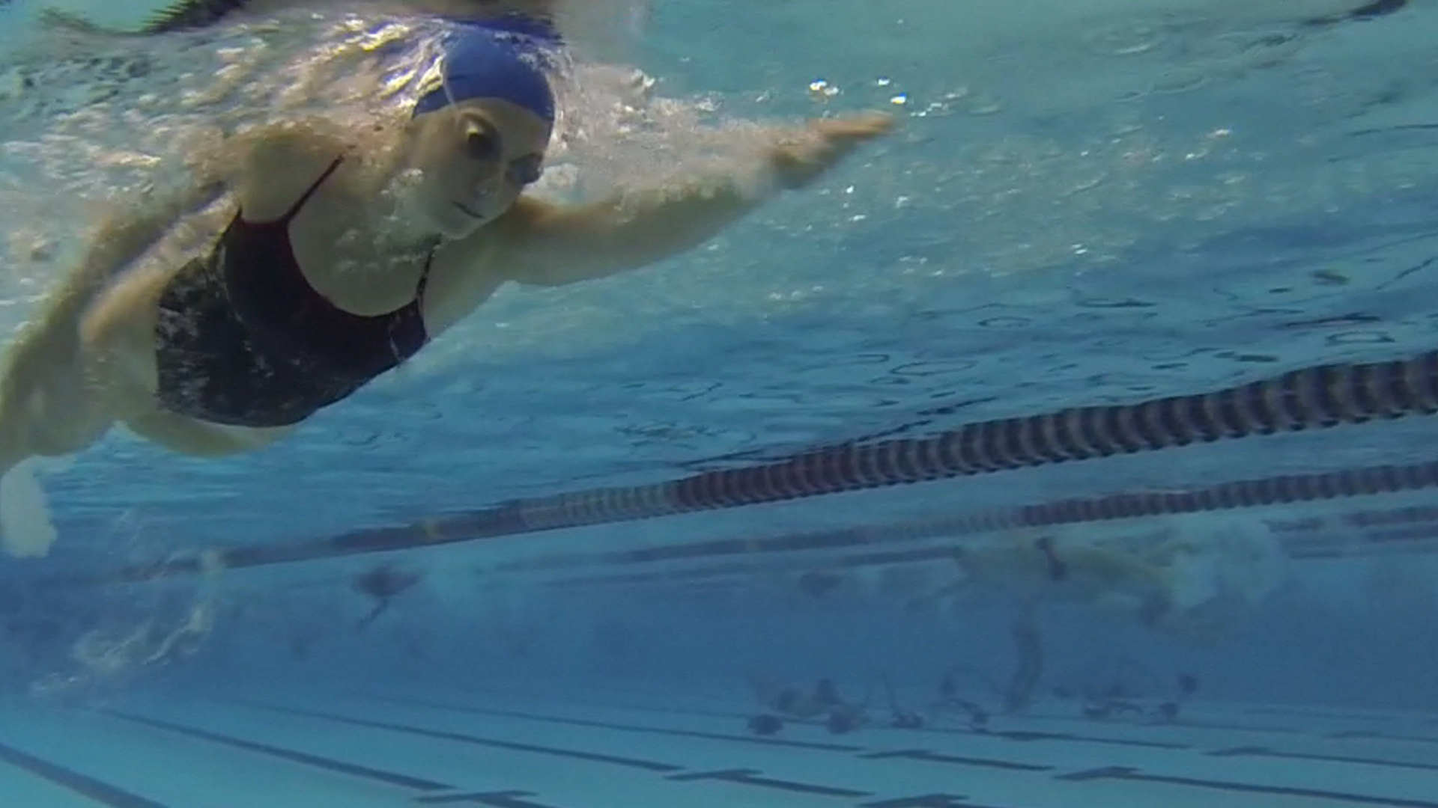


Coaching Swimming
Coaching Swimming was developed by the NFHS and the National Interscholastic Swim Coaches Association of America (NISCA). This course teaches the basic skills of the four competitive strokes, and also includes starts, turns and finishes. It also provides material on how to best administer a successful swimming program.
Course Objectives
Units
How to successfully administer a student first swimming program including—recruitment, pre-event management, interscholastic coaching philosophy, differences in club v. high school, communication and risk minimization
Become familiar with the NFHS Swimming Rules Book and local guidelines
Learn the basics of the four competitive swimming strokes—freestyle, backstroke, breaststroke and butterfly
Learn the elements of the start and the two basic types of turns
Administering the Program
Competitive Swim Strokes
Starts
Turns and Finishes
More Information at nfhslearn.com!
Notes:
Coaching Swimming is a course developed by the NFHS in conjunction with the National Interscholastic Swim Coaches Association (NISCA). This course teaches the fundamentals of becoming an effective swim coach. The course explores the different types of dives and the training required to execute the to the best of the diver’s ability.
More:
- Unlimited access to course & resources for one year from date of purchase.
- Use as an elective to fulfill AIC or CIC certification requirements.

Slide 47
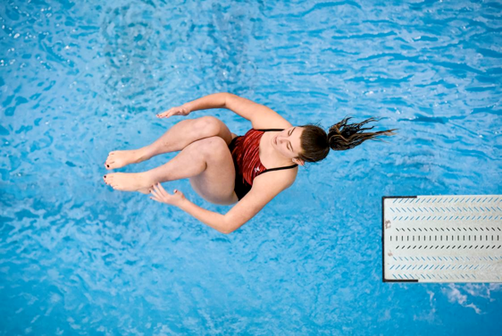
www.nfhslearn.com
Coaching Diving
Course Objectives
Units
Coaching Fundamentals: components of a dive, direction designations and position designations
Dryland: body positioning, drills, basic jumping skills and hurdle progressions
Forward and Backward Dives: feet-first entry, front fall-in, headfirst entry
Inward, Reverse and Twisting Skills: demonstrations and testing
Teaching Methodology
Fundamentals
Dryland Skills
Forward Skills
Backward Skills
Inward Skills
Reverse Skills
Twisting Skills
www.nfhs.org
Notes:
Coaching Diving is a course developed by the NFHS in conjunction with the National Interscholastic Swim Coaches Association (NISCA) and USA Diving. This course teaches the fundamentals of becoming an effective diving coach. The course explores the different types of dives and the training required to execute the to the best of the diver’s ability.
More:
- Unlimited access to course & resources for one year from date of purchase.
- Use as an elective to fulfill AIC or CIC certification requirements.

Slide 48
NFHS Network

Slide 49


NFHS Network
By 2025, every high school sporting event in America will be streamed live.
The NFHS Network will be
THE DESTINATION for fans
to view these broadcasts.
27 Different Sports and Activities
www.NFHSnetwork.com
Notes:
The NFHS Network is the leader in streaming Live and On Demand high school sports.
Partnered with the National Federation of State High School Associations, 45 high school state athletic/activities associations, and PlayOn! Sports, the NFHS Network is a joint venture created to provide fans with the ability to stream high school sports on any device, from wherever they are.
All NFHS Network events are available to watch online at www.NFHSnetwork.com and through the NFHS Network Live App for iOS and Android. Follow us on Facebook, Twitter, Instagram, and YouTube.
Watching high school sports and events has never been easier.
The NFHS Network’s goal is to broadcast live all 2 million high school sporting events by 2025.
The NFHS Network covers 27 different regular season and postseason sports, as well as other high school activities, celebrating the accomplishments of students-athletes, student broadcasters, and high schools across the country.

Slide 50


Over 1 million events this year…
Notes:
The NFHS Network will broadcast over 150,000 live events this year. If your school is not a member of the NFHS Network School Broadcast Program, please contact us at Mark.Koski@NFHSnetwork.com

Slide 51
2023-24 NFHS Swimming and diving resources

Slide 52

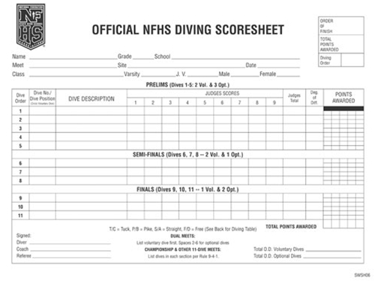
NFHS swimming and diving publications
The Rules Book, Scorebook and other Swimming and Diving materials can be ordered online at www.nfhs.com, or by calling 1-800-776-3462.
Notes:
The NFHS swimming and diving publications are available to order online or by using the toll-free number.

Slide 53


NFHS swimming and diving publications
The revised manuals will be available on or before July 1, 2023.
Notes:
The NFHS Swimming Officials Guideline Manual and the Diving Officials Guidelines Manual will be available on or before July 1st on the swimming and diving page of www.nfhs.org. The manuals are posted in word format so that state associations may tailor them to fit their specific needs.

Slide 54

Thank You
National Federation of State High School Associations
PO Box 690 | Indianapolis, IN 46206
Phone: 317-972-6900 | Fax: 317.822.5700
www.nfhs.org | www.nfhslearn.com | www.nfhsnetwork.com

