Slide 1
2023-24 NFhs basketball rules powerpoint
Rules Changes
Editorial Changes
Points of Emphasis

Slide 2

Sponsor Slide
remove this text and place artwork centered here
Notes:
BISON – THE EXCLUSIVE PARTNER FOR THE SPORT OF BASKETBALL

Slide 3



COSMA Accredited &
NIAAA Partner
Interscholastic Focus &
Industry-Connected Faculty
MAA Program
Overview
Part-Time Program
7-Week Classes
3 Start Dates Per Year
30 Credit Hours
11 courses
No GRE/GMAT Required
Earn and Prepare for NIAAA Certification
Expansive
Alumni Network

Slide 4
LTC 501 Guiding Foundations and Philosophies
LTC 502 Strategies for Organization Management
LTC 503 Enhancing Organization Management
LTC 504 Legal issues I (Liability for Sports Injuries & Risk Management)
LTC 506 Legal Issues II (Title IX & Sexual Harassment)
LTC 508 Legal Issues III (Hazing, Constitutional Law, Disabilities Law & Employment/Labor Law)
LTC 511 Concepts and Strategies for Interscholastic Budgeting and Finance Using Excel Spreadsheets
LTC 611 Concepts and Strategies for Interscholastic Fundraising, Marketing, Promotions and Booster Clubs
LTC 630 Interscholastic Contest Management – Planning, Preparation & Methods
LTC 707 Assessment of Interscholastic Athletic Programs and Personnel
LTC 719 Athletic Administration: Leadership, Management/Supervision and Decision-Making Concepts, Methods and Applications
NIAAA LTCs in the MAA Curriculum
Upon completing the OHIO MAA program, students will have earned credit for 11 NIAAA Leadership Training Courses

Slide 5
Admission Requirements
Admission Requirements
NO GRE / GMAT REQUIRED
Bachelor’s degree from regionally accredited four-year institution
2.7 GPA
Official Transcripts from all institutions attended
Two Letters of Recommendation
2+ Years of interscholastic athletic administration, coaching or related experience
Personal Statement
Professional Resume/CV
$50 Application Fee
Total Estimated Cost, Minus Fees
$18,150 (Ohio Resident)
$18,720 (Non-Resident)
* Listed Tuition is for estimating purposes only and is subject to change.

Slide 6
GradCAT
Graduate Career Acceleration Team
Career Support Services
Now and For Life
Four (4) Month Program
Individual Career Coach
Branding Expert
Career Concierge
Annual Career Coaching Session for Life
Spotlight Technology Platform
Lifetime Access
Job Search Resources
Occupation Explorer
Job Opportunities
Personal Assessments
Templates
Webinars
Online Courses/Skilling

Slide 7
National federation of state high school associations (NFHS)

Slide 8

National Federation of
State High School Associations
NFHS (located in Indianapolis, IN – Est. 1920):
  National leader and advocate for
  high school athletics and
  performing arts programs.
  Serves 51 state associations, 19,500
  high schools and 12 million student
  participants.
  Writes playing rules for 17 high school
  sports for boys and girls.
  Offers online education courses for high school coaches,
  officials, parents, students and others.
  Ensures that students have opportunity to enjoy healthy participation, achievement and good sportsmanship in education-based athletics.
Notes:
NFHS (located in Indianapolis, IN – Est. 1920):
National leader and advocate for
high school athletics and
performing arts programs.
Serves 51 state associations, 19,500
high schools and 12 million student
participants.
Writes playing rules for 17 high school
sports for boys and girls.
Offers online education courses for high school coaches,
officials, parents, students and others.
Ensures that students have opportunity to enjoy healthy participation, achievement and good sportsmanship in education-based athletics.

Slide 9








NFHS Rules Review Committee
The NFHS Rules Review Committee is chaired by the chief operating officer and composed of all rules editors. After each committee concludes its deliberations and has adopted its recommended changes for the subsequent year, such revisions will be evaluated by the Rules Review Committee.
Davis Whitfield
Chief Operating Officer
Lindsey Atkinson
Basketball, Girls Lacrosse and Volleyball
Bob Colgate
Football and Sports
Medicine
Sandy Searcy
Softball, Swimming & Diving and Water Polo
Elliot Hopkins
Baseball and Wrestling
Julie Cochran
Cross Country, Gymnastics, Field Hockey, Soccer and
Track & Field
James Weaver
Boys Lacrosse
and Spirit
Dan Schuster
Ice Hockey
Notes:
The NFHS Rules Review Committee is chaired by the chief operating officer and composed of all rules editors. After each committee concludes its deliberations and has adopted its recommended changes for the subsequent year, such revisions will be evaluated by the Rules Review Committee.

Slide 10



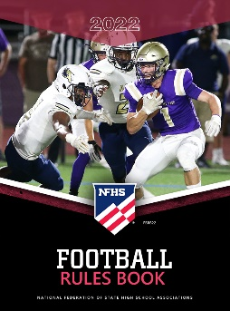



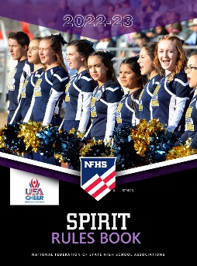










National Federation of
State High School Associations
The NFHS writes playing rules for 17 sports
for boys and girls at the high school level.
  Publishes 4 million pieces of materials annually.
Notes:
The NFHS writes playing rules for 17 sports
for boys and girls at the high school level.
Publishes 4 million pieces of materials annually.

Slide 11

NEW NFHS AllAccess – Website
AllAccess is the New NFHS Digital Publications Platform that includes:
  Rules Publications
  High School Today Magazine
  Policy Debate Quarterlies
  Other NFHS Digital Publications
Website organized for associations and individuals to assign books and manage purchases
Visit www.allaccess.nfhs.org
Notes:
AllAccess is the New NFHS Digital Publications Platform that includes:
Rules Publications
High School Today Magazine
Policy Debate Quarterlies
Other NFHS Digital Publications
Website organized for associations and individuals to assign books and manage purchases
Visit www.allaccess.nfhs.org

Slide 12
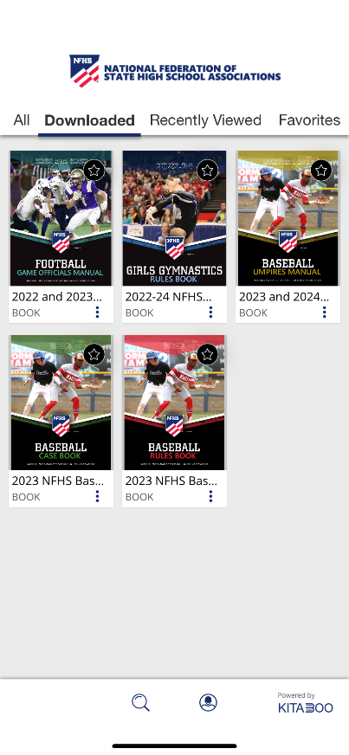


NEW NFHS AllAccess – Mobile App
Access Via Website or Mobile App:
View available publications for sale
View publications assigned to you
Download books for offline viewing
Read publications as an e-book
  Book features include:
    Table of contents
    Highlighting text
    Creating ‘sticky notes’ on pages
    Searching for terms
    Mark-up pen feature
    Viewing highlights and notes on data page
Available on App Store and Google Play
Notes:
Access Via Website or Mobile App:
View available publications for sale
View publications assigned to you
Download books for offline viewing
Read publications as an e-book
Book features include:
Table of contents
Highlighting text
Creating ‘sticky notes’ on pages
Searching for terms
Mark-up pen feature
Viewing highlights and notes on data page
Available on App Store and Google Play

Slide 13
2023-24 NFHS Basketball
Rules Changes

Slide 14
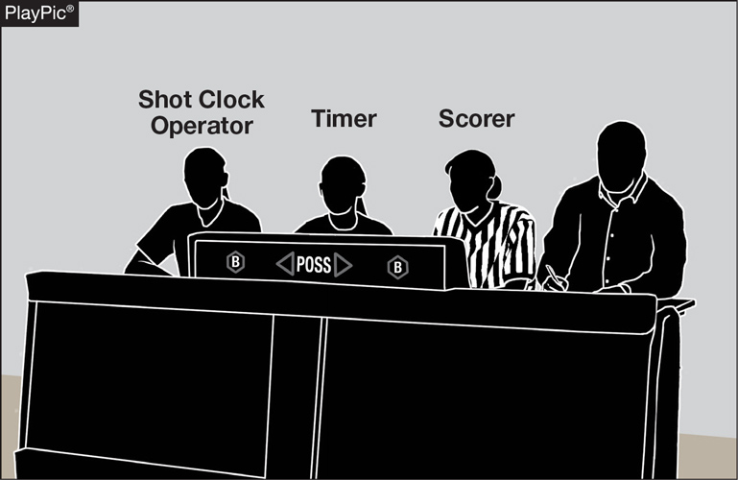
GAME AND TABLE OFFICIALS
2-1-3 NOTE
If utilizing a shot clock, the shot clock operator shall be located at the scorer’s and timer’s table.
This allows the officiating crew to quickly identify the person who is operating the shot clock should there be a timing issue that needs to be addressed.
Notes:
If utilizing a shot clock, the shot clock operator shall be located at the scorer’s and timer’s table.
Rationale: This allows the officiating crew to quickly identify the person who is operating the shot clock should there be a timing issue that needs to be addressed.

Slide 15
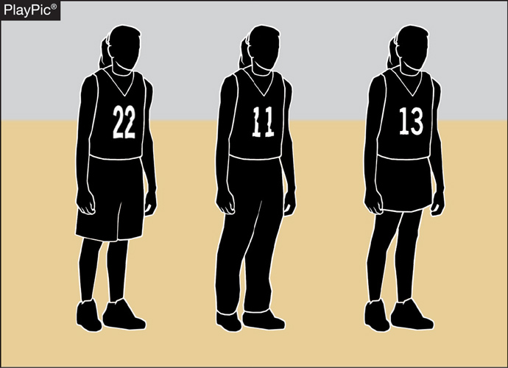
UNIFORMS
3-4-5
Teammates may wear multiple styles of uniform bottoms including shorts, skirts or pants, so long as they are like-colored.
Not all team members need to wear the same style.
However, all styles must meet uniform requirements for visible manufacturer logos and trademarks.
Notes:
Teammates may wear multiple styles of uniform bottoms including shorts, skirts or pants, so long as they are like-colored.
Not all team members need to wear the same style.
However, all styles must meet uniform requirements for visible manufacturer logos and trademarks
Rationale: Clarifies that teammates must all wear like-colored uniform bottoms but may wear multiple styles while aligning language with other NFHS rules codes.

Slide 16
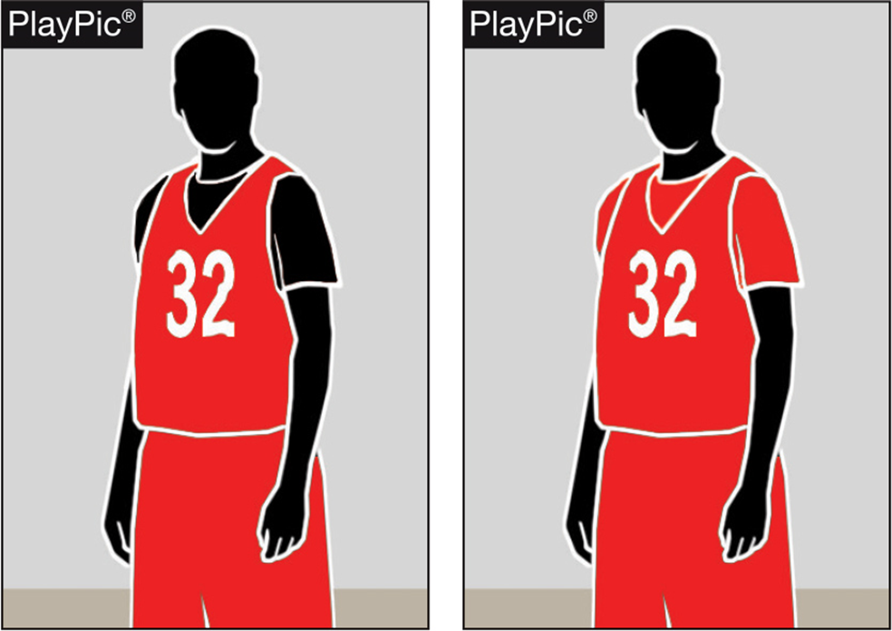
Team Member’s Equipment, Apparel
3-5-6
If the visiting team is wearing undershirts with their dark jerseys, the undershirts may now be a single solid color similar to the torso of the jersey or solid black.
Notes:
If the visiting team is wearing undershirts with their dark jerseys, the undershirts may now be a single solid color similar to the torso of the jersey or solid black.
Rationale: Allows schools with hard-to-find colors to wear black under visiting team jerseys while continuing to require all team members to match.

Slide 17
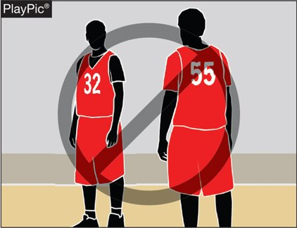
Team Member’s Equipment, Apparel
3-5-6
Team members in this PlayPic may wear either solid black or solid red undershirts, but players on the same team cannot wear both.
If players choose to wear an undershirt, all undershirts must be the same color.
Notes:
Team members in this PlayPic may wear either solid black or solid red undershirts, but players on the same team cannot wear both.
If players choose to wear an undershirt, all undershirts must be the same color.

Slide 18
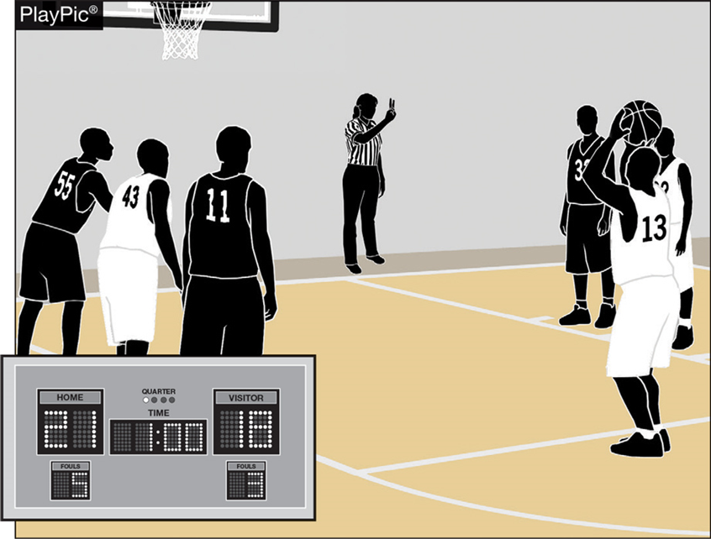
BONUS FREE THROWS
4-8-1
Two free throws will now be awarded for all common fouls, except for a player-control foul or team-control foul, beginning with the fifth team foul in each quarter.
Team fouls will be reset to zero at the end of each quarter, excluding the fourth quarter if an overtime period is needed.
Notes:
Two free throws will now be awarded for all common fouls, except for a player-control foul or team-control foul, beginning with the fifth team foul in each quarter.
Team fouls will be reset to zero at the end of each quarter, excluding the fourth quarter if an overtime period is needed.
Rationale: Improves flow by providing an opportunity for teams to adjust their play by not carrying over fouls from quarters 1 and 3 to quarters 2 and 4 while significantly reducing the opportunity for correctable errors to occur. Minimizes risk of injury by eliminating the one-and-one and reducing opportunities for rough play during rebounding opportunities.

Slide 19
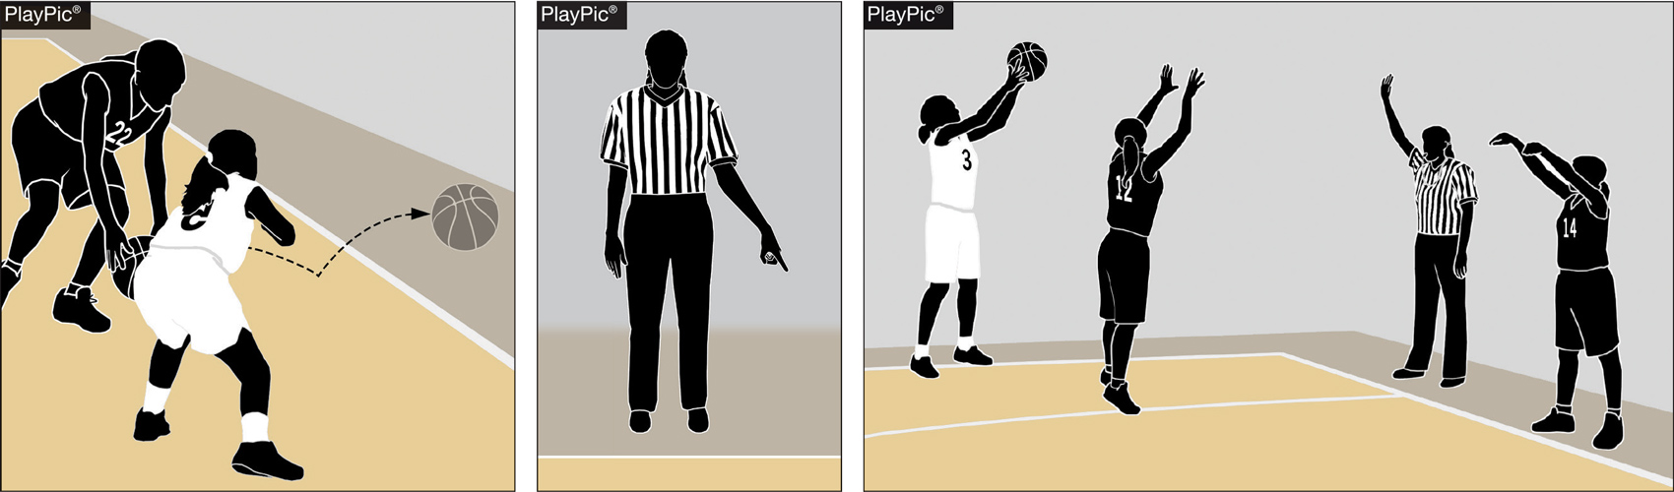
Resumption of play procedure, throw-ins 7-5-2 thru 4 (NEW)
After an out of bounds violation in either the frontcourt or the backcourt by either team, the throw-in shall be at the designated spot nearest to where the ball went out of bounds.
Notes:
After an out of bounds violation in either the frontcourt or the backcourt by either team, the throw-in shall be at the designated spot nearest to where the ball went out of bounds.

Slide 20
Resumption of play procedure, throw-ins 7-5-2 thru 4 (NEW)
After a violation or a foul before the bonus is in effect by either team or any other stoppage in play, the throw-in location will be determined by the location of the violation/foul or the location of the ball when the stoppage occurs:
  Frontcourt throw-in – one of the newly established four designated spots (28-foot mark along each sideline or 3-feet outside the lane line along the end line).
  Backcourt throw-in – the designated spot nearest the foul, violation or other stoppage.
Notes:
After a violation or a foul before the bonus is in effect by either team or any other stoppage in play, the throw-in location will be determined by the location of the violation/foul or the location of the ball when the stoppage occurs:
Frontcourt throw-in – one of the newly established four designated spots (28-foot mark along each sideline or 3-feet outside the lane line along the end line).
Backcourt throw-in – the designated spot nearest the foul, violation or other stoppage.
Rationale: Simplifies throw-in procedure when a team gains or retains possession for situations other than an out-of-bounds throw-in.

Slide 21
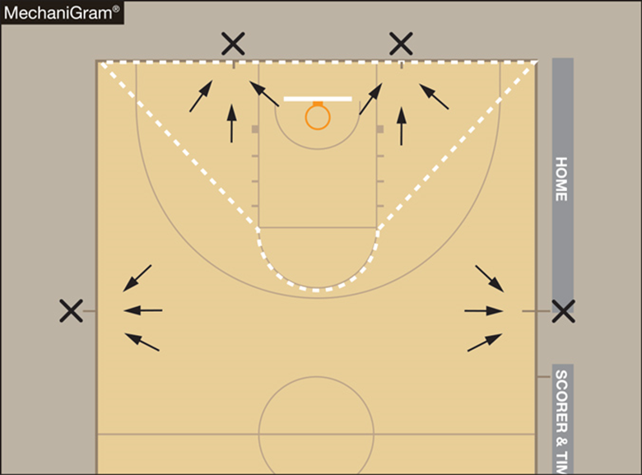
Resumption of play procedure, throw-ins [7-5-2 thru 4 (NEW)]
Frontcourt throw-ins – Officials shall determine the throw-in spot by using an imaginary line (dotted line).
  If the stoppage of play occurs inside the dotted imaginary line, the spot shall be the nearest point on the end line 3-feet outside the lane line.
  If the stoppage of play occurs outside the dotted imaginary line, the spot shall be the nearest 28-foot mark along each sideline.
NOTE: Court markings are not required.
Notes:
Frontcourt throw-ins – Officials shall determine the throw-in spot by using an imaginary line (dotted line).
If the stoppage of play occurs inside the dotted imaginary line, the spot shall be the nearest point on the end line 3-feet outside the lane line.
If the stoppage of play occurs outside the dotted imaginary line, the spot shall be the nearest 28-foot mark along each sideline.
NOTE: Court markings are not required.

Slide 22
Throw-in administration
7-6-6
When an official administers a throw-in to the wrong team, the officials may now rectify the mistake at any time before the first dead ball after the ball becomes live unless there is a change in possession.
After the ball becomes dead or the correct team gains possession, the time to correct the mistake has expired.
Notes:
When an official administers a throw-in to the wrong team, the officials may now rectify the mistake at any time before the first dead ball after the ball becomes live unless there is a change in possession.
After the ball becomes dead or the correct team gains possession, the time to correct the mistake has expired.
Rationale: Allows for a correction of an official's mistake in a more reasonable timeframe.

Slide 23
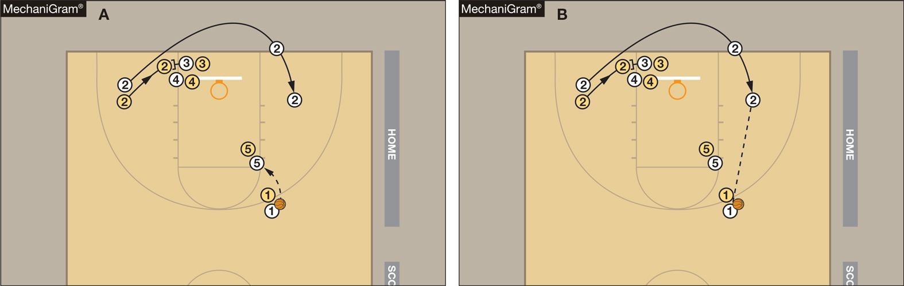
Out of BOUNDS
9-3-3
Legal
Illegal
A player may now step out of bounds as long as the player is not the first player to touch the ball, or the player did not step out of bounds to avoid a violation (MechaniGram A).
Any player who steps out of bounds under the player’s own volition and is the first player to touch the ball after returning to the playing court or does so to avoid a violation has committed a violation (MechaniGram B).
Notes:
A player may now step out of bounds as long as the player is not the first player to touch the ball, or the player did not step out of bounds to avoid a violation (MechaniGram A).
Any player who steps out of bounds under the player’s own volition and is the first player to touch the ball after returning to the playing court or does so to avoid a violation has committed a violation (MechaniGram B).
Rationale: Allows a player to step out of bounds if they gain no advantage and penalizes a team only if they gain an advantage by leaving the court and returning to avoid a violation or to be the first to touch the ball.

Slide 24
2023-24 NFHS Basketball
Editorial Changes

Slide 25
GAME AND TABLE OFFICIALS
2-1-1
The official’s uniform shall be a black-and-white striped shirt, black pants, predominantly black shoes and black socks.
Rationale: A change from the word “primarily” to “predominantly” allows official more footwear options.
Notes:
The official’s uniform shall be a black-and-white striped shirt, black pants, predominantly black shoes and black socks.
Rationale: A change from the word “primarily” to “predominantly” allows official more footwear options.

Slide 26
Setting Direction of Initial arrow
4-3-2
Alternating-possession control is established, and the initial direction of the possession arrow is set toward the opponent’s basket when:
ART. 2 . . . Entering an overtime period, the ball is placed at the disposal of the free thrower after a common foul when the bonus free throws are in effect.
Rationale: Clarifies that the possession arrow is set towards the opponent’s basket when the ball is placed at the disposal of the free thrower after a common foul when the bonus rule is in effect, which can only occur, entering an overtime period.
Notes:
Alternating-possession control is established, and the initial direction of the possession arrow is set toward the opponent’s basket when:
ART. 2 . . . Entering an overtime period, the ball is placed at the disposal of the free thrower after a common foul when the bonus free throws are in effect.
Rationale: Clarifies that the possession arrow is set towards the opponent’s basket when the ball is placed at the disposal of the free thrower after a common foul when the bonus rule is in effect, which can only occur, entering an overtime period.

Slide 27
Foul
4-19-13
ART. 13 . . . A team foul is any personal foul or technical foul (except indirect technical fouls) which is charged to either team. All team fouls are counted to reach the bonus free throws for the quarter in which they are assessed.
Rationale: Clarifies that team fouls are only counted towards the bonus in the quarter in which they were assessed.
Notes:
ART. 13 . . . A team foul is any personal foul or technical foul (except indirect technical fouls) which is charged to either team. All team fouls are counted to reach the bonus free throws for the quarter in which they are assessed.
Rationale: Clarifies that team fouls are only counted towards the bonus in the quarter in which they were assessed.

Slide 28
Shot clock Guidelines
THE SHOT CLOCK OPERATOR SHALL:
    6. Stop the timing device and reset to full amount:
    b. When any of the following occurs:
    ii: A single technical foul assessed to the defensive team.
    v: A violation, and the defense is awarded the ball for a throw-in.
    Rationale: All technical fouls per NFHS Rule 10 Penalty result in a change of possession, two free throws and the ball at the division line (unless simultaneous offsetting), therefore a full shot clock reset would occur.
    A violation by the defense, such as a kicked ball, will result in a full reset to the offensive team and a violation by the offense will result in a turnover and thus a full reset.
Notes:
Editorial Changes to the guidelines include:
THE SHOT CLOCK OPERATOR SHALL:
6. Stop the timing device and reset to full amount:
b. When any of the following occurs:
ii: A single technical foul assessed to the defensive team.
v: A violation, and the defense is awarded the ball for a throw-in.
Rationale: All technical fouls per NFHS Rule 10 Penalty result in a change of possession, two free throws and the ball at the division line (unless simultaneous offsetting), therefore a full shot clock reset would occur.
A violation by the defense, such as a kicked ball, will result in a full reset to the offensive team and a violation by the offense will result in a turnover and thus a full reset.

Slide 29
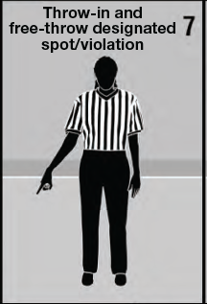
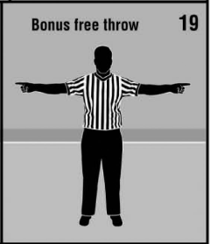
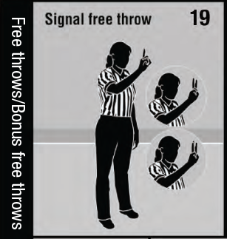
Official NFHS Basketball Signals
Officials Signal #7 – Clarified description to include throw-in violation.
Officials Signal #19 – Removed “Bonus free throw” signal and included “Bonus free throws” in title of new #19 “Signal free throw.”
Notes:
Officials Signal #7 – Clarified description to include throw-in violation.
Officials Signal #19 – Removed “Bonus free throw” signal and included “Bonus free throws” in title of new #19 “Signal free throw.”

Slide 30
2023-24 NFHS Basketball
Points of Emphasis

Slide 31
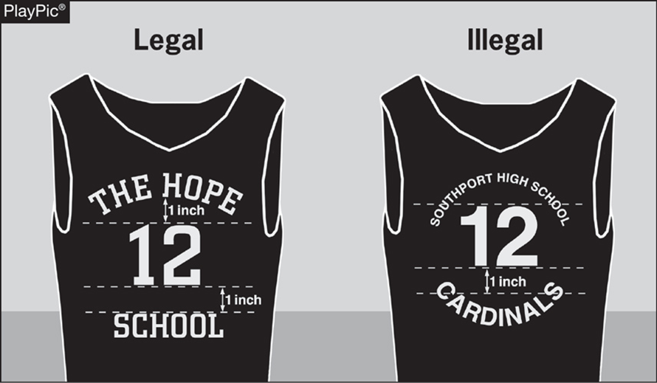
Uniforms, Equipment and apparel
Coaches and school administrators must ensure that legal uniforms are being ordered and purchased from manufacturers/distributors.
If in doubt, prior to purchasing uniforms, equipment or apparel, confirm legality with the local state association.
An NFHS basketball uniform guide was created to illustrate the proper uniform design. That document and an animated presentation can be found on the NFHS website.
Notes:
Coaches and school administrators must ensure that legal uniforms are being ordered and purchased from manufacturers/distributors.
If in doubt, prior to purchasing uniforms, equipment or apparel, confirm legality with the local state association.
An NFHS basketball uniform guide was created to illustrate the proper uniform design. That document and an animated presentation can be found on the NFHS website.

Slide 32

Uniforms, Equipment and apparel
Requests to make an exception to rule 3-4, Uniforms (Pink Out Night, Retro/Throw Back Night, Military Appreciation Night) must be submitted to the state association before the event for approval.
Uniform requirements MAY NOT be altered by mutual agreement between schools or coaches.
Notes:
Requests to make an exception to rule 3-4, Uniforms (Pink Out Night, Retro/Throw Back Night, Military Appreciation Night) must be submitted to the state association before the event for approval.
Uniform requirements MAY NOT be altered by mutual agreement between schools or coaches.

Slide 33
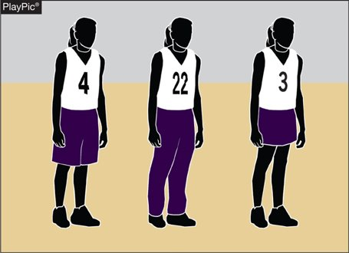
Uniforms, Equipment and apparel
Uniform bottoms do not have to match the torso of the uniform.
With the adoption of rule 3-4-5, uniform bottoms must be like-colored among teammates.
The bottom style may differ for every player, but the color must be the same.
Rolling and/or tucking of uniform bottoms is permissible, as long as the compression tights/sleeves, if worn, are color compliant.
Notes:
Uniform bottoms do not have to match the torso of the uniform.
With the adoption of rule 3-4-5, uniform bottoms must be like-colored among teammates.
The bottom style may differ for every player, but the color must be the same.
Rolling and/or tucking of uniform bottoms is permissible, as long as the compression tights/sleeves, if worn, are color compliant.

Slide 34
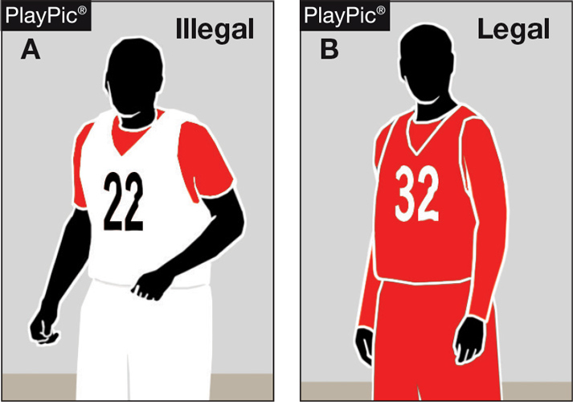
Uniforms, Equipment and apparel
Undershirts, if worn by the home team, shall be white, hemmed, not have frayed or ragged edges, and if they have sleeves, they shall be the same length.
Undershirts, if worn by the visiting team, must be a single solid color similar to the torso of the jersey or solid black and meet all other requirements as listed above. Team members may wear either the single solid color or black, but not both.
Notes:
Undershirts, if worn by the home team, shall be white, hemmed, not have frayed or ragged edges, and if they have sleeves, they shall be the same length.
Undershirts, if worn by the visiting team, must be a single solid color similar to the torso of the jersey or solid black and meet all other requirements as listed above. Team members may wear either the single solid color or black, but not both.

Slide 35
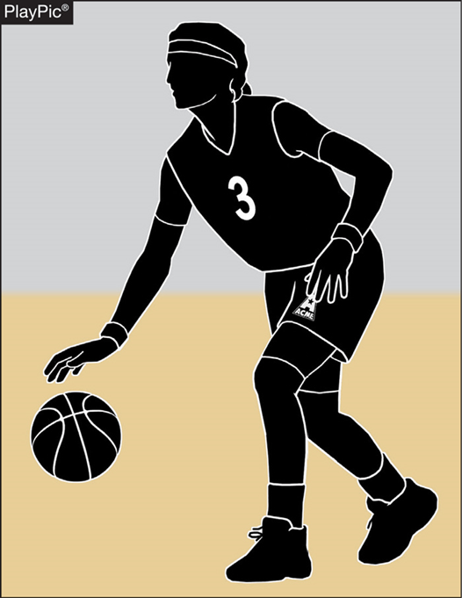
Uniforms, Equipment and apparel
Arm sleeves, knee sleeves, lower leg sleeves, compression shorts and tights are permissible.
Anything worn on the arm and/or leg is a sleeve, except a knee brace, and shall meet the color restrictions.
Sleeves/tights and compression shorts shall be black, white, beige or the predominant color of the jersey and the same color shall be worn by teammates.
All sleeves/tights and compression shorts shall be the same solid color and shall be the same color as any headband or wristband worn.
Notes:
Arm sleeves, knee sleeves, lower leg sleeves, compression shorts and tights are permissible.
Anything worn on the arm and/or leg is a sleeve, except a knee brace, and shall meet the color restrictions.
Sleeves/tights and compression shorts shall be black, white, beige or the predominant color of the jersey and the same color shall be worn by teammates.
All sleeves/tights and compression shorts shall be the same solid color and shall be the same color as any headband or wristband worn.

Slide 36
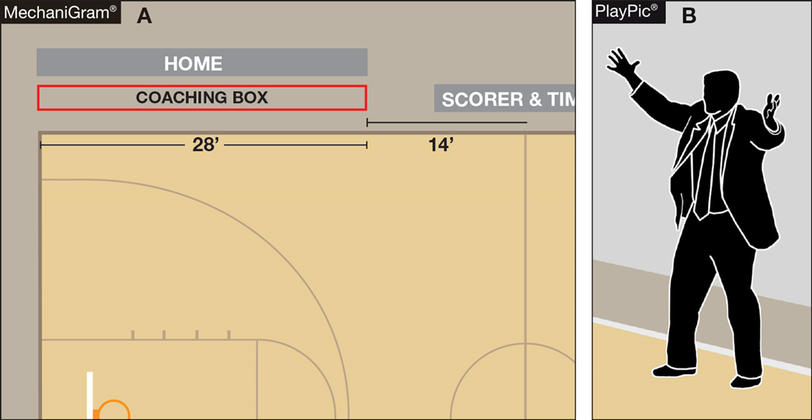
BENCH DECORUM
Through the enforcement of existing rules, coaches and bench personnel are expected to exhibit appropriate and acceptable behaviors.
Coaches are expected to remain in the coaching box.
Coaches who go beyond the 28-foot line, or more importantly onto the playing court, gain a distinct advantage that is not within the spirit or intent of the rules.
Notes:
Through the enforcement of existing rules, coaches and bench personnel are expected to exhibit appropriate and acceptable behaviors.
Coaches are expected to remain in the coaching box.
Coaches who go beyond the 28-foot line, or more importantly onto the playing court, gain a distinct advantage that is not within the spirit or intent of the rules.

Slide 37
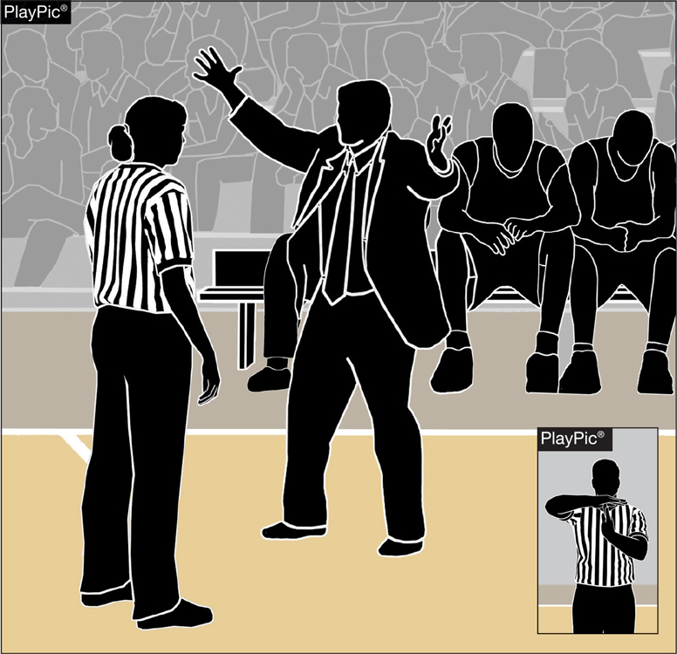
BENCH DECORUM
While the bench area expands during a time-out, the bench area does not extend beyond the 28-foot line.
Coaches and other bench personnel may not move to the extended bench area until the time-out begins to ensure bench personnel do not create inadvertent contact with opposing players still on the playing court.
Coaches who leave the expanded bench area to engage officials inappropriately are subject to a warning or bench technical foul.
Notes:
While the bench area expands during a time-out, the bench area does not extend beyond the 28-foot line.
Coaches and other bench personnel may not move to the extended bench area until the time-out begins to ensure bench personnel do not create inadvertent contact with opposing players still on the playing court.
Coaches who leave the expanded bench area to engage officials inappropriately are subject to a warning or bench technical foul.

Slide 38
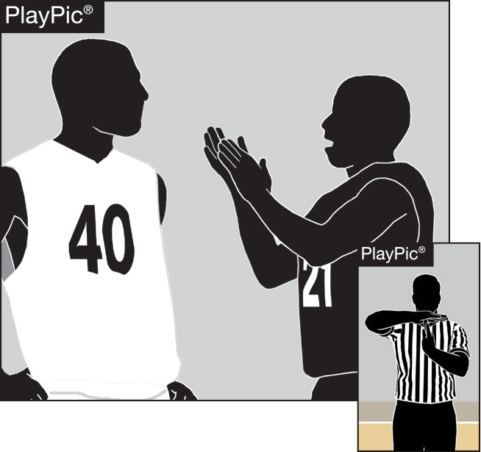
BENCH DECORUM
Misconduct, including taunting; baiting; finger-pointing; trash talking or using inappropriate gestures by players; coaches or bench personnel, is not permitted.
Players and coaches are not allowed to disrespectfully or inappropriately address and/or gesture at an official after a ruling is made on the court.
Player and coach behavior, which in the official’s judgment is determined to be a taunt of an opponent or a disrespectful act toward an official, shall be penalized by assessing a technical foul.
Notes:
Misconduct, including taunting; baiting; finger-pointing; trash talking or using inappropriate gestures by players; coaches or bench personnel, is not permitted.
Players and coaches are not allowed to disrespectfully or inappropriately address and/or gesture at an official after a ruling is made on the court.
Player and coach behavior, which in the official’s judgment is determined to be a taunt of an opponent or a disrespectful act toward an official, shall be penalized by assessing a technical foul.

Slide 39
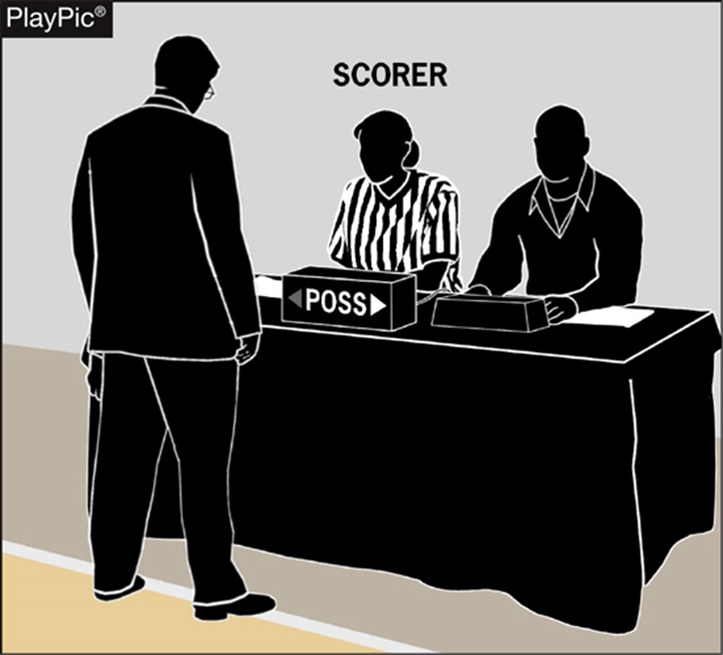
BENCH DECORUM
Assistant coaches are not authorized to approach the scorer’s table at any time.
The head coach is permitted to go to the scorer’s table to request a 60-second time-out to confer with personnel regarding a correctable error or to prevent or rectify a timing or scoring mistake/error or an alternating possession mistake.
Notes:
Assistant coaches are not authorized to approach the scorer’s table at any time.
The head coach is permitted to go to the scorer’s table to request a 60-second time-out to confer with personnel regarding a correctable error or to prevent or rectify a timing or scoring mistake/error or an alternating possession mistake.

Slide 40
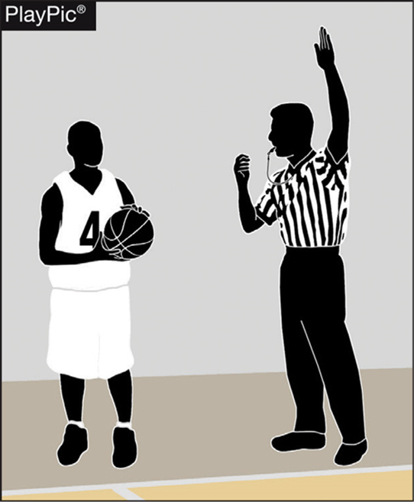
THROW-INS — PROPER LOCATIONS
Proper inbound spots contribute to the overall flow and fairness of the game.
Coaches design specific plays and strategies based on where the ball will be put in play.
It is therefore essential for game officials to be diligent in administering the ball at the proper throw-in location.
Any time a team causes the ball to go out of bounds, the throw-in occurs from the spot where the ball went out of bounds.
Notes:
Proper inbound spots contribute to the overall flow and fairness of the game.
Coaches design specific plays and strategies based on where the ball will be put in play.
It is therefore essential for game officials to be diligent in administering the ball at the proper throw-in location.
Any time a team causes the ball to go out of bounds, the throw-in occurs from the spot where the ball went out of bounds.

Slide 41
THROW-INS — PROPER LOCATIONS
When a violation, defensive foul before the bonus or dead ball (inadvertent whistle, held ball, etc.) occurs that will result in a throw-in, officials must ask themselves three questions:
  Where did the violation/foul occur?
  Is the throw-in team in their frontcourt or backcourt?
  Where was the ball when the interruption occurred?
Notes:
When a violation, defensive foul before the bonus or dead ball (inadvertent whistle, held ball, etc.) occurs that will result in a throw-in, officials must ask themselves three questions:
Where did the violation/foul occur?
Is the throw-in team in their frontcourt or backcourt?
Where was the ball when the interruption occurred?

Slide 42
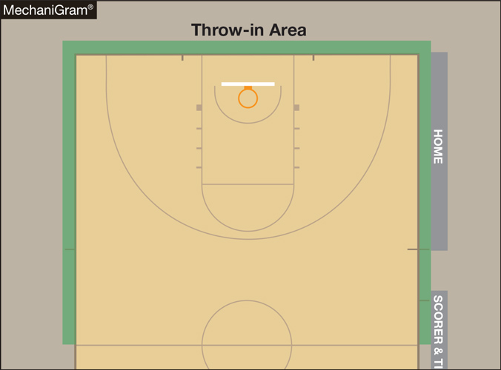
THROW-INS — PROPER LOCATIONS
When a team will gain or retain possession in its backcourt after a violation, foul prior to the bonus or stoppage in play, play will resume with a throw-in at either the point of interruption or the designated spot nearest to where the violation or foul occurred.
Notes:
When a team will gain or retain possession in its backcourt after a violation, foul prior to the bonus or stoppage in play, play will resume with a throw-in at either the point of interruption or the designated spot nearest to where the violation or foul occurred.

Slide 43
THROW-INS — PROPER LOCATIONS
When a team will gain or retain possession in its frontcourt, play will resume with a throw-in from one of the four designated frontcourt spots.
Notes:
When a team will gain or retain possession in its frontcourt, play will resume with a throw-in from one of the four designated frontcourt spots.

Slide 44
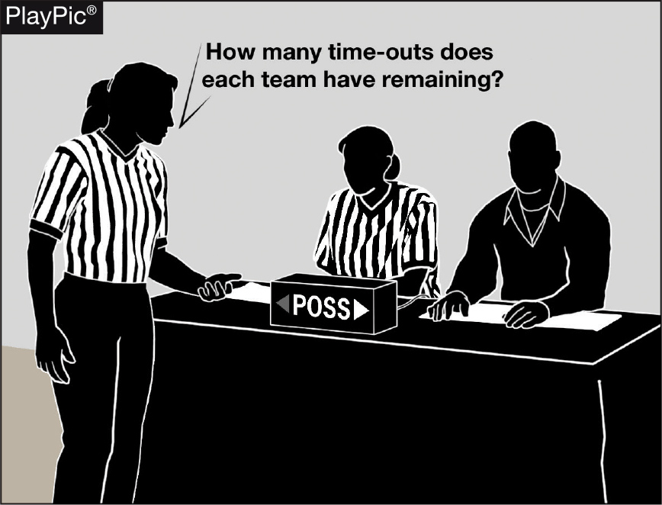
End-of-game protocols
As a game nears the end of playing time, officials need to remind each other of the game-ending procedures to prevent potential issues.
Late-game time-outs provide the best opportunities to:
  Confirm scorebook accuracy with the scorer, the number of time-outs remaining for each team and the number of team fouls/impact on the bonus.
  Remind the timer to watch officials for clock-start and clock-stop signals and be prepared to assist in aiding officials regarding whether a last-second shot was released prior to the end of time.
Notes:
As a game nears the end of playing time, officials need to remind each other of the game-ending procedures to prevent potential issues.
Late-game time-outs provide the best opportunities to:
Confirm scorebook accuracy with the scorer, the number of time-outs remaining for each team and the number of team fouls/impact on the bonus.
Remind the timer to watch officials for clock-start and clock-stop signals and be prepared to assist in aiding officials regarding whether a last-second shot was released prior to the end of time.

Slide 45
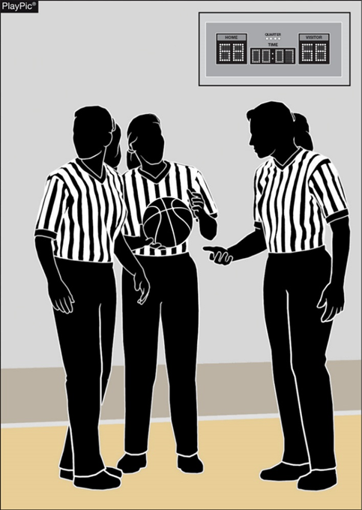
End-of-game protocols
During late-game time-outs the officials should discuss the following among the crew:
  Last-second shot responsibility.
  Unless the ball is tapped, no try can be attempted on a throw-in or free throw with .3 seconds or less remaining.
  Intentional/flagrant fouls are two shots and a designated spot throw-in.
  If a foul occurs as the game-ending horn sounds and the score can be tied or the game won by the ensuing free throws, the official must administer the free throws. If they will not change the outcome, they shall not be attempted.
Notes:
During late-game time-outs the officials should discuss the following among the crew:
Last-second shot responsibility.
Unless the ball is tapped, no try can be attempted on a throw-in or free throw with .3 seconds or less remaining.
Intentional/flagrant fouls are two shots and a designated spot throw-in.
If a foul occurs as the game-ending horn sounds and the score can be tied or the game won by the ensuing free throws, the official must administer the free throws. If they will not change the outcome, they shall not be attempted.

Slide 46
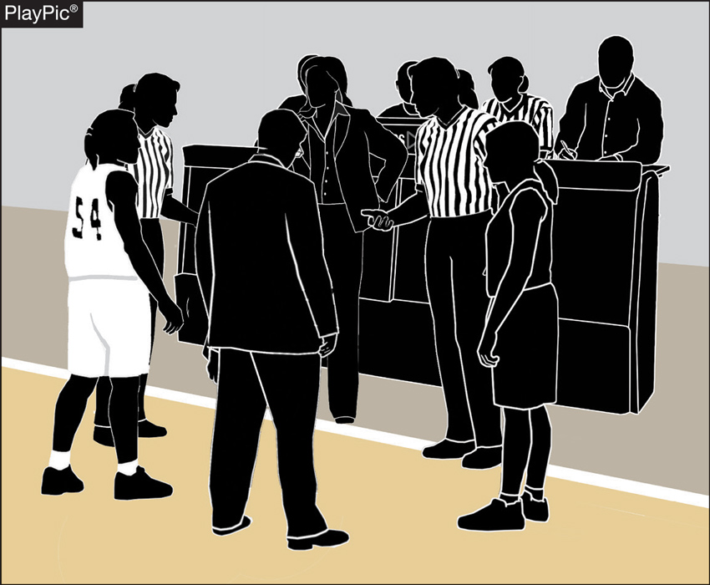
End-of-game protocols
If the score is tied at the end of regulation time, inform each team and the table officials of the overtime procedures (length of overtime period, additional 60-second time-out, etc.).
Notes:
If the score is tied at the end of regulation time, inform each team and the table officials of the overtime procedures (length of overtime period, additional 60-second time-out, etc.).

Slide 47
End-of-game protocols
Following the game-ending horn, the referee should confirm with the scorer that everything is correct, then leave the floor with their partner(s).
In situations when the score is separated by three points or less, it may be necessary to verbally confirm with the scorer.
In games when the margin of victory is larger, a visual signal such as a thumb’s-up will suffice.
Be confident everything is correct, as the officials’ jurisdiction ends when the entire crew leaves the visual confines of the playing court.
Notes:
Following the game-ending horn, the referee should confirm with the scorer that everything is correct, then leave the floor with their partner(s).
In situations when the score is separated by three points or less, it may be necessary to verbally confirm with the scorer.
In games when the margin of victory is larger, a visual signal such as a thumb’s-up will suffice.
Be confident everything is correct, as the officials’ jurisdiction ends when the entire crew leaves the visual confines of the playing court.

Slide 48
NFHS OFFICIALS Education

Slide 49





OFFICIALS EDUCATION
Content remains free of charge
TEACHING
AIDS
RULES
CHANGES
DIAGRAMS
VIDEO
LIBRARY
OFFICIALS
COURSES
Notes:
Sport-Specific Officiating courses are offered in several sports. They are ideal for new officials and those in the first few years of officiating. These courses introduce officials to the mechanics and techniques used in the sport and provide specific information on an area within that sport. Individuals can complete a course within 30-45 minutes. These courses are free to all officials and prospective officials.
“Interscholastic Officiating” is a general course on sports officiating, and it is free to all officials and prospective officials. This course provides an introduction to skills and concepts used as an official. Several topics are covered such as: basics of becoming and staying an official, science of officiating, art of officiating, how to combine these skills for successful officiating.
Video clips are made available to NFHS Officials Association members. The video is clipped on specific topics and provides the rules references as well as dialogue on the topic.
The courses and videos are offered at www.NFHSLearn.com .
Courses Available:
Officiating Football
Officiating Volleyball – Ball Handling
Officiating Volleyball – Alignment
Officiating Volleyball – E-Whistle
Officiating Basketball
Officiating Basketball – Three-Person Mechanics
Officiating Basketball - Pre-Game Conference
Soccer – Fouls and Misconduct
Soccer – Offside
Soccer - Pre-Game Conference
Swimming and Diving
Officiating Wrestling
Umpiring Softball
Officiating Field Hockey
Officiating Track and Field
Future Courses to be Considered:
Umpiring Baseball
Umpiring Softball – 2 Person Mechanics
Communication Among Officials and Coaches

Slide 50



Future Developments:
Auto Assign
Mobil Assign
Customized Game and Travel Fees
Mass Update Capabilities
Integrated Playoff Financial Reporting
Improvements:
Invoicing
Updated Financial Reporting
Playoff and Tournament Bracketing
Eligibility Tracking Notifications
NFHS Learn Integration
Coming Fall 2023:
NFHS Exam Center
New Team App
New Form Builder
Year Three Accomplishments
16
194,810
$29M
States
Registering
Officials
Contests
Assigned
Payments
Sent to
Officials
100% FREE to your state as a NFHS-Member Benefit.
Notes:
NFHS CENTER FOR OFFICIALS SERVICES (COS)
Your Complete Solution for Officials Management and More:
Registration
Assignment
Payment
Testing
Background Checks
For More Information on the NFHS – Center for Officials Services (COS) Contact:
Dana Pappas, Director of Officiating Services, dpappas@nfhs.org
Also If You’re Interested in Eligibility and Monitoring Requirements Contact
the Folks at Dragonfly:
Kirk Miller, Dragonfly, kirk@dragonflyathletics.com
Brandon Wallace, Dragonfly, brandon@dragonflyathletics.com

Slide 51
NFHS Learning Center

Slide 52

Notes:
The NFHS Learning Center is the home to more than 90 online professional development courses for everyone within the interscholastic community - coaches, students, officials, parents, administrators, and individuals within performing arts programs. More than 60 courses are available for free.

Slide 53
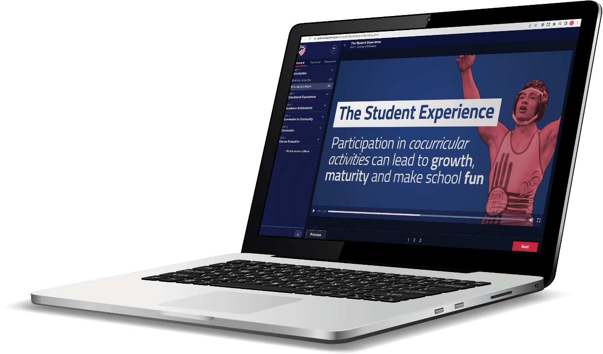
Over 17.8 million courses delivered!
Concussion in Sports – 7M
Heat Illness Prevention – 2.1M+
Sudden Cardiac Arrest – 2.2M+
The Collapsed Athlete (2020) – 51,000+
Concussion for Students – 1.1M+
Implicit Bias (2021) – 90,000+
Fundamentals of Coaching – 900,000+
First Aid, Health and Safety – 400,000+
Protecting Students from Abuse – 220,000+
Student Mental Health and Suicide Prevention – 227,000+
Bullying, Hazing and Inappropriate Behaviors – 400,000+
Appearance & Performance Enhancing Drugs and Substances – 118,000+
COVID-19 for Coaches and Administrators – 360,000+

Slide 54
NFHS Network

Slide 55


NFHS Network
By 2025, every high school sporting event in America will be streamed live.
The NFHS Network will be
THE DESTINATION for fans
to view these broadcasts.
27 Different Sports and Activities
www.NFHSnetwork.com
Notes:
The NFHS Network is the leader in streaming Live and On Demand high school sports.
Partnered with the National Federation of State High School Associations, 45 high school state athletic/activities associations, and PlayOn! Sports, the NFHS Network is a joint venture created to provide fans with the ability to stream high school sports on any device, from wherever they are.
All NFHS Network events are available to watch online at www.NFHSnetwork.com and through the NFHS Network Live App for iOS and Android. Follow us on Facebook, Twitter, Instagram, and YouTube.
Watching high school sports and events has never been easier.
The NFHS Network’s goal to broadcast live all 2 million high school sporting events by 2025.
The NFHS Network covers 27 different regular season and postseason sports, as well as other high school activities, celebrating the accomplishments of students-athletes, student broadcasters, and high schools across the country.

Slide 56

Over 1 million events this year…
Notes:
The NFHS Network will broadcast over 150,000 live events this year. If your school is not a member of the NFHS Network School Broadcast Program, please contact us at Mark.Koski@NFHSnetwork.com

Slide 57

Thank You
National Federation of State High School Associations
PO Box 690 | Indianapolis, IN 46206
Phone: 317-972-6900 | Fax: 317.822.5700
www.nfhs.org | www.nfhslearn.com | www.nfhsnetwork.com

