Slide 1
2022 NFHS Softball Rules PowerPoint
Rules Changes
Major Editorial Changes
Points of Emphasis

Slide 2
National federation of state high school associations (NFHS)

Slide 3

National Federation of
State High School Associations
NFHS (located in Indianapolis, IN – Est. 1920):
  National leader and advocate for
  high school athletics and
  performing arts programs.
  Serves 51 state associations, 19,500
  high schools and 12 million student
  participants.
  Writes playing rules for 17 high school
  sports for boys and girls.
  Offers online education courses for high school coaches,
  officials, parents, students and others.
  Ensures that students have opportunity to enjoy healthy participation, achievement and good sportsmanship in education-based athletics.
Notes:
The NFHS is the national leader and advocate for high school athletics and performing arts programs. Services of the NFHS reach more than 19,000 high schools and 12 million participants throughout the eight NFHS sections across the U.S.
A significant responsibility of the NFHS is the commitment to writing quality playing rules for 17 high school sports for boys and girls, in addition to providing educational resources for high school coaches, officials, parents and students.
It is the vision of the NFHS to help prepare tomorrow’s leaders for the next level of life through the many program offerings in education-based athletics and activities.

Slide 4








NFHS Rules Review Committee
The NFHS Rules Review Committee is chaired by the chief operating officer and composed of all rules editors. After each committee concludes its deliberations and has adopted its recommended changes for the subsequent year, such revisions will be evaluated by the Rules Review Committee.
Davis Whitfield
Chief Operating Officer
Lindsey Atkinson
Basketball, Girls Lacrosse and Volleyball
Bob Colgate
Football and Sports
Medicine
Sandy Searcy
Softball, Swimming & Diving and Water Polo
Elliot Hopkins
Baseball and Wrestling
Julie Cochran
Cross Country, Gymnastics, Field Hockey, Soccer and
Track & Field
James Weaver
Boys Lacrosse
and Spirit
Dan Schuster
Ice Hockey
Notes:
All rules committee recommended rules changes are vetted through the NFHS Rules Review Committee before advancing to the NFHS Board of Directors for final action. The committee, as you see, is comprised of all NFHS Director of Sports and chaired by the NFHS Chief Operating Officer.

Slide 5



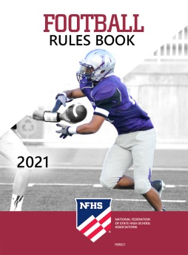
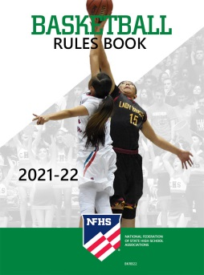
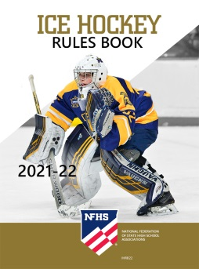
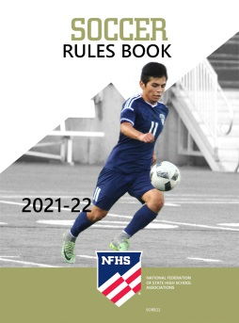




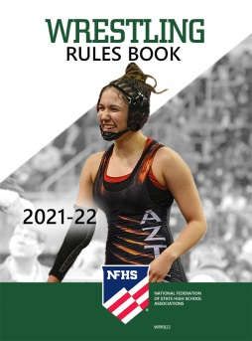
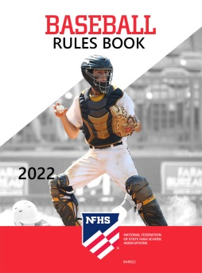

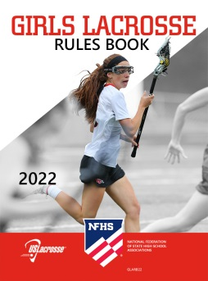
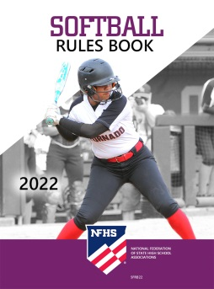


National Federation of
State High School Associations
The NFHS writes playing rules for 17 sports
for boys and girls at the high school level.
  Publishes 4 million pieces of materials annually.
Notes:
The NFHS writes playing rules for 17 sports, publishes High School Today (HST) along with several other key publications totaling over four million pieces annually.

Slide 6

NFHS Rules Book as e-Books
E-books features:
  Searchable
  Highlight areas of interest
  Make notes
  Easy navigation
  Adjustable viewing size
  Immediate availability
Notes:
The NFHS Rules and Case Book e-books are available for $6.99 each.

Slide 7

NEW NFHS Rules App
Rules App features:
  Searchable
  Highlight notes
  Bookmarks
  Quizzes for all sports
  Easy navigation
  Immediate availability
  Free to paid members of the NFHS Coaches
  and Officials Associations
  www.nfhs.org/erules for more information
Notes:
Rules app for all NFHS rules books and case books are available on iTunes and Google Play. Rules books and case books are cross-linked and enabled for searchable content.
App is free to download
Each book subscription is $6.99
NFHS Coaches and Officials Association paid members get all books for free
100% states members get books for free in sports designated by their state

Slide 8

Guidelines for Schools and state associations for consideration of accommodations
Notes:
To assist state associations in working with schools for the inclusion of students with disabilities the following guide prepared by the NFHS Task Force on the Inclusion of Students with Disabilities is being provided for your review.
Following these guidelines will assist in the individual student assessment by the student and the school.
When requesting a possible accommodation, coaches should work with their school and the state association as early as possible in the sport season.
Contest officials shall defer decisions on rule accommodations to the respective state association.
This information serves as a guide. Each state association may develop its own process.

Slide 9
2022 nfhs softball RULES CHANGES

Slide 10
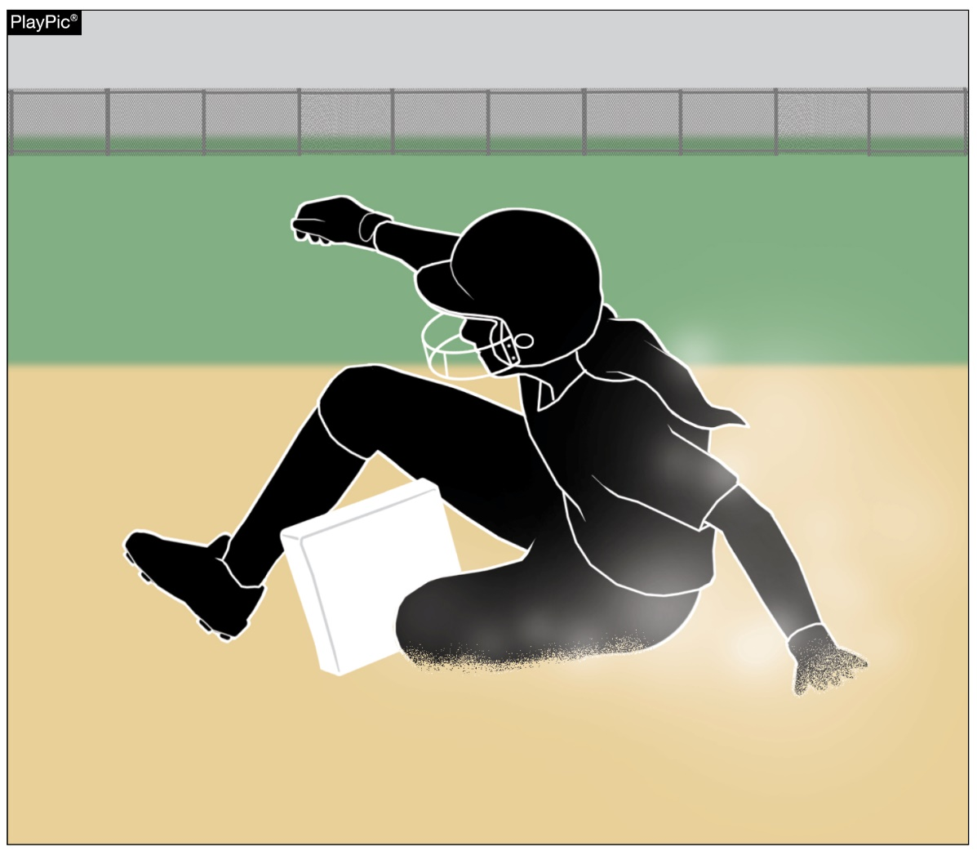
Bases, plates
Rule 1-2-1
Bases may be designed to disengage from their anchor system.
Notes:
Rule 1-2-1: Bases may be designed to disengage from their anchor system.
Rationale: Language was added to clarify that break away bases are permitted. Rule 8-8-14 EFFECT states a runner reaching a base safely will not be out for being off the base if it becomes dislodged. The NFHS interpretation has been that breakaway bases are permitted. The suggested change formalizes this interpretation and places it with other regulations covering the field and its equipment.

Slide 11
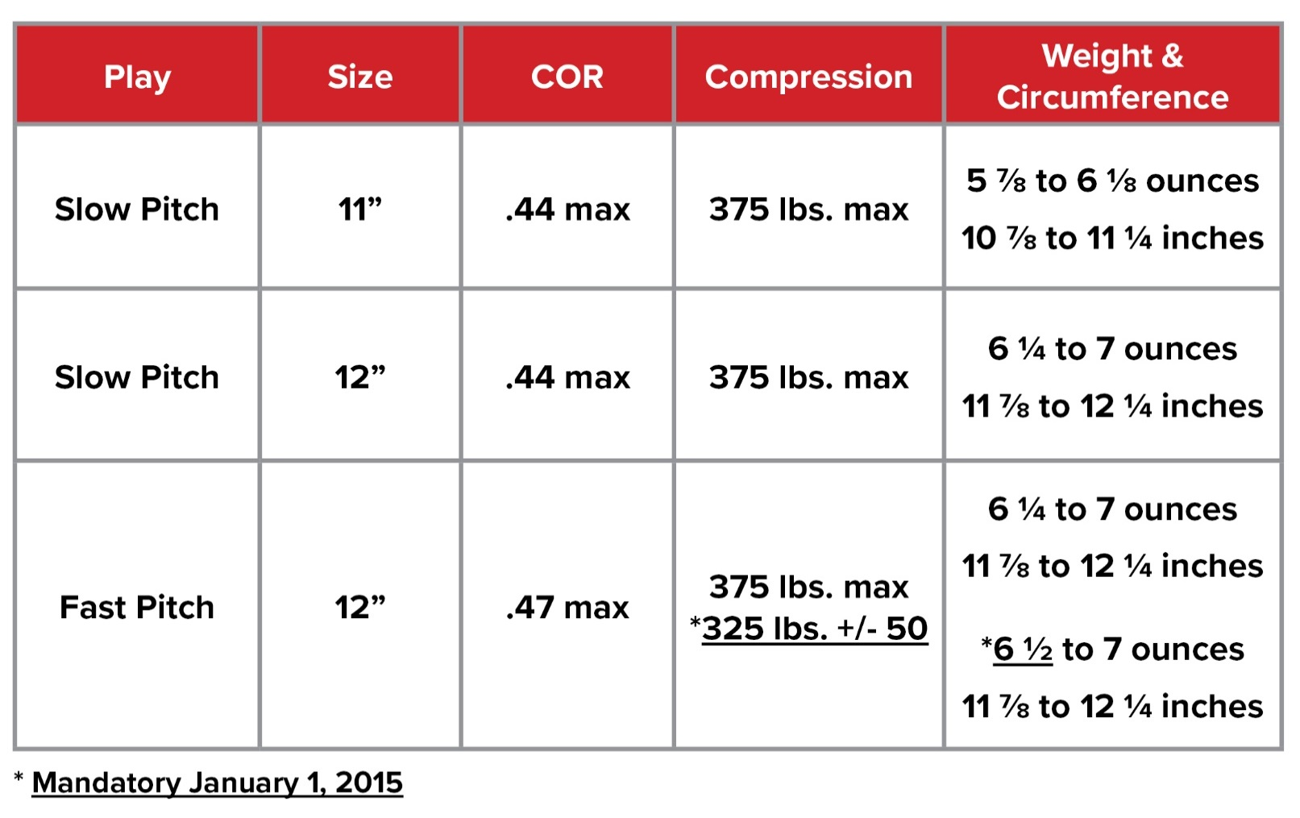
softballs
Rule 1-3-3
The new ball specifications are permissible currently and will be required January 1, 2025, for high school competition.
Balls manufactured with the current specifications will be permitted for use through 2024.
*Mandatory January 1, 2025
Notes:
Rule 1-3-3
The new ball specifications are permissible currently and will be required January 1, 2025, for high school competition.
Balls manufactured with the current specifications will be permitted for use through 2024.
Rationale: Ball tolerance specifications for the 12-inch Fast Pitch Softball have been standardized for NFHS, NCAA, and USA Softball. After conducting research on whether the minimal changes might have an impact on safety, it was determined that changing the weight from 6¼ to 6½ ounces would not increase batted ball speed. Any balls manufactured with the former specifications will be permitted through 2024, to allow for state associations manufacturers to reduce current inventory. The new ball specifications are permitted for use during the 2021-22 season and will be required by January 1, 2025.

Slide 12
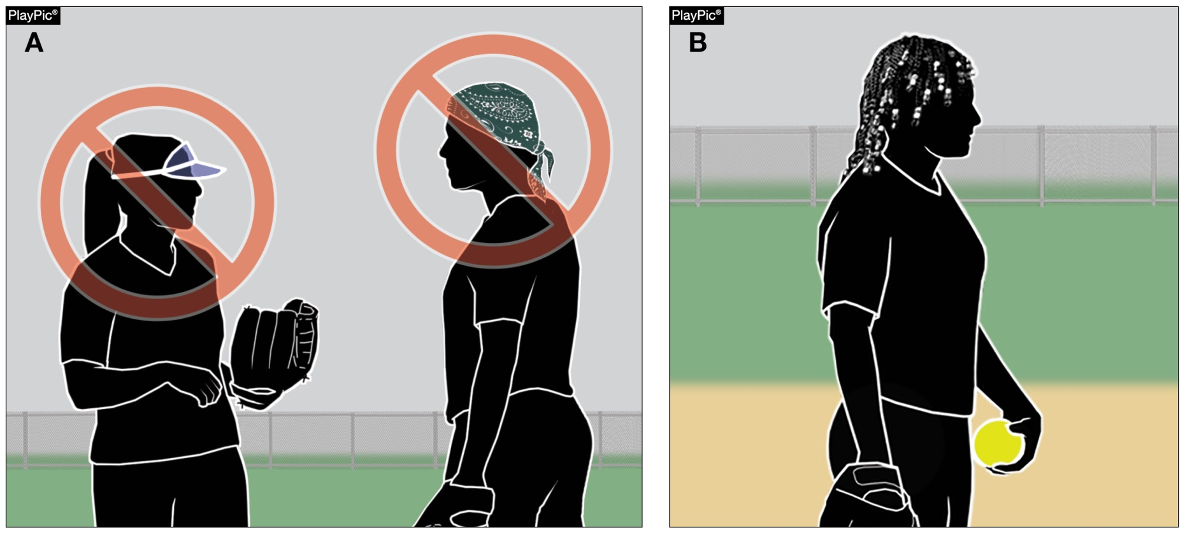
Uniforms, player equipment rule 3-2-5b, 3-2-12
Plastic visors and bandannas are still prohibited. However, language prohibiting hard items to control the hair, such as beads, has been removed.
Notes:
Rule 3-2-5b, 3-2-12 – Language prohibiting hard items to control the hair, such as beads, has been removed. However, plastic visors and bandannas are still prohibited.
Rationale: This change removes the language prohibiting hard items to control the hair and aligns language with other NFHS rules codes. Language was also removed in Rule 3-2-12 that prohibited players from wearing hard cosmetic or decorative items.

Slide 13
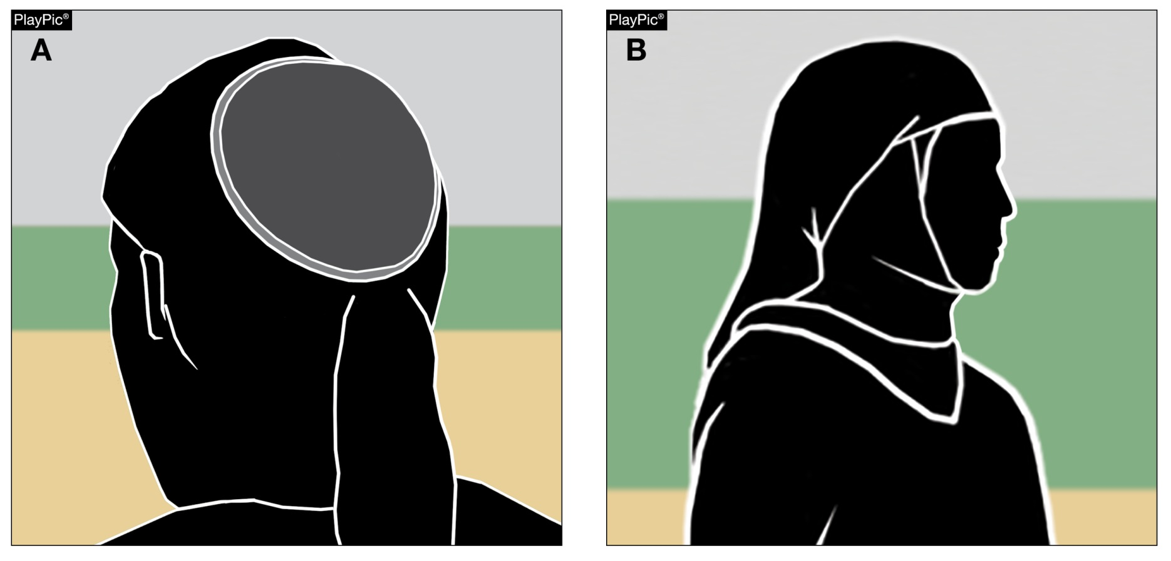
Uniforms, player equipment rule 3-2-5c
Players may wear head coverings for religious reasons. The headwear must be made of non-abrasive, soft materials and must fit securely so that it is unlikely to come off during play. Head coverings worn for medical reasons must still receive state association approval.
Notes:
Rule 3-2-5c: Players may wear head coverings for religious reasons. The headwear must be made of non-abrasive, soft materials and must fit securely so that it is unlikely to come off during play. Head coverings worn for medical reasons must still receive state association approval.
Rationale: This rule change eliminates the need for authorization from the state association for religious headwear while maintaining the requirement for approval of head coverings worn for medical reasons. The State Association shall be notified after the contest if there is a concern as to whether the head covering was worn for religious reasons.

Slide 14
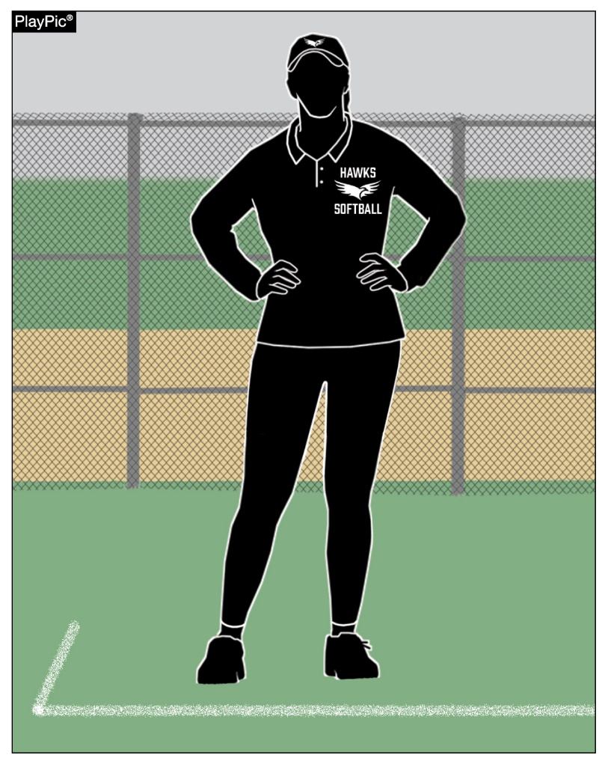
Coach attire
Rule 3-5-3
While in live-ball areas, a coach shall be attired in a school uniform or jersey/coaching shirt with slacks, shorts, or other leg coverings in school colors or colors of khaki, black, white or gray.
Notes:
Rule 3-5-3: While in live-ball areas, a coach shall be attired in a school uniform or jersey/coaching shirt with slacks, shorts, or other leg coverings in school colors or colors of khaki, black, white or gray.
Rationale: Edits for grammatical purposes. Additional language brings a coach’s attire up to date with current language used to describe a coaching garment. Reports have been submitted indicating that some female coaches were disqualified from coaching a contest due to being attired in apparel not specifically listed in the current rule. New language better defines permissible coach’s attire.

Slide 15
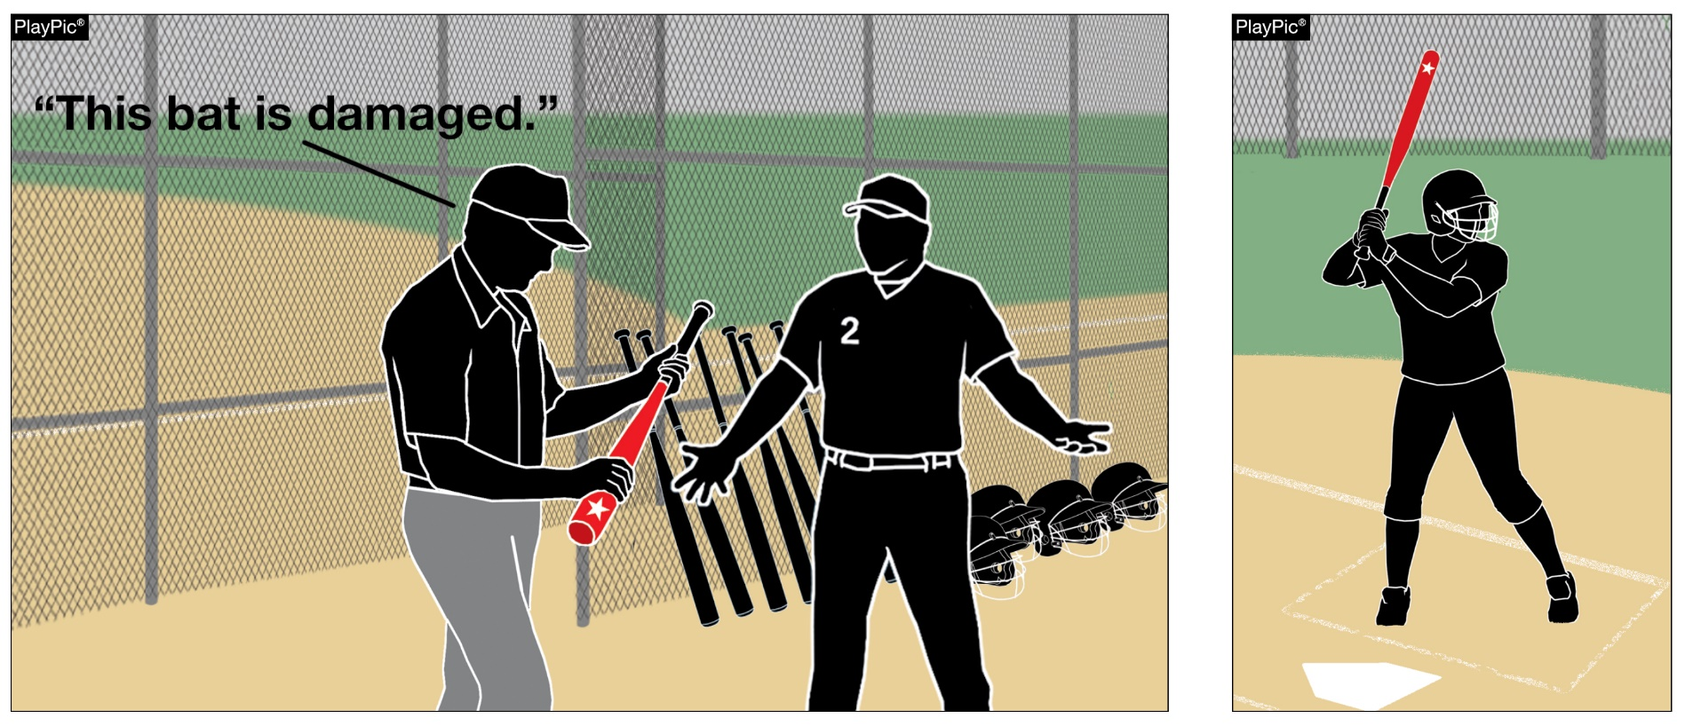
BENCH AND FIELD CONDUCT
Rule 3-6-21 & penalty (NEW)
Batters shall not use a damaged bat that was previously removed from the game by an umpire. PENALTY: The batter shall be called out and the batter and head coach shall be restricted to the dugout for the remainder of the game.
Notes:
Rule 3-6-21 and PENALTY: Batters shall not use a damaged bat that was previously removed from the game by an umpire. PENALTY: The offender shall be called out and the offender and head coach shall be restricted to the dugout for the remainder of the game.
Rationale: This new article clarifies that a damaged bat, which had been previously removed by an umpire, cannot be reintroduced to the game. It also adds a penalty, which states that the batter is out and both the player and the head coach are restricted to the dugout.
For clarification, a damaged bat is defined as a bat that was once legal and subsequently found to have cracks, rattles, dents or burrs; an illegal bat is defined as a bat that has been altered or does not meet the required specifications of a legal bat has been altered or is non-approved (Rule 7-4-2). The first offense for bringing a damaged bat into the batter’s box is the removal of the damaged equipment from the contest without further penalty. A second offense for bringing a damaged into the batter’s box or is discovered having used a damaged bat a second time will result in the batter being called out, and the head coach and the offender will be restricted to the dugout for the remainder of the contest, and all runners not put out on the play must return to the base occupied at the time of the pitch.

Slide 16
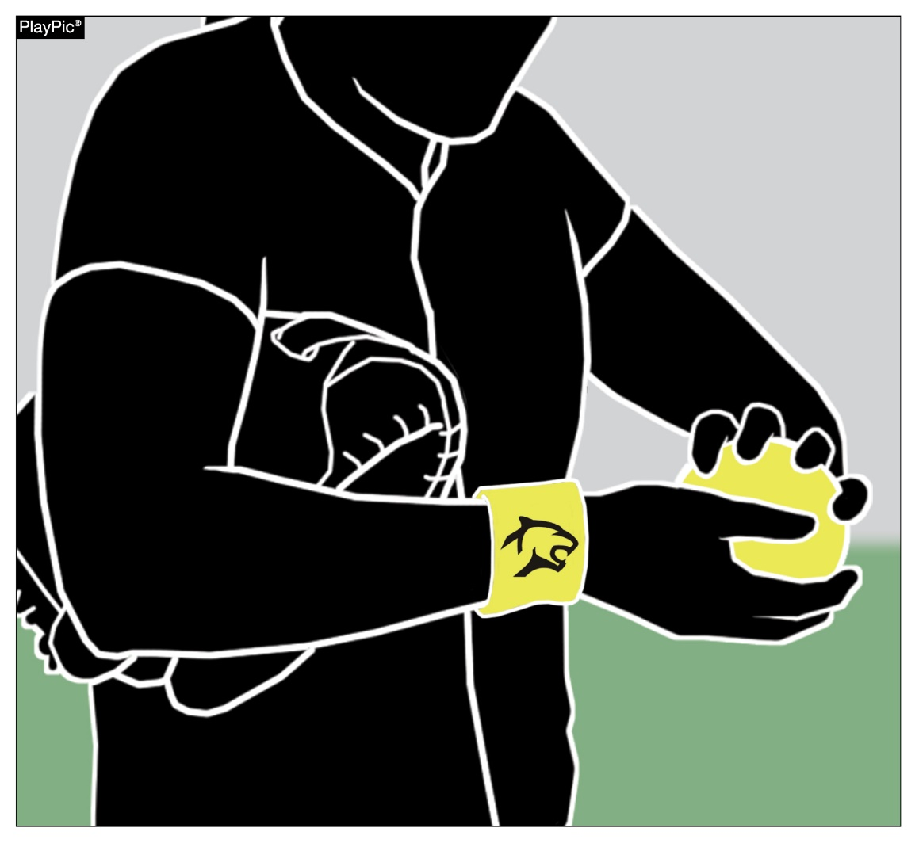
Infractions by Pitcher (fp) rule 6-2-2 & Note (NEW)
Pitchers are prohibited from wearing anything on the pitching hand, wrist, arm or thighs which the umpire judges to be distracting to the batter.
This language has been moved out of the penalty for 6-2-2 and a new note was created to clarify distracting items fall under equipment and are not subject to an illegal pitch penalty.
Notes:
Rule 6-2-2 & NOTE - Pitchers are prohibited from wearing anything on the pitching hand, wrist, arm or thighs which the umpire judges to be distracting to the batter.
This language has been moved out of the penalty for 6-2-2 and a new note was created to clarify distracting items fall under equipment and are not subject to an illegal pitch penalty.
Rationale: The pitcher having an item on the pitching hand, wrist, arm or thigh is a violation of the equipment rule and is already addressed in 3-2-9 with a penalty. Having it as a part of 6-2-2 invokes a different penalty than prescribed by Rule 3-2-9. Making it a note in this section still provides the support to keep pitchers legal in this section but removes the discrepancy in penalties.

Slide 17
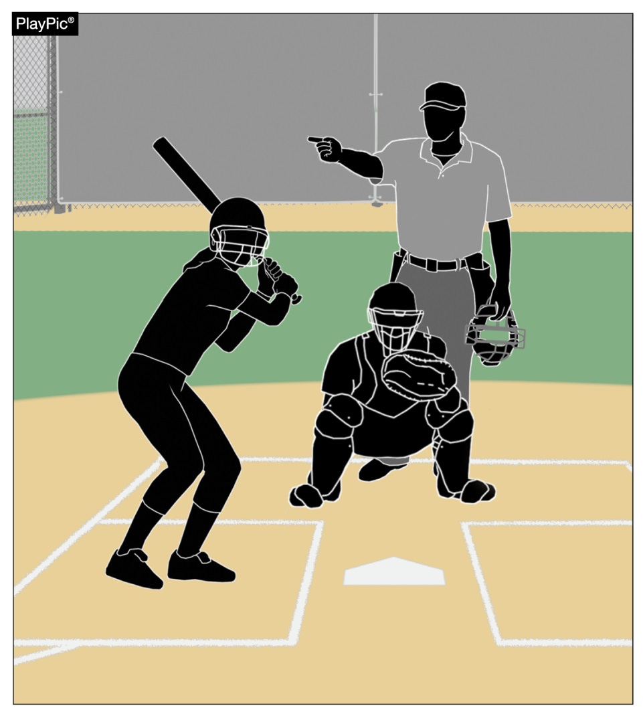
Damaged bat
Rule 7-4-15 (NEW)
Adds language to identify a batter entering the batter’s box with a damaged bat previously removed from the game is out.
Notes:
Rule 7-4-15 (NEW): Adds language to identify a batter entering the batter’s box with a damaged bat previously removed from the game is out.
Rationale: The addition of Rule 3-6-21, which defines the penalty for re-introducing a previously removed damaged bat to the game, necessitated adding new Rule 7-4-15 defining situations when the batter is out.

Slide 18
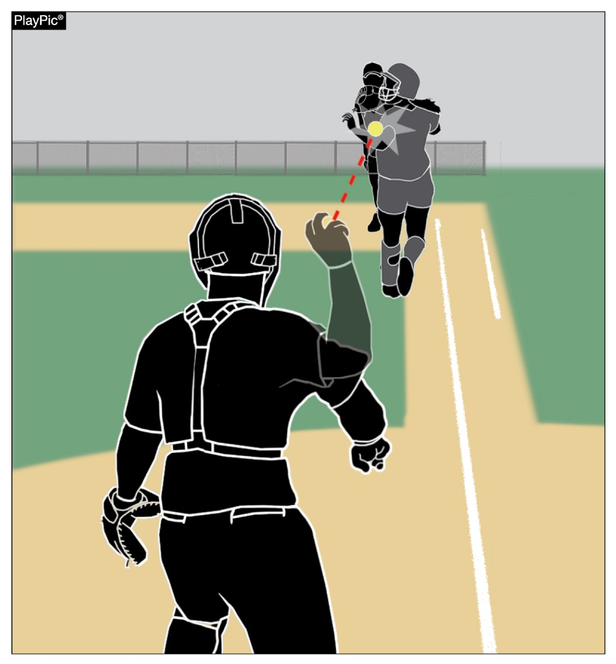
Batter-runner is out rule 8-2-6
A runner is considered outside the running lane if either foot last contacted the ground completely outside the lane.
Notes:
Rule 8-2-6: A runner is considered outside the running lane if either foot last contacted the ground completely outside the lane.
Rationale: The change clarifies a batter-runner’s location in relationship to the running lane when either foot is in the air. The batter-runner is considered to be outside of the running lane if either foot last contacted the ground completely outside the running lane.
There has been some confusion about how this rule should be officiated. Some umpires base their ruling on whether the runner’s foot is on the ground or in the air at the time of the interference. For example, the runner is not guilty of interference if they lift their foot right before being hit with the ball but are guilty of interference if the ball hits them while their foot is in contact with the ground. The intent of this rule is to ensure the batter-runner runs in the running lane. This new wording more adequately describes the intent of the rule and will provide more consistent enforcement.

Slide 19
2022 NFHS Softball
Major Editorial Changes

Slide 20
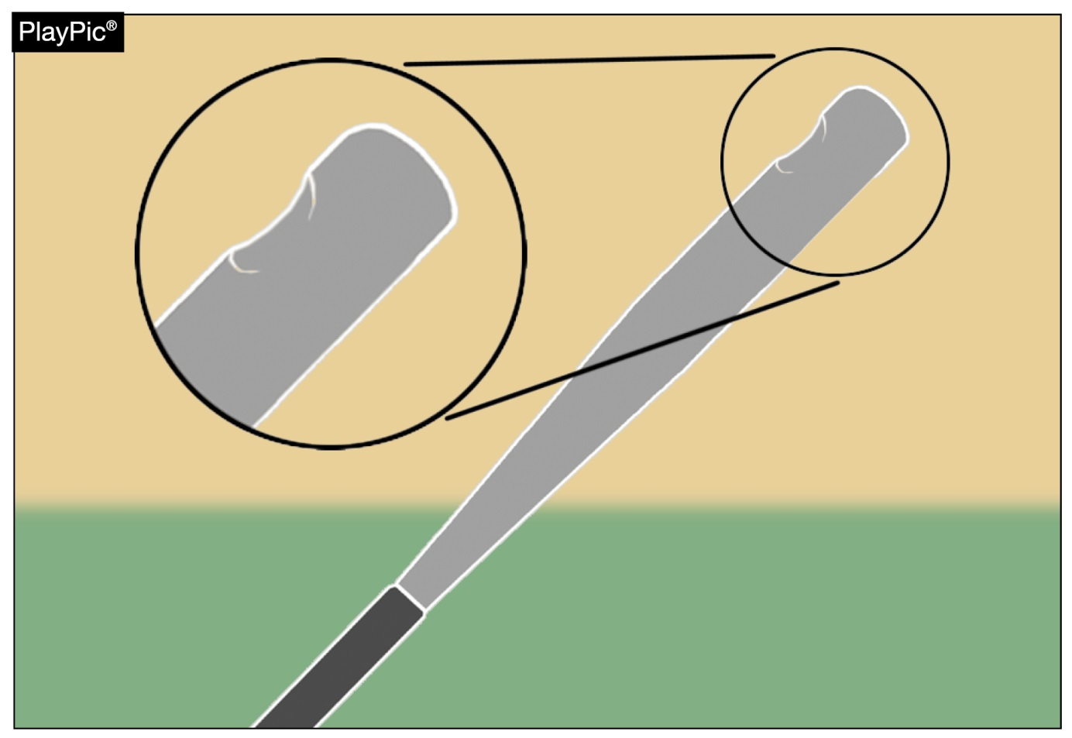
Damaged bat rule 2-4-3
A damaged bat is one that could deface the ball and the bat shall be removed when initially detected without penalty.
Also, a penalty was added for a batter detected using a damaged bat after it has been previously removed from the game.
Notes:
Rule 2-4-3: A damaged bat is one that could deface the ball and the bat shall be removed when initially detected without penalty. Also, a penalty was added for a batter detected using a damaged bat after it has been previously removed from the game.
Rationale: The addition of Rule 3-6-21, which defines the penalty for re-introducing a previously removed damaged bat to the game, necessitated adding language to the definition of a damaged bat in Rule 2-4-3.

Slide 21
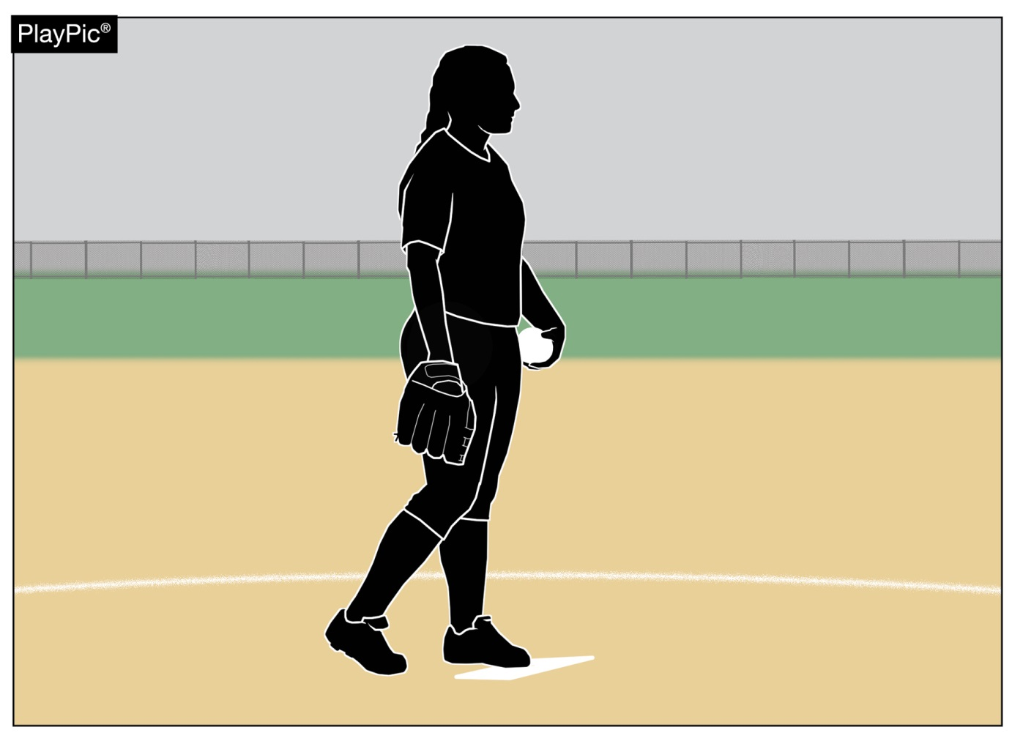
pitcher rule 2-44
The pitcher is the player who is designated in the scorebook as being responsible for delivering (pitching) the ball to the batter.
Notes:
Rule 2-44: The pitcher is the player who is designated in the scorebook as being responsible for delivering (pitching) the ball to the batter.
Rationale: Because defensive changes, including to the pitcher, are not required to be reported the pitcher may not be designated in the scorebook. This clarification will match this rule to 2-10-1 (catcher definition) and will eliminate potential conflict/confusion with 8-9-2 which defines for whom a courtesy runner may be used.

Slide 22
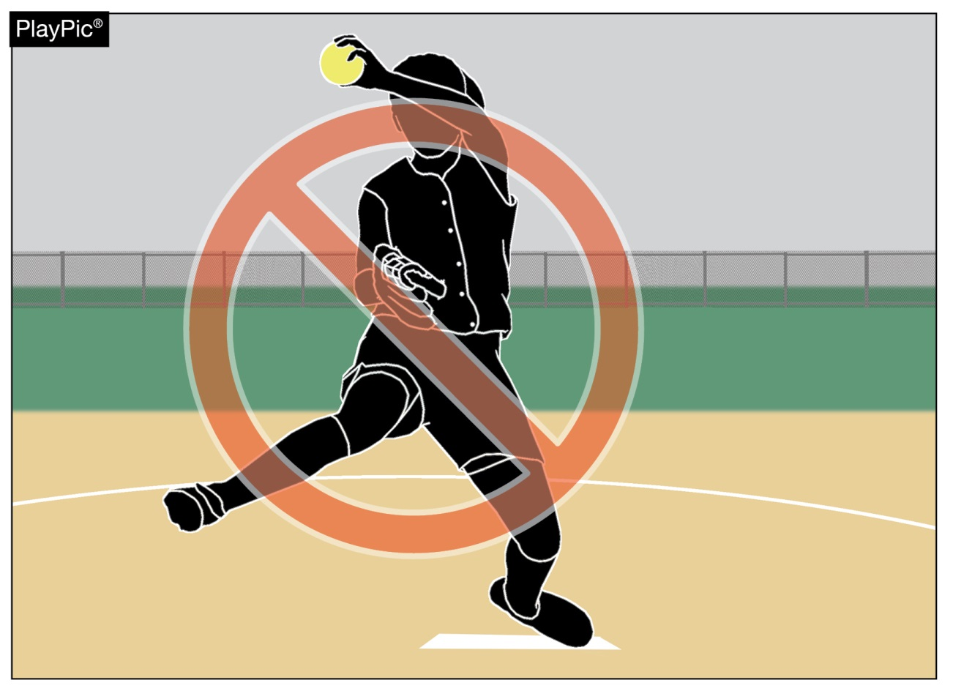
Warm-up pitches rule 3-7-1 Note
Clarifies no warm-up pitches are permitted if a pitcher is removed and then returns to the pitching circle in the same half-inning.
Notes:
Rule 3-7-1 NOTE: Clarifies no warm-up pitches are permitted if a pitcher is removed and then returns to the pitching circle in the same half-inning.

Slide 23
Doubleheaders rule 4-2-3 note 2
The number of innings for one or both games of a doubleheader may be scheduled for less than seven innings, by state association adoption.
Notes:
Rule 4-2-3 NOTE 2: The number of innings for one or both games of a doubleheader may be scheduled for less than seven innings, by state association adoption.
Rationale: Current state association game-ending procedures still apply.

Slide 24
Dead ball rule 5-1
TABLE 5-1 BALL DEAD IMMEDIATELY
Activity | References | Awards or Penalties | References
12. Fair ball touches a spectator. | 5-1-1f | Award all runners appropriate number of bases in umpire's judgement. | 8-4-3j
13. Fair ball bounces over, through or lodges in fence. | 5-1-1f | Award all runners two bases. | 8-4-3g
Table 5-1 previously combined two different rules with two completely different penalties/awards. The change separates the two rules and penalties/awards.
The remaining rule references were renumbered.
Notes:
Rule 5-1 Dead Ball Table: Table 5-1 previously combined two different rules with two completely different penalties/awards. The change separates the two rules and penalties/awards. The remaining rule references were renumbered.

Slide 25
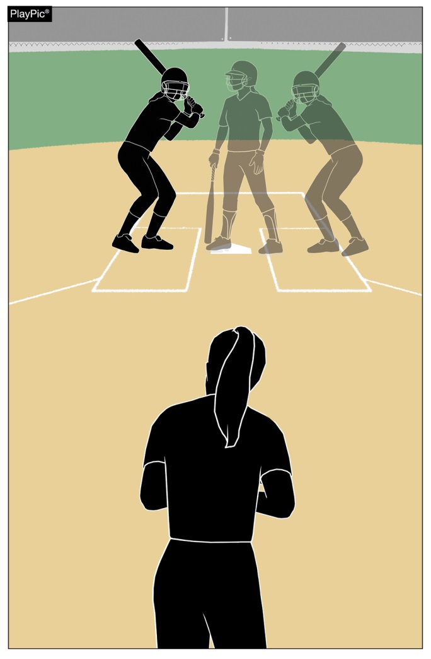
Batter’s box restrictions rule 7-3-1
A batter may not step out of the batter’s box when the pitcher is in contact with the pitcher’s plate.
Notes:
Rule 7-3-1: A batter may not step out of the batter’s box when the pitcher is in contact with the pitcher’s plate.
Rationale: Aligns language with a rule change from the previous year.

Slide 26
2022 NFHS Softball Points of Emphasis

Slide 27
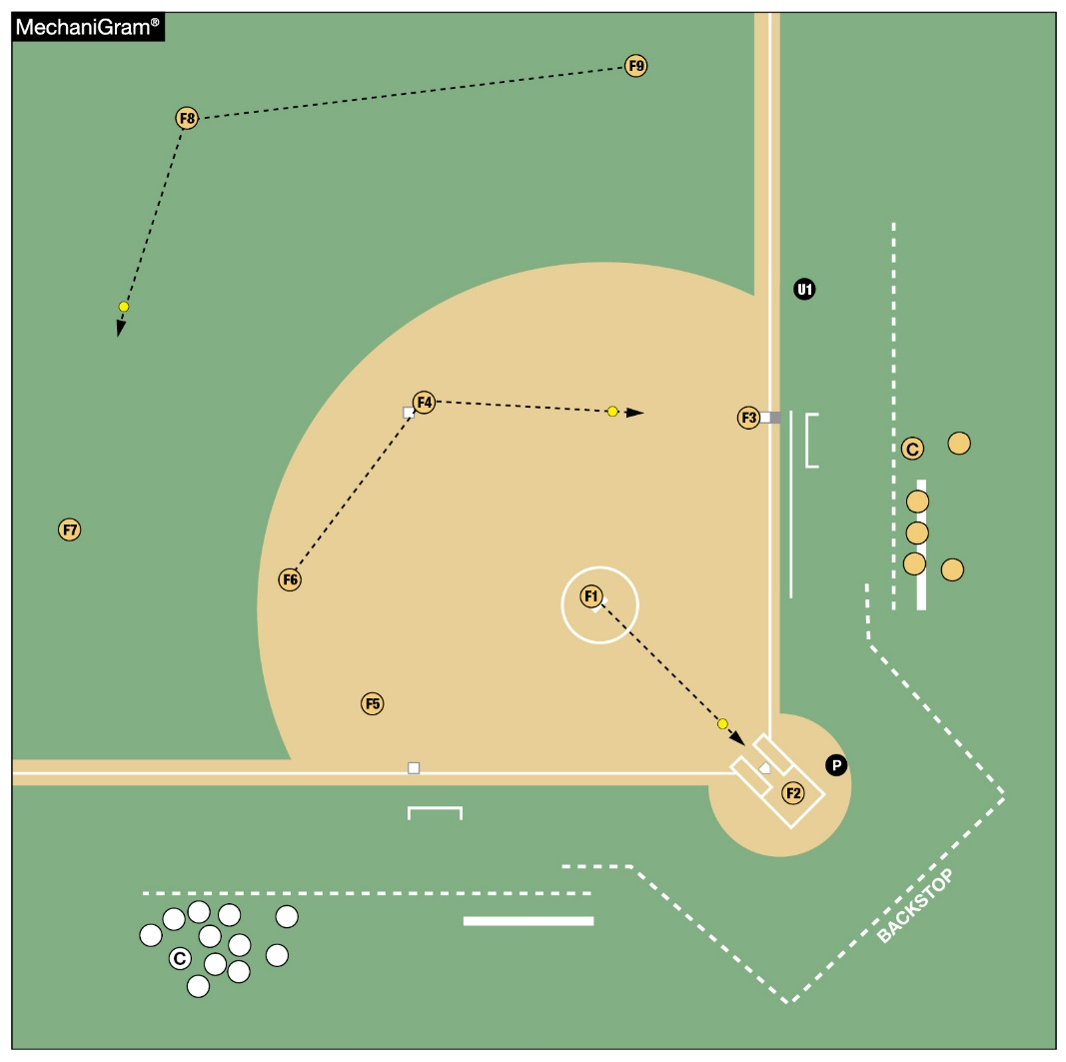
Huddles between innings
Teams choosing to huddle:
should be in a safe location
when the other team is
warming up on the field;
does not impede the warm
up of the defensive team;
does not place them in areas
where overthrows are likely.
Notes:
HUDDLES BETWEEN INNINGS
If a team chooses to huddle on the field after a third out while the other team is warming up, care should be taken to ensure they do so in a safe location. In between innings as the defensive team takes the field and begins to throw the ball, the offensive team should only huddle in an area that does not impede the warm-up of the defensive team nor places them in areas where overthrows are likely. Huddling should be limited to the amount of time needed for the defensive players to make their warm-up throws, during the one minute permitted by rule. Huddling in appropriate areas will assist with minimizing risk to participants.

Slide 28
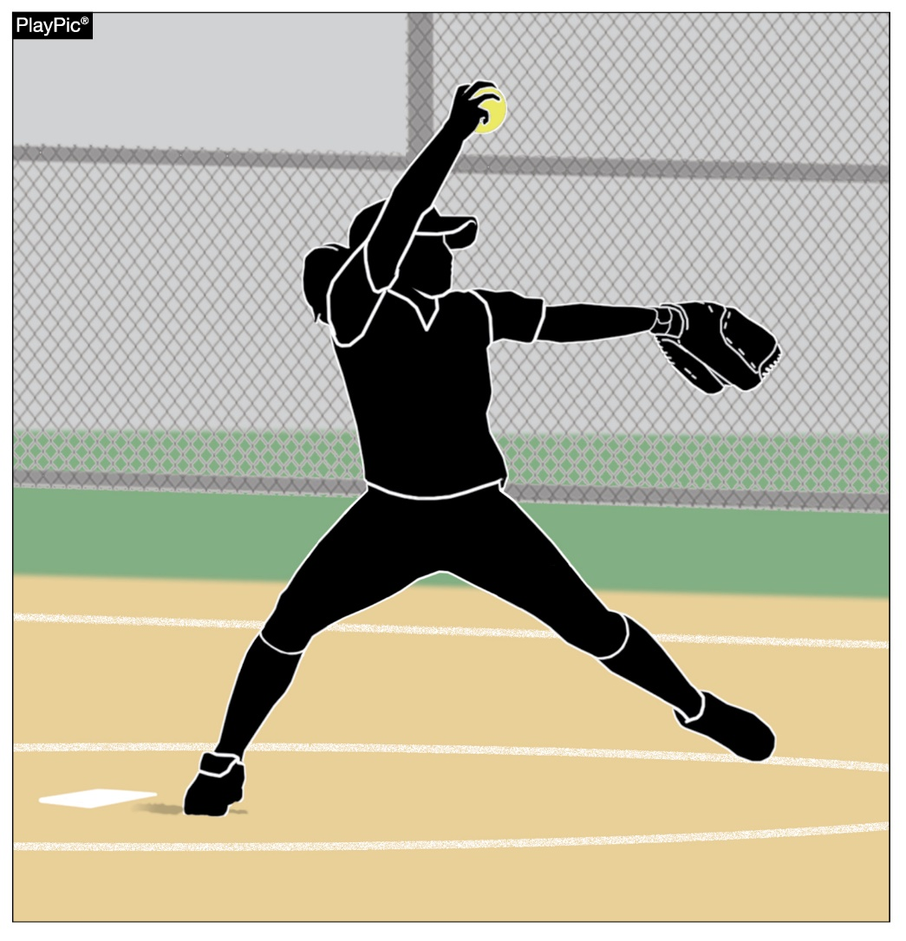
Guidance for pitcher utilization
Ongoing concern regarding overuse injuries of the shoulder and elbow of softball pitchers at the high school level;
Available injury data do not warrant the implementation of pitch or inning limitations;
Committees will continue to monitor all available research.
Notes:
GUIDANCE FOR PITCHER UTILIZATION
The past several years have seen an increasing concern regarding overuse injuries of the shoulder and elbow among softball pitchers at the high school level. The NFHS Sports Medicine Advisory Committee (SMAC) and the NFHS Softball Rules Committee continue to monitor injury rates of high school softball players through the National High School Sports-Related Injury Surveillance Study [High School Reporting Online (RIO)], which is an annual collection of injuries experienced while participating in high school sports. The injury data are presented to the NFHS Softball Rules Committee each year and reviewed when applicable to rule proposals.
At this point in time, the available injury data do not warrant the implementation of pitch or inning limitations for high school softball. Proper technical, mental, nutritional and physical training before, during and after pitching with appropriate rest and recovery time are important components in the development of a softball pitcher, from youth through high school. The development of multiple pitchers on a team will help share the pitching load as well.
The NFHS Softball Rules Committee and the NFHS SMAC will continue to monitor RIO and other available research regarding shoulder and elbow injury risk for high school softball pitchers.

Slide 29
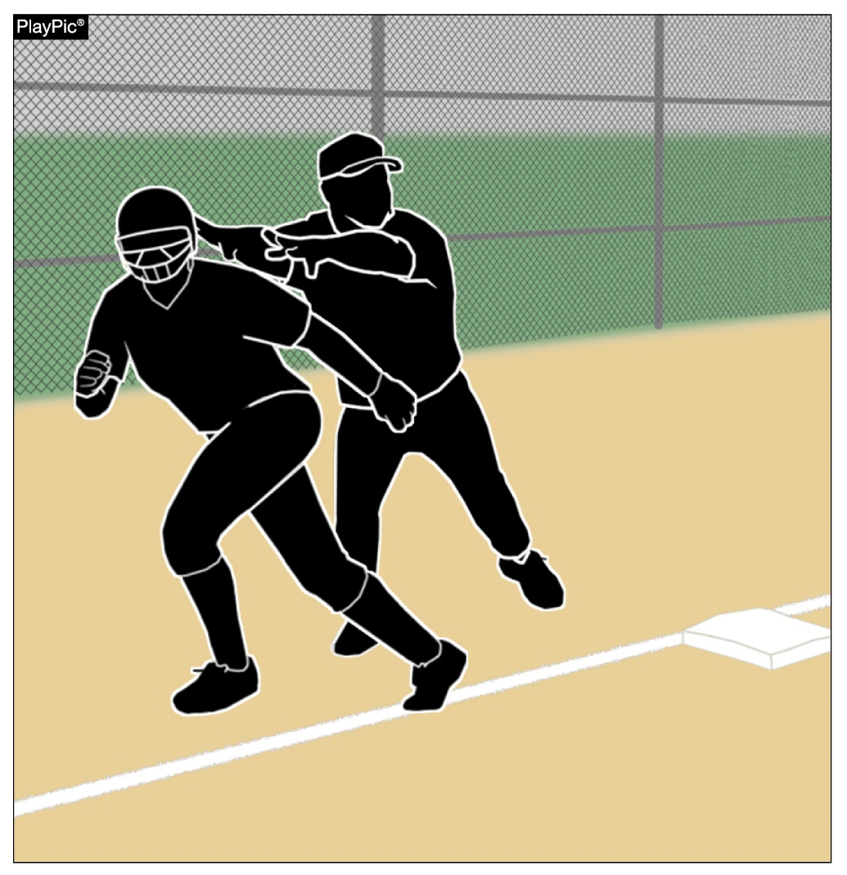
Assisting a runner
Coaches or any other team personnel are not permitted to assist a runner during playing action.
When a home run occurs, although the ball is out of play (enters dead ball territory), runners have live ball running responsibilities and are still required to legally run the bases.
Notes:
ASSISTING A RUNNER
To score a run, the runner must legally advance to and touch first, second, third and then home plate. Coaches or any other team personnel are not permitted to assist a runner in any manner during playing action. When a home run occurs, although the ball is out of play (enters dead-ball territory), runners have live-ball running responsibilities and are still required to legally run the bases. If someone other than another runner physically assists a runner, the assisted runner is ruled out. Similarly, if the runner passes another runner they would be ruled out. Lastly, if the runner misses a base and it is properly appealed, the runner would also be ruled out.

Slide 30
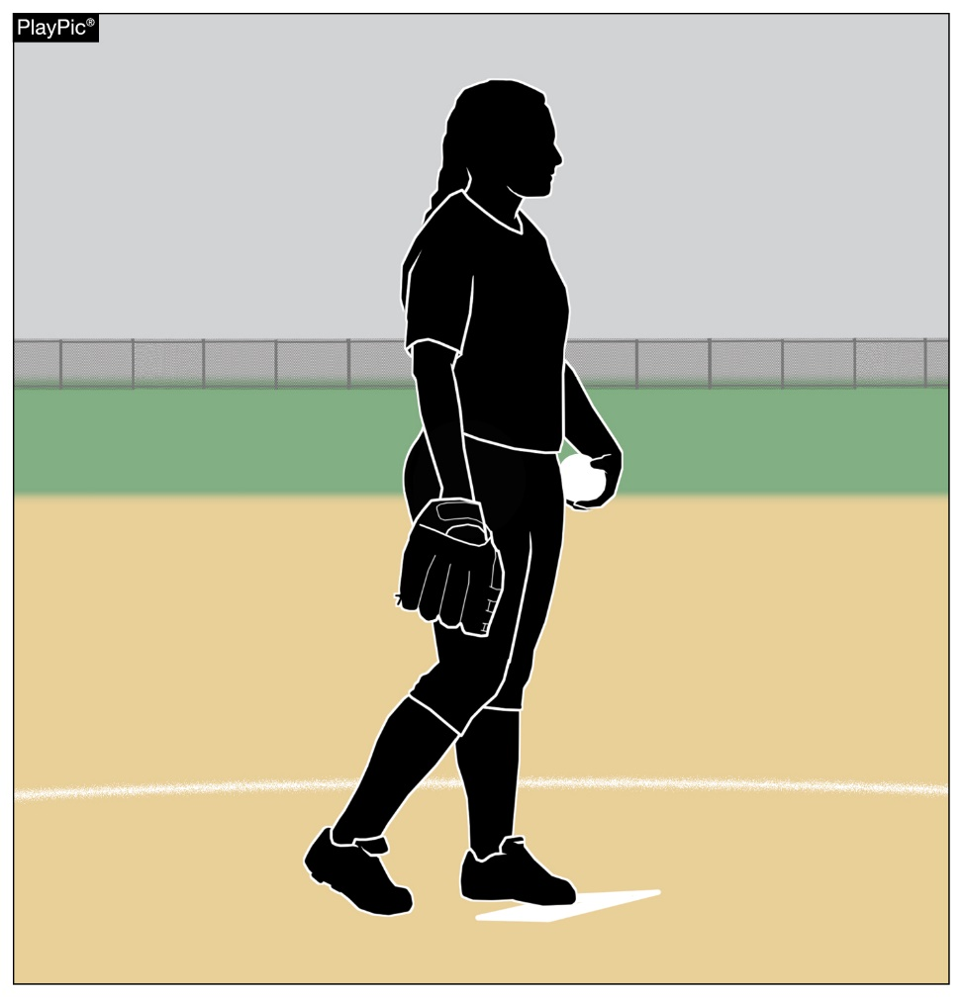
Pitcher simulating taking a sign
While the pivot foot is in contact with the pitcher’s plate and prior to bringing the hands together, the pitcher must take or simulate taking a signal from the catcher.
A signal may be taken from a coach either by hand signal, verbal call, or by looking up on a wristband with a playbook/playcard.
If the pitcher does not pause after stepping onto the pitcher’s plate, an illegal pitch should be called.
Notes:
PITCHER SIMULATING TAKING A SIGN
While the pivot foot is in contact with the pitcher’s plate and prior to bringing the hands together the pitcher must take or simulate taking a signal from the catcher. A signal may be taken from a coach either by hand signal, verbal call, or by looking up on a wristband with a playbook/playcard. This signal can be taken while in contact with the pitcher’s plate or while standing behind the pitcher’s plate prior to taking a position in contact with the pitcher’s plate. None of these actions are illegal by rule; the only requirement is that no matter where or from whom the actual signal is obtained, the pitcher must take a position with the pivot foot in contact with the pitcher’s plate with the hands separated and simulate taking a signal from the catcher prior to bring their hands together, an illegal pitch should be called.

Slide 31
NFHS OFFICIALS Education

Slide 32







OFFICIALS EDUCATION
CONTENT IS NOW FREE
TEACHING AIDS
RULES
CHANGES
VIDEO
LIBRARY
OFFICIALS
COURSES
DIAGRAMS
Notes:
Sport-Specific Officiating courses are offered in several sports. They are ideal for new officials and those in the first few years of officiating. These courses introduce officials to the mechanics and techniques used in the sport and provide specific information on an area within that sport. Individuals can complete a course within 30-45 minutes. These courses are free to all officials and prospective officials.
“Interscholastic Officiating” is a general course on sports officiating, and it is free to all officials and prospective officials. This course provides an introduction to skills and concepts used as an official. Several topics are covered such as: basics of becoming and staying an official, science of officiating, art of officiating, how to combine these skills for successful officiating.
Video clips are made available to NFHS Officials Association members. The video is clipped on specific topics and provides the rules references as well as dialogue on the topic.
The courses and videos are offered at www.NFHSLearn.com .
Courses Available:
Officiating Football
Officiating Volleyball – Ball Handling
Officiating Volleyball – Alignment
Officiating Volleyball – E-Whistle
Officiating Basketball
Officiating Basketball – Three-Person Mechanics
Officiating Basketball - Pre-Game Conference
Soccer – Fouls and Misconduct
Soccer – Offside
Soccer - Pre-Game Conference
Swimming and Diving
Officiating Wrestling
Umpiring Softball
Officiating Field Hockey
Officiating Track and Field
Future Courses to be Considered:
Umpiring Baseball
Umpiring Softball – 2 Person Mechanics
Communication Among Officials and Coaches

Slide 33

Notes:
NFHS CENTER FOR OFFICIALS SERVICES (COS)
Your Complete Solution for Officials Management and More:
Registration
Assignment
Payment
Testing
Background Checks
For More Information on the NFHS – Center for Officials Services (COS) Contact:
Theresia Wynns, Director of Sports and Officials, twynns@nfhs.org
Also If You’re Interested in Eligibility and Monitoring Requirements Contact
the Folks at Dragonfly:
Kirk Miller, Dragonfly, kirk@dragonflyathletics.com
Brandon Wallace, Dragonfly, brandon@dragonflyathletics.com

Slide 34
NFHS Learning Center

Slide 35

Notes:
The NFHS Learning Center can be accessed at www.nfhslearn.com. It has over 80 online courses and over 50 of those can be accessed at no cost. There are courses for everyone within the interscholastic community including coaches, students, administrators, parents, officials, and individuals within performing arts programs. All courses include a completion certificate and can be accessed 24 hours a day, 7 days a week and completed at the learner’s pace. Get your community involved in professional development today at the NFHS Learning Center!

Slide 36
NFHS Network

Slide 37


NFHS Network
By 2025, every high school sporting event in America will be streamed live.
The NFHS Network will be
THE DESTINATION for fans
to view these broadcasts.
27 Different Sports and Activities.
www.NFHSnetwork.com
Notes:
The NFHS Network is the leader in streaming Live and On Demand high school sports.
Partnered with the National Federation of State High School Associations, 45 high school state athletic/activities associations, and PlayOn! Sports, the NFHS Network is a joint venture created to provide fans with the ability to stream high school sports on any device, from wherever they are.
All NFHS Network events are available to watch online at www.NFHSnetwork.com and through the NFHS Network Live App for iOS and Android. Follow us on Facebook, Twitter, Instagram, and YouTube.
Watching high school sports and events has never been easier.
The NFHS Network’s goal to broadcast live all 2 million high school sporting events by 2025.
The NFHS Network covers 27 different regular season and postseason sports, as well as other high school activities, celebrating the accomplishments of students-athletes, student broadcasters, and high schools across the country.

Slide 38

Notes:
The NFHS Network will broadcast over 150,000 live events this year. If your school is not a member of the NFHS Network School Broadcast Program, please contact us at Mark.Koski@NFHSnetwork.com

Slide 39
2022 NFHS softball resources

Slide 40

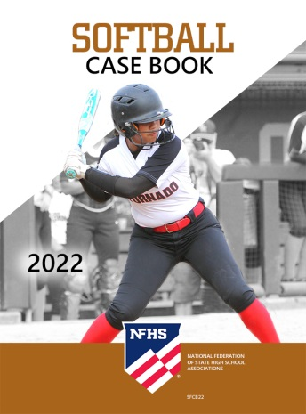



nfhs softball resources
NFHS Rules Books, Case Books
and other softball resources can be ordered:
  online at www.nfhs.com
  by calling 1-800-776-3462
Notes:
NFHS SOFTBALL PUBLICATIONS
The NFHS softball publications are available to order online or by using the toll-free number.

Slide 41

Thank You
National Federation of State High School Associations
PO Box 690 | Indianapolis, IN 46206
Phone: 317-972-6900 | Fax: 317.822.5700
www.nfhs.org | www.nfhslearn.com | www.nfhsnetwork.com

