Slide 1
2022 NFHS Football rules powerpoint
Notes:
This PowerPoint presentation from the National Federation of State High School Associations (NFHS) covers the following:
2022 NFHS Football Rules Changes-
2022 NFHS Football Editorial Changes-
2022 NFHS Football Points of Emphasis-
2022 NFHS Football Rules Reminders-
2022-2023 NFHS Football Game Officials Manual Reminders-
2022-23 NFHS Football Information-

Slide 2
National federation of state high school associations (NFHS)

Slide 3

National Federation of
State High School Associations
NFHS (located in Indianapolis, IN – Est. 1920):
  National leader and advocate for
  high school athletics and
  performing arts programs.
  Serves 51 state associations, 19,500
  high schools and 12 million student
  participants.
  Writes playing rules for 17 high school
  sports for boys and girls.
  Offers online education courses for high school coaches,
  officials, parents, students and others.
  Ensures that students have opportunity to enjoy healthy participation, achievement and good sportsmanship in education-based athletics.
Notes:
Comment on Slide:
Overview of the NFHS.

Slide 4








NFHS Rules Review Committee
The NFHS Rules Review Committee is chaired by the chief operating officer and composed of all rules editors. After each committee concludes its deliberations and has adopted its recommended changes for the subsequent year, such revisions will be evaluated by the Rules Review Committee.
Davis Whitfield
Chief Operating Officer
Lindsey Atkinson
Basketball, Girls Lacrosse and Volleyball
Bob Colgate
Football and Sports
Medicine
Sandy Searcy
Softball, Swimming & Diving and Water Polo
Elliot Hopkins
Baseball and Wrestling
Julie Cochran
Cross Country, Gymnastics, Field Hockey, Soccer and
Track & Field
James Weaver
Boys Lacrosse
and Spirit
Dan Schuster
Ice Hockey
Notes:
Comment on Slide:
Overview of NFHS Rules Review Committee.

Slide 5

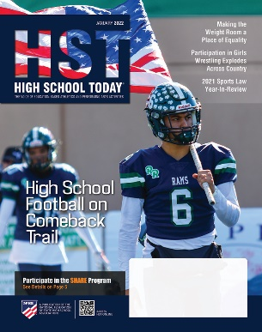

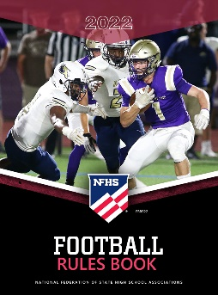


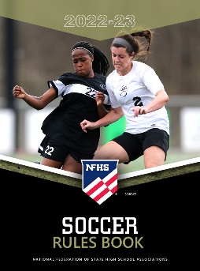
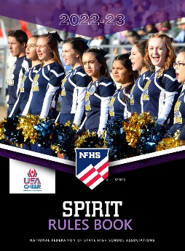


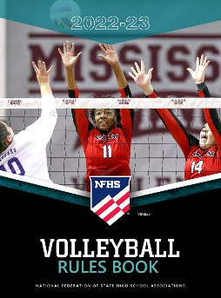







National Federation of
State High School Associations
The NFHS writes playing rules for 17 sports
for boys and girls at the high school level.
  Publishes 4 million pieces of materials annually.
Notes:
Comment on Slide:
Overview of NFHS Rules Books and Publications.

Slide 6
2022 nfhs football rules changes

Slide 7
Nfhs football rules
Each state high school association adopting these NFHS football rules is the sole and exclusive source of binding rules interpretations for contests involving its member schools. Any person having questions about the interpretation of NFHS football rules should contact the football rules interpreter designated by the respective state high school association.
The NFHS is the sole and exclusive source of model interpretations of NFHS football rules. State rules interpreters may contact the NFHS for model football rules interpretations. No other model football rules interpretations should be considered.
Notes:
Comment on Slide:
This statement appears at the bottom of page two in the 2022 NFHS Football Rules Book.

Slide 8
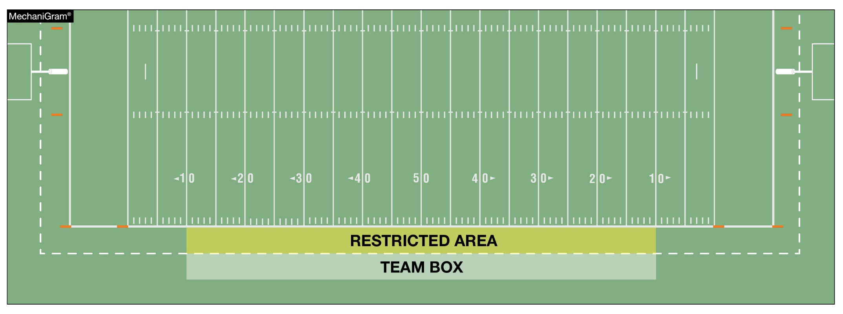
TEAM BOXES rule 1-2-3g NOTES 3. (NEW), TABLE 1-7 (3.) (New)
It is permissible for state associations to approve an extension of the team box and to determine the individuals who may be in the extended area, provided such extension is the same for both teams.
Notes:
Rule Change:
RULE 1 – SECTION 2 THE FIELD ANE MARKINGS …
ART. 3 . . . Lines and other markings: …
g. Team boxes shall be marked on each side of the field outside the coaches’ area between the 25-yard lines for use of coaches, substitutes, athletic trainers, etc., affiliated with the team. The coaches' area is a minimum of a 2-yard belt between the front of the team box and the sideline, and becomes a restricted area when the ball is live.
NOTES:
1. It is permissible for both team boxes to be on the same side of the field, provided each team box is marked between respective 20- and 45-yard lines.
2. It is recommended goal lines and the team box boundaries be marked in a color which contrasts with other field markings and the area between the sidelines and the team box boundaries be solid white or marked with diagonal lines.
3. It is permissible for state associations to approve an extension of the team box and to determine the individuals who may be in the extended area, provided such extension is the same for both teams.
RULE 1 – TABLE 1-7 – TABLE OF STATE ASSOCIATION ADOPTIONS …
3. Approve an extension of the team box if the same for both teams. (1-2-3g NOTE 3)
Rationale for Change:
By state association adoption, the team box may now be extended beyond the 25-yard line.

Slide 9
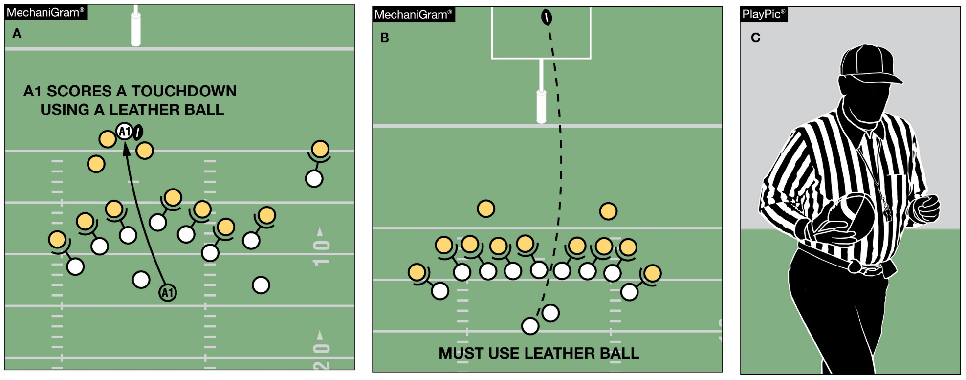
Game balls rule 1-3-3
Any game official may order the ball changed between downs. Unless the ball is ordered changed by the Referee or another game official, Team A scoring a touchdown with one ball (MechaniGram A) may not request a different ball for the try (MechaniGram B) but may use a different approved ball for the ensuing free kick (PlayPic C).
Notes:
Rule Change:
RULE 1 – SECTION 3 GAME EQUIPMENT …
ART. 3 . . . The referee shall decide whether the ball meets specifications, and the referee or any other game official may order the ball changed between downs.
Rationale for Change:
Any game official may order the ball changed between downs.
Case Book: See SITUATIONS 1.3.3A, 1.3.3B

Slide 10
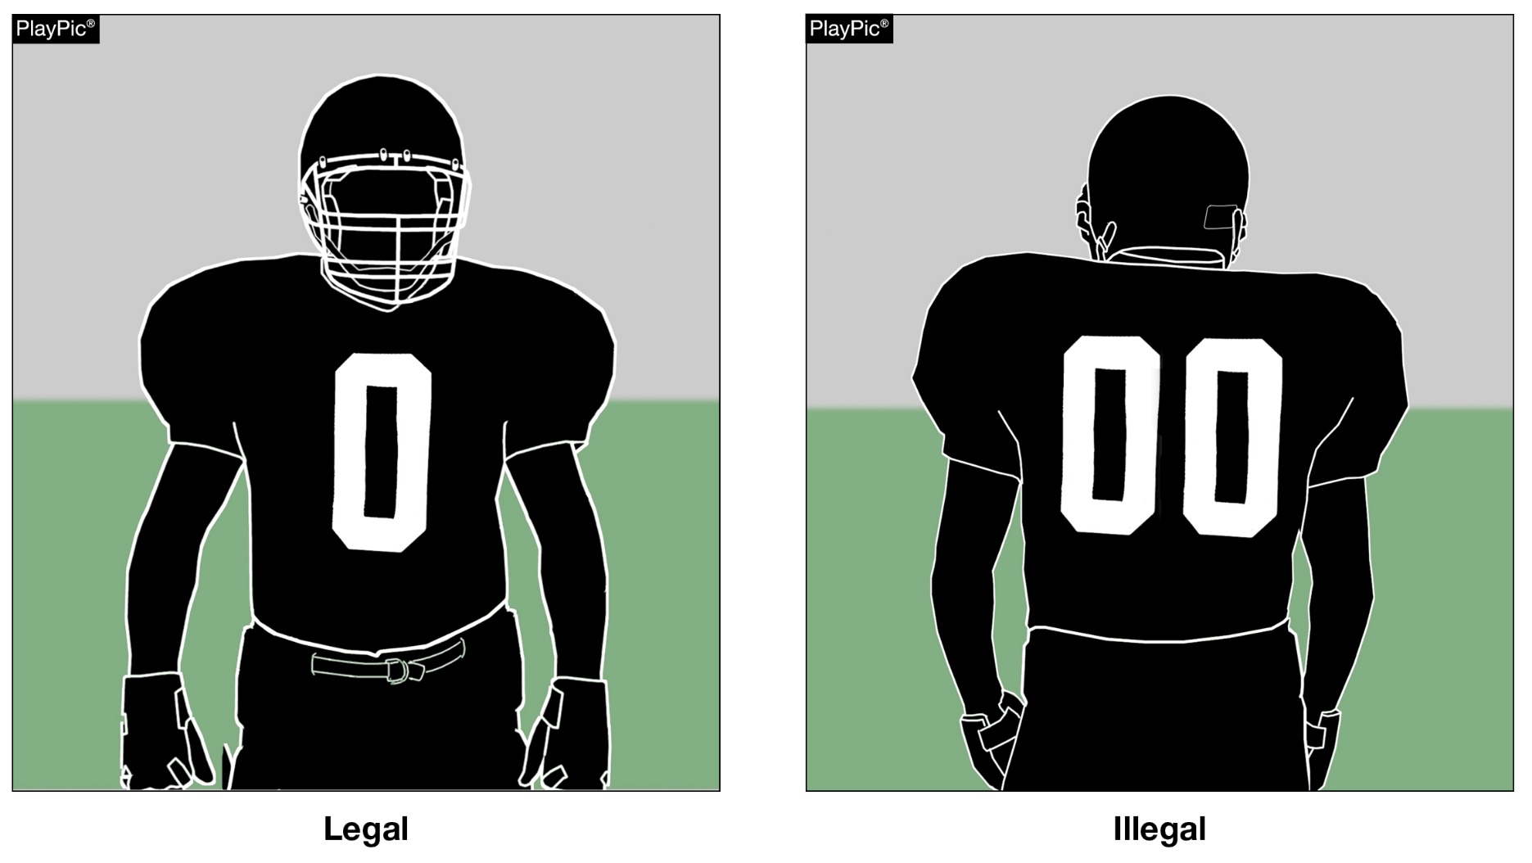
Jersey numbers rule 1-4-3, FIGURE 1-4-2, Rule 1-5-1c(1), rule 7-2-5b EXCEPTIONS, RULE 7-5-6a
Each player shall be numbered 0 though 99 inclusive. Any number preceded by the digit zero such as “00” is illegal.
Notes:
Rule Change:
RULE 1 – SECTION 4 PLAYER DESIGNATIONS …
ART. 3 . . . Each player shall be numbered 0 through 99 inclusive. Any number preceded by the digit zero is illegal. See 7-2-5.
RULE 1 – SECTION 5 PLAYER EQUIPMENT …
ART. 1 . . . Mandatory equipment. Each player shall participate while wearing the following pieces of properly fitted equipment, which shall be professionally
manufactured and not altered to decrease protection: …
c. Numbers
The numbers shall be clearly visible and legible using Arabic numbers 0-99 inclusive and shall be on the front and back of the jersey.
RULE 7 – SECTION 2 FORMATION/POSITION, NUMBERSING AND ACTION AT THE SNAP …
ART. 5 . . . Player formation and numbering requirements include:
a. No more than four A players may be backs and only one A player
b. At the snap, at least five A players on their line of scrimmage must be numbered 50-79.
EXCEPTIONS:
1. On first, second or third down, when A sets or shifts into a scrimmage-kick formation as in 2-14-2a, the snapper may be a player numbered 0 to 49 or 80 to 99. If Team A has the snapper in the game under this exception, Team A shall have four players wearing numbers 50-79 on its line of scrimmage. The snapper in the game under this exception must be between the ends and is an ineligible forward-pass receiver during that down unless the pass is touched by B (7-5-6b).
2. On fourth down or during a kick try, when A sets or shifts into a scrimmage-kick formation, any A player numbered 0 to 49 or 80 to 99 may take the position of any A player numbered 50 to 79. A player in the game under this exception must assume an initial position on his line of scrimmage between the ends and he remains an ineligible forward-pass receiver during that down unless the pass is touched by B (7-5-6b).
RULE 7 – SECTION 5 FORWARD-PASS CLASSIFICATION …
ART. 6 . . . Pass eligibility rules apply only to a legal forward pass. The following players are eligible pass receivers:
All A players eligible by position and number including those who, at the time of the snap, are on the ends of their scrimmage line or legally behind the line (possible total of six) and are numbered 0-49 or 80-99. (7-2-5b EXCEPTION 2)
Rationale for Change:
The single digit number "0" is now a legal number.
Case Book: See SITUATION 1.4.3

Slide 11
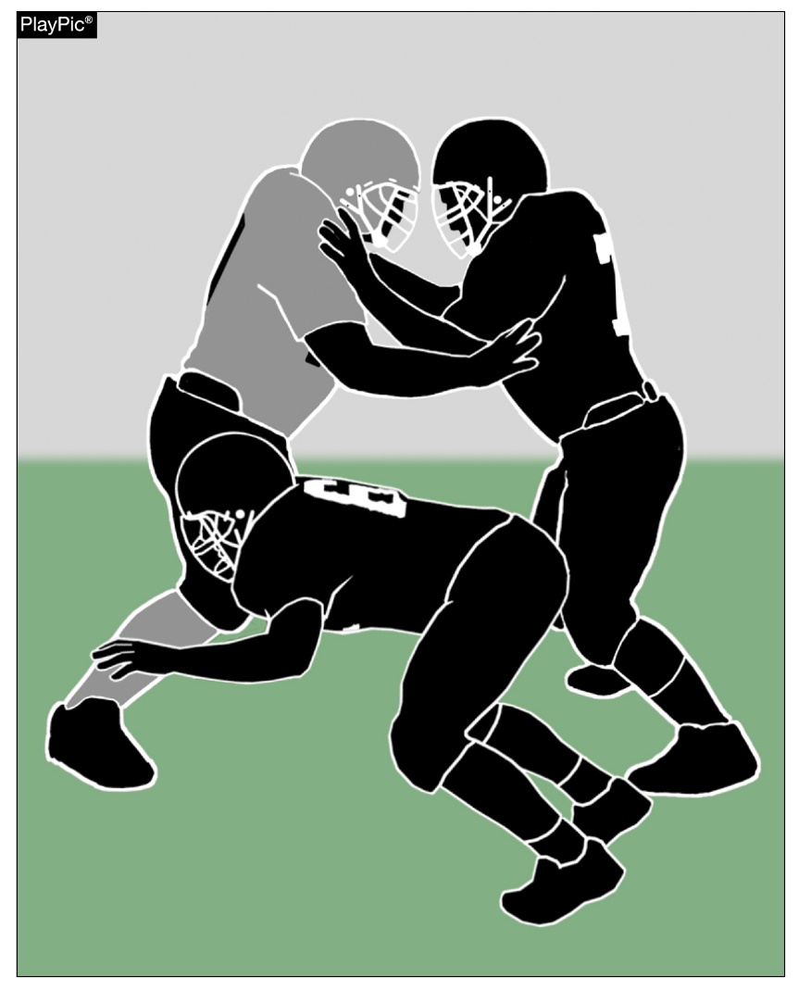
CHOP BLOCK
RULE 2-3-8
A chop block is combination block by two or more teammates against an opponent other than the runner, with or without delay, where one of the blocks is below the waist and one of the blocks is above the waist.
Notes:
Rule Change:
RULE 2 – SECTION 3 BLOCKING …
ART. 8 . . . Chop block is a combination block by two or more teammates against an opponent other than the runner, with or without delay, where one of the blocks is below the waist and one of the blocks is above the waist.
Rationale for Change:
A chop block has been redefined as an illegal combination block where contact is made above and below the waist.
Case Book: See SITUATION 9.3.2F
CORRECTED - 9.3.2 SITUATION F: A1 and A2 combine in blocking B1 as follows: (a) both block B1 downfield with A1 making contact above the waist and A2 simultaneously making contact below the waist but above the knees; or (b) both block B1 in the free-blocking zone with A1's block above the waist and A2's block below the waist; or (c) A1 blocks B1 above the waist as part of immediate, initial action following the snap and at the same time, A2 blocks B1 below the waist and above the knees; or (d) both A1 and A2 block B1 below the knees from the front of B1 while in the free-blocking zone. RULING: In (a), (b) and (c) illegal chop block by A2; Illegal block below the waist by A2 in (a) since the block is not in the free-blocking zone even if part of the immediate, initial action following the snap; in (b) illegal chop block by A2; in (c) the block by A2 is legal if both blockers were on the line of scrimmage and in the free-blocking zone at the snap and the block was part of the immediate, initial action following the snap; in (d) this combination or multiple block is legal if the block and both blockers were in the free-blocking zone at the snap and the block was part of the immediate, initial action following the snap. (2-17-2, 9-3-6)

Slide 12
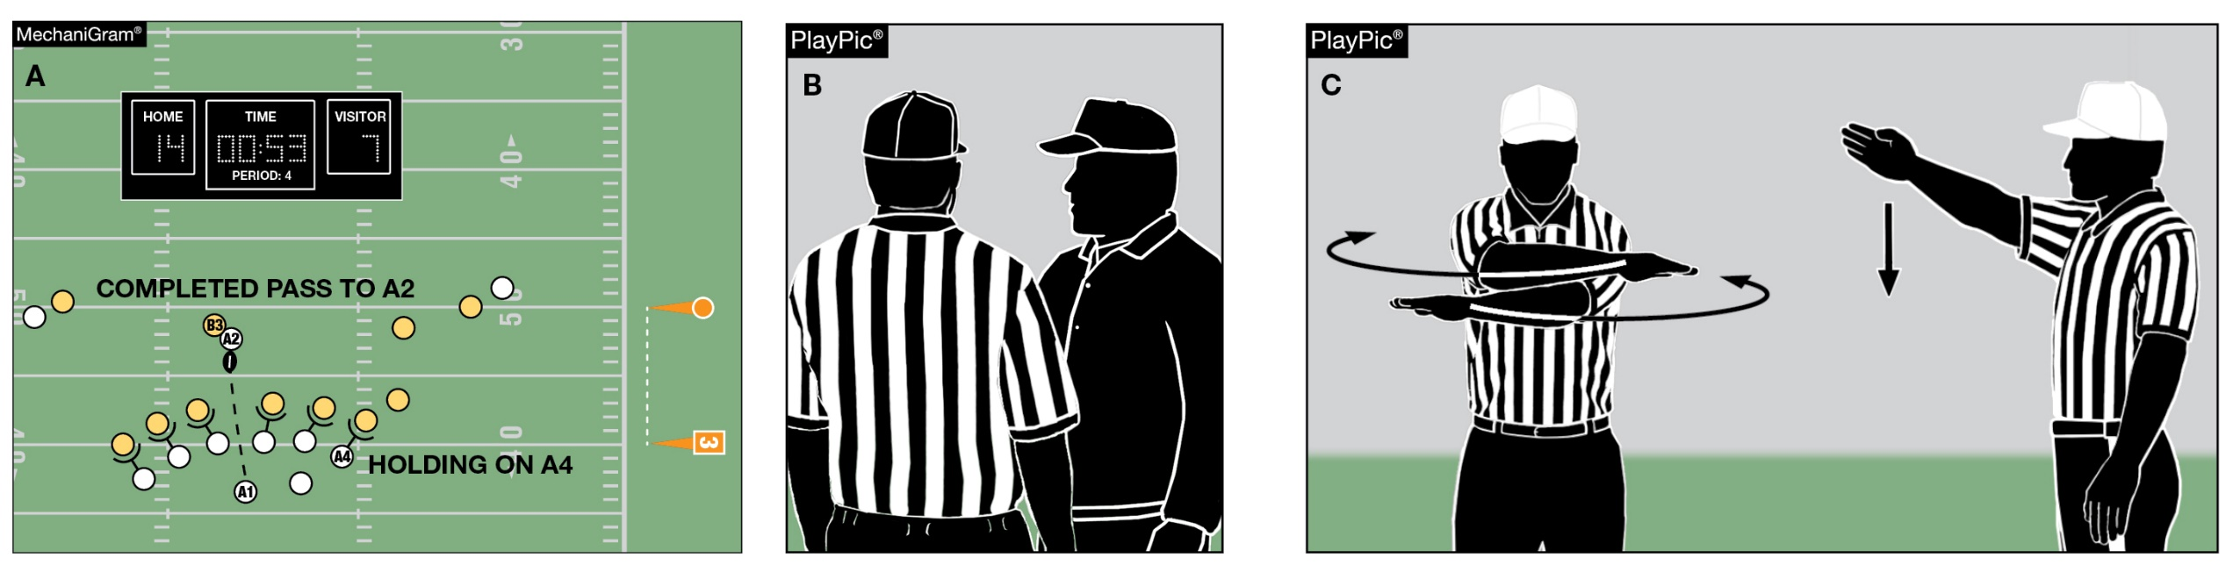
Game clock option
RULE 3-4-7
When a foul is committed with less than two minutes remaining in either half, the offended team has the option to start the game clock on the snap. In MechaniGram A, Team B trails when Team A fouls. Team B’s coach is consulted (PlayPic B), choosing to decline the penalty and have the clock started on the snap (PlayPic C).
Notes:
Rule Change:
RULE 3 – SECTION 4 STARTING AND STOPPING THE GAME CLOCK …
ART. 7 . . . When a foul is committed with less than two minutes remaining in either half, the offended team will have the option to start the game clock on the snap.
Rationale for Change:
Changed the offended team's game clock options following a foul committed with less than two minutes remaining in either half.
Case Book: See SITUATIONS 3.4.7A, 3.4.7C, 3.4.7D

Slide 13
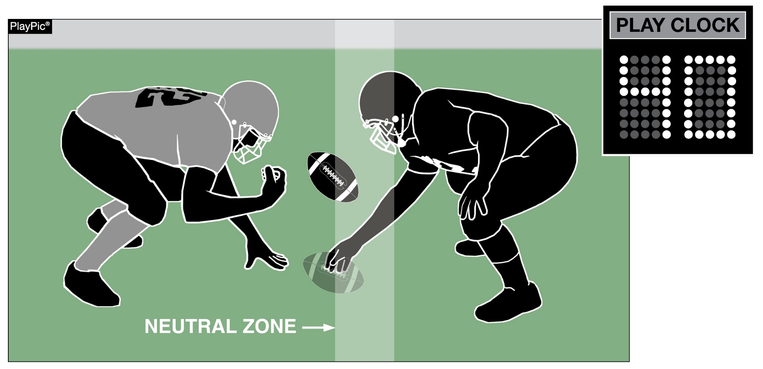
PLAY CLOCK
RULE 3-6-1a(1)e EXCEPTION 2. (NEW)
When the clock is stopped due to Rule 3-5-7i and Team B is the only team to foul, the play clock will be set to 40 seconds.
Notes:
Rule Change:
RULE 3 – SECTION 6 PLAY CLOCK, BALL READY FOR PLAY AND DELAY …
ART. 1 . . . Play clock and ready-for-play:
a. Play clock:
1. 25 seconds will be on the play clock and start on the ready-for-play signal:
(a) Prior to a try following a score;
(b) To start a period or overtime series;
(c) Following administration of an inadvertent whistle;
(d) Following a charged time-out;
(e) Following an official's time-out as in 3-5-7 or 3-5-10.
EXCEPTIONS:
1. 3-5-7b;
2. 3-5-7e, 3-5-7i or 3-5-10 if related to a defensive player.
Rationale for Change:
Added a new exception to the play clock administration following a foul committed only by the defensive team.

Slide 14
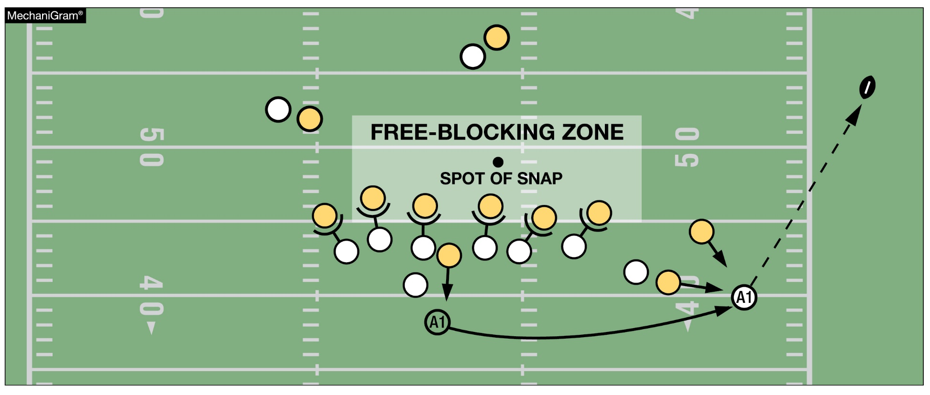
INTENTIONAL GROUNDING
RULE 7-5-2d EXCEPTION 2. (NEW), TABLE 7-5-2, TABLE 7-5
It is legal for a player to conserve yardage by intentionally throwing an incomplete forward pass if the passer has been beyond the lateral boundary of the free-blocking zone as established at the snap; and the pass reaches the neutral zone, including the extension beyond the sideline.
Notes:
Rule Change:
RULE 7 – SECTION 5 FORWARD-PASS CLASSIFICATION …
ART. 2 . . . An illegal forward pass is a foul. Illegal forward passes include:
a. A pass after team possession has changed during the down.
b. A pass from beyond the neutral zone.
c. A second and subsequent forward pass(es) thrown during a down.
d. A pass intentionally thrown into an area not occupied by an eligible offensive receiver, or thrown incomplete to save loss of yardage or to conserve time.
EXCEPTIONS:
1. It is legal for a player positioned directly behind the snapper to conserve time by intentionally throwing the ball forward to the ground immediately after receiving the snap that has neither been muffed nor touched the ground.
2. It is legal for a player to conserve yardage by intentionally throwing an incomplete forward pass if:
a. The passer has been beyond the lateral boundary of the free-blocking zone as established at the snap; and
b. The pass reaches the neutral zone, including the extension beyond the sideline.
Rationale for Change:
Added a new exception that allows the passer to legally throw the ball away to conserve yardage.
Case Book: See SITUATIONS 7.5.2A, 7.5.2C

Slide 15
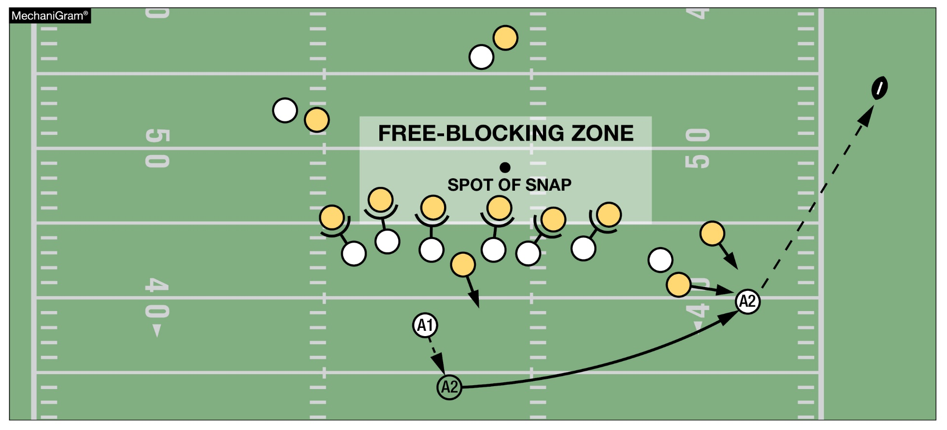
INTENTIONAL GROUNDING
RULE 7-5-2d EXCEPTION 2. (NEW), TABLE 7-5-2, TABLE 7-5
Legal. The player taking advantage of the new rules exception need not be the player who received the snap.
Notes:
Comment on Slide:
See comments on slide.

Slide 16
2022 nfhs football editorial changes

Slide 17
2022 Nfhs football editorial changes
1-5-1f | Changed the size of the font on the dimensions for the cleats.
TABLE 1-7 | Re-numbered all 17 items in TABLE 1-7.
2-28-2 | Added: “If a scrimmage kick occurs, the neutral zone shall not be expanded into the end zone” to the rule for further clarification.
3-5-9 | Added: “game official” to the rule for clarification.
3-5-11 | Added: “altering the” to the rule for clarification.
5-2-4 | Revised the format of the rule for clarity due to the length of it.
6-2-6 | Added: “If a scrimmage kick occurs,” to the rule for clarification
7-5 PENALTY | Changed the rules reference for Intentional Grounding to Art. 2d.
TABLE 9-3-6 | Deleted.
10-2-2, 10-2-3 | Clarifying the terminology between “foul” and “penalty.”
Notes:
Comment on Slide:
This slide lists the rules references and a brief description of the football editorial changes that were made to the 2022 NFHS Football Rules Book.

Slide 18
2022 Nfhs football editorial changes
FOOTBALL PENALTY ENFORCEMENT - FIGURES | Updated Figures 1 and 2.
FOOTBALL FUNDAMENTALS – V-3, VII-2 | Clarified the Football Fundamentals for “Free Kicks” and “Passes.”
RESOLVING TIED GAMES – 5-1-1, 8-3 | Deleted the following from 5-1-1 and added it to 8-3: “If the team on offense scores a touchdown, it is entitled to the opportunity for a try unless the points would not affect the outcome of the game or playoff qualifying.
SIX-PLAYER RULES DIFFERENCES – RULE 2 and 7 | Deleted the word “clear” before pass.
PENALTY SUMMARY | Updated the rules reference for Intentional Grounding (also loss of down) to 7-5-2d.
Notes:
Comment on Slide:
This slide lists the rules references and a brief description of the football editorial changes that were made to the 2022 NFHS Football Rules Book.

Slide 19
2022 nfhs football rules reminders

Slide 20
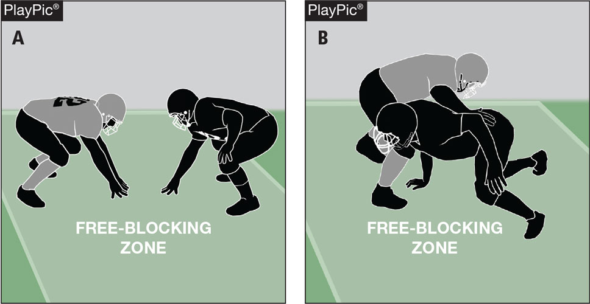
blocking below the waist
Rule 2-17-2c
In PlayPic A, both players are in the free-blocking zone and on their lines of scrimmage. In PlayPic B, the block is legal because it is in the zone at the time of the snap, is an immediate, initial action following the snap, and both players began the play on their lines of scrimmage and in the free-blocking zone.
Notes:
Rules Reminder:
RULE 2 – SECTION 17 – FREE-BLOCKING ZONE – LEGAL BLOCKING BELOW THE WAIST AND LEGAL BLOCK IN THE BACK
ART. 1 . . . The free-blocking zone is a rectangular area extending laterally 4 yards either side of the spot of the snap and 3 yards behind each line of scrimmage. A player is in the free-blocking zone when any part of his body is in the zone at the snap.
ART. 2 . . . Blocking below the waist is permitted in the free-blocking zone when the following conditions are met:
a. All players involved in the blocking are on the line of scrimmage and in the zone at the snap.
b. The contact is in the zone.
c. The block is an immediate, initial action following the snap.
Comment on Slide:
Rule change in 2021. Further clarified that blocking below the waist now requires the block to begin immediately following the snap.
Due to the 2021 NFHS change in the blocking below the waist rule, game officials should be aware of the start of the block.
Case Book: See SITUATIONS 9.3.2A, 9.3.2B, 9.3.2C, 9.3.2D, 9.3.2E, 9.3.2F, 9.3.2G, 9.3.2H

Slide 21
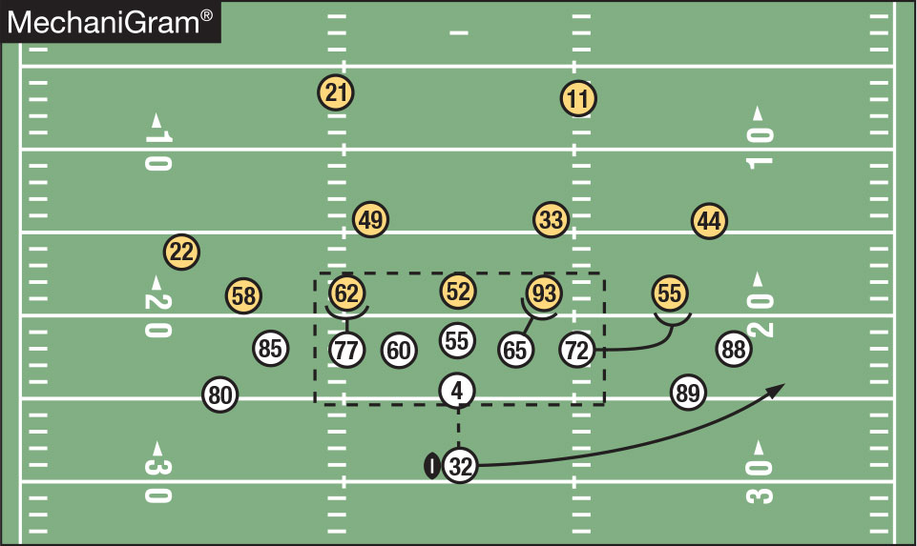
Blocking below the waist
Rules 2-17-1, 2-17-2, 2-17-4
It is legal for offensive linemen to block below the waist in the free-blocking zone, provided both players were on their lines of scrimmage and within the zone at the time of the snap and the block is an immediate, initial action following the snap. No. 77 could only block No. 62 below the waist if the block was immediate, initial action following the snap. No. 65 can block No. 93 below the waist even though No. 93 is playing off his shoulder, if the block is an immediate, initial action following the snap. No. 72 could not block No. 55 below the waist at any time during this play.
Notes:
Rules Reminder:
Comment on Slide:
See comments on slide.

Slide 22
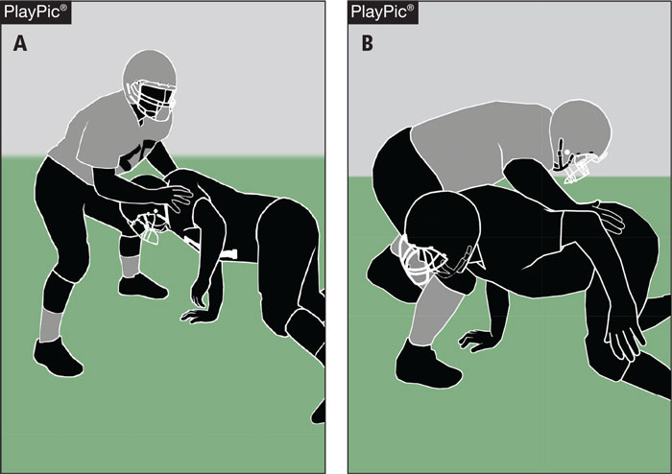
blocking below the waist rules 2-3-7, 2-17-1, 2-17-2, 9-3-2
While in the free-blocking zone, the initial contact in PlayPic A is with the hands below the waist. When the blocker finishes the block below the waist as in PlayPic B, it is not a foul. A block below the waist is legal if it occurs in the free-blocking zone, provided both players were on their lines of scrimmage and within the zone at the time of the snap and the block is an immediate, initial action following the snap.
Notes:
Rules Reminder:
Comment on Slide:
See comments on slide.

Slide 23
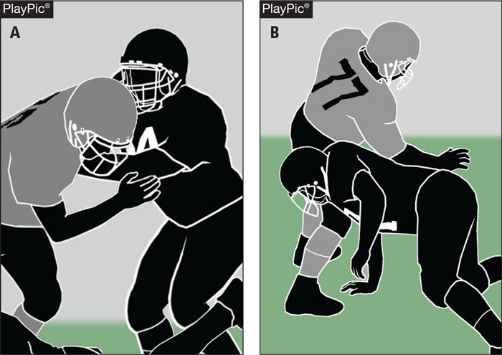
blocking below the waist rules 2-3-7, 2-17-1, 2-17-2, 9-3-2
The initial contact in PlayPic A is above the waist. In PlayPic B, the blocker then loses contact and the blocker starts a new block below the waist, this is a foul. A block below the waist is legal if it occurs in the free-blocking zone, provided both players were on their lines of scrimmage and within the zone at the time of the snap and the block is an immediate, initial action following the snap.
Notes:
Rules Reminder:
Comment on Slide:
See comments on slide.

Slide 24
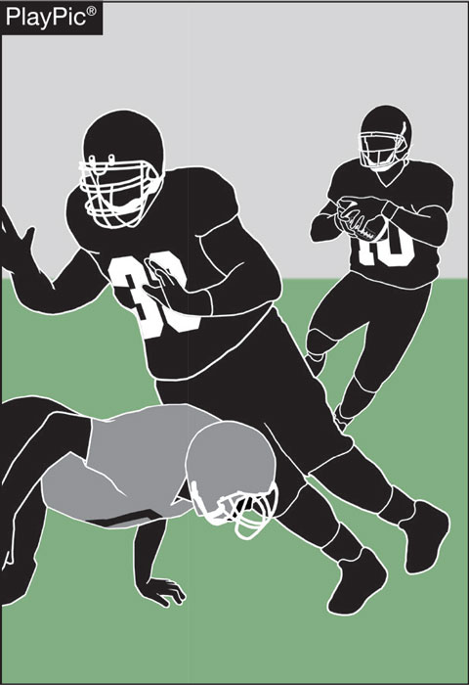
blocking below the waist rules 2-3-7, 2-17-2, 9-3-2
The rules regarding blocking below the waist apply equally to both teams. In the PlayPic, the defender goes below the waist outside the free-blocking zone to take out the lead blocker. This is an illegal block by the defender. A block below the waist is only legal if it occurs in the free-blocking zone, provided both players were on their lines of scrimmage and within the zone at the time of the snap and the block is an immediate, initial action following the snap.
Notes:
Rules Reminder:
Comment on Slide:
See comments on slide.

Slide 25
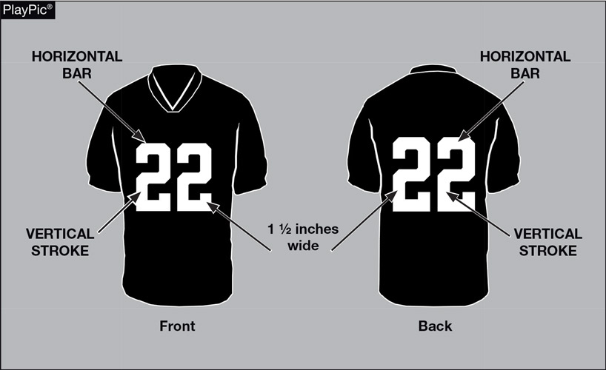
FOOTBALL JERSEY NUMBERS
RULE 1-5-1c(3)
The entire body of the number (the continuous horizontal bars and vertical strokes) exclusive of any border(s) shall be approximately 1 1/2 – inches wide.
Notes:
Rules Reminder:
RULE 1 – SECTION 5 – PLAYER EQUIPMENT
ART. 1 . . . Mandatory equipment. Each player shall participate while wearing the following pieces of properly fitted equipment, which shall be professionally manufactured and not altered to decrease protection: …
c. Numbers
1. The numbers shall be clearly visible and legible using Arabic numbers 0-99 inclusive and shall be on the front and back of the jersey.
2. The numbers, inclusive of any border(s), shall be centered horizontally at least 8 inches and 10 inches high on front and back, respectively.
3. The entire body of the number (the continuous horizontal bars and vertical strokes) exclusive of any border(s) shall be approximately 1½-inches wide.
4. The color and style of the number shall be the same on the front and back.
5. Through the 2023 season, the body of the number (the continuous horizontal bars and vertical strokes) shall be either:
(a) a continuous color(s) contrasting with the jersey color; or
(b) the same solid color(s) as the jersey with a minimum of one border that is at least ¼-inch in width of a single solid contrasting color.
6. Effective with the 2024 season, the entire body of the number (the continuous horizontal bars and vertical strokes) shall be a single solid color that clearly contrasts with the body color of the jersey.
Comment on Slide:
Rule change in 2019. The purpose of numbers on jerseys is to provide clear identification of players. In order to enhance the ability to easily identify players, the committee has clarified the size requirements for jersey numbers through the 2023 season. The committee also added a new requirement that, effective in the 2024 season, jersey numbers must be a single solid color that clearly contrasts with the body color of the jersey.

Slide 26
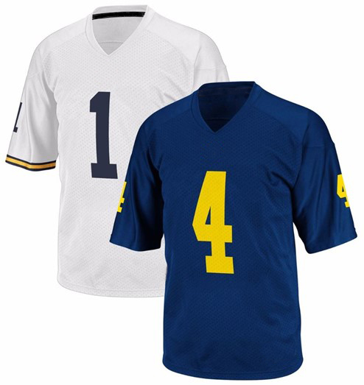
2024 - Football JERSEY numbers
RULES 1-5-1c; 1-5-1c(6)
Effective with the 2024 season, the entire body of the number (the continuous horizontal bars and vertical strokes) shall be a single solid color that clearly contrasts with the body color of the jersey.
Notes:
Rules Reminder:
Comment on Slide:
See comments on slide.

Slide 27
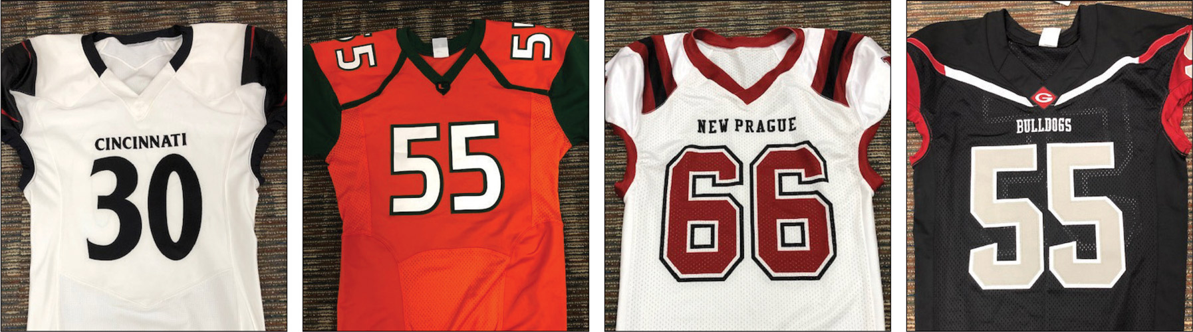
Football JERSEY numbers
RULES 1-5-1c; 1-5-1c(6)
A
B
C
D
The style of the numbers on all four of these jerseys are legal now and will be in 2024 too.
.
Notes:
Rules Reminder:
RULE 1 – SECTION 5 – PLAYER EQUIPMENT
ART. 1 . . . Mandatory equipment. Each player shall participate while wearing the following pieces of properly fitted equipment, which shall be professionally manufactured and not altered to decrease protection: …
c. Numbers
1. The numbers shall be clearly visible and legible using Arabic numbers 0-99 inclusive and shall be on the front and back of the jersey.
2. The numbers, inclusive of any border(s), shall be centered horizontally at least 8 inches and 10 inches high on front and back, respectively.
3. The entire body of the number (the continuous horizontal bars and vertical strokes) exclusive of any border(s) shall be approximately 1½-inches wide.
4. The color and style of the number shall be the same on the front and back.
5. Through the 2023 season, the body of the number (the continuous horizontal bars and vertical strokes) shall be either:
(a) a continuous color(s) contrasting with the jersey color; or
(b) the same solid color(s) as the jersey with a minimum of one border that is at least ¼-inch in width of a single solid contrasting color.
6. Effective with the 2024 season, the entire body of the number (the continuous horizontal bars and vertical strokes) shall be a single solid color that clearly contrasts with the body color of the jersey.
Comment on Slide:
Rule change in 2019. The purpose of numbers on jerseys is to provide clear identification of players. In order to enhance the ability to easily identify players, the committee has clarified the size requirements for jersey numbers through the 2023 season. The committee also added a new requirement that, effective in the 2024 season, jersey numbers must be a single solid color that clearly contrasts with the body color of the jersey.

Slide 28
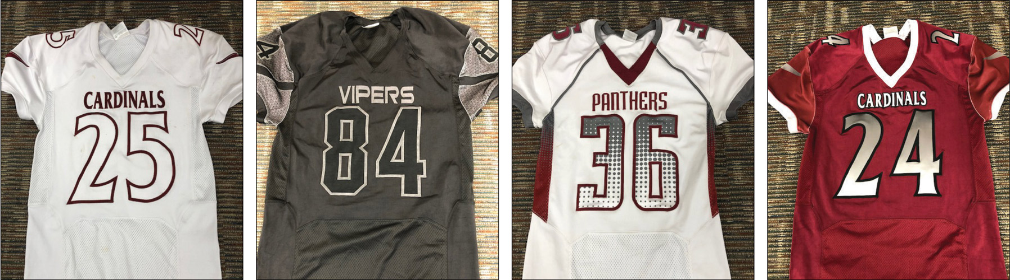
Football JERSEY numbers
RULES 1-5-1c; 1-5-1c(6)
A
B
C
D
The style of the numbers on these jerseys are legal through the 2023 season. The following four types of number designs will be illegal in 2024.
Notes:
Rules Reminders:
RULE 1 – SECTION 5 – PLAYER EQUIPMENT
ART. 1 . . . Mandatory equipment. Each player shall participate while wearing the following pieces of properly fitted equipment, which shall be professionally manufactured and not altered to decrease protection: …
c. Numbers
1. The numbers shall be clearly visible and legible using Arabic numbers 0-99 inclusive and shall be on the front and back of the jersey.
2. The numbers, inclusive of any border(s), shall be centered horizontally at least 8 inches and 10 inches high on front and back, respectively.
3. The entire body of the number (the continuous horizontal bars and vertical strokes) exclusive of any border(s) shall be approximately 1½-inches wide.
4. The color and style of the number shall be the same on the front and back.
5. Through the 2023 season, the body of the number (the continuous horizontal bars and vertical strokes) shall be either:
(a) a continuous color(s) contrasting with the jersey color; or
(b) the same solid color(s) as the jersey with a minimum of one border that is at least ¼-inch in width of a single solid contrasting color.
6. Effective with the 2024 season, the entire body of the number (the continuous horizontal bars and vertical strokes) shall be a single solid color that clearly contrasts with the body color of the jersey.
Comment on Slide:
Rule change in 2019. The purpose of numbers on jerseys is to provide clear identification of players. In order to enhance the ability to easily identify players, the committee has clarified the size requirements for jersey numbers through the 2023 season. The committee also added a new requirement that, effective in the 2024 season, jersey numbers must be a single solid color that clearly contrasts with the body color of the jersey.

Slide 29
2022 nfhs football points of emphasis

Slide 30
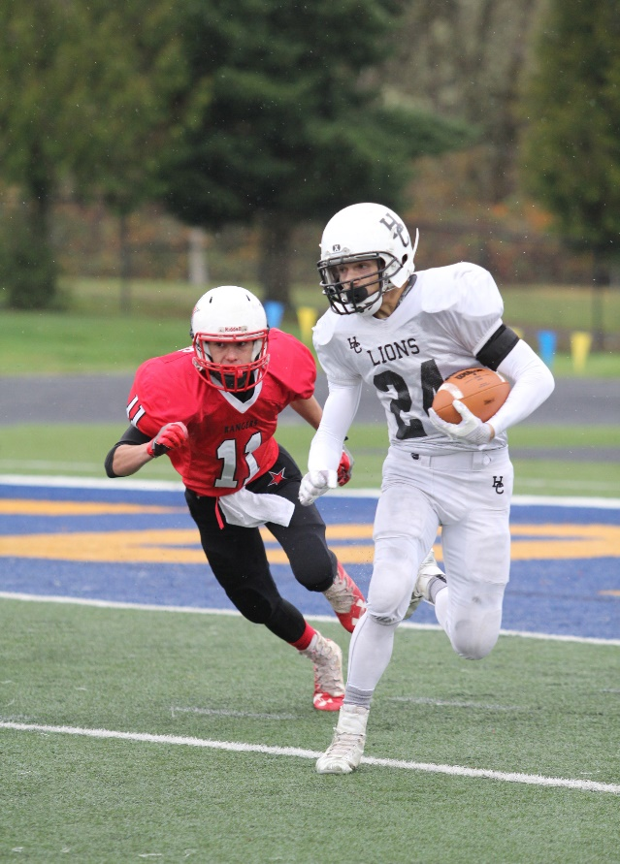
2022 nfhs football points of emphasis
1. Sportsmanship
Targeting/Defenseless Player
3. Legal Uniforms and Equipment
Notes:
Comment on Slide:
The following football points of emphasis were selected by the NFHS Football Rules Committee for the 2022 high school football season. These three football points of emphasis need to be stressed to all coaches, game officials, players, parents, school administrators, appropriate health-care professionals and all others who have an interest in high school football.

Slide 31
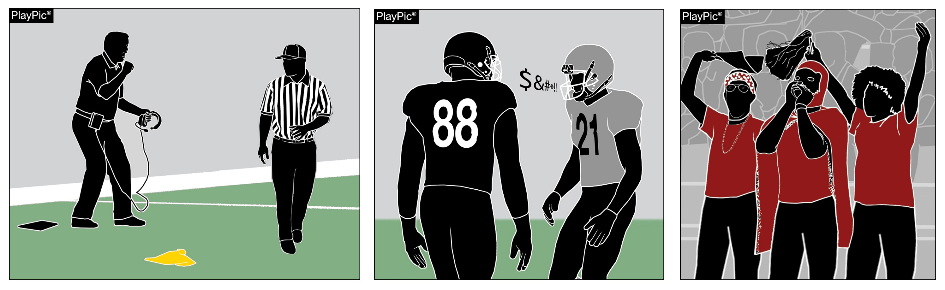
sportsmanship
Poor sportsmanship by coaches and players sets a negative tone for fans, game officials and others.
Notes:
Sportsmanship (Point of Emphasis):
Good sporting behavior is one of the fundamental ingredients to the continued success and enjoyment of education-based high school sports and activities. In fact, in the 103-year history of organized high school sports in the United States, good sportsmanship has been one of the most important outcomes of high school activity programs.
NFHS playing rules are written to encourage sportsmanship. Participation in these programs should promote respect, integrity and sportsmanship. However, for these ideals to occur, everyone involved in these programs must be doing their part.
The NFHS is concerned that unsporting behavior in education-based athletics has increased across all sports. As a result, the NFHS has made sportsmanship the No. 1 Point of Emphasis for the 2022-23 school year.
Sportsmanship, or good sporting behavior, is about treating one another with respect and exhibiting appropriate behavior. It is about being fair, honest and caring. When these types of appropriate behavior occur, competitive play is more enjoyable for everyone.
Coaches set the tone during football games with their display of sportsmanship. If these individuals act in a sportsmanlike manner, their behavior sets the tone for players, spectators and others. If coaches, however, are complaining constantly about the decision of game officials, spectators are more likely to do the same.
There must be a collaborative, working relationship between game officials and game administration to promote good sportsmanship and safely conduct the game. Everyone has their roles to play in creating a positive, sportsmanlike atmosphere at games.
Game officials should focus on the actions of players, coaches and other sideline personnel. A positive, open line of communication between game officials and coaches ultimately results in a better game for everyone involved.
Game officials, however, should never engage with spectators who are exhibiting unsporting behavior. Once the game begins, school administration is responsible for dealing with unruly spectators. A proactive approach by school administration includes monitoring the behavior of spectators and intervening as needed.
If spectators are using demeaning or profane language at game officials – or at others in the stands – those individuals should be removed from the game by school administration.
In recent years, a heightened level of unsportsmanlike behavior has been occurring by spectators at high school football games, and it must be stopped. The use of demeaning language, or hate speech, by students, parents and other fans must cease.
High school football and other activities exist to lift people up, not demean or tear people down. The goal is to treat everyone fairly and treat each other with respect. Any speech or harassment that is insulting, demeaning or hurtful will not be tolerated.
High schools must establish a culture that values the worth of every single person – both players on the school’s team and players on the opposing team. There must be a no-tolerance policy regarding behavior that shows disrespect for another individual.
Good sports win with humility, lose with grace and do both with dignity. It takes the efforts of everyone every day to ensure that sportsmanship remains one of the top priorities in education-based activity programs.

Slide 32
sportsmanship
Fans must not employ language or acts that defames, demeans, abuses, or bullies a competitor, game official, or another fan. Issues with fan behavior should be directly referred to contest management by game officials.
Notes:
Sportsmanship (Point of Emphasis) continued:
In providing an optimal experience to players, fans, coaches and game officials, the NFHS has continually made sportsmanship a priority. Players and coaches are the most visible exhibitors of good sportsmanship. The behavior of coaches and players sets the tone for fans, game officials and others. There is no place in scholastic sports for language that defames, demeans, abuses or bullies another competitor, teammate, game official or fan. Language of this nature should not be tolerated in the school building, at games or at practice. Education-based athletics, and specifically high school football, should serve as an example of how
intense competition and civility can coexist.
Coaches and players must represent their schools and communities as ambassadors of good sporting behavior beginning with pregame activities and concluding with end-of-game procedures. Game officials are charged with enforcing NFHS football rules and penalizing unsportsmanlike behavior.
Communities are often defined by their treatment of, and interaction with, visiting teams and their fans. Foul language and inflammatory speech are not acceptable displays of sportsmanship and good sporting behavior.
Sportsmanship is a basic, vital component of education-based athletics. The lessons learned, humility, respect and integrity are the cornerstones of sportsmanship. Those lessons do not include the acceptance of profane or foul language. Those same lessons are forged and exhibited long before they are on display in the spotlight of the athletic arena. More importantly, they remain in place long after the final whistle of athletic competition. Good sports make sportsmanship a priority.

Slide 33
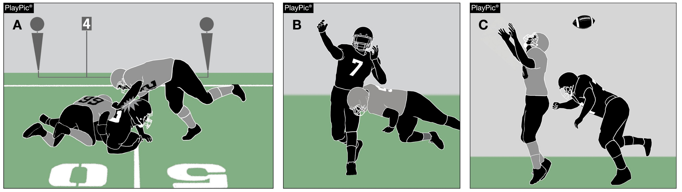
TARGETING/DEFENSELESS PLAYER
A downed runner is defenseless and cannot protect himself against unnecessary contact (PlayPic A). Once a pass is thrown, a passer is defined as a defenseless player (PlayPic B). A pass receiver attempting to catch a pass, or a pass receiver who has clearly relaxed when the player has missed the pass or feels he can no longer catch the pass, should be considered defenseless (PlayPic C).
Notes:
TARGETING/DEFENSELESS PLAYER (Point of Emphasis):
The NFHS Football Rules Committee feels coaches, game officials and players have all worked together to recognize and remove most targeting fouls from the game, but considerable work still needs to be done understanding/penalizing illegal defenseless player contact. As stakeholders in the game, removing needless contact from football should be prioritized by coaches, game officials and players.
Targeting is an act by any player who takes aim and initiates contact against an opponent above the shoulders with the helmet, forearm, hand, fist, elbow or shoulders. A defenseless player is a player, who, because of his physical position and focus of concentration, is especially vulnerable to injury. For added defenseless player clarification, please refer to 2.32.16 COMMENT in the 2022 NFHS Football Case Book.
Since defenseless players are especially vulnerable to potential injury, coaches should use video, on-field demonstrations, and establish zero tolerance of this illegal contact during practice and games to help players realize the importance of contacting players legally.
Game officials must have a clear understanding of the guidelines for defenseless player contact (Rule 9-4-3g). They must diligently observe all action and watch for illegal contact against players who are deemed defenseless. Any player contacting a defenseless player is responsible to make legal contact. Game officials must draw a distinction between contact necessary to make a legal block or tackle and that which is excessive. When there is a question in the game officials’ mind about the severity of contact, the contact should be deemed excessive.
Legal contact is required by players at all times. It is imperative that players have a clear understanding of what contact is acceptable and be able to recognize when players are considered defenseless. Players must realize that when contacting any player the responsibility for making legal contact resides with the person making the contact. Forceful contact that is avoidable should be considered unnecessary.
To ensure the long-term success of high school football, risk minimization must remain a priority for all stakeholders of the game. Coaches, game officials and players must understand the importance of removing unnecessary contact from the game. A concerted effort must be made by all to eliminate targeting and illegal defenseless player contact from football.

Slide 34
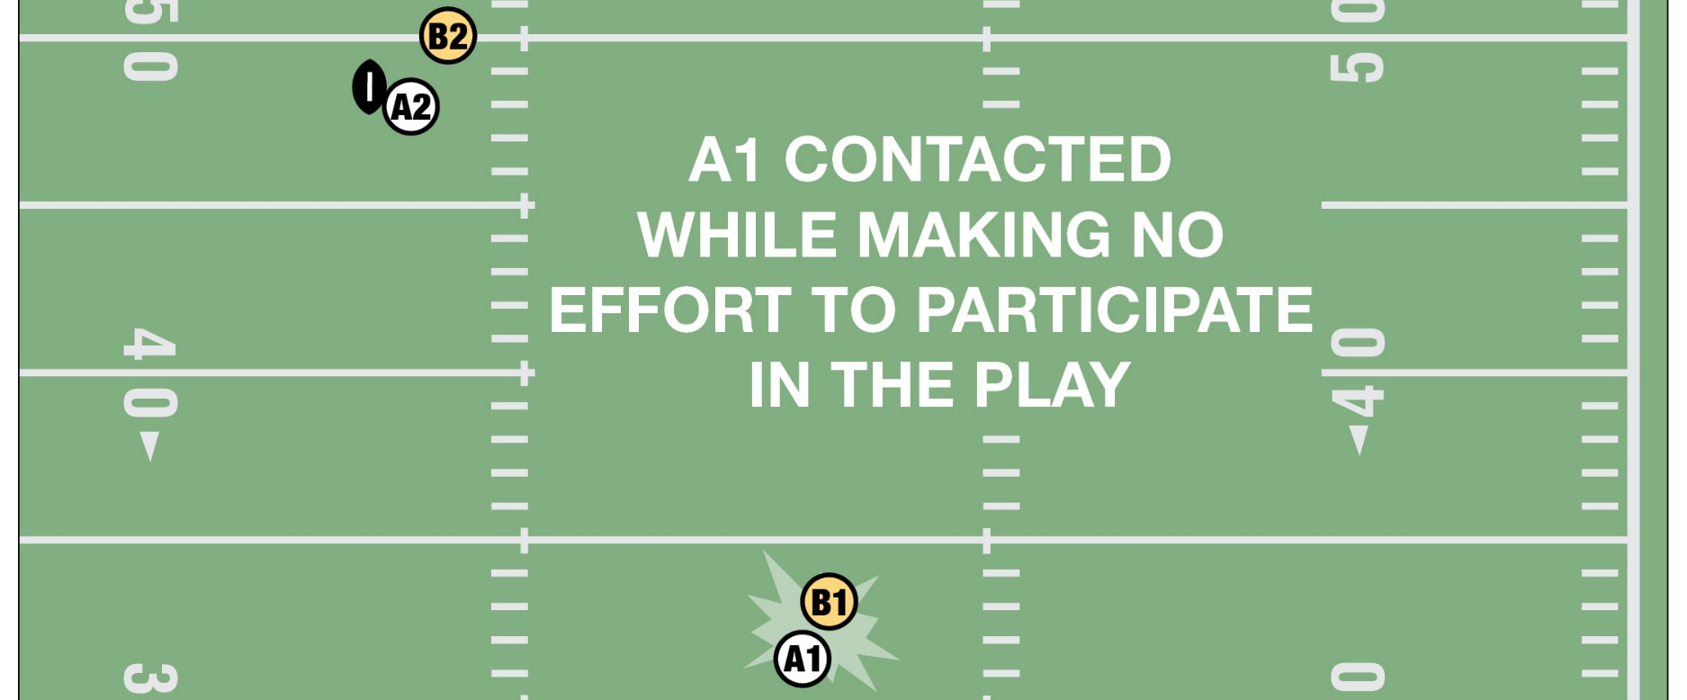
TARGETING/Defenseless player
A1 is obviously out of the play and not in the immediate vicinity of the runner. A1 is by definition defenseless. The contact by B1 is a personal foul.
Notes:
TARGETING/DEFENSELESS PLAYER (Point of Emphasis) continued:
See comments on slide.

Slide 35
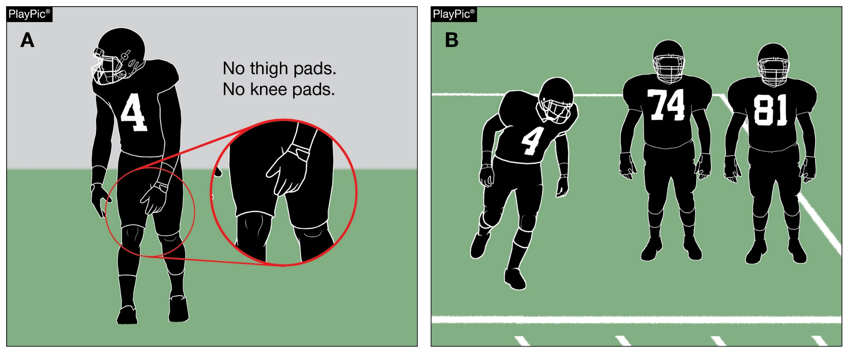
LEGAL UNIFORMS/EQUIPMENT
Players who fail to wear required equipment during a down (PlayPic A) must be replaced for one down (PlayPic B).
Notes:
LEGAL UNIFORMS/EQUIPMENT (Point of Emphasis):
The purpose of the NFHS Football Equipment Rules is to ensure the safety and protection of both the player wearing the equipment and their opponent. Due to the potential for injury, it is essential that game officials strictly enforce equipment rules and that coaches support that enforcement.
The head coach is primarily responsible for the legality of a team’s equipment. Prior to the start of each game, the head coach must verify to the referee and another game official that all players are legally equipped in compliance with the rules and that no illegal equipment will be used. Most equipment violations can be prevented by the coaching staff communicating the equipment rules to players prior to the teams arriving at the game.
During pregame duties, game officials should take time to spot-check players for illegal or improperly worn equipment and alert players and coaching staffs of any potential violations. Game officials should not allow any players to participate until all equipment issues have been resolved.
Prior to the ball becoming live, game officials through normal observations should verify that each player is properly and legally equipped. If a player is observed to not meet proper equipment rules, the play clock should be stopped and the equipment violation addressed. Different rules will apply to enforcement depending if the stoppage was for illegal, improperly worn or missing equipment.
Unless halftime or overtime intermission occurs, any time the play clock is interrupted for improperly worn or missing equipment by a player, the player is to be removed from the game for at least one play. Examples of improperly worn equipment include but are not limited to: Knee pads that do not cover the player’s knees; shoulder pads that are not fully covered by the jersey; undershirts not tucked in that extend below the top of the waistline of the pants; and failure to wear a tooth or mouth protector. If any equipment becomes improperly worn during play, correction must be made before continued player participation is allowed. The player would not be required to be removed from the game if the repair can be made promptly and does not delay the ready for play by more than 25 seconds.
Any time a player is found participating with illegal equipment, the player is to be removed from the game and the head coach should be penalized for unsportsmanlike conduct. Examples of illegal equipment include but are not limited to: Eye shade that is not a solid stroke or includes words, numbers, logos or other symbols; eye shields that are not clear (without the presence of any tint); play cards not worn on the wrist or arm; and uniform adornments (exemptions are legal towels and sweatbands properly worn).

Slide 36
2022-2023 nfhs football game officials manual

Slide 37
2022-2023 Nfhs football game officials manual REMINDERS
Game Officials Manual
2022 was a print year for the NFHS Football Game Officials Manual.
The NFHS Football Game Officials Manual Committee added and/or updated the following items for 2022-2023:
1. Added a new section on Seven-Game Officials
2. Updated the Guides for – “When in Question”
3. Added new 2022-2023 Game Officials Manual Points of Emphasis
4. Made minor edits/clarifications to the Manual
Notes:
Comment on Slide:
Reminders for 2022 from the NFHS Football Game Officials Manual Committee on the 2022-2023 NFHS Football Game Officials Manual and other items.
See comments on the slide.

Slide 38
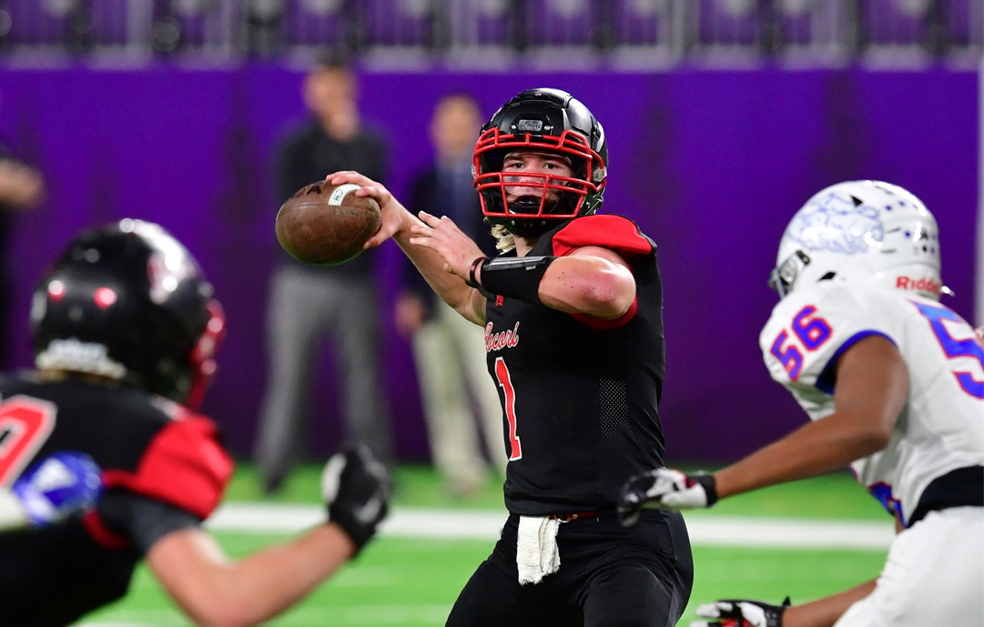
2022-2023 nfhs football game officials manual committee points of emphasis
Game Officials Manual
1. Communication Between Coaches and Game Officials
2. Officiating Intentional Grounding
3. Free-Kick Mechanics
4. Time-Sensitive Situations – End of Second and Fourth Periods
Notes:
Comment on Slide:
The following football points of emphasis were selected by the NFHS Football Game Officials Manual Committee for the 2022-2023 high school football seasons. These four football points of emphasis from the NFHS Football Game Officials Manual Committee, need to be stressed to all coaches, game officials, players, parents, school administrators, appropriate health-care professionals and all others who have an interest in high school football.

Slide 39
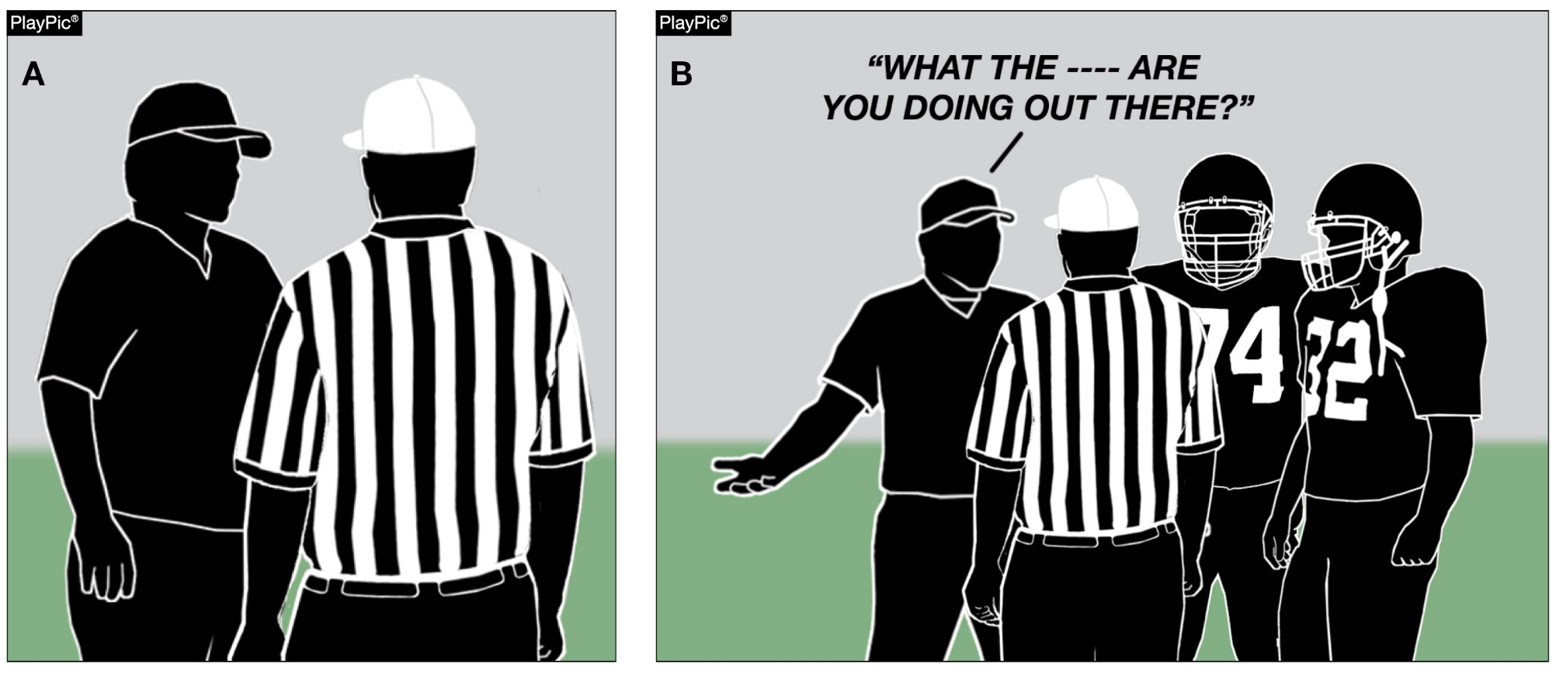
COMMUNICATION BETWEEN COACHES AND GAME OFFICIALS
Game officials must actively listen to what a coach is saying, then respond factually and unemotionally (PlayPic A).
If coaches show little respect for game officials and make derogatory comments, their players will likely treat game officials similarly (PlayPic B).
Notes:
COMMUNICATION BETWEEN COACHES AND GAME OFFICIALS (Manual Point of Emphasis):
Football is an emotional game, due not only to the amount of physical contact between players but also to the competitive spirit ingrained in most players and coaches. Game officials and coaches must recognize the passion and intensity inherent in the game and manage their interactions in a way that avoids stoking the fire of emotional response to game situations.
Game officials must recognize their role in the game: to provide a service to the coaches and players in an unemotional and impartial manner. Game officials must always be respectful and maintain a calm demeanor in their comments to coaches, especially when tension is high. Game officials must avoid the urge to respond in kind to coaches who are vocal in their disagreement of the judgment of game officials. The game official’s job is to de-escalate the tension and explain the decision in a concise and matter-of-fact manner. This is difficult to do, especially when a coach is screaming at a game official. In those cases, the game official must actively listen to what the coach is saying and then respond factually and unemotionally. Game officials must anticipate game situations where coaches will be upset and pre-emptively diffuse the situation. This requires strong communications skills and empathy and understanding of the coach’s perspective. A game official should never threaten the coach with consequences for their behavior, nor should a game official become defensive. If a coach crosses the line, then the game official’s option is to flag the coach for unsportsmanlike conduct. However, throwing a flag should be a last resort. A better approach is to clearly and calmly tell the coach that the comments or behavior are unacceptable, and that it’s difficult to focus on the action on the field if the coach is repeatedly distracting the game official.
Coaches must understand that their behavior has a profound impact on their players. Players tend to behave the way their coaches behave. If coaches show little respect for game officials and make derogatory comments, players will likely treat game officials similarly. Coaches should win gracefully and lose with dignity. Coaches must also understand that the football field is an extension of the classroom and must set a strong example for their players to follow. This includes respecting the decisions of game officials even when they disagree, and handling disagreements in a civil and dignified manner. This doesn’t mean that coaches must accept everything that occurs during the game without emotion. Rather, it means that if there is a disagreement, any discussion with game officials regarding that disagreement should be constructive and respectful, not confrontational. Handling any disagreement in a business-like manner teaches players good sportsmanship, which is a perennial focus of the NFHS.
By communicating respectfully, both game officials and coaches will leave with a positive experience. Neither game officials nor coaches do their jobs for the money; rather, they do it because of their love of the game. Through coaches’ and game officials’ behavior toward each other, players will learn a valuable life lesson regarding how to handle conflict.

Slide 40
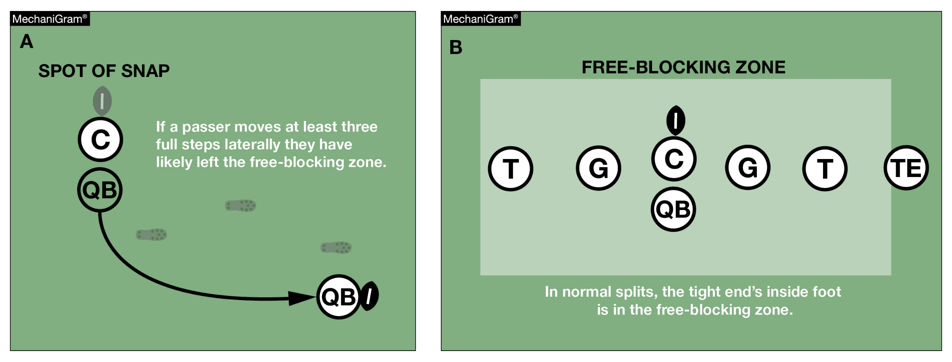
OFFICIATING Intentional grounding
If a passer moves at least three full steps laterally, game officials should strongly consider whether or not the passer has left the free-blocking zone.
Notes:
OFFICIATING INTENTIONAL GROUNDING (Manual Point of Emphasis):
A new, second exception to the intentional grounding rule has been added effective with the 2022 season.
Intentional grounding is a foul when a forward pass is thrown into an area not occupied by an eligible offensive receiver, or, when a forward pass is intentionally thrown incomplete to save loss of yardage or to conserve time. These acts are fouls in NFHS play with two exceptions:
• NFHS Rule 7-5-2 EXCEPTION 1. – It is legal for a player positioned directly behind the snapper to conserve time by intentionally throwing the ball forward to the ground immediately after receiving the snap that has neither been muffed nor touched the ground.
• NFHS Rule 7-5-2 EXCEPTION 2, (NEW) – It is legal for a player to conserve yardage by intentionally throwing an incomplete forward pass if:
a) The passer has been beyond the lateral boundary of the free-blocking zone as established at the snap; and
b) The pass reaches the neutral zone including the extension beyond the sideline.
The free-blocking zone, as determined at the snap, is 4 yards on each side of the football (3 yards in 6-, 8-, and 9-player). The referee can use the following guidelines to judge whether the passer has been beyond the lateral boundary of the free-blocking zone:
• If a passer moves at least three full steps laterally they have likely left the free-blocking zone.
• In normal splits, the inside foot of the tight end is in the free-blocking zone.
• The distance between a hash mark and the nearest goal post upright is 5 yards.
• The goal post uprights are almost 4 yards from the center of the field.
• By keeping these distances in mind, if the ball is spotted on a hash mark, on a goal post upright, or in the center of the field, then these become very convenient points of reference to assist in determining whether the passer was beyond the lateral boundary of the free-blocking zone.

Slide 41
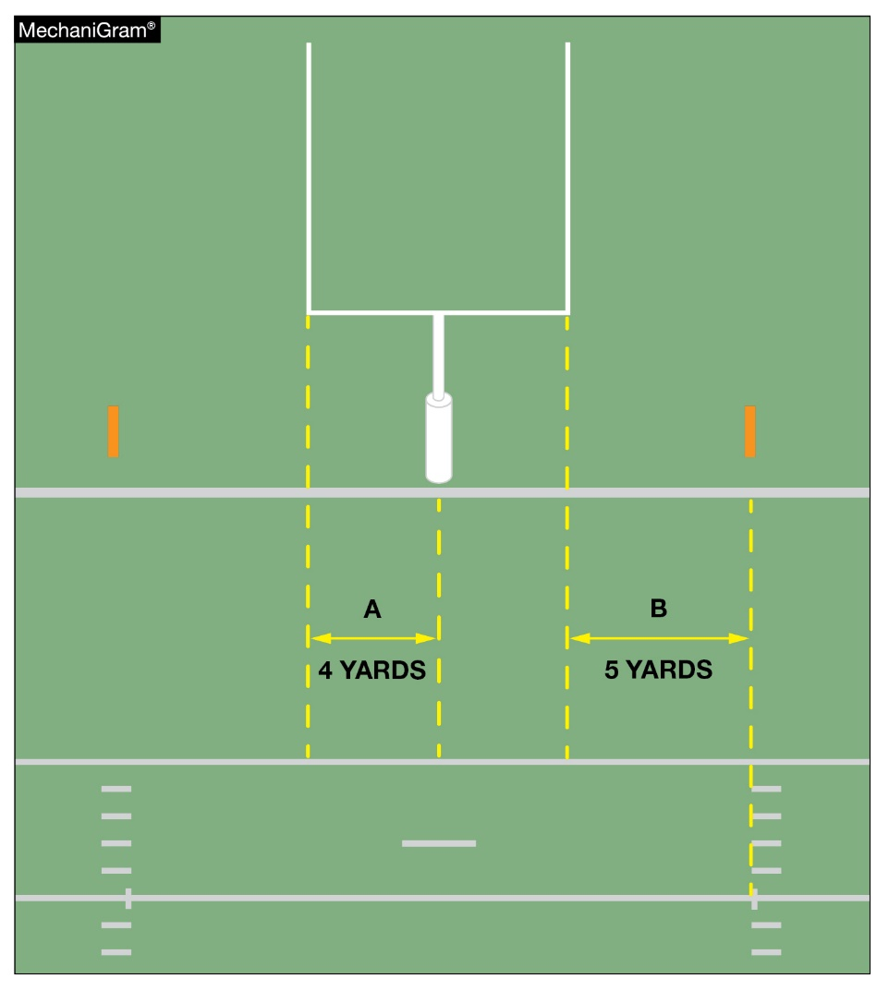
OFFICIATING Intentional grounding
A. The goal post uprights are nearly four yards from the center of the field.
B. The distance between a hash mark and the nearest goal post upright is five yards. Should the ball be spotted on the hash mark, on a goal post upright, or in the center of the field, these become very convenient points of reference.
Notes:
OFFICIATING INTENTIONAL GROUNDING (Manual Point of Emphasis) continued:
Remember, if the passer has not met both requirements in EXCEPTION 2, it remains a foul if there was no eligible offensive receiver in the area, or, if an eligible offensive receiver in the area cannot make a bona-fide attempt to catch the forward pass (e.g., the forward pass is intentionally thrown to the ground short of an eligible offensive receiver, or the forward pass is intentionally thrown over an eligible offensive receiver’s head). Many game officials choose to ignore this foul if there is an eligible offensive receiver in the general area of the forward pass. However, if the referee judges the forward pass was intentionally thrown incomplete, it is a foul. This is a foul that requires good crew communication and could be called after the game officials have gathered and discussed the play, or could result in the referee rescinding a flag that was dropped at the time the pass was thrown should a game official have additional information to provide to the referee that could alter the ruling.
Knowledgeable game officials recognize that some passes are incomplete or do not arrive in the immediate vicinity of the eligible offensive receiver because of the lack of skill on the part of the passer, a broken pattern on the part of the intended eligible offensive receiver, or because the passer’s accuracy was affected by the action of the defense. These game officials can also recognize an intentional and purposeful act and they can consistently and judiciously administer the rules so that the team whose passer purposely incompletes a pass is penalized as required. When a foul does occur, the penalty flag needs to be thrown by the referee. The penalty is 5 yards from the spot of the foul and loss of down.
GUIDES FOR “WHEN IN QUESTION”
• Passer in or outside of free-blocking zone……….outside
• Forward pass crossed the neutral zone or the neutral zone extended……….has crossed

Slide 42
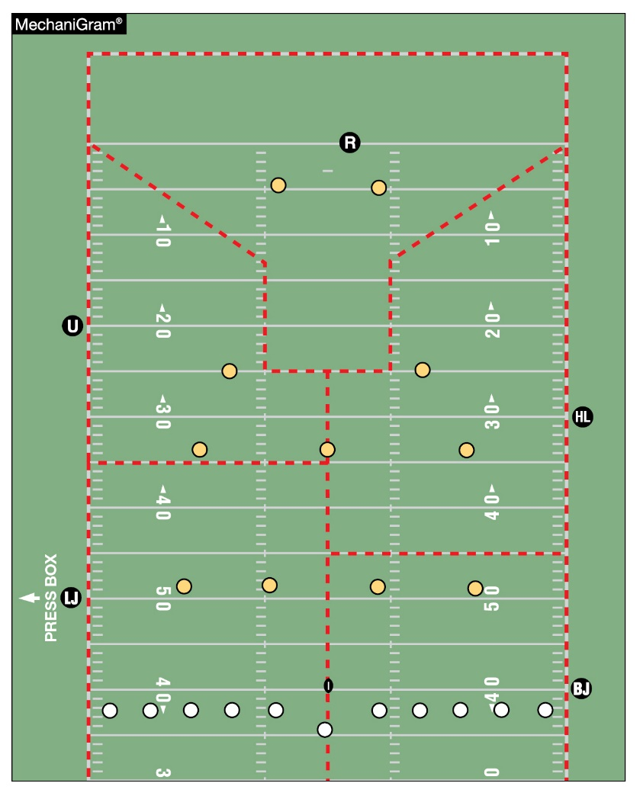
FREE-KICK MECHANICS
Successful coverage of free kicks depends on game officials observing players in their assigned coverage zones. For the traditional deep kick, coverage of the goal line and pylons, downfield movement, return in or away from the game official’s position, starting the game clock and likely areas of illegal contact must be covered in the pre-game conference.
Notes:
FREE-KICK MECHANICS (Manual Point of Emphasis):
Except for the kickoffs starting each half, all others follow success or failure of teams on the previous series and are an opportunity to improve their position for subsequent play. During a kickoff, all 22 players are briefly moving the same direction (no kickoff shall start with more or less than 22 players ), then heading toward each other at full speed eventually merging at a point of attack. Contact must be observed over the entire field while officials themselves are moving - a challenging task whether four-, five- or seven-crew members are present.
Successful coverage of kickoffs rests on a thorough pregame discussion. Depending on the number of crew members used, specific assignments of free-kick lines, the legality of the kick, downfield areas or numbered kicking team members must be acknowledged. For the traditional deep kick, coverage of the goal line and pylons, downfield movement, return in or away from the game official’s position, clock starting and likely areas of illegal contact must be covered. Teams may prefer a shorter kick (referred to as a “pooch” kick) or they may execute a squib kick. Both types of kicks limit return options. A fair catch is a possible outcome of a pooch kick. Understanding of which game official has responsibility for the catch versus contact around the receiver must be discussed. The squib kick is quickly grounded and maintains the status of a kick and the officiating challenges of a loose ball. Illegal contact, first touching and ultimate possession require precise crew actions.
The onside kick is a unique challenge. Responsibility for the kick legality, free kick lines, first touching by Team K, contact – both who initiated and if legal – must be discussed because contact will occur quickly. Possession will be aggressively fought for. Quick and decisive movement, determination of possession and restraining of extra participants are needed.
Fouls on free kicks range from the dead ball (encroachment and illegal kicking formation), live-ball fouls where it is critical to determine if the foul occurred during the kick or after change of possession to correctly enforce and the most common – the free kick out of bounds untouched by Team R. Careful explanations of options to the offended sideline requires precise crew communication in offering possible enforcement scenarios.
With a thorough pregame discussion of free kick mechanics, rules and different kick scenarios, the crew will be better equipped to handle unusual circumstances that may arise.

Slide 43
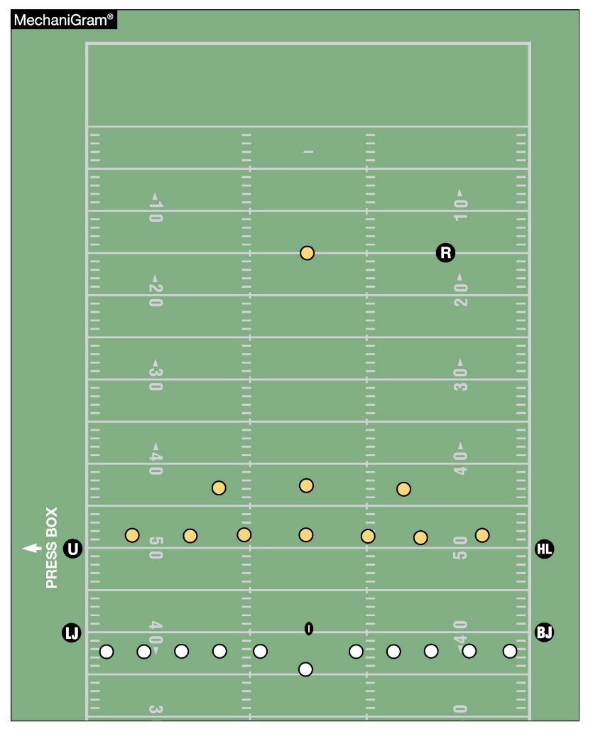
FREE-KICK MECHANICS
Onside kicks are especially challenging. Responsibility for the kick legality, free kick lines, first touching by Team K, contact— both who initiated and if legal — must be considered because contact will occur quickly. Teams will aggressively fight for possession. Quick and decisive movement, determination of possession and observation of participants not involved in the area around the ball is needed.
Notes:
FREE-KICK MECHANICS (Manual Point of Emphasis) continued:
See comments on slide.

Slide 44
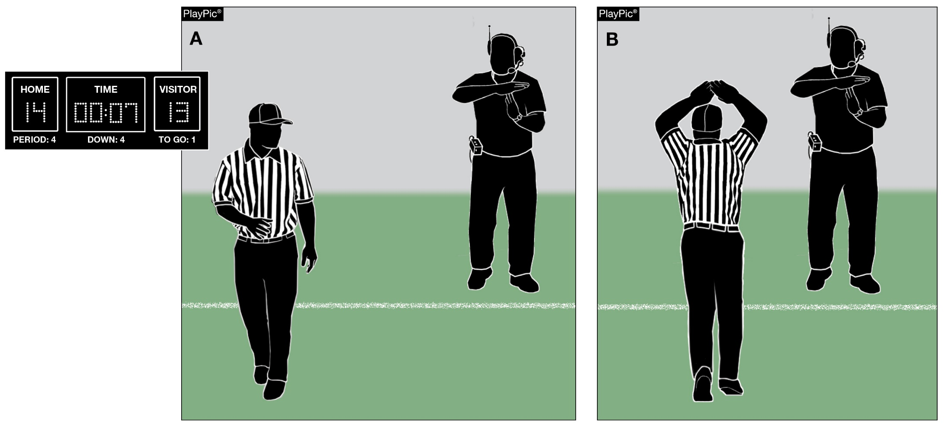
Time-Sensitive Situations – End of Second and Fourth Periods
Late in the second or fourth period, game officials should be aware of situations in which coaches may wish to request time-outs. Factors impacting the time remaining in a game include score, field position, available timeouts, injury and penalty timing. A quick glance to the sideline in those situations can save valuable seconds.
Notes:
TIME-SENSITIVE SITUATIONS – END OF SECOND AND FOURTH PERIODS (Manual Point of Emphasis):
Why is this important? One minute at the beginning of the game and one minute at the end of the game are both 60 seconds. Factors impacting the time remaining in a game include: score, field position, available time-outs, injury and penalty timing, and an early season game against a state championship. When one or a number of these situations occur, the game can become time-sensitive and the number of seconds in a minute carry great importance. Not only will the game be on the line, but everyone will be watching the clock.
NFHS football rules have been put in place to protect the integrity of the game timing. These rules are designed to prevent a team from either using an excessive amount of time or unfairly conserving time. The key to working time-sensitive situations is to understand the environment, and communicate that understanding to the game officials, coaches and players.
Working in a time-sensitive environment requires a heightened sense of awareness. When there are natural breaks in the game, game officials should remind each other when these conditions may exist. Game officials should discuss special clock rules relating to game time, fouls and injuries. Coaches should be reminded of the number of remaining time-outs, and that the game officials will be looking to them for their use. Game officials should also keep both teams informed of when the game clock will be starting (on the ready-for-play or on the snap). Game officials must know when to hustle to get the ball spotted, and referees should maintain a consistent tempo when winding the clock after an awarded first down, usually six to eight seconds into the play clock. If time may expire during live play, the off-game official (first to complete dead ball officiating) should check the game clock to determine if time remains in the half. If there is a penalty or other clock stopping event, game officials need to know whether the half is over, there is time remaining on the game clock or whether there will be an untimed down.
So, why is all of this important? Being prepared for time-sensitive situations can be the difference between a good night’s sleep and multiple restless nights.

Slide 45
2022-23 NFHS
Football information

Slide 46
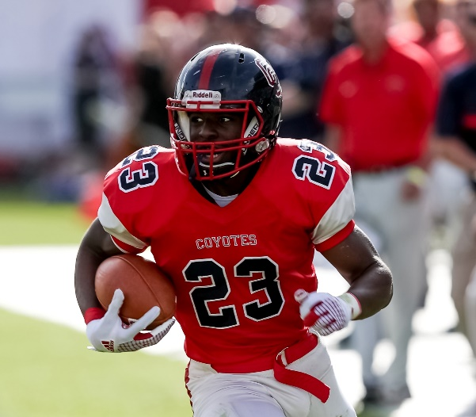
2023 nfhs football rule change proposal online form
Due:
November 1, 2022
Must be submitted to your state association office for approval.
Notes:
Comment on Slide:
ALL 2023 NFHS Football Rule Change Proposal Online Forms must first go through the state association office before it can be sent to the NFHS.
Only member state associations, football coaches and football game officials approved by the member state association, members of the NFHS Football Rules Committee and the NFHS can submit football rule change online proposal forms.
ALL 2023 NFHS Football Rule Change Online Proposal Forms must be submitted electronically online to the NFHS.

Slide 47
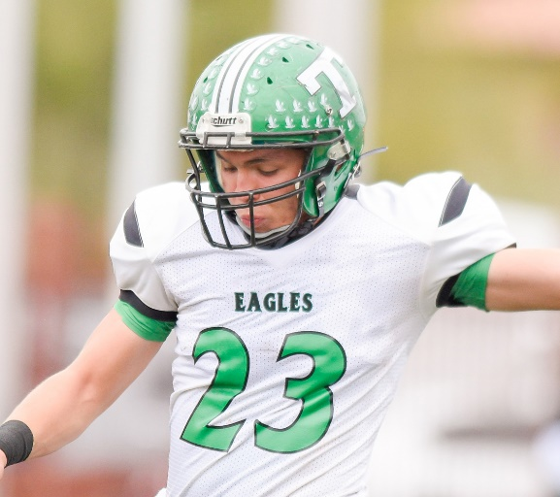
2022-23 nfhs football information
2022 In-Person NFHS Football Rules State Interpreters Meeting
  June 28, 2022 (NFHS Summer Meeting – San Antonio, TX)
  4:00 p.m. (Central Time)
2022 Online Mid-Season NFHS Football Rules Webinar
  September 26, 2022
  2:00 p.m. (Eastern Time)
2023 NFHS Football Rule Change Proposal Form Due
  November 1, 2022
2023 NFHS Football Rules Committee Meeting
  January 8-10, 2023
  Indianapolis, Indiana
Notes:
Comment on Slide:
2022-23 NFHS information with regards to football.

Slide 48
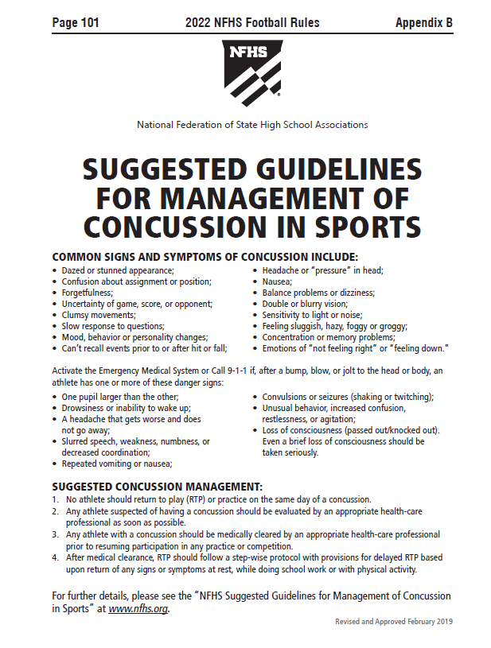
Nfhs suggested guidelines For management of concussion in sports
In the Appendix
in all of the
2022-23 NFHS
Rules Book
Notes:
Comment on Slide:
The “NFHS Suggested Guidelines for Management of Concussion” is in the Appendix in all of the 2022-23 NFHS Rules Books and was developed by the NFHS Sports Medicine Advisory Committee (SMAC).

Slide 49

NFHS Rules App
Rules App features:
  Searchable
  Highlight notes
  Bookmarks
  Quizzes for all sports
  Easy navigation
  Immediate availability
  Free to paid members of the NFHS Coaches
  and Officials Associations
  www.nfhs.org/erules for more information
Notes:
Comment on Slide:
NFHS Rules App is free to download.
Each book subscription is $6.99.
NFHS Coaches and Officials Association paid members get all books for free.
100% states members get books for free in sports designated by their state.
For 2022 – Rules Apps for all NFHS rules books and case books available on iTunes and Google Play. Rules books and case books will be cross-linked. Searchable content.

Slide 50
NFHS OFFICIALS Education

Slide 51





OFFICIALS EDUCATION
Content remains free of charge
TEACHING
AIDS
RULES
CHANGES
DIAGRAMS
VIDEO
LIBRARY
OFFICIALS
COURSES
Notes:
Comment on Slide:
Sport-Specific Officiating courses are offered in several sports. They are ideal for new officials and those in the first few years of officiating. These courses introduce officials to the mechanics and techniques used in the sport and provide specific information on an area within that sport. Individuals can complete a course within 30-45 minutes. These courses are free to all officials and prospective officials.
“Interscholastic Officiating” is a general course on sports officiating, and it is free to all officials and prospective officials. This course provides an introduction to skills and concepts used as an official. Several topics are covered such as: basics of becoming and staying an official, science of officiating, art of officiating, how to combine these skills for successful officiating.
Video clips are made available to NFHS Officials Association members. The video is clipped on specific topics and provides the rules references as well as dialogue on the topic.
The courses and videos are offered at www.NFHSLearn.com .
Courses Available:
Officiating Football
Officiating Volleyball – Ball Handling
Officiating Volleyball – Alignment
Officiating Volleyball – E-Whistle
Officiating Basketball
Officiating Basketball – Three-Person Mechanics
Officiating Basketball - Pre-Game Conference
Soccer – Fouls and Misconduct
Soccer – Offside
Soccer - Pre-Game Conference
Swimming and Diving
Officiating Wrestling
Umpiring Softball
Officiating Field Hockey
Officiating Track and Field
Future Courses to be Considered:
Umpiring Baseball
Umpiring Softball – 2 Person Mechanics
Communication Among Officials and Coaches

Slide 52


Future Developments
Improved Schedule View
Year Two Accomplishments
Auto-Assign
Years of Service
14
121,508
$9.2M
Enhanced Payment Capabilities
States
Registering
Officials
Contests
Assigned
Payments
Sent to
Officials
100% FREE to your state as a NFHS-Member Benefit.
Notes:
Comment on Slide:
NFHS CENTER FOR OFFICIALS SERVICES (COS)
Your Complete Solution for Officials Management and More:
Registration
Assignment
Payment
Testing
Background Checks
For More Information on the NFHS – Center for Officials Services (COS) Contact:
Dana Pappas, Director of Officiating Services, dpappas@nfhs.org
Also If You’re Interested in Eligibility and Monitoring Requirements Contact
the Folks at Dragonfly:
Kirk Miller, Dragonfly, kirk@dragonflyathletics.com
Brandon Wallace, Dragonfly, brandon@dragonflyathletics.com

Slide 53
NFHS Learning Center

Slide 54

Notes:
Comment on Slide:
The NFHS Learning Center is the home to more than 90 online professional development courses for everyone within the interscholastic community - coaches, students, officials, parents, administrators, and individuals within performing arts programs. More than 60 courses are available for free.
The NFHS is an Accredited Institution and has delivered more than 15 million courses on its NFHS Learning Center platform since its inception in 2007. In receiving national accreditation by Cognia, the NFHS has upheld itself to rigorous standards that focus on productive learning environments, equitable resource allocation that meet the needs of learners, and effective leadership.
The NFHS Learning Center features its flagship coaching course, “Fundamentals of Coaching,” as well as several health and safety courses that have been completed by millions of individuals, such as “Concussion in Sports,” “Heat Illness Prevention,” “Sudden Cardiac Arrest” and “Protecting Students from Abuse.” The NFHS Learning Center offers several national credentials that can be earned by individuals who complete specific NFHS courses. Through the School Honor Roll Program, schools can earn a physical banner to hang in their school.
To learn more and start your professional development journey, please visit the NFHS Learning Center at NFHSLearn.com.

Slide 55
NFHS Network

Slide 56


NFHS Network
By 2025, every high school sporting event in America will be streamed live.
The NFHS Network will be
THE DESTINATION for fans
to view these broadcasts.
27 Different Sports and Activities
www.NFHSnetwork.com
Notes:
Comment on Slide:
The NFHS Network is the leader in streaming Live and On Demand high school sports.
Partnered with the National Federation of State High School Associations, 45 high school state athletic/activities associations, and PlayOn! Sports, the NFHS Network is a joint venture created to provide fans with the ability to stream high school sports on any device, from wherever they are.
All NFHS Network events are available to watch online at www.NFHSnetwork.com and through the NFHS Network Live App for iOS and Android. Follow us on Facebook, Twitter, Instagram, and YouTube.
Watching high school sports and events has never been easier.
The NFHS Network’s goal to broadcast live all 2 million high school sporting events by 2025.
The NFHS Network covers 27 different regular season and postseason sports, as well as other high school activities, celebrating the accomplishments of students-athletes, student broadcasters, and high schools across the country.

Slide 57

Over 1 million events this year…
Notes:
Comment on Slide:
The NFHS Network will broadcast over 150,000 live events this year. If your school is not a member of the NFHS Network School Broadcast Program, please contact us at Mark.Koski@NFHSnetwork.com

Slide 58

Thank You
National Federation of State High School Associations
PO Box 690 | Indianapolis, IN 46206
Phone: 317-972-6900 | Fax: 317.822.5700
www.nfhs.org | www.nfhslearn.com | www.nfhsnetwork.com

