Slide 1
2022 NFHS Baseball Rules Powerpoint
B. Elliot Hopkins, MLD, CAA
NFHS Director of Sports, Sanctioning and Student Services
Notes:
Thank you for participating in this annual interpretation meeting. While the rules of baseball are in great shape, we continue to work toward improving the sport by recruiting and retaining more young people. We have to continue to strive to provide safe conditions and place them in situations that they are able to find success in some aspect of the sport. Ultimately, our goal is for them to be safe, have fun and gain some valuable life lessons from participation. New additions to our rules are indicated by underlining of the change. Deletions are noted by a strike-through of the deleted text.

Slide 2
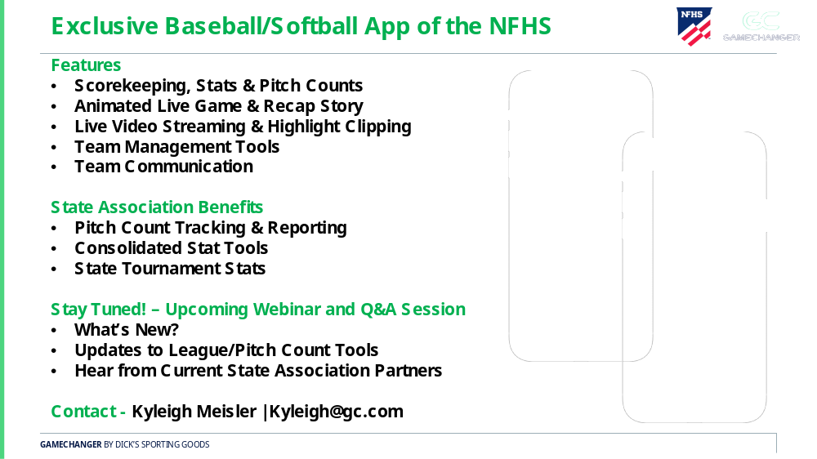
NFHS Corporate partner
Notes:
The NFHS welcomes and thanks Game Changer as our exclusive corporate partner. As their status with the NFHS has been contractually established, they are the only company that can use our logo/wordmark.

Slide 3
Important facts and dates
*2018-19 Participation Results
  Baseball (4) 482,740 [down from 2017-18 {487,097}]
  Girls’: 1,284 (down from 2017-18 1,762)
In-person Interpretation Meeting Date
  January 19-20, 2022
Mid-Season Webinar Date
  April 22, 2022
Rule Change Proposal Submission Dates
  Open Date: September 1, 2021
  Close Date: May 1, 2022
Rules Committee Date
  June 5-7, 2022

Slide 4

National Federation of
State High School Associations
NFHS (located in Indianapolis, IN – Est. 1920):
  National leader and advocate for
  high school athletics and
  performing arts programs.
  Serves 51 state associations, 19,500
  high schools and 12 million student
  participants.
  Writes playing rules for 17 high school
  sports for boys and girls.
  Offers online education courses for high school coaches,
  officials, parents, students and others.
  Ensures that students have opportunity to enjoy healthy participation, achievement and good sportsmanship in education-based athletics.
Notes:
The NFHS is the national leader and advocate for high school athletics and performing arts programs. Services of the NFHS reach more than 19,000 high schools and 12 million participants throughout the 8 NFHS sections across the U.S.
A significant responsibility of the NFHS is the commitment to writing quality playing rules for 17 high school sports for boys and girls, in addition to providing educational resources for high school coaches, officials, parents and students.

Slide 5







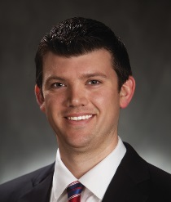
NFHS Rules Review Committee
The NFHS Rules Review Committee is chaired by the chief operating officer and composed of all rules editors. After each committee concludes its deliberations and has adopted its recommended changes for the subsequent year, such revisions will be evaluated by the Rules Review Committee.
Davis Whitfield
Chief Operating Officer
Lindsey Atkinson
Basketball, Girls Lacrosse and Volleyball
Bob Colgate
Football and Sports
Medicine
Sandy Searcy
Softball, Swimming & Diving and Water Polo
Elliot Hopkins
Baseball and Wrestling
Julie Cochran
Cross Country, Gymnastics, Field Hockey, Soccer and
Track & Field
James Weaver
Boys Lacrosse
and Spirit
Dan Schuster
Ice Hockey
Notes:
All rules committee recommended rules changes are vetted through the NFHS Rules Review Committee before advancing to the NFHS Board of Directors for final action. The committee is comprised of all NFHS Director of Sports and chaired by the NFHS Chief Operating Officer.

Slide 6
RULES CHANGES

Slide 7
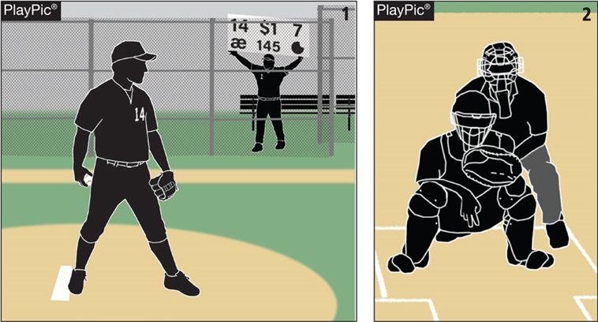
Rule 6-1-1
Pitching

Slide 8
Rule 6-1-1
ART. 1 . . . The pitcher shall pitch while facing the batter from either a windup position (Art.2) or set position (Art.3). The position of his feet determine whether he will pitch from the windup or the set position. He shall take or simulate taking his sign from the catcher with his pivot foot in contact with the pitcher’s plate. The pitching regulations begin when he intentionally contacts the pitcher’s plate. Turning the shoulders after bringing the hands together during or after the stretch is a balk. He shall not make a quick-return pitch in an attempt to catch a batter off balance. The catcher shall have both feet in the catcher’s box at the time of the pitch. If a pitcher is ambidextrous, the umpire shall require the pitcher to face a batter as either a left-handed or right-handed pitcher, but not both.

Slide 9
Rule 6-1-1
Rationale:
The pitcher acquiring the sign from the catcher is one of the fundamental rules of baseball. It not only signals the defensive team that action is about to be initiated, but it also establishes when an offensive base runner(s) can take a lead-off from his/her base. That simple act has evolved over the last decade but was not supported by an accompanying rule. This change validates the pitcher taking the sign from the dugout/bench via “call” signs, numbers, colors, or an arm wristband/placard that contains printed cards where the defensive set up/pitching repertoire is located. This aspect of the game has become more sophisticated to match the skill level and ability of today’s high school baseball player.

Slide 10
NFHS baseball Points Of emphasis

Slide 11
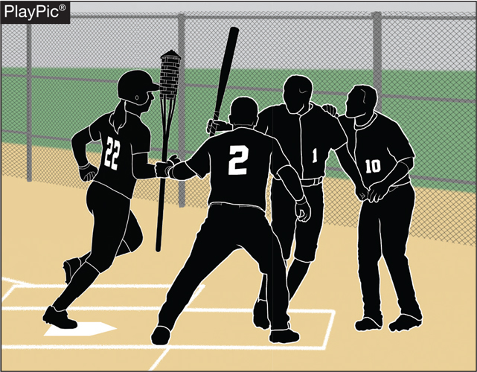
Excessive celebration

Slide 12
Excessive celebration
The game has evolved from celebratory high-fives and cheers to choreographed celebrations that include props and players being assigned specific roles.
If coaches are unable to manage the emotions of their players or the theatrics of celebration, then the game umpires have existing rules that provide warnings, possible restrictions and ultimately ejections from the contest.

Slide 13

PROPER USE OF EQUIPMENT
Notes:
24 should be 2 - 4

Slide 14
PROPER USE OF EQUIPMENT
Equipment manufacturers spend millions of dollars to ensure that their products are held to high industry standards. Most products are tested as to how they are supposed to be worn or used. When someone alters that product, it violates the equipment’s warranty and leaves the end-user uncertain that the product will perform…or protect the wearer from injury or harm.
Bats, helmets, chest and chin protectors should not be modified or used in a way that it was not designed by the manufacturer.
Doing so violates the equipment’s warrant and creates a product that may not perform as intended nor protect the user from injury or harm.

Slide 15

SITTING ON BUCKETS (COACHES)

Slide 16
SITTING ON BUCKETS (COACHES)
Coaches, players, substitutes, attendants or other bench personnel shall not leave the dugout during live ball for any unauthorized purpose.
Coaches or team personnel may not sit outside the dugout/bench on buckets or stools.
We have an obligation to protect and set a good example for the students we coach and care about; not to entice them to break the rules. High school sports have always been about teaching skill and work ethic while modeling appropriate behavior. Staying in the dugout/bench area is another example of showing our students the “right” way to do things.

Slide 17

LODGED BALL PROCEDURE

Slide 18
LODGED BALL PROCEDURE
When a lodged ball situation occurs, there is always a lot of energy behind if the ball is truly lodged or is the defensive player practicing gamesmanship. We have seen at different levels that when a ball gets lodged in a glove the quick-thinking fielder removes his glove and throws it to the respective base to register the force out. While it is an exciting play that takes skill and a little bit of luck to accomplish, we do not have that many lodged balls in high school baseball.
  A baseball that remains on the playing field but has become wedged, stuck, lost, unreachable, is defined to be a lodged ball.
If the ball impacts something, stops abruptly, and does not fall or roll immediately, it is considered lodged.

Slide 19
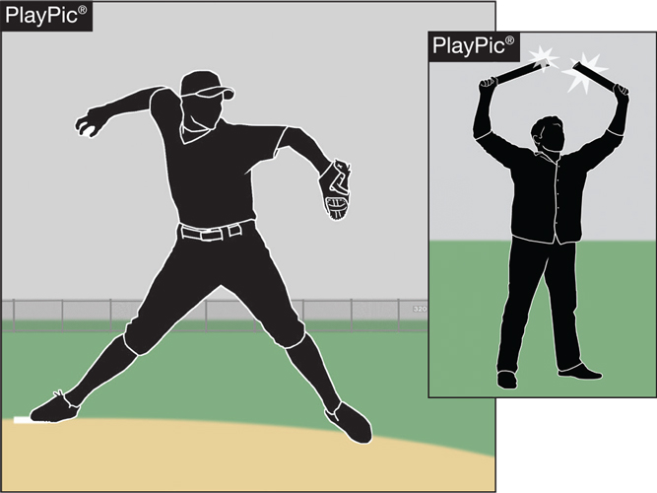
SPORTSMANSHIP

Slide 20
SPORTSMANSHIP
Chants/intentional distractions/loud noises (natural or artificial) directed at the opponent’s pitcher prior to his pitching, the batter preparing to hit, or a fielder getting ready to make a play is not good sportsmanship and should not be accepted.
Players are not allowed to stand or kneel outside their dugout/bench and make “cat-calls” or any other disparaging remarks to the other team. Rooting for your team is an integral part of high school baseball. Supporting your teammates is extremely important and encouraged, however, making disparaging remarks toward your opponent is not part of the game, in fact it detracts from the contest. The purpose of interscholastic sports is educational.

Slide 21
Rules Reminders

Slide 22




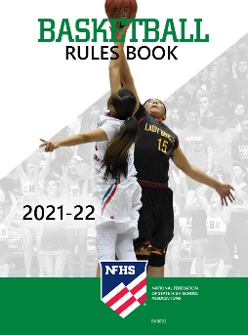
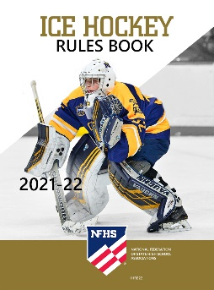





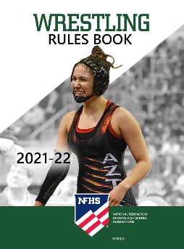
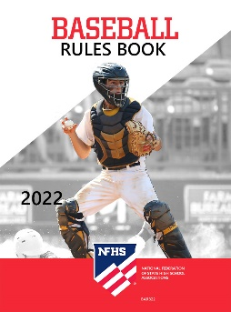

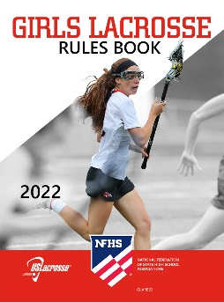
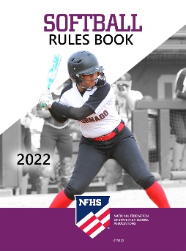


National Federation of
State High School Associations
The NFHS writes playing rules for 17 sports
for boys and girls at the high school level.
  Publishes 4 million pieces of materials annually.
Notes:
The NFHS writes playing rules for 17 sports, publishes High School Today (HST) along with several other key publications totaling over 4 million pieces annually.

Slide 23

NFHS Rules Book as e-Books
E-books features:
  Searchable
  Highlight areas of interest
  Make notes
  Easy navigation
  Adjustable viewing size
  Immediate availability

Slide 24

NEW NFHS Rules App
Rules App features:
  Searchable
  Highlight notes
  Bookmarks
  Quizzes for all sports
  Easy navigation
  Immediate availability
  Free to paid members of the NFHS Coaches
  and Officials Associations
  www.nfhs.org/erules for more information
Notes:
Rules app for all NFHS rules books and case books are available on iTunes and Google Play. Rules books and case books are cross-linked and enabled for searchable content.
App is free to download.
Each book subscription is $6.99.
NFHS Coaches and Officials Association paid members get all books for free.
100% states members get books for free in sports designated by their state.

Slide 25

Guidelines for Schools and state associations for consideration of accommodations
Notes:
To assist state associations in working with schools for the inclusion of students with disabilities, the following guide prepared by the NFHS Task Force on the Inclusion of Students with Disabilities is being provided for your review.
Following these guidelines will assist in the individual student assessment by the student and the school.
When requesting a possible accommodation, coaches should work with their school and the state association as early as possible in the sport season.
Contest officials shall defer decisions on rule accommodations to the respective state association.
This information serves as a guide. Each state association may develop its own process.

Slide 26
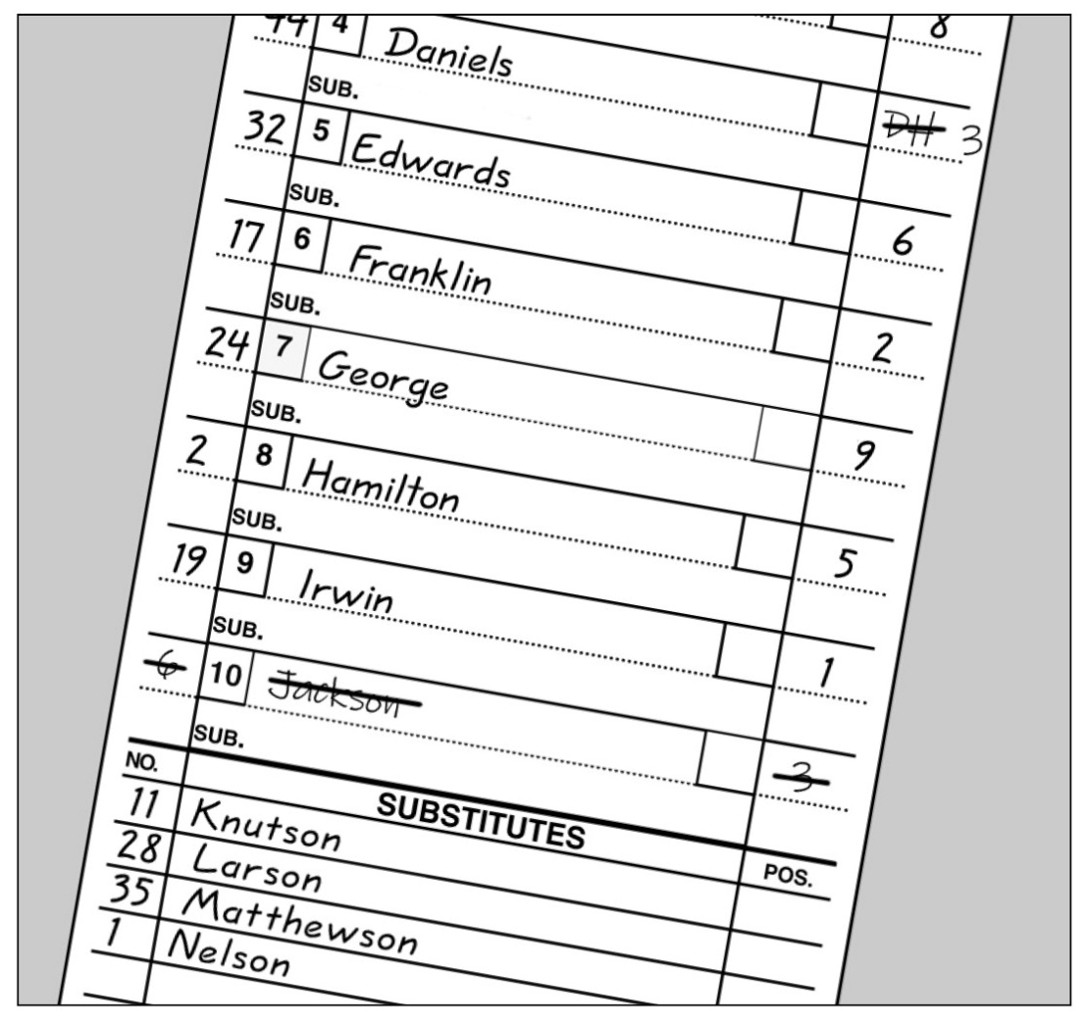
Designated hitter
Rule 3-1-4a2
While there is no change from the previous DH rule.
The role of a standard DH is still terminated for the remainder of the game when the designated hitter or any previous designated hitter assumes a defensive position.

Slide 27
NFHS learning center

Slide 28

Notes:
The NFHS Learning Center, accessed at NFHSLearn.com has over 70 online professional development courses for the entire interscholastic community, including coaches, administrators, officials, parents, students, and individuals within performing arts programs. The mission and purpose of the NFHS Learning Center is focused on growing professional development opportunities. Those opportunities include courses, but now also incorporate additional videos such as “The Parent Seat” and “Beyond The Scoreboard,” which are short videos created to show to parents at Parent Meetings or show during events. The NFHS Learning Center has delivered over 10,000,000 courses and looks to continue to educate and be a valuable resource for the entire interscholastic community. Learn more at NFHSLearn.com!

Slide 29







OFFICIALS EDUCATION
CONTENT IS NOW FREE
TEACHING AIDS
RULES
CHANGES
VIDEO
LIBRARY
OFFICIALS
COURSES
DIAGRAMS
Notes:
Sport-Specific Officiating courses are offered in several sports. They are ideal for new officials and those in the first few years of officiating. These courses introduce officials to the mechanics and techniques used in the sport and provide specific information on an area within that sport. Individuals can complete a course within 30-45 minutes. These courses are free to all officials and prospective officials.
“Interscholastic Officiating” is a general course on sports officiating, and it is free to all officials and prospective officials. This course provides an introduction to skills and concepts used as an official. Several topics are covered such as: basics of becoming and staying an official, science of officiating, art of officiating, how to combine these skills for successful officiating.
Video clips are made available to NFHS Officials Association members. The video is clipped on specific topics and provides the rules references as well as dialogue on the topic.
The courses and videos are offered at www.NFHSLearn.com .
Courses Available:
Officiating Football
Officiating Volleyball – Ball Handling
Officiating Volleyball – Alignment
Officiating Volleyball – E-Whistle
Officiating Basketball
Officiating Basketball – Three-Person Mechanics
Officiating Basketball - Pre-Game Conference
Soccer – Fouls and Misconduct
Soccer – Offside
Soccer - Pre-Game Conference
Swimming and Diving
Officiating Wrestling
Umpiring Softball
Officiating Field Hockey
Officiating Track and Field
Future Courses to be Considered:
Umpiring Baseball
Umpiring Softball – 2 Person Mechanics
Communication Among Officials and Coaches

Slide 30

Notes:
NFHS CENTER FOR OFFICIALS SERVICES (COS)
Your Complete Solution for Officials Management and More:
Registration
Assignment
Payment
Testing
Background Checks
For More Information on the NFHS – Center for Officials Services (COS) Contact:
Theresia Wynns, Director of Sports and Officials, twynns@nfhs.org
Also If You’re Interested in Eligibility and Monitoring Requirements Contact
the Folks at Dragonfly:
Kirk Miller, Dragonfly, kirk@dragonflyathletics.com
Brandon Wallace, Dragonfly, brandon@dragonflyathletics.com

Slide 31
NFHS OFFICIALS EDUCATION
SPORT-SPECIFIC COURSES
Courses Available
  Officiating Football
  Soccer – Fouls and Misconduct
  Swimming and Diving
  Officiating Wrestling
  Officiating Basketball
  Umpiring Softball
  Officiating Volleyball – Ball Handling
Future Courses
  Officiating Baseball
  Basketball – Three-Person Mechanics
  Field Hockey
  Track and Field
  Volleyball – Overlapping
  Softball – Mechanics
  Communication Among Officials and Coaches
  Soccer - Offside
Notes:
NFHS OFFICIAL EDUCATION
Courses Available
Officiating Football
Soccer – Fouls and Misconduct
Swimming and Diving
Officiating Wrestling
Officiating Basketball
Umpiring Softball
Officiating Volleyball – Ball Handling
Future Courses
Officiating Baseball
Basketball – Three-Person Mechanics
Field Hockey
Track and Field
Volleyball – Overlapping
Softball – Mechanics
Communication Among Officials and Coaches
Soccer - Offside

Slide 32
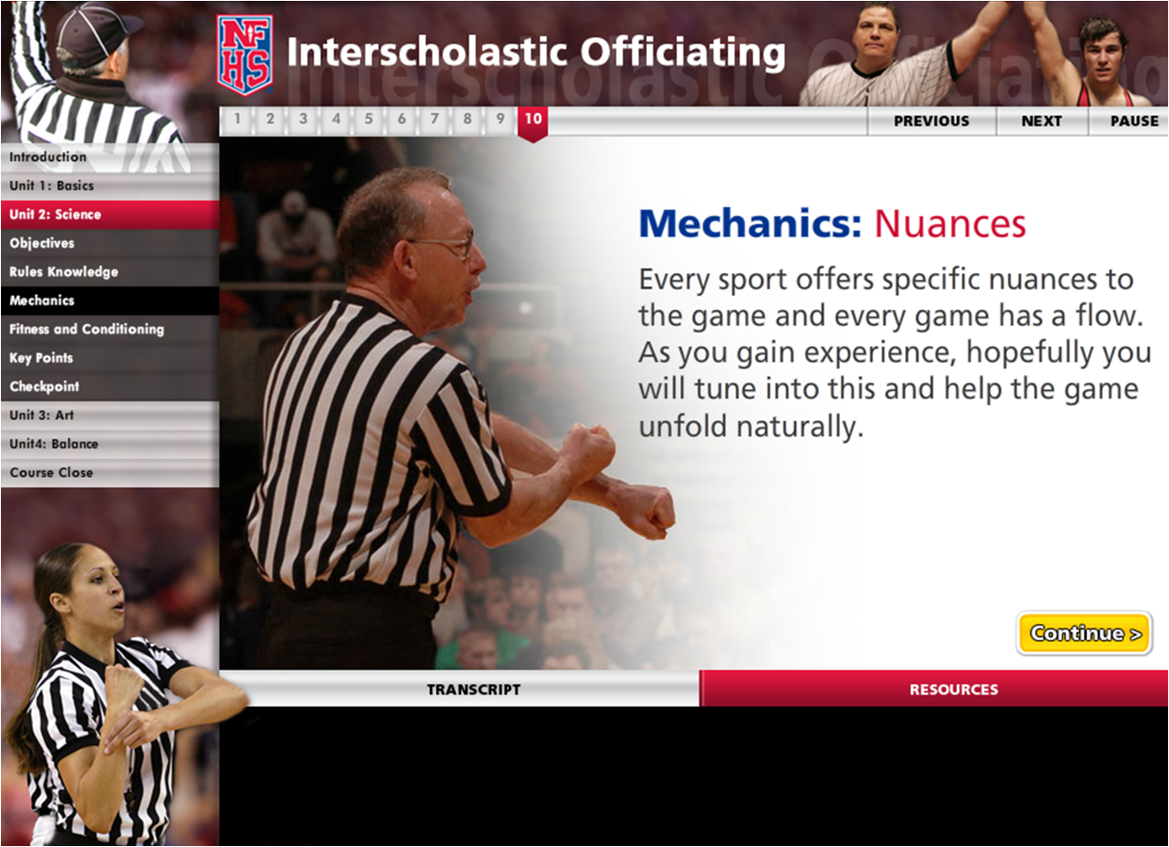
Interscholastic Officiating www.nfhslearn.com
Introduction to skills and concepts used as an official
Ideal for new officials or those in first few years
of officiating
30-45 minutes to complete
Topics include: basics of becoming and staying an official, science of officiating, art of officiating, how to combine these skills for successful officiating
Course is FREE to any NFHS Officials Association member
Non-members course is $20
API available to state associations to collect results
Notes:
The Interscholastic Officiating Course contains the following information:
Introduction to skills and concepts used as an official
Ideal for new officials or those in first few years of officiating
30-45 minutes to complete
Topics include: basics of becoming and staying an official, science of officiating, art of officiating, how to combine these skills for successful officiating
Course is FREE to any NFHS Officials Association member
Non-members course is $20
API available to state associations to collect results

Slide 33

Notes:
VIDEO FOR TEACHING AND LEARNING
The new video library is located at www.nfhslearn.com
A variety of video in many sports is provided.

Slide 34


Slide 35

Nfhs learning center www.nfhslearn.com
Professional Development For ALL
  Coaches
  Officials
  Administrators
  Parents
  Students
  Performing Arts
Notes:
Digital platform for online professional development courses are available on www.nfhslearn.com.

Slide 36
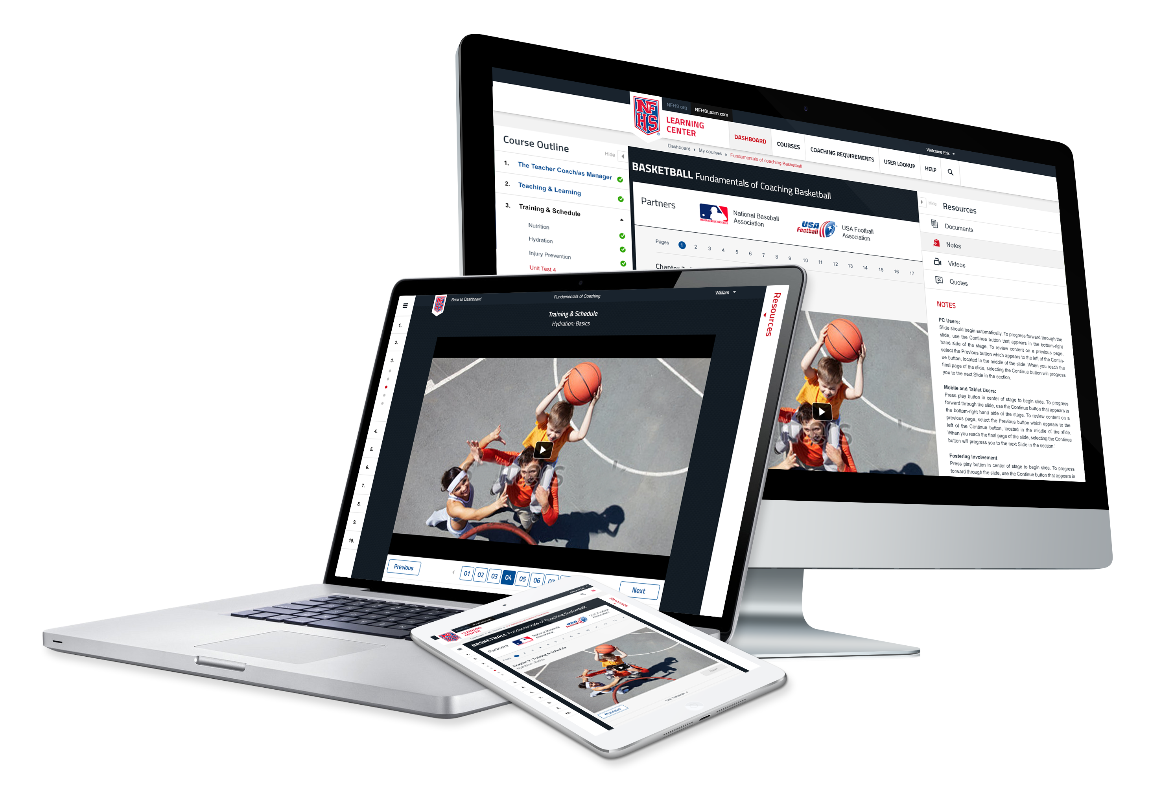
www.nfhslearn.com
FREE courses include:
  Bullying, Hazing and Inappropriate Behaviors
  Student Mental Health and Suicide Prevention
  Understanding Copyright and Compliance
  Protecting Students from Abuse
  Hazing Prevention for Students
  Coaching Unified Sports
  ACL Injury Prevention
  Sportsmanship
  And many more
Notes:
FREE courses include:
Bullying, Hazing and Inappropriate Behaviors
Student Mental Health and Suicide Prevention
Understanding Copyright and Compliance
Protecting Students from Abuse
Hazing Prevention for Students
Coaching Unified Sports
ACL Injury Prevention
Sportsmanship
And many more

Slide 37
NFHS Network

Slide 38


NFHS Network
By 2025, every high school sporting event in America will be streamed live.
The NFHS Network will be
THE DESTINATION for fans
to view these broadcasts.
27 Different Sports and Activities
www.NFHSnetwork.com
Notes:
The NFHS Network is the leader in streaming Live and On Demand high school sports.
Partnered with the National Federation of State High School Associations, 45 high school state athletic/activities associations, and PlayOn! Sports, the NFHS Network is a joint venture created to provide fans with the ability to stream high school sports on any device, from wherever they are.
All NFHS Network events are available to watch online at www.NFHSnetwork.com and through the NFHS Network Live App for iOS and Android. Follow us on Facebook, Twitter, Instagram, and YouTube.
Watching high school sports and events has never been easier.
The NFHS Network’s goal to broadcast live all 2 million high school sporting events by 2025.
The NFHS Network covers 27 different regular season and postseason sports, as well as other high school activities, celebrating the accomplishments of students-athletes, student broadcasters, and high schools across the country.

Slide 39

Notes:
What is the NFHS Network?
The NFHS Network celebrates and showcases the unique accomplishments of students, whether they are a student-athlete participating in the 27 different
sports covered by the Network, or one of the student broadcasters from schools around the country that produce events through the School Broadcast
Program. The NFHS Network also features state playoff and championship events for the 34 state members of the NFHS Network.

Slide 40

Notes:
The NFHS Network will broadcast over 150,000 live events this year. If your school is not a member of the NFHS Network School Broadcast Program, please contact us at Mark.Koski@NFHSnetwork.com

Slide 41
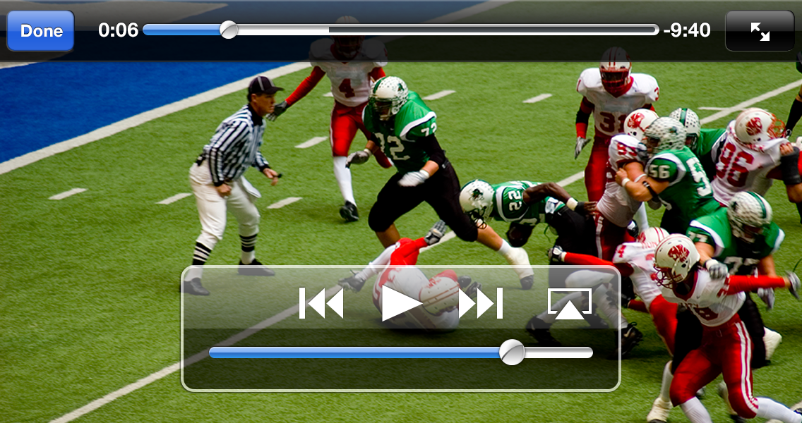
NFHS Network
View from mobile…
Notes:
What is the NFHS Network?
For all questions regarding difficulty viewing, inability to find a specific event link, technical issues within a broadcast, trouble subscribing, billing questions, etc.,
please contact memberadmin@NFHSNetwork.com or 877-978-2311.
There are customer representatives standing by to respond to issues and get fans set-up to view their events as quickly as possible. We are happy to issue
refunds if you are viewing a game that is experiencing technical difficulties, as well as for as accidental duplicate charges or unwanted renewal charges for
recurring subscriptions.

Slide 42
Thank you and have a great Baseball season!
www

