Slide 1
2022-23 nfhs wrestling rule interpretation powerpoint
B. Elliot Hopkins, MLD, CAA
Director of Sports, Sanctioning and Student Services

Slide 2

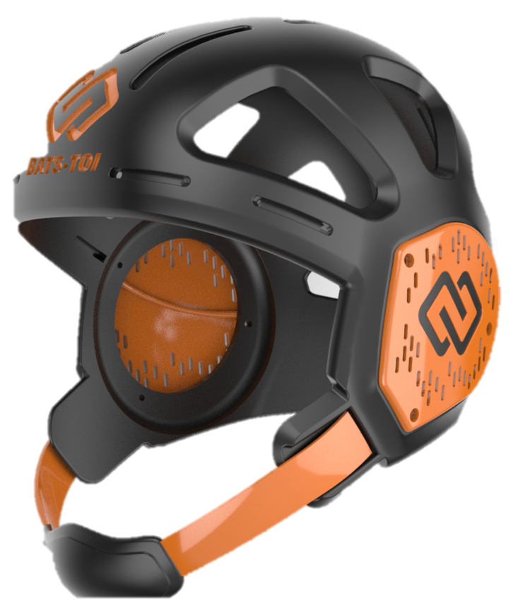
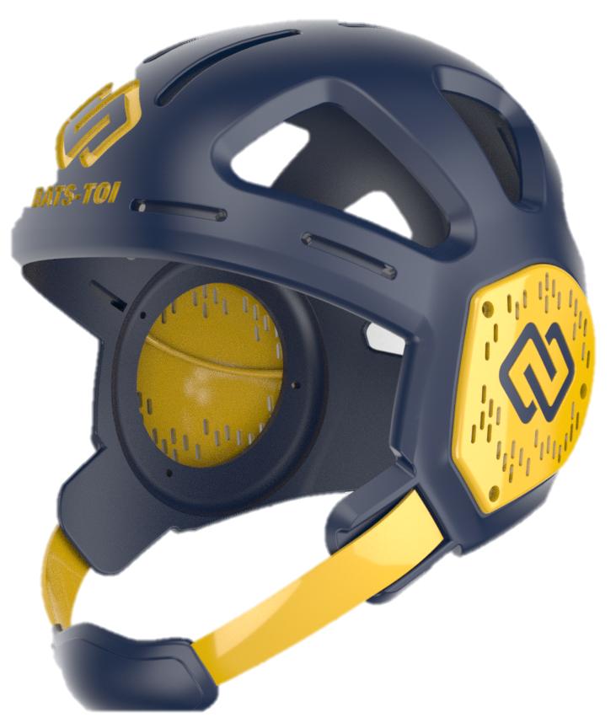
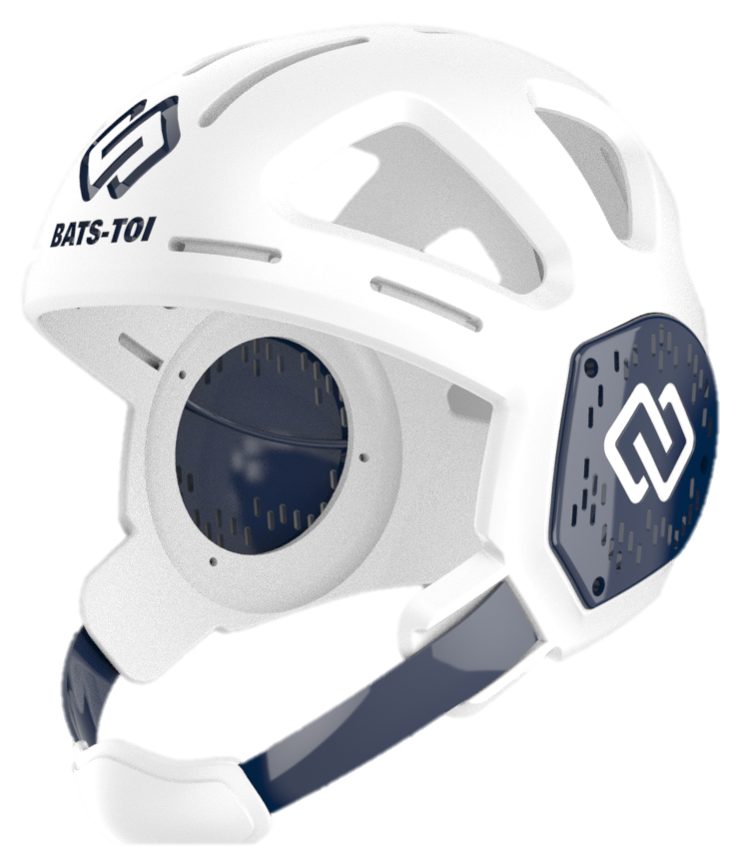
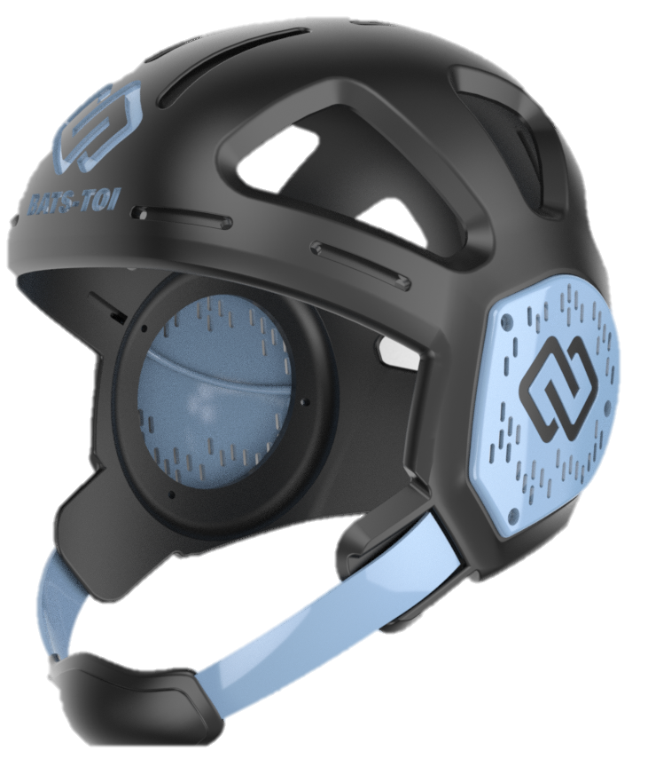
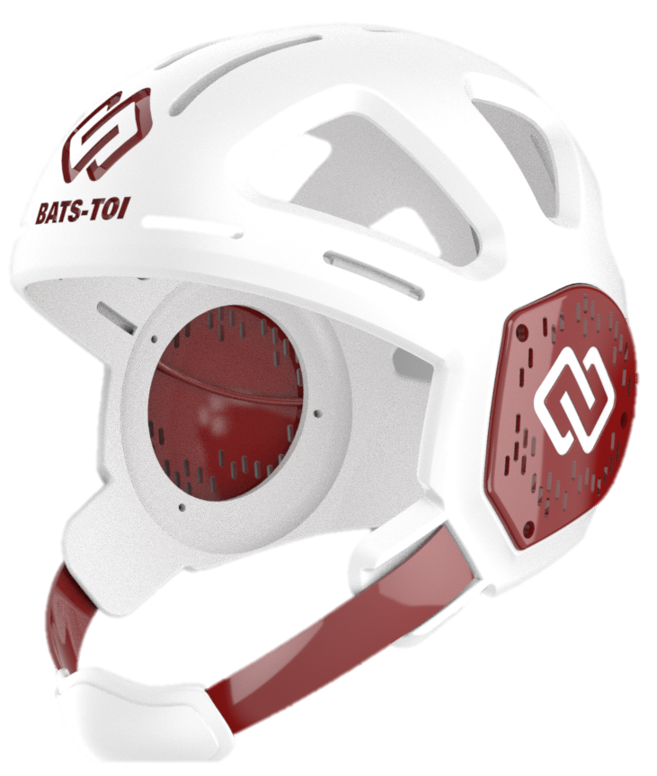
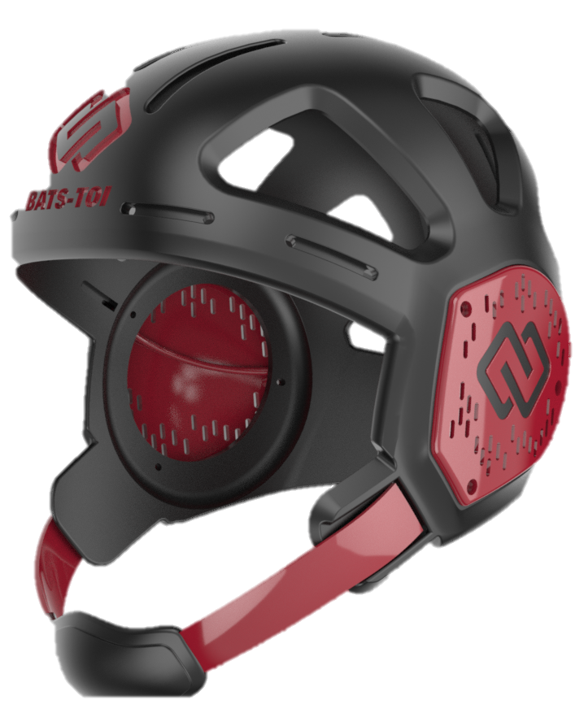
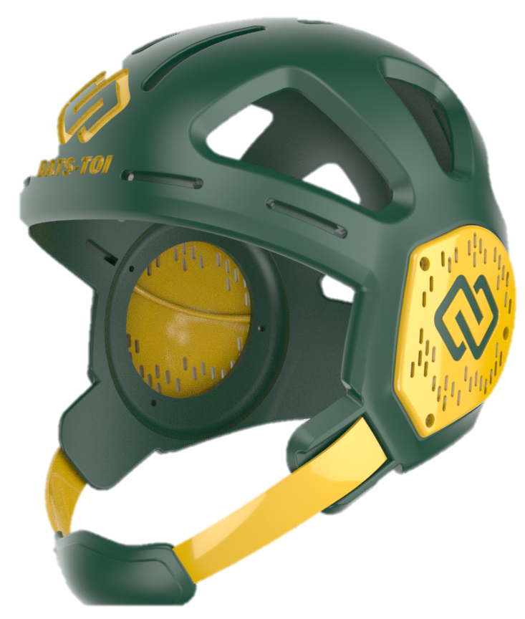


THE MERCADO® HEADGEAR
Official Wrestling Headgear Partner of NFHS
Award-winning patented design
Impact certified in the US/EU for safety & performance
Custom fit for stability
Light weight and breathable
Engineered at Columbia University and NYU
Worn by top wrestlers
www.batstoi.com

Slide 3

National Federation of
State High School Associations
NFHS (located in Indianapolis, IN – Est. 1920):
  National leader and advocate for
  high school athletics and
  performing arts programs.
  Serves 51 state associations, 19,500
  high schools and 12 million student
  participants.
  Writes playing rules for 17 high school
  sports for boys and girls.
  Offers online education courses for high school coaches,
  officials, parents, students and others.
  Ensures that students have opportunity to enjoy healthy participation, achievement and good sportsmanship in education-based athletics.
Notes:
The NFHS is the national leader and advocate for high school athletics and performing arts programs. Services of the NFHS reach more than 19,000 high schools and 12 million participants throughout the 8 NFHS sections across the U.S.
A significant responsibility of the NFHS is the commitment to writing quality playing rules for 17 high school sports for boys and girls, in addition to providing educational resources for high school coaches, officials, parents and students.
It is the vision of the NFHS to help prepare tomorrow’s leaders for the next level of life through the many program offerings in education-based athletics and activities.

Slide 4








NFHS Rules Review Committee
The NFHS Rules Review Committee is chaired by the chief operating officer and composed of all rules editors. After each committee concludes its deliberations and has adopted its recommended changes for the subsequent year, such revisions will be evaluated by the Rules Review Committee.
Davis Whitfield
Chief Operating Officer
Lindsey Atkinson
Basketball, Girls Lacrosse and Volleyball
Bob Colgate
Football and Sports
Medicine
Sandy Searcy
Softball, Swimming & Diving and Water Polo
Elliot Hopkins
Baseball and Wrestling
Julie Cochran
Cross Country, Gymnastics, Field Hockey, Soccer and
Track & Field
James Weaver
Boys Lacrosse
and Spirit
Dan Schuster
Ice Hockey
Notes:
All rules committee recommended rules changes are vetted through the NFHS Rules Review Committee before advancing to the NFHS Board of Directors for final action. The committee is comprised of all NFHS Director of Sports and chaired by the NFHS Chief Operating Officer.

Slide 5
Rule changes

Slide 6
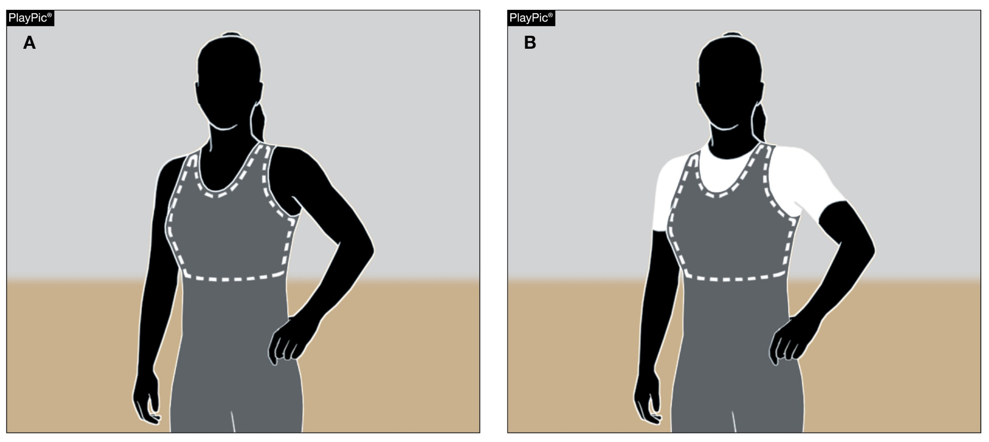
Uniforms
4-1-1a Note, 4-1-1c note

Slide 7
Rule 4-1-1a NOTE
ART. 1a. . . NOTE: Female contestants wearing a one-piece singlet shall wear a sports bra that completely covers their breasts and minimizes the risk of exposure (PlayPic A). Compression shirts worn underneath a one-piece singlet are permitted but not required for female contestants unless needed to ensure complete coverage.

Slide 8
Rule 4-1-1c NOTE
ART. 1c. . . NOTE: Female contestants choosing to wear a form-fitted compression shirt, whether as part of a two-piece uniform or under a one-piece singlet, shall also wear a sports bra that completely covers their breasts and minimizes the risk of exposure (PlayPic B).

Slide 9
Rule 4-1-1a and 4-1-1c NOTES
RATIONALE:
To address numerous reported incidents of officials telling female contestants that ALL females are required to wear a compression shirt under their singlet in addition of wearing a sports bra, we believe the wrestling community is in need of clarification for both notes.

Slide 10
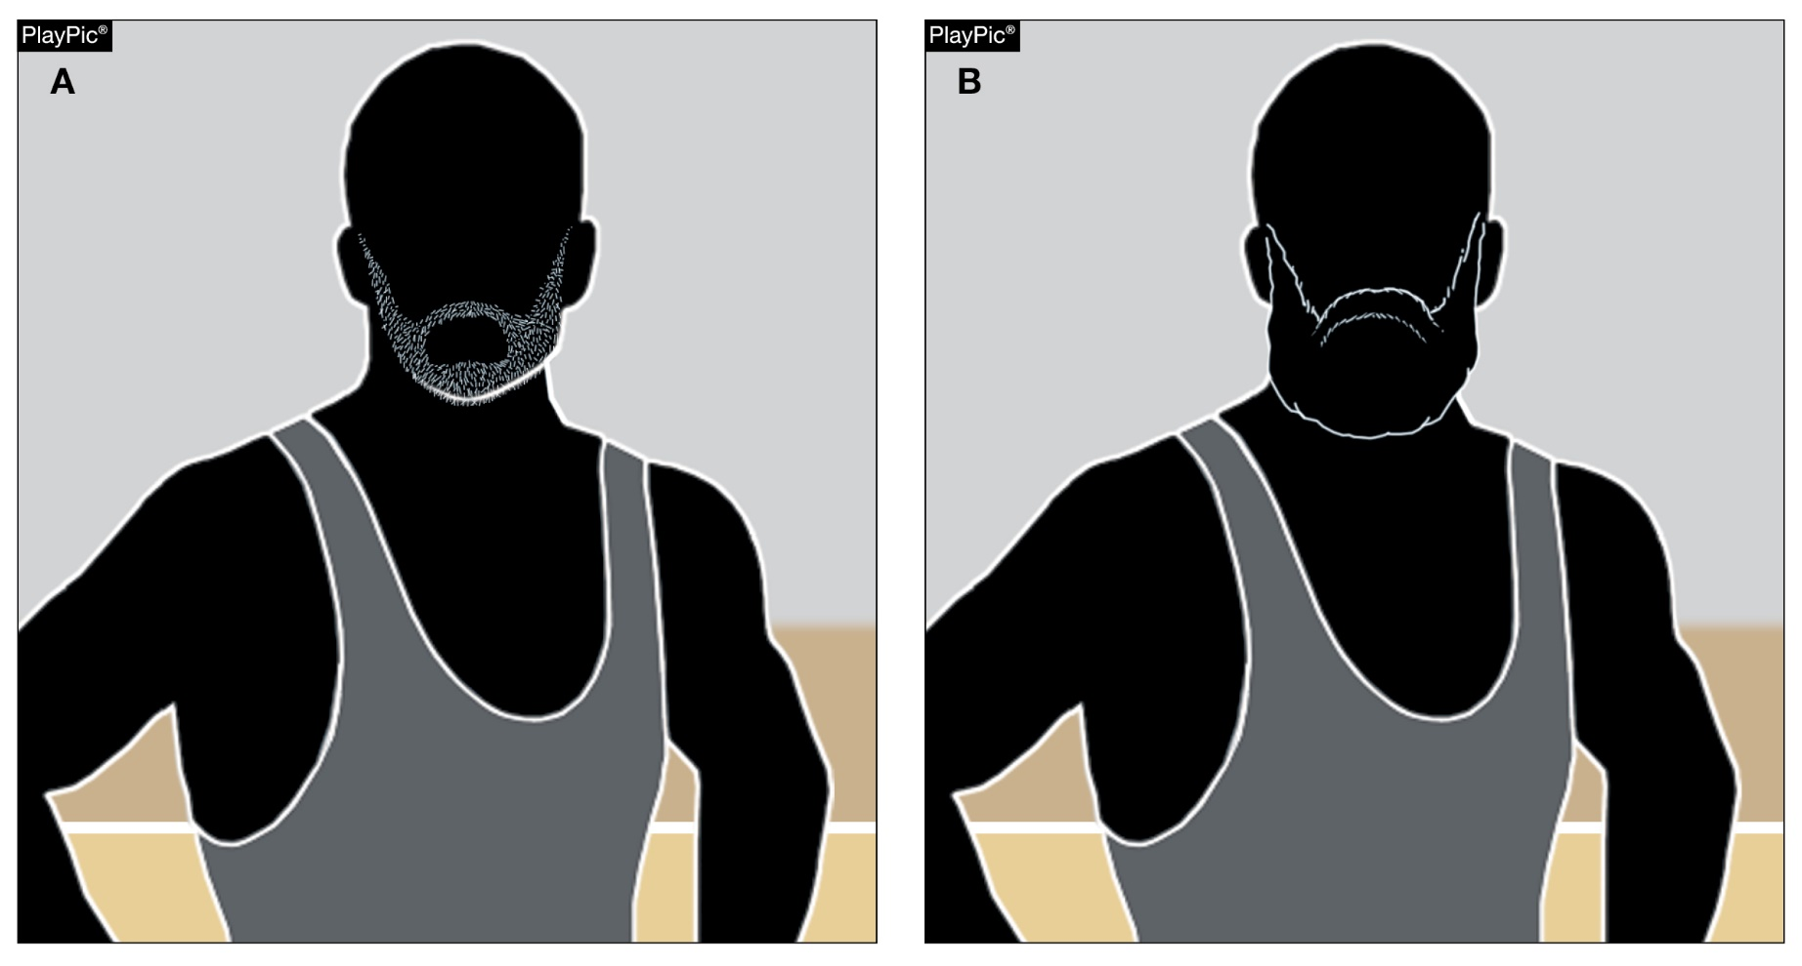
Rule 4-2-1 Facial hair
ILLEGAL
ILLEGAL

Slide 11
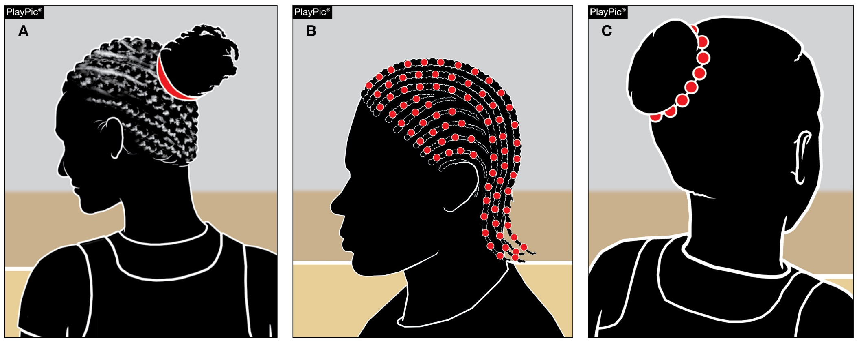
Rule 4-2-1 HAIR control and adornments
Hair control devices and other adornments in the hair that are securely fastened and do not present an increased risk to the wrestler, teammates or opponents are allowed. The hair control device and adornments in PlayPic B and PlayPic C would need to be covered with a legal hair cover.

Slide 12
Rule 4-2-1 Facial hair and hair control
ART. 1 . . . Facial hair trimmed to a length so that the skin is visible for medical examinations is allowed. Facial hair that does not allow for a proper medical examination to be performed, (PlayPic A and B) as determined by an appropriate health care professional overseeing medical examinations, shall be immediately trimmed to within the guidelines. A wrestler may not compete until the facial hair is trimmed and the medical examination is completed. Hair control devices and other adornments in the hair that are securely fastened and do not present an increased risk to the wrestler, teammates or opponents are allowed.

Slide 13
Rule 4-2-1 Facial hair and hair control
A wrestler may contain his/her hair in a legal hair cover. The legal hair cover, if worn, shall be attached to the ear guards. A bandanna is not considered a legal hair cover. The legal hair cover must be of a solid material and be nonabrasive. The wrestler opting to wear a legal hair cover must wear it to the weigh-in procedure and be checked for grooming with it on. The legal hair cover must be removed prior to the wrestler stepping on the scale to be weighed. If a referee is not present at weigh-ins, the hair cover must be checked by the meet referee upon arrival at the site.

Slide 14
Rule 4-2-1 Facial hair and hair control
Wrestlers that do not meet the requirement shall be required to wear a face mask. All legal hair covers and face masks will be considered as special equipment

Slide 15
Rule 4-2-1 Facial hair and hair control
Rationale:
Several member state associations successfully piloted a facial hair experiment during each of the last two seasons. There were no issues reported to those participating state associations.
The pilot study was supported by the respective state associations’ Sport Medicine Advisory Committees (SMAC) whose members work as physicians at their states’ wrestling championships. Member state associations did not experience any difficulties in performing skin checks.

Slide 16
Current Weight Classifications rule 4-4-1
Currently we have 14 weight classes for boy and girl wrestlers. They are: 106 lbs., 113 lbs., 120 lbs., 126 lbs.,132 lbs., 138 lbs., 145 lbs., 152 lbs., 160 lbs., 170 lbs., 182 lbs., 195 lbs., 220 lbs., 285 lbs.
The three new weight classes for boys and three new weight classes for girls shall go into effect July 1, 2023.
We recommend that you contact your local state association to find out if they are adopting the new weight classifications prior to the effective date.

Slide 17
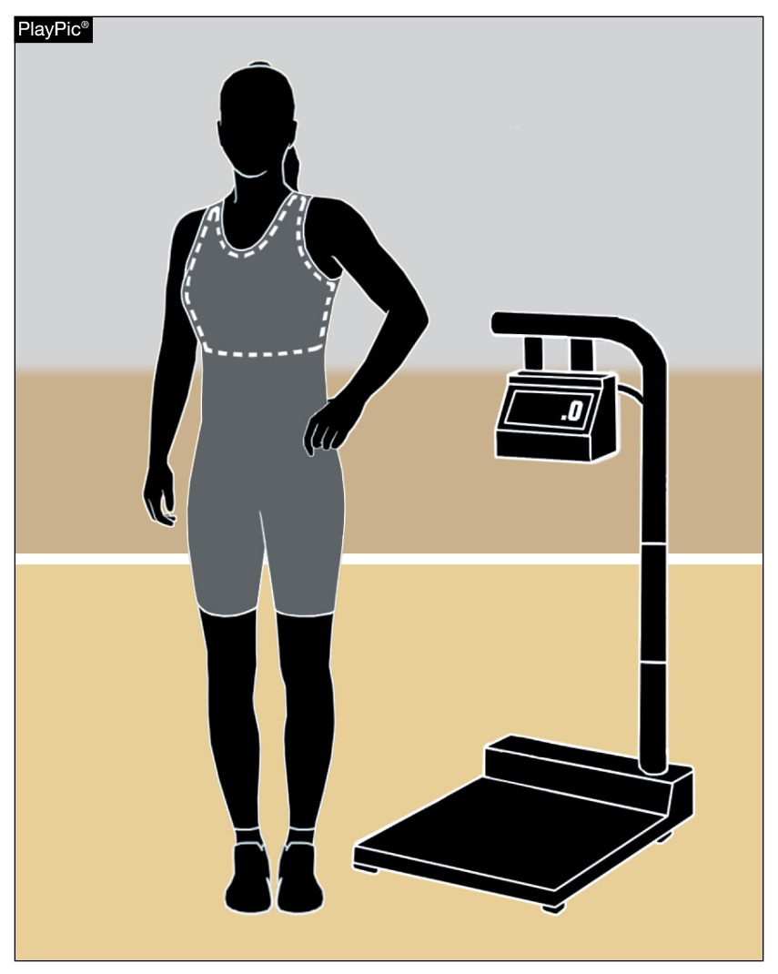
Rule 4-5-7 Weighing-in

Slide 18
Rule 4-5-7 weighing-in
ART. 7 . . . All contestants shall weigh-in wearing a legal uniform (4-1-1) and a suitable undergarment that completely covers the buttocks and the groin area. Contestants shall not weigh-in wearing shoes or ear guards. Female contestants shall also wear a sports bra that completely covers their breasts and minimizes the risk of exposure. For female contestants wearing a compression shirt under a one-piece singlet in order to comply with the definition of a legal uniform (4-1-1). If the compression shirt is part of the legal uniform, the contestant shall weigh-in wearing the compression shirt. Contestants may wear socks that cannot be removed or added if the wrestlers do not make weight.

Slide 19
Rule 4-5-7 weighing-in
Rationale:
Rule 4-5-7 is a clarification of what female wrestlers shall wear at the weigh-in.

Slide 20
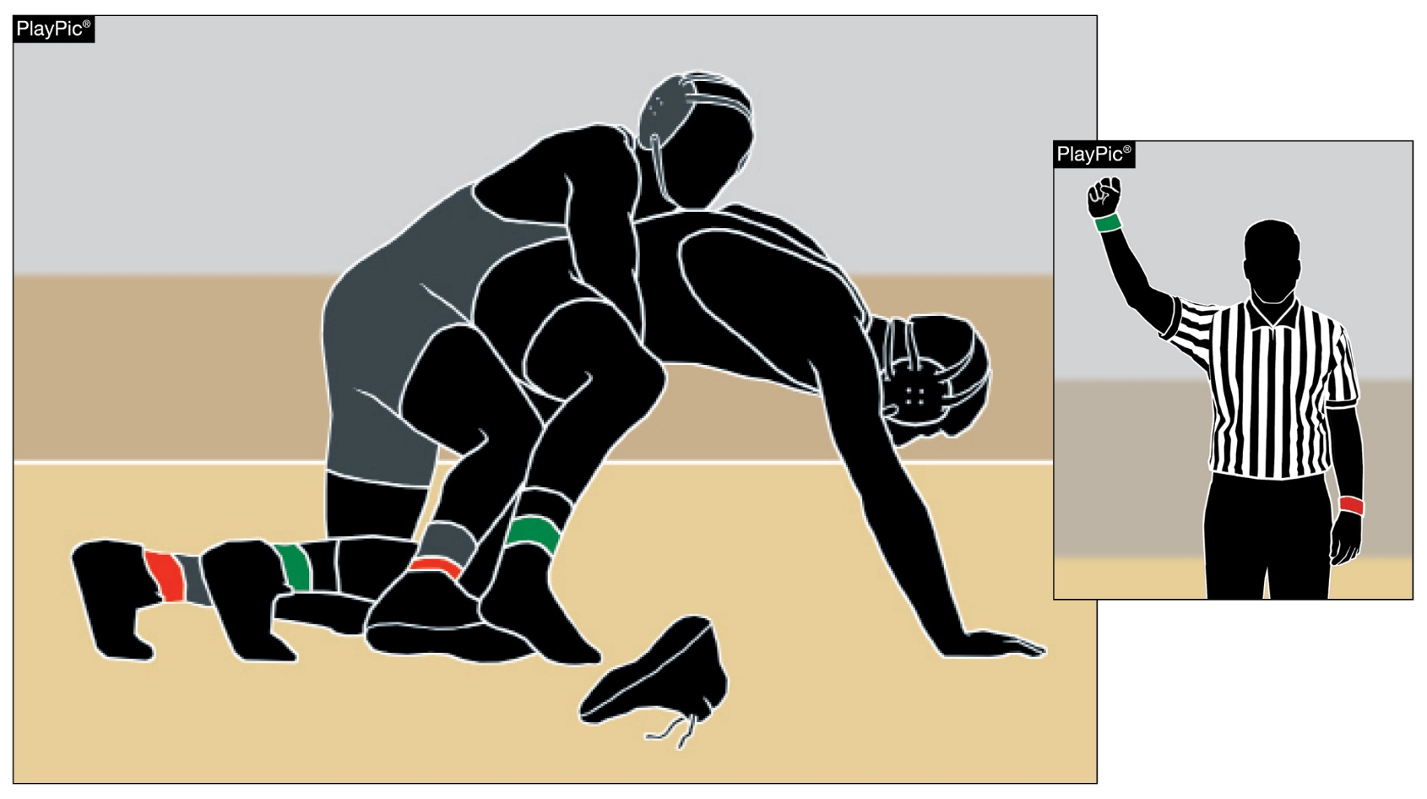
SHOELACES
4-1-3, 5-24-6d, 5-27-1e, 7-3-5, 7-6-6d, 8-1-1, 8-1-2f exc. (2), 8-1-4 exc., stalling penalty chart
.

Slide 21
Rule 4-1-3 wrestlers’ uniform (shoelaces)
ART. 3 . . . Wrestlers shall wear light heelless wrestling shoes, reaching above the ankles, if laces are visible, they shall be secured in an acceptable fashion. If the shoelaces come untied or shoe comes off, the penalty would be an automatic stalling call.
RATIONALE:
The penalty to issue a technical violation and use one of two injury time-outs is too punitive for shoelaces that become untied and/or the shoe(s) come off. An appropriate penalty would be correcting the infraction by issuing a stalling call.

Slide 22
Rule 5-24-6d STALLING (SHOELACES)
ART. 6 . . . It is stalling when either wrestler:
a. repeatedly grasps or interlocks around one leg of the opponent to prevent scoring; or
b. delays the match. This includes straggling back from out of bounds, unnecessarily changing or adjusting equipment or delay in assuming the starting position on the mat; or
c. repeatedly creates a stalemate situation to prevent an opponent from scoring.
d. shoelaces become untied, or shoe comes off.

Slide 23
Rule 5-27-1e,f TECHNICAL VIOLATIONS (SHOELACES)
ART. 1 . . . These are the types of technical violations. Each is penalized without warning as outlined in Rule 7-3:
a. Intentionally going out of the wrestling area or forcing an opponent out of the wrestling area to avoid imminent scoring situation.
b. Grasping of clothing, mat or ear guards.
c. Interlocking or overlapping the hands, fingers or arms.
d. Leaving the wrestling area without referee’s permission.

Slide 24
Rule 5-27-1e,f TECHNICAL VIOLATIONS (SHOELACES)
e. Reporting to the scorer’s table not properly equipped, ready to wrestle or any equipment that is detected as being illegal after the match has started.
f. Shoe coming off during wrestling action.

Slide 25
Rule 5-27-1e,f TECHNICAL VIOLATIONS (SHOELACES)
RATIONALE:
The penalty to issue a technical violation and use one of two injury time outs is too severe for a shoe to become untied or come off. A more prudent penalty would be correcting the infraction by issuing a stalling call. These rules are in support of the change.

Slide 26
Rule 7-3-5 TECHNICAL VIOLATIONS (SHOELACES)
ART. 5 . . . Reporting to the scorer’s table, not properly equipped, or shoe coming off during wrestling action or not ready to wrestle, or any equipment that is detected as being illegal after the match has started is a technical violation. (See Penalty Chart)
RATIONALE:
The penalty to issue a technical violation and use one of two injury time outs is too severe for a shoe to become untied or coming off. A more prudent penalty would be correcting the infraction by issuing a stalling call. These rules are in support of the change.

Slide 27
Rule 7-6-6d STALLING (SHOELACES)
ART. 6 . . . It is stalling when either wrestler:
repeatedly grasps or interlocks around one leg of the opponent to prevent scoring; or
b. delays the match. This includes straggling back from out of bounds, unnecessarily changing or adjusting equipment or delay in assuming the starting position on the mat; or
c. repeatedly creates a stalemate situation to prevent an opponent from scoring; or
d. has shoelaces that become untied or shoe comes off.

Slide 28
Rule 7-6-6d STALLING (SHOELACES)
RATIONALE:
The penalty to issue a technical violation and use one of two injury time outs is too severe for a shoe to become untied or come off. A more prudent penalty would be correcting the infraction by issuing a stalling call. These rules are in support of the change.

Slide 29
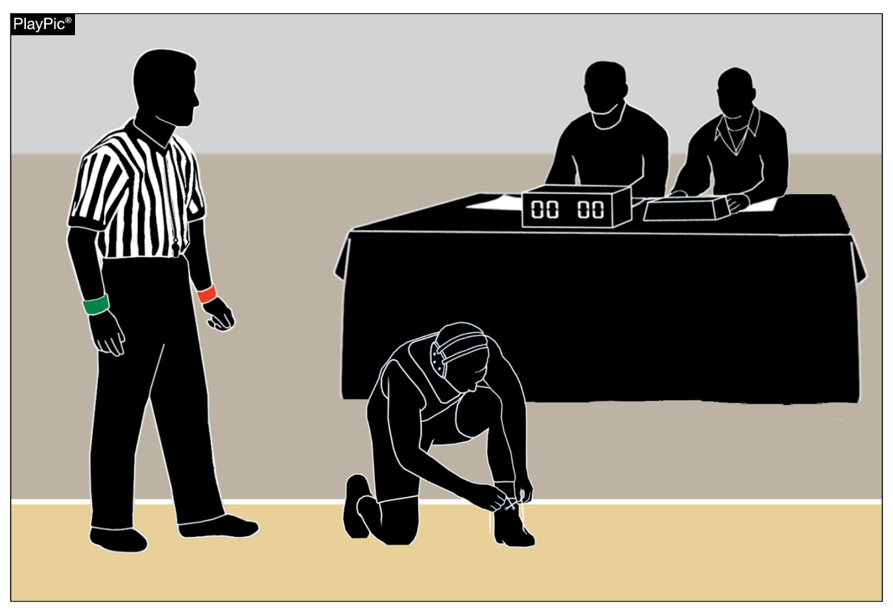
Rule 8-1-1, 8-1-2 (2)EXC., 8-1-4 EXC.
Penalty administration
Any contestant not reporting to the scorer’s table, not properly equipped or not ready to wrestle is a technical violation. Penalties for shoe and shoelace violations before the match started would be subject to injury time.

Slide 30
Rule 8-1-1 penalty administration (shoelaces)
ART. 1 . . . Any contestant not reporting to the scorer’s table not properly equipped or not ready to wrestle is a technical violation. A wrestler with greasy substance on the body or uniform, improper grooming, objectionable pads and braces, illegal equipment, illegal uniform or any equipment that is detected as being illegal after the match has started shall be disqualified if not removed or corrected within the 1 ½ minute injury time. Penalties for shoe and shoelace violations, would not be subject to injury time, and would be penalized as stalling only after the match has started.

Slide 31
Rule 8-1-1 penalty administration (shoelaces)
RATIONALE:
When a wrestler reports to the table not being ready to wrestle, the penalty is to issue a technical violation and use one of two injury time outs. However, when wrestler’s shoe becomes untied or comes off during the match, the penalty will be a stalling call.

Slide 32
Rule 8-1-2 EXC. penalty administration (shoelaces)
ART. 2 . . . When indicating an infraction, the referee shall stop the match with the following exceptions:
a. warning or penalizing the defensive wrestler for stalling (except when a two-point stall is awarded);
b. warning or penalizing for stalling in the neutral position (except when a two-point stall is awarded);

Slide 33
Rule 8-1-2 EXC. penalty administration (shoelaces)
c. warning or penalizing the defensive wrestler for stalling or a technical violation when the defensive wrestler is on their feet (regardless of the position/location of the offensive wrestler) (except when a two-point stall is awarded);
d. in a pinning situation, to penalize the defensive wrestler;
EXCEPTION: When the situation has concluded, the referee shall stop the match, signal and verbally announce the infraction and award points earned.

Slide 34
Rule 8-1-2 EXC. penalty administration (shoelaces)
e. Locked hands or grasping of clothing by the offensive wrestler while the defensive wrestler is attempting an escape or reversal;
EXCEPTION: The referee shall stop the match when it is obvious the defensive wrestler will not complete an escape or reversal. If the defensive wrestler is successful with the escape or reversal, the match shall not be stopped to award points.
f. Grasping of clothing by the wrestler being taken down when a takedown is imminent.

Slide 35
Rule 8-1-2 EXC. penalty administration (shoelaces)
EXCEPTION: The referee shall stop the match when it is obvious that the takedown will not be completed. If the takedown is successful, the match shall not be stopped to award points.
(2) EXCEPTION: Related to stall calls including the two-point stall call, as shown in items a-f above. The match would not be stopped to warn or penalize for stalling, including a two-point stall. If the stalling is for any shoes or shoelace violations, during any significant action or imminent scoring situations.

Slide 36
Rule 8-1-2 EXC. penalty administration (shoelaces)
RATIONALE:
The penalty to issue a technical violation and use one of two injury time outs is too severe for a shoe to become untied or come off. A more prudent penalty would be correcting the infraction by issuing a stalling call. These rules are in support of the change.

Slide 37
Rule 8-1-4 EXC. penalty administration (shoelaces)
ART. 4 . . . Warnings and penalties for stalling are cumulative throughout the match and are penalized independent of the progressive penalty chart. On the first offense the wrestler will receive a warning. The opponent of the offender will be awarded one match point on the second and third offense. The match shall be stopped on the fourth offense and the opponent shall be awarded two points and given choice of position. A fifth offense shall result in disqualification. (See Stalling Penalty Chart)

Slide 38
Rule 8-1-4 EXC. penalty administration (shoelaces)
EXCEPTION: Related to stall calls including the two-point stall call, as shown in items a-f above. The match would not be stopped to warn or penalize for stalling, including a two-point stall. If the stalling is for any shoes or shoelace violations, during any significant action or imminent scoring situations.

Slide 39
Rule 8-1-4 EXC. penalty administration (shoelaces)
RATIONALE:
The penalty to issue a technical violation and use one of two injury time outs is too severe for a shoe to become untied or come off. A more prudent penalty would be correcting the infraction by issuing a stalling call. These rules are in support of the change.

Slide 40
STALLING PENALTY CHART (SHOELACES)
**The match would not be stopped to warn or penalize for stalling, including a two-point stall, if the stalling is for any shoes or shoelace violations, during any significant action or imminent scoring situations.
RATIONALE:
The penalty to issue a technical violation and use one of two injury time outs is too severe for a shoe to become untied or coming off. A more prudent penalty would be correcting the infraction by issuing a stalling call. These rules are in support of the change.

Slide 41
Editorial changes

Slide 42
Rule 3-1-14 referee’s duties
ART. 14. . . During injury, blood, HNC or recovery time-outs, the referee should be in a position to monitor the appropriate clock and wrestlers. The referee should notify the coach and/or wrestler at the one-minute mark and the 30-second mark as to the amount of time remaining.
RATIONALE:
Clarification.

Slide 43
Rule 5-21-1 random draw
ART. 1. . . Random draw is the random selection of one of the 14 weight classes (effective July 1, 2023, the draw will be used for one of the 12, 13, or 14 weight classes) to determine the starting weigh-in order and order of weight classes for the dual meet. A random draw for championship final matches for an individual tournament, regular season and/or state high school championship series may be used for competition. The draw shall take place immediately preceding the weigh-ins and be supervised by the referee or other authorized person. The weight class drawn will be considered an odd match and will determine which weight class will start weigh-ins and the dual meet with the other weight classes following in the sequential order.

Slide 44
Rule 5-21-1 random draw
RATIONALE:
Clarification.

Slide 45
Corrections

Slide 46
Corrections
Rules 4-1-3 and 7-3-5 are not shaded.
8-1-2g (listed in the Summary of the Rules in the rules book) does not exist. It is the (2) Exception to 8-1-2f.

Slide 47
Points of emphasis

Slide 48
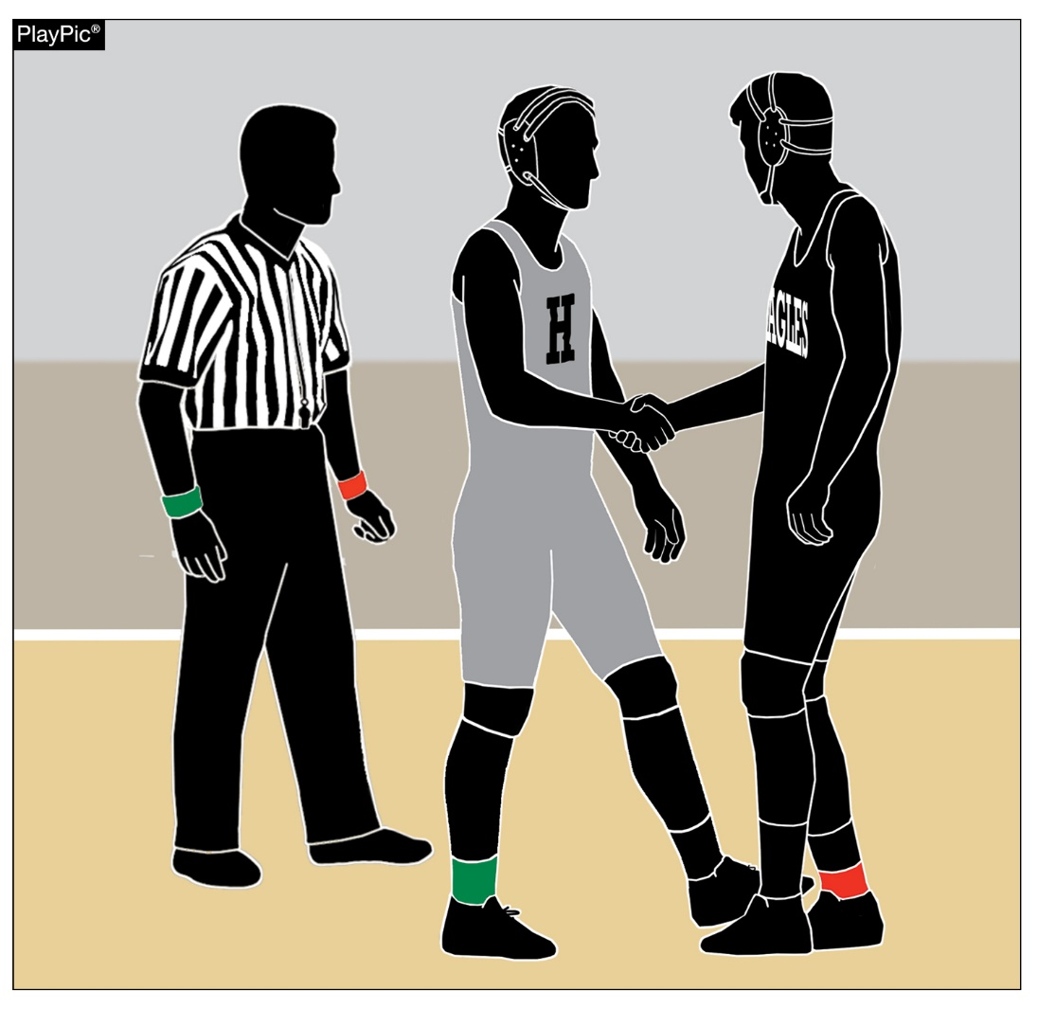
Good sporting behavior

Slide 49
sportsmanship
Good sporting behavior is one of the fundamental ingredients to the continued success and enjoyment of education-based high school sports and activities. In fact, in the 103-year history of organized high school sports in the United States, good sportsmanship has been one of the most important outcomes of high school activity programs.

Slide 50
sportsmanship
NFHS playing rules are written to encourage sportsmanship. Participation in these programs should promote respect, integrity and sportsmanship. However, for these ideals to occur, everyone involved in these programs must be doing their part.
The NFHS is concerned that unsporting behavior in education-based athletics has increased across all sports. As a result, the NFHS has made sportsmanship the No. 1 Point of Emphasis for the 2022-23 school year.

Slide 51
sportsmanship
Sportsmanship, or good sporting behavior, is about treating one another with respect and exhibiting appropriate behavior. It is about being fair, honest and caring. When these types of appropriate behavior occur, competitive play is more enjoyable for everyone.
Coaches set the tone at athletic contests with their display of sportsmanship. If these individuals act in a sportsmanlike manner, their behavior sets the tone for players, spectators and others. If coaches, however, are complaining constantly about the decision of contest officials, spectators are more likely to do the same.

Slide 52
sportsmanship
There must be a collaborative, working relationship between contest officials and game administration to promote good sportsmanship and safely conduct the contest. Everyone has their roles to play in creating a positive, sportsmanlike atmosphere at contests.
Officials should focus on the actions of players, coaches and other bench/sideline personnel. A positive, open line of communication between officials and coaches ultimately results in a better contest for everyone involved.

Slide 53
sportsmanship
Contest officials, however, should never engage with spectators who are exhibiting unsporting behavior. Once the contest begins, school administration is responsible for dealing with unruly spectators. A proactive approach by school administration includes monitoring the behavior of spectators and intervening as needed.
If spectators are using demeaning or profane language at officials – or at others in the stands – those individuals should be removed from the contest by school administration.

Slide 54
sportsmanship
In recent years, a heightened level of unsportsmanlike behavior has been occurring by spectators at high school sporting events, and it must be stopped. The use of demeaning language, or hate speech, by students, parents and other fans must cease.
High school sports and other activities exist to lift people up, not demean or tear people down. The goal is to treat everyone fairly and treat each other with respect. Any speech or harassment that is insulting, demeaning or hurtful will not be tolerated.

Slide 55
sportsmanship
High schools must establish a culture that values the worth of every single person – both players on the school’s team and players on the opposing team. There must be a no-tolerance policy regarding behavior that shows disrespect for another individual.
Good sports win with humility, lose with grace and do both with dignity. It takes the efforts of everyone every day to ensure that sportsmanship remains one of the top priorities in education-based activity programs.

Slide 56
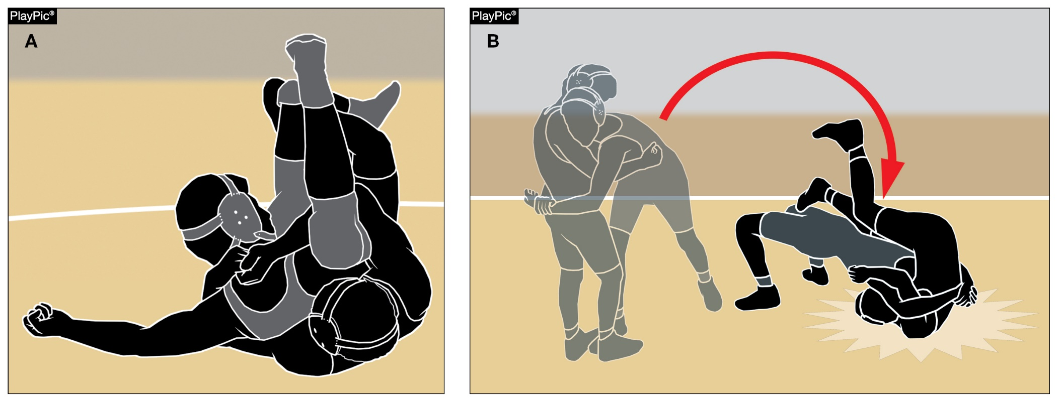
Illegal harmful holds and maneuvers
Coaches and referees must work together to keep illegal and dangerous techniques such as the Nelson cradle (PlayPic A) and the straight-back salto (PlayPic B) out of the sport.

Slide 57
Illegal harmful holds and maneuvers
Illegal, Harmful Holds and Maneuvers
In the purest form of wrestling, two similar sized athletes use their strength, guile, ability and repertoire of moves to control and dominate their opponent. We have always made moves and maneuvers that intentionally injure or punish a wrestler illegal and work on removing them from our sport. We are noticing that some moves, maneuvers and holds are starting to filter down to our level from other influences that are not education-based athletics.

Slide 58
Illegal harmful holds and maneuvers
We abhor any move, maneuver or hold that intentionally injures limbs and joints or penetrates any body cavities. Allowing those techniques to infiltrate into our sport is irresponsible, dangerous and in certain jurisdictions illegal.
No one wants to drive any students out of the sport. If parents are not confident that their children are in a well-managed risk environment, then they will not let them participate. That would be devastating to a sport that we have already seen a trend of declining participation numbers.

Slide 59
Illegal harmful holds and maneuvers
We need to do everything possible in our schools to attract more students and retain them in our programs. Eliminating questionable moves, maneuvers and holds is the first place to start. Regardless of your role as either coach or referee, you must work together to keep certain techniques out of our sport.
Wrestling is one of the oldest sports in the world. The benefits of participating are phenomenal in developing high school students to better understand their bodies, appreciate discipline, be self-reliant and develop toughness that will be a life skill that they will use their entire lives.

Slide 60
Illegal harmful holds and maneuvers
Let us direct our attention to preserving our sport for many more generations to come.

Slide 61
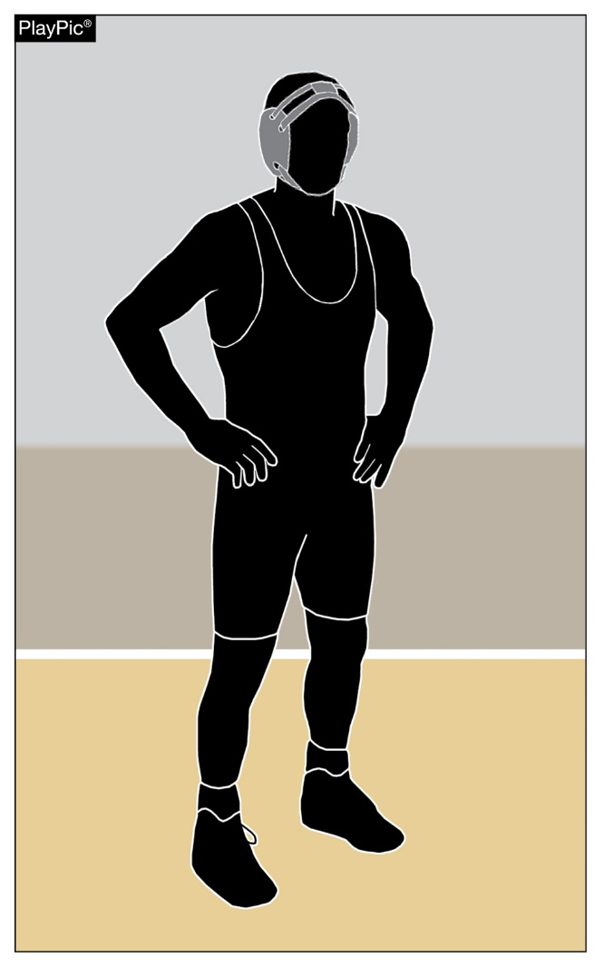
Uniforms

Slide 62
uniforms
Uniforms are a key component in every sport. However, they are extremely important to wrestling because their proper wearing, cleanliness and sizing is critical to their functionality for the wrestler. A dirty, mis-sized uniform is an impediment that interferes with wrestling. Keeping the uniform washed and clean reduces risks of transmitting skin issues which protects the opponent, referee and provides comfort for the wearer.

Slide 63
uniforms
Wherever possible a uniform (singlet or two-piece) should be issued to a student that best fits their size, weight and gender. It is disconcerting to have a lighter weight wrestler wearing a stretched out uniform while wrestling and the back of their uniform is touching the mat during competition. The referee has no other choice but to award a fall to their opponent.

Slide 64
uniforms
In fairness and practicality, we cannot expect a girl to perform her best if she has to be concerned in the back of her mind about her uniform and if it will support her while she is competing. We are not suggesting a wholesale overhaul of your uniform stock, but we are asking you to inspect what you have and if it is financially feasible replace your inventory with newer and properly fitted uniforms. It will benefit the morale and confidence of your wrestlers. Whereas a properly fitted uniform might have resulted in a different result. We have experienced an increase of over 30,000 girls entering our sport and many are being issued male uniforms.

Slide 65
Rules Reminders

Slide 66
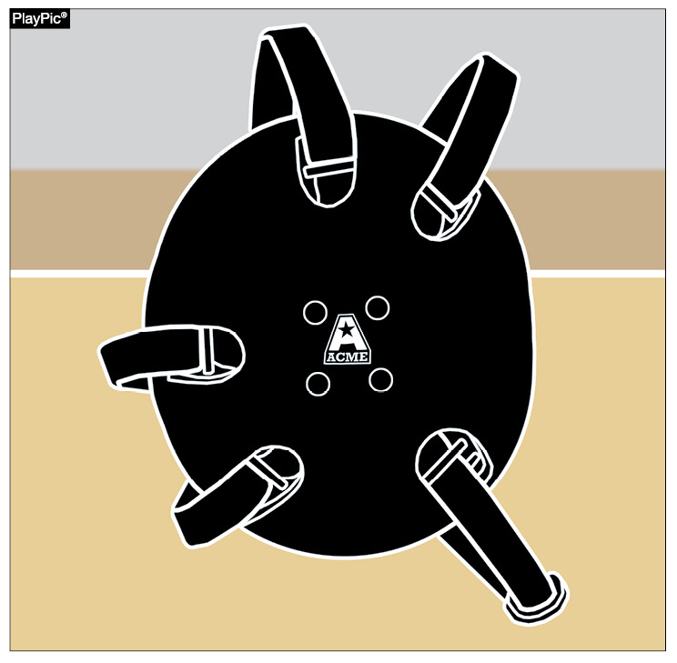
Logo on EAR GUARDS
Rule 4-1-4
Any manufacturer's logo/trademark/reference that appears on the wrestling ear guards, including legal head covering, can be no more than 2-1/4 square inches with no dimension more than 2-1/4 inches and may appear no more than once on each cup of the ear guards.
No additional manufacturer's logo/trademark or promotional reference shall be allowed on the wrestling ear guard. [Effective July 1, 2022]

Slide 67



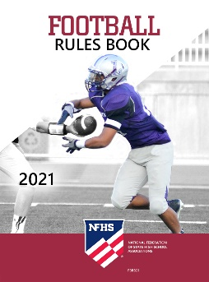
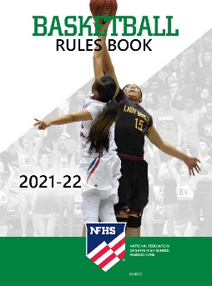
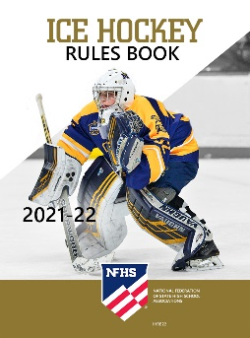
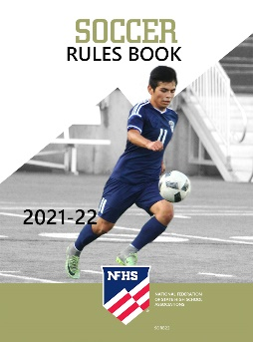




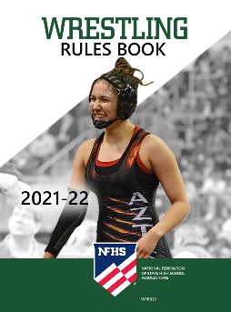


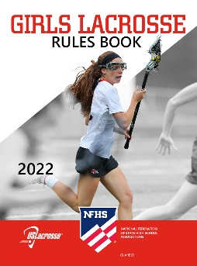



National Federation of
State High School Associations
The NFHS writes playing rules for 17 sports
for boys and girls at the high school level.
  Publishes 4 million pieces of materials annually.

Slide 68

NEW NFHS Rules App
Rules App features:
  Searchable
  Highlight notes
  Bookmarks
  Quizzes for all sports
  Easy navigation
  Immediate availability
  Free to paid members of the NFHS Coaches
  and Officials Associations
  www.nfhs.org/erules for more information
Notes:
Rules app for all NFHS rules books and case books are available on iTunes and Google Play. Rules books and case books are cross-linked and enabled for searchable content.
App is free to download.
Each book subscription is $6.99.
NFHS Coaches and Officials Association paid members get all books for free.
100% states members get books for free in sports designated by their state.

Slide 69

Guidelines for Schools and state associations for consideration of accommodations
Notes:
To assist state associations in working with schools for the inclusion of students with disabilities, the following guide prepared by the NFHS Task Force on the Inclusion of Students with Disabilities is being provided for your review.
Following these guidelines will assist in the individual student assessment by the student and the school.
When requesting a possible accommodation, coaches should work with their school and the state association as early as possible in the sport season.
Contest officials shall defer decisions on rule accommodations to the respective state association.
This information serves as a guide. Each state association may develop its own process.

Slide 70
NFHS Learning Center

Slide 71

Notes:
The NFHS Learning Center is the home to more than 90 online professional development courses for everyone within the interscholastic community - coaches, students, officials, parents, administrators, and individuals within performing arts programs. More than 60 courses are available for free.
The NFHS is an Accredited Institution and has delivered more than 15 million courses on its NFHS Learning Center platform since its inception in 2007. In receiving national accreditation by Cognia, the NFHS has upheld itself to rigorous standards that focus on productive learning environments, equitable resource allocation that meet the needs of learners, and effective leadership.
The NFHS Learning Center features its flagship coaching course, “Fundamentals of Coaching,” as well as several health and safety courses that have been completed by millions of individuals, such as “Concussion in Sports,” “Heat Illness Prevention,” “Sudden Cardiac Arrest” and “Protecting Students from Abuse.” The NFHS Learning Center offers several national credentials that can be earned by individuals who complete specific NFHS courses. Through the School Honor Roll Program, schools can earn a physical banner to hang in their school.
To learn more and start your professional development journey, please visit the NFHS Learning Center at NFHSLearn.com.

Slide 72
NFHS Network

Slide 73


NFHS Network
By 2025, every high school sporting event in America will be streamed live.
The NFHS Network will be
THE DESTINATION for fans
to view these broadcasts.
27 Different Sports and Activities
www.NFHSnetwork.com
Notes:
The NFHS Network is the leader in streaming Live and On Demand high school sports.
Partnered with the National Federation of State High School Associations, 45 high school state athletic/activities associations, and PlayOn! Sports, the NFHS Network is a joint venture created to provide fans with the ability to stream high school sports on any device, from wherever they are.
All NFHS Network events are available to watch online at www.NFHSnetwork.com and through the NFHS Network Live App for iOS and Android. Follow us on Facebook, Twitter, Instagram, and YouTube.
Watching high school sports and events has never been easier.
The NFHS Network’s goal to broadcast live all 2 million high school sporting events by 2025.
The NFHS Network covers 27 different regular season and postseason sports, as well as other high school activities, celebrating the accomplishments of students-athletes, student broadcasters, and high schools across the country.

Slide 74

Notes:
The NFHS Network will broadcast over 150,000 live events this year. If your school is not a member of the NFHS Network School Broadcast Program, please contact us at Mark.Koski@NFHSnetwork.com

Slide 75
Thank you. Have a wonderful season!

