Slide 1
2022-23 NFHS Volleyball Rules PowerPoint
Rules Changes
Points of Emphasis

Slide 2




OFFICIAL VOLLEYBALL PARTNER OF THE
NATIONAL FEDERATION OF STATE HIGH SCHOOL ASSOCIATIONS

Slide 3
National federation of state high school associations (NFHS)

Slide 4

National Federation of
State High School Associations
NFHS (located in Indianapolis, IN – Est. 1920):
  National leader and advocate for
  high school athletics and
  performing arts programs.
  Serves 51 state associations, 19,500
  high schools and 12 million student
  participants.
  Writes playing rules for 17 high school
  sports for boys and girls.
  Offers online education courses for high school coaches,
  officials, parents, students and others.
  Ensures that students have opportunity to enjoy healthy participation, achievement and good sportsmanship in education-based athletics.

Slide 5






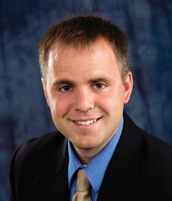
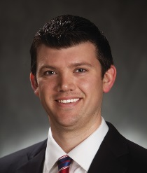
NFHS Rules Review Committee
The NFHS Rules Review Committee is chaired by the chief operating officer and composed of all rules editors. After each committee concludes its deliberations and has adopted its recommended changes for the subsequent year, such revisions will be evaluated by the Rules Review Committee.
Davis Whitfield
Chief Operating Officer
Lindsey Atkinson
Basketball, Girls Lacrosse and Volleyball
Bob Colgate
Football and Sports
Medicine
Sandy Searcy
Softball, Swimming & Diving and Water Polo
Elliot Hopkins
Baseball and Wrestling
Julie Cochran
Cross Country, Gymnastics, Field Hockey, Soccer and
Track & Field
James Weaver
Boys Lacrosse
and Spirit
Dan Schuster
Ice Hockey

Slide 6



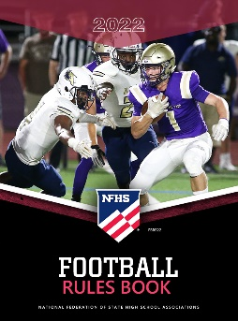






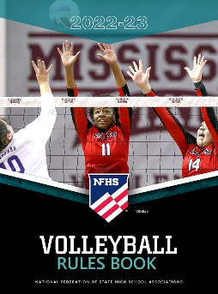







National Federation of
State High School Associations
The NFHS writes playing rules for 17 sports
for boys and girls at the high school level.
  Publishes 4 million pieces of materials annually.

Slide 7
2022-23 NFHS Volleyball
Rules Changes

Slide 8
State association Notification
3-1-3 Penalty & 4-2 Penalty 3
Rule 3-1-3 PENALTY requires officials to notify the state association when the administration of the contest is compromised due to insufficient padding of the standards, floor/wall cables and/or first referee’s platform.
Rule 4-2 PENALTY requires officials to notify the state association when a team cannot legally uniform six players for competition.
Language has been added to clarify that, when notified, state associations may determine the appropriate action/penalty(s), if necessary, to address the issue(s).
Notes:
Rule 3-1-3 PENALITY requires officials to notify the state association when the administration of the contest is compromised due to insufficient padding of the standards, floor/wall cables and/or first referee’s platform.
Rule 4-2 PENALTY requires officials to notify the state association when a team cannot legally uniform six players for competition.
Language has been added to clarify that, when notified, state associations may determine the appropriate action/penalty(s), if necessary, to address the issue(s).
Rationale: Clarifies that state associations have the authority to determine the action and/or penalty(s), if necessary, to address these issues.

Slide 9
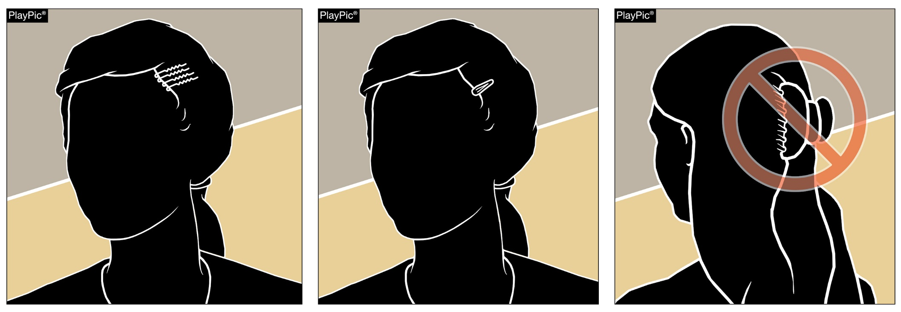
Equipment and accessories
4-1-6a
Hair control devices that are securely fastened and do not increase risk to the athlete, teammates and opponents are permitted.
Hair clips that are hard, protrude from the head and/or are easily dislodged do not comply and are not legal.
Notes:
Hair control devices that are securely fastened and do not increase risk to the athlete, teammates and opponents are permitted.
Hair clips that are hard, protrude from the head and/or are easily dislodged do not comply and are not legal.
Rationale: Eliminates the size restrictions of hair control devices while maintaining that the risk of injury to the athlete, teammates and opponents should not be compromised.

Slide 10
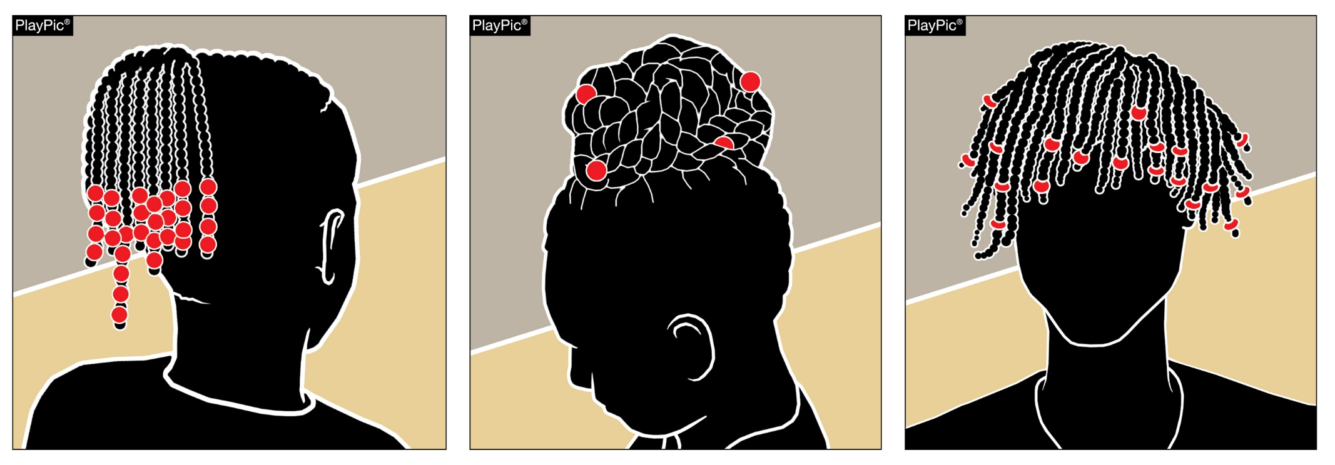
Equipment and accessories
4-1-6a
Hair adornments that are securely fastened and do not increase risk to the player, teammates or opponents are permitted.
Notes:
Hair adornments that are securely fastened and do not increase risk to the player, teammates or opponents are permitted.
Rationale: Creates inclusivity of hair styles while maintaining that the risk of injury to the athlete, teammates and opponents should not be compromised.

Slide 11
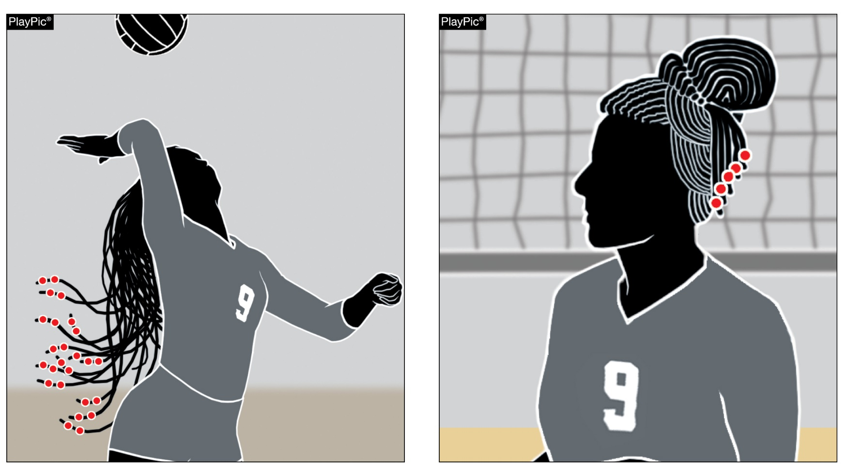
Equipment and accessories
4-1-6a
Hair adornments that are not securely fastened or do increase the risk to the player, teammates or opponents should be addressed by the official with the coach.
The player shall have the opportunity to make legal or remove.
Non-compliant
Compliant
Notes:
Hair adornments that are not securely fastened or do increase the risk to the player, teammates or opponents should be addressed by the official with the coach.
The player shall have the opportunity to make legal or remove.
Rationale: Creates inclusivity of hair styles while maintaining that the risk of injury to the athlete, teammates and opponents should not be compromised.

Slide 12
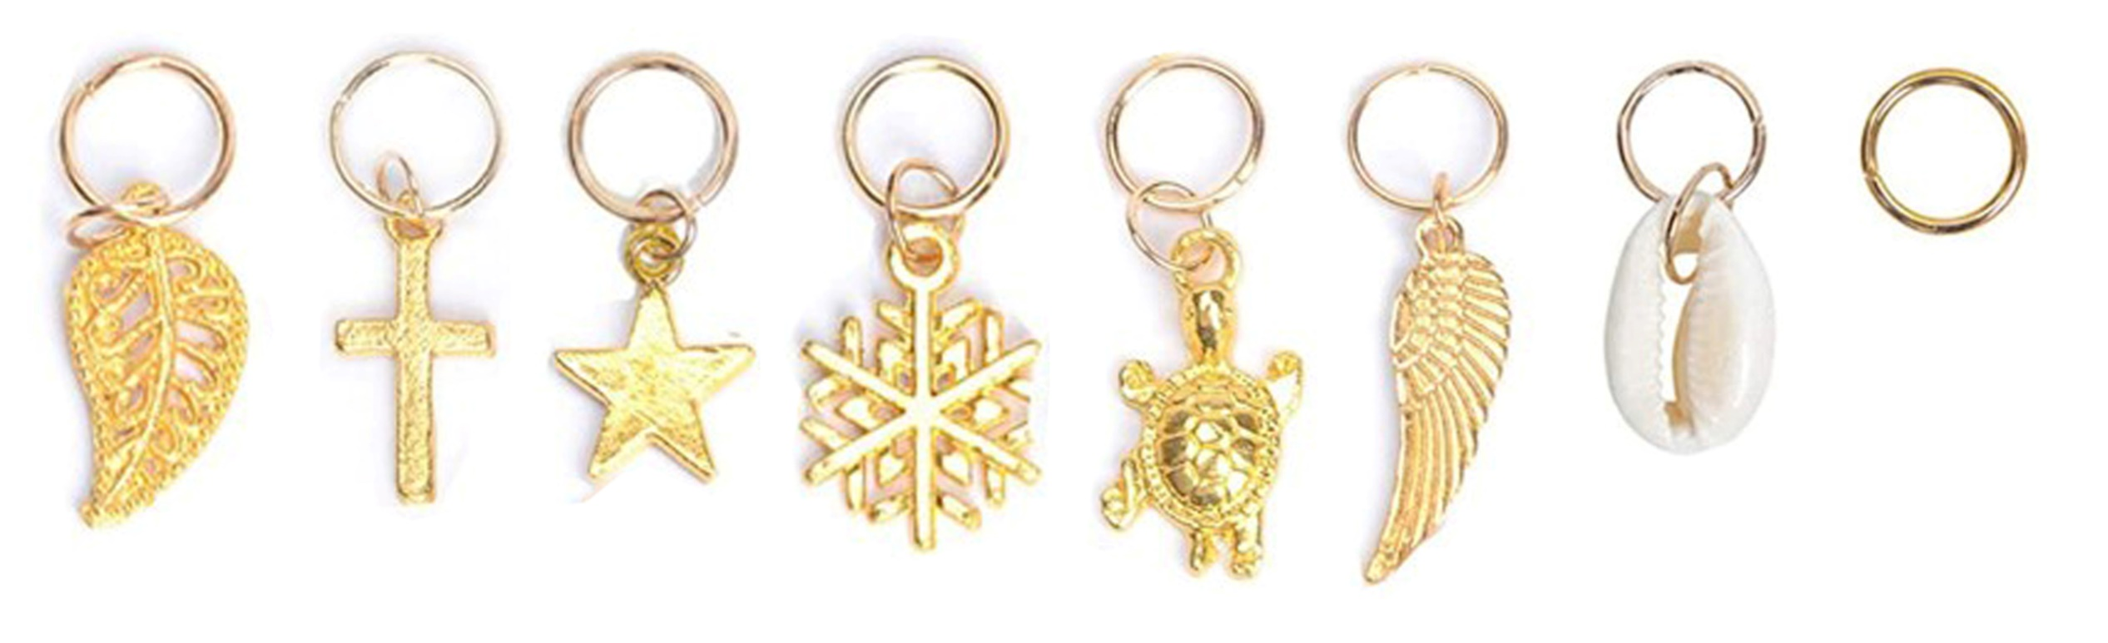
Equipment and accessories
4-1-6a
Hair charms are considered jewelry and per rule 4-1-7 would not be permitted.
Notes:
Hair charms are considered jewelry and per rule 4-1-7 would not be permitted.
Rationale: Maintains consistency that charms worn in the hair are considered jewelry and are not allowed.

Slide 13
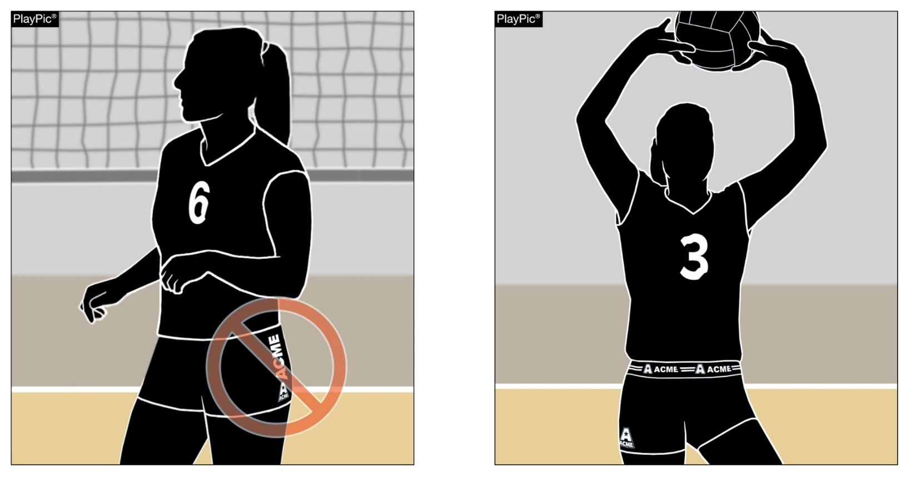
Legal uniform
4-2-1f
Uniform bottom waistbands may have additional manufacturer’s logos/trademarks/references.
One manufacturer’s logo/trademark/reference, no more than 2¼ square inches is permitted on each piece of uniform.
Notes:
One manufacturer’s logo/trademark/reference, no more than 2¼ square inches is permitted on each piece of uniform.
Uniform bottom waistbands may have additional manufacturer’s logos/trademarks/references.
Rationale: Allows for multiple and eliminates size restrictions of manufacturer logos/trademarks/references on the uniform waistband ONLY, minimizing issues related to illegal uniform bottoms.

Slide 14
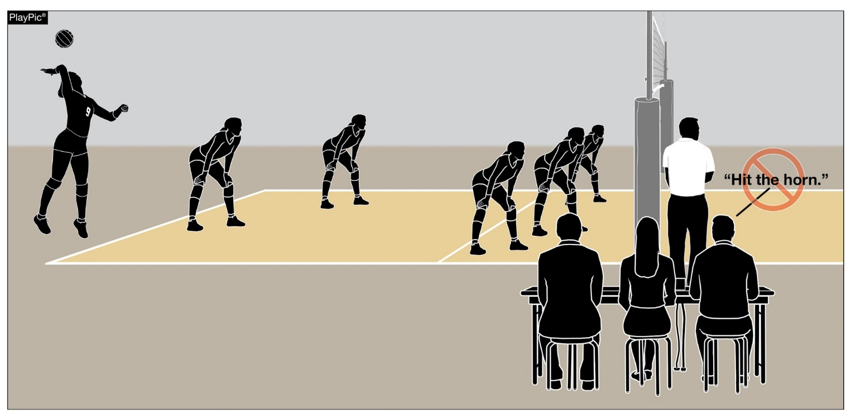
Scorer and libero tracker responsibilities 5-6-3b, e; 5-7-3e
When an improper server is recognized by the scorer or an illegal libero replacement is recognized by the libero tracker, play shall not be interrupted by sounding the audio device.
The scorer or libero tracker shall notify the second referee during the first dead ball.
Notes:
When an improper server is recognized by the scorer or an illegal libero replacement is recognized by the libero tracker, play shall not be interrupted by sounding the audio device.
The scorer or libero tracker shall notify the second referee during the first dead ball.
Rationale: Allows the match to continue without interruption until the second referee is notified and can verify the improper server/illegal replacement during the next dead ball.

Slide 15
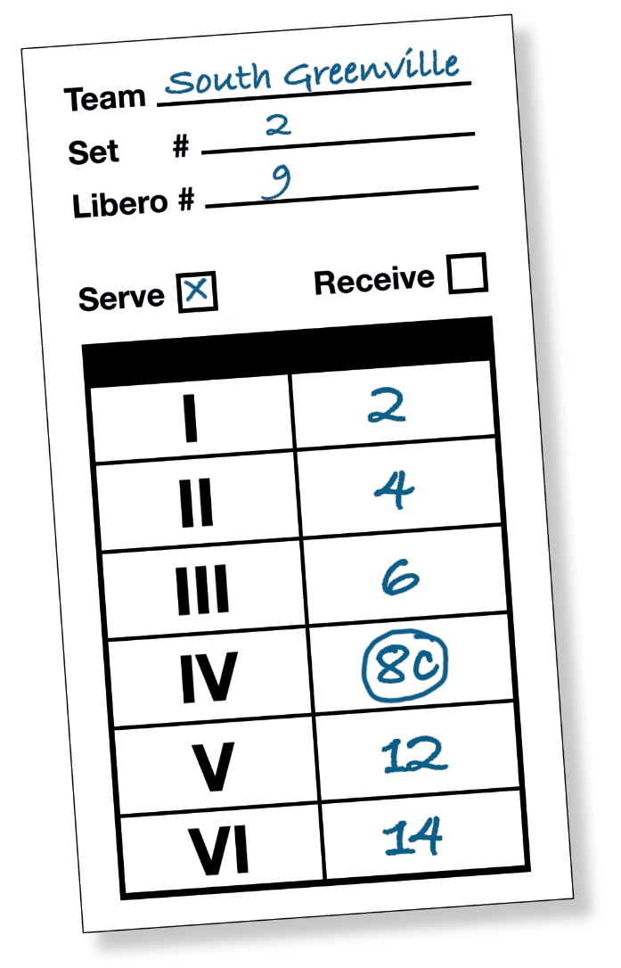
Lineup
7-1-2c
The head coach is now required to indicate the playing captain with a “C” next to the player’s number on the lineup aligning language with the NFHS Volleyball Case Book and Officials Manual.
Notes:
The head coach is now required to indicate the playing captain with a “C” next to the player’s number on the lineup aligning language with the NFHS Volleyball Case Book and Officials Manual.
Rationale: Aligns language in the Case Book and Officials Manual that requires playing captains to be indicated on the lineup.

Slide 16
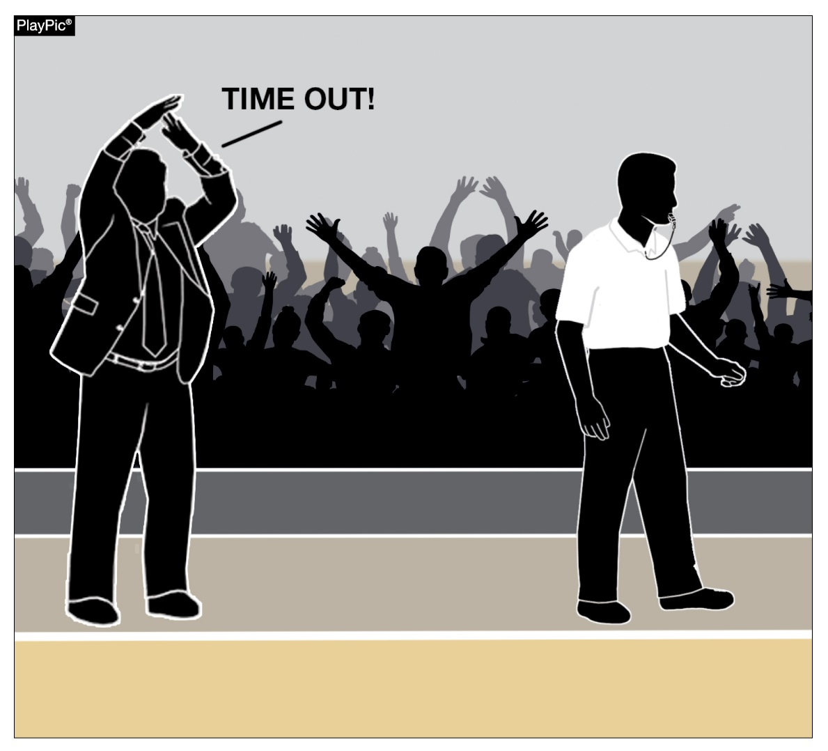
Time-outs and intermission
11-2-1
Time-out requests by the head coach or playing captain may be signaled or verbalized.
This change allows for a verbal signal to be recognized when hand signals are not seen.
Notes:
Time-out requests by the head coach or playing captain may be signaled or verbalized.
This change allows for a verbal signal to be recognized when hand signals are not seen.
Rationale: Establishes that both verbal and non-verbal signals for a time-out are permitted.

Slide 17
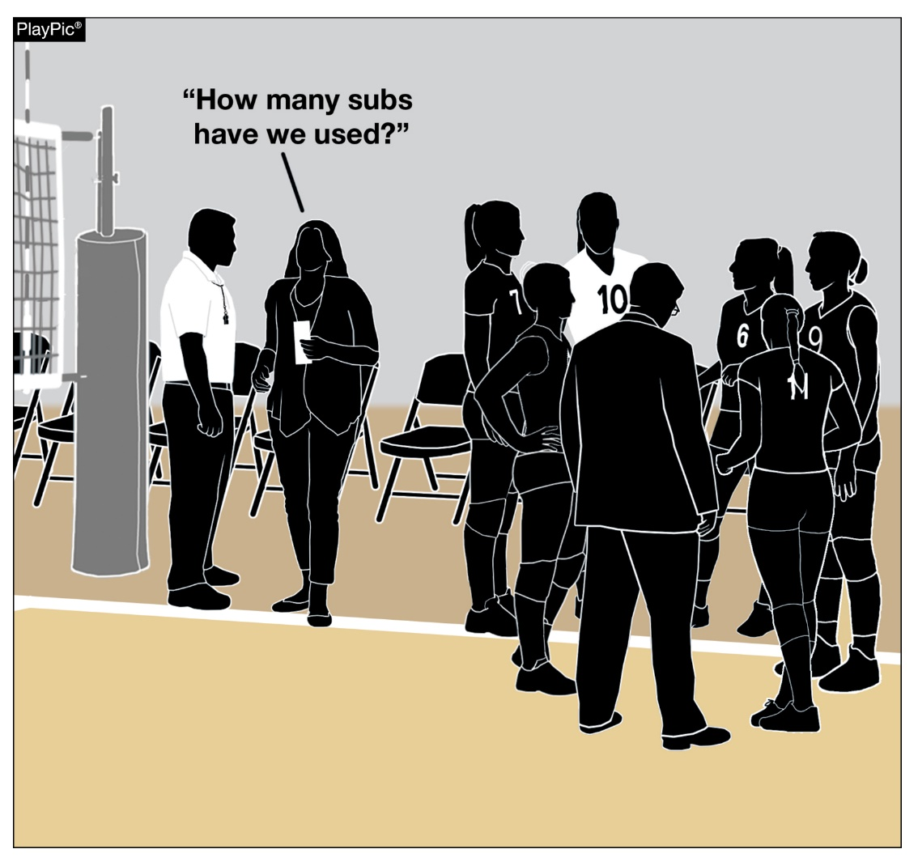
Conduct
12-2-5a
Assistance coaches may stand during a dead ball situation and ask the second referee to:
  Review the accuracy of the score;
  Verify the number of time-outs used;
  Verify substitutions used by their team;
  Request the serving order of their team;
  Verify the proper server for the opponent.
This administrative communication aligns with the allowed communication between the assistant coach with the second referee.
Notes:
Assistance coaches may stand during a dead ball situation and ask the second referee to:
Review the accuracy of the score;
Verify the number of time-outs used;
Verify substitutions used by their team;
Request the serving order of their team;
Verify the proper server for the opponent.
This administrative communication aligns with the allowed communication between the assistant coach with the second referee.
Rationale: Clarifies that assistant coaches may ask the second referee, during a dead-ball situation, for the number of time-outs and/or the number of substitutions used by their team.

Slide 18
2022-23 NFHS Volleyball
Points of Emphasis

Slide 19
Playable/nonplayable areas
It is the responsibility of the host school to adhere to the requirements of both the court and all game equipment as outlined in Rules 2 and 3.
  The match shall not be played when padding requirements are not met and the state association shall be notified to determine further action or penalty, as deemed necessary.
  When game equipment, other than required padding, does not meet rule specifications, the match shall be conducted, and the improper conditions reported to the appropriate authority.
Officials evaluate each site before their assigned match and determine playable and nonplayable areas, keeping risk minimization and fairness in mind in the application of the rules.
State or regional assignors may create and provide a compilation of ground rules for each school prior to each season to help mitigate potential confusion.
Notes:
It is the responsibility of the host school to adhere to the requirements of both the court and all game equipment as outlined in Rules 2 and 3.
The match shall not be played when padding requirements are not met and the state association shall be notified to determine further action or penalty, as deemed necessary.
When game equipment, other than required padding, does not meet rule specifications, the match shall be conducted, and the improper conditions reported to the appropriate authority.
Officials evaluate each site before their assigned match and determine playable and nonplayable areas, keeping risk minimization and fairness in mind in the application of the rules.
State or regional assignors may create and provide a compilation of ground rules for each school prior to each season to help mitigate potential confusion.

Slide 20
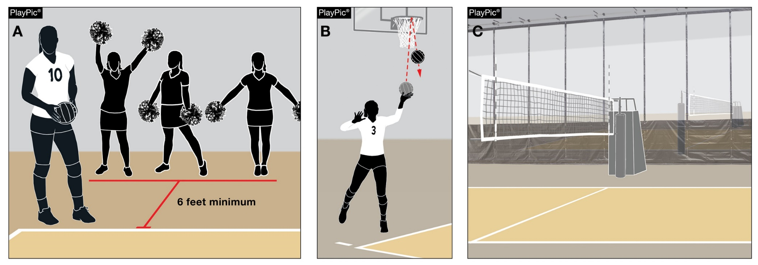
Playable/nonplayable areas
Officials may need to communicate ground rules during the pre-match conference addressing the following:
Extended space needed for serving when the minimum 6 feet (2 meters) is not available (PlayPic A);
Overhead obstructions (basketball goals, batting cages, wrestling and/or cheer mats, running tracks, ceiling fans, speakers, beams, air ducts, ropes, lighting, banners, flags, scoreboard, etc.) ( PlayPic B);
Divider nets (PlayPic C).
Notes:
Officials may need to communicate ground rules during the pre-match conference addressing the following:
Extended space needed for serving when the minimum 6 feet (2 meters) is not available (PlayPic A);
Overhead obstructions (basketball goals, batting cages, wrestling and/or cheer mats, running tracks, ceiling fans, speakers, beams, air ducts, ropes, lighting, banners, flags, scoreboard, etc.) ( PlayPic B);
Divider nets (PlayPic C).

Slide 21
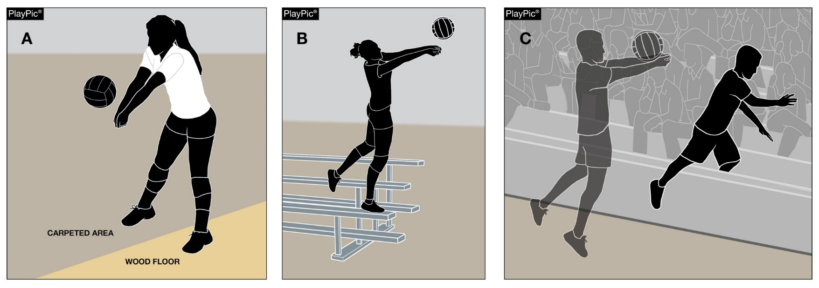
Playable/nonplayable areas
Rule 2-4-2 allows a player to retrieve a ball near a nonplayable area, if a body part is in contact with the playable area during the player’s contact of the ball – regardless of if a foot or another body part is in the nonplayable area. (PlayPic A)
  It is not the location of the ball, but the locale of the player.
  A player can reach into a nonplayable area.
  A player can also enter the nonplayable area after contact. (PlayPic C)
  Being in contact with anything to gain an advantage, like bleachers, is illegal. (Play Pic B)
Notes:
Rule 2-4-2 allows a player to retrieve a ball near a nonplayable area, if a body part is in contact with the playable area during the player’s contact of the ball – regardless of if a foot or another body part is in the nonplayable area. (PlayPic A)
It is not the location of the ball, but the locale of the player.
A player can reach into a nonplayable area.
A player can also enter the nonplayable area after contact. (PlayPic C)
Being in contact with anything to gain an advantage, like bleachers, is illegal. (Play Pic B)

Slide 22
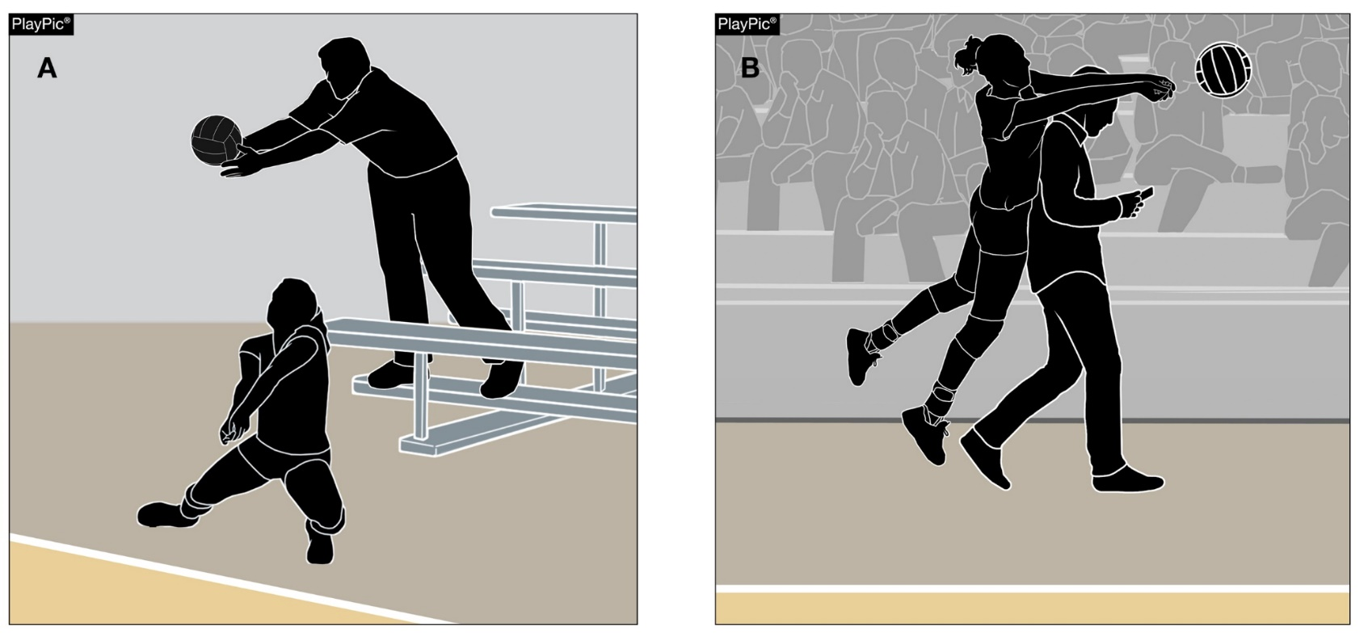
Playable/nonplayable areas
While playing a ball near spectators, a fan might interfere with a player or the ball, even without contacting the ball or player.
Referees must determine if the player had a legitimate effort to make a play.
There are times when both referees need to convene to decide if there was interference and the play should be replayed or if the ball is ruled dead.
Notes:
While playing a ball near spectators, a fan might interfere with a player or the ball, even without contacting the ball or player.
Referees must determine if the player had a legitimate effort to make a play.
There are times when both referees need to convene to decide if there was interference and the play should be replayed or if the ball is ruled dead.

Slide 23
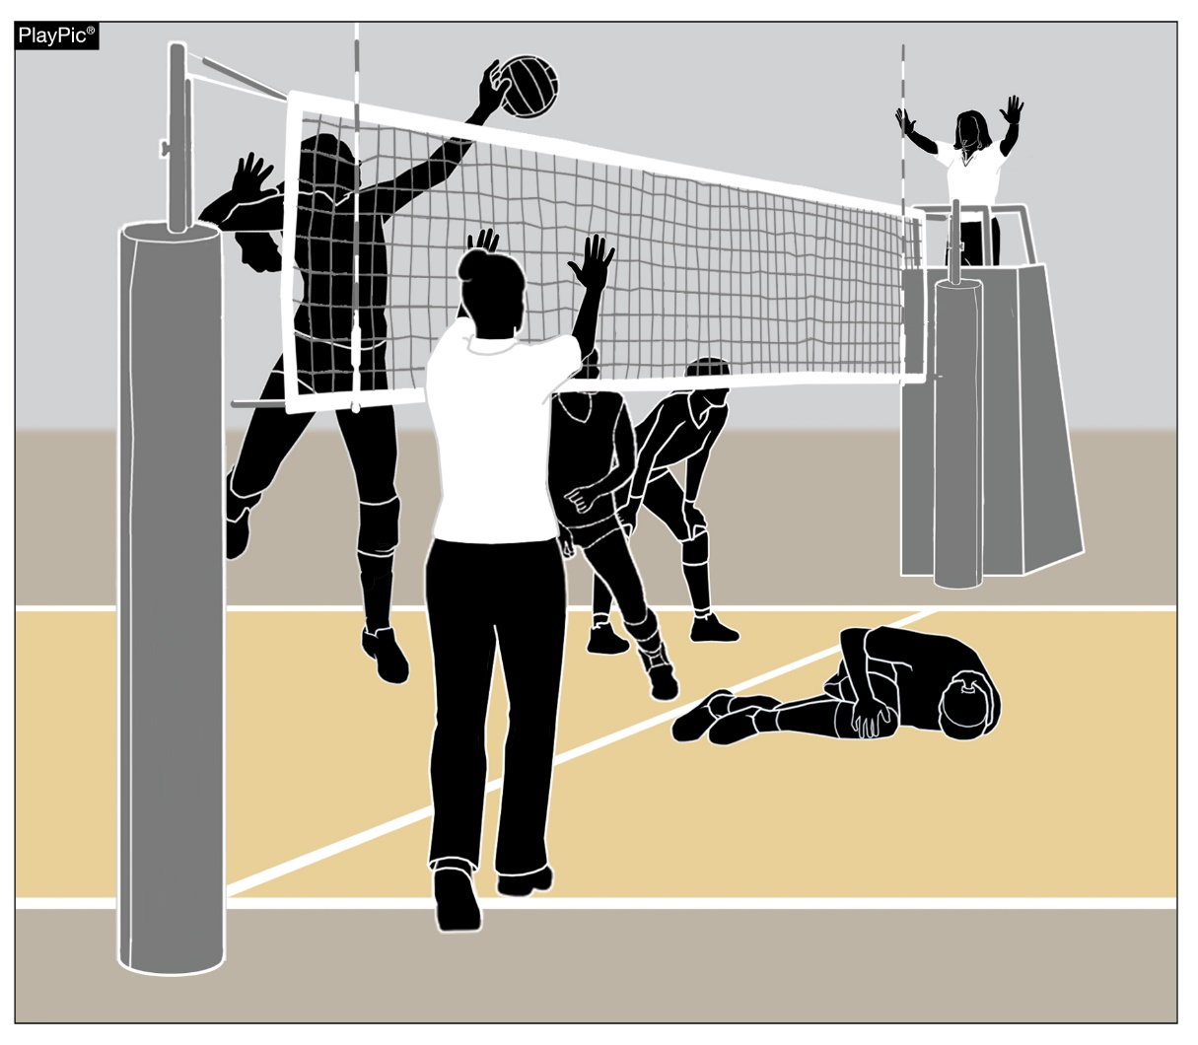
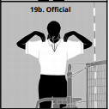
Injury procedure
Risk minimization is the officials’ primary responsibility.
If an injury occurs during play, either referee can suspend play by sounding a loud double whistle and holding up both hands.
Both officials should signal a referee’s time-out.
Notes:
Risk minimization is the officials’ primary responsibility.
If an injury occurs during play, either referee can suspend play by sounding a loud double whistle and holding up both hands.
Both officials should signal a referee’s time-out.

Slide 24
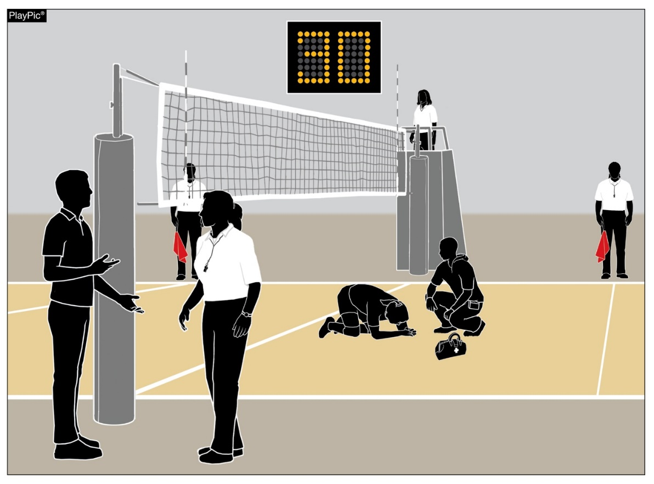
Injury procedure
The first referee remains on the stand, while the second referee allows the injured players’ coach or medical staff to attend to the injured player.
Line Judges should take their time-out position near the first referee.
All officials should refrain from taking a position near the injured player.
Rule 11-4-1 allows the coach 30 seconds to decide:
  The player can continue to play,
  To substitute/replace the injured player, or
  Take a time-out (if the team still has one remaining).
The second referee needs to communicate with one of the injured team’s coaches regarding their options and then explain that they have 30 seconds to choose an option before starting the watch.
Notes:
The first referee remains on the stand, while the second referee allows the injured players’ coach or medical staff to attend to the injured player.
Line Judges should take their time-out position near the first referee.
All officials should refrain from taking a position near the injured player.
Rule 11-4-1 allows the coach 30 seconds to decide:
The player can continue to play,
To substitute/replace the injured player, or
Take a time-out (if the team still has one remaining).
The second referee needs to communicate with one of the injured team’s coaches regarding their options and then explain that they have 30 seconds to choose an option before starting the watch.

Slide 25
Injury procedure
A player does not have to be moved within the 30-second period. Only team personnel or medical staff decides on the appropriateness of moving an injured player, regardless of how long it may take.
If the coach opts to substitute, the injured player does not follow normal substitution protocol.
Once the injured player is removed from the playing surface safely, the second referee follows the substitution protocol – signal/whistle – ensure that the substitute is recognized and recorded by the scorer.
If play was interrupted, the referees will administer a replay and continue play.
The injured player who is legally replaced, may return to the set.
Notes:
A player does not have to be moved within the 30-second period. Only team personnel or medical staff decides on the appropriateness of moving an injured player, regardless of how long it may take.
If the coach opts to substitute, the injured player does not follow normal substitution protocol.
Once the injured player is removed from the playing surface safely, the second referee follows the substitution protocol – signal/whistle – ensure that the substitute is recognized and recorded by the scorer.
If play was interrupted, the referees will administer a replay and continue play.
The injured player who is legally replaced, may return to the set.

Slide 26
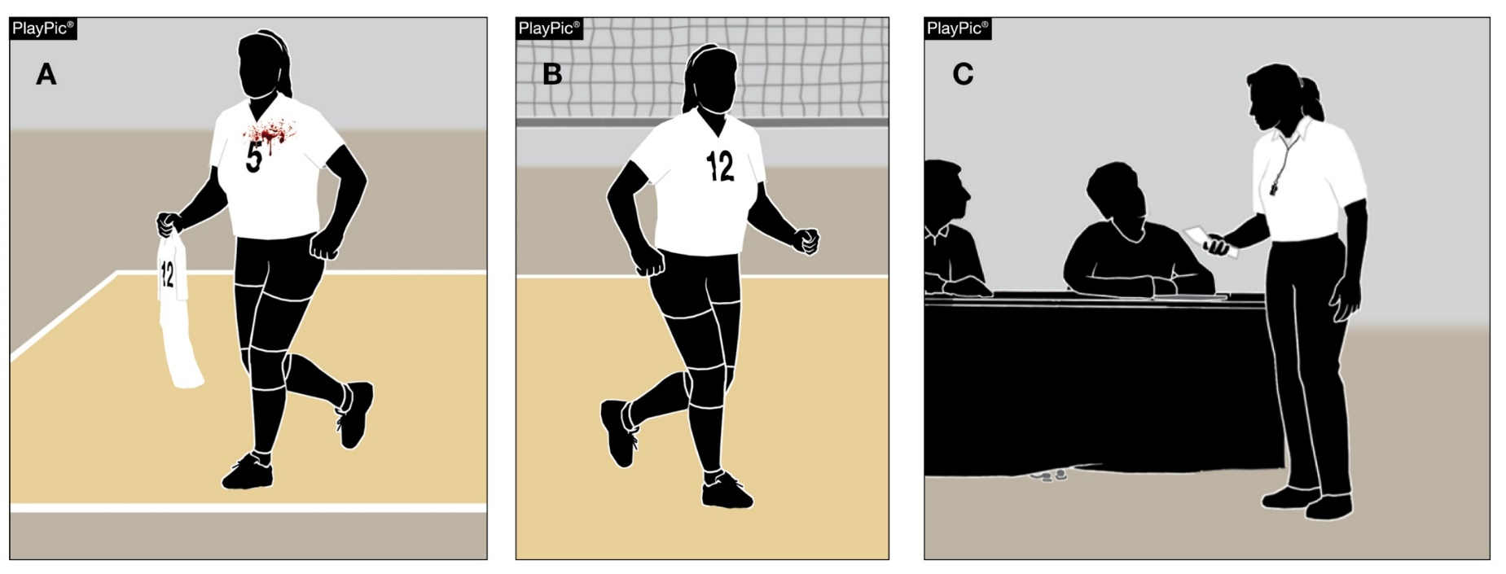
Injury procedure
Blood Situations:
As soon as an official recognizes blood on a player, uniform, equipment or playing surface, play shall be suspended.
Team personnel can aid a player.
If there is blood on a jersey or player equipment, it must be appropriately cleaned or removed.
The referees will allow a player to change jerseys – away from the court area.
The second referee should scan the court and check the game ball(s) to ensure there is no blood.
Medical staff can attend to the court and game ball(s) with the appropriate solution to remove any blood.
Notes:
As soon as an official recognizes blood on a player, uniform, equipment or playing surface, play shall be suspended.
Team personnel can aid a player.
If there is blood on a jersey or player equipment, it must be appropriately cleaned or removed.
The referees will allow a player to change jerseys – away from the court area.
The second referee should scan the court and check the game ball(s) to ensure there is no blood.
Medical staff can attend to the court and game ball(s) with the appropriate solution to remove any blood.

Slide 27
Injury procedure
Concussion Protocols:
Any athlete who exhibits signs, symptoms, or behaviors consistent with a concussion (such as loss of consciousness, headache, dizziness, confusion, or balance problems) shall be immediately removed from the contest and shall not return until cleared by an appropriate health-care professional.
  It is not the responsibility of an official to assess a potential concussion.
  It is appropriate for an official to suggest to a coach to attend to a player exhibiting the above signs, refraining from assessing that you think the player has a concussion.
Notes:
Concussion Protocols:
Any athlete who exhibits signs, symptoms, or behaviors consistent with a concussion (such as loss of consciousness, headache, dizziness, confusion, or balance problems) shall be immediately removed from the contest and shall not return until cleared by an appropriate health-care professional.
It is not the responsibility of an official to assess a potential concussion.
It is appropriate for an official to suggest to a coach to attend to a player exhibiting the above signs, refraining from assessing that you think the player has a concussion.

Slide 28
Injury procedure
Exceptional Substitution:
If a team has exhausted their allowable 18 substitutions or no legal substitutes are available, and an injury occurs where a replacement is needed, a team may be granted an exceptional substitute in priority order.
  By a teammate who has never played in the set or a player who has played in that position.
  By any non-libero teammate on the bench who is not currently being replaced by the libero.
  By a libero if no other possible substitutes exist. (Must change jerseys.)
The substitute counts as a team substitution and the injured player cannot re-enter that set if replaced by an exceptional substitute.
Notes:
Exceptional Substitution:
If a team has exhausted their allowable 18 substitutions or no legal substitutes are available, and an injury occurs where a replacement is needed, a team may be granted an exceptional substitute in priority order.
By a teammate who has never played in the set or a player who has played in that position.
By any non-libero teammate on the bench who is not currently being replaced by the libero.
By a libero if no other possible substitutes exist. (Must change jerseys.)
The substitute counts as a team substitution and the injured player cannot re-enter that set if replaced by an exceptional substitute.

Slide 29
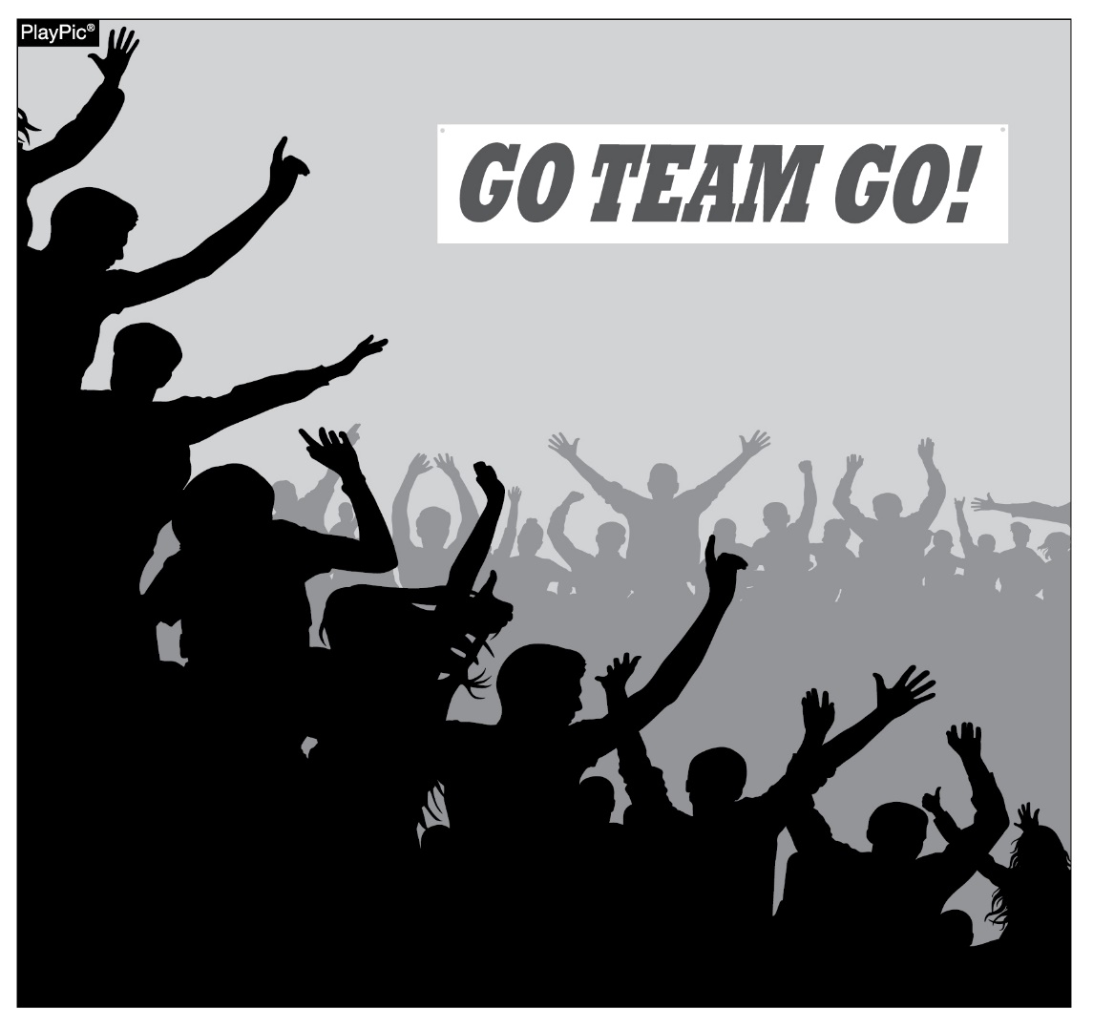
sportsmanship
NFHS playing rules are written to encourage sportsmanship. Participation in these programs should promote respect, integrity and sportsmanship. However, for these ideals to occur, everyone involved in these programs must be doing their part.
Notes:
NFHS playing rules are written to encourage sportsmanship. Participation in these programs should promote respect, integrity and sportsmanship. However, for these ideals to occur, everyone involved in these programs must be doing their part.
Sportsmanship, or good sporting behavior, is about treating one another with respect and exhibiting appropriate behavior. It is about being fair, honest and caring. When these types of appropriate behavior occur, competitive play is more enjoyable for everyone.

Slide 30
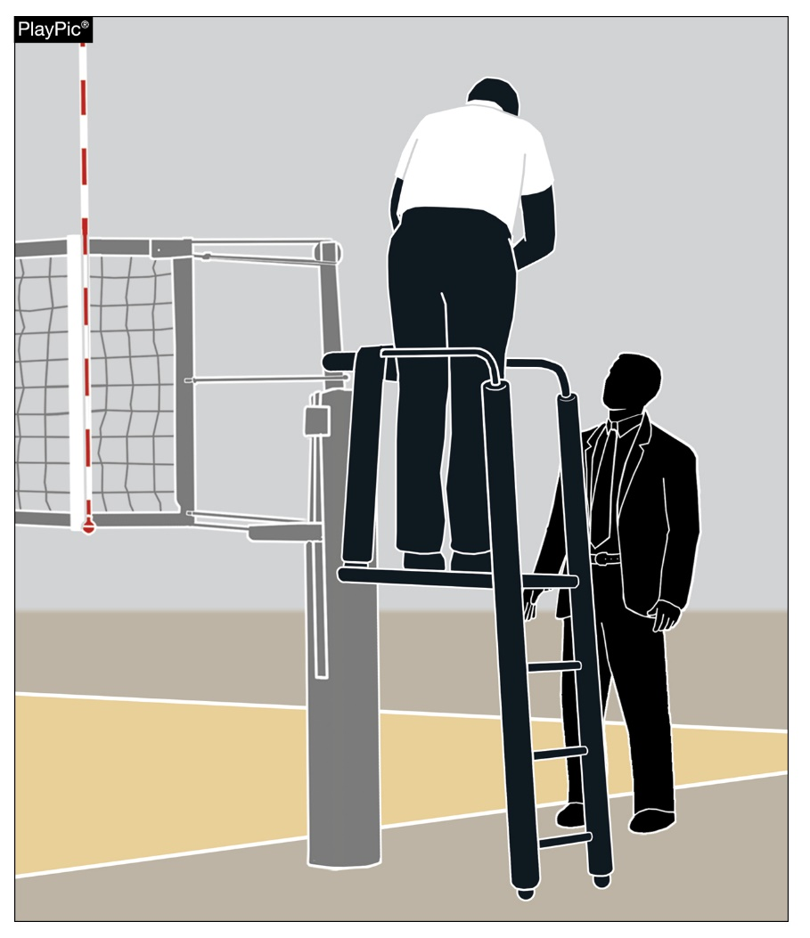
sportsmanship
There must be a collaborative, working relationship between contest officials and game administration to promote good sportsmanship and safely conduct the contest.
Everyone has their roles to play in creating a positive, sportsmanlike atmosphere at contests.
Notes:
There must be a collaborative, working relationship between contest officials and game administration to promote good sportsmanship and safely conduct the contest.
Everyone has their roles to play in creating a positive, sportsmanlike atmosphere at contests.

Slide 31
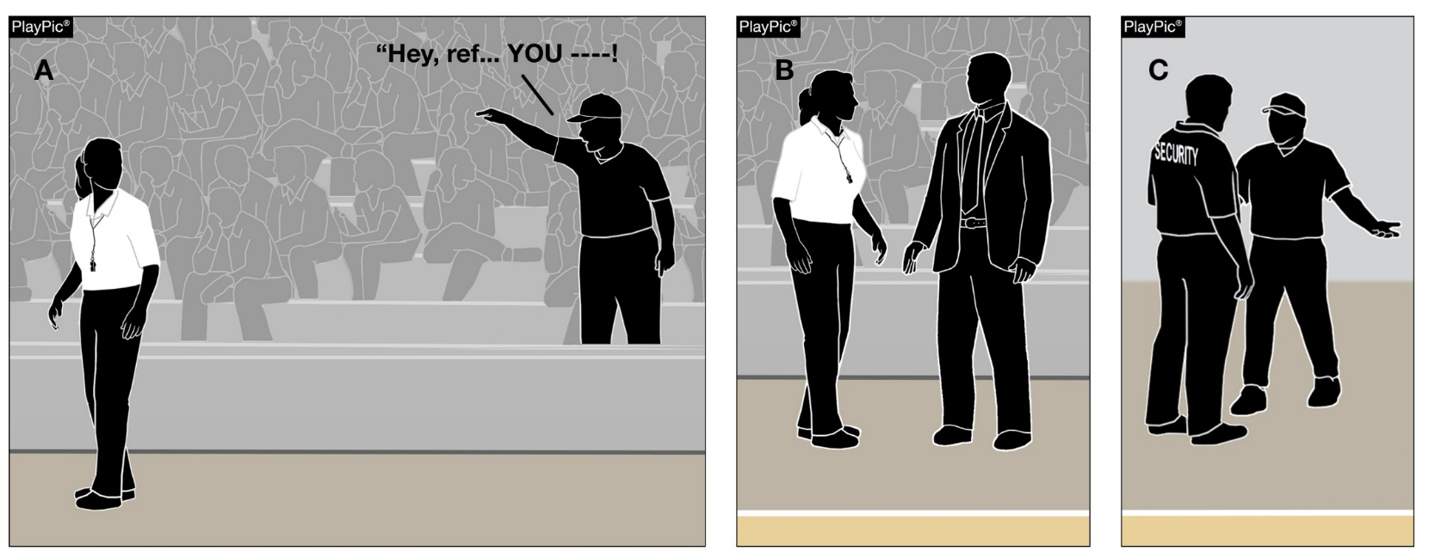
sportsmanship
Contest officials should never engage with spectators who are exhibiting unsporting behavior.
Once the contest begins, school administration is responsible for dealing with unruly spectators.
If spectators are using demeaning or profane language at officials – or at others in the stands – those individuals should be removed from the contest by school administration.
Notes:
Contest officials should never engage with spectators who are exhibiting unsporting behavior.
Once the contest begins, school administration is responsible for dealing with unruly spectators.
If spectators are using demeaning or profane language at officials – or at others in the stands – those individuals should be removed from the contest by school administration.

Slide 32
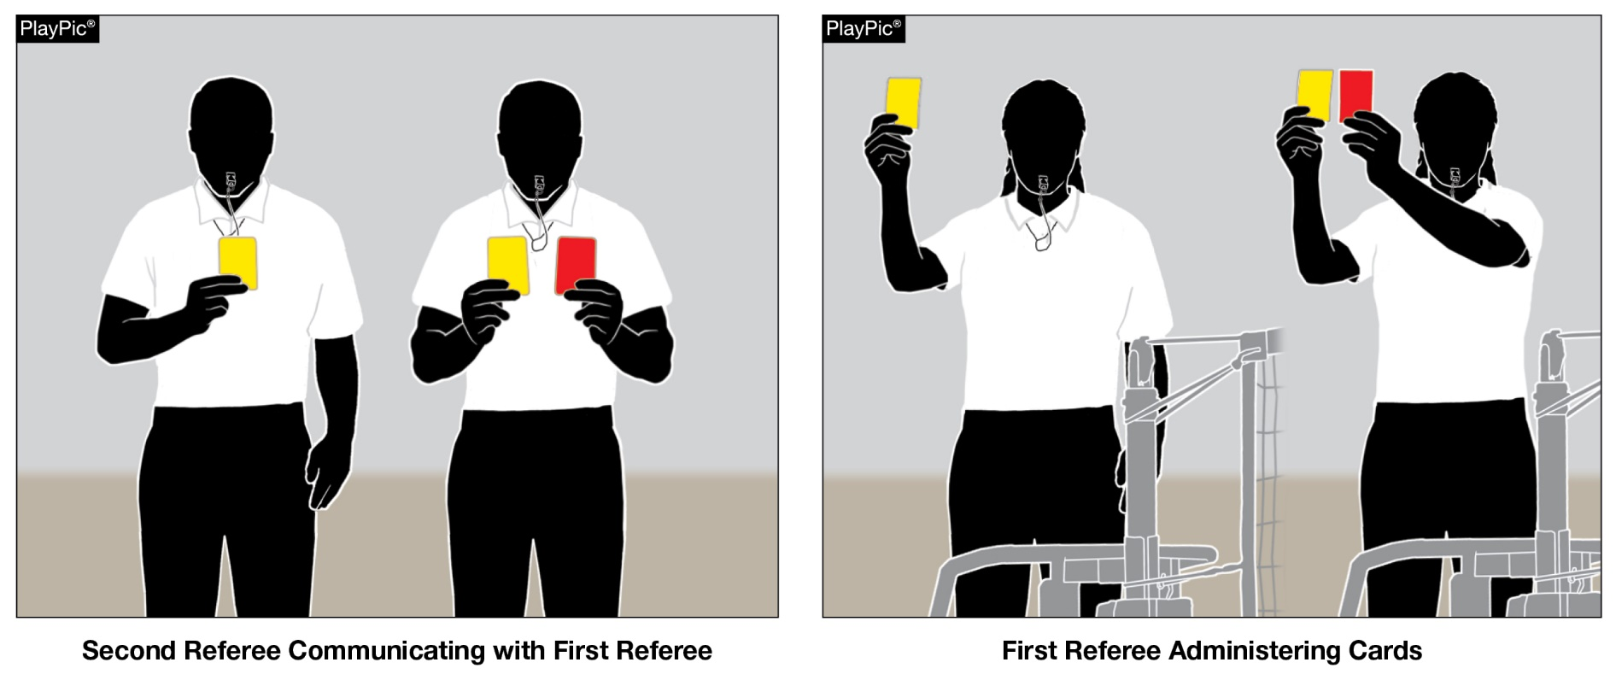
Sportsmanship
When warranted, referees should administer cards in order to control unsporting conduct violations by coaches, players and/or team benches.
Notes:
When warranted, referees should administer cards in order to control unsporting conduct violations by coaches, players and/or team benches.

Slide 33
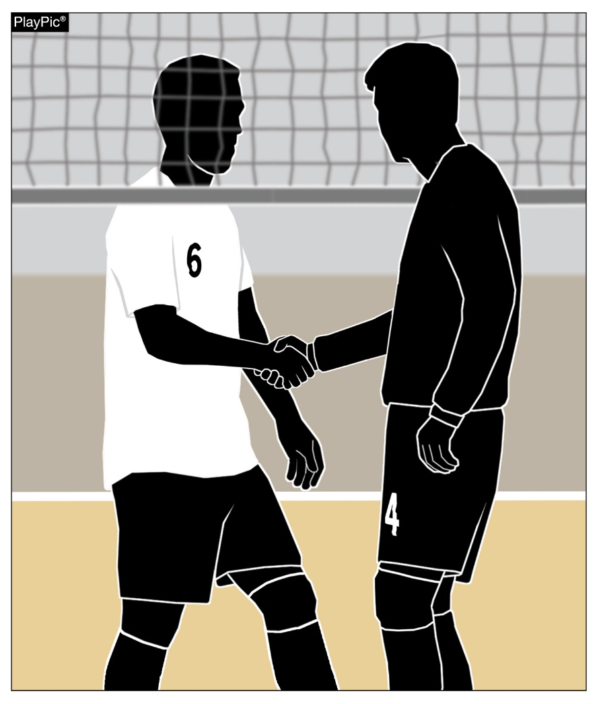
sportsmanship
Good sports win with humility, lose with grace and do both with dignity.
It takes the efforts of everyone every day to ensure that sportsmanship remains one of the top priorities in education-based activity programs.
Notes:
Good sports win with humility, lose with grace and do both with dignity.
It takes the efforts of everyone every day to ensure that sportsmanship remains one of the top priorities in education-based activity programs.

Slide 34
NFHS OFFICIALS Education

Slide 36







OFFICIALS EDUCATION
CONTENT IS NOW FREE
TEACHING AIDS
RULES
CHANGES
VIDEO
LIBRARY
OFFICIALS
COURSES
DIAGRAMS
Notes:
Sport-Specific Officiating courses are offered in several sports. They are ideal for new officials and those in the first few years of officiating. These courses introduce officials to the mechanics and techniques used in the sport and provide specific information on an area within that sport. Individuals can complete a course within 30-45 minutes. These courses are free to all officials and prospective officials.
“Interscholastic Officiating” is a general course on sports officiating, and it is free to all officials and prospective officials. This course provides an introduction to skills and concepts used as an official. Several topics are covered such as: basics of becoming and staying an official, science of officiating, art of officiating, how to combine these skills for successful officiating.
Video clips are made available to NFHS Officials Association members. The video is clipped on specific topics and provides the rules references as well as dialogue on the topic.
The courses and videos are offered at www.NFHSLearn.com .
Courses Available:
Officiating Football
Officiating Volleyball – Ball Handling
Officiating Volleyball – Alignment
Officiating Volleyball – E-Whistle
Officiating Basketball
Officiating Basketball – Three-Person Mechanics
Officiating Basketball - Pre-Game Conference
Soccer – Fouls and Misconduct
Soccer – Offside
Soccer - Pre-Game Conference
Swimming and Diving
Officiating Wrestling
Umpiring Softball
Officiating Field Hockey
Officiating Track and Field
Future Courses to be Considered:
Umpiring Baseball
Umpiring Softball – 2 Person Mechanics
Communication Among Officials and Coaches

Slide 37

Notes:
NFHS CENTER FOR OFFICIALS SERVICES (COS)
Your Complete Solution for Officials Management and More:
Registration
Assignment
Payment
Testing
Background Checks
For More Information on the NFHS – Center for Officials Services (COS) Contact:
Theresia Wynns, Director of Sports and Officials, twynns@nfhs.org
Also If You’re Interested in Eligibility and Monitoring Requirements Contact
the Folks at Dragonfly:
Kirk Miller, Dragonfly, kirk@dragonflyathletics.com
Brandon Wallace, Dragonfly, brandon@dragonflyathletics.com

Slide 38
NFHS Learning Center

Slide 39

Notes:
The NFHS Learning Center can be accessed at www.nfhslearn.com. It has over 80 online courses and over 50 of those can be accessed at no cost. There are courses for everyone within the interscholastic community including coaches, students, administrators, parents, officials, and individuals within performing arts programs. All courses include a completion certificate and can be accessed 24 hours a day, 7 days a week and completed at the learner’s pace. Get your community involved in professional development today at the NFHS Learning Center!

Slide 40
NFHS Network

Slide 41


NFHS Network
By 2025, every high school sporting event in America will be streamed live.
The NFHS Network will be
THE DESTINATION for fans
to view these broadcasts.
27 Different Sports and Activities
www.NFHSnetwork.com
Notes:
The NFHS Network is the leader in streaming Live and On Demand high school sports.
Partnered with the National Federation of State High School Associations, 45 high school state athletic/activities associations, and PlayOn! Sports, the NFHS Network is a joint venture created to provide fans with the ability to stream high school sports on any device, from wherever they are.
All NFHS Network events are available to watch online at www.NFHSnetwork.com and through the NFHS Network Live App for iOS and Android. Follow us on Facebook, Twitter, Instagram, and YouTube.
Watching high school sports and events has never been easier.
The NFHS Network’s goal to broadcast live all 2 million high school sporting events by 2025.
The NFHS Network covers 27 different regular season and postseason sports, as well as other high school activities, celebrating the accomplishments of students-athletes, student broadcasters, and high schools across the country.

Slide 42

Over 1 million events this year…
Notes:
The NFHS Network will broadcast over 150,000 live events this year. If your school is not a member of the NFHS Network School Broadcast Program, please contact us at Mark.Koski@NFHSnetwork.com

Slide 43

Thank You
National Federation of State High School Associations
PO Box 690 | Indianapolis, IN 46206
Phone: 317-972-6900 | Fax: 317.822.5700
www.nfhs.org | www.nfhslearn.com | www.nfhsnetwork.com

