Slide 1
2022-23 NFHS Swimming and diving Rules PowerPoint
Rules Changes
Major Editorial Changes
Points of Emphasis

Slide 2
National federation of state high school associations (NFHS)

Slide 3

National Federation of
State High School Associations
NFHS (located in Indianapolis, IN – Est. 1920):
  National leader and advocate for
  high school athletics and
  performing arts programs.
  Serves 51 state associations, 19,500
  high schools and 12 million student
  participants.
  Writes playing rules for 17 high school
  sports for boys and girls.
  Offers online education courses for high school coaches,
  officials, parents, students and others.
  Ensures that students have opportunity to enjoy healthy participation, achievement and good sportsmanship in education-based athletics.
Notes:
The NFHS is the national leader and advocate for high school athletics and performing arts programs. Services of the NFHS reach more than 19,000 high schools and 12 million participants throughout the eight NFHS sections across the U.S.
A significant responsibility of the NFHS is the commitment to writing quality playing rules for 17 high school sports for boys and girls, in addition to providing educational resources for high school coaches, officials, parents and students.
It is the vision of the NFHS to help prepare tomorrow’s leaders for the next level of life through the many program offerings in education-based athletics and activities.

Slide 4








NFHS Rules Review Committee
The NFHS Rules Review Committee is chaired by the chief operating officer and composed of all rules editors. After each committee concludes its deliberations and has adopted its recommended changes for the subsequent year, such revisions will be evaluated by the Rules Review Committee.
Davis Whitfield
Chief Operating Officer
Lindsey Atkinson
Basketball, Girls Lacrosse and Volleyball
Bob Colgate
Football and Sports
Medicine
Sandy Searcy
Softball, Swimming & Diving and Water Polo
Elliot Hopkins
Baseball and Wrestling
Julie Cochran
Cross Country, Gymnastics, Field Hockey, Soccer and
Track & Field
James Weaver
Boys Lacrosse
and Spirit
Dan Schuster
Ice Hockey
Notes:
All rules committee recommended rules changes are vetted through the NFHS Rules Review Committee before advancing to the NFHS Board of Directors for final action. The committee, as you see, is comprised of all NFHS Director of Sports and chaired by the NFHS Chief Operating Officer.

Slide 5
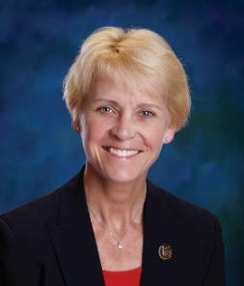




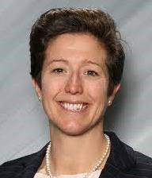
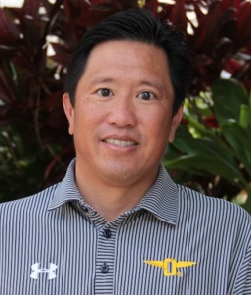
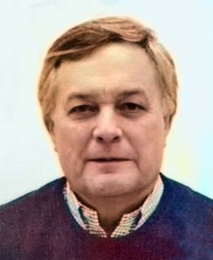
NFHS Rules Committee
Dr. Karissa Niehoff
NFHS
Publisher
Sandy Searcy
NFHS
Editor
Melissa Mertz
Mechanicsburg, PA
Chair -2022
Bob Ouellette
Hollis, NH
Section 1 –2023
Darren Bilberry
Lexington, KY
Section 2 - 2022
Kellie Doucette
Gainesville
Section 3 - 2025
Jason Eslinger
Urbandale, IA
Section 4 - 2024
Rod Garman
Topeka, KS
Section 5 - 2022
Monica Abelein
Lakewood, CO
Section 6 - 2023
Erin Coy
Gilbert, AZ
Section 7 - 2034
K.T. Emerson
Wilson, OR
Section 8 - 2025
Kenneth Chew
Honolulu, HI
Coaches - 2025
Joe Plack
Deerfield, IL
Officials - 2024
Notes:
Photos of the 2022 NFHS Swimming and Diving Rules Committee members include the representation of eight sections, the NFHS Officials Association, the NFHS Coaches Association, and Rules Committee Chair.

Slide 6


















National Federation of
State High School Associations
The NFHS writes playing rules for 17 sports
for boys and girls at the high school level.
  Publishes 4 million pieces of materials annually.
Notes:
The NFHS writes playing rules for 17 sports, publishes High School Today (HST) along with several other key publications totaling over four million pieces annually.

Slide 7

NEW NFHS Rules App
Rules App features:
  Searchable
  Highlight notes
  Bookmarks
  Quizzes for all sports
  Easy navigation
  Immediate availability
  Free to paid members of the NFHS Coaches
  and Officials Associations
  www.nfhs.org/erules for more information
Notes:
Rules app for all NFHS rules books and case books are available on iTunes and Google Play. Rules books and case books are cross-linked and enabled for searchable content.
App is free to download
Each book subscription is $6.99
NFHS Coaches and Officials Association paid members get all books for free
100% states members get books for free in sports designated by their state

Slide 8
Guidelines for Schools and state associations for consideration of accommodations
Request of Accommodation by School
State Association Review
Written Determination from State Association
Competition with Approval of Accommodation
Notes:
To assist state associations in working with schools for the inclusion of students with disabilities the following guide prepared by the NFHS Task Force on the Inclusion of Students with Disabilities is being provided for your review.
Following these guidelines will assist in the individual student assessment by the student and the school.
When requesting a possible accommodation, coaches should work with their school and the state association as early as possible in the sport season.
Contest officials shall defer decisions on rule accommodations to the respective state association.
This information serves as a guide. Each state association may develop its own process.

Slide 9
2022-23 nfhs swimming and diving RULES CHANGES

Slide 10
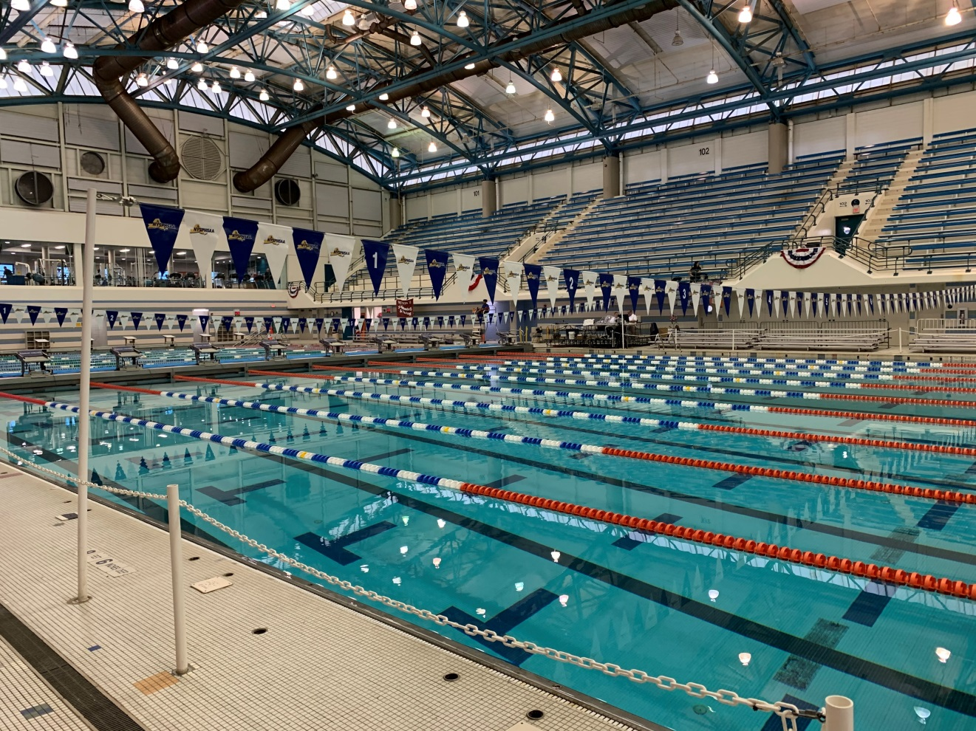
Pool construction
2-3-1
2-3-1 states that the
markings on pools
constructed after
January 1, 2023, will
be in line with FINA,
NCAA and USA
Swimming.
Notes:
Rule 2-3-1 Changes the width of the line on the pool bottom, length of the crossline, where the line terminates from the end wall and end wall targets below the water.
Rule 2-4-4 Moves language regarding end walls to rule 2-3-1
Rationale: The updated language standardizes the size and distance of pool markings for newly constructed or renovated facilities after January 1, 2023. The change places the recommended tolerance for end walls above water into Rule 2-3-1 and changes the recommendation from 2 inches (5.08 centimeters) to a maximum of 12 inches (0.3 meters) above the water surface.

Slide 11
Pool Markings
2-4-4 and 2-4-4 Table (new)
Recommendations for pools constructed or renovated after January 1, 2023.
Renovations include, but are not limited to, painting, liner replacements, remodeling of pools.
Pool Markings | Before January 1, 2023 | After January 1, 2023
Width of line on pool bottom | 10 to 12 inches (25 to 30.48 cm.) | 7.87 to 11.81 inches (.2 m. to .3 m)
Length of cross line | 36 inches (.9144 meters) | 3 feet 4 inches (1.0 meter)
Line terminates from end wall | 60 to 80 inches (1.5 to 2.0 meters) | 6 feet 7 inches (2.0 meters)
End wall targets below water | 3 feet 6 inches (1.0668 meters) | 3 feet 4 inches (1.0 meter)
Notes:
Rule 2-4-4 Moves language regarding end walls to rule 2-3-1.
Rule 2-4-4 Table (New) Easily identifies updated measurements.
Rationale: The new language standardizes the size and distance of pool markings for newly constructed or renovated facilities after January 1, 2023.

Slide 12
2022-23 nfhs swimming and diving Major editorial CHANGES

Slide 13
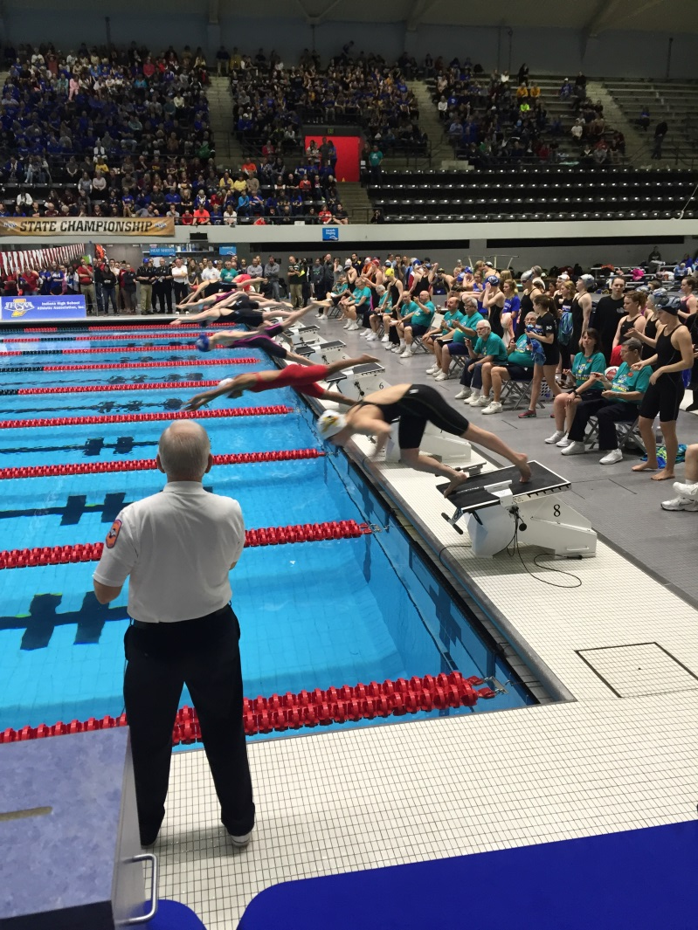
Equipment for swimming events
2-7-3
ART 3 . . . The starting
signal shall be loud
enough to
ensure insure a
fair start.
Notes:
ART 3 . . . The starting signal shall be loud enough to ensure insure a fair start.
Rationale: Grammatical correction.

Slide 14
Lap counter
3-4 PENALTY
PENALTY: For the lap counter aiding the swimmer, violating deck position, or interfering in any manner with the competition, the competitor in that lane shall be disqualified. For a lap counter entering the water without permission of the referee, see Rule 3-6-4
PENALTY 1.
Notes:
PENALTY: For the lap counter aiding the swimmer, violating deck position, or interfering in any manner with the competition, the competitor in that lane shall be disqualified. For a lap counter entering the water without permission of the referee, see Rule 3-6-4 PENALTY 1.
Rationale:
The added language clarifies the penalty for interference by a lap counter versus the penalty for a lap counter entering the water without permission by the referee.

Slide 15
Team scoring
7-2-4
ART. 4 . . . When a meet is suspended due to power failure or other unforeseen circumstances, it may be resumed from the point of suspension unless state association Rules determine otherwise. Resumed meets start from the point of suspension with the score and entries the same as when they were at the time the meet was suspended.
Notes:
ART. 4 . . . When a meet is suspended due to power failure or other unforeseen circumstances, it may be resumed from the point of suspension unless state association Rules determine otherwise. Resumed meets start from the point of suspension with the score and entries the same as when they were at the time the meet was suspended.
Rationale: Grammatical correction.

Slide 16
Starts and finishes
8-1-3 penalty 2
PENALTIES
1. The swimmer or relay team is disqualified from the event
a. And shall not swim when in violation of items a-d above;
b. If the starting signal has been given before the
disqualification is declared, the race shall continue without
recall. (8-1-4)
2. These same penalties apply in championship meets when
there is dual confirmation is required.
Notes:
PENALTIES
1. The swimmer or relay team is disqualified from the event
a. And shall not swim when in violation of items a-d above;
b. If the starting signal has been given before the
disqualification is declared, the race shall continue without
recall. (8-1-4)
2. These same penalties apply in championship meets when
there is dual confirmation is required.
Rationale: Grammatical correction.

Slide 17
Relay events
8-3-2 NOTE
NOTE: In meets where other relay events are part of the schedule, those events they shall be swum in accordance with all rules governing the strokes involved. In the backstroke relay events, all takeoffs except the initial start shall be from a forward start, after which the swimmers are permitted one immediate arm pull in the prone position prior to turning over on their backs. (5-1-1 NOTES)
Notes:
8-3-2 NOTE: In meets where other relay events are part of the schedule, those events they shall be swum in accordance with all rules governing the strokes involved. In the backstroke relay events, all takeoffs except the initial start shall be from a forward start, after which the swimmers are permitted one immediate arm pull in the prone position prior to turning over on their backs. (5-1-1 NOTES)
Rationale: Grammatical correction.

Slide 18
2022-23 nfhs swimming and diving points of emphasis

Slide 19
sportsmanship
NFHS playing rules are written to encourage sportsmanship. Participation in these programs should promote respect, integrity and sportsmanship.
However, for these ideals to occur, everyone involved in these programs must be doing their part.
Notes:
Sportsmanship
Good sporting behavior is one of the fundamental ingredients to the continued success and enjoyment of education-based high school sports and activities. In fact, in the 103-year history of organized high school sports in the United States, good sportsmanship has been one of the most important outcomes of high school activity programs. NFHS playing rules are written to encourage sportsmanship. Participation in these programs should promote respect, integrity and sportsmanship. However, for these ideals to occur, everyone involved in these programs must be doing their part.

Slide 20
sportsmanship
There must be a collaborative, working relationship between contest officials and game administration to promote good sportsmanship and safely conduct the contest.
Everyone has their roles to play in creating a positive, sportsmanlike atmosphere at contests.
Notes:
Sportsmanship
The NFHS is concerned that unsporting behavior in education-based athletics has increased across all sports. As a result, the NFHS has made sportsmanship the No. 1 Point of Emphasis for the 2022-23 school year. Sportsmanship, or good sporting behavior, is about treating one another with respect and exhibiting appropriate behavior. It is about being fair, honest and caring. When these types of appropriate behavior occur, competitive play is more enjoyable for everyone. Coaches set the tone at athletic contests with their display of sportsmanship. If these individuals act in a sportsmanlike manner, their behavior sets the tone for players, spectators and others. If coaches, however, are complaining constantly about the decision of contest officials, spectators are more likely to do the same. There must be a collaborative, working relationship between contest officials and game administration to promote good sportsmanship and safely conduct the contest. Everyone has their roles to play in creating a positive, sportsmanlike atmosphere at contests.

Slide 21
sportsmanship
Contest officials should never engage with spectators who are exhibiting unsporting behavior.
Once the contest begins, school administration is responsible for dealing with unruly spectators.
If spectators are using demeaning or profane language at officials – or at others in the stands – those individuals should be removed from the contest by school administration.
Notes:
Sportsmanship
Officials should focus on the actions of players, coaches and other bench/sideline personnel. A positive, open line of communication between officials and coaches ultimately results in a better contest for everyone involved. Contest officials, however, should never engage with spectators who are exhibiting unsporting behavior. Once the contest begins, school administration is responsible for dealing with unruly spectators. A proactive approach by school administration includes monitoring the behavior of spectators and intervening as needed. If spectators are using demeaning or profane language at officials – or at others in the stands – those individuals should be removed from the contest by school administration.

Slide 22
sportsmanship
Good sports win with humility, lose with grace and do both with dignity.
It takes the efforts of everyone every day to ensure that sportsmanship remains one of the top priorities in education-based activity programs.
Notes:
Sportsmanship
A proactive approach by school administration includes monitoring the behavior of spectators and intervening as needed. If spectators are using demeaning or profane language at officials – or at others in the stands – those individuals should be removed from the contest by school administration. In recent years, a heightened level of unsportsmanlike behavior has been occurring by spectators at high school sporting events, and it must be stopped. The use of demeaning language, or hate speech, by students, parents and other fans must cease. High school sports and other activities exist to lift people up, not demean or tear people down. The goal is to treat everyone fairly and treat each other with respect. Any speech or harassment that is insulting, demeaning or hurtful will not be tolerated. High schools must establish a culture that values the worth of every single person – both players on the school’s team and players on the opposing team. There must be a no-tolerance policy regarding behavior that shows disrespect for another individual. Good sports win with humility, lose with grace and do both with dignity. It takes the efforts of everyone every day to ensure that sportsmanship remains one of the top priorities in education-based activity programs.

Slide 23
Diving announcer error
Announcer errors occasionally occur at all levels of competition.
Errors should be corrected so that divers are not forced to perform dives they are not prepared for.
Options for equitable solutions are identified in this Points of Emphasis.
Notes:
Diving Announcer Error
Announcer errors occur most frequently in dual meets but may occur in championship meets as well. When errors do occur, they should be corrected to prevent divers from being penalized by doing dives that they are not prepared for, or repeating dives already performed. In all cases the diver should be given time to be properly prepared to perform the dive.

Slide 24
Diving announcer error
During a meet without cuts, a diver may choose to keep the score. Scores for the diver should be entered in the appropriate round on the scoresheet.
During a championship meet, a diver may accept scores but the referee should ensure no rules are violated as a result.
If accepting score causes a rules violation or the diver does not accept the scores, the announced dive will be performed when the diver has had appropriate time to prepare.
Notes:
Diving Announcer Error
When an announcer error occurs:
during a dual meet or a championship format meet without cuts, the diver performs the dive announced and chooses to accept the scores. The referee should instruct the table to record scores for the dive actually performed and in the appropriate round on the scoresheet. The dive that was not performed will then become the next dive and the rest of the dives will be performed in the appropriate order. Additionally, the announcer and table should note the adjustments on the scoresheet;
during a championship meet which includes cuts, when the diver chooses to accept the scores, the referee should verify that acceptance will not create a violation of a legal order of dives, causing an unfair competitive advantage (and possibly result in a penalty in a later round). Before allowing the diver to accept the scores the referee needs to check the diver’s list to verify that no rules are being violated. Changes can be made if both dives occur in the prelims, both occur in the semi-finals, or if both occur in the finals without creating a penalty;
if accepting the scores will cause a violation of the NFHS Championship meet dive order, or the diver does not accept the scores, or the dive announced was not written on the score sheet, the announcer shall announce the correct dive and the diver shall perform that dive when they have had proper time to prepare. A referee should never allow a change that will result in penalties later in the meet. Within these limitations, the diving referee has broad discretion to assure the least possible negative impact upon the diver for the official’s error.

Slide 25
Relay entries
Competitor becomes participant when card is delivered to meet director at specified time and place.
In relays, the names of the four competing swimmers must be submitted at the designated time and place as well.
While the coach may name the lead-off swimmer at the designated time and place, there is no penalty for incorrectly listing the name.
Notes:
Relay Entries
A competitor becomes a participant in an event when the official entry card is delivered to the meet director, or designee, at a specified time and place. For relays, eight individuals may be designated, if the state association requires. The penalty for submitting an inaccurate entry card, one that does not bear the name of the event, coach’s signature, school name, and submitted time if one exists, is disqualification from the event. Four swimmers declared on the relay card, submitted at the designated time and place prior to the start of the event, are permitted to report to the blocks and compete. The coach shall submit the name of the lead-off swimmer at the specified time and place prior to the start of the event, although there is no penalty for incorrectly listing that name. There is no NFHS mandate to list the order of swimmers, which is not a required part of the entry process.

Slide 26
Provide deck space for officials
Schools are reminded to provide deck space for officials, coaches and competitors.
It is recommended officials are afforded at least 3 feet for officials to do their work.
The referee shall determine positioning and jurisdiction of deck officials which depend on the number of officials and pool configuration.
Notes:
Provide Deck Space for Officials
NFHS swimming and diving officials work in swimming facilities with a wide variety of pool configurations which sometimes necessitate creative ways to officiate strokes. Schools are reminded of the importance of officials to be provided space on the deck that allows for free movement during the swimming event. It is recommended that a minimum of 3 feet be established for officials on the deck. In addition, adequate space should be provided for coaches and competitors to safely move about on deck. The referee shall determine the positioning and jurisdiction of all deck officials, which depend on the number of officials being used and the pool configuration. Officials may need to ask meet management for assistance in keeping a clear path to move up and down the sides and ends of the pool.

Slide 27
Diving area safety
Standards for clearance recommended for one-meter diving specify 10 feet from the center of the board to the side wall.
Facility management and officials should remove obstacles that pose a risk to competitors.
Notes:
Diving Area Safety
Rule 9-1-1 states the diving pool may be separate from or part of the swimming pool and the following standards for clearance are recommended for one-meter diving, with the measurement from the center of board to pool side wall a distance of 10 feet. Risk minimization and athlete safety should be a high priority. Divers, by rule are required to dive in front of the diving board and judges are instructed to reduce scores accordingly when they fail to do so. In addition, it is recommended that facilities management and officials remove any obstacles that may pose a risk (lane lines, backstroke flags, other athletes, etc.) as best practices and to minimize risk.

Slide 28
NFHS OFFICIALS Education

Slide 29





OFFICIALS EDUCATION
Content remains free of charge
TEACHING
AIDS
RULES
CHANGES
DIAGRAMS
VIDEO
LIBRARY
OFFICIALS
COURSES
Notes:
Sport-Specific Officiating courses are offered in several sports. They are ideal for new officials and those in the first few years of officiating. These courses introduce officials to the mechanics and techniques used in the sport and provide specific information on an area within that sport. Individuals can complete a course within 30-45 minutes. These courses are free to all officials and prospective officials.
“Interscholastic Officiating” is a general course on sports officiating, and it is free to all officials and prospective officials. This course provides an introduction to skills and concepts used as an official. Several topics are covered such as: basics of becoming and staying an official, science of officiating, art of officiating, how to combine these skills for successful officiating.
Video clips are made available to NFHS Officials Association members. The video is clipped on specific topics and provides the rules references as well as dialogue on the topic.
The courses and videos are offered at www.NFHSLearn.com .
Courses Available:
Officiating Football
Officiating Volleyball – Ball Handling
Officiating Volleyball – Alignment
Officiating Volleyball – E-Whistle
Officiating Basketball
Officiating Basketball – Three-Person Mechanics
Officiating Basketball - Pre-Game Conference
Soccer – Fouls and Misconduct
Soccer – Offside
Soccer - Pre-Game Conference
Swimming and Diving
Officiating Wrestling
Umpiring Softball
Officiating Field Hockey
Officiating Track and Field
Future Courses to be Considered:
Umpiring Baseball
Umpiring Softball – 2 Person Mechanics
Communication Among Officials and Coaches

Slide 30


Future Developments
Improved Schedule View
Year Two Accomplishments
Auto-Assign
Years of Service
14
121,508
$9.2M
Enhanced Payment Capabilities
States
Registering
Officials
Contests
Assigned
Payments
Sent to
Officials
100% FREE to your state as a NFHS-Member Benefit.
Notes:
NFHS CENTER FOR OFFICIALS SERVICES (COS)
Your Complete Solution for Officials Management and More:
Registration
Assignment
Payment
Testing
Background Checks
For More Information on the NFHS – Center for Officials Services (COS) Contact:
Dana Pappas, Director of Officiating Services, dpappas@nfhs.org
Also If You’re Interested in Eligibility and Monitoring Requirements Contact
the Folks at Dragonfly:
Kirk Miller, Dragonfly, kirk@dragonflyathletics.com
Brandon Wallace, Dragonfly, brandon@dragonflyathletics.com

Slide 31
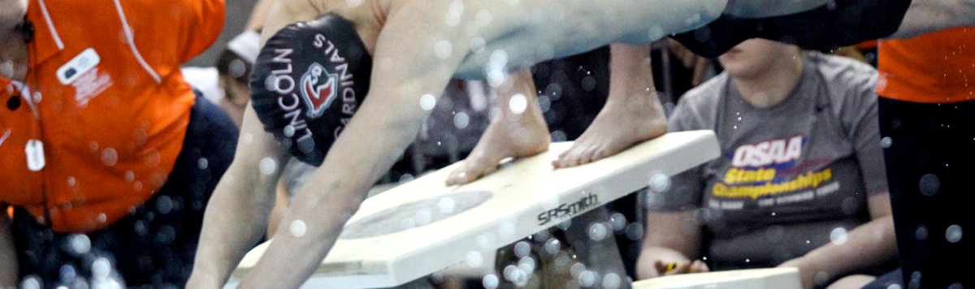



Officiating Swimming & Diving
Course Objectives
Units
Understand the roles of professionalism, rules knowledge, and communication and how they help ensure a fair meet.
Know how to consistently identify swimming violations in each type of event.
Learn the elements of a proper dive and how to score dives appropriately.
Elements of Professional Development
Officiating Swimming
Officiating Diving
Judging Practicum
Unlimited access to course for 1 year from the date of purchase
Approved by NFHS for 3 course clock hours
Notes:
Officiating Swimming and Diving is a course developed by the NFHS in conjunction with the National Interscholastic Swim Coaches Association (NISCA) and USA Diving. This course defines the elements of professional development and the fundamentals of officiating strokes and turns. The course also explores officiating and judging diving and provides a judging practicum that includes feedback of submitted scores. Officials may select either the swimming track, the diving track, or both, depending on rules required by their state association.
More:
- Unlimited access to course & resources for one year from date of purchase
- Use as an elective to fulfill AIC or CIC certification requirements

Slide 32
NFHS Learning Center

Slide 33

Notes:
The NFHS Learning Center is the home to more than 90 online professional development courses for everyone within the interscholastic community - coaches, students, officials, parents, administrators, and individuals within performing arts programs. More than 60 courses are available for free.
The NFHS is an Accredited Institution and has delivered more than 15 million courses on its NFHS Learning Center platform since its inception in 2007. In receiving national accreditation by Cognia, the NFHS has upheld itself to rigorous standards that focus on productive learning environments, equitable resource allocation that meet the needs of learners, and effective leadership.
The NFHS Learning Center features its flagship coaching course, “Fundamentals of Coaching,” as well as several health and safety courses that have been completed by millions of individuals, such as “Concussion in Sports,” “Heat Illness Prevention,” “Sudden Cardiac Arrest” and “Protecting Students from Abuse.” The NFHS Learning Center offers several national credentials that can be earned by individuals who complete specific NFHS courses. Through the School Honor Roll Program, schools can earn a physical banner to hang in their school.
To learn more and start your professional development journey, please visit the NFHS Learning Center at NFHSLearn.com.

Slide 34

Notes:
The NFHS has partnered with the National Interscholastic Swim Coaches Association to present the online Coaching Swimming course. Go to www.nfhslearn.com to view the trailer, description and outline for this course. Encourage your coaches to sign-up today!

Slide 35
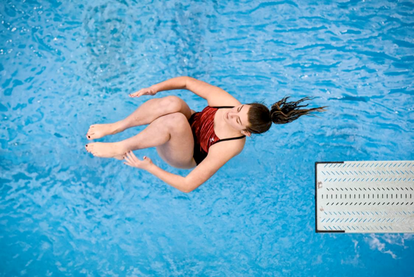
www.nfhslearn.com
Coaching Diving
Course Objectives
Units
Coaching Fundamentals: components of a dive, direction designations and position designations
Dryland: body positioning, drills, basic jumping skills and hurdle progressions
Forward and Backward Dives: feet-first entry, front fall-in, headfirst entry
Inward, Reverse and Twisting Skills: demonstrations and testing
Teaching Methodology
Fundamentals
Dryland Skills
Forward Skills
Backward Skills
Inward Skills
Reverse Skills
Twisting Skills
www.nfhs.org
Notes:
Coaching Diving is a course developed by the NFHS in conjunction with the National Interscholastic Swim Coaches Association (NISCA) and USA Diving. This course teaches the fundamentals of becoming an effective diving coach. The course explores the different types of dives and the training required to execute the to the best of the diver’s ability.
More:
- Unlimited access to course & resources for one year from date of purchase.
- Use as an elective to fulfill AIC or CIC certification requirements.

Slide 36
NFHS Network

Slide 37


NFHS Network
By 2025, every high school sporting event in America will be streamed live.
The NFHS Network will be
THE DESTINATION for fans
to view these broadcasts.
27 Different Sports and Activities
www.NFHSnetwork.com
Notes:
The NFHS Network is the leader in streaming Live and On Demand high school sports.
Partnered with the National Federation of State High School Associations, 45 high school state athletic/activities associations, and PlayOn! Sports, the NFHS Network is a joint venture created to provide fans with the ability to stream high school sports on any device, from wherever they are.
All NFHS Network events are available to watch online at www.NFHSnetwork.com and through the NFHS Network Live App for iOS and Android. Follow us on Facebook, Twitter, Instagram, and YouTube.
Watching high school sports and events has never been easier.
The NFHS Network’s goal to broadcast live all 2 million high school sporting events by 2025.
The NFHS Network covers 27 different regular season and postseason sports, as well as other high school activities, celebrating the accomplishments of students-athletes, student broadcasters, and high schools across the country.

Slide 38

Over 1 million events this year…
Notes:
The NFHS Network will broadcast over 150,000 live events this year. If your school is not a member of the NFHS Network School Broadcast Program, please contact us at Mark.Koski@NFHSnetwork.com

Slide 39
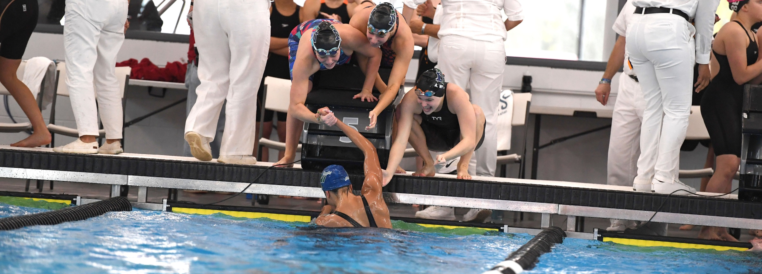
2022-23 nfhs swimming and diving resources

Slide 40

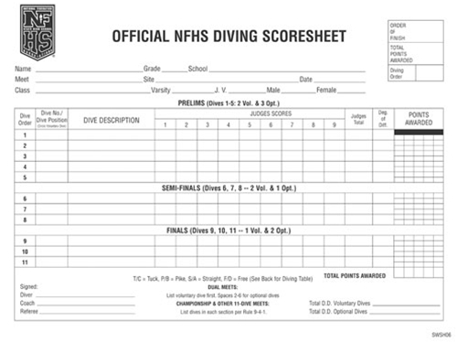
NFHS swimming and diving publications
The Rules Book, Scorebook and other Swimming and Diving materials can be ordered online at www.nfhs.com, or by calling 1-800-776-3462.
Notes:
The NFHS swimming and diving publications are available to order online or by using the toll-free number.

Slide 41


NFHS swimming and diving publications
The revised manuals will be available
July 1, 2022.
Notes:
The NFHS Swimming Officials Guideline Manual and the Diving Officials Guidelines Manual will be available July 1st on the swimming and diving page of www.nfhs.org. The manuals are posted in word format so that state associations may tailor them to fit their specific needs.

Slide 42

Thank You
National Federation of State High School Associations
PO Box 690 | Indianapolis, IN 46206
Phone: 317-972-6900 | Fax: 317.822.5700
www.nfhs.org | www.nfhslearn.com | www.nfhsnetwork.com

