Slide 1
2023 NFHS Softball Rules PowerPoint
Rules Changes
Major Editorial Changes
Points of Emphasis

Slide 2
National federation of state high school associations (NFHS)

Slide 3

National Federation of
State High School Associations
NFHS (located in Indianapolis, IN – Est. 1920):
  National leader and advocate for
  high school athletics and
  performing arts programs.
  Serves 51 state associations, 19,500
  high schools and 12 million student
  participants.
  Writes playing rules for 17 high school
  sports for boys and girls.
  Offers online education courses for high school coaches,
  officials, parents, students and others.
  Ensures that students have opportunity to enjoy healthy participation, achievement and good sportsmanship in education-based athletics.
Notes:
The NFHS is the national leader and advocate for high school athletics and performing arts programs. Services of the NFHS reach more than 19,000 high schools and 12 million participants throughout the eight NFHS sections across the U.S.
A significant responsibility of the NFHS is the commitment to writing quality playing rules for 17 high school sports for boys and girls, in addition to providing educational resources for high school coaches, officials, parents and students.
It is the vision of the NFHS to help prepare tomorrow’s leaders for the next level of life through the many program offerings in education-based athletics and activities.

Slide 4








NFHS Rules Review Committee
The NFHS Rules Review Committee is chaired by the chief operating officer and composed of all rules editors. After each committee concludes its deliberations and has adopted its recommended changes for the subsequent year, such revisions will be evaluated by the Rules Review Committee.
Davis Whitfield
Chief Operating Officer
Lindsey Atkinson
Basketball, Girls Lacrosse and Volleyball
Bob Colgate
Football and Sports
Medicine
Sandy Searcy
Softball, Swimming & Diving and Water Polo
Elliot Hopkins
Baseball and Wrestling
Julie Cochran
Cross Country, Gymnastics, Field Hockey, Soccer and
Track & Field
James Weaver
Boys Lacrosse
and Spirit
Dan Schuster
Ice Hockey
Notes:
All rules committee recommended rules changes are vetted through the NFHS Rules Review Committee before advancing to the NFHS Board of Directors for final action. The committee, as you see, is comprised of all NFHS Director of Sports and chaired by the NFHS Chief Operating Officer.

Slide 5
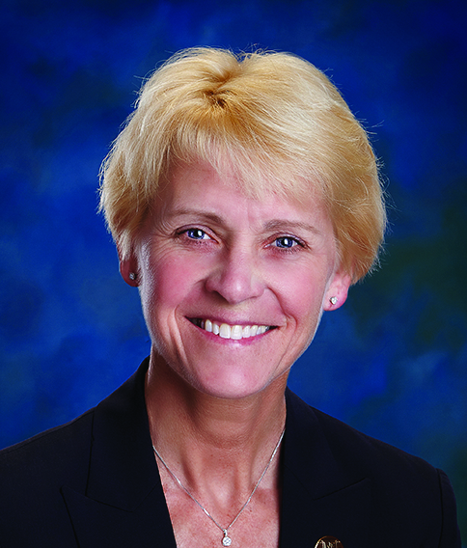
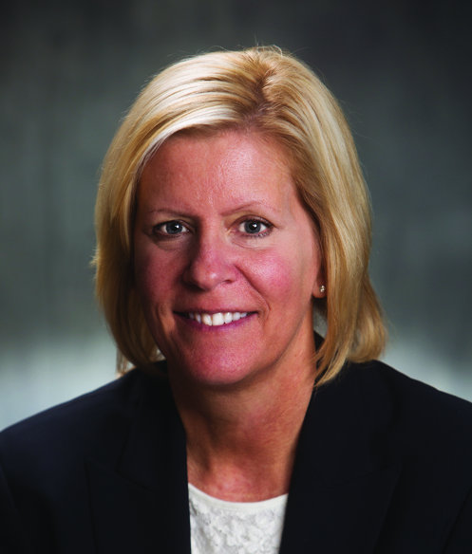
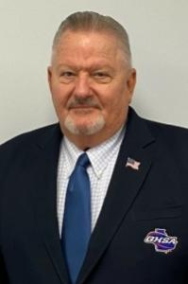
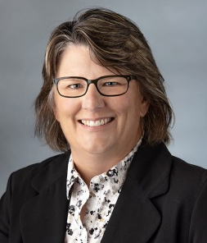

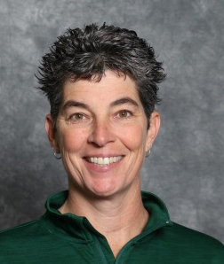
NFHS Softball Rules Committee
Dr. Karissa Niehoff
NFHS
Publisher
Sandy Searcy
NFHS
Editor
Amy Cassell
Oklahomna
Chair – 2022
Dennis Crowe
Maine
Section 1 – 2024
Sarah Bridenbaugh
Kentucky
Section 2 – 2025
Erine Yarbrough
Georgia
Section 3 – 2022
Cathy Creighton
Iowa
Section 1 – 2023
Diane Smith
Kansas
Section 5 – 2024
Steve Roberts
Arkansas
Section 6 – 2025
Missy Kilbey
Hawaii
Section 7 – 2022
Kelly Foster
Oregon
Section 8 – 2023
BJ Kuntz
NFHS Coaches Association
Willie Moore
NFHS Officials Association
Notes:
Photos of the 2022 NFHS Softball Rules Committee members include the representation of eight sections, the NFHS Officials Association, the NFHS Coaches Association, and Rules Committee Chair.

Slide 6




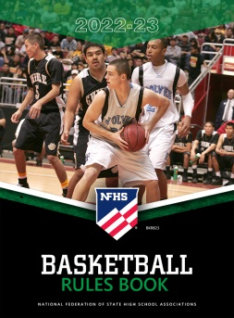













National Federation of
State High School Associations
The NFHS writes playing rules for 17 sports
for boys and girls at the high school level.
  Publishes 4 million pieces of materials annually.
Notes:
The NFHS writes playing rules for 17 sports, publishes High School Today (HST) along with several other key publications totaling over four million pieces annually.

Slide 7

NEW NFHS Rules App
Rules App features:
  Searchable
  Highlight notes
  Bookmarks
  Quizzes for all sports
  Easy navigation
  Immediate availability
  Free to paid members of the NFHS Coaches
  and Officials Associations
  www.nfhs.org/erules for more information
Notes:
Rules app for all NFHS rules books and case books are available on iTunes and Google Play. Rules books and case books are cross-linked and enabled for searchable content.
App is free to download
Each book subscription is $6.99
NFHS Coaches and Officials Association paid members get all books for free
100% states members get books for free in sports designated by their state

Slide 8
Guidelines for Schools and state associations for consideration of accommodations
Request of Accommodation by School
State Association Review
Written Determination from State Association
Competition with Approval of Accommodation
Notes:
To assist state associations in working with schools for the inclusion of students with disabilities the following guide prepared by the NFHS Task Force on the Inclusion of Students with Disabilities is being provided for your review.
Following these guidelines will assist in the individual student assessment by the student and the school.
When requesting a possible accommodation, coaches should work with their school and the state association as early as possible in the sport season.
Contest officials shall defer decisions on rule accommodations to the respective state association.
This information serves as a guide. Each state association may develop its own process.

Slide 9
2023 nfhs softball RULES CHANGES

Slide 10
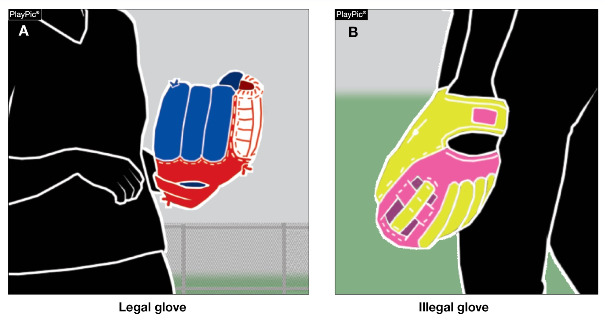
Gloves/mitts rule 1-4-1a, b
Gloves/mitts are now permitted to be more than two colors. Gloves/mitts, lacing and seams still may not be the color of the ball.
Notes:
Rule 1-4-1a, b: Gloves/mitts are now permitted to be more than two colors. Gloves/mitts, lacing and seams still may not be the color of the ball.
Rationale: The rule change removes the number of color restrictions on the glove, including laces and seams, but does not permit any part of the glove to match the color of the ball. This change allows for the rule to be less restrictive, providing more options. The glove still cannot have an optic-colored marking which gives the appearance of the ball or is judged to be distracting to the umpire.

Slide 11
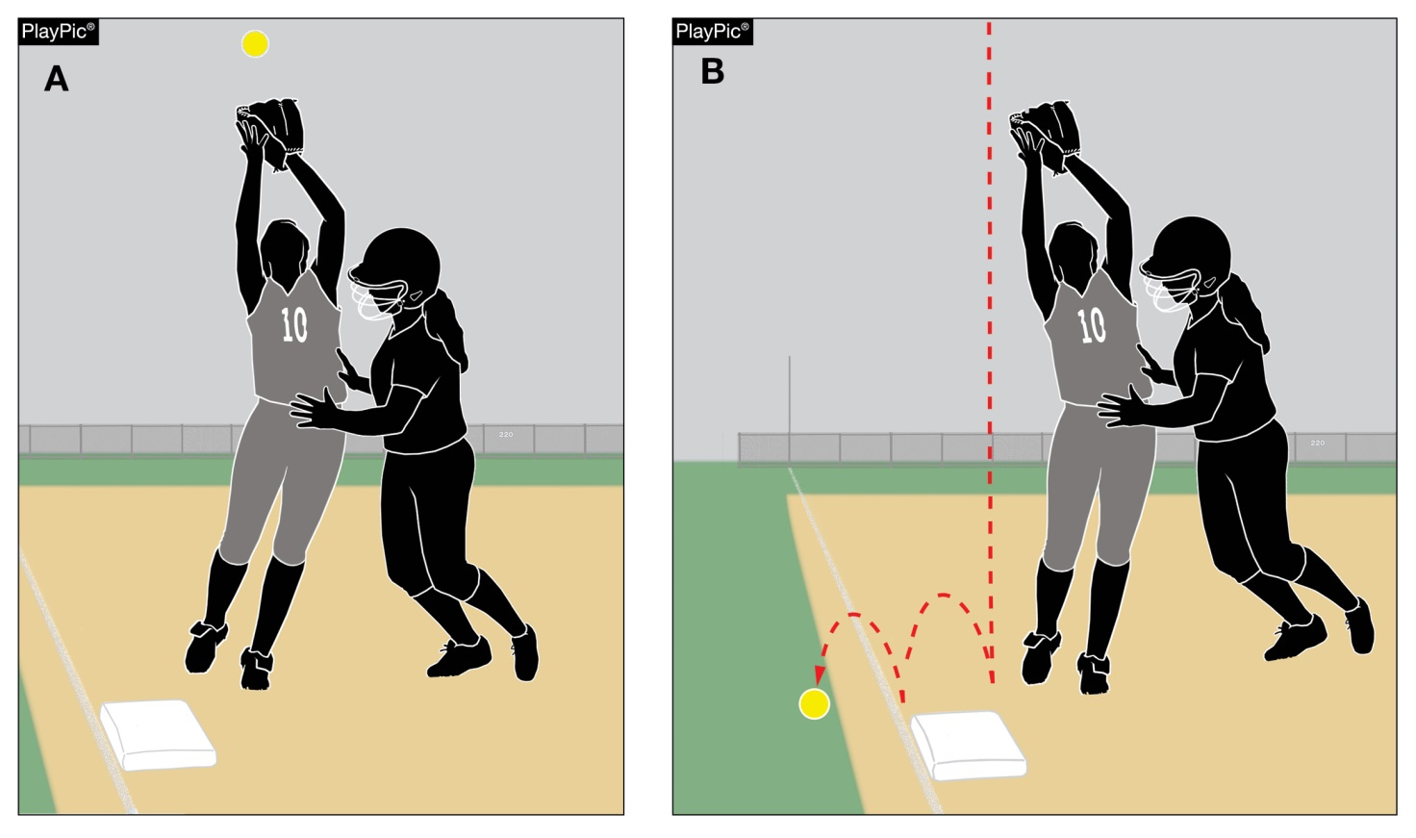
Fair ball rule 2-20-1g (NEW)
If an offensive player interferes with a defensive player attempting to field a batted ball while the ball is over fair territory, it is a fair ball.
Notes:
Rule 2-20-1g (NEW): If an offensive player interferes with a defensive player attempting to field a batted ball while the ball is over fair territory, it is a fair ball.
Rationale: This change allows the definition of a fair ball to reflect what umpires have always enforced as part of the definition of a fair ball. It is intended to mirror the definition of a foul ball. (2-25-1e)

Slide 12
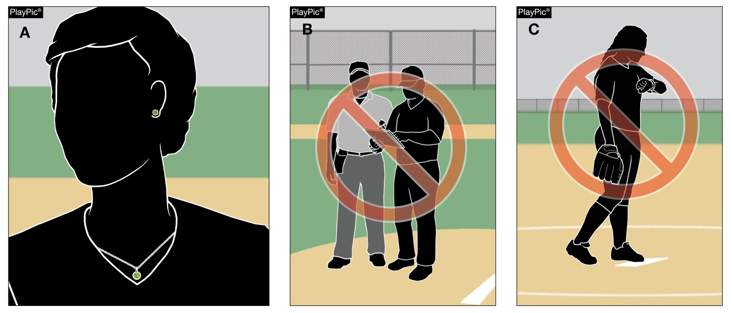
UNIFORMS, PLAYER EQUIPMENT rules 3-6-11
Jewelry is no longer prohibited. However, Rule 1-8-6 is still in effect, which prohibits team personnel from using electronic devices to communicate or transmit data outside of the dugout.
Notes:
Rules 3-6-11: Jewelry is no longer prohibited. However, 1-8-6 is still in effect, which prohibits team personnel from using electronic devices to communicate or transmit data outside of the dugout.
Rationale: The NFHS Softball Committee removed the former Rule 3-2-12 prohibiting jewelry, which places the softball rules in line with other NFHS sports that do not have the restriction. These sports have no documented data of an increased risk for injury while wearing jewelry. With this change, medical alert and religious medals are no longer a concern. Umpires still have the authority to rule on anything that is considered a distraction or increases risk to any player.

Slide 13
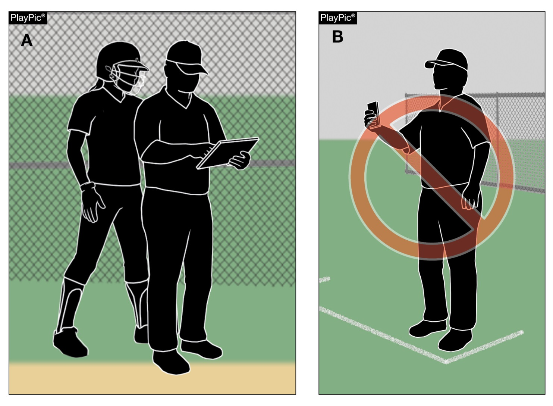
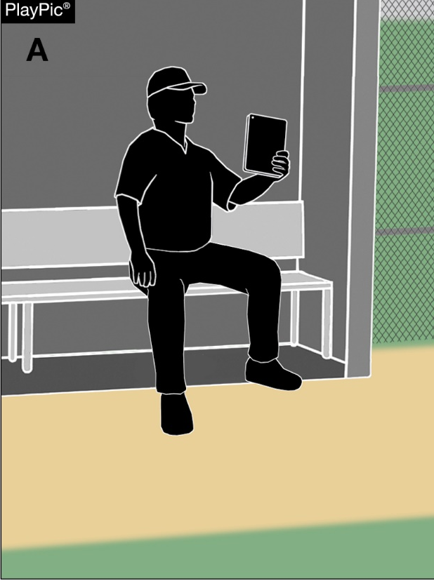
Bench and field conduct rule 3-6-11
Clarifies where electronic devices may be used for coaching purposes during a game.
Notes:
Rule 3-6-11: Clarifies where electronic devices may be used for coaching purposes during a game.
Rationale: The rule prohibiting jewelry has been removed, allowing team personnel to now wear jewelry; however, the rule regarding the use of electronics is still in place. The use of electronic devices by team personnel to transmit or record information pertaining to their players or team’s performance is only permitted within the dugout. Items such as smartwatches are permitted to be utilized as a watch but cannot be used to transmit or receive data outside of the dugout.

Slide 14
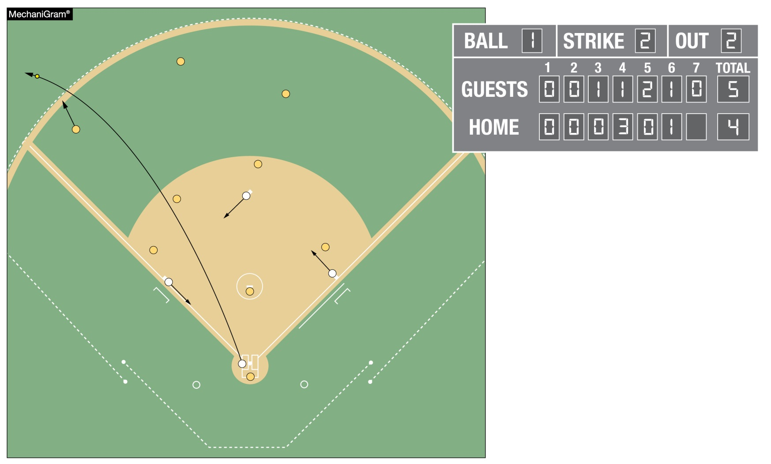
Ending a game rule 4-2-1
Allows for all runs to be counted when a fair batted ball clears the home run fence to end the game.
Notes:
Rule 4-2-1: Allows for all runs to be counted when a fair batted ball clears the home run fence to end the game.
Rationale: All runs scored by virtue of the home run will be included in individual and team statistics.

Slide 15
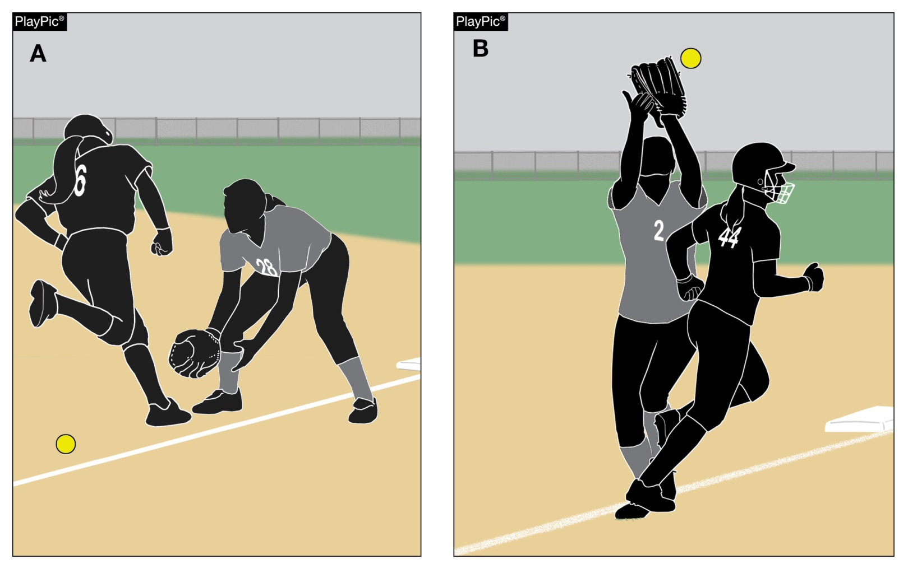
Batter-runner is out rule 8-2-7
Clarifies and further defines what constitutes batter-runner interference; including while a fielder is attempting to field a fly ball over foul territory.
Notes:
Rule 8-2-7: This clarifies batter-runner interference on a fly ball over foul territory.
Rationale: This has always been the enforcement but was not listed in the section covering batter-runner. The language is consistent with the rule covering interference on an initial play on a fair-batted ball and aligns with Rule 8-6-10.

Slide 16
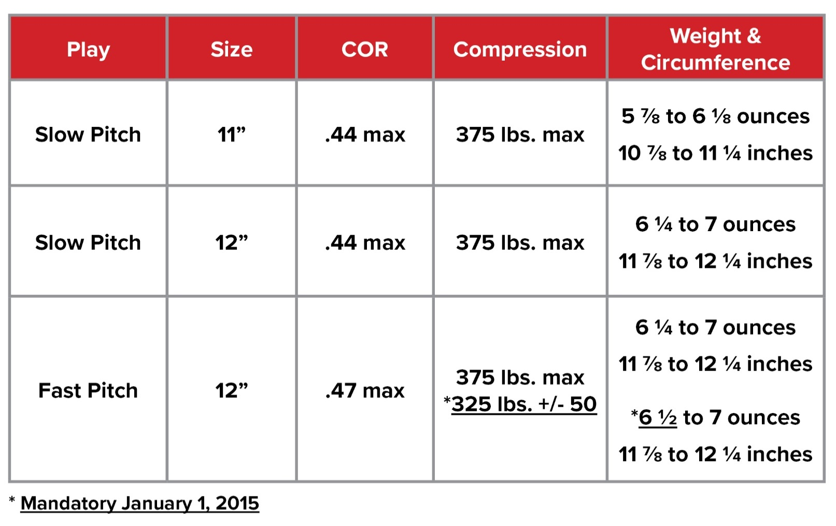
softballs
Rule 1-3-3
The new ball specifications are permissible currently and will be required January 1, 2025, for high school competition.
Balls manufactured with the current specifications will be permitted for use through 2024.
*Mandatory January 1, 2025
Notes:
Rule 1-3-3
The new ball specifications are permissible currently and will be required January 1, 2025, for high school competition.
Balls manufactured with the current specifications will be permitted for use through 2024.
Rationale: Ball tolerance specifications for the 12-inch Fast Pitch Softball have been standardized for NFHS, NCAA, and USA Softball. After conducting research on whether the minimal changes might have an impact on safety, it was determined that changing the weight from 6¼ to 6½ ounces would not increase batted ball speed. Any balls manufactured with the former specifications will be permitted through 2024, to allow for state associations manufacturers to reduce current inventory. The new ball specifications are permitted for use during the 2021-22 season and will be required by January 1, 2025.

Slide 17
2023 nfhs softball editorial CHANGES

Slide 18
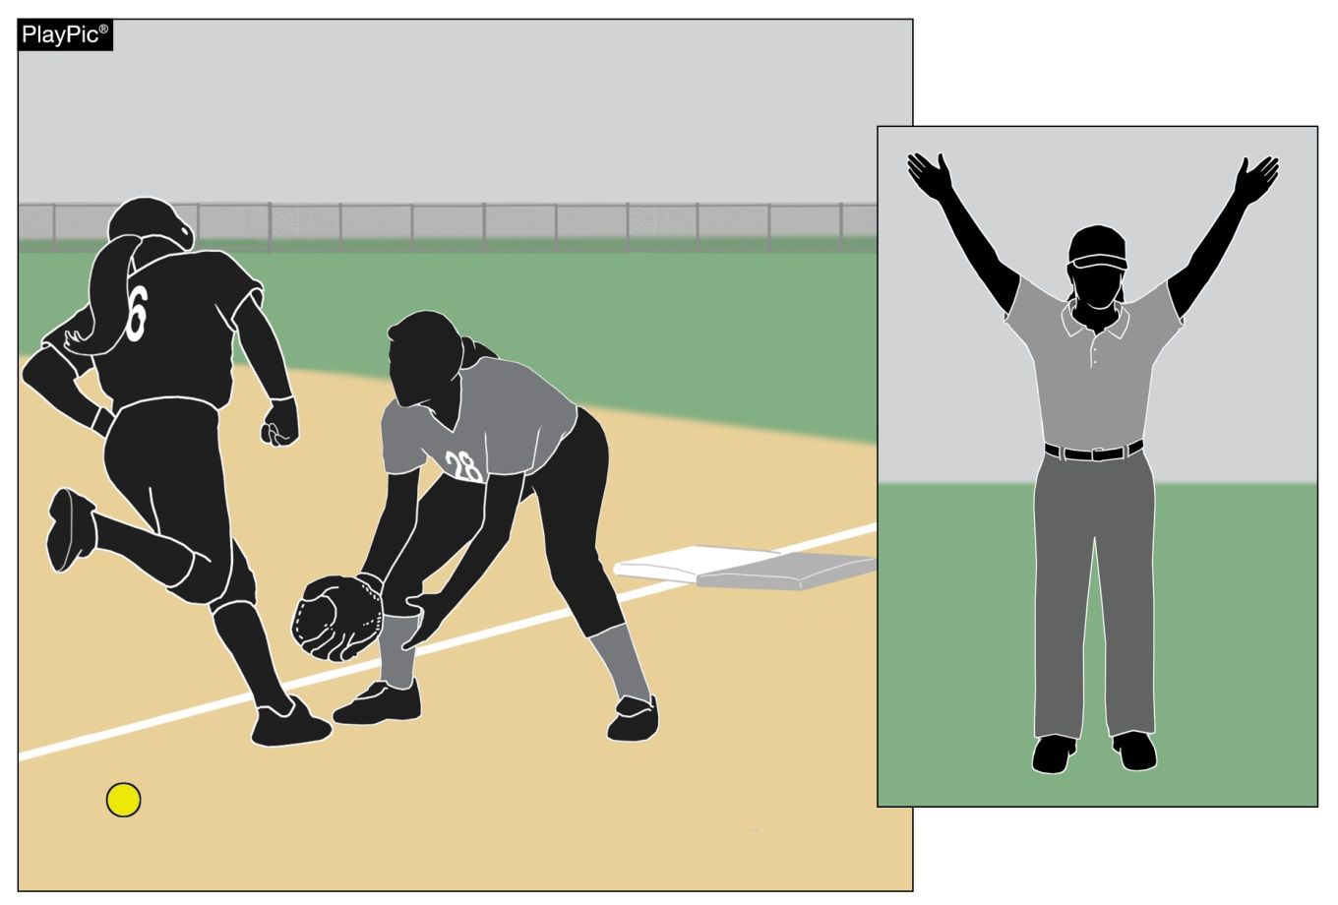
Foul, foul tip rule 2-25-1e
While over foul territory, an offensive player a runner interferes with a defensive player attempting to field a batted ball.
Notes:
Rule 2-25-1e: While over foul territory, an offensive player a runner interferes with a defensive player attempting to field a batted ball.
Rationale: Clearly defines that any offensive player can commit interference on a batted ball while over foul territory. This has always been the enforcement but by changing the word from runner to offensive player it makes the rule more inclusive and easily interpreted.

Slide 19
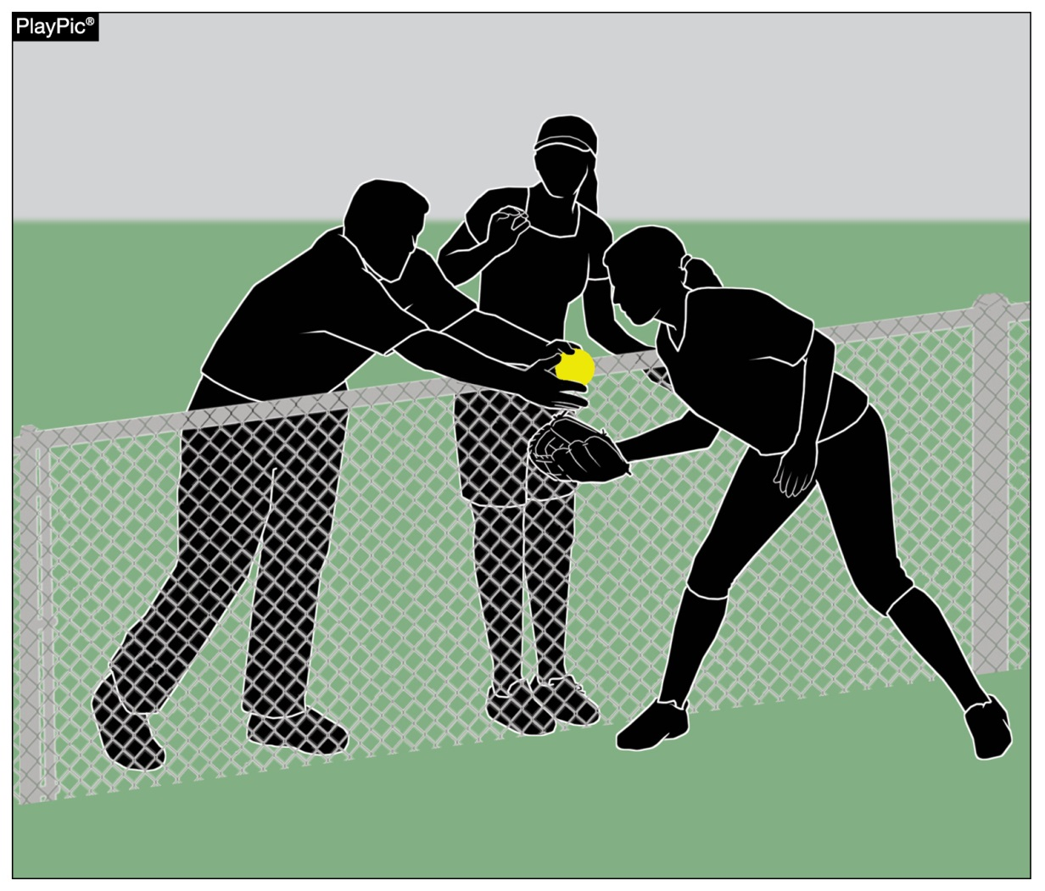
Batter is out rule 7-4-11
When a spectator reaches
into live ball territory and interferes with a fielder’s opportunity to catch a fly ball. A fair or foul (other than a foul tip, not a third strike) ball is caught in flight by a fielder or such catch is prevented by a spectator reaching into the playing area.
Notes:
Rule 7-4-11: When a spectator reaches into live ball territory and interferes with a fielder’s opportunity to catch a fly ball. A fair or foul (other than a foul tip, not a third strike) ball is caught in flight by a fielder or such catch is prevented by a spectator reaching into the playing area.
Rationale: This better defines spectator interference on a fair or foul fly ball. The previous rule language was confusing on a fly ball when there was spectator interference preventing the defense from catching the ball.

Slide 20
2023 nfhs softball points of emphasis

Slide 21
sportsmanship
NFHS playing rules are written to encourage sportsmanship. Participation in these programs should promote respect, integrity and sportsmanship.
However, for these ideals to occur, everyone involved in these programs must be doing their part.
Notes:
Sportsmanship
Good sporting behavior is one of the fundamental ingredients to the continued success and enjoyment of education-based high school sports and activities. In fact, in the 103-year history of organized high school sports in the United States, good sportsmanship has been one of the most important outcomes of high school activity programs. NFHS playing rules are written to encourage sportsmanship. Participation in these programs should promote respect, integrity and sportsmanship. However, for these ideals to occur, everyone involved in these programs must be doing their part.

Slide 22
sportsmanship
There must be a collaborative, working relationship between contest officials and game administration to promote good sportsmanship and safely conduct the contest.
Everyone has their roles to play in creating a positive, sportsmanlike atmosphere at contests.
Notes:
Sportsmanship
The NFHS is concerned that unsporting behavior in education-based athletics has increased across all sports. As a result, the NFHS has made sportsmanship the No. 1 Point of Emphasis for the 2022-23 school year. Sportsmanship, or good sporting behavior, is about treating one another with respect and exhibiting appropriate behavior. It is about being fair, honest and caring. When these types of appropriate behavior occur, competitive play is more enjoyable for everyone. Coaches set the tone at athletic contests with their display of sportsmanship. If these individuals act in a sportsmanlike manner, their behavior sets the tone for players, spectators and others. If coaches, however, are complaining constantly about the decision of contest officials, spectators are more likely to do the same. There must be a collaborative, working relationship between contest officials and game administration to promote good sportsmanship and safely conduct the contest. Everyone has their roles to play in creating a positive, sportsmanlike atmosphere at contests.

Slide 23
sportsmanship
Contest officials should never engage with spectators who are exhibiting unsporting behavior.
Once the contest begins, school administration is responsible for dealing with unruly spectators.
If spectators are using demeaning or profane language at officials – or at others in the stands – those individuals should be removed from the contest by school administration.
Notes:
Sportsmanship
Officials should focus on the actions of players, coaches and other bench/sideline personnel. A positive, open line of communication between officials and coaches ultimately results in a better contest for everyone involved. Contest officials, however, should never engage with spectators who are exhibiting unsporting behavior. Once the contest begins, school administration is responsible for dealing with unruly spectators. A proactive approach by school administration includes monitoring the behavior of spectators and intervening as needed. If spectators are using demeaning or profane language at officials – or at others in the stands – those individuals should be removed from the contest by school administration.

Slide 24
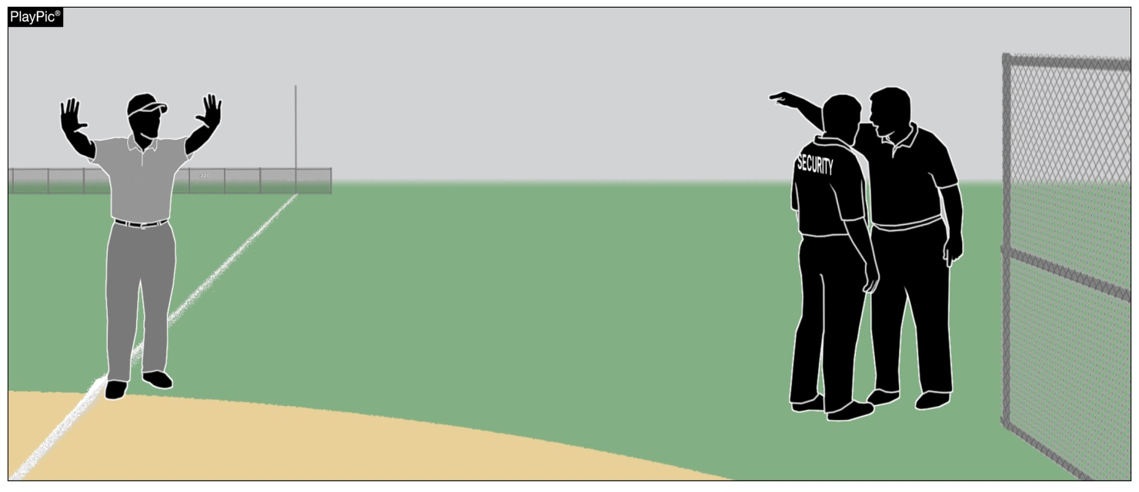
sportsmanship
Good sports win with humility, lose with grace and do both with dignity.
It takes the efforts of everyone every day to ensure that sportsmanship remains one of the top priorities in education-based activity programs.
Notes:
Sportsmanship
A proactive approach by school administration includes monitoring the behavior of spectators and intervening as needed. If spectators are using demeaning or profane language at officials – or at others in the stands – those individuals should be removed from the contest by school administration. In recent years, a heightened level of unsportsmanlike behavior has been occurring by spectators at high school sporting events, and it must be stopped. The use of demeaning language, or hate speech, by students, parents and other fans must cease. High school sports and other activities exist to lift people up, not demean or tear people down. The goal is to treat everyone fairly and treat each other with respect. Any speech or harassment that is insulting, demeaning or hurtful will not be tolerated. High schools must establish a culture that values the worth of every single person – both players on the school’s team and players on the opposing team. There must be a no-tolerance policy regarding behavior that shows disrespect for another individual. Good sports win with humility, lose with grace and do both with dignity. It takes the efforts of everyone every day to ensure that sportsmanship remains one of the top priorities in education-based activity programs.

Slide 25
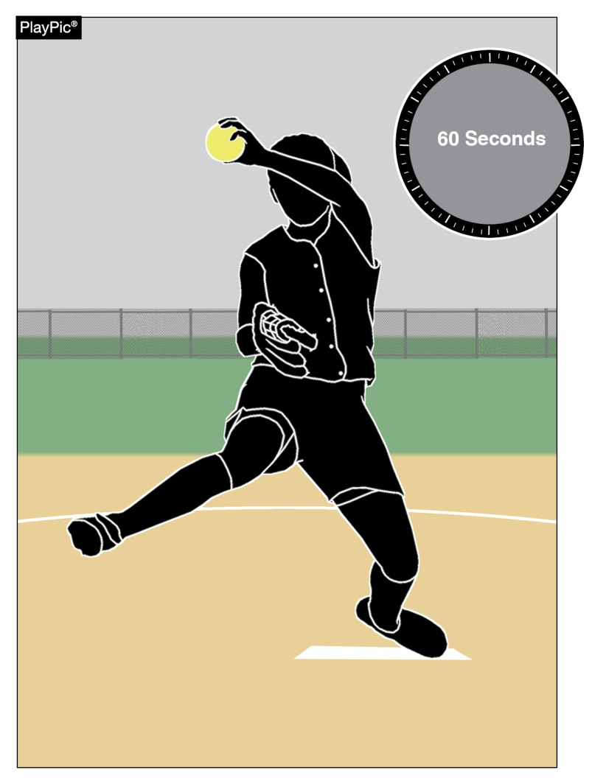
Time between innings
Umpires and coaches should pay strict attention to the 60-second time limit between half-innings.
At the beginning of each half-inning no more than one minute may be used to deliver no more than five pitches to the catcher or other teammate.
The one-minute time limit begins from the third out of the previous half-inning.
A pitcher returning to the pitching position in the same half inning will not be granted any warm-up pitches.
Umpires may authorize more pitches during inclement weather or if a pitcher was removed due to injury or by rule.
Notes:
TIME BETWEEN INNINGS
As a point of emphasis umpires and coaches should pay strict attention to the 60 second time limit between half-innings. In accordance with Rule 6-2-5 at the beginning of each half-inning no more than one minute may be used to deliver no more than five pitches to the catcher or other teammate. The one-minute time limit begins from the third out of the previous half-inning. A pitcher returning to the pitching position in the same half inning will not be granted any warm-up pitches. Umpires may authorize more pitches during inclement weather or if a pitcher was removed due to injury or by rule.

Slide 26
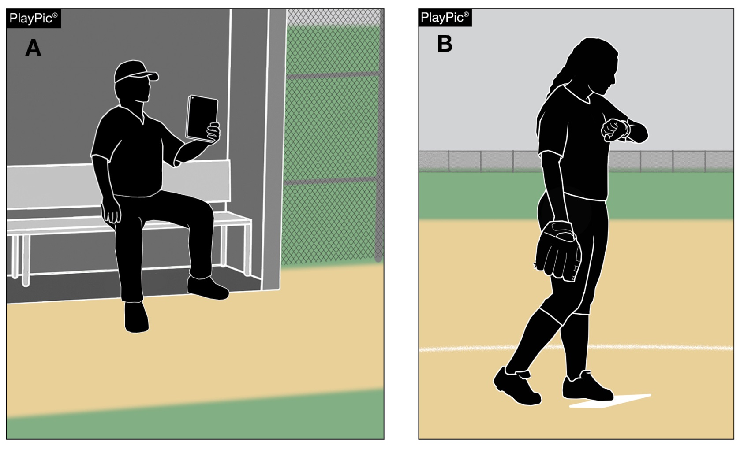
Jewelry and electronic communication
The rule prohibiting jewelry has been removed.
The rule regarding the use of electronics is still in place.
The use of electronic devices by team personnel to transmit or record information pertaining to their players or team’s performance is only permitted within the dugout.
Items such as smart watches are permitted to be utilized as a watch but cannot be used to transmit or receive data outside of the dugout.
Notes:
JEWELRY AND ELECTRONIC COMMUNICATION
The rule prohibiting jewelry has been removed allowing team personnel to now wear jewelry; however, the rule regarding the use of electronics is still in place. The use of electronic devices by team personnel to transmit or record information pertaining to their players or team’s performance is only permitted within the dugout. Items such as smart watches are permitted to be utilized as a watch but cannot be used to transmit or receive data outside of the dugout.

Slide 27
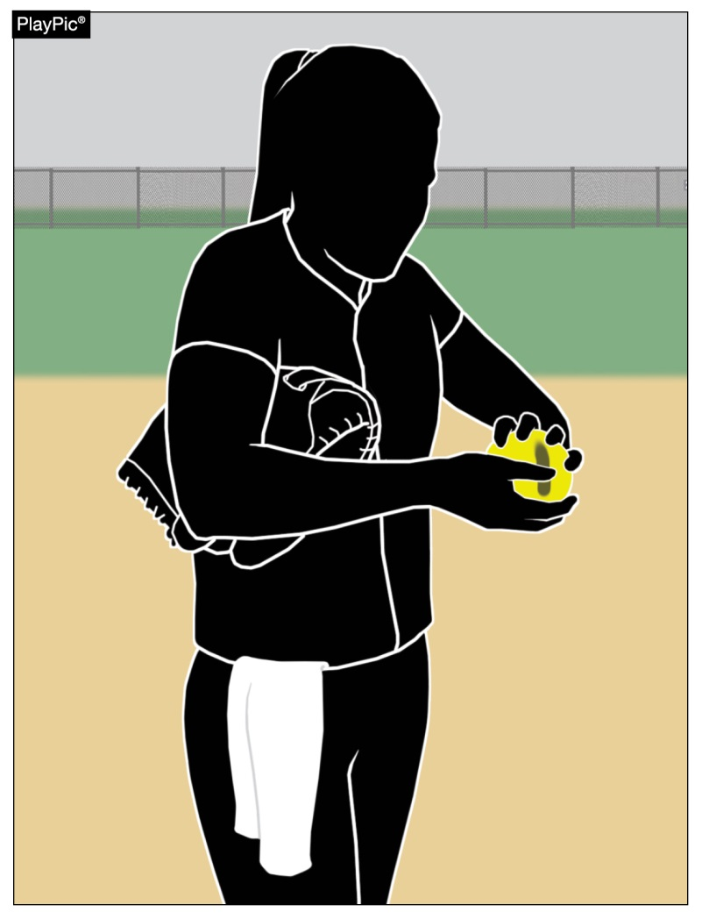
Comparable drying agents
Pitchers are not permitted to use any foreign substance on the ball or on contact points of the pitching hand or fingers.
No foreign substances may be applied to the ball.
If a pitcher licks their fingers, the player must wipe their fingers prior to touching the ball.
Comparable drying agents listed on the USA Softball website (USAsoftball.org) are permitted, and powdered rosin is also permitted.
It is not necessary to wipe off the drying agent before making contact with the ball.
Notes:
COMPARABLE DRYING AGENTS
Pitchers are not permitted to use any substance on the ball or on contact points of the pitching hand or fingers; also, no foreign substances may be applied to the ball. If a pitcher licks their fingers, the player must wipe their fingers prior to touching the ball. Comparable drying agents listed on the USA website (USAsoftball.org) are permitted, and powdered rosin is also permitted. It is not necessary to wipe off the drying agent before making contact with the ball.

Slide 28
NFHS OFFICIALS Education

Slide 29





OFFICIALS EDUCATION
Content remains free of charge
TEACHING
AIDS
RULES
CHANGES
DIAGRAMS
VIDEO
LIBRARY
OFFICIALS
COURSES
Notes:
Sport-Specific Officiating courses are offered in several sports. They are ideal for new officials and those in the first few years of officiating. These courses introduce officials to the mechanics and techniques used in the sport and provide specific information on an area within that sport. Individuals can complete a course within 30-45 minutes. These courses are free to all officials and prospective officials.
“Interscholastic Officiating” is a general course on sports officiating, and it is free to all officials and prospective officials. This course provides an introduction to skills and concepts used as an official. Several topics are covered such as: basics of becoming and staying an official, science of officiating, art of officiating, how to combine these skills for successful officiating.
Video clips are made available to NFHS Officials Association members. The video is clipped on specific topics and provides the rules references as well as dialogue on the topic.
The courses and videos are offered at www.NFHSLearn.com .
Courses Available:
Officiating Football
Officiating Volleyball – Ball Handling
Officiating Volleyball – Alignment
Officiating Volleyball – E-Whistle
Officiating Basketball
Officiating Basketball – Three-Person Mechanics
Officiating Basketball – Pre-Game Conference
Soccer – Fouls and Misconduct
Soccer – Offside
Soccer – Pre-Game Conference
Swimming and Diving
Officiating Wrestling
Umpiring Softball
Officiating Field Hockey
Officiating Track and Field
Future Courses to be Considered:
Umpiring Baseball
Umpiring Softball – 2 Person Mechanics
Communication Among Officials and Coaches

Slide 30


Future Developments
Improved Schedule View
Year Two Accomplishments
Auto-Assign
Years of Service
14
121,508
$9.2M
Enhanced Payment Capabilities
States
Registering
Officials
Contests
Assigned
Payments
Sent to
Officials
100% FREE to your state as a NFHS-Member Benefit.
Notes:
NFHS CENTER FOR OFFICIALS SERVICES (COS)
Your Complete Solution for Officials Management and More:
Registration
Assignment
Payment
Testing
Background Checks
For More Information on the NFHS – Center for Officials Services (COS) Contact:
Dana Pappas, Director of Officiating Services, dpappas@nfhs.org
Also If You’re Interested in Eligibility and Monitoring Requirements Contact
the Folks at Dragonfly:
Kirk Miller, Dragonfly, kirk@dragonflyathletics.com
Brandon Wallace, Dragonfly, brandon@dragonflyathletics.com

Slide 31
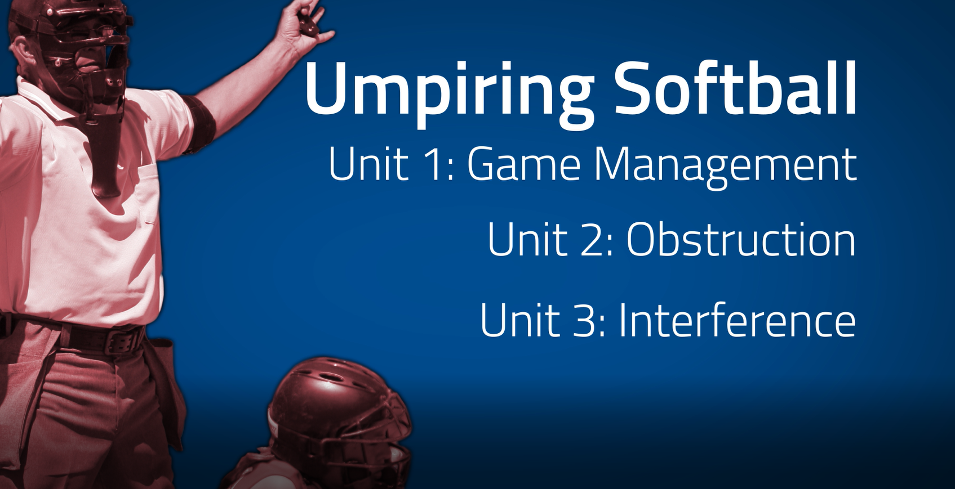
www.nfhs.org
Notes:
UMPIRING SOFTBALL
In partnership with USA Softball, the NFHS has developed the first in a line of educational softball courses. This first course addresses game management as well as obstruction and interference.

Slide 32
NFHS Learning Center

Slide 33

Notes:
The NFHS Learning Center is the home to more than 90 online professional development courses for everyone within the interscholastic community - coaches, students, officials, parents, administrators, and individuals within performing arts programs. More than 60 courses are available for free.
The NFHS is an Accredited Institution and has delivered more than 15 million courses on its NFHS Learning Center platform since its inception in 2007. In receiving national accreditation by Cognia, the NFHS has upheld itself to rigorous standards that focus on productive learning environments, equitable resource allocation that meet the needs of learners, and effective leadership.
The NFHS Learning Center features its flagship coaching course, “Fundamentals of Coaching,” as well as several health and safety courses that have been completed by millions of individuals, such as “Concussion in Sports,” “Heat Illness Prevention,” “Sudden Cardiac Arrest” and “Protecting Students from Abuse.” The NFHS Learning Center offers several national credentials that can be earned by individuals who complete specific NFHS courses. Through the School Honor Roll Program, schools can earn a physical banner to hang in their school.
To learn more and start your professional development journey, please visit the NFHS Learning Center at NFHSLearn.com.

Slide 34
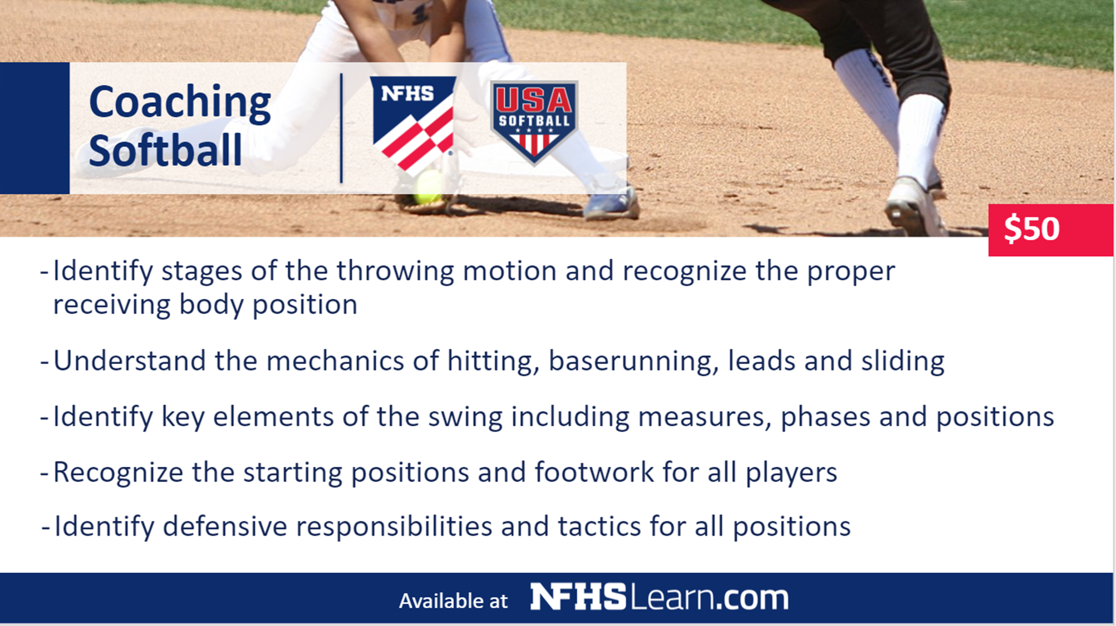



Coaching Softball
$50
Identify stages of the throwing motion and recognize the
proper receiving body position
Understand the mechanics of hitting, baserunning, leads and sliding
Identify key elements of the swing including phases and positions
Recognize the starting positions and footwork for all players
Identify defensive responsibilities and tactics for all positions
Available at
Notes:
The NFHS partnered with USA Softball to present the online Coaching Softball course. Go to www.nfhslearn.com to view the trailer, description and outline for this course, and encourage your coaches to sign-up today!

Slide 35
NFHS Network

Slide 36


NFHS Network
By 2025, every high school sporting event in America will be streamed live.
The NFHS Network will be
THE DESTINATION for fans
to view these broadcasts.
27 Different Sports and Activities.
www.NFHSnetwork.com
Notes:
The NFHS Network is the leader in streaming Live and On Demand high school sports.
Partnered with the National Federation of State High School Associations, 45 high school state athletic/activities associations, and PlayOn! Sports, the NFHS Network is a joint venture created to provide fans with the ability to stream high school sports on any device, from wherever they are.
All NFHS Network events are available to watch online at www.NFHSnetwork.com and through the NFHS Network Live App for iOS and Android. Follow us on Facebook, Twitter, Instagram, and YouTube.
Watching high school sports and events has never been easier.
The NFHS Network’s goal to broadcast live all 2 million high school sporting events by 2025.
The NFHS Network covers 27 different regular season and postseason sports, as well as other high school activities, celebrating the accomplishments of students-athletes, student broadcasters, and high schools across the country.

Slide 37


Over 1 million events this year…
Notes:
The NFHS Network will broadcast over 150,000 live events this year. If your school is not a member of the NFHS Network School Broadcast Program, please contact us at Mark.Koski@NFHSnetwork.com

Slide 38

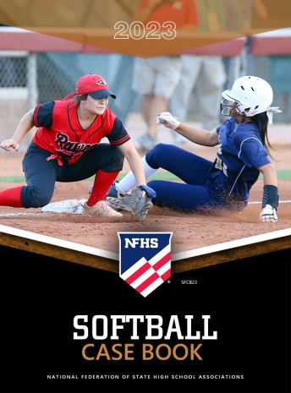



nfhs softball resources
NFHS Rules Books, Case Books
and other softball resources can be ordered:
  online at www.nfhs.com or
  by calling 1-800-776-3462
Notes:
NFHS SOFTBALL PUBLICATIONS
The NFHS softball publications are available to order online or by using the toll-free number.

Slide 39

Thank You
National Federation of State High School Associations
PO Box 690 | Indianapolis, IN 46206
Phone: 317-972-6900 | Fax: 317.822.5700
www.nfhs.org | www.nfhslearn.com | www.nfhsnetwork.com

