Slide 1
2022-23 Soccer Rules PowerPoint
Rules Changes
Major Editorial Changes
Points of Emphasis
Copyright© 2022 National Federation of State High School Associations. All Rights Reserved.
This copyrighted power point is presented by the NFHS. This material shall only be reproduced or distributed by member state associations for teaching and training purposes. Distribution to the public is prohibited without the express written consent from the NFHS. Please contact Davis Whitfield, COO at dwhitfield@nfhs.org with requests.

Slide 2

National Federation of
State High School Associations
NFHS (located in Indianapolis, IN – Est. 1920):
  National leader and advocate for
  high school athletics and
  performing arts programs.
  Serves 51 state associations, 19,500
  high schools and 12 million student
  participants.
  Writes playing rules for 17 high school
  sports for boys and girls.
  Offers online education courses for high school coaches,
  officials, parents, students and others.
  Ensures that students have opportunity to enjoy healthy participation, achievement and good sportsmanship in education-based athletics.
Notes:
The NFHS is the national leadership organization for high school sports and fine arts activities;
We serve as the National authority on interscholastic sports and activities; conduct national meetings; sanctions interstate events; produces national publication for high school administrators;
National source for interscholastic coach training and national information center.
VISION - It is the vision of the NFHS to help prepare tomorrow’s leaders for the next level of life through the many program offerings in education-based athletics and activities.
The National Federation of State High School Associations (NFHS) is the national leader for education-based high school athletics and activities,
which prepare tomorrow’s leaders for the next level of life through innovative programs, healthy participation, achievement, and development of positive relationships.
MISSION - A significant responsibility of the NFHS is the commitment to writing quality playing rules.
The National Federation of State High School Associations (NFHS) serves its members by providing leadership for the administration of education-based high school athletics and activities
through the writing of playing rules that emphasize health and safety, educational programs that develop leaders, and administrative support to increase participation opportunities and promote sportsmanship.
NFHS Membership includes 50-member state associations plus the District of Columbia.
Our membership is split into 8 different sections which are depicted in this map you see here.
The NFHS reaches more almost 20,000 high schools and 12 million participants throughout the 8 NFHS sections across the U.S.

Slide 3









NFHS Rules Review Committee
The NFHS Rules Review Committee is chaired by the chief operating officer and composed of all rules editors. After each committee concludes its deliberations and has adopted its recommended changes for the subsequent year, such revisions will be evaluated by the Rules Review Committee.
Davis Whitfield
Chief Operating Officer
Lindsey Atkinson
Girls Lacrosse and Volleyball
Bob Colgate
Football and Sports
Medicine
Sandy Searcy
Softball, Swimming & Diving and Water Polo
Elliot Hopkins
Baseball and Wrestling
Julie Cochran
Cross Country, Gymnastics, Field Hockey and
Track & Field
James Weaver
Boys Lacrosse
and Spirit
Theresia Wynns
Basketball and Soccer
Dan Schuster
Ice Hockey

Slide 4
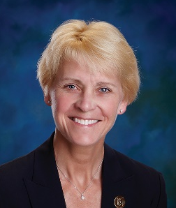
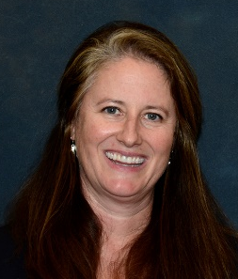









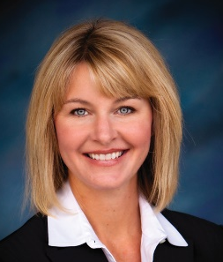
NFhS Rules Committee
Dr. Karissa Niehoff
NFHS
Publisher
Julie Cochran
NFHS
Editor
Dr. Stan Latta
State College, PA
Chair- 2025
Mark Berkowitz
Weston, CT
Coaches- 2022
Gibby Reynolds
Wilsonville, OR
Officials- 2024
Mike Andrew
Binghamton, NY
Section 1- 2024
John Johnson
Wadsworth, OH
Section 2- 2022
Marvin Chou
Montgomery, AL
Section 3- 2025
Andy Frushour
East Lansing, MI
Section 4- 2022
Saul Hernandez
Dodge City, KS
Section 5- 2025
Joey Walters
North Little Rock, AR
Section 6- 2024
Daniel Klein
Mesa, AZ
Section 7- 2023
Julie Hammons
Boise, ID
Section 8- 2025

Slide 5

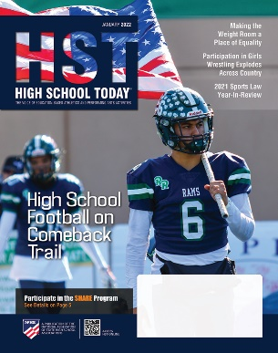

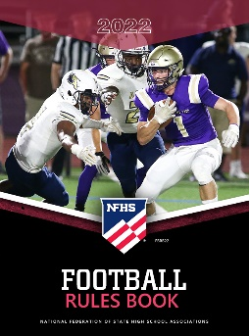



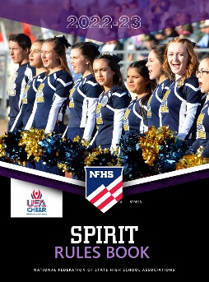


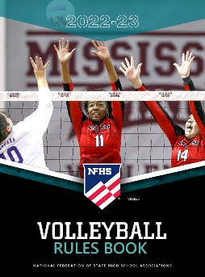







National Federation of
State High School Associations
The NFHS writes playing rules for 17 sports
for boys and girls at the high school level.
  Publishes 4 million pieces of materials annually.
Notes:
The NFHS writes rules for 17 sports, publishes High School Today along with several other key publications totaling over 4 million pieces annually.

Slide 6
2022-2023 nfhs soccer RULES CHANGES

Slide 7
OTHER EQUIPMENT
4-2-2
Hair control devices and other adornments worn in the hair must meet the following criteria:
Be securely fastened to the head.
Do not present an increased risk to the player, teammates or opponent.
This change promotes the inclusion of participants based on their cultural and religious beliefs.
Notes:
Hair control devices and other adornments worn in the hair must meet the following criteria:
Be securely fastened to the head.
Do not present an increased risk to the player, teammates or opponent.
This change promotes the inclusion of participants based on their cultural and religious beliefs.
Rationale: Creates inclusivity of hair styles while maintaining that the risk of injury to the athlete, teammates and opponents should not be compromised.

Slide 8
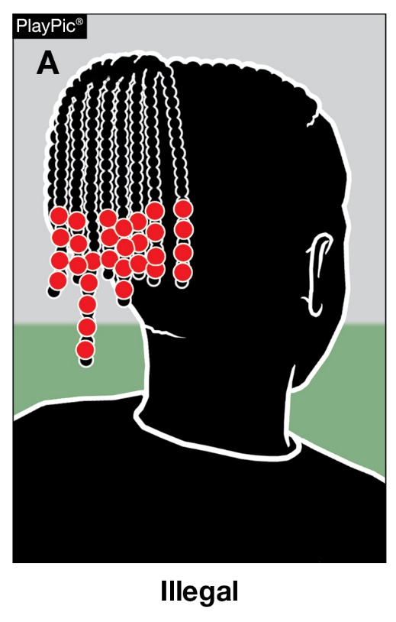
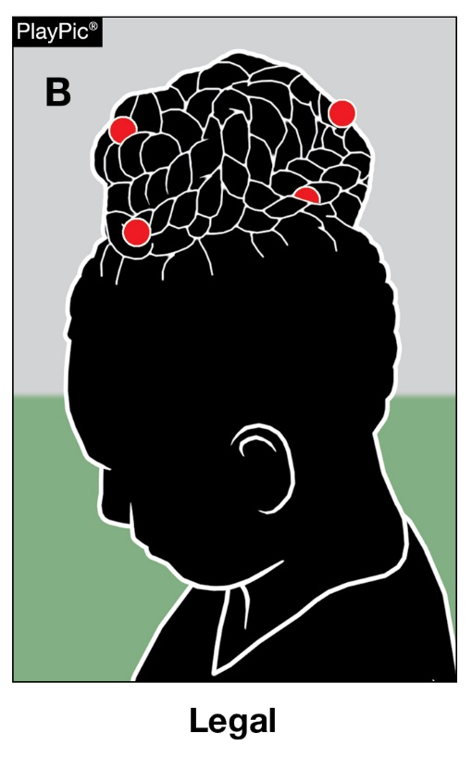
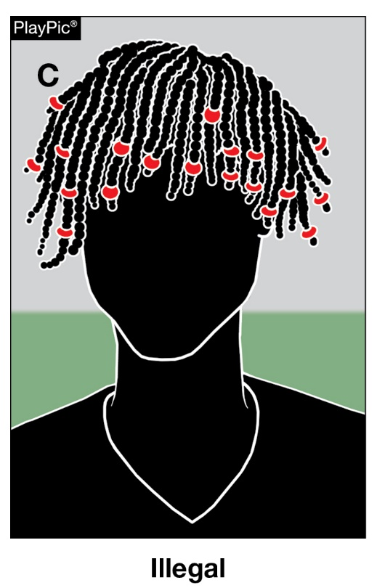
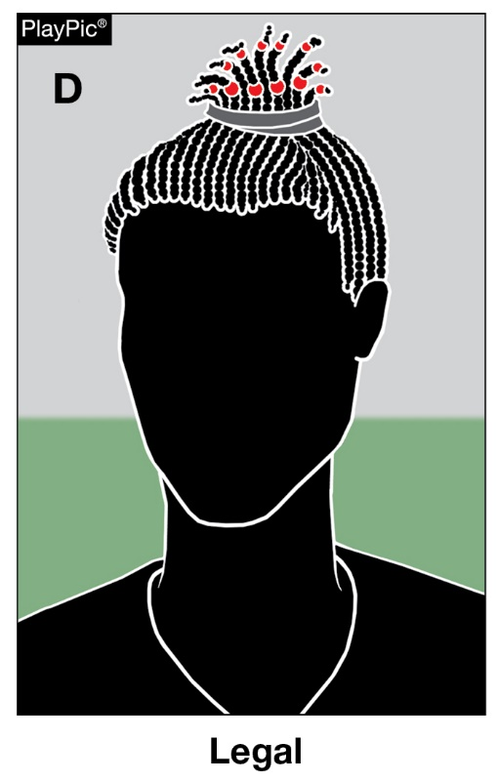
OTHER EQUIPMENT
4-2-2
In PlayPics A and C, the beads worn by each player are not securely fastened to the head. In PlayPic B and D, the beads worn are securely fastened to the head.
Notes:
Hair adornments that are securely fastened and do not increase risk to the player, teammates or opponents are permitted.
Rationale: Creates inclusivity of hair styles while maintaining that the risk of injury to the athlete, teammates and opponents should not be compromised.

Slide 9
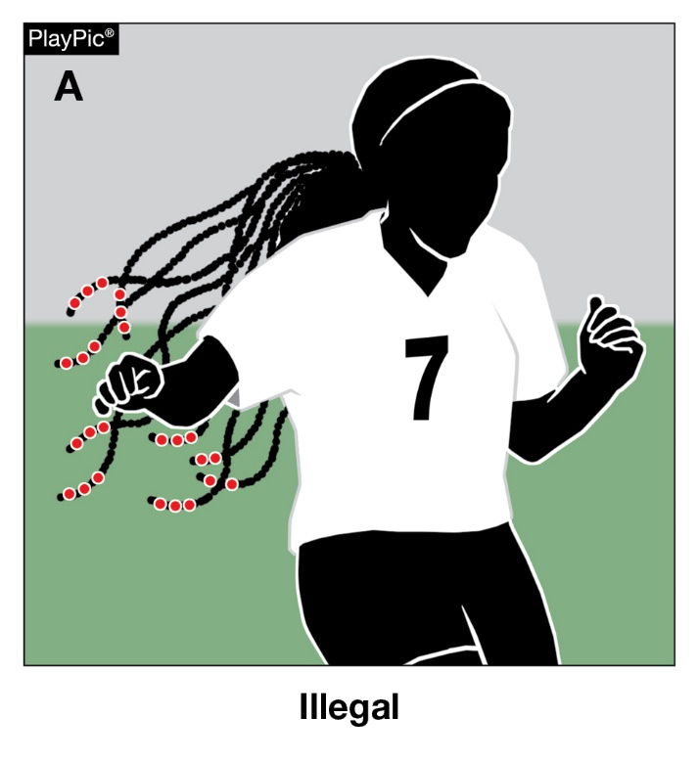
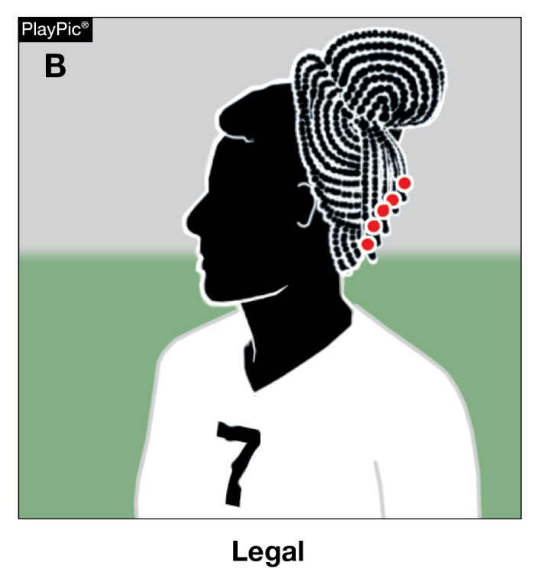
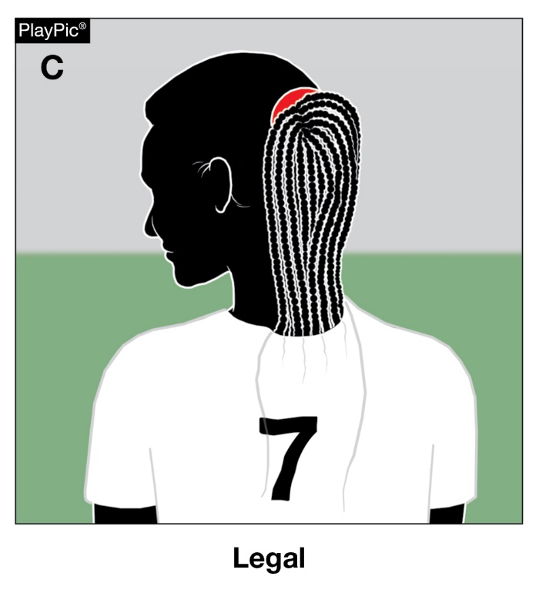
OTHER EQUIPMENT
4-2-2
In PlayPics A, the player cannot participate with the hair adornments worn in the current position since the adornments are not securely fastened to the head. Play Pics B and C are options to make legal.
Notes:
Hair put into a bun brings hair into compliance.
Hair tucked into the jersey or covered brings hair into compliance.
Rationale: Creates inclusivity of hair styles while maintaining that the risk of injury to the athlete, teammates and opponents should not be compromised.

Slide 10
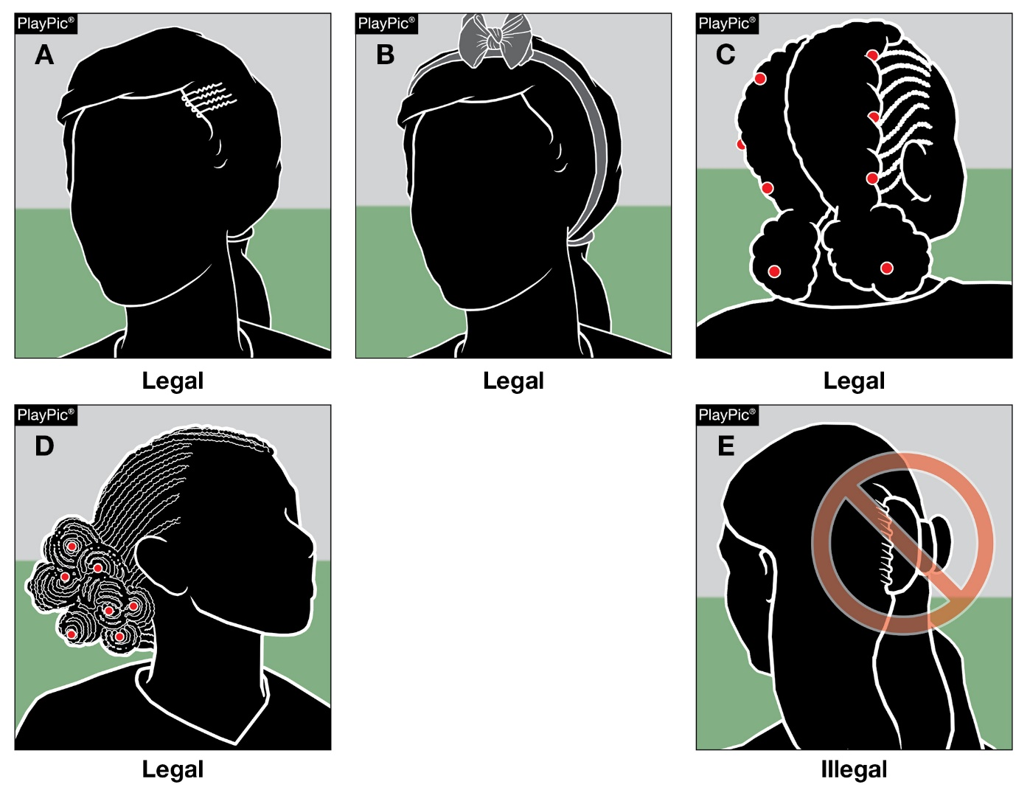
OTHER EQUIPMENT
4-2-2
In PlayPics A, B, C and D, the hair control devices worn are securely fastened and are legal.
In PlayPic E, the hair control device is illegal as it is not securely fastened to the head.
Notes:
Hair control devices that are securely fastened and do not increase risk to the athlete, teammates and opponents are permitted.
Hair clips that are hard, protrude from the head and/or are easily dislodged do not comply and are not legal.
Rationale: Creates inclusivity of hair styles while maintaining that the risk of injury to the athlete, teammates and opponents should not be compromised.

Slide 11
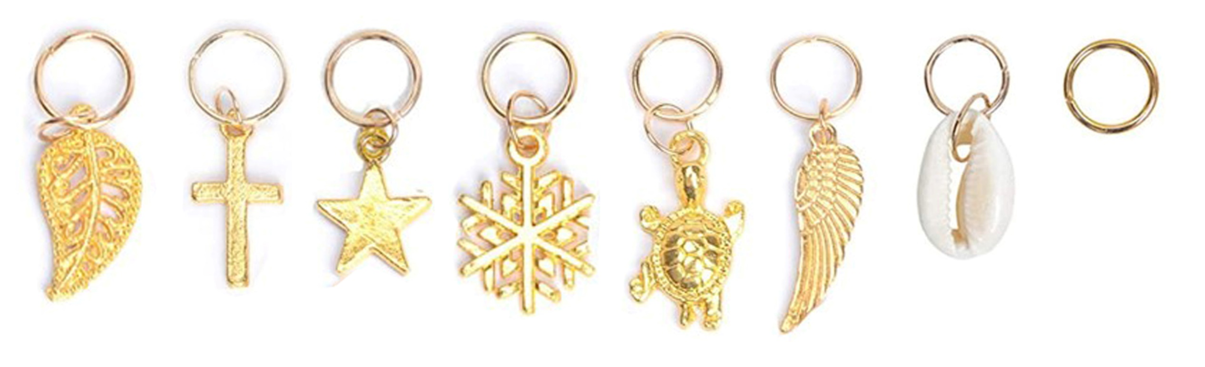
Equipment and accessories
4-1-6a
Hair charms are considered jewelry and per rule 4-1-7 would not be permitted.
Notes:
Hair charms are considered jewelry and per rule 4-2-4 would not be permitted.
Rationale: Maintains consistency that charms worn in the hair are considered jewelry and are not allowed.

Slide 12
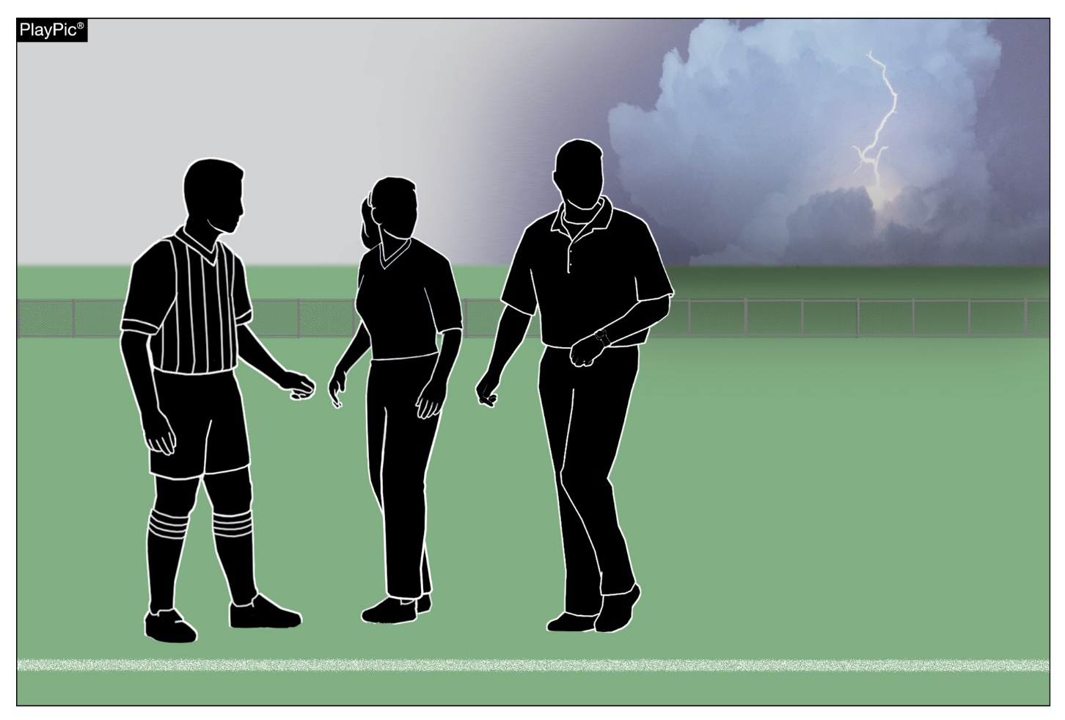
Suspended game
7-1-3
State associations may adopt game-ending procedures for suspended game.
Unless set forth by state association adoption, unless tied, it is an official game if one complete half or more of the game has been played.
State association procedures also govern games in which one complete half has not been completed
Notes:
State associations may adopt game-ending procedures for suspended game.
Unless set forth by state association adoption, unless tied, it is an official game if one complete half or more of the game has been played.
State association procedures also govern games in which one complete half has not been completed
Rationale: This allows states that may require the game to be played in its entirety (for post-season or regular season seeding play), to do so without a conflict with the current rule.

Slide 13
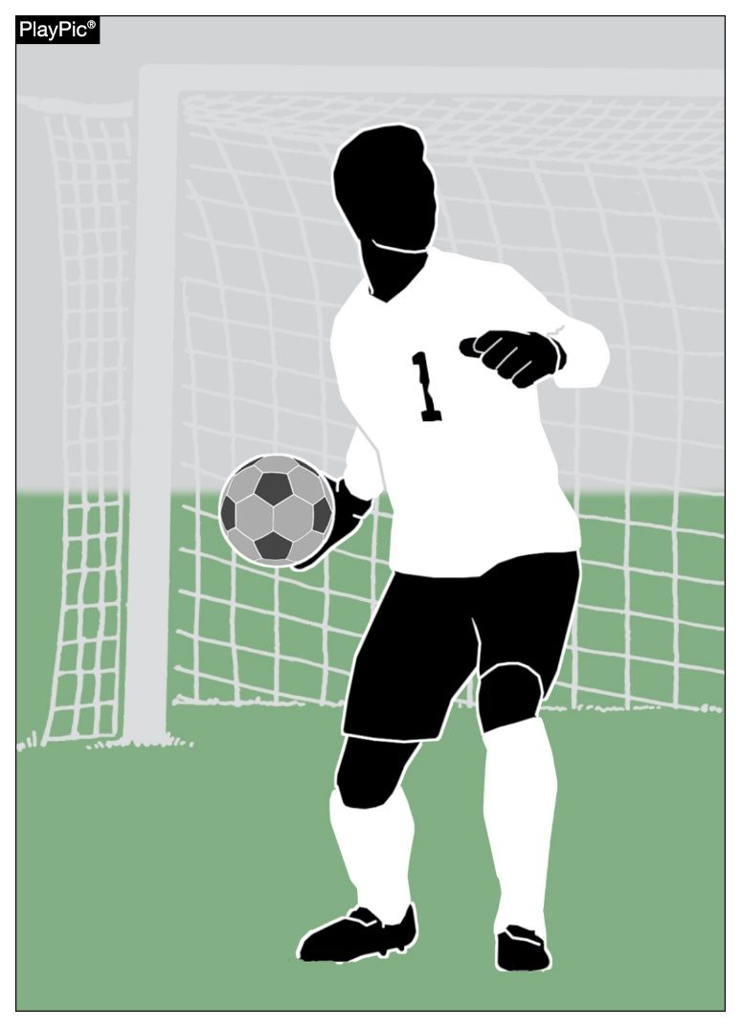
GOALS
10-1-2f, 10-1-3h new
A goal may not be scored directly from a goalkeeper’s throw into the opponent’s goal.
A goal may be scored for the opponents when a goalkeeper throws the ball into the team’s own goal.
Notes:
A goal may not be scored directly from a goalkeeper’s throw into the opponent’s goal.
A goal may be scored for the opponents when a goalkeeper throws the ball into the team’s own goal.
Rationale: Defined the outcomes on a goalkeeper’s throw when throwing the ball directly or own goal.

Slide 14
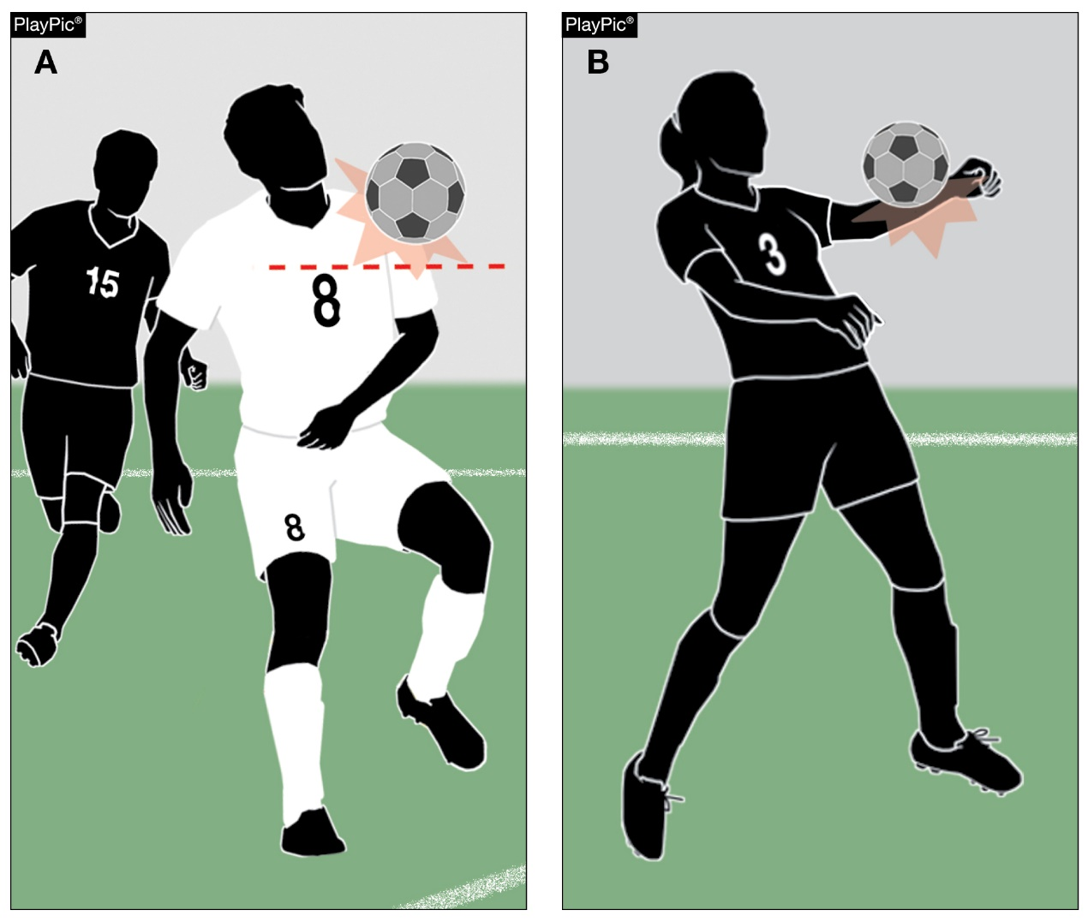
Handling
12-2
For the purposes of determining handling offences, the upper boundary of the arm is in line with the bottom of the armpit.
Notes:
For the purposes of determining handling offences, the upper boundary of the arm is in line with the bottom of the armpit.
Rationale: Defines the arm for the purposes of determining handling and offside.

Slide 15
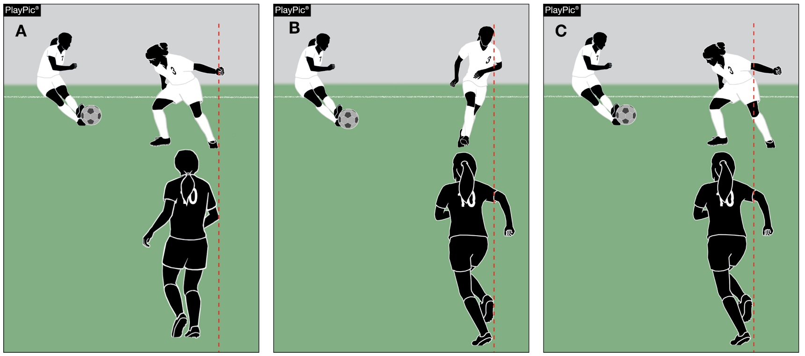
Offside definitions of playing terms
11-1-1, 18-1-1s
In PlayPic A, offside is judged by the upper boundary of #10’s arm — in line with the bottom of the armpit compared to #3 of the attacking team. #3 of the attacking team is not offside.
In PlayPic B, even though #10’s right arm is beyond #3’s left shoulder, #3 is offside. The position of the hand/lower arm is not considered when determining offside.
In PlayPic C, even though part of #10’s hand/lower arm is beyond #3’s left leg, #3 is offside.
For the purposes of determining offside, the upper boundary of the arm is in line with the bottom of the armpit.
Notes:
In PlayPic A, offside is judged by the upper boundary of #10’s arm — in line with the bottom of the armpit compared to #3 of the attacking team. #3 of the attacking team is not offside.
In PlayPic B, even though #10’s right arm is beyond #3’s left shoulder, #3 is offside. The position of the hand/lower arm is not considered when determining offside.
In PlayPic C, even though part of #10’s hand/lower arm is beyond #3’s left leg, #3 is offside.
Rationale: Defines the arm for the purposes of determining handling and offside.

Slide 16
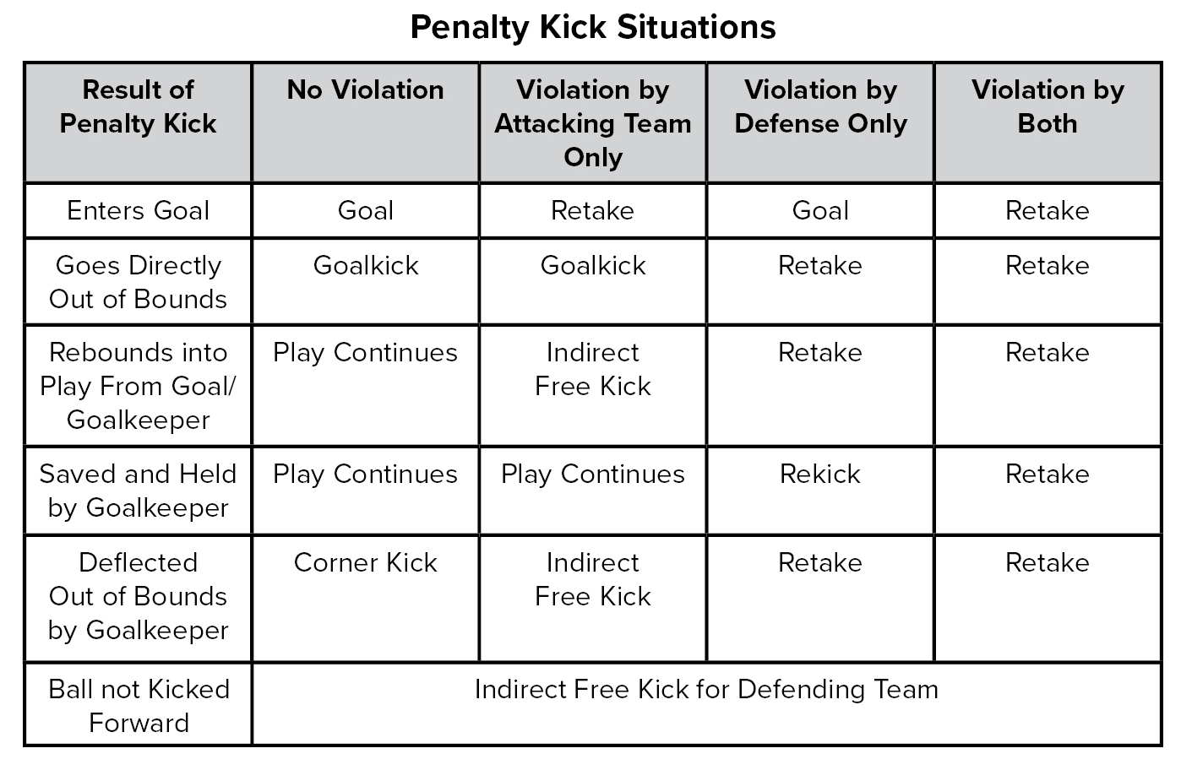
Penalty kick
14-1 penalty
When the ball is not kicked forward on a penalty kick, the defending team is now awarded an indirect free kick. The penalty kick is no longer retaken in this instance.
Additionally, language changes were made to the Penalty Kick Situations Chart to more accurately describe a kick taken again as a Retake.
Notes:
When the ball is not kicked forward on a penalty kick, the defending team is now awarded an indirect free kick. The penalty kick is no longer retaken in this instance.
Additionally, language changes were made to the Penalty Kick Situations Chart to more accurately describe a kick taken again as a Retake.
Rationale: Penalizes the kicking team for not kicking the ball forward on penalty kick.

Slide 17
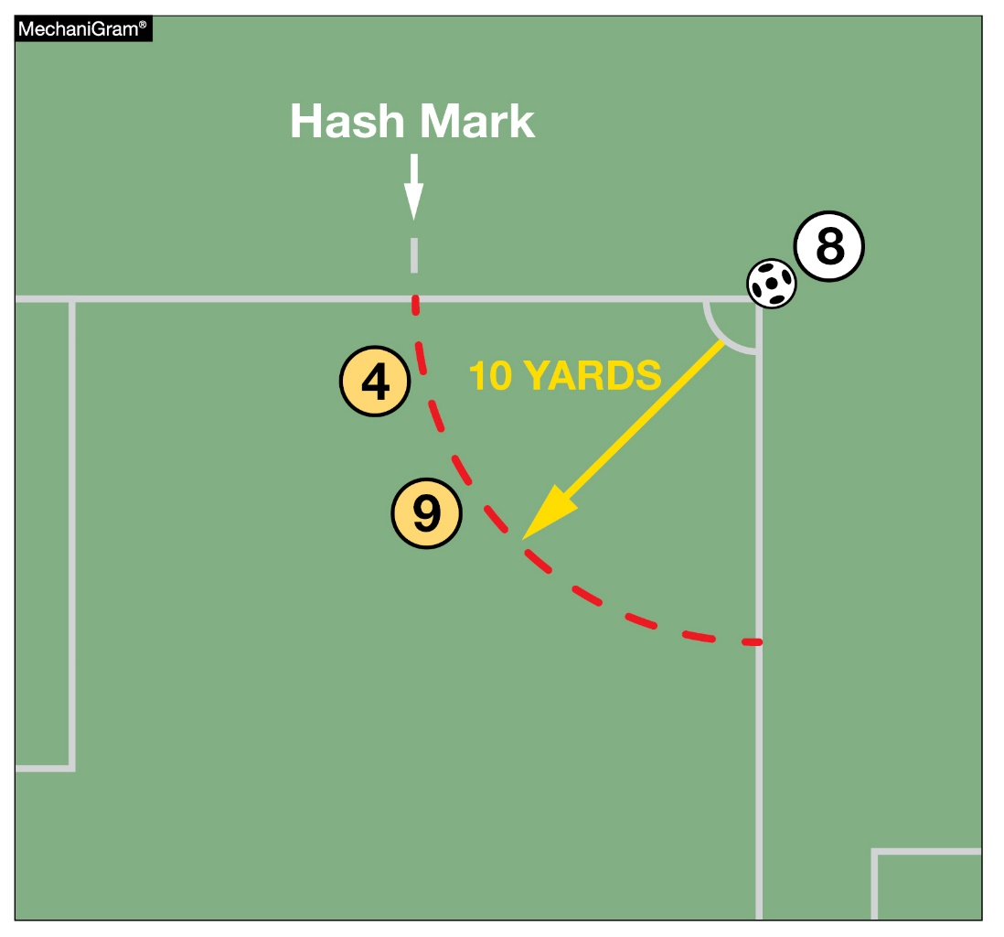
Corner kick
17-1-2, 17-1-3
Players of the defending team shall be at least 10 yards from the corner arc circle until the ball has been kicked.
The distance is now measured from the corner arc instead of the ball.
Notes:
Players of the defending team shall be at least 10 yards from the corner arc circle until the ball has been kicked.
The distance is now measured from the corner arc instead of the ball.
Rationale: Clarifies the proper distance for the opposing team on a corner kick.

Slide 18
2022-2023 NFHS soccer editorial changes

Slide 19
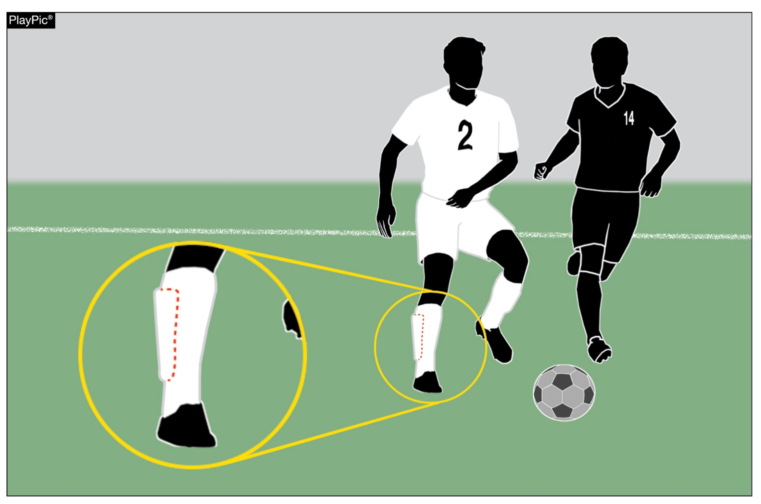
Required equipment
4-1-1
4-1-1 was reorganized to assist with easier flow and understanding.
Shinguards must:
Provide adequate and reasonable protection.
Be professionally manufactured.
Be age and size-appropriate.
Not be altered to decrease protection.
Be worn under the socks and worn with the bottom edge no higher than 2 inches about the ankle.
Meet the NOCSAE standards at the time of manufacture.
Additionally, shinguards must be worn properly.
Notes:
4-1-1 was reorganized to assist with easier flow and understanding.
Shinguards must:
Provide adequate and reasonable protection.
Be professionally manufactured.
Be age and size-appropriate.
Not be altered to decrease protection.
Be worn under the socks and worn with the bottom edge no higher than 2 inches about the ankle.
Meet the NOCSAE standards at the time of manufacture.
Additionally, shinguards must be worn properly.
Rationale: A reorganization of the uniform rule to assist with easier flow and understanding

Slide 20
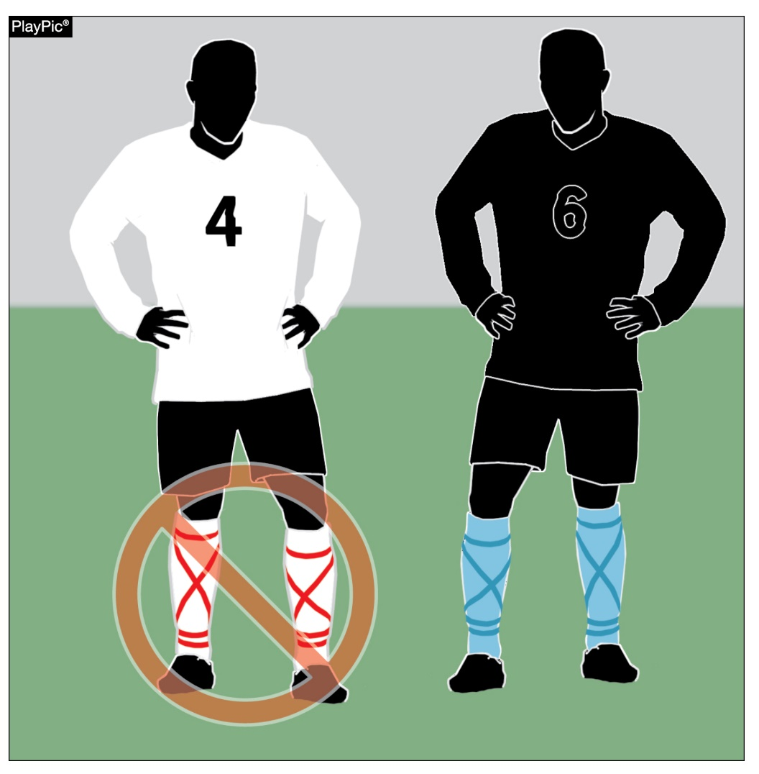
Required equipment
4-1-1 (SOCKS)
Teammates shall wear the same-colored socks.
Visiting team players wear solid white socks
Home team players wear socks of a single dominant color, but not necessarily the color of the jersey.
If tape or a similar material (stays/straps) is applied externally to the socks, it must be of similar color as that part of the sock to which it is applied.
If sock is modified by cutting off the foot of the sock, then any visible material worn under the sock and above the ankle must be of similar color to the predominant color of the sock.
Notes:
ART. 1 . . . The required player equipment includes a jersey, shorts, socks, suitable shoes and shinguards. With the exception of socks, equipment shall not be modified from its original manufactured state and shall be worn in the manner the manufacturer intended it to be worn.
Teammates shall wear the same-colored socks.
Visiting team players wear solid white socks
Home team players wear socks of a single dominant color, but not necessarily the color of the jersey.
If tape or a similar material (stays/straps) is applied externally to the socks, it must be of similar color as that part of the sock to which it is applied.
If sock bottoms are modified by cutting off the foot of the sock then any visible material worn under the sock and above the ankle must be of similar color to the predominant color of the sock.
Rationale: A reorganization of the uniform rule to assist with easier flow and understanding.

Slide 21
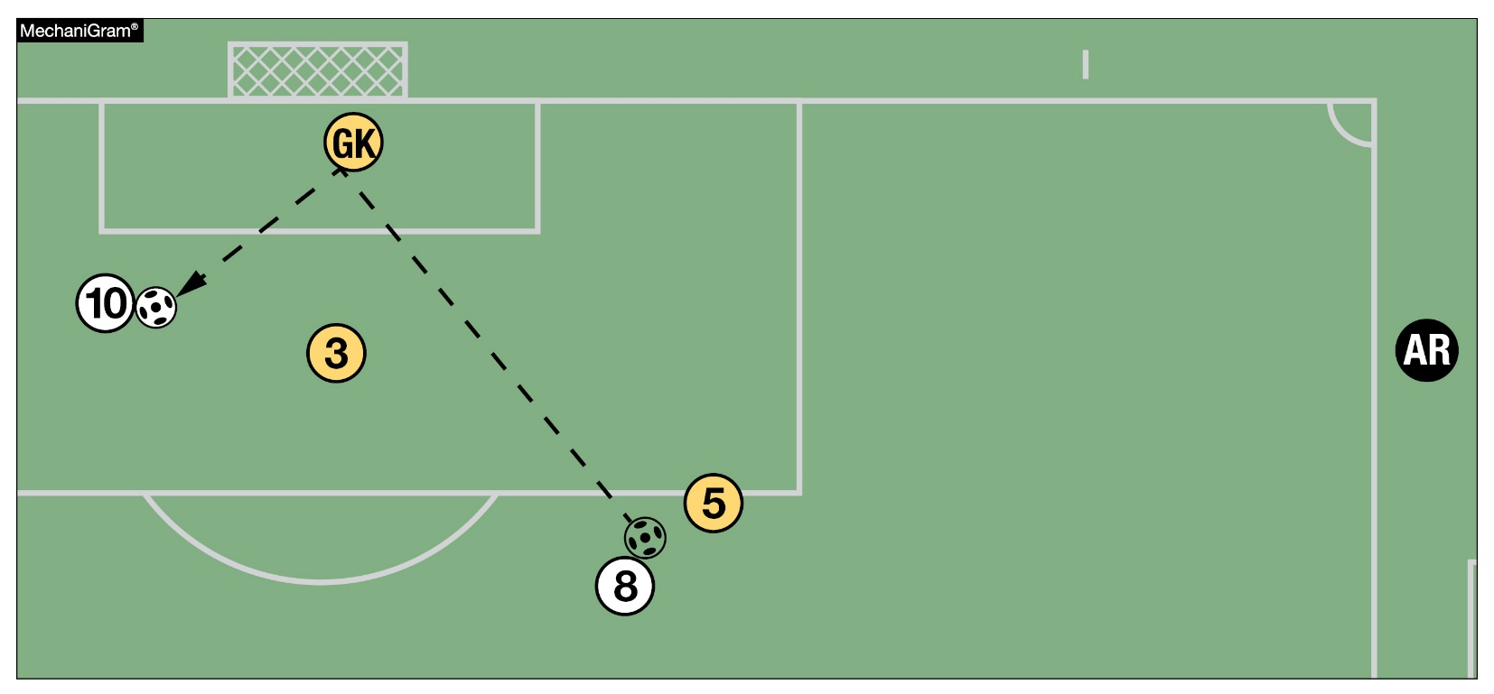
Offside
11-1-4b
11-1-4b was revised to clarify that offside shall be ruled if the player is gaining an advantage by being in an offside position.
In this MechaniGram, A10 is offside since the player is receiving the ball from a deliberate save by the goalkeeper.
Notes:
11-1-4b was revised to clarify that offside shall be ruled if the player is gaining an advantage by being in an offside position.
In this MechaniGram, A10 is offside since the player is receiving the ball from a deliberate save by the goalkeeper.
Rationale: Consistent language throughout the book and better understanding that the player is gaining an advantage.

Slide 22
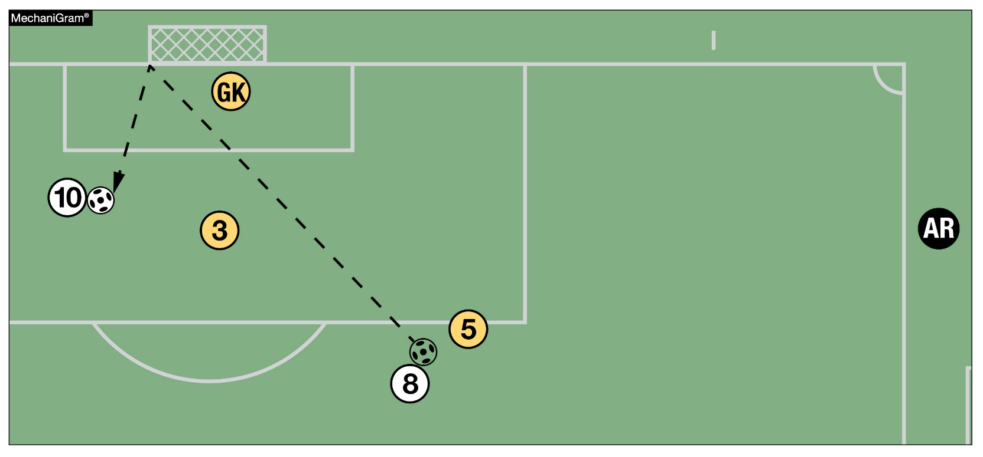
Offside
11-1-4b
11-1-4b was revised to clarify that offside shall be ruled if the player is gaining an advantage by being in an offside position.
In this MechaniGram, A10 is offside since the player is gaining an advantage by playing the ball after it hits the post.
Notes:
In this MechaniGram, A10 is offside since the player is gaining an advantage by playing the ball after it hits the post.

Slide 23
Points of emphasis

Slide 24
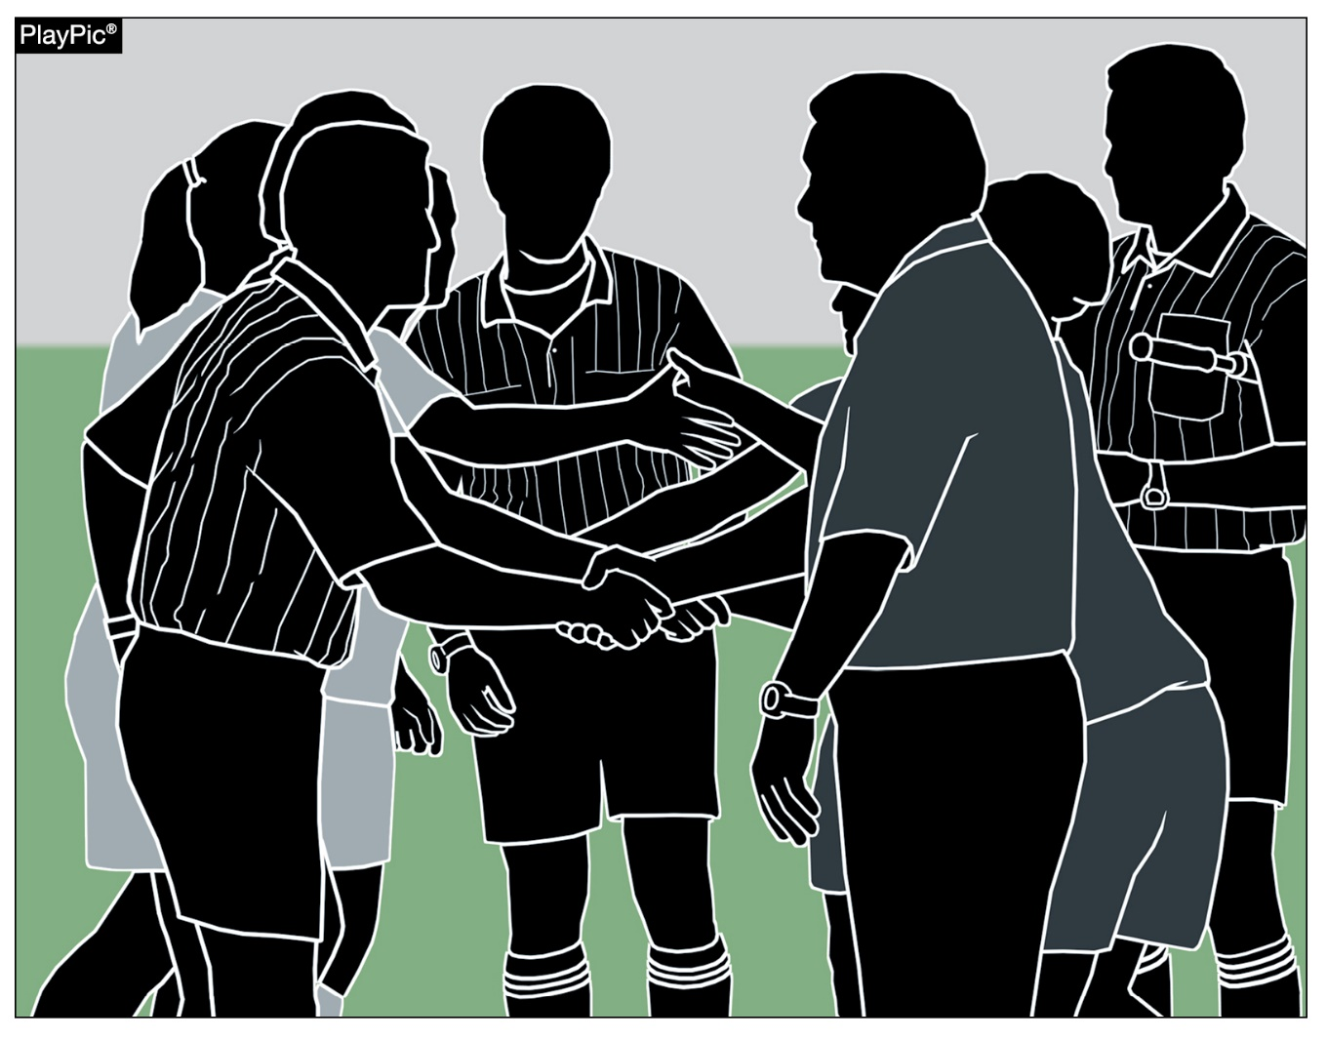
sportsmanship
The NFHS is concerned that unsporting behavior in education-based athletic has increased across all sports. As a result, the NFHS has made sportsmanship the no. 1 Point of Emphasis for the 2022-23 school year.
The interscholastic coach is responsible for setting the tone at athletic contests and must act in a sportsmanlike manner.
If coaches are complaining constantly about the decision of contest officials, spectators are likely to do the same.
Notes:
The NFHS is concerned that unsporting behavior in education-based athletic has increased across all sports. As a result, the NFHS has made sportsmanship the no. 1 Point of Emphasis for the 2022-23 school year.
The interscholastic coach is responsible for setting the tone at athletic contests and must act in a sportsmanlike manner.
If coaches are complaining constantly about the decision of contest officials, spectators are likely to do the same.

Slide 25
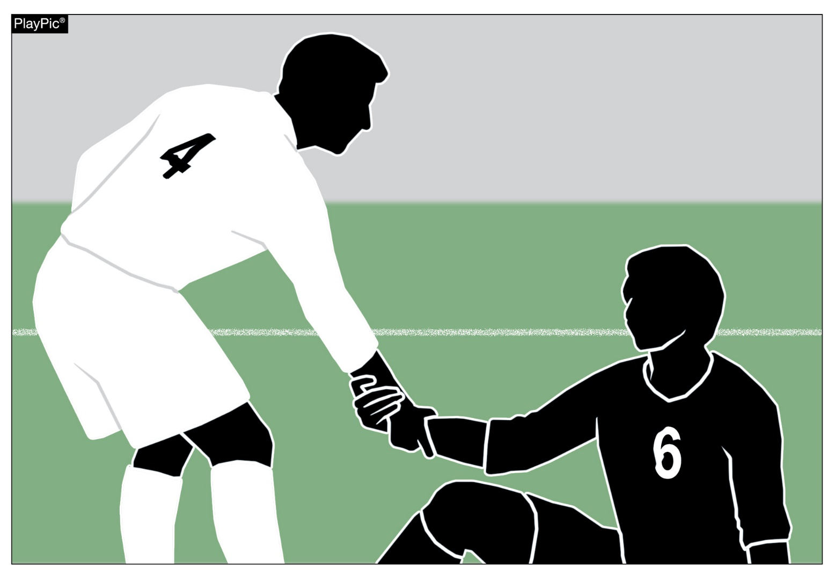
sportsmanship
A positive, open line of communication between officials and coaches ultimately leads to better behavior by student-athletes.
Good sporting behavior is expected before, during and after every contest.
Notes:
A positive, open line of communication between officials and coaches ultimately leads to better behavior by student-athletes.
Good sporting behavior is expected before, during and after every contest.

Slide 26
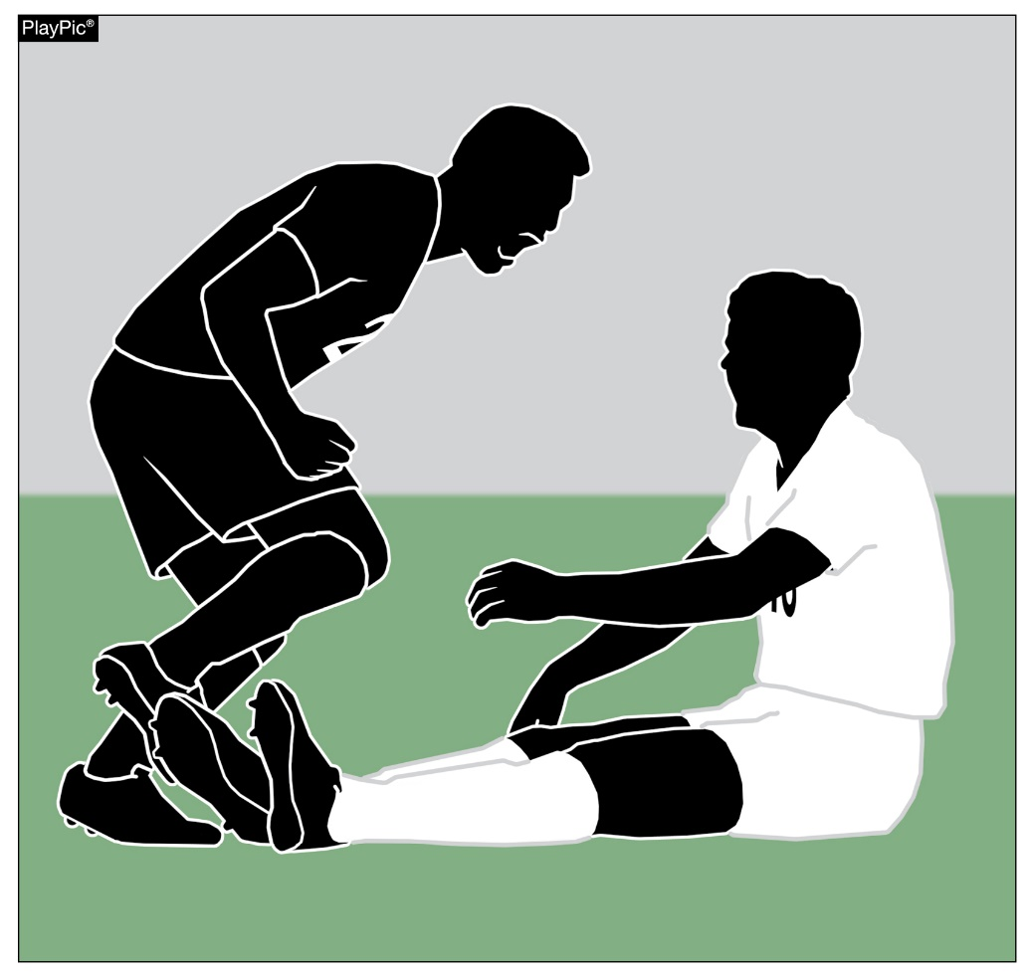
sportsmanship
Contest officials should never engage with spectators who are exhibiting unsporting behavior. Instead, school administration, or in their absence, the home team’s head coach is responsible for dealing with unruly spectators.
The NFHS is concerned about unsporting behavior inhibiting the recruitment and retainment of officials.
In addition, an environment with demeaning language, taunting and/or hate speech directed at players does not further the mission of education-based activity programs.
Notes:
Contest officials should never engage with spectators who are exhibiting unsporting behavior. Instead, school administration, or in their absence, the home team’s head coach is responsible for dealing with unruly spectators.
The NFHS is concerned about unsporting behavior inhibiting the recruitment and retainment of officials.
In addition, an environment with demeaning language, taunting and/or hate speech directed at players does not further the mission of education-based activity programs.

Slide 27
Strategic time-wasting techniques
Time-wasting techniques disrupt the flow of the game and allow a team to gain an unfair advantage.
Officials must be aware of these tactics including:
Goalkeepers holding the ball for longer than 6 seconds before releasing the ball into play.
Delays on restarts such as free kicks or throw-ins. For example, when players take unnecessary time to set up a free kick or throw-in by re-tying their shoe or adjusting their uniform.
Team excessively substituting before the 5-minute rule applies.
Notes:
Time-wasting techniques disrupt the flow of the game and allow a team to gain an unfair advantage.
Officials must be aware of these tactics including:
Goalkeepers holding the ball for longer than 6 seconds before releasing the ball into play.
Delays on restarts such as free kicks or throw-ins. For example, when players take unnecessary time to set up a free kick or throw-in by re-tying their shoe or adjusting their uniform.
Team excessively substituting before the 5-minute rule applies.

Slide 28
Penalty kick
A stutter step or a hesitation move is permissible.
The ball must be kicked forward.
If the ball is not kicked forward, an indirect free kick is awarded to the defending team from the penalty kick mark.
Notes:
A stutter step or a hesitation move is permissible.
The ball must be kicked forward.
If the ball is not kicked forward, an indirect free kick is awarded to the defending team from the penalty kick mark.

Slide 29
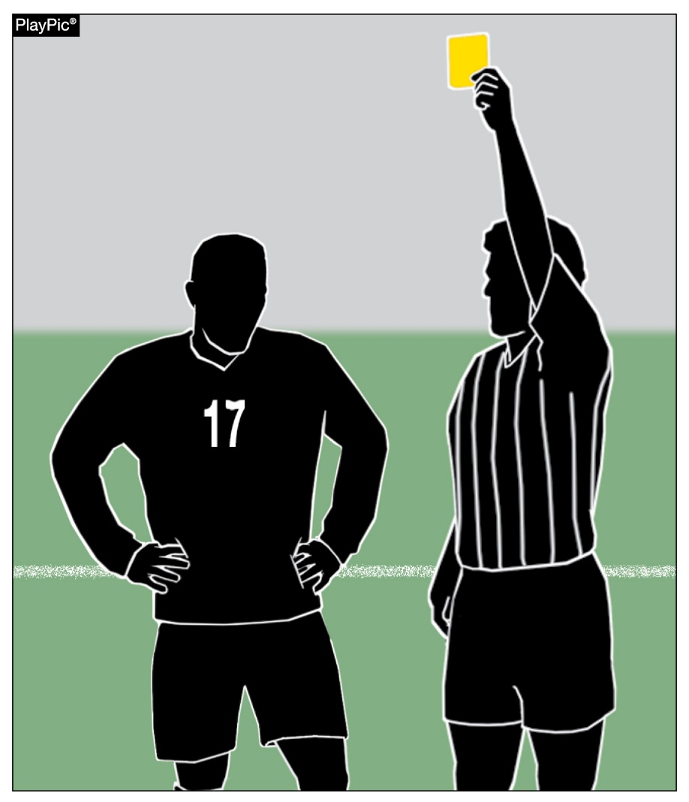
dissent
Rule 12-8-1c defines dissent.
Expressions of frustration or disappointment or private dissatisfaction not directed at anyone can usually be handled by a verbal warning or private discussion with the player.
Simply disagreeing with an official’s decision isn’t always dissent. Several factors to consider in each situation.
Continual public complaining, prolonged and repeated actions or personally directing comments at the referees must be dealt with.
Notes:
Rule 12-8-1c defines dissent.
Expressions of frustration or disappointment or private dissatisfaction not directed at anyone can usually be handled by a verbal warning or private discussion with the player.
Simply disagreeing with an official’s decision isn’t always dissent. Several factors to consider in each situation.
Continual public complaining, prolonged and repeated actions or personally directing comments at the referees must be dealt with.

Slide 30
NFHS OFFICIALS Education

Slide 31





OFFICIALS EDUCATION
Content remains free of charge
TEACHING
AIDS
RULES
CHANGES
DIAGRAMS
VIDEO
LIBRARY
OFFICIALS
COURSES
Notes:
Sport-Specific Officiating courses are offered in several sports. They are ideal for new officials and those in the first few years of officiating. These courses introduce officials to the mechanics and techniques used in the sport and provide specific information on an area within that sport. Individuals can complete a course within 30-45 minutes. These courses are free to all officials and prospective officials.
“Interscholastic Officiating” is a general course on sports officiating, and it is free to all officials and prospective officials. This course provides an introduction to skills and concepts used as an official. Several topics are covered such as: basics of becoming and staying an official, science of officiating, art of officiating, how to combine these skills for successful officiating.
Video clips are made available to NFHS Officials Association members. The video is clipped on specific topics and provides the rules references as well as dialogue on the topic.
The courses and videos are offered at www.NFHSLearn.com .
Courses Available:
Officiating Football
Officiating Volleyball – Ball Handling
Officiating Volleyball – Alignment
Officiating Volleyball – E-Whistle
Officiating Basketball
Officiating Basketball – Three-Person Mechanics
Officiating Basketball - Pre-Game Conference
Soccer – Fouls and Misconduct
Soccer – Offside
Soccer - Pre-Game Conference
Swimming and Diving
Officiating Wrestling
Umpiring Softball
Officiating Field Hockey
Officiating Track and Field
Future Courses to be Considered:
Umpiring Baseball
Umpiring Softball – 2 Person Mechanics
Communication Among Officials and Coaches

Slide 32


Future Developments
Improved Schedule View
Year Two Accomplishments
Auto-Assign
Years of Service
14
121,508
$9.2M
Enhanced Payment Capabilities
States
Registering
Officials
Contests
Assigned
Payments
Sent to
Officials
100% FREE to your state as a NFHS-Member Benefit.
Notes:
NFHS CENTER FOR OFFICIALS SERVICES (COS)
Your Complete Solution for Officials Management and More:
Registration
Assignment
Payment
Testing
Background Checks
For More Information on the NFHS – Center for Officials Services (COS) Contact:
Dana Pappas, Director of Officiating Services, dpappas@nfhs.org
Also If You’re Interested in Eligibility and Monitoring Requirements Contact
the Folks at Dragonfly:
Kirk Miller, Dragonfly, kirk@dragonflyathletics.com
Brandon Wallace, Dragonfly, brandon@dragonflyathletics.com

Slide 33
NFHS Learning Center

Slide 34

Notes:
The NFHS Learning Center is the home to more than 90 online professional development courses for everyone within the interscholastic community - coaches, students, officials, parents, administrators, and individuals within performing arts programs. More than 60 courses are available for free.
The NFHS is an Accredited Institution and has delivered more than 15 million courses on its NFHS Learning Center platform since its inception in 2007. In receiving national accreditation by Cognia, the NFHS has upheld itself to rigorous standards that focus on productive learning environments, equitable resource allocation that meet the needs of learners, and effective leadership.
The NFHS Learning Center features its flagship coaching course, “Fundamentals of Coaching,” as well as several health and safety courses that have been completed by millions of individuals, such as “Concussion in Sports,” “Heat Illness Prevention,” “Sudden Cardiac Arrest” and “Protecting Students from Abuse.” The NFHS Learning Center offers several national credentials that can be earned by individuals who complete specific NFHS courses. Through the School Honor Roll Program, schools can earn a physical banner to hang in their school.
To learn more and start your professional development journey, please visit the NFHS Learning Center at NFHSLearn.com.

Slide 35
NFHS Network

Slide 36


NFHS Network
By 2025, every high school sporting event in America will be streamed live.
The NFHS Network will be
THE DESTINATION for fans
to view these broadcasts.
27 Different Sports and Activities
www.NFHSnetwork.com
Notes:
The NFHS Network is the leader in streaming Live and On Demand high school sports.
Partnered with the National Federation of State High School Associations, 45 high school state athletic/activities associations, and PlayOn! Sports, the NFHS Network is a joint venture created to provide fans with the ability to stream high school sports on any device, from wherever they are.
All NFHS Network events are available to watch online at www.NFHSnetwork.com and through the NFHS Network Live App for iOS and Android. Follow us on Facebook, Twitter, Instagram, and YouTube.
Watching high school sports and events has never been easier.
The NFHS Network’s goal to broadcast live all 2 million high school sporting events by 2025.
The NFHS Network covers 27 different regular season and postseason sports, as well as other high school activities, celebrating the accomplishments of students-athletes, student broadcasters, and high schools across the country.

Slide 37

Over 1 million events this year…
Notes:
The NFHS Network will broadcast over 150,000 live events this year. If your school is not a member of the NFHS Network School Broadcast Program, please contact us at Mark.Koski@NFHSnetwork.com

Slide 38

Thank You
National Federation of State High School Associations
PO Box 690 | Indianapolis, IN 46206
Phone: 317-972-6900 | Fax: 317.822.5700
www.nfhs.org | www.nfhslearn.com | www.nfhsnetwork.com

