Slide 1
2021-22 nfhs wrestling rule interpretation powerpoint
B. Elliot Hopkins, MLD, CAA
Director of Sports, Sanctioning and Student Services

Slide 2

National Federation of
State High School Associations
NFHS (located in Indianapolis, IN – Est. 1920):
  National leader and advocate for
  high school athletics and
  performing arts programs.
  Serves 51 state associations, 19,500
  high schools and 12 million student
  participants.
  Writes playing rules for 17 high school
  sports for boys and girls.
  Offers online education courses for high school coaches,
  officials, parents, students and others.
  Ensures that students have opportunity to enjoy healthy participation, achievement and good sportsmanship in education-based athletics.
Notes:
The NFHS is the national leader and advocate for high school athletics and performing arts programs. Services of the NFHS reach more than 19,000 high schools and 12 million participants throughout the 8 NFHS sections across the U.S.
A significant responsibility of the NFHS is the commitment to writing quality playing rules for 17 high school sports for boys and girls, in addition to providing educational resources for high school coaches, officials, parents and students.
It is the vision of the NFHS to help prepare tomorrow’s leaders for the next level of life through the many program offerings in education-based athletics and activities.

Slide 3









NFHS Rules Review Committee
The NFHS Rules Review Committee is chaired by the chief operating officer and composed of all rules editors. After each committee concludes its deliberations and has adopted its recommended changes for the subsequent year, such revisions will be evaluated by the Rules Review Committee.
Davis Whitfield
Chief Operating Officer
Lindsey Atkinson
Girls Lacrosse and Volleyball
Bob Colgate
Football and Sports
Medicine
Sandy Searcy
Softball, Swimming & Diving and Water Polo
Elliot Hopkins
Baseball and Wrestling
Julie Cochran
Cross Country, Gymnastics, Field Hockey and
Track & Field
James Weaver
Boys Lacrosse
and Spirit
Theresia Wynns
Basketball and Soccer
Dan Schuster
Ice Hockey
Notes:
All committee recommended rules changes are vetted through the NFHS Rules Review Committee before advancing to the NFHS Board of Directors for final action. The committee is comprised of all NFHS Director of Sports and chaired by the NFHS Chief Operating Officer.

Slide 4
Rule changes

Slide 5
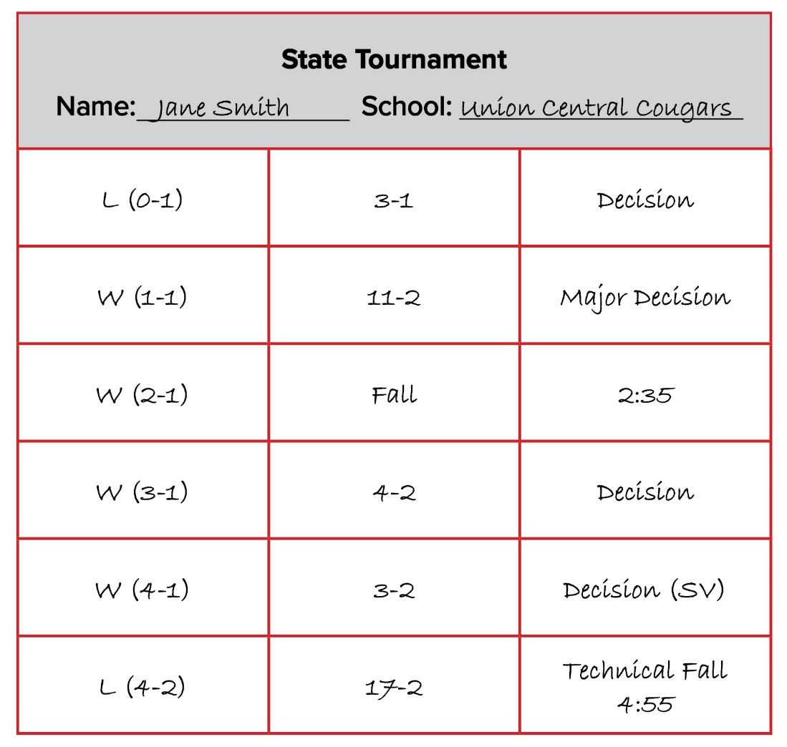
Representation
Rule 1-4-3 Exception

Slide 6
Rule 1-4-3 Exception
ART. 3 . . . No wrestler shall represent the school in more than one weight class in any meet or wrestle in more than five matches (championship or consolation), excluding forfeits in any one day of competition. Exception: No wrestler shall wrestle in more than six matches (championship or consolation), excluding forfeits in any one day of a tournament conducted by the state high school association for qualification to the state high school championships or the championships themselves.
Rationale:
Increasing the number of matches from five to six would allow postseason tournaments with more than 8 competitors in a weight class to complete the tournament in one day. This would be a substantial help for post-season qualifying tournaments and state championship events where travel can be extreme. In many cases, this would eliminate the need for schools to stay overnight in order to participate in their respective state qualifying tournaments and state championship events.

Slide 7
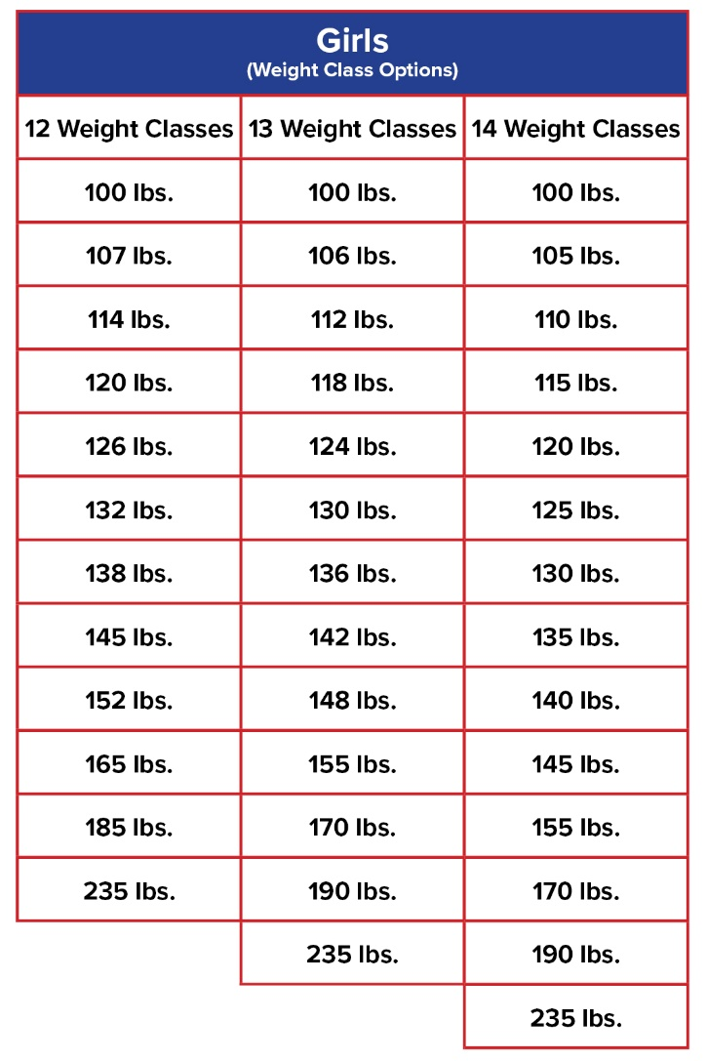
Weight Classifications
Rule 4-4-1a AND b (NEW)
For the first time, the NFHS has adopted standardized weight classes for girls wrestling (when girls wrestle girls).
Effective July 1, 2023: State associations can adopt one of three sets of weight classes.

Slide 8
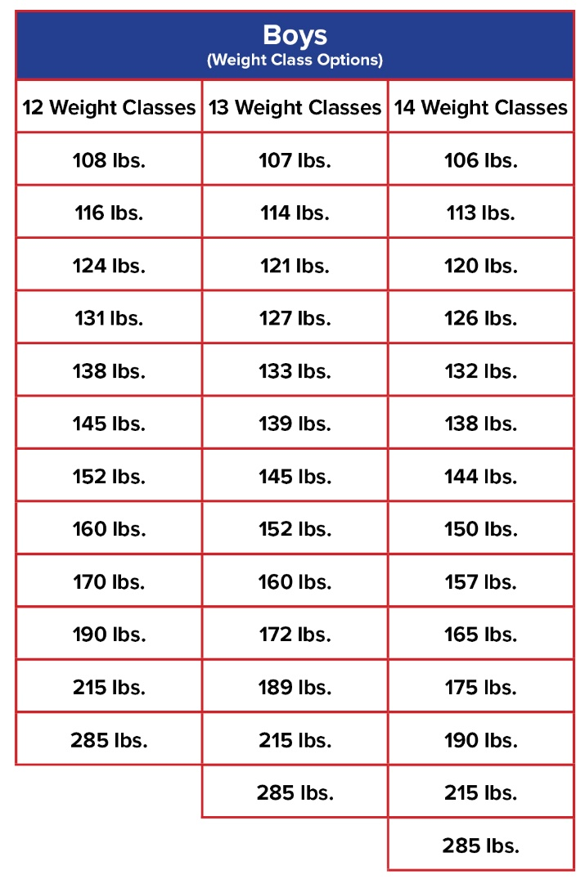
Weight Classifications
Rule 4-4-1a AND b (NEW)
Effective July 1, 2023: State associations can adopt one of three sets of weight classes for boys wrestling (or when girls wrestle boys).

Slide 9
Rule 4-4-1a
ART. 1 . . . A state association shall select one weight class. Competition shall be in one of the following sets of weight classes when girls are wrestling girls:
a.(12) 100 lbs., 107 lbs., 114 lbs., 120 lbs., 126 lbs., 132 lbs., 138 lbs., 145 lbs., 152 lbs., 165 lbs., 185 lbs., 235 lbs.
(13) 100 lbs., 106 lbs., 112 lbs., 118 lbs., 124 lbs., 130 lbs., 136 lbs., 142 lbs., 148 lbs., 155 lbs., 170 lbs., 190 lbs., 235 lbs.
(14) 100 lbs., 105 lbs., 110 lbs., 115 lbs., 120 lbs., 125 lbs., 130 lbs., 135 lbs., 140 lbs., 145 lbs., 155 lbs., 170 lbs., 190 lbs., 235 lbs.

Slide 10
Rule 4-4-1b
b. A state association shall select one weight class. Competition shall be in one of the following sets of weight classes when boys wrestle boys (or when boys wrestle girls):
(12) 108 lbs., 116 lbs., 124 lbs., 131 lbs., 138 lbs., 145 lbs., 152 lbs., 160 lbs., 170 lbs., 190 lbs., 215 lbs., 285 lbs.
(13) 107 lbs., 114 lbs., 121 lbs., 127 lbs., 133 lbs., 139 lbs., 145 lbs., 152 lbs., 160 lbs., 172 lbs., 189 lbs., 215 lbs., 285 lbs.
(14) 106 lbs., 113 lbs., 120 lbs., 126 lbs., 132 lbs. 138 lbs., 144 lbs., 150 lbs., 157 lbs., 165 lbs., 175 lbs., 190 lbs., 215 lbs., 285 lbs.

Slide 11
RULES 4-4-1a and b
Rationale:
Effective July 1, 2023: We have more member state associations (32) sponsoring girls wrestling and providing an equal number of uniform weight classifications is now necessary. Due to fluctuating demographics of our student enrollment, each state association shall select one of the three sets (12, 13, 14) of listed weight classes for boys and one of the three sets (12, 13, 14) for girls. These recommended weights are based upon data from over 215,000 National Wrestling Coaches Association (NWCA) assessments.

Slide 12
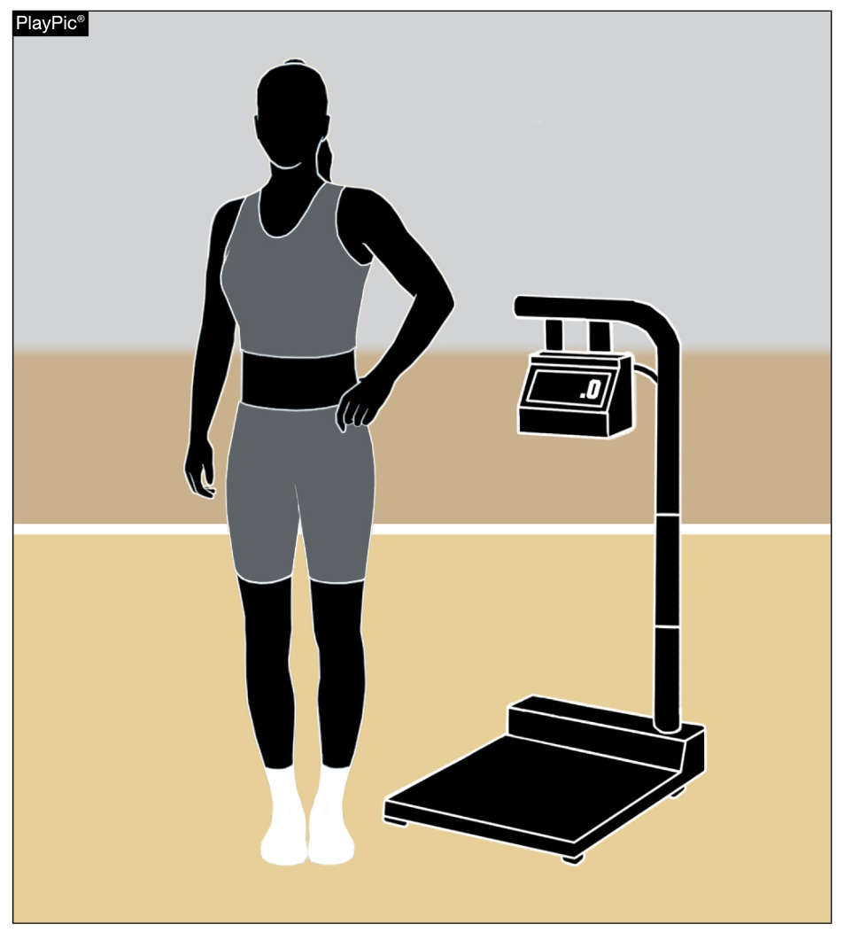
Weighing in
Rule 4-5-7
Contestants are no longer required to exclusively wear low-cut socks, if worn. Any style of socks can be worn while weighing in.

Slide 13
Rule 4-5-7
ART. 7 . . . All contestants shall weigh-in wearing a legal uniform (4-4-1) and a suitable undergarment that completely covers the buttocks and the groin area. Contestants shall not weigh-in wearing shoes or ear guards. Female contestants shall also wear a suitable form-fitted compression undergarment that completely covers their breasts. Contestants may wear low-cut socks that cannot be removed or added if the wrestlers do not make weight.
NOTE: No additional weight allowance shall be granted for weighing-in wearing a legal uniform.
Rationale:
With the new 2020 rule change concerning the weigh-in process; that all wrestlers wear a legal school uniform with appropriate undergarment(s) which makes the skin check a separate procedure. The requirement of low-cut socks to see all necessary skin is a moot point. Any length socks should be acceptable to wear during weigh-in. This solves a long-time argument concerning socks length.

Slide 14
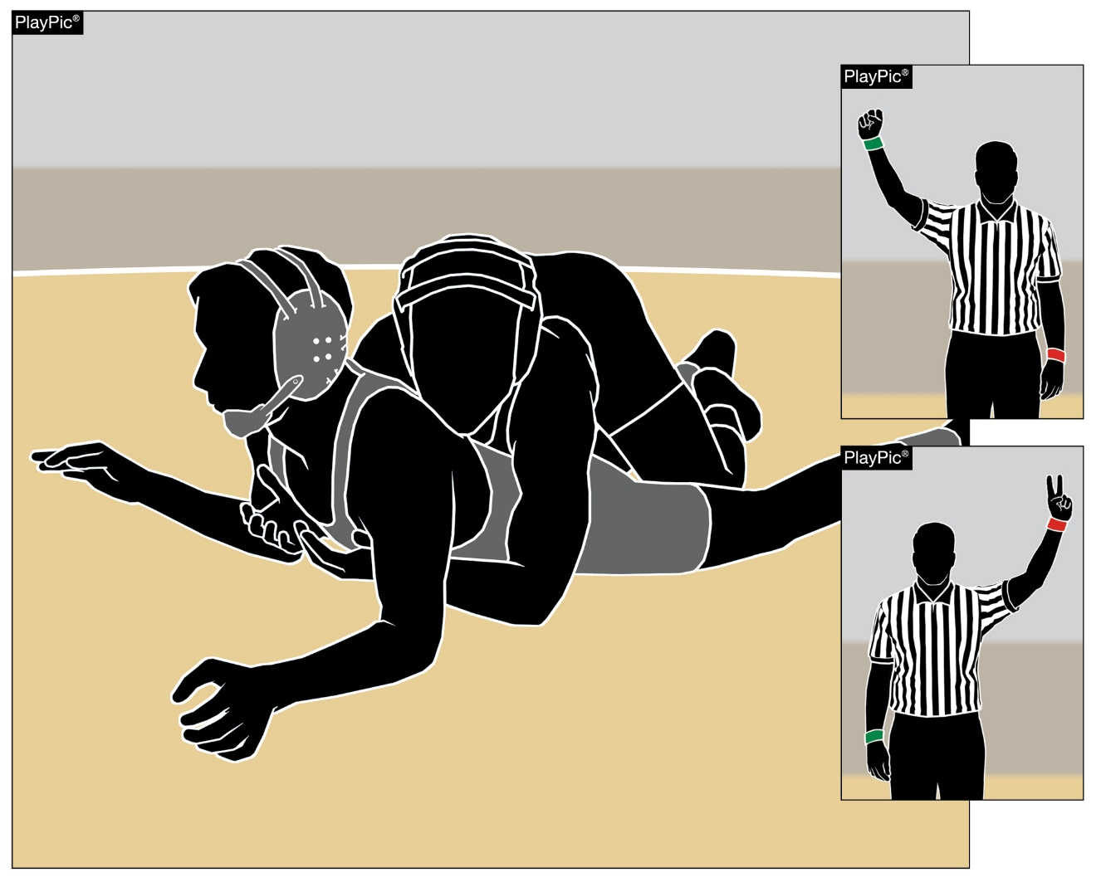
Deletion of the two-point stalling penalty during BAD TIME
Rule 5-1-1e

Slide 15
Rule 5-1-1e
ART. 1 . . . Bad time is wrestled with the wrestlers in the wrong position or the wrong wrestler being given choice of position:
Sub-articles a.– d. remain the same.
e. on the next restart after opponent receives a two-point stalling penalty.
Rationale:
The sub-article is no longer needed due to the 2020 NFHS 8-2 rule change.

Slide 16
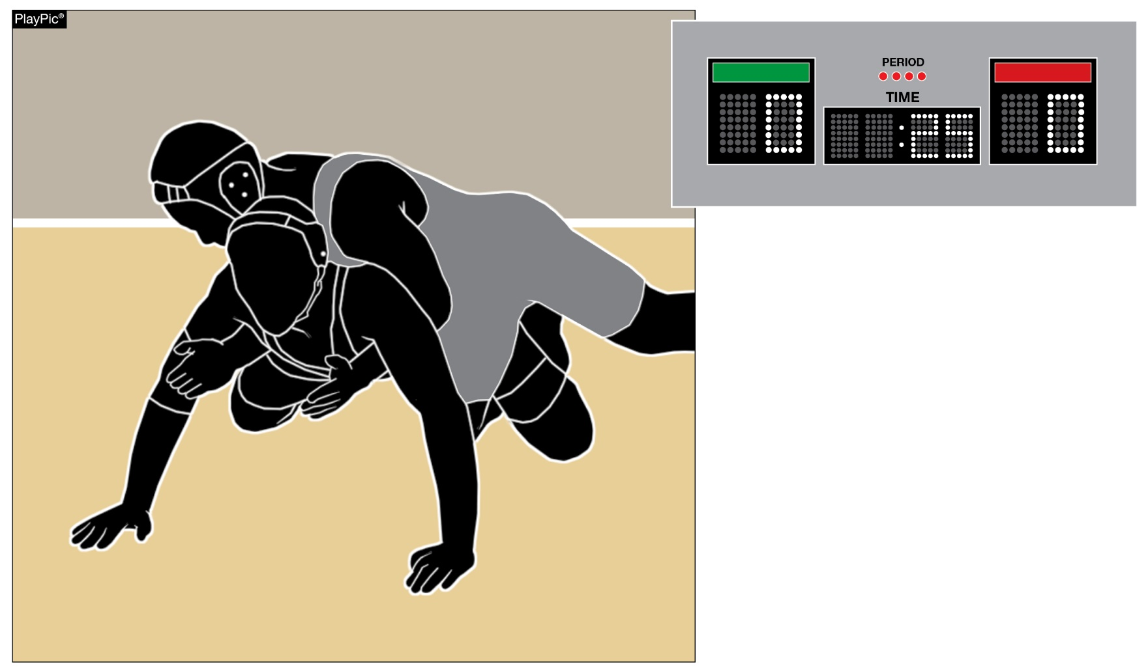
Head, Neck and Cervical during bad time will not be voided
Rule 5-1-3f (new)
When HNC injury time occurs during bad time, the HNC time used will not be voided.

Slide 17
Rule 5-1-3f
ART. 3 . . . Any points, penalties, or injury time that occurred during bad time shall be voided with the following exceptions:
Sub-articles a.-e. remain the same.
f. Head/Neck/Cervical Column (HNC) injury time.
Rationale:
With the addition of a head/neck/cervical injury timeout definition and separate injury rule, this amendment is needed to accommodate the modification of this injury timeout rule as it relates to bad time.

Slide 18
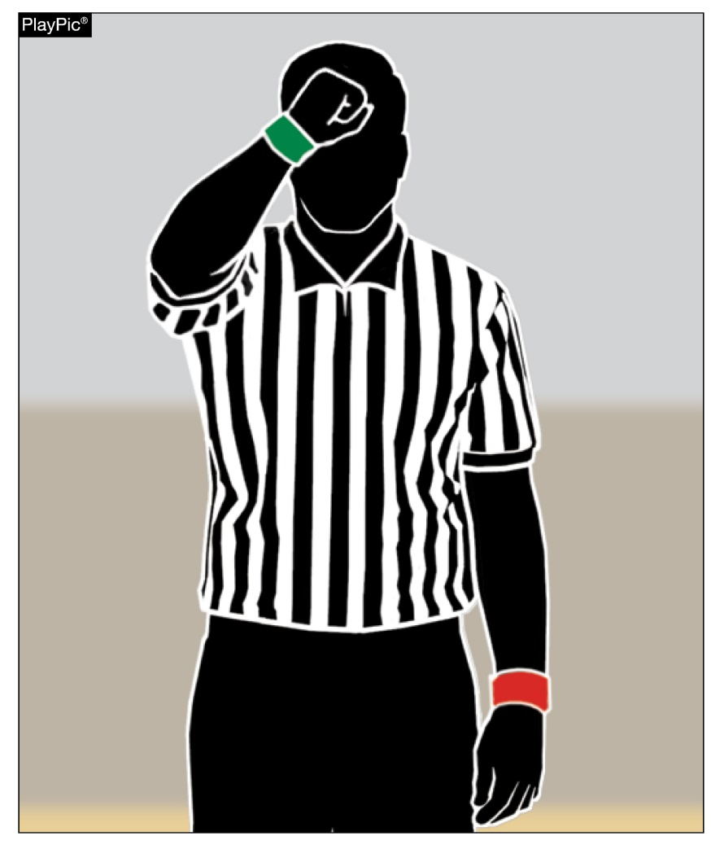
Head, Neck and Cervical column (HNC) recovery time clarification
Rule 5-28-3
HNC time-out is not connected to recovery time.
When HNC time is used, the time used does not impact a wrestler’s recovery time allowance.

Slide 19
Rule 5-28-3
ART. 3 . . . Recovery time. If a contestant is injured as a result of an illegal hold/ maneuver, unnecessary roughness, unsportsmanlike conduct during the match or the result of a false start (by the opponent) in the neutral position, the wrestler is entitled to two minutes of recovery time, which is not deducted from the injured wrestler's injury time allowance nor shall it constitute an HNC timeout. (5-28-6, 6-4-3, 8-2-2)
Rationale:
This proposed rule change is partnered with the proposed change to rules 5-28-6, 6-4-3, 6-6-2 and 8-2-4b1&2, 8-2-6.

Slide 20
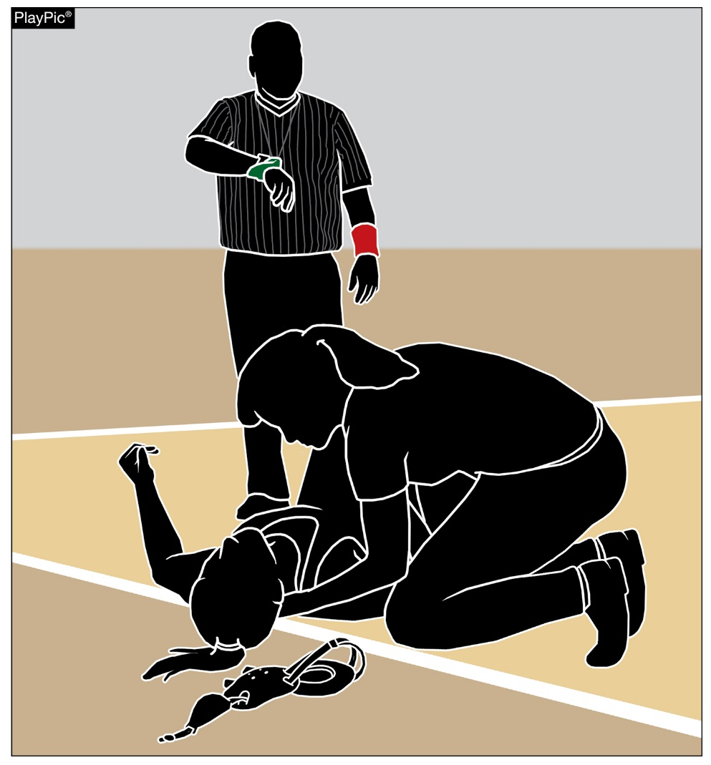
Head, Neck and Cervical definition time-out
Rule 5-28-6
The appropriate health-care professional can evaluate the injured athlete for up to five minutes during Head, Neck and Cervical Column (HNC) time.
A second use of HNC time will cause the wrestler to default the match.

Slide 21
Rule 5-28-6
ART. 6 . . . Head/Neck/Cervical Column (HNC). If a contestant is injured, and the onsite appropriate health-care professional (AHCP) determines that additional time is needed will have up to five (5) minutes (maximum) to evaluate the wrestler’s head and neck involving the cervical column and/or nervous system. the wrestler is entitled to five (5) minutes, minus the elapsed injury time. A second occurrence of injury to the head and neck involving the cervical column and/or nervous system in the same match shall require the wrestler to default the match. (8-2-4a, 8-2-4b1 & 2)
Rationale:
There was a desire to establish a separate injury time-out that involves the head and neck involving the cervical column and/or nervous system and not connect it with the existing two (2) 1 ½ minute injury time-outs or any other stoppage of the match. This separate timeout is supported and covered in existing rules that give the referee the authority to observe signs, symptoms and behaviors of a concussion and respond appropriately.

Slide 22
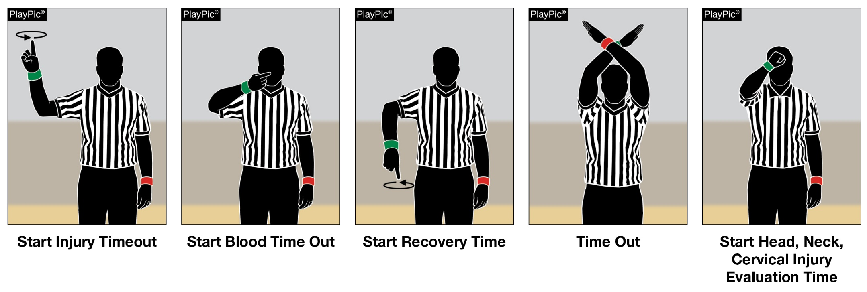
Head, Neck and Cervical Column and/or nervous system (HNC) Added as a Time-OUT
Rule 6-4-3
The HNC time-out is the 5th occurrence in which a referee may stop a match. Other time-outs are: blood, injury, recovery and referee’s.
HNC time gives an appropriate health-care professional the ability to properly evaluate the wrestler.

Slide 23
Rule 6-4-3
ART. 3 . . . If a wrestler is injured due to legal or illegal action, the referee shall stop the match under these certain conditions: a) injury time; b) blood time; c) recovery time; d) referee’s time; e) Head/Neck/Cervical Column (HNC) injury time. (5-28-3, 5-28-6, 8-2-4a, 8-2-4b1 & 2)
Rationale:
There was a desire to establish a separate injury time-out that involves the head and neck involving the cervical column and/or nervous system. This change would identify this occurrence as a separate timeout.

Slide 24
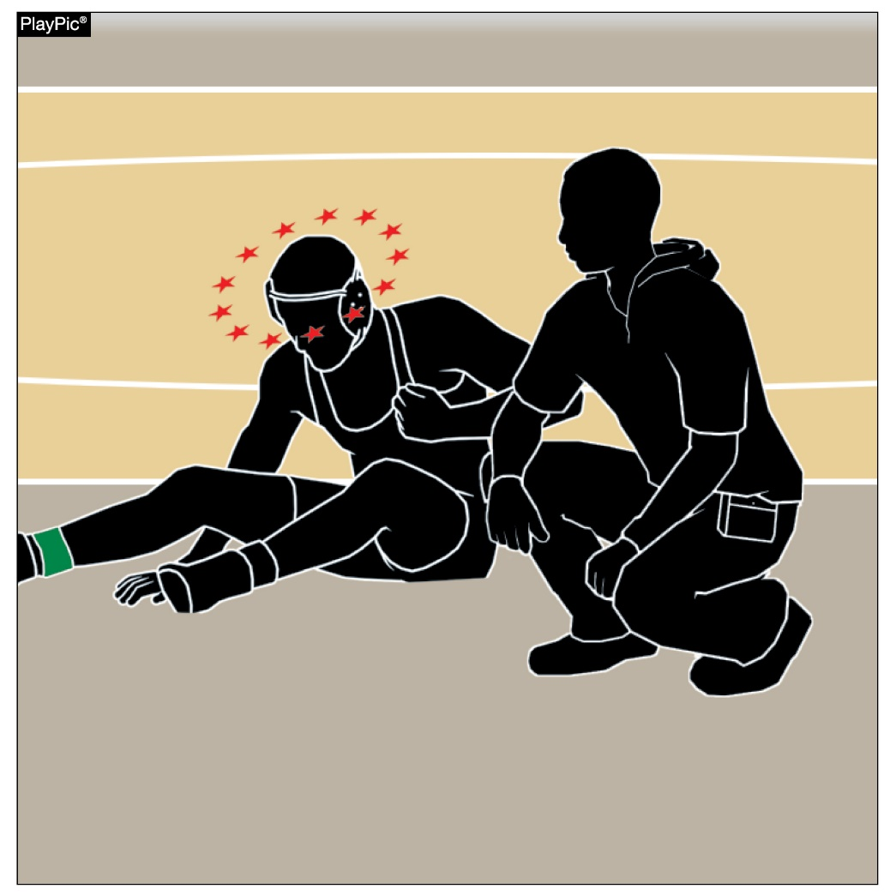
Head, Neck and Cervical column
Rule 8-2-4b 1 and 2 Evaluation procedure
When an appropriate health-care professional (physician or certified athletic trainer) is present, they can evaluate the HNC area for up to five minutes. When one is not present, only injury time of up to one minute and 30 seconds can be used.
Notes:
CROP PHOTO TO SUBJECT ON LEFT

Slide 25
Rule 8-2-4b1
ART. 4 . . .
Sub-article a. remains the same.
b. The following modifications to injury time-outs will be used in all competition regarding injuries to the head and neck involving cervical column and/or nervous system:
1. In the absence of appropriate health-care professional, (physician or certified athletic trainer) all injuries to the head and neck involving the cervical column and/or nervous system (HNC) will be covered by the same timeframe as other injuries Rule 8-2-4a. (5-28-3, 5-28-6, 6-4-3, 8-2-6 and 8-2-9 8-2-1)

Slide 26
Rule 8-2-4b2
2. When appropriate health-care professional(s) are present they have jurisdiction to extend the allowed time limit to a maximum of five (5) minutes for evaluation of the injuries to the head and neck involving the cervical column and/or nervous system only, at which time the athlete would be required to prepare without delay for continuation or default the match. When appropriate health-care professional(s) (physician or certified athletic trainer) are present they have jurisdiction to evaluate the injured wrestler for injuries to the head and neck involving the cervical column and/or nervous system only during the allowed time limit (maximum) of five (5) minutes. After that evaluation, the wrestler would be required to prepare without delay for continuation or default the match.
3. A second occurrence of injury to the head and neck involving the cervical column and/or nervous system in the same match shall require the wrestler to default the match.
NOTE: When this provision is used, the time consumed for the injury will in no way affect time used, or available, for other types of injuries.

Slide 27
Rule 8-2-4b 1 and 2
Rationale:
There was a desire to establish a separate injury time-out that involves the head and neck involving the cervical column and/or nervous system and not connect it with the existing two (2) 1 ½ minute injury time-outs. This separate timeout is supported and covered in existing rules that give the referee the authority to observe signs, symptoms and behaviors of a concussion and respond appropriately.

Slide 28
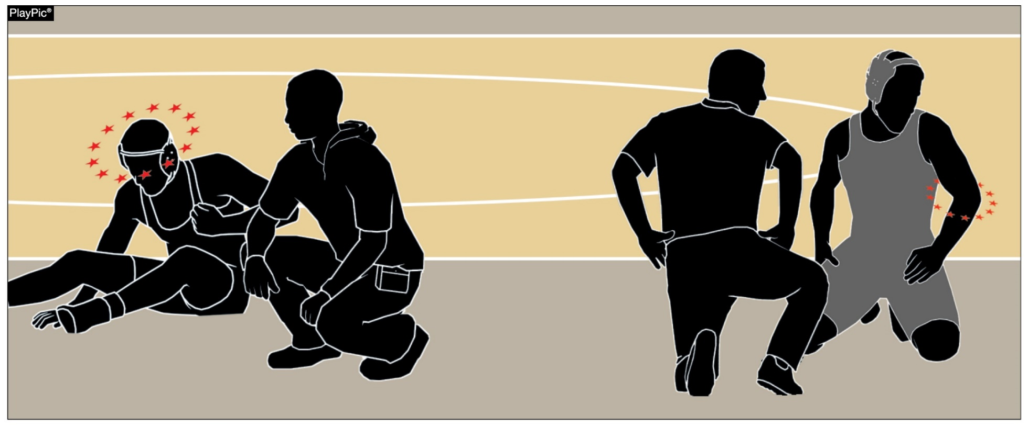
Coaching allowed during Head, Neck and Cervical time-out
Rule 8-2-6
Coaching is permitted during injury time, blood time, recovery time and HNC time. Two team attendants and appropriate health-care professional(s) may attend to either wrestler.

Slide 29
Rule 8-2-6
ART. 6 . . . During a timeout for injury, recovery blood time, recovery time or head and neck involving the cervical column and/or nervous system time, two team attendants and appropriate health-care professionals shall be permitted on the mat with either wrestler. Coaching is allowed during injury time, blood time, recovery time or head and neck involving the cervical column and/or nervous system time.
Rationale:
In conjunction with the other rule changes of the addition of injury timeout of the head, neck involving the cervical column and /or nervous system (HNC), it is necessary to reorder the various injury timeouts and add HNC.

Slide 30
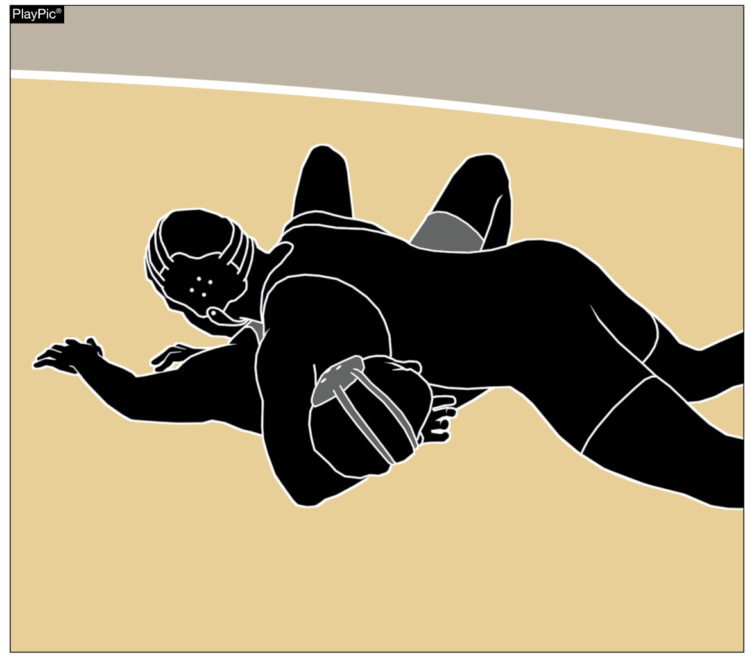
Imminent scoring when an injury occurs
Rule 8-2-9
When a match is stopped for injury (including HNC) and the referee determines imminent scoring, including near-fall, would have been successful, the referee shall charge the injury timeout and award the applicable points to the non-injured wrestler.
HNC injury time-out does not count against a wrestler’s injury time allowance.

Slide 31
Rule 8-2-9
ART. 9 . . . When a match is stopped for an injury, including HNC, during an imminent scoring situation and the referee determines that scoring (takedown, reversal, escape, near-fall) would have been successful if the wrestling had continued, the referee shall charge an injury time-out, or if appropriate an HNC timeout, to the injured contestant and award applicable points to the non-injured wrestler.
Rationale:
This proposed rule change is partnered with the proposed change to Rules 5-28-3, 5-28-6, 6-4-3, 8-2-4b1&2 and 8-2-6.

Slide 32
Editorial changes

Slide 33
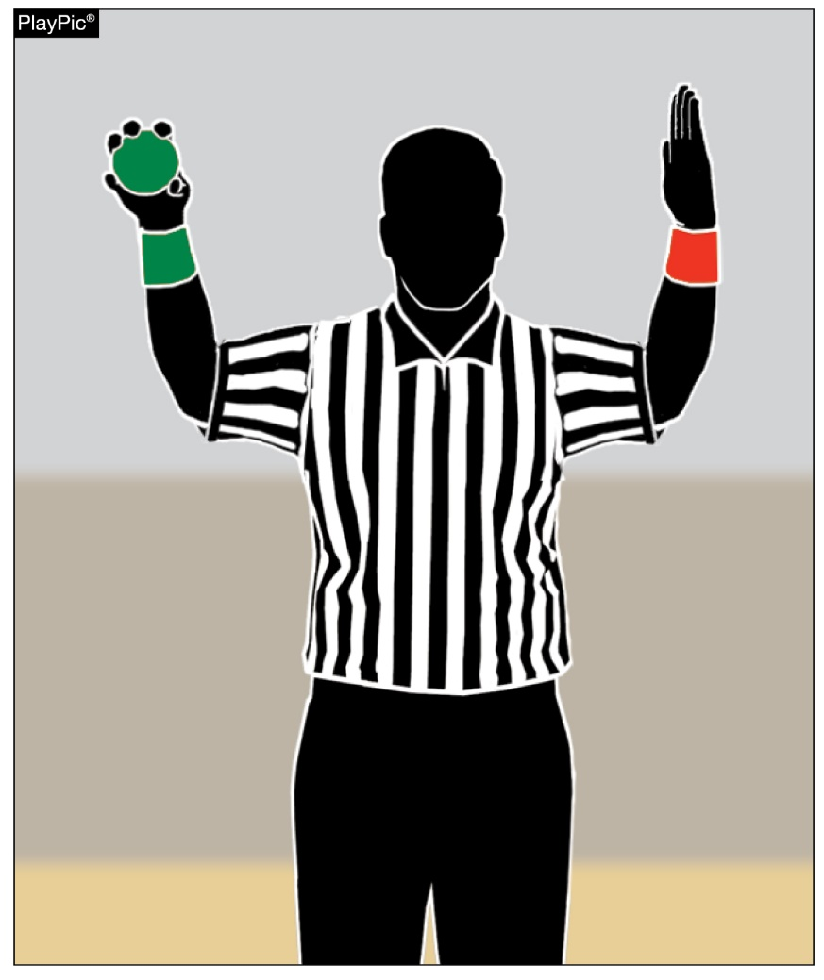
Choice of position not affected by forfeits
Rule 6-3-1
Which team has choice at the end of the first period is not affected by multiple forfeits during a dual meet.

Slide 34
Rule 6-3-1
ART. 1 . . . The winner of the toss shall choose the odd or even numbered weight classes listed consecutively. This choice is not altered in case of fall, default, forfeit(s) or disqualification.
Rationale:
Clarification.

Slide 35
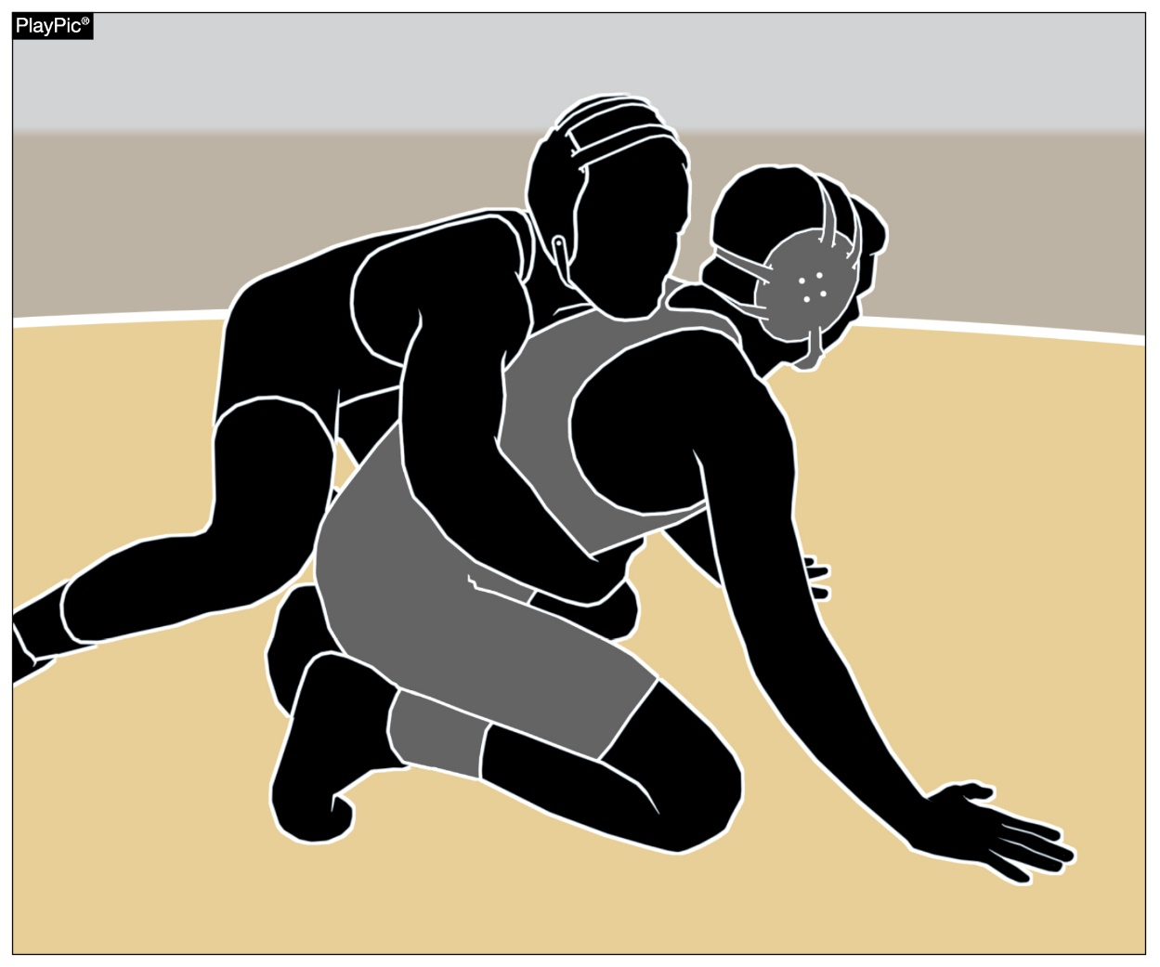
Correction of Errors does not void hnc time used
Rule 6-6-2
When an error occurs in the positioning of wrestlers and bad time occurs, HNC time is not voided.

Slide 36
Rule 6-6-2
ART. 2 . . . When an error occurs in positioning of wrestlers:
a. At the start of the third period; or
b. At the start of the second 30-second tiebreaker; or
c. At the start of the ultimate tiebreaker; or
d. After the opponent has taken his/her second injury time-out; or
e. On the next restart after the opponent receives a two-point stalling penalty.

Slide 37
Rule 6-6-2
NOTE: All points earned during bad time are canceled – Exceptions: In Rule 5-1-3, any points, penalties, or injury time that occurred during bad time shall be voided excluding the exceptions of 5-1-3a-f, following corrections made and a rest of one (1) minute, the period shall be re-wrestled. In other situations when there is bad time, and if the amount of bad time can be determined by the referee, bad time shall be deleted and/or re-wrestled without delay.
Rationale:
Editorial. It was necessary to add the HNC rule as an exception and to restructure the note for clarity purposes.

Slide 38
Points of emphasis

Slide 39
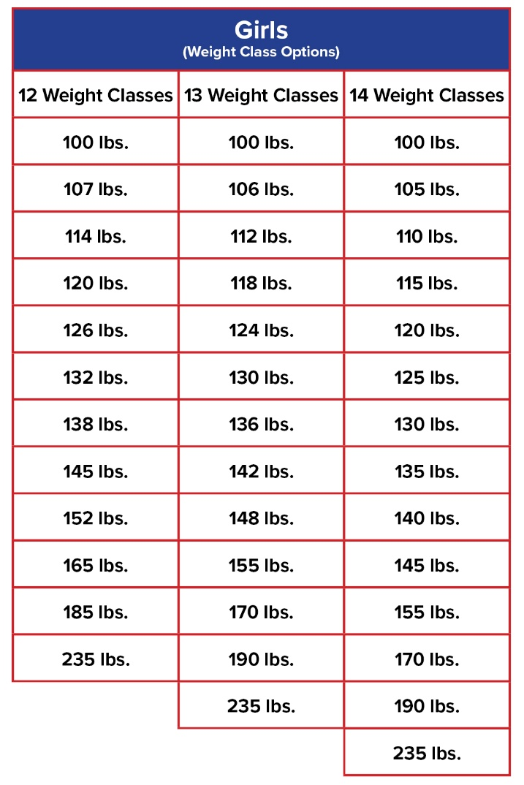
Boys and Girls Weight Classifications
State associations will have the option to adopt NFHS Girls Wrestling weight classes.
The new procedure also provides state associations the flexibility to select one set of weight classifications for boys and another for girls.

Slide 40
Boys and Girls Weight Classifications (cont.)
Discussion about weight classes invariably creates a lot of energy around the number of classifications and the actual weights themselves. The 2011-12 academic season was the last time high school weight classes were modified. Based on your perspective, fortunately or unfortunately the world has changed dramatically since 2011.

Slide 41
Boys and Girls Weight Classifications (cont.)
We have an increased interest in our sport by girls with growing participation numbers and the 30th state association will be sponsoring and hosting a girls’ wrestling championship next school year. Simply stated, it is time to offer a uniform set of weights for girls in different classifications for states to select one that best fits their needs (and allow for growth in the future).

Slide 42
Boys and Girls Weight Classifications (cont.)
Boys’ wrestling continues to decline, there are some mitigating factors that contribute to the downturn. In part, one of those factors is reflective of our fluctuating student enrollment demographics nationally. Towns and cities have shifted their populations and we are witnessing a phenomenon playing out across the country that schools and their enrolled student bases are changing drastically.

Slide 43
Boys and Girls Weight Classifications (cont.)
Many of our member state associations have struggled filling 14 weight classifications since we changed the weights in 2011. The new rule of providing an option for state associations selecting 12, 13 or 14 weight classifications makes tremendous sense and will allow them the chance to address some of those challenges and allow more students to benefit from wrestling.

Slide 44
Boys and Girls Weight Classifications (cont.)
Consequently, the suggested weights are data and science driven. These recommended weights are based upon data from 215,000 body fat assessments from high school students nationally by the National Wrestling Coaches Association (NWCA).

Slide 45
Boys and Girls Weight Classifications (cont.)
We have established the implementation date as July 1, 2023 to give coaches, schools and students the opportunity and time to prepare for the new weights. Our goal for this rule change is to give states who needed flexibility the chance to make better educated decisions in their state and to allow more students to wrestle.

Slide 46
Head/neck/cervical column (HNC) time-out
The HNC time-out is the 5th occurrence in which a referee may stop a match. Other time-outs are: Blood, injury, recovery, referee’s.
HNC time gives an appropriate health-care professional the ability to properly evaluate the wrestler.

Slide 47
Head/Neck/Cervical Column (HNC) Time-out (cont.)
There was a desire to establish a separate injury time-out that involves the head and neck involving the cervical column and/or nervous system and not connect it with the existing 1 ½ minute injury time-outs. The HNC timeout is the 5th occurrence that a referee would stop a match.

Slide 48
Head/Neck/Cervical Column (HNC) Time-out (cont.)
This separate timeout is supported and covered in existing rules that give the referee the authority to observe signs, symptoms and behaviors of a concussion and respond appropriately with or without an appropriate health-care professional present.

Slide 49
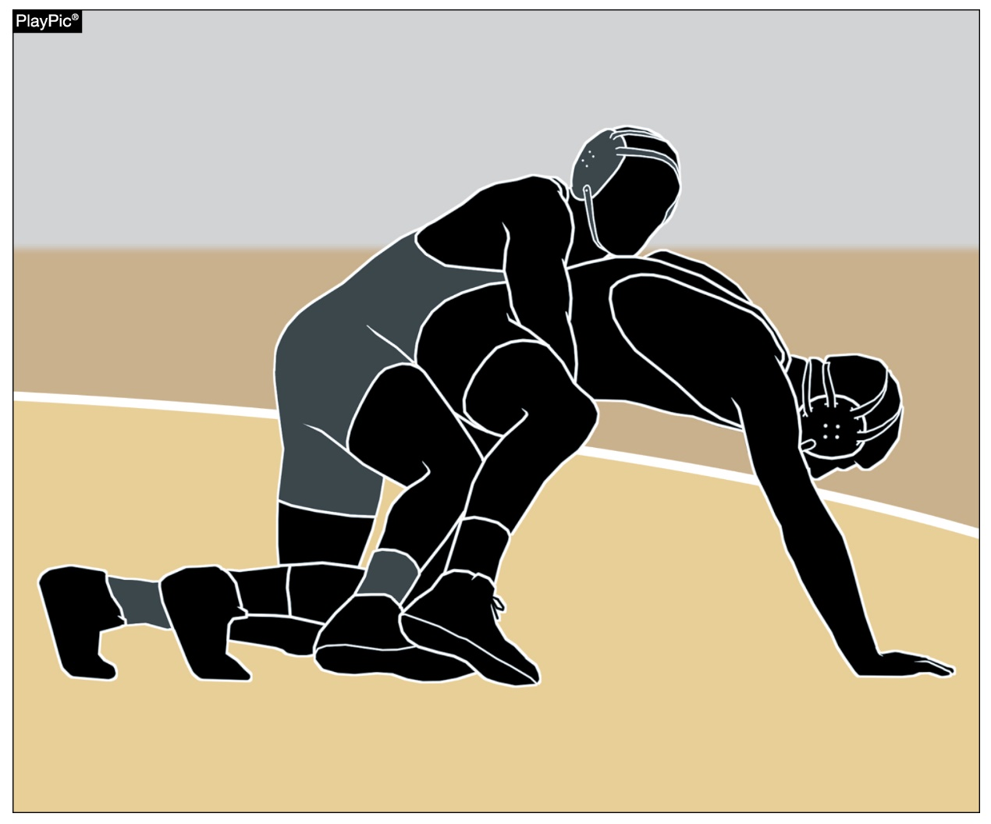
Stalling in the ultimate tiebreaker
While stalling can be penalized severely during the course of a match, the Ultimate Tiebreaker (UT) is a unique scenario in which the offensive wrestler is rewarded by maintaining control/riding out.

Slide 50
Stalling in the Ultimate Tiebreaker
Stalling by nature and by definition is something we typically do not reward during regulation time of a match. In fact, it is severely penalized because wrestling is an attacking and rigorous activity. The aggressive wrestler benefits in the number of points he/she accumulates during a match. But the Ultimate Tiebreaker (UT) is a unique one-time situation that has some different nuances. In proper context, we have wrestled an entire regulation match, three overtimes (one 60 second and two 30 second) and remain tied. If no scoring occurs during the UT, the offensive wrestler is rewarded a match point during the UT for maintaining control/riding out (6-7-1c8, 9-1-8, Scoring Symbols (pg. 58)) and will ultimately win the match.

Slide 51
Rules Reminders

Slide 52
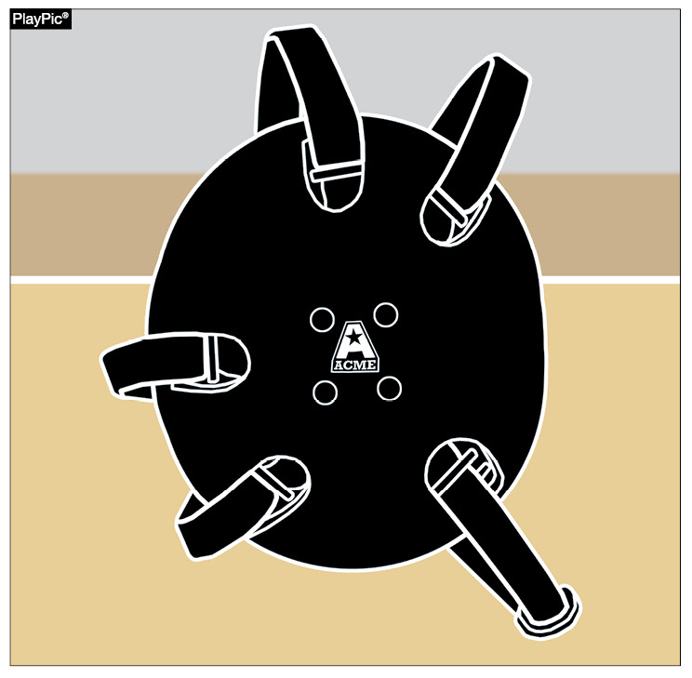
Logo on EAR GUARDS
Rule 4-1-4
Any manufacturer's logo/trademark/reference that appears on the wrestling ear guards, including legal head covering, can be no more than 2-1/4 square inches with no dimension more than 2-1/4 inches and may appear no more than once on ear guards.
No additional manufacturer's logo/trademark or promotional reference shall be allowed on the wrestling ear guard. [Effective July 1, 2022]

Slide 53
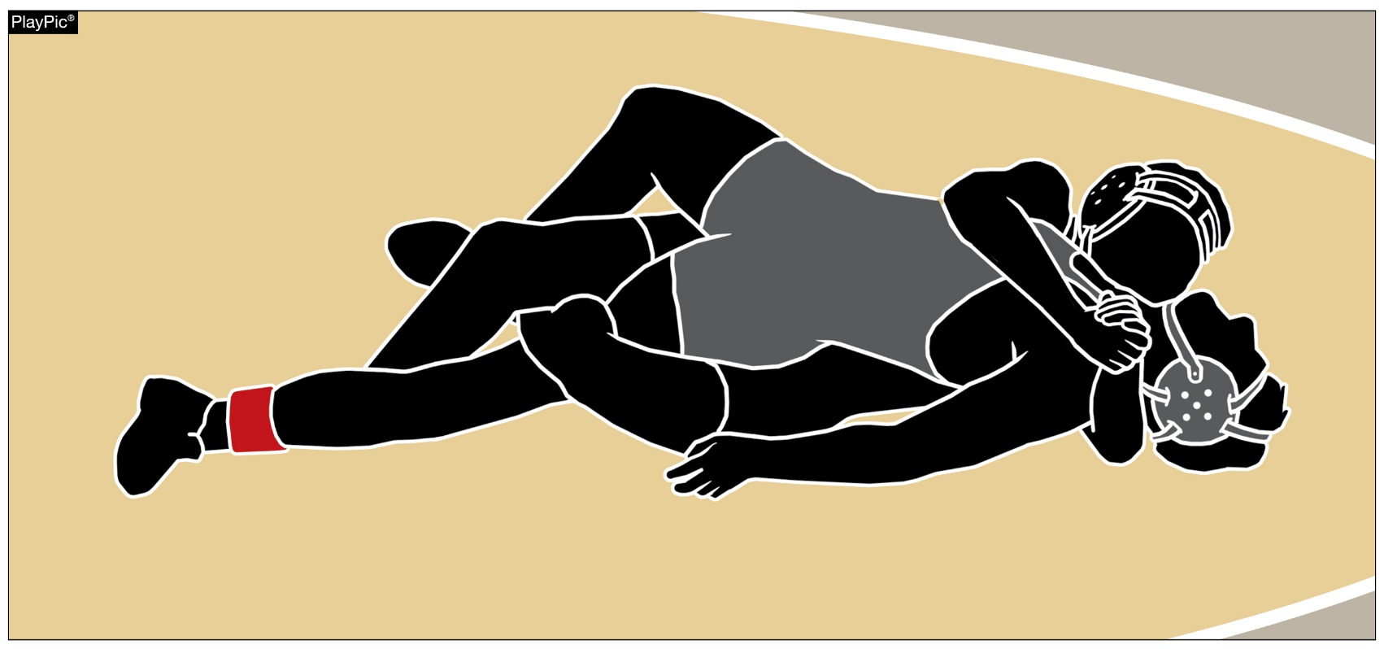
Illustration #53
Rule 7-1-5d
Illustration #53 in the NFHS Wrestling Rules Book has been updated to clarify that once near-fall criteria are met, this is a legal headlock.

Slide 54



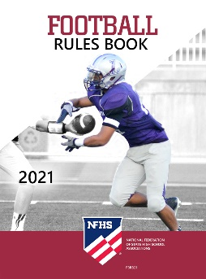
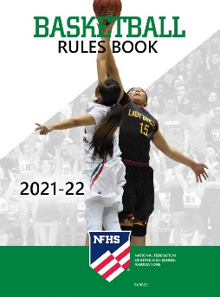
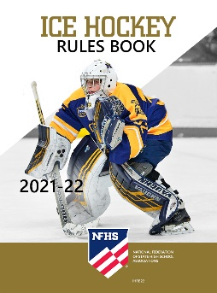
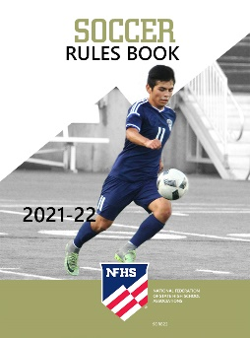




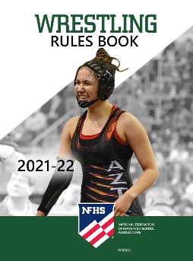
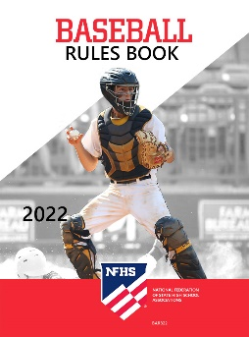

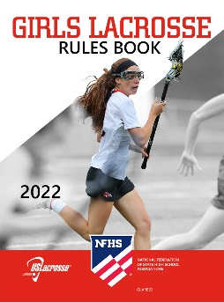
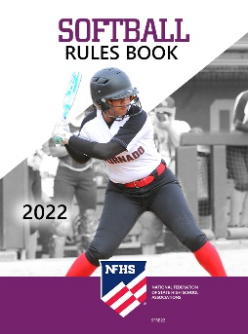


National Federation of
State High School Associations
The NFHS writes playing rules for 17 sports
for boys and girls at the high school level.
  Publishes 4 million pieces of materials annually.

Slide 55

NFHS Rules Book as e-Books
E-books features:
  Searchable
  Highlight areas of interest
  Make notes
  Easy navigation
  Adjustable viewing size
  Immediate availability

Slide 56

NEW NFHS Rules App
Rules App features:
  Searchable
  Highlight notes
  Bookmarks
  Quizzes for all sports
  Easy navigation
  Immediate availability
  Free to paid members of the NFHS Coaches
  and Officials Associations
  www.nfhs.org/erules for more information
Notes:
Rules app for all NFHS rules books and case books are available on iTunes and Google Play. Rules books and case books are cross-linked and enabled for searchable content.
App is free to download.
Each book subscription is $6.99.
NFHS Coaches and Officials Association paid members get all books for free.
100% states members get books for free in sports designated by their state.

Slide 57

Guidelines for Schools and state associations for consideration of accommodations
Notes:
To assist state associations in working with schools for the inclusion of students with disabilities, the following guide prepared by the NFHS Task Force on the Inclusion of Students with Disabilities is being provided for your review.
Following these guidelines will assist in the individual student assessment by the student and the school.
When requesting a possible accommodation, coaches should work with their school and the state association as early as possible in the sport season.
Contest officials shall defer decisions on rule accommodations to the respective state association.
This information serves as a guide. Each state association may develop its own process.

Slide 58
NFHS Learning Center

Slide 59

Notes:
The NFHS Learning Center can be accessed at www.nfhslearn.com. It has over 80 online courses and over 50 of those can be accessed at no cost. There are courses for everyone within the interscholastic community including coaches, students, administrators, parents, officials, and individuals within performing arts programs. All courses include a completion certificate and can be accessed 24 hours a day, 7 days a week and completed at the learner’s pace. Get your community involved in professional development today at the NFHS Learning Center!

Slide 60
NFHS Network

Slide 61


NFHS Network
By 2025, every high school sporting event in America will be streamed live.
The NFHS Network will be
THE DESTINATION for fans
to view these broadcasts.
27 Different Sports and Activities
www.NFHSnetwork.com
Notes:
The NFHS Network is the leader in streaming Live and On Demand high school sports.
Partnered with the National Federation of State High School Associations, 45 high school state athletic/activities associations, and PlayOn! Sports, the NFHS Network is a joint venture created to provide fans with the ability to stream high school sports on any device, from wherever they are.
All NFHS Network events are available to watch online at www.NFHSnetwork.com and through the NFHS Network Live App for iOS and Android. Follow us on Facebook, Twitter, Instagram, and YouTube.
Watching high school sports and events has never been easier.
The NFHS Network’s goal to broadcast live all 2 million high school sporting events by 2025.
The NFHS Network covers 27 different regular season and postseason sports, as well as other high school activities, celebrating the accomplishments of students-athletes, student broadcasters, and high schools across the country.

Slide 62

Notes:
The NFHS Network will broadcast over 150,000 live events this year. If your school is not a member of the NFHS Network School Broadcast Program, please contact us at Mark.Koski@NFHSnetwork.com

Slide 63
Thank you. Have a wonderful season!

