Slide 1
2021-22 NFHS Sport Rules PowerPoint
Rules Changes
Major Editorial Changes
Points of Emphasis

Slide 2
National federation of state high school associations (NFHS)

Slide 3

National Federation of
State High School Associations
NFHS (located in Indianapolis, IN – Est. 1920):
  National leader and advocate for
  high school athletics and
  performing arts programs.
  Serves 51 state associations, 19,500
  high schools and 12 million student
  participants.
  Writes playing rules for 17 high school
  sports for boys and girls.
  Offers online education courses for high school coaches,
  officials, parents, students and others.
  Ensures that students have opportunity to enjoy healthy participation, achievement and good sportsmanship in education-based athletics.
Notes:
The NFHS is the national leader and advocate for high school athletics and performing arts programs. Services of the NFHS reach more than 19,000 high schools and 12 million participants throughout the eight NFHS sections across the U.S.
A significant responsibility of the NFHS is the commitment to writing quality playing rules for 17 high school sports for boys and girls, in addition to providing educational resources for high school coaches, officials, parents and students.
It is the vision of the NFHS to help prepare tomorrow’s leaders for the next level of life through the many program offerings in education-based athletics and activities.

Slide 4









NFHS Rules Review Committee
The NFHS Rules Review Committee is chaired by the chief operating officer and composed of all rules editors. After each committee concludes its deliberations and has adopted its recommended changes for the subsequent year, such revisions will be evaluated by the Rules Review Committee.
Davis Whitfield
Chief Operating Officer
Lindsey Atkinson
Girls Lacrosse and Volleyball
Bob Colgate
Football and Sports
Medicine
Sandy Searcy
Softball, Swimming & Diving and Water Polo
Elliot Hopkins
Baseball and Wrestling
Julie Cochran
Cross Country, Gymnastics, Field Hockey and
Track & Field
James Weaver
Boys Lacrosse
and Spirit
Theresia Wynns
Basketball and Soccer
Dan Schuster
Ice Hockey
Notes:
All rules committee recommended rules changes are vetted through the NFHS Rules Review Committee before advancing to the NFHS Board of Directors for final action. The committee, as you see, is comprised of all NFHS Director of Sports and chaired by the NFHS Chief Operating Officer.

Slide 5


















National Federation of
State High School Associations
The NFHS writes playing rules for 17 sports
for boys and girls at the high school level.
  Publishes four million pieces of materials annually.
Notes:
The NFHS writes playing rules for 17 sports, publishes High School Today (HST) along with several other key publications totaling over four million pieces annually.

Slide 6

NFHS Rules Book as e-Books
E-books features:
  Searchable
  Highlight areas of interest
  Make notes
  Easy navigation
  Adjustable viewing size
  Immediate availability
Notes:
The NFHS Rules and Case Book e-books are available for $6.99 each.

Slide 7

NEW NFHS Rules App
Rules App features:
  Searchable
  Highlight notes
  Bookmarks
  Quizzes for all sports
  Easy navigation
  Immediate availability
  Free to paid members of the NFHS Coaches
  and Officials Associations
  www.nfhs.org/erules for more information
Notes:
Rules app for all NFHS rules books and case books are available on iTunes and Google Play. Rules books and case books are cross-linked and enabled for searchable content.
App is free to download
Each book subscription is $6.99
NFHS Coaches and Officials Association paid members get all books for free
100% states members get books for free in sports designated by their state

Slide 8

Guidelines for Schools and state associations for consideration of accommodations
Notes:
To assist state associations in working with schools for the inclusion of students with disabilities the following guide prepared by the NFHS Task Force on the Inclusion of Students with Disabilities is being provided for your review.
Following these guidelines will assist in the individual student assessment by the student and the school.
When requesting a possible accommodation, coaches should work with their school and the state association as early as possible in the sport season.
Contest officials shall defer decisions on rule accommodations to the respective state association.
This information serves as a guide. Each state association may develop its own process.

Slide 9
2021-22 nfhs Swimming and Diving RULES CHANGES

Slide 10
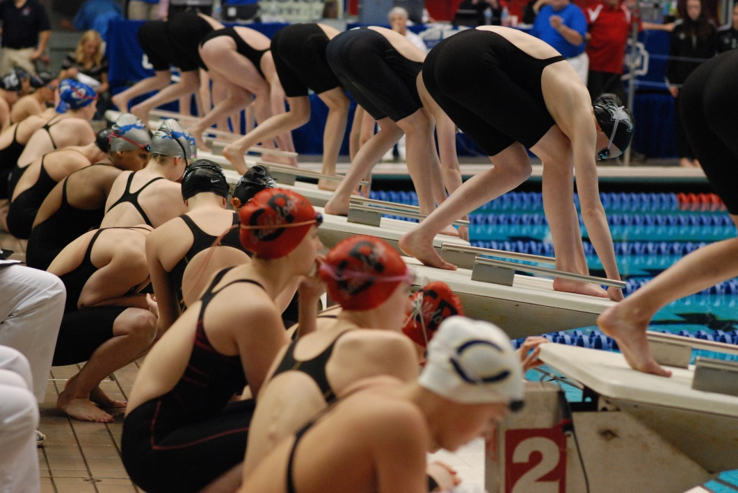
Entries by Individuals
3-2-5
Changes protocol for declaration
of the lead-off swimmer in a
relay to be submitted prior to
the start of the event.
Notes:
Rule 3-2-5:
Changes protocol for declaration of the lead-off swimmer in a relay to be submitted prior to the start of the event.
Rationale: The lead-off swimmer must be declared at the specified time and place prior to the start of the event, which is consistent with entry procedures for identification of all relay participants. The change in language clarifies the reporting process for relays, removing language referencing lead-off swimmers and adding to rule 3-2-5.

Slide 11

uniforms
3-3-5
Permits competitors to wear
suits providing full body coverage
for religious reasons.
The suit must meet the requirements
of Rule 3-3-4b(1-3).
Questions about a specific suit must be
addressed by the state association after
the meet.
Notes:
Rule 3-3-5:
Permits competitors to wear suits providing full body coverage for religious reasons.
The suit must meet the requirements of Rule 3-3-4b(1-3).
Questions about a specific suit must be addressed by the state association after the meet.
Rationale: The new rule eliminates the need for state association authorization of suits providing full body coverage. Added language allows for freedom of religion without creating a competitive advantage for the athlete. Suits worn for religious reasons must adhere to all provisions of Rule 3-3-4b, with one exception: the suit may include a fastening system.

Slide 12
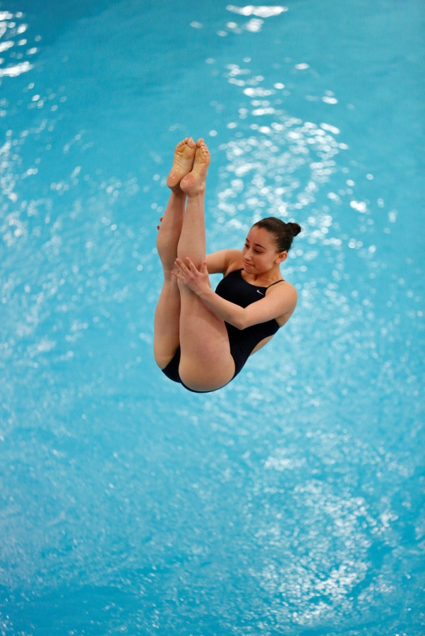
uniforms
3-3-6c
Permits the application of
temporary adhesives for divers.
Minimizes hand slippage.
Aligns with national trends.
Notes:
Rule 3-3-6c:
Permits the application of temporary adhesives for divers.
Minimizes hand slippage.
Aligns with national trends.
Rationale: Allows divers to protect themselves from hand slippage, minimizing risks for the diver. This rule change is consistent and in line with national trends of the sport.

Slide 13
Qualifying Procedures
5-4-3, new note
Clarifies protocol for conducting swim-offs and purposes the time can be used for.
NOTE: Swim-off times are considered official and can be used for record or other purposes.
Notes:
Rule 5-4-3, NEW NOTE:
Clarifies protocol for conducting swim-offs and the purposes the time can be used for.
NOTE: Swim-off times are considered official and can be used for record or other purposes.
Rationale: Updated language clarifies the impact of the swim-off time for future purposes.

Slide 14
MANAGING DIVING COMPETITION
9-2-1
During championship meets, diving boards should be open for practice if breaks between sessions extend longer than ten minutes.
Access to practice dives/approaches should be as equitable as possible but does not require divers to perform an equal number
of dives or approaches.
Notes:
Rule 9-2-1:
During championship meets, diving boards should be open for practice if breaks between sessions extend longer than ten minutes.
Access to practice dives/approaches should be as equitable as possible but does not require divers to perform an equal number
of dives or approaches.
Rationale: Defines when diving boards shall be made available for practice during the break between sessions of a championship meet, unless the meet director establishes specific guidelines prior to the start of competition.

Slide 15
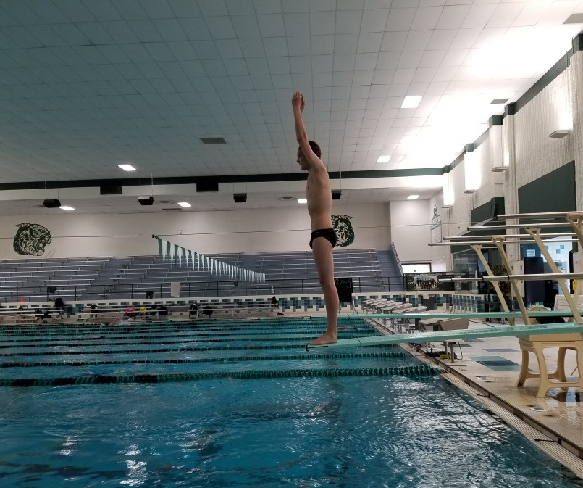
DIVING CONTESTANTS
9-3-7
Standing forward takeoffs are permitted.
Diver must declare intent to the referee prior to the dive.
The diving referee shall deduct 2 points from each judge’s award for violation of the forward approach.
Notes:
Rule 9-3-7:
Standing forward takeoffs are permitted.
Diver must declare intent to the referee prior to the dive.
The diving referee shall deduct 2 points from each judge’s award for violation of the forward approach.
Rationale: The standing forward takeoff is a critical part of the educational process in teaching new dives. This provision allows divers to participate in competition sooner, encouraging growth in the sport.

Slide 16
DIVING CONTESTANTS
9-3-7 PENALTIES
If the diver does not declare the intent to perform a forward standing takeoff, both penalties will NOT be assessed:
Either the diver declares intent to do a standing takeoff and receives a two-point deduction from each judge; or
The diver fails to declare intent making it an unsatisfactory dive and receives no more than two points per judge.
Both calls will be made by the diving referee.
Notes:
Rule 9-3-7 PENALTIES:
If the diver does not declare the intent to perform a forward standing takeoff, both penalties will NOT be assessed:
- Either the diver declares intent to do a standing takeoff and receives a two-point deduction from each judge; or
- The diver fails to declare intent making it an unsatisfactory dive and receives no more than two points per judge.
Both calls will be made by the diving referee.
Rationale: The intent is for only one deduction to be made. Either the diver is assessed a two-point deduction from each judge or if they do not declare their intent prior to dive, the penalty is that the referee declares it an unsatisfactory dive (and the diver receives a maximum score of two points from each judge).

Slide 17
FORM OF THE DIVES
9-5-2, new note
Describes the starting positing for a standing forward takeoff.
Adds language to define the number of oscillations permitted.
The NOTE reminds us that the standing forward takeoff is now considered a violation of the forward approach.
Notes:
9-5-2, NEW NOTE:
Describes the starting positing for a standing forward takeoff.
Adds language to define the number of oscillations permitted.
The NOTE reminds us that the standing forward takeoff is now considered a violation of the forward approach.
Rationale: Creates consistent language to a backwards standing takeoff.

Slide 18
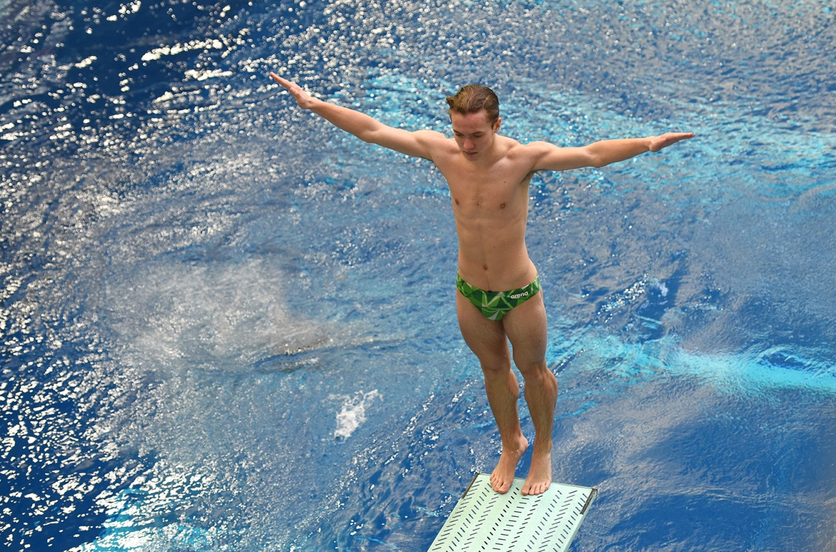
FORM OF THE DIVES
9-5-4b
Clarifies only four
oscillations are permitted
before the diver leaves
the board.
Notes:
9-5-4b:
Clarifies only four oscillations are permitted before the diver leaves the board.
Rationale: The removal of vague language (before the arms move from the starting position) clarifies there can be no more than four oscillations while on the diving board.

Slide 19
FORM OF THE DIVES
9-5-5
Added a standing forward takeoff to the description of a balk.
The balk shall be declared before the dive is scored.
A diver who fails to declare the intent to perform a forward standing takeoff (receives score of maximum 2 points) and commits a balk (mandatory deduction of 2 points), will receive a score of zero.
Notes:
Rule 9-5-5:
Added a standing forward takeoff to the description of a balk.
The balk shall be declared before the dive is scored.
A diver who fails to declare the intent to perform a forward standing takeoff (receives score of maximum 2 points) and commits a balk (mandatory deduction of 2 points), will receive a score of zero.
Rationale: It is possible to balk on a standing forward takeoff.

Slide 20
FORM OF THE DIVES
9-5-5
Unsatisfactory dives that receive a two-point deduction are not
considered "Fail Dives“, because the diver technically scores points and then
receives a deduction. They are considered Zero Sum Dives.
Examples are:
failing to come out of a somersault after committing a balk;
performing a dive in clearly the wrong position on an undeclared standing forward takeoff;
balking and then hitting the board;
failing to come out of a twist with a balk or undeclared standing forward takeoff.
Notes:
Rule 9-5-5:
Unsatisfactory dives that receive a two-point deduction are not considered "Fail Dives" because the diver technically scored points and then receives a deduction. They are considered Zero Sum Dives.
Examples:
failing to come out of a somersault after committing a balk;
performing a dive clearly in the wrong position on an undeclared standing forward takeoff;
balking and then hitting the board;
failing to come out of a twist with a balk or undeclared standing forward takeoff.
Rationale: All of these dives technically score points and then receive a deduction resulting in zero points. They should not be considered a "Fail Dive".

Slide 21
DIVING OFFICIALS
9-6-2i, 9-6-4 New
Permits announcer errors to be immediately corrected by allowing a diver to perform the correct dive prior to the next dive.
Defines process to rectify announcing errors that occur during diving competition.
Notes:
9-6-2i, 9-6-4 NEW:
Permits announcer errors to be immediately corrected by allowing a diver to perform the correct dive prior to the next dive.
Defines process to rectify announcing errors that occur during diving competition.
Rationale: Language establishes protocol when an announcer error occurs. The diver should not be penalized for the error of meet personnel.

Slide 22
Awarding points
9-7-4f, 9-7-5, 9-8-2c
9-7-4c: An undeclared standing forward takeoff was added to the unsatisfactory category.
9-7-5: A dive performed from a forward standing position was removed from the failed category.
9-8-2c: Added forward standing takeoff to the list of takeoffs in which the feet cannot leave the board without a mandatory deduction.
Notes:
Rules 9-7-4f, 9-7-5, 9-8-2c:
9-7-4c: An undeclared standing forward takeoff was added to the unsatisfactory category.
9-7-5: A dive performed from a forward standing position was removed from the failed category.
9-8-2c: Added forward standing takeoff to the list of takeoffs in which the feet cannot leave the board without a mandatory deduction.
Rationale: To define what is and what is not acceptable for divers and to assist diving referees in making the proper calls during a competition.

Slide 23
2021-22 nfhs swimming and diving Major editorial CHANGES

Slide 24
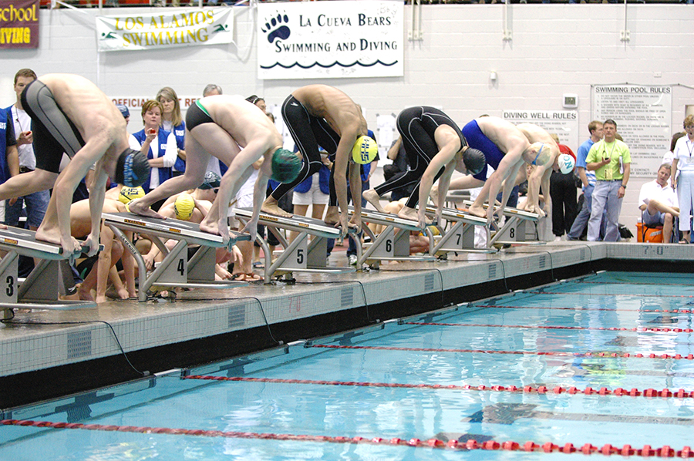
Meet management
1-4-2
Seeding is the process of assigning competitors into heats by time in swimming and by score or by lot in diving.
Notes:
Rule 1-4-2:
Seeding is the process of assigning competitors into heats by time in swimming and by score or by lot in diving.
Rationale: This definition was adjusted to describe the seeding process of both swimming and diving events. The definition formerly addressed only swimming events.

Slide 25
uniforms
3-3-2 PENALTIES 1 & 2
PENALTIES: When an official discovers a competitor wearing illegal attire as described in Article 2, the official shall:
1. When observed prior to the start of the heat/dive … If the
competitor cannot comply without delaying the start of the heat/dive, the competitor is disqualified from that event/dive and shall not be eligible for further competition until in legal attire;
2. When observed after the heat/dive officially begins … disqualify
the competitor at the completion of the heat/dive; nullify the
competitor's performance time/score and the competitor shall
not be eligible for further competition until in legal attire.
Notes:
Rule 3-3-2 PENALTIES 1 & 2:
PENALTIES: When an official discovers a competitor wearing illegal attire as described in Article 2, the official shall:
1. When observed prior to the start of the heat/dive … If the competitor cannot comply without delaying the start of the heat/ dive, the competitor is
disqualified from that event/dive and shall not be eligible for further competition until in legal attire;
2. When observed after the heat/dive officially begins … disqualify the competitor at the completion of the heat/dive; nullify the competitor's performance
time/score and the competitor shall not be eligible for further competition until in legal attire.
Rationale: The change aligns the penalty language with the rule language.

Slide 26
Stroke Judges
4-1-1, 4-4, 4-4-1, 4-4-2, 4-5-3, 4-7
SECTION 4 STROKE JUDGES
For championship meets, there shall be at least two stroke judges,
one positioned on each side of the pool, each moving along the
length of the swimming course.
Notes:
Rules 4-1-1, 4-4, 4-4-1, 4-4-2, 4-5-3, 4-7:
SECTION 4 STROKE JUDGES
For championship meets, there shall be at least two stroke judges, one positioned on each side of the pool, each moving along the length of the swimming course.
Rationale: Changed stroke inspector to stroke judge to be consistent with other officials’ titles.

Slide 27
Timing and judging
6-2-2, 6-4-1b(3)
6-1-2: When using timing devices that calibrate to the thousandth of a second, the last decimal place shall be dropped so the official time reads in the hundredths.
6-2-2: The digits representing thousandths of a second shall be dropped so the official time reads in the hundredths.
6-4-1b(3): The digits representing thousandths of a second shall be dropped so the official time reads in the hundredths.
Notes:
Rules 6-2-2, 6-4-1b(3):
6-1-2: When using timing devices that calibrate to the thousandth of a second, the last decimal place shall be dropped so the official time reads in the
hundredths.
6-2-2: The digits representing thousandths of a second shall be dropped so the official time reads in the hundredths.
6-4-1b(3): The digits representing thousandths of a second shall be dropped so the official time reads in the hundredths.
Rationale: The change aligns wording consistent with Rule 6-1-2.

Slide 28
Relay events
8-3-3
The first swimmer of a relay team, once called to the starting platform by the referee’s long whistle, shall not change the swimming order in the relay event with any teammate.
Notes:
Rule 8-3-3:
The first swimmer of a relay team, once called to the starting platform by the referee’s long whistle, shall not change the swimming order in the relay event with any teammate.
Rationale: Rule 1-4-3 defines when a race starts: A race officially begins when the swimmers are called to the starting platforms by the referee’s long whistle. The edit aligns the language of both rules.

Slide 29
Diving officials
9-6-1, 9-6-5
9-6-1: … Judges may award 10 to 0 points for any dive, independent of the other officials judges, except when the diving referee instructs the judging panel to award a maximum point value for an unsatisfactory or failed dive.
9-6-5: The scorer shall list the award given each dive by each judge in the proper order…
Notes:
Rules 9-6-1, 9-6-5:
9-6-1: Judges may award 10 to 0 points for any dive, independent of the other officials judges, except when the diving referee instructs the judging panel to award a maximum point value for an unsatisfactory or failed dive.
Rationale: Judges are not always officials in high school diving.
9-6-5: The scorer shall list the award given each dive by each judge in the proper order…
Rationale: the purpose of recording the scores is to be able to go back and verify the scores given. This isn't possible if the scores are not recorded in the proper order.

Slide 30
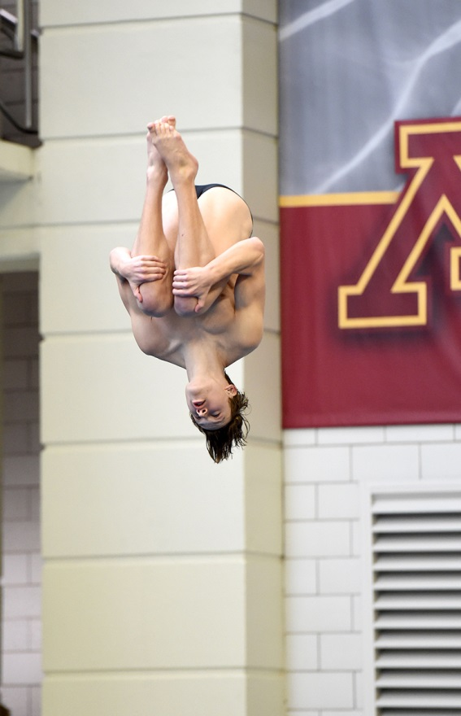
Mandatory deductions
9-8-2d
ART. 2 . . . Each diving judge shall
deduct ½ -2 points for:
d. Spreading the knees wider than
the shoulders in the tuck
position.
Notes:
Rule 9-8-2d:
ART. 2 . . . Each diving judge shall deduct ½ -2 points for:
d. Spreading the knees wider than the shoulders in the tuck position.
Rationale: Language clarifies what constitutes a judge’s deduction of ½ - 2 points.

Slide 31
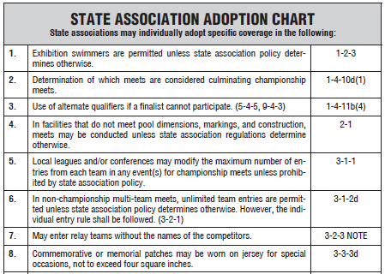
State adoption table
New to the 2021-22 Swimming
and Diving Rules Book is a State
Association Adoption Chart found
on page 91.
The chart identifies all allowable
state association adoptions found
within the rules book – providing
a summary of the rule and rules
references.
Notes:
State Adoption Table
New to the 2021-22 Swimming and Diving Rules Book is this State Association Adoption Chart found on page 91.
The chart identifies all allowable state association adoptions found within the rules book – providing a summary of the rule and rules references.

Slide 32
2021-22 nfhs swimming and diving points of emphasis

Slide 33
Suggested meet warmup procedures
Review appropriate supervision protocol, safety suggestions, management of spring lanes, and lane selection;
Warm-up procedures should focus on risk minimization;
Communicate protocol to visiting teams;
Coaches should ensure their athletes adhere to site procedures.
Notes:
Suggested Meet Warm-Up Procedures
The NFHS Swimming and Diving Rules Committee recommends schools follow the Meet Warm-up Procedures located on page 5 of the rules book. It is vitally important to review appropriate supervision protocol, safety suggestions, proper management of pace/sprint lanes, lane selection and other pertinent issues to aid in organizing warmups to ensure a safe, healthy and sportsmanlike environment. It is important each school maintains an established warm-up procedure that focuses on risk minimization and communicates that procedure to visiting schools/teams. Coaches should insist that their athletes always follow the rules and site procedures for warm-ups to provide an environment free of unnecessary injuries. This includes lane occupancy and number of athletes in the water at one time.

Slide 34
Responsibilities for counting lengths
If a lap counter malfunction occurs, it is competitor’s responsibility to count proper lengths in the 500-yard freestyle event;
If lap counter aids competitor, the competitor is disqualified;
If lap counter enters water during race, all competitors of the team in the race are disqualified;
If the starter sounds the warning device at the incorrect time competitors shall not be penalized for circumstances beyond their control.
Notes:
Responsibility of Official, Competitor and Lap Counter in Distance Events
When lap counter malfunctions (i.e., the lap counting device is inadvertently dropped into the water or an incorrect count is shown), it is the responsibility of the competitor to know the lap count and complete the prescribed distance. However, if the lap counter aids the competitor, violates deck position or interferes with the competition, the competitor in that lane shall be disqualified. All competitors of the team in the race shall be disqualified if the lap counter enters the water in accordance with Rule 3, Article 4 and penalties. In the case of the starter sounding the warning device at an incorrect time, the referee has the authority to intervene. Swimmers may be instructed to swim additional distance to complete the race; if no other remedy is usable, the referee may order the race to be re-swum when there is obvious unfairness caused by outside factors. The competitor shall not be penalized for circumstances out of the competitor’s control.

Slide 35
Updating Diving Rules
Diving rules were updated, clarified, and enhanced:
  Forward standing takeoffs are now permitted;
  Temporary adhesives are now permitted;
  Diving warmup times between sessions are defined;
  Protocol for correcting announcer errors during competition.
Notes:
Updating Diving Rules
Several rules pertaining to diving were updated, clarified, and enhanced to promote participation and risk minimization. Forward standing takeoffs are now permitted, which provides an opportunity for divers who are learning new skills to participate in the competitive environment earlier. This concept speaks to the NFHS education-based philosophy. Permitting use of temporary adhesives and promotion of diving warmup between sessions during championship meets minimizes risk to the competitor; clarification of protocol if the dive is announced incorrectly and provides the diver options for corrective action.

Slide 36
NFHS OFFICIALS Education

Slide 37







OFFICIALS EDUCATION
CONTENT IS NOW FREE
RULES
CHANGES
VIDEO
LIBRARY
OFFICIALS
COURSES
TEACHING AIDS
DIAGRAMS
Notes:
OFFICIALS EDUCATION
Every opportunity should be taken to improve upon officiating. Clinics, course work, observations, video review, and association meetings should all be considered when attempting to improve one’s skills in officiating. The NFHS has provided opportunities for officials and prospective officials to take courses and to review video to support learning and developing officiating skills.
Sport-Specific Officiating courses are offered in several sports. They are ideal for new officials and those in the first few years of officiating. These courses introduce officials to the mechanics and techniques used in the sport and provide specific information on an area within that sport. Individuals can complete a course within 30-45 minutes. These courses are free to all licensed officials and prospective officials.
“Interscholastic Officiating” is a general course on sports officiating and it is free to all officials. This course provides an introduction to skills and concepts used as an official. Several topics are covered such as: basics of becoming an official and continuing to officiate, science of officiating, art of officiating, how to combine these skills for successful officiating.
Video clips are made available to NFHS Officials Association members. The video is clipped on specific topics and provides the rules references as well as dialogue on the topic.
The courses and videos are offered at www.NFHSLearn.com .
Courses Available:
Officiating Football
Officiating Volleyball – Ball Handling
Officiating Volleyball – Alignment
Officiating Basketball
Officiating Basketball – Three-Person Mechanics
Soccer – Fouls and Misconduct
Soccer - Offside
Swimming and Diving
Officiating Wrestling
Umpiring Softball
Future Courses to be Considered:
Umpiring Baseball
Field Hockey
Track and Field
Umpiring Softball – Mechanics
Communication Among Officials and Coaches

Slide 38

Notes:
Your Complete Solution for Officials Management and More:
Registration
Assignment
Payment
Testing
Background Checks
For More Information on the NFHS – Center for Officials Services (COS) Contact:
Davis Whitfield, NFHS, dwhitfield@nfhs.org or Karissa Niehoff, NFHS, kniehoff@nfhs.org

Slide 39
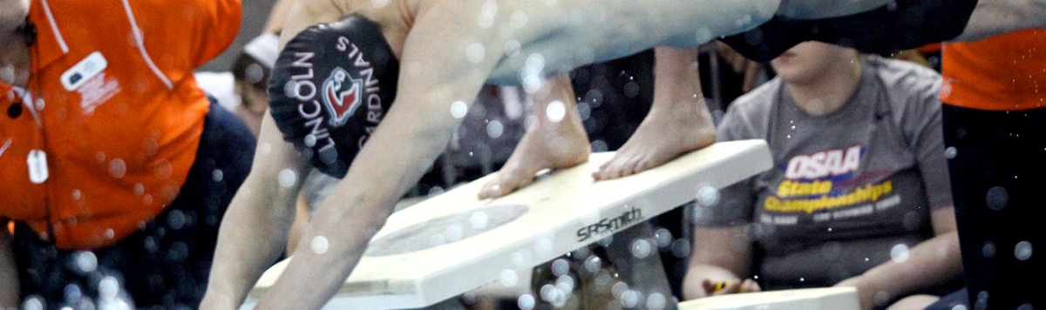



Officiating Swimming & Diving
Course Objectives
Units
Understand the roles of professionalism, rules knowledge, and communication and how they help ensure a fair meet.
Know how to consistently identify swimming violations in each type of event.
Learn the elements of a proper dive and how to score dives appropriately.
Elements of Professional Development
Officiating Swimming
Officiating Diving
Judging Practicum
Unlimited access to course for 1 year from the date of purchase
Approved by NFHS for 3 course clock hours
Notes:
Officiating Swimming and Diving is a course developed by the NFHS in conjunction with the National Interscholastic Swim Coaches Association (NISCA) and USA Diving. This course defines the elements of professional development and the fundamentals of officiating strokes and turns. The course also explores officiating and judging diving and provides a judging practicum that includes feedback of submitted scores. Officials may select either the swimming track, the diving track, or both, depending on rules required by their state association.
More:
- Unlimited access to course & resources for one year from date of purchase
- Use as an elective to fulfill AIC or CIC certification requirements

Slide 40
NFHS Learning Center

Slide 41

Notes:
The NFHS Learning Center, accessed at NFHSLearn.com has over 70 online professional development courses for the entire interscholastic community, including coaches, administrators, officials, parents, students, and individuals within performing arts programs. The mission and purpose of the NFHS Learning Center is focused on growing professional development opportunities. Those opportunities include courses, but now also incorporate additional videos such as “The Parent Seat” and “Beyond The Scoreboard,” which are short videos created to show to parents at Parent Meetings or show during events. The NFHS Learning Center has delivered over 10,000,000 courses and looks to continue to educate and be a valuable resource for the entire interscholastic community. Learn more at NFHSLearn.com!

Slide 42

Notes:
The NFHS has partnered with the National Interscholastic Swim Coaches Association to present the online Coaching Swimming course. Go to www.nfhslearn.com to view the trailer, description and outline for this course. Encourage your coaches to sign-up today!

Slide 43
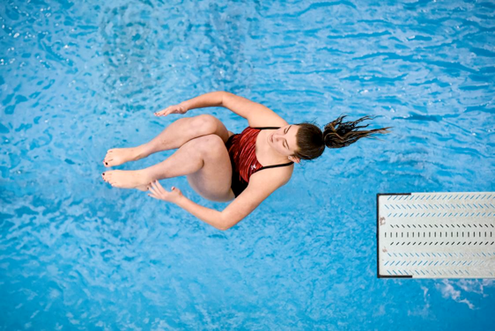
www.nfhslearn.com
Coaching Diving
Course Objectives
Units
Coaching Fundamentals: components of a dive, direction designations and position designations
Dryland: body positioning, drills, basic jumping skills and hurdle progressions
Forward and Backward Dives: feet-first entry, front fall-in, headfirst entry
Inward, Reverse and Twisting Skills: demonstrations and testing
Teaching Methodology
Fundamentals
Dryland Skills
Forward Skills
Backward Skills
Inward Skills
Reverse Skills
Twisting Skills
www.nfhs.org
Notes:
Coaching Diving is a course developed by the NFHS in conjunction with the National Interscholastic Swim Coaches Association (NISCA) and USA Diving. This course teaches the fundamentals of becoming an effective diving coach. The course explores the different types of dives and the training required to execute the to the best of the diver’s ability.
More:
- Unlimited access to course & resources for one year from date of purchase.
- Use as an elective to fulfill AIC or CIC certification requirements.

Slide 44
NFHS Network

Slide 45


NFHS Network
By 2025, every high school sporting event in America will be streamed live.
The NFHS Network will be
THE DESTINATION for fans
to view these broadcasts.
There will be 27 Different Sports and Activities.
www.NFHSnetwork.com
Notes:
The NFHS Network is the leader in streaming Live and On Demand high school sports.
Partnered with the National Federation of State High School Associations, 45 high school state athletic/activities associations, and PlayOn! Sports, the NFHS Network is a joint venture created to provide fans with the ability to stream high school sports on any device, from wherever they are.
All NFHS Network events are available to watch online at www.NFHSnetwork.com and through the NFHS Network Live App for iOS and Android. Follow us on Facebook, Twitter, Instagram, and YouTube.
Watching high school sports and events has never been easier.
The NFHS Network’s goal is to broadcast live all 2 two million high school sporting events by 2025.
The NFHS Network covers 27 different regular season and postseason sports, as well as other high school activities, celebrating the accomplishments of students-athletes, student broadcasters, and high schools across the country.

Slide 46

Notes:
The NFHS Network will broadcast over 150,000 live events this year. If your school is not a member of the NFHS Network School Broadcast Program, please contact NFHS staff member Mark Koski at Mark.Koski@NFHSnetwork.com.

Slide 47
2021 nfhs swimming and diving resources

Slide 48

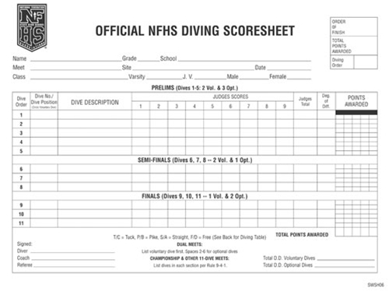
NFHS swimming and diving publications
The Rules Book, Scorebook and other Swimming and Diving materials can be ordered online at www.nfhs.com, or by calling 1-800-776-3462.
Notes:
The NFHS swimming and diving publications are available to order online or by using the toll-free number.

Slide 49


NFHS swimming and diving publications
The revised manuals will be available
July 1, 2021.
Notes:
The NFHS Swimming Officials Guideline Manual and the Diving Officials Guidelines Manual will be available July 1st on the swimming and diving page of www.nfhs.org. The manuals are posted in word format so that state associations may tailor them to fit their specific needs.

Slide 50

Thank You
National Federation of State High School Associations
PO Box 690 | Indianapolis, IN 46206
Phone: 317-972-6900 | Fax: 317.822.5700
www.nfhs.org | www.nfhslearn.com | www.nfhsnetwork.com

