Slide 1
2020-21 NFHS Soccer Rules PowerPoint
Rules Changes
Major Editorials
Points of Emphasis

Slide 2
National federation of state high school associations (NFHS)
2021-22 SOCCER INFORMATION
Notes:
2021-22 NATIONAL FEDERATION OF STATE HIGH SCHOOL ASSOCIATIONS (NFHS)

Slide 3
SOCCER ANNOUNCEMENTS
Mid-Season Webinars
  Fall – September 16, 2021; 2:00 p.m.
  Spring - April 7, 2022; 2:00 p.m.
  Fall – September 15, 2022; p.m.
Rule Change Proposal Form is now Open for Soccer
Proposals Due Date – November 1
Soccer Interpretations – distributed later this month
Notes:
SOCCER ANNOUNCEMENTS
Mid-Season Webinars
Fall – September 16, 2021; 2:00 p.m.
Spring - April 7, 2022; 2:00 p.m.
Fall – September 15, 2022; p.m.
Rule Change Proposal Form is now Open for Soccer
Proposals Due Date – November 1
Soccer Interpretations – distributed later this month

Slide 4
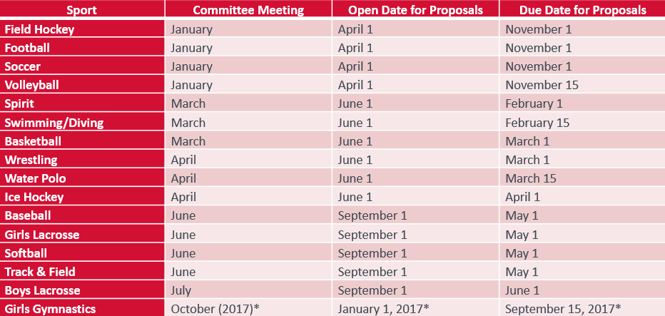
Standardized Open and Close Dates for NFHS Rule Change Proposal submission
*These are standard annual open and close dates with the exception of girls gymnastics which will always occur during odd number year. (i.e. 2017, 2019, etc.)

Slide 5
National federation of state high school associations (NFHS)
2021-22 ABOUT NFHS
Notes:
2021-22 NATIONAL FEDERATION OF STATE HIGH SCHOOL ASSOCIATIONS (NFHS)

Slide 6

National Federation of
State High School Associations
NFHS (located in Indianapolis, IN – Est. 1920):
  National leader and advocate for
  high school athletics and
  performing arts programs.
  Serves 51 state associations, 19,500
  high schools and 12 million student
  participants.
  Writes playing rules for 17 high school
  sports for boys and girls.
  Offers online education courses for high school coaches,
  officials, parents, students and others.
  Ensures that students have opportunity to enjoy healthy participation, achievement and good sportsmanship in education-based athletics.
Notes:
National Federation of State High School Associations
NFHS (located in Indianapolis, IN – Est. 1920):
National leader and advocate for
high school athletics and
performing arts programs.
Serves 51 state associations, 19,500
high schools and 12 million student
participants.
Writes playing rules for 17 high school
sports for boys and girls.
Offers online education courses for high school coaches,
officials, parents, students and others.
Ensures that students have opportunity to enjoy healthy participation, achievement and good sportsmanship in education-based athletics

Slide 7
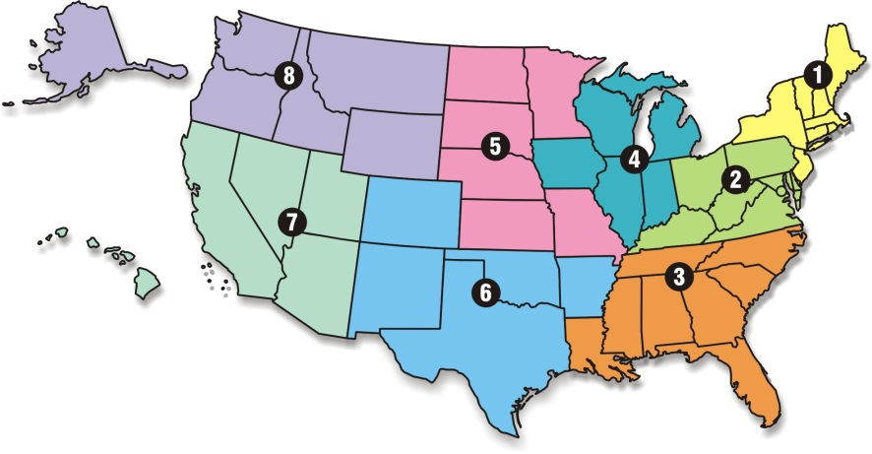



NFHS SOCCER RULES COMMITTEE
Dr. Karissa L. Niehoff
NFHS
Publisher
Theresia Wynns
NFHS
Editor
Dr. Stan Latta
State College, PA
Chair - 2023
Mark Berkowitz
Weston, CT
Coaches - 2022
Gibby Reynolds
Wilsonville, OR
Officials - 2024
Mike Andrew
Binghamton, NY
Section 1 - 2024
John Johnson
Wadsworth, OH
Section 2 - 2022
Alex Ozuna
Alachua, FL
Section 3 - 2021
Andy Frushour
East Lansing, MI
Section 4 - 2022
John Krogstrand
Pierre, SD
Section 5 - 2021
Joey Walters
North Little Rock, AR
Section 6 - 2024
Daniel Klein
Mesa, AZ
Section 7 - 2023
Kevin Skaggs
Buffalo, WY
Section 8 - 2021

Slide 8








NFHS Rules Review Committee
The NFHS Rules Review Committee is chaired by the chief operating officer and composed of all rules editors. After each committee concludes its deliberations and has adopted its recommended changes for the subsequent year, such revisions will be evaluated by the Rules Review Committee.
Davis Whitfield
Chief Operating Officer
Lindsey Atkinson
Girls Lacrosse and Volleyball
Bob Colgate
Football and Sports
Medicine
Sandy Searcy
Softball, Swimming & Diving and Water Polo
Elliot Hopkins
Baseball and Wrestling
Julie Cochran
Cross Country, Gymnastics, Field Hockey and
Track & Field
James Weaver
Boys Lacrosse
and Spirit
Theresia Wynns
Basketball and Soccer
Dan Schuster
Ice Hockey
Notes:
NFHS RULE REVIEW COMMITTEE
The NFHS Rules Review Committee is chaired by the chief operating officer and composed of all rules editors. After each committee concludes its deliberations and has adopted its recommended changes for the subsequent year, such revisions will be evaluated by the Rules Review Committee.

Slide 9



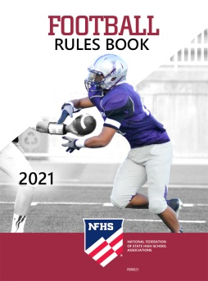














National Federation of
State High School Associations
The NFHS writes playing rules for 17 sports
for boys and girls at the high school level.
  Publishes 4 million pieces of materials annually.
Notes:
NATIONAL FEDERATION OF STATE HIGH SCHOOL ASSOCIATIONS
The NFHS writes playing rules for 17 sports
for boys and girls at the high school level.
Publishes 4 million pieces of materials annually.

Slide 10

NFHS Rules Book as e-Books
E-books features:
  Searchable
  Highlight areas of interest
  Make notes
  Easy navigation
  Adjustable viewing size
  Immediate availability
Notes:
NFHS RULES BOOK AS E-BOOKS
E-books features:
Searchable
Highlight areas of interest
Make notes
Easy navigation
Adjustable viewing size
Immediate availability

Slide 11
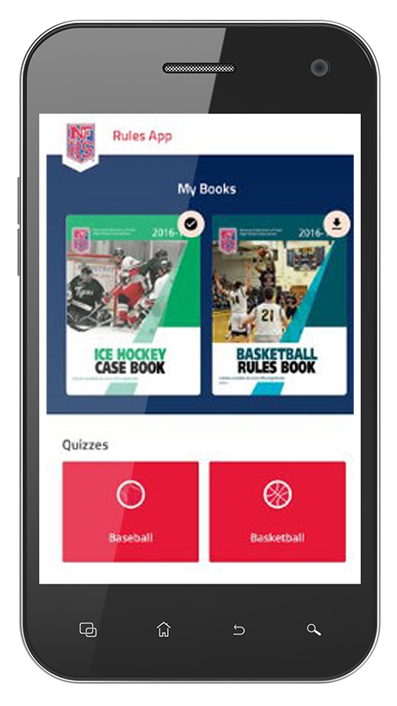
NEW NFHS Rules App
Rules App features:
  Searchable
  Highlight notes
  Bookmarks
  Quizzes for all sports
  Easy navigation
  Immediate availability
  Free to paid members of the NFHS Coaches
  and Officials Associations
  www.nfhs.org/erules for more information
Notes:
NFHS RULES APP
Rules App features:
Searchable
Highlight notes
Bookmarks
Quizzes for all sports
Easy navigation
Immediate availability
Free to paid members of the NFHS Coaches
and Officials Associations
www.nfhs.org/erules for more information

Slide 12
2021-22 nfhs SOCCER RULES CHANGES
Notes:
2021-22 NFHS SOCCER RULES CHANGES

Slide 13
Rule 4-2-10 NEW Head coverings
Head coverings worn for religious reasons shall not be made of abrasive or hard materials; and must fit securely.
Notes:
Rule 4-2-10 NEW Head Coverings
Head coverings worn for religious reasons shall not be made of abrasive or hard materials; and must fit securely.

Slide 14

Head Covering Worn for Religious Reasons: 4-2-10 NEW
Players wearing head coverings for religious reasons are permitted to play provided the head covering is not abrasive, hard, or dangerous to any other player and is securely attached.
A note from the state association is not necessary.
Cannot be attached with items made of metal, i.e., clips, bobby pins, barrettes.
LEGAL
LEGAL
Notes:
Head Covering Worn for Religious Reasons: 4-2-10 NEW
Players wearing head coverings for religious reasons are permitted to play provided the head covering is not abrasive, hard, or dangerous to any other player and is securely attached.
A note from the state association is not necessary.
Cannot be attached with items made of metal, i.e., clips, bobby pins, barrettes.

Slide 15
Rule 4-2-11 HEAD COVERING FOR
MEDICAL REASONS
In addition to the above permitted uses, state associations (or designee) may on an individual basis permit a player to participate while wearing a head covering for medical or cosmetic reasons if it is required by a licensed physician. A physician’s statement is required before the state association can approve a covering which is not abrasive, hard or dangerous to any other player and which is attached in such a way it is highly unlikely that it will come off during play.
Notes:
RULE 4-2-11 New Article
In addition to the above permitted uses, state associations (or designee) may on an individual basis permit a player to participate while wearing a head covering for medical or cosmetic reasons if it is required by a licensed physician. A physician’s statement is required before the state association can approve a covering which is not abrasive, hard or dangerous to any other player and which is attached in such a way it is highly unlikely that it will come off during play.

Slide 16
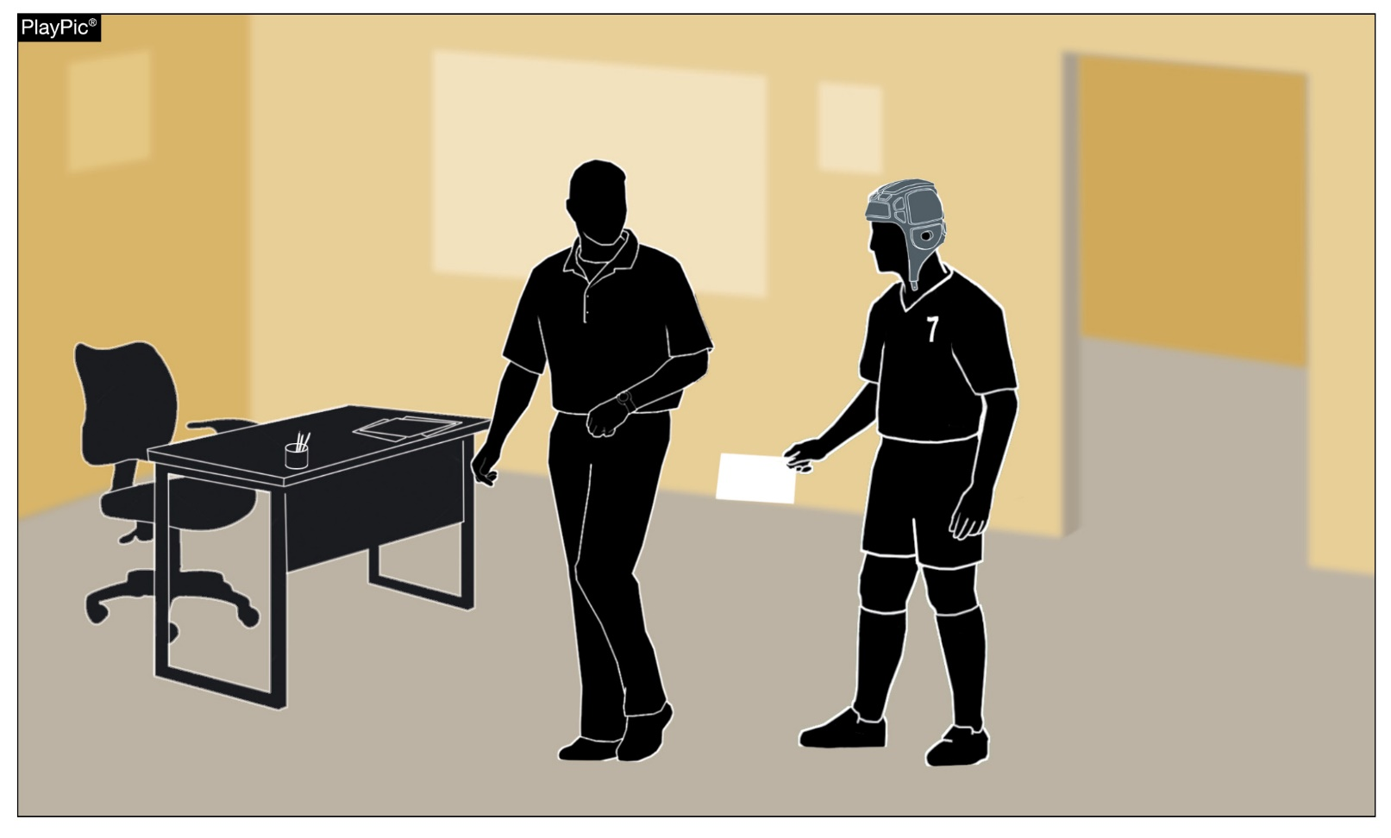
Head Covering Worn for Medical/Cosmetic Reasons: 4-2-11 New
Players must have a doctor’s note and seek state association permission to wear a head covering to play. State permission must be in writing.
Notes:
Head Covering Worn for Medical/Cosmetic Reasons: 4-2-11 New
Players must have a doctor’s note and seek state association permission to wear a head covering to play. State permission must be in writing.

Slide 17
2021-22 nfhs SOCCER editorial CHANGES
Notes:
2021-22 NFHS SOCCER EDITORIAL CHANGES

Slide 18
RULE 13-3-2 FREE KICK – HOW TAKEN
The ball shall be kicked while it is stationary on the ground at the spot specified by the official. The ball is in play when it is kicked and moves.
Notes:
RULE 13-3-2
The ball shall be kicked while it is stationary on the ground at the spot specified by the official. The ball is in play when it is kicked and moves.
Rationale: Replace with wording from 16-1-3- says more simply "the ball is in play when it is kicked and moves." Consistency in language will help prevent misunderstanding by officials that the requirement is different. Rule 13-3-2 and Rule 16-1-3 establish that a ball is in play on a free kick from inside the penalty area and from a goal kick when kicked and moved but do so in different language.

Slide 19

Free Kick — How Taken: 13-3-2
The ball is in play when it is kicked, and it moves.
Notes:
Free Kick — How Taken: 13-3-2
The ball is in play when it is kicked, and it moves.

Slide 20
2021-22 soccer pointS of emphasis
Notes:
2021-22 SOCCEER POINTS OF EMPHASIS

Slide 21
Properly Worn Uniforms and Marked Fields
It is important that games are played on fields marked in a consistent manner, and players wear uniforms according to NFHS rules. If a field is improperly marked and/or if a team wears an illegal uniform the referee shall contact the state association, who will work with school administrators to make appropriate changes. In addition, during pregame communication with school administration, game officials are also encouraged to communicate these corrective actions directly to administrators.
Notes:
Properly Worn Uniforms and Marked Fields
It is important that games are played on fields marked in a consistent manner, and players wear uniforms according to NFHS rules. If a field is improperly marked and/or if a team wears an illegal uniform the referee shall contact the state association, who will work with school administrators to make appropriate changes. In addition, during pregame communication with school administration, game officials are also encouraged to communicate these corrective actions directly to administrators.

Slide 22
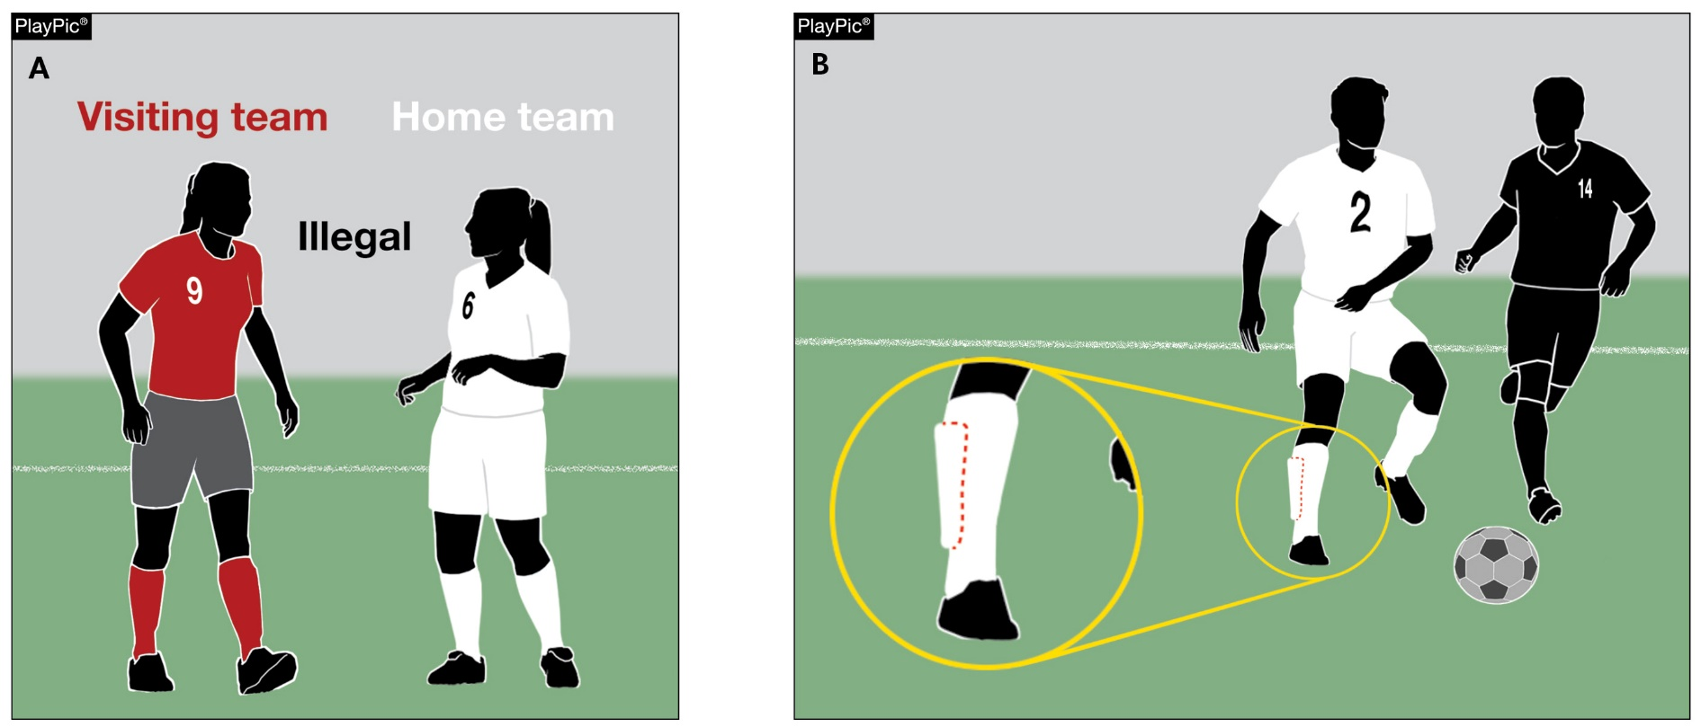
Properly Worn Uniforms and Marked Fields
The home team must wear darker colored jerseys and the visiting team must wear white jerseys (PlayPic A).
In PlayPic B, the player is not wearing shin guards as intended to be worn. Players should wear equipment as it is intended to be worn.
Notes:
Properly Worn Uniforms and Marked Fields
The home team must wear darker colored jerseys and the visiting team must wear white jerseys (PlayPic A).
In PlayPic B, the player is not wearing shin guards as intended to be worn. Player should wear equipment as it is intended to be worn.

Slide 23
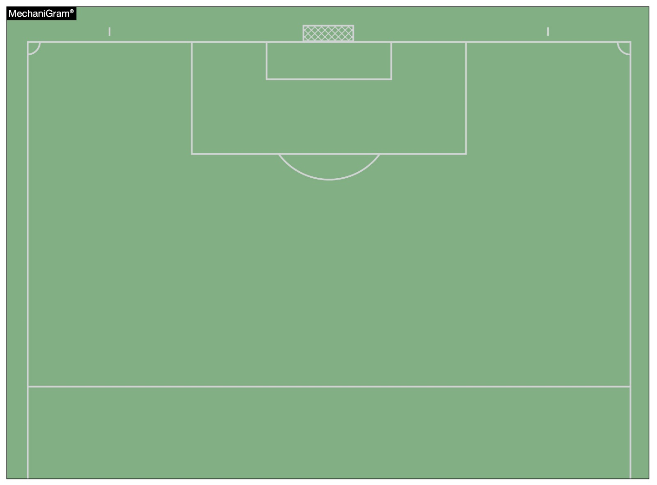
Properly Worn Uniforms and Marked Fields
The fields should be properly marked.
Non-compliance of field markings should be reported to the school athletic administrator and the state association.
The game is still played.
In the MechaniGram, the center circle is not marked as required by rule.
Notes:
Properly Worn Uniforms and Marked Fields
The fields should be properly marked.
Non-compliance of field markings should be reported to the school athletic administrator and the state association.
The game is still played.
In the MechaniGram, the center circle is not marked as required by rule.

Slide 24
Reckless and Serious Foul Play
Soccer is a contact sport and as such officials must be prepared to effectively manage the flow and intensity of the game. Understanding the differences between fair and hard play and a foul that is either Reckless or Serious is important to ensuring fair play and the safety of the players. Reckless play is defined as “a player has acted with disregard of the danger to, or consequences for, the opponent. A player who displays reckless play shall be cautioned.” Serious Foul Play is defined as “any play in which the player commits one of the offenses punishable with a direct free kick and uses disproportionate and unnecessary force against an opponent while playing for the ball.” It is critical that officials recognize the differences between the two and the corresponding penalty.
Notes:
Reckless and Serious Foul Play
Soccer is a contact sport and as such officials must be prepared to effectively manage the flow and intensity of the game. Understanding the differences between fair and hard play and a foul that is either Reckless or Serious is important to ensuring fair play and the safety of the players. Reckless play is defined as “a player has acted with disregard of the danger to, or consequences for, the opponent. A player who displays reckless play shall be cautioned.” Serious Foul Play is defined as ”any play in which the player commits one of the offenses punishable with a direct free kick and uses disproportionate and unnecessary force against an opponent while playing for the ball.” It is critical that officials recognize the differences between the two and the corresponding penalty.

Slide 25
Reckless and Serious Foul Play (con’t.)
Although officials cannot eliminate a player from engaging in reckless or serious foul play, there are Preventive mechanics that can be used to control this type of play from occurring during the
match by:
  Addressing fair play and good sportsmanship during the pregame meeting with the coach- es and captains. Let them know your expectations for competitive and fair play.
  Talk to the players and captains during the match. When the intensity of play increases and fouls become more prevalent remind the players of your expectations. Control the temperature of play by warning, whistle and when necessary, cards.
  Deal with reckless and serious foul play immediately. Be sure to let the players and coaches know that you will not tolerate that level of play during the match. When warranted use cards to address these behaviors.
  Use of Headsets. Officials who have used headsets in communicating between and among the crew have found this to be an effective tool in helping to control play and deal immediately with unsporting and dangerous play.
Notes:
Reckless and Serious Foul Play, con’t.
Although officials cannot eliminate a player from engaging in reckless or serious foul play, there are Preventive mechanics that can be used to control this type of play from occurring during the
match by:
Addressing fair play and good sportsmanship during the pregame meeting with the coach- es and captains. Let them know your expectations for competitive and fair play.
Talk to the players and captains during the match. When the intensity of play increases and fouls become more prevalent remind the players of your expectations. Control the temperature of play by warning, whistle and when necessary, cards.
Deal with reckless and serious foul play immediately. Be sure to let the players and coaches know that you will not tolerate that level of play during the match. When warranted use cards to address these behaviors.
Use of Headsets. Officials who have used headsets in communicating between and among the crew have found this to be an effective tool in helping to control play and deal immediately with unsporting and dangerous play.

Slide 26
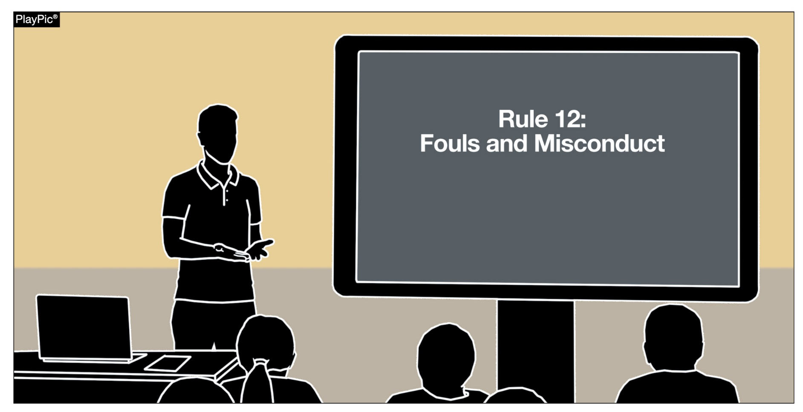
Reckless and Serious Foul Play
Referees are encouraged to attend meetings and view videos — when possible — to discuss and learn more about fouls and misconduct.
Notes:
Reckless and Serious Foul Play
Referees are encouraged to attend meetings and view videos — when possible — to discuss and learn more about fouls and misconduct.

Slide 27
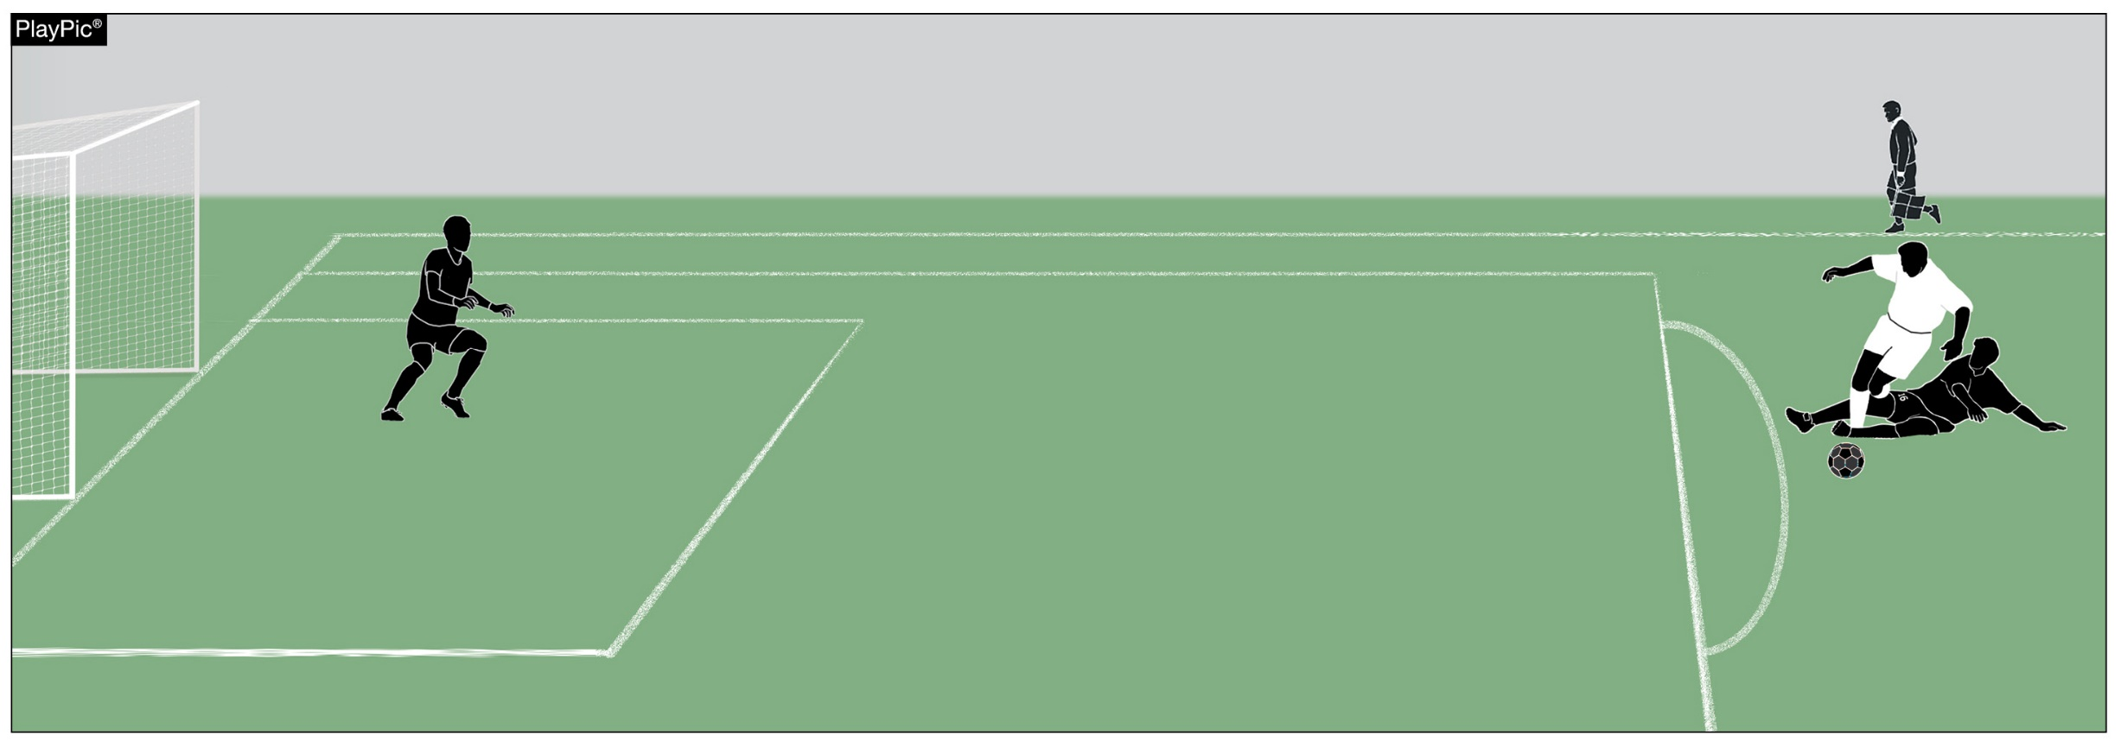
Reckless and Serious Foul Play: Denial of Goal Scoring Opportunity
When an attacker is fouled and denied a goal scoring opportunity outside the penalty area and a goal is not scored, the fouling player is disqualified (red card).
Notes:
Reckless and Serious Foul Play: Denial of Goal Scoring Opportunity
When an attacker is fouled and denied a goal scoring opportunity outside the penalty area and a goal is not scored, the fouling player is disqualified (red card).

Slide 28
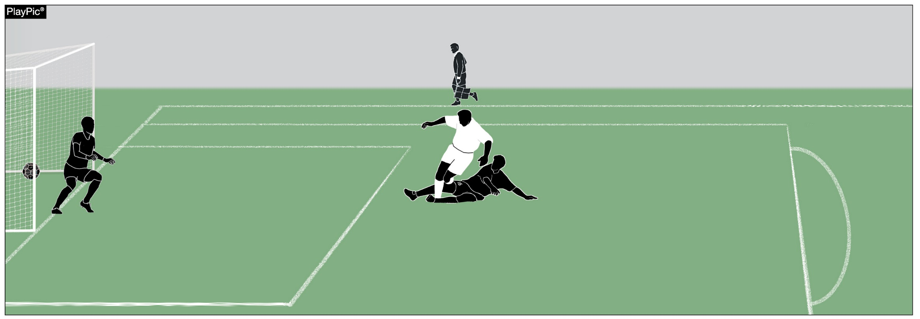
Reckless and Serious Foul Play: Denial of Goal Scoring Opportunity
When an attacker is fouled and the goal is scored, the fouling player is cautioned (yellow card).
Notes:
Reckless and Serious Foul Play: Denial of Goal Scoring Opportunity
When an attacker is fouled and the goal is scored, the fouling player is cautioned (yellow card).

Slide 29
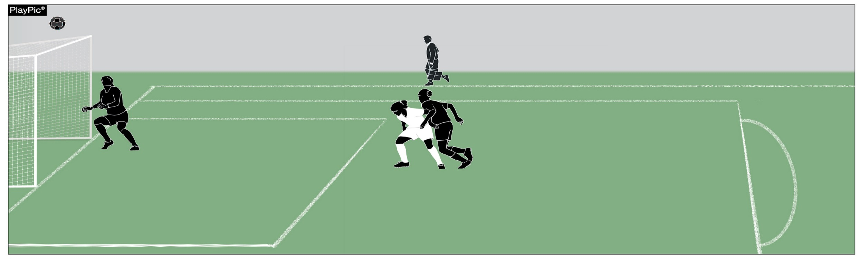
Reckless and Serious Foul Play: Denial of Goal Scoring Opportunity
A player who commits a foul inside the penalty area in an attempt to play the ball and a goal is not scored and the referee awards a penalty kick the fouling player is cautioned. If the player commits a foul while not attempting to play the ball and the goal is not scored and the referee awards a penalty kick , the fouling player is disqualified (red card).
Notes:
Reckless and Serious Foul Play: Denial of Goal Scoring Opportunity
A player who commits a foul inside the penalty area in an attempt to play the ball and a goal is not scored and the referee awards a penalty kick the fouling player is cautioned. If the player commits a foul while not attempting to play the ball and the goal is not scored and the referee awards a penalty kick , the fouling player is disqualified (red card).

Slide 30
High School Athletics is Education-Based
High school athletics are education-based, and for this reason some mechanics of our game are intentionally different from other levels of soccer. Playing sports and participating in interscholastic activities is a privilege that students earn by maintaining academic standards and good conduct in and outside the classrooms.
As an extension of the classroom, the goal of education-based athletics, in addition to core academic subjects learned in the classroom, is that students experience additional educational opportunities through their participation in sports. Beyond the specific skills of a sport, these individuals can learn important principles that can guide them the rest of their lives. Learning the life skills of sportsmanship, playing by the rules, teamwork and perseverance will pay huge dividends throughout these students’ lives. Certainly, improving skills and winning games is a part of the overall goal, but the quest to win games, events, and championships cannot come at the expense of providing these educational opportunities.
Notes:
High School Athletics is Education-Based
High school athletics are education-based, and for this reason some mechanics of our game are intentionally different from other levels of soccer. Playing sports and participating in interscholastic activities is a privilege that students earn by maintaining academic standards and good conduct in and outside the classrooms.
As an extension of the classroom, the goal of education-based athletics, in addition to core academic subjects learned in the classroom, is that students experience additional educational opportunities through their participation in sports. Beyond the specific skills of a sport, these individuals can learn important principles that can guide them the rest of their lives. Learning the life skills of sportsmanship, playing by the rules, teamwork and perseverance will pay huge dividends throughout these students’ lives. Certainly, improving skills and winning games is a part of the overall goal, but the quest to win games, events, and championships cannot come at the expense of providing these educational opportunities.

Slide 31
High School Athletics is Education-Based (con’t.)
The required pregame meeting is a time for officials to communicate expectations to both head coaches and captains. This meeting for both head coaches and captains should cover pertinent rules, sportsmanship, the coin toss, and legally equipped players. This meeting is a purposeful start to an education-based interscholastic match.
Notes:
High School Athletics is Education-Based, con’t.
The required pregame meeting is a time for officials to communicate expectations to both head coaches and captains. This meeting for both head coaches and captains should cover pertinent rules, sportsmanship, the coin toss, and legally equipped players. This meeting is a purposeful start to an education-based interscholastic match.

Slide 32
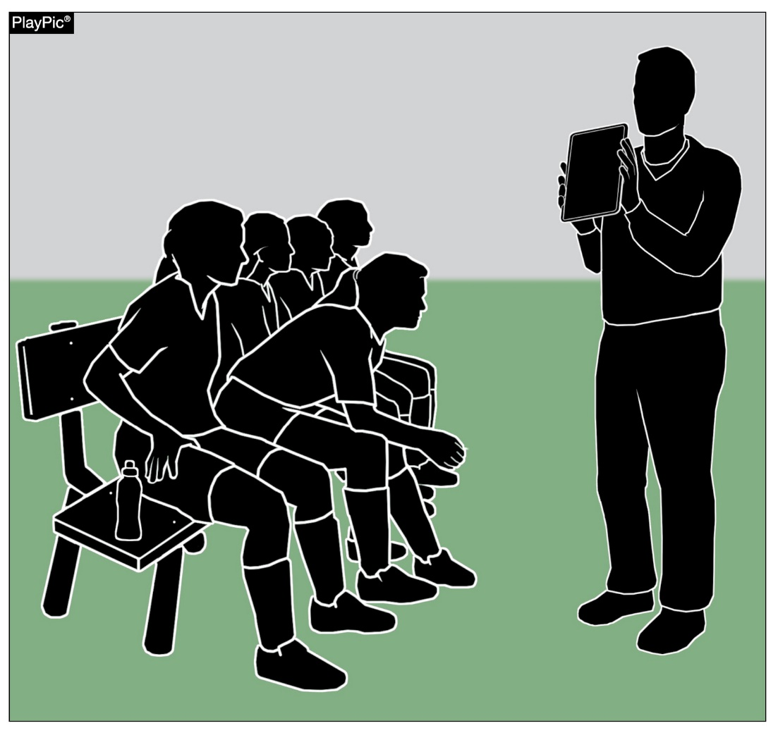
High School Athletics is Education-Based
The soccer pitch is a classroom. Coaches are responsible for helping players understand the fine points of the game.
Notes:
High School Athletics is Education-Based
The soccer pitch is a classroom. Coaches are responsible for helping players understand the fine points of the game.

Slide 33
Sportsmanship
Interscholastic athletic programs must promote good character, enhance the integrity of education, and foster civility in society. Student-athletes, coaches and all others associated with interscholastic athletic programs, as well as those who attend interscholastic athletic events, should adhere to the fundamental values of honesty, integrity, respect, caring, cooperation, trustworthiness, leadership, tolerance, and personal responsibility.
The message of good sportsmanship should be addressed by school administration with their students, coaches, parents, and spectators alike, which includes a message which prohibits taunting and the use of profanity during games. Coaches and officials should model good sportsmanship during the pregame, game, and post-game. A short but firm statement by the official outlining the action that will be taken for unsporting conduct would be appropriate. Check with your state association. They may have provided a statement for use by officials in the pre-game meeting.
Notes:
Sportsmanship
Interscholastic athletic programs must promote good character, enhance the integrity of education, and foster civility in society. Student-athletes, coaches and all others associated with interscholastic athletic programs, as well as those who attend interscholastic athletic events, should adhere to the fundamental values of honesty, integrity, respect, caring, cooperation, trustworthiness, leadership, tolerance, and personal responsibility.
The message of good sportsmanship should be addressed by school administration with their students, coaches, parents, and spectators alike, which includes a message which prohibits taunting and the use of profanity during games. Coaches and officials should model good sportsmanship during the pregame, game, and post-game. A short but firm statement by the official outlining the action that will be taken for unsporting conduct would be appropriate. Check with your state association. They may have provided a statement for use by officials in the pre-game meeting.

Slide 34
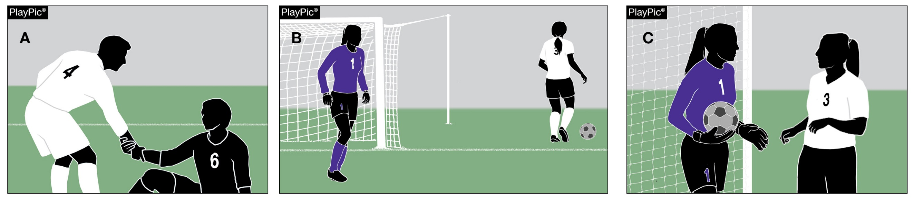
Sportsmanship
Positive sporting habits are expected of players, coaches, spectators, and others involved with the game.
In PlayPic A, #4 helps up opponent #6. In PlayPics B and C, #3 chases down the ball for the opposing goalkeeper, #1.
Notes:
Sportsmanship
Positive sporting habits are expected of players, coaches, spectators, and others involved with the game.
In PlayPic A, #4 helps up opponent #6. In PlayPics B and C, #3 chases down the ball for the opposing goalkeeper, #1.

Slide 35
Professional Responsibilities for Officials
Officials are an integral part of education-based athletics and for this reason it is important that officials conduct themselves in a professional manner that upholds the dignity of this vital role. For this reason, an official shall prepare themselves both physically and mentally, shall dress neatly and appropriately, shall master both the rules of the game and the mechanics necessary to enforce the rules, shall exercise impartial authority in a firm and controlled manner and shall stay up to date with game management and health and safety requirements. Additionally, officials shall uphold the honor and dignity of the profession in all interactions with student-athletes, coaches, school administrators and spectators alike.
It is important that officials take steps to educate themselves with the NFHS Officials Code of Ethics in the soccer rules book as well as their state association’s officials’ handbooks.
Notes:
Professional Responsibilities for Officials
Officials are an integral part of education-based athletics and for this reason it is important that officials conduct themselves in a professional manner that upholds the dignity of this vital role. For this reason, an official shall prepare themselves both physically and mentally, shall dress neatly and appropriately, shall master both the rules of the game and the mechanics necessary to enforce the rules, shall exercise impartial authority in a firm and controlled manner and shall stay up to date with game management and health and safety requirements. Additionally, officials shall uphold the honor and dignity of the profession in all interactions with student-athletes, coaches, school administrators and spectators alike.
It is important that officials take steps to educate themselves with the NFHS Officials Code of Ethics in the soccer rules book as well as their state association’s officials’ handbooks.

Slide 36
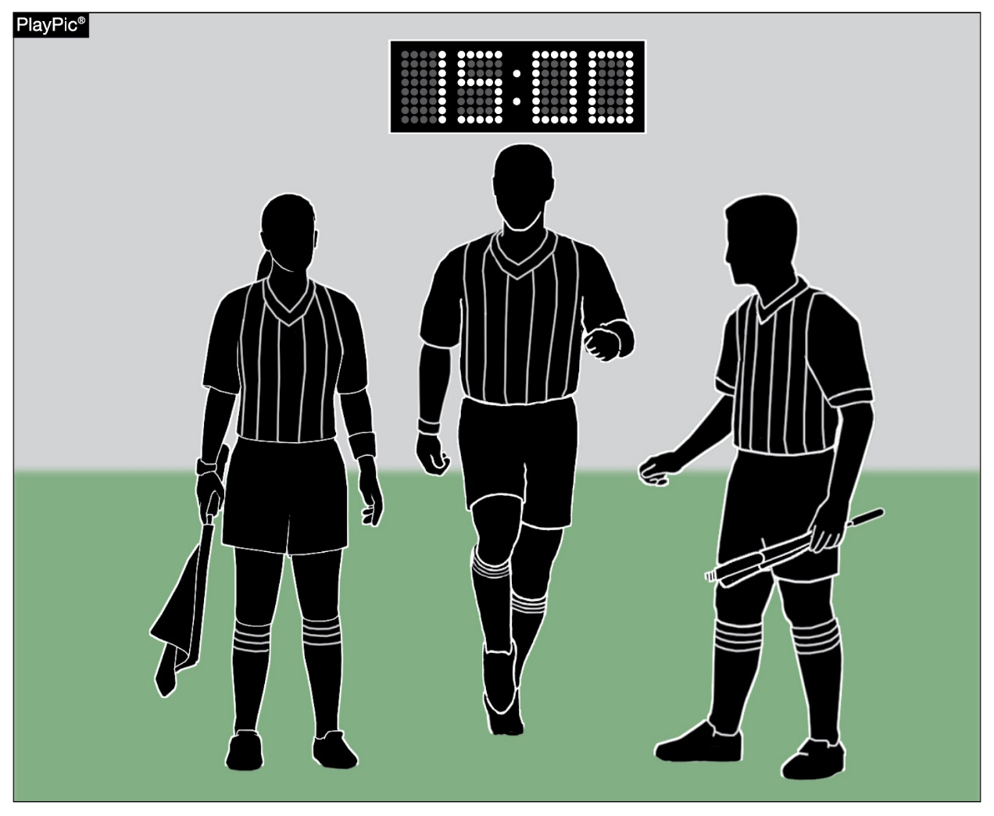
Professional responsibilities for officials
It is important for contest officials to conduct themselves in a professional manner that upholds the dignity of the position. This includes arriving on time, conducting the proper pregame, knowing and applying the NFHS rules properly, speaking to players and coaches in a professional manner, and completing any necessary postgame reports.
Notes:
Professional Responsibilities for Officials
It is important for contest officials to conduct themselves in a professional manner that upholds the dignity of the position. This includes arriving on time, conducting the proper pregame, knowing and applying the NFHS rules properly, speaking to players and coaches in a professional manner, and completing any necessary postgame reports.

Slide 37
2021-22 NFHS OFFICIALS Education
Notes:
2021-22 NFHS OFFICIALS EDUCATION

Slide 38







OFFICIALS EDUCATION CONTENT IS NOW FREE
TEACHING AIDS
RULES
CHANGES
VIDEO
LIBRARY
OFFICIALS
COURSES
DIAGRAMS
Notes:
OFFICIALS EDUCATION
Every opportunity should be taken to improve upon officiating. Clinics, course work, observations, video review, association meetings should all be considered when attempting to improve one’s skills in officiating. The NFHS has provided opportunities for officials and prospective officials to take courses and to review video to support learning and developing officiating skills.
Sport-Specific Officiating courses are offered in several sports. They are ideal for new officials and those in the first few years of officiating. These courses introduce officials to the mechanics and techniques used in the sport and provide specific information on an area within that sport. Individuals can complete a course within 30-45 minutes. These courses are free to all licensed officials and prospective officials.
“Interscholastic Officiating” is a general course on sports officiating, and it is free to all officials and prospective officials. This course introduces interested persons to skills and concepts used as an official. Several topics are covered such as: basics of becoming and staying an official, science of officiating, art of officiating, how to combine these skills for successful officiating.
Video clips are made available to NFHS Officials Association members. The video is clipped on specific topics and provides the rules references as well as dialogue on the topic.
The courses and videos are offered at www.NFHSLearn.com .
Courses Available:
Officiating Football
Officiating Volleyball – Ball Handling
Officiating Volleyball – Alignment
Officiating Volleyball – E-Whistle
Officiating Basketball
Officiating Basketball – Three-Person Mechanics
Officiating Basketball - Pre-Game Conference
Soccer – Fouls and Misconduct
Soccer – Offside
Soccer - Pre-Game Conference
Swimming and Diving
Officiating Wrestling
Umpiring Softball
Officiating Field Hockey
Officiating Track and Field
Future Courses to be Considered:
Umpiring Baseball
Umpiring Softball – 2 Person Mechanics
Communication Among Officials and Coaches

Slide 39

Notes:
NFHS CENTER FOR OFFICIALS SERVICES (COS)
Your Complete Solution for Officials Management and More:
Registration
Assignment
Payment
Testing
Background Checks
For More Information on the NFHS – Center for Officials Services (COS) Contact:
Theresia Wynns, Director of Sports and Officials, twynns@nfhs.org
Also If You’re Interested in Eligibility and Monitoring Requirements Contact
the Folks at Dragonfly:
Kirk Miller, Dragonfly, kirk@dragonflyathletics.com
Brandon Wallace, Dragonfly, brandon@dragonflyathletics.com

Slide 40
2021-22 NFHS Learning Center
Notes:
2021-22 NFHS LEARNING CENTER

Slide 41

Notes:
The NFHS Learning Center can be accessed at www.nfhslearn.com. It has over 80 online courses and over 50 of those can be accessed at no cost. There are courses for everyone within the interscholastic community including coaches, students, administrators, parents, officials, and individuals within performing arts programs. All courses include a completion certificate and can be accessed 24 hours a day, 7 days a week and completed at the learner’s pace. Get your community involved in professional development today at the NFHS Learning Center!

Slide 42




Implicit
Bias
New FREE Course!
Units
What is Implicit Bias?
Why does Implicit Bias Matter?
Managing Implicit Bias
Available at
Notes:
Implicit biases are the automatic reactions we have toward other people based on our past learning and expectations. Studies show that Implicit Bias affects the experiences of students in school athletic and activity programs. The NFHS has partnered with Project Implicit to bring you this course, Implicit Bias. Studies support that there is a relationship between implicit bias and real-world behavior, which highlights the importance of being aware of and managing your bias. This course defines and illustrates examples of Implicit Bias and provides research on how it impacts our society.

Slide 43
2021-22 NFHS Network
Notes:
2021-22 NFHS NETWORK

Slide 44


NFHS Network
By 2025, every high school sporting event in America will be streamed live.
The NFHS Network will be
THE DESTINATION for fans
to view these broadcasts.
27 Different Sports and Activities
www.NFHSnetwork.com
Notes:
The NFHS Network is the leader in streaming Live and On Demand high school sports.
Partnered with the National Federation of State High School Associations, 45 high school state athletic/activities associations, and PlayOn! Sports, the NFHS Network is a joint venture created to provide fans with the ability to stream high school sports on any device, from wherever they are.
All NFHS Network events are available to watch online at www.NFHSnetwork.com and through the NFHS Network Live App for iOS and Android. Follow us on Facebook, Twitter, Instagram, and YouTube.
Watching high school sports and events has never been easier.
The NFHS Network’s goal to broadcast live all 2 million high school sporting events by 2025.
The NFHS Network covers 27 different regular season and postseason sports, as well as other high school activities, celebrating the accomplishments of students-athletes, student broadcasters, and high schools across the country.

Slide 45

Notes:
The NFHS Network will broadcast over 150,000 live events this year. If your school is not a member of the NFHS Network School Broadcast Program, please contact us at Mark.Koski@NFHSnetwork.com

Slide 46

Thank You
National Federation of State High School Associations
PO Box 690 | Indianapolis, IN 46206
Phone: 317-972-6900 | Fax: 317.822.5700
www.nfhs.org | www.nfhslearn.com | www.nfhsnetwork.com
Notes:
THANK YOU.
National Federation of State High School Associations
PO Box 690 | Indianapolis, IN 46206
Phone: 317-972-6900 | Fax: 317.822.5700
www.nfhs.org | www.nfhslearn.com | www.nfhsnetwork.com

