Slide 1
2020 NFHS football rules powerpoint
Notes:
This PowerPoint presentation from the National Federation of State High School Associations (NFHS) covers the following:
2020 NFHS Football Rules Changes-
2020 NFHS Football Editorial Changes-
2020 NFHS Football Points of Emphasis-
2020 NFHS Football Rules Reminders-
2020-21 NFHS Football Game Officials Manual Changes-
2020-21 NFHS Football Information-

Slide 2
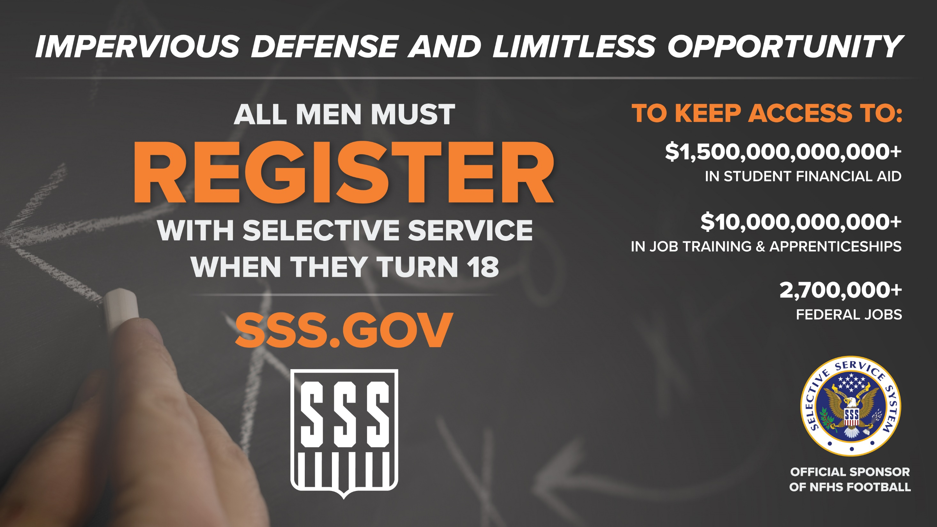
Notes:
Comment on Slide:
Selective Service is the Official Sponsor of NFHS Football for 2020

Slide 3
National federation of state high school associations (NFHS)

Slide 4

National Federation of
State High School Associations
NFHS (located in Indianapolis, IN – Est. 1920):
  National leader and advocate for
  high school athletics and
  performing arts programs.
  Serves 51 state associations, 19,500
  high schools and 12 million student
  participants.
  Writes playing rules for 17 high school
  sports for boys and girls.
  Offers online education courses for high school coaches,
  officials, parents, students and others.
  Ensures that students have opportunity to enjoy healthy participation, achievement and good sportsmanship in education-based athletics.
Notes:
Comment on Slide:
Overview of the NFHS.

Slide 5









NFHS Rules Review Committee
The NFHS Rules Review Committee is chaired by the chief operating officer and composed of all rules editors. After each committee concludes its deliberations and has adopted its recommended changes for the subsequent year, such revisions will be evaluated by the Rules Review Committee.
Davis Whitfield
Chief Operating Officer
Lindsey Atkinson
Girls Lacrosse and Volleyball
Bob Colgate
Football and Sports
Medicine
Sandy Searcy
Softball, Swimming & Diving and Water Polo
Elliot Hopkins
Baseball and Wrestling
Julie Cochran
Cross Country, Gymnastics, Field Hockey and
Track & Field
James Weaver
Boys Lacrosse
and Spirit
Theresia Wynns
Basketball and Soccer
Dan Schuster
Ice Hockey
Notes:
Comment on Slide:
Overview of NFHS Rules Review Committee.

Slide 6

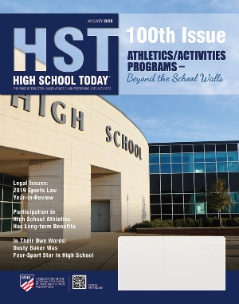
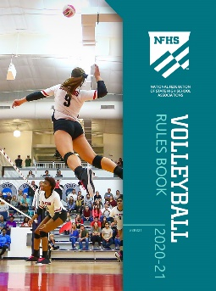
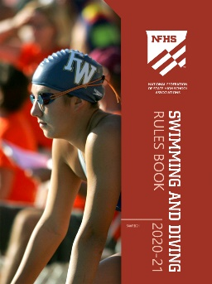
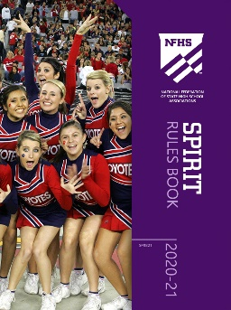
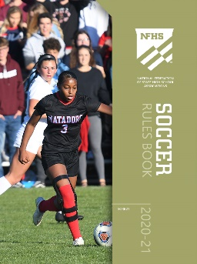
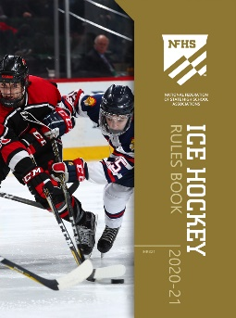
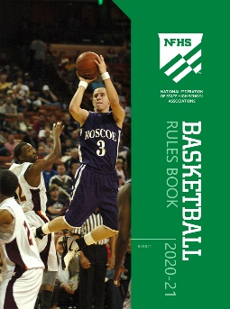
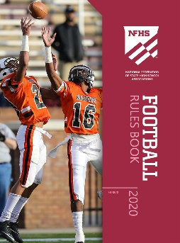
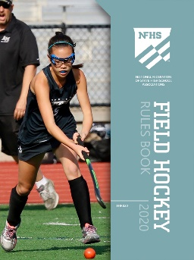

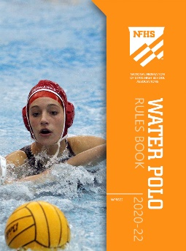
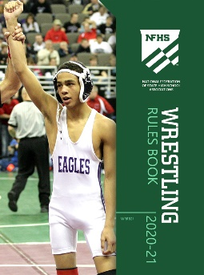
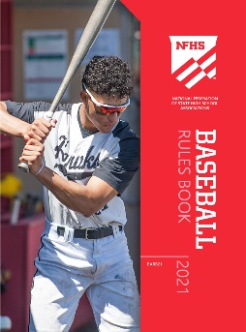
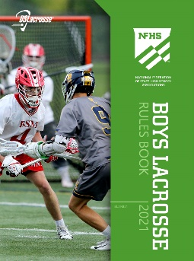
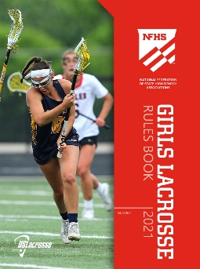
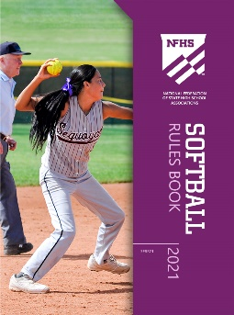
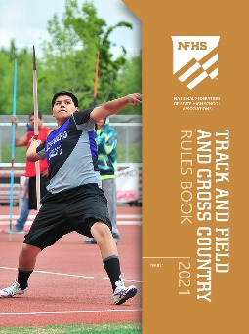
National Federation of
State High School Associations
The NFHS writes playing rules for 17 sports
for boys and girls at the high school level.
  Publishes 4 million pieces of materials annually.
Notes:
Comment on Slide:
Overview of NFHS Rules Books and Publications.

Slide 7
2020 nfhs football rules changes

Slide 8
Nfhs football rules
Each state high school association adopting these NFHS football rules is the sole and exclusive source of binding rules interpretations for contests involving its member schools. Any person having questions about the interpretation of NFHS football rules should contact the football rules interpreter designated by his or her state high school association.
The NFHS is the sole and exclusive source of model interpretations of NFHS football rules. State rules interpreters may contact the NFHS for model football rules interpretations. No other model football rules interpretations should be considered.
Notes:
Comment on Slide:
This statement appears at the bottom of page two in the 2020 NFHS Football Rules Book.

Slide 9
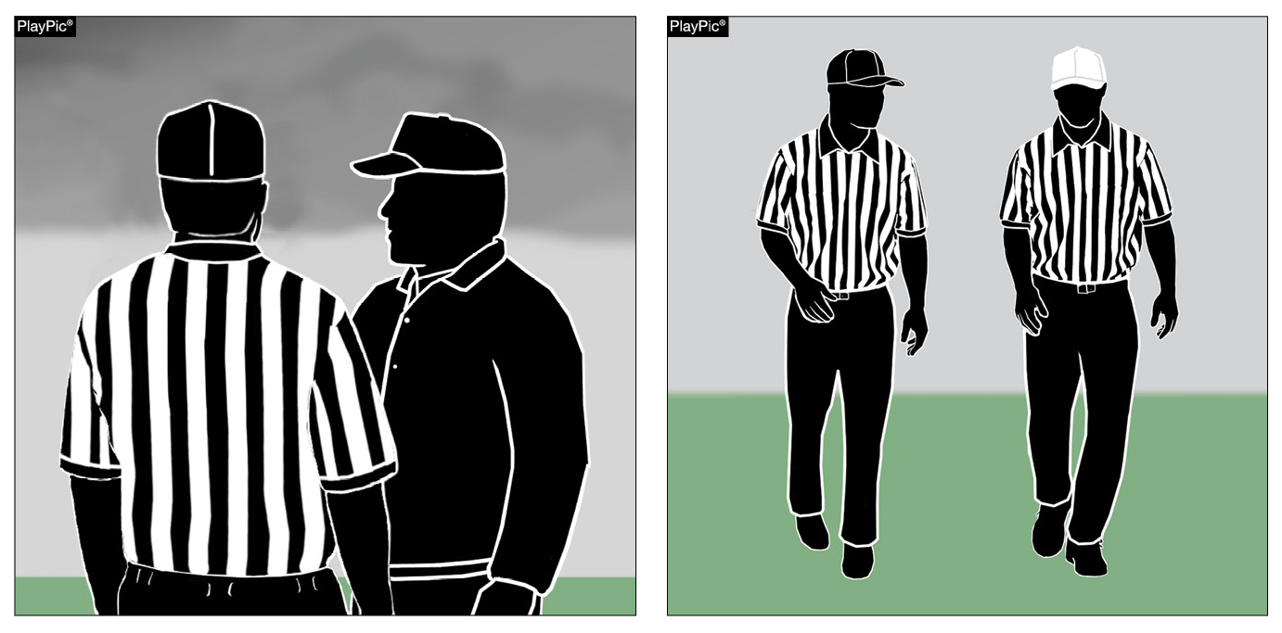

DESIGNATING TEAM REPRESENTATIVE
RULES 1-4-1, 1-4-4 (NEW), 2-32-5, 3-5-2, 10-1-1, 10-1-2, 10-2-4
Prior to the game the head coach will notify the referee of the designated representative (coach or player) who will make decisions regarding penalty acceptance or declination (PlayPic A). When a foul occurs, the linesman or line judge will inform the referee as to the penalty decision if a coach is the decision maker (PlayPic B).
A
B
Notes:
Rule Change:
RULE 1 – SECTION 4 – PLAYER DESIGNATIONS
ART. 1 . . . Each team shall designate a player as field captain, and he is the only player who may communicate with game officials.
ART. 4 . . . Each head coach shall designate a representative who will make decisions regarding penalty acceptance or declination. His first choice of any offered decision is final. Decisions involving penalties shall be made before any charged time-out is granted either team. The head coach's designee shall remain in place for the entire game except in case of emergency.
RULE 2 – SECTION 32 – PLAYER DESIGNATIONS
ART. 5 . . . A captain of a team is a player designated to represent his team during:
a. The pregame and overtime coin toss. (Limit of four captains in game uniform.)
b. Penalty decisions following a foul (if designated by the head coach, as in 1-4-4).
c. Ball placement on a try, a kickoff, after a safety, after a fair catch or awarded fair catch, after a touchback and to start an overtime.
RULE 3 – SECTION 5 – CHARGED AND OFFICIAL'S TIME-OUTS — INTERMISSIONS
ART. 2 . . . A charged team time-out occurs when the ball is dead and:
a. The request of either a player or the head coach (or head coach's designee) is legally granted. When a decision on a penalty is pending, a time-out shall not be granted to either team until the designated representative makes his choice. …
RULE 10 – SECTION 1 – PROCEDURE AFTER A FOUL
ART. 1 . . . When a foul occurs during a live ball, the referee shall, at the end of the down, notify both teams. He shall inform the designated representative of the offended team regarding the rights of penalty acceptance or declination and shall indicate to him the number of the ensuing down, distance to be gained, and status of the ball for each available choice. The distance penalty for any foul may be declined. If the penalty is declined or if there is a double foul, there is no loss of distance. In case of a double foul, the designated representative is not consulted since the penalties offset. The choice of options may not be revoked. Decisions involving penalties shall be made before any charged time-out is granted either team.
ART. 2 . . . When a foul occurs during a dead ball between downs or prior to a free kick or snap, the covering official shall not permit the ball to become alive. The referee shall notify both teams, and the designated representative of the offended team will be presented with the options and the effect of acceptance or declination on the down and distance to be gained. The designated representative may accept or decline the penalty.
RULE 10 – SECTION 2 – DOUBLE AND MULTIPLE FOULS
ART. 4 . . . When two or more live-ball fouls (other than nonplayer or unsportsmanlike) are committed during the same down by the same team (multiple fouls), only one penalty may be enforced. The designated representative of the offended team may choose which one shall be administered, or all penalties may be declined. When a team commits a nonplayer or unsportsmanlike foul during that same down, it is administered from the succeeding spot as established by the acceptance or declination of the penalty for the other foul.
Rationale for Change:
Prior to the game, the head coach will notify the referee of the designated representative (coach or player) who will make decisions regarding penalty acceptance or declination.
Case Book: See SITUATIONS 1.4.1, 3.7.3D, 4.2.3B, 8.2.2F, 9.4.4D, 10.1.1B, 10.2.2A, 10.2.2B, 10.2.2C, 10.2.4, 10.4.5E

Slide 10
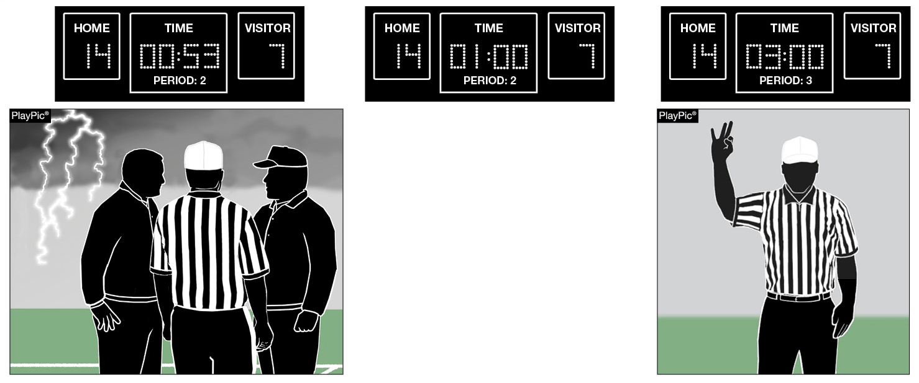
Halftime Intermission Option Following Weather DelaY
RULE 3-1-6c EXCEPTION (NEW)
HALFTIME INTERMISSION
A
B
If weather causes a delay of at least 30 minutes during the last three minutes of the second period, the opposing coaches may mutually agree to shorten the halftime intermission below the 10-minute minimum (PlayPic A). The mandatory 3-minute warm-up must take place before the third period begins (PlayPic B).
Notes:
Rule Change:
RULE 3 – SECTION 1 – LENGTH OF PERIODS – HALFTIME INTERMISSION
ART. 6 . . . State high school associations may determine the length of halftime intermission, provided it is not less than 10 minutes and not more than 20 minutes.
a. 15 minutes is normal for halftime intermission.
b. Halftime intermission may be increased to a maximum of 20 minutes, provided opponents have been notified no later than five minutes prior to the game.
c. By mutual agreement of the opposing coaches, the halftime intermission may be reduced to a minimum of 10 minutes (not including the mandatory warm-up period).
EXCEPTION: If the game is interrupted due to weather during the last three minutes of the second period, and the delay is at least 30 minutes, the opposing coaches can mutually agree to shorten halftime intermission, provided there is at least a one-minute intermission (not including the three-minute warm-up period).
Rationale for Change:
The halftime intermission may be shortened by mutual agreement of opposing coaches if a weather delay occurs during the last three minutes of the second period.
Case Book: See SITUATIONS 3.1.1A, 3.1.1B

Slide 11
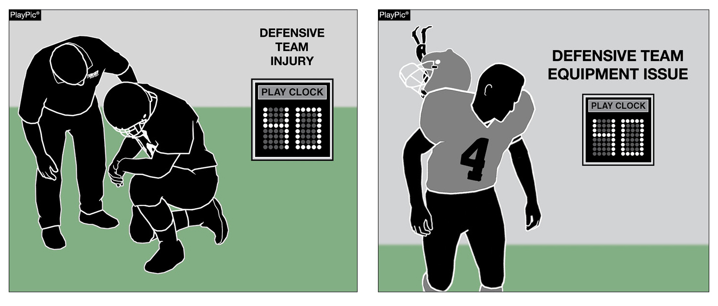
40-Second Play Clock Clarification
RUles 3-6-1a(1)e EXCEPTIONS 2 and 3 (NEW)
A
B
The play clock will be set to 40 seconds when an officials’ time-out is initially taken for an injury to a defensive player (PlayPic A) or a defensive player has an equipment issue (PlayPic B).
Notes:
Rule Change:
RULE 3 – SECTION 6 – PLAY CLOCK, BALL READY FOR PLAY AND DELAY
ART. 1 . . . Play clock and ready-for-play:
a. Play clock:
1. 25 seconds will be on the play clock and start on the ready-for-play signal:
(a) Prior to a try following a score;
(b) To start a period or overtime series;
(c) Following administration of an inadvertent whistle;
(d) Following a charged time-out;
(e) Following an official's time-out as in 3-5-7 or 3-5-10.
EXCEPTIONS:
1. 3-5-7b;
2. 3-5-7e if initially related to a defensive player; and
3. 3-5-10 if initially related to a defensive player.
(f) Following a legal kick, when either team is awarded a new series; and
(g) Following the stoppage of the play clock by the referee for any other reason. …
Rationale for Change:
To eliminate a potential timing advantage gained by the defensive team, the rules committee approved the play clock being set to 40 seconds when an officials’ time-out is taken for an injury to a defensive player or a defensive player has an equipment issue.

Slide 12
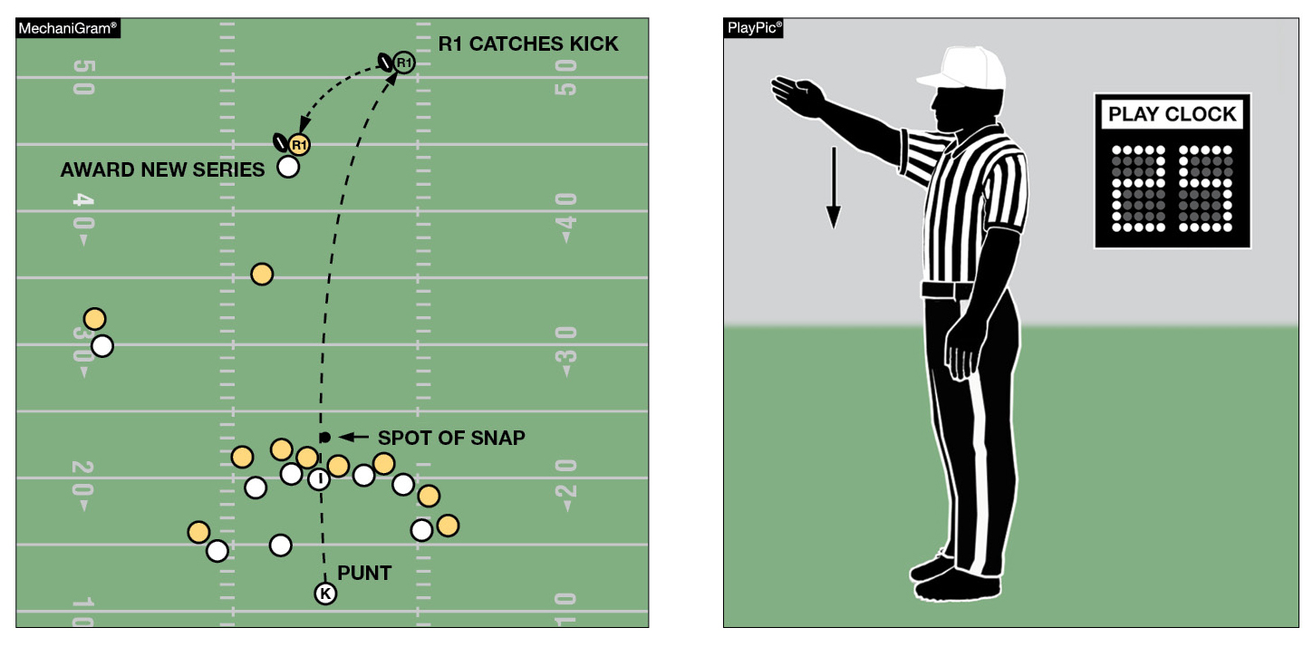
25-Second Play Clock Clarification
RULE 3-6-1a(1)f (NEW)
A
B
When either team is awarded a new series after a legal kick (MechaniGram A), the play clock is set to 25 seconds and starts with the ready-for-play signal (PlayPic B).
Notes:
Rule Change:
RULE 3 – SECTION 6 – PLAY CLOCK, BALL READY FOR PLAY AND DELAY
ART. 1 . . . Play clock and ready-for-play:
a. Play clock:
1. 25 seconds will be on the play clock and start on the ready-for-play signal:
(a) Prior to a try following a score;
(b) To start a period or overtime series;
(c) Following administration of an inadvertent whistle;
(d) Following a charged time-out;
(e) Following an official's time-out as in 3-5-7 or 3-5-10.
EXCEPTIONS:
1. 3-5-7b;
2. 3-5-7e if initially related to a defensive player; and
3. 3-5-10 if initially related to a defensive player.
(f) Following a legal kick, when either team is awarded a new series; and
(g) Following the stoppage of the play clock by the referee for any other reason. …
Rationale for Change:
Following a legal kick when either team is awarded a new series, the play clock will be set to 25 seconds.

Slide 13
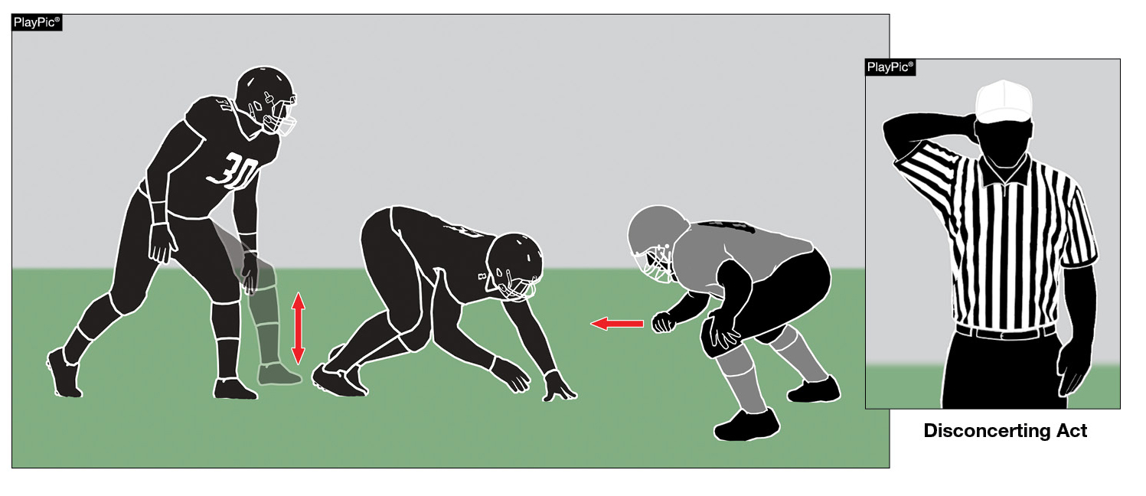
Disconcerting Act FOUL AND Penalty Reclassified
RULES 7-1-9 (NEW), 7-1-9 PENALTY (NEW)
23
Disconcerting acts or words by the defense has been reclassified from an unsportsmanlike foul to a disconcerting act foul, and the penalty changed from 15 yards to 5 yards. Signal 23 will be used to indicate the foul.
Notes:
Rule Change:
RULE 7 – SECTION 1 – BEFORE THE SNAP
ART. 9 . . . No defensive player shall use disconcerting acts or words prior to the snap in an attempt to interfere with A's signals or movements.
PENALTY: Arts. 1, 5, 6 – Encroachment – (S7-18) – 5 yards; Arts. 2, 3 – snap infraction (S7-19) – 5 yards; Art. 7 – false start – (S7-19) – 5 yards; Art. 9 – disconcerting act – (S7-23) – 5 yards.
Rationale for Change:
Disconcerting acts or words by the defense has been reclassified from a unsportsmanlike foul to a disconcerting act foul, and the penalty changed from 15 yards to 5 yards.
Case Book: See SITUATIONS 7.1.7C, 7.1.9

Slide 14
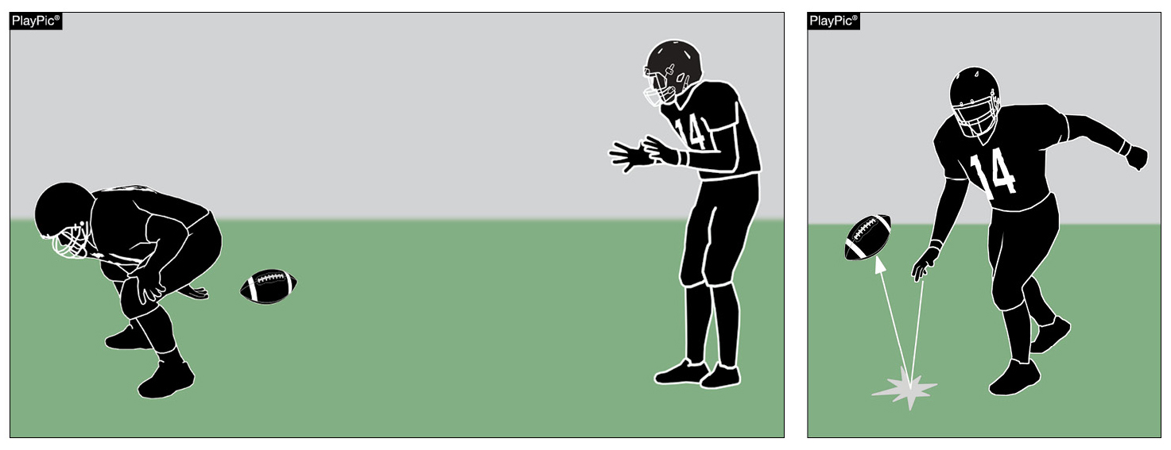
Spiking the ball to conserve time
7-5-2e EXCEPTION, TABLE 7-5-2e EXCEPTION, TABLE 7-5e EXCEPTION
The exception to allow a player to conserve time by intentionally throwing the ball forward to the ground immediately after receiving the snap has been expanded. This exception now includes snaps that are not hand-to-hand.
Notes:
Rule Change:
RULE 7 – SECTION 5 – FORWARD-PASS CLASSIFICATION …
ART. 2 . . . An illegal forward pass is a foul. Illegal forward passes include:
a. A pass after team possession has changed during the down.
b. A pass from beyond the neutral zone.
c. A second and subsequent forward pass(es) thrown during a down.
d. A pass intentionally thrown into an area not occupied by an eligible offensive receiver.
e. A pass intentionally thrown incomplete to save loss of yardage or to conserve time.
EXCEPTION: It is legal for a player positioned directly behind the snapper to conserve time by intentionally throwing the ball forward to the ground immediately after receiving the snap that has neither been muffed nor touched the ground.
TABLE 7-5-2e EXCEPTION, TABLE 7-5e EXCEPTION …
e. Pass intentionally thrown incomplete to save loss of yardage or conserve time.
EXCEPTION: It is legal for a player positioned directly behind the snapper to conserve time by intentionally throwing the ball forward to the ground immediately after receiving the snap that has neither been muffed nor touched the ground.
Rationale for Change:
The exception to allow a player to conserve time by intentionally throwing the ball forward to the ground immediately after receiving the snap, has been expanded to include any player positioned directly behind the center. This exception now includes snaps that are not hand-to-hand.
Case Book: See SITUATIONS 7.5.2B, 7.5.2G

Slide 15
2020 nfhs football editorial changes

Slide 16
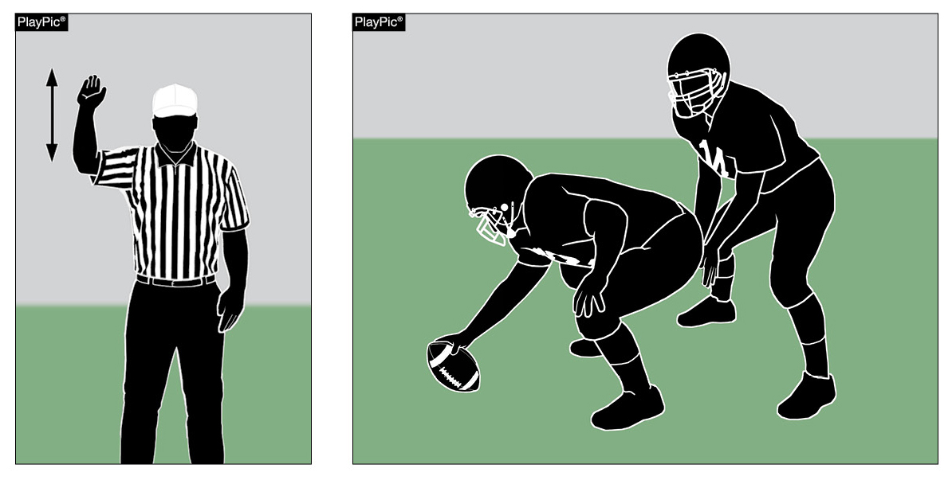
Correcting Play Clock Errors
RULE 3-4-9 (NEW)
A
B
The referee shall have the authority to correct obvious errors in timing by the play clock (PlayPic A) if discovery is prior to the snap (PlayPic B).
Notes:
Editorial Change:
RULE 3 – SECTION 4 – STARTING AND STOPPING THE GAME CLOCK
ART. 9 . . . The referee shall have the authority to correct obvious errors in timing by the play clock if discovery is prior to the snap.
Rationale for Change:
Clarification

Slide 17
2020 Nfhs football editorial changes
NOCSAE Warning Label | Updated the language in the NOCSAE Warning Label.
1-3-1d and g | Added reference to “Figure 1-3-1”
1-3-1i (NEW) | Added a new heading for “Method of Measuring the Ball”
Table 1-7 | Updated Table 1-7 of allowable State Association Adoptions for football.
2-33-2 | Penalty decisions following a foul further clarified.
2-41-9 | Further defined the spot where a run ends.
3-1-6 (NEW) | Added a new Article on halftime intermission that use to be in TABLE 3-1.
3-1-7 (NEW) | Added a new Article on three-minute warm-up period that use to be in TABLE 3-1.
TABLE 3-1 | Added mandatory three-minute warm-up period to TABLE 3-1.
3-4-8 | Grammar edit to the Article.
7-2-5a | Clarified player formation and numbering requirements.
7-5-12 | Deleted a portion of the Article that dealt with lineman.
Notes:
Comment on Slide:
This slide lists the rules references and a brief description of the football editorial changes that were made to the 2020 NFHS Football Rules Book.

Slide 18
2020 Nfhs football editorial changes
TABLE 7-5 | Clarified enforcement spots and added rules references to TABLE 7-5.
8-2-4 | Deleted “results of the play” and added “penalty.”
9-5-1d | Re-lettered items under Article 1 after deleting item on disconcerting act.
9-9 PENALTY | Deleted a signal reference in Article 3.
10-4-2 EXCEPTION | Added “legal” before “free or scrimmage kick down.”
10-5-1j | Added “legal” before “kick.”
Penalty Summary | New format. Added “Disconcerting Act” foul under loss of 5-yards penalty.
NFHS Official Football Signals | Added New Signal 17 on play clock and revised Signal 23 for disconcerting act.
Appendix H (NEW) | Added a new Appendix H on “Modifications for Competition Below Ninth Grade.”
Index | Added Intermission, Length of Halftime to Index.
Notes:
Comment on Slide:
This slide lists the rules references and a brief description of the football editorial changes that were made to the 2020 NFHS Football Rules Book.

Slide 19
2020 nfhs football rules reminders

Slide 20
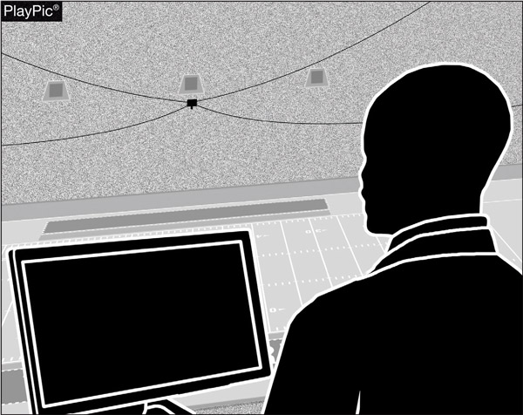
Postseason instant REPLAY
RULES 1-3-7 NOTE, TABLE 1-7 — 1-3-7 NOTE
By adoption, state associations may create instant replay procedures that permit game or replay officials to use a replay monitor during state postseason contests to determine if a decision by the on-field game officials is incorrect.
Notes:
Rules Reminder:
RULE 1 – SECTION 3 – GAME EQUIPMENT
ART. 7 . . . Other than replay or television monitoring equipment, game officials may use supplementary equipment to aid in game administration as authorized by the state association.
NOTE: A state association may create instant-replay procedures that permit game or replay officials to use a replay monitor during state postseason contests to determine if a decision by the on-field game officials is incorrect.
RULE 1 – SECTION 7 – STATE ASSOCIATION ADOPTIONS
5. Authorize the use of instant replay during state postseason contests. (1-3-7 NOTE)
Comment on Slide:
Rule change in 2019. By state association adoption, instant replay may only be used during state postseason contests to review decisions by the on-field game officials. This adoption would allow state associations to develop protocols for use of video replay.
Case Book: See SITUATIONS 1.1.9, 1.3.7

Slide 21
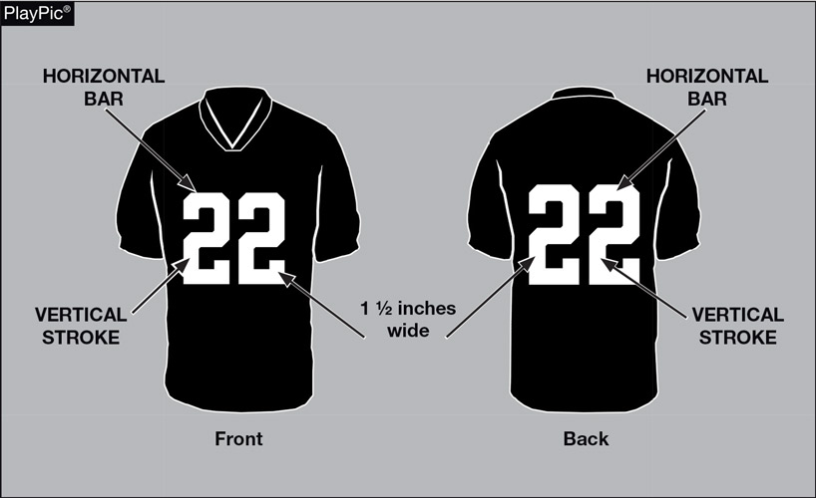
FOOTBALL JERSEY NUMBERS
RULE 1-5-1c
The entire body of the number (the continuous horizontal bars and vertical strokes) exclusive of any border(s) shall be approximately 1½-inches wide, and a single solid color that clearly contrasts with the body color of the jersey starting in 2024.
Notes:
Rules Reminder:
RULE 1 – SECTION 5 – PLAYER EQUIPMENT
ART. 1 . . . Mandatory equipment. Each player shall participate while wearing the following pieces of properly fitted equipment, which shall be professionally manufactured and not altered to decrease protection: …
c. Numbers
1. The numbers shall be clearly visible and legible using Arabic numbers 1-99 inclusive and shall be on the front and back of the jersey.
2. The numbers, inclusive of any border(s), shall be centered horizontally at least 8 inches and 10 inches high on front and back, respectively.
3. The entire body of the number (the continuous horizontal bars and vertical strokes) exclusive of any border(s) shall be approximately 1½-inches wide.
4. The color and style of the number shall be the same on the front and back.
5. Through the 2023 season, the body of the number (the continuous horizontal bars and vertical strokes) shall be either:
(a) a continuous color(s) contrasting with the jersey color; or
(b) the same solid color(s) as the jersey with a minimum of one border that is at least ¼-inch in width of a single solid contrasting color.
6. Effective with the 2024 season, the entire body of the number (the continuous horizontal bars and vertical strokes) shall be a single solid color that clearly contrasts with the body color of the jersey.
Comment on Slide:
Rule change in 2019. The purpose of numbers on jerseys is to provide clear identification of players. In order to enhance the ability to easily identify players, the committee has clarified the size requirements for jersey numbers through the 2023 season. The committee also added a new requirement that, effective in the 2024 season, jersey numbers must be a single solid color that clearly contrasts with the body color of the jersey.

Slide 22
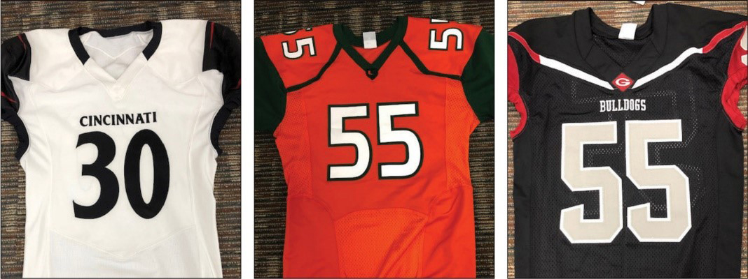
Football JERSEY numbers
RULES 1-5-1c, 1-5-1c(6)
The style of the numbers on all three of these jerseys are legal now and will be in 2024 as well.
Notes:
Rules Reminder:
RULE 1 – SECTION 5 – PLAYER EQUIPMENT
ART. 1 . . . Mandatory equipment. Each player shall participate while wearing the following pieces of properly fitted equipment, which shall be professionally manufactured and not altered to decrease protection: …
c. Numbers
1. The numbers shall be clearly visible and legible using Arabic numbers 1-99 inclusive and shall be on the front and back of the jersey.
2. The numbers, inclusive of any border(s), shall be centered horizontally at least 8 inches and 10 inches high on front and back, respectively.
3. The entire body of the number (the continuous horizontal bars and vertical strokes) exclusive of any border(s) shall be approximately 1½-inches wide.
4. The color and style of the number shall be the same on the front and back.
5. Through the 2023 season, the body of the number (the continuous horizontal bars and vertical strokes) shall be either:
(a) a continuous color(s) contrasting with the jersey color; or
(b) the same solid color(s) as the jersey with a minimum of one border that is at least ¼-inch in width of a single solid contrasting color.
6. Effective with the 2024 season, the entire body of the number (the continuous horizontal bars and vertical strokes) shall be a single solid color that clearly contrasts with the body color of the jersey.
Comment on Slide:
Rule change in 2019. The purpose of numbers on jerseys is to provide clear identification of players. In order to enhance the ability to easily identify players, the committee has clarified the size requirements for jersey numbers through the 2023 season. The committee also added a new requirement that, effective in the 2024 season, jersey numbers must be a single solid color that clearly contrasts with the body color of the jersey.

Slide 23
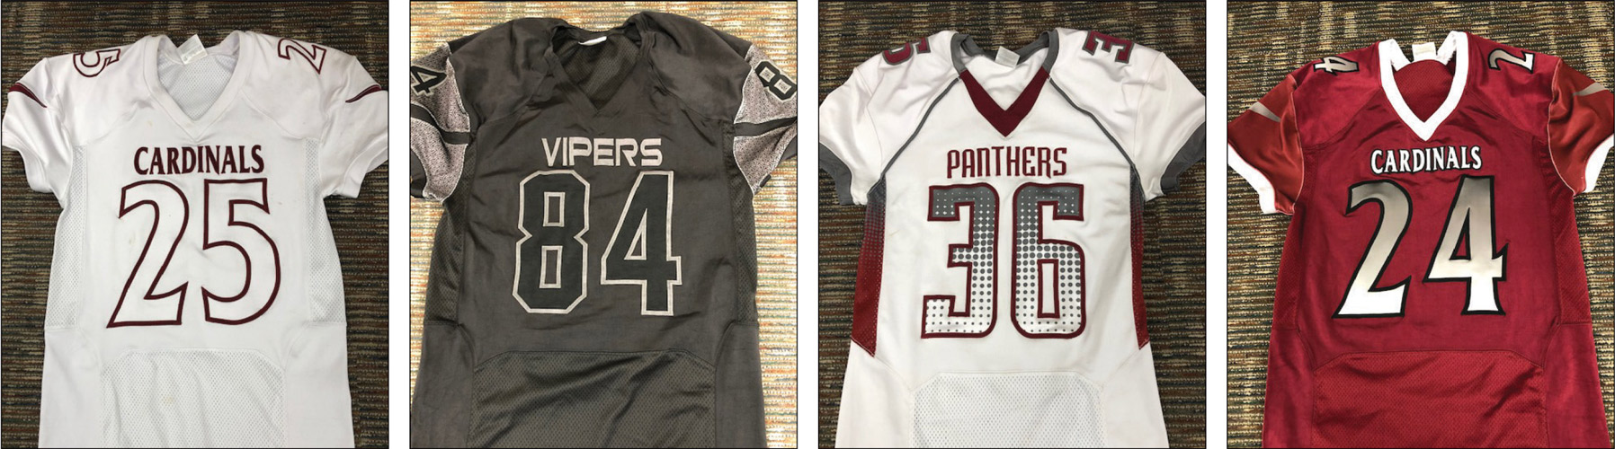
Football JERSEY numbers
RULES 1-5-1c, 1-5-1c(6)
The style of the numbers on these jerseys are legal through the 2023 season. The following four types of number designs will be illegal in 2024.
Notes:
Rules Reminders:
RULE 1 – SECTION 5 – PLAYER EQUIPMENT
ART. 1 . . . Mandatory equipment. Each player shall participate while wearing the following pieces of properly fitted equipment, which shall be professionally manufactured and not altered to decrease protection: …
c. Numbers
1. The numbers shall be clearly visible and legible using Arabic numbers 1-99 inclusive and shall be on the front and back of the jersey.
2. The numbers, inclusive of any border(s), shall be centered horizontally at least 8 inches and 10 inches high on front and back, respectively.
3. The entire body of the number (the continuous horizontal bars and vertical strokes) exclusive of any border(s) shall be approximately 1½-inches wide.
4. The color and style of the number shall be the same on the front and back.
5. Through the 2023 season, the body of the number (the continuous horizontal bars and vertical strokes) shall be either:
(a) a continuous color(s) contrasting with the jersey color; or
(b) the same solid color(s) as the jersey with a minimum of one border that is at least ¼-inch in width of a single solid contrasting color.
6. Effective with the 2024 season, the entire body of the number (the continuous horizontal bars and vertical strokes) shall be a single solid color that clearly contrasts with the body color of the jersey.
Comment on Slide:
Rule change in 2019. The purpose of numbers on jerseys is to provide clear identification of players. In order to enhance the ability to easily identify players, the committee has clarified the size requirements for jersey numbers through the 2023 season. The committee also added a new requirement that, effective in the 2024 season, jersey numbers must be a single solid color that clearly contrasts with the body color of the jersey.

Slide 24
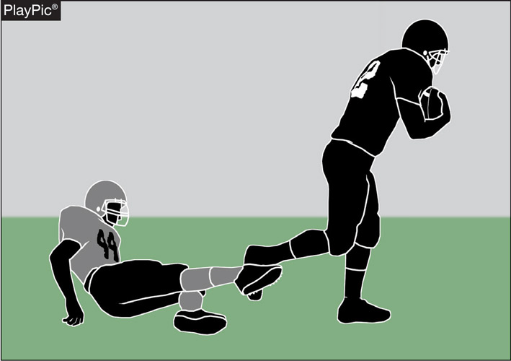
Tripping rules 2-45, 9-4-3o, 9-4-3o PENALTY
The foul for tripping has been expanded to include the runner. It is now illegal to trip any opponent. Tripping is the intentional use of the lower leg or foot to obstruct an opponent below the knee. The penalty is 15 yards.
Notes:
Rules Reminder:
RULE 2 – SECTION 45 – TRIPPING
Tripping is the intentional use of the lower leg or foot to obstruct an opponent below the knee.
RULE 9 – SECTION 4 – ILLEGAL PERSONAL CONTACT
ART. 3 . . . No player or nonplayer shall: …
o. Trip an opponent.
PENALTY: … Art. 3o – illegal tripping – (S38-46) – 15 yards; …
Comment on Slide:
Rule change in 2019. In an effort to decrease risk, tripping the runner is now prohibited. It is now a foul to intentionally use the lower leg or foot to obstruct a runner below the knees.
Case Book: See SITUATION 2.42.1

Slide 25
2020 nfhs football points of emphasis

Slide 26
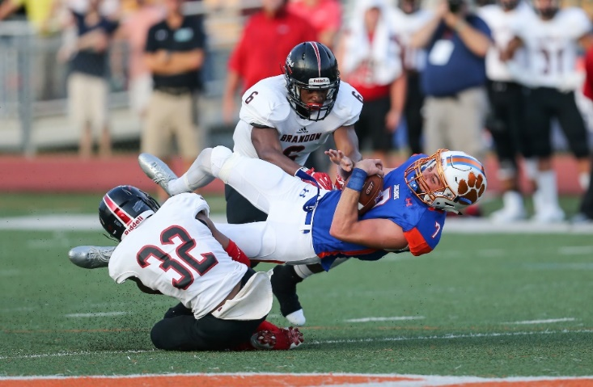
2020 nfhs football points of emphasis
1. Sportsmanship
Intentional Grounding
3. Ineligible Downfield and Line of Scrimmage Formation
Notes:
Comment on Slide:
The following football points of emphasis were selected by the NFHS Football Rules Committee for the 2020 high school football season. These three football points of emphasis need to be stressed to all coaches, game officials, players, parents, school administrators, appropriate health-care professionals and all others who have an interest in high school football.

Slide 27
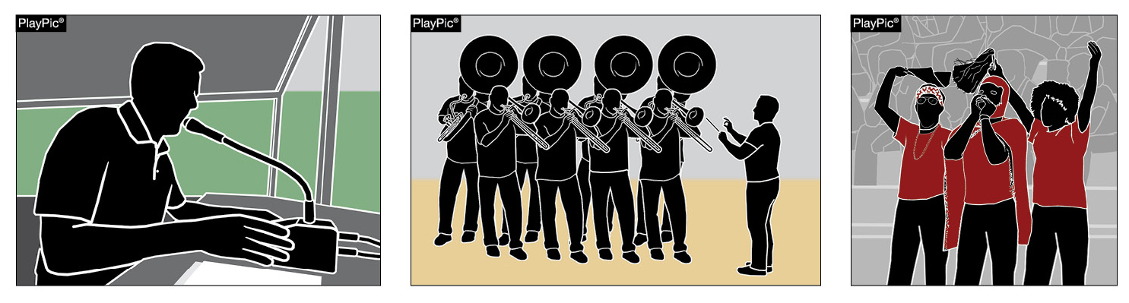
SPORTSMANSHIP
A
B
C
When considering sportsmanship, many may first think only of the game participants (athletes and coaches) within the timeframe of the game. Although players and coaches are the most visible in their displays of sportsmanship, proper sportsmanship also includes public address announcers (PlayPic A), bands (PlayPic B) and spectators (PlayPic C).
Notes:
Sportsmanship (Point of Emphasis):
When considering sportsmanship, many may first think only of the game participants (athletes and coaches) within the timeframe of the game. However, proper sportsmanship also includes the pregame warm-up period, postgame handshake activity, spectator behavior (both students and adults), parents of athletes, public-address announcements and announcers, and bands. All of the above constituents have a role in promoting good sportsmanship.
Players and coaches are the most visible in their displays of sportsmanship. Their behavior sets the tone for fans, game officials and others. As recognizable personalities, it is an expectation that coaches model good behavior. Players must represent their schools and communities as ambassadors of good sporting behavior beginning with pregame activities and concluding with end-of-game activities.
Game officials generally do not assume control until taking the field approximately 30 minutes prior to the scheduled kickoff. Therefore, coaching staffs and game administrators must be vigilant and responsible for ensuring proper sportsmanship during this time. Once the contest begins, school administrators are responsible for the proper conduct of all spectators. This may take the form of reading a sportsmanship public-address announcement prior to the contest and remaining vigilant for possible issues during the contest. Student bodies and spectators in general should be reminded that any behaviors conducted at the expense of the opponents is unacceptable and will be addressed accordingly.
Public-address announcers are responsible for delivering pertinent game-related information – not to be a play-by-play person or cheerleader. Taking liberties with biased and/or inflammatory announcements must not be tolerated. Their purpose is not to editorialize the quality of play or incite the home crowd in any way.
Working with the band/music director, the school administration must set proper guidelines and ensure compliance regarding when live or recorded music may be utilized.
Good sportsmanship does not occur on its own. Only with specific planning and coordination by all constituents is good sportsmanship achievable. Good sportsmanship is about respect. Good sports win with humility, lose with grace and do both with dignity.

Slide 28
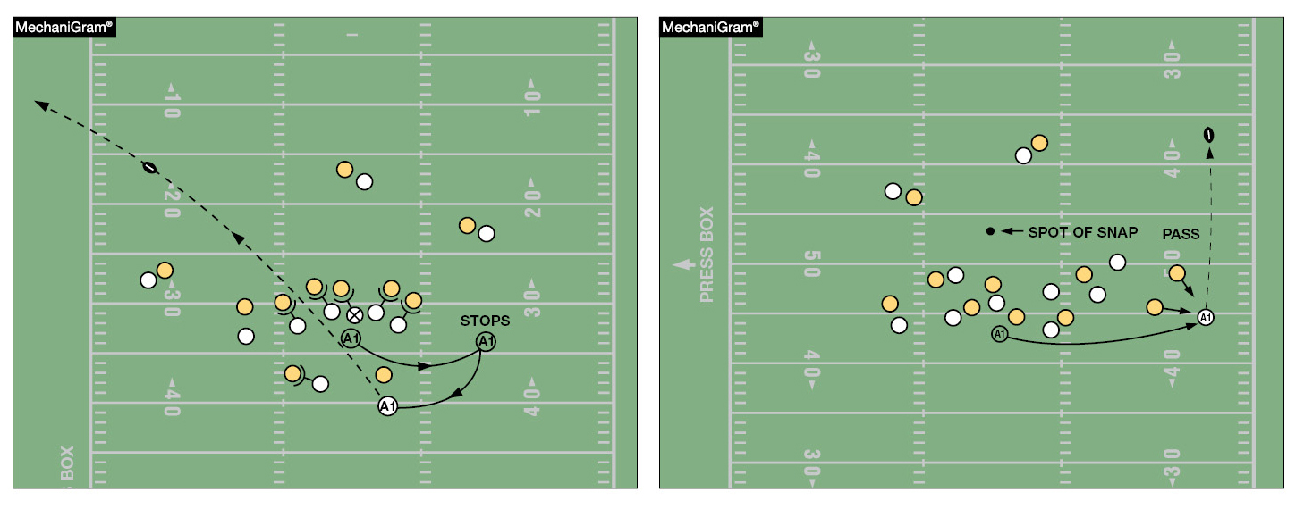
INTENTIONAL GROUNDING
A
B
Under NFHS rules, unless using the legal exception in Rule 7-5-2e, intentional grounding is a foul whenever a forward pass is thrown to prevent a loss of yardage or to conserve time (PlayPic A) or to an area not occupied by an eligible receiver (PlayPic B). High school referees need to be aware of these situations and, with the help of the line judge and linesman, make the correct call under NFHS football rules.
Notes:
Intentional Grounding (Point of Emphasis):
Due to the growing prevalence of televised football, one of the most misunderstood rules at the high school level is intentional grounding. Under NFHS rules, intentional grounding is a foul whenever a legal forward pass is thrown into an area not occupied by an eligible receiver, or when a pass is thrown to prevent a loss of yardage or to conserve time. The only exception to this rule is when the passer intentionally throws the ball forward to the ground immediately after receiving the snap.
Under NFHS rules, it is a foul if there was no eligible receiver in the area of the pass, regardless of the passer’s position on the field. Across the country, we are seeing more high school quarterbacks throw the ball away to avoid a sack when outside the pocket, thinking this is legal based on what is seen on television. High school referees need to be aware of these situations and, with the help of the line judge and linesman, make the correct call under NFHS football rules. This is a foul that should be called after the game officials have gathered and discussed the play. When a foul does occur, the penalty flag needs to be thrown by the referee. The penalty is 5 yards from the spot of the foul and a loss of down.

Slide 29
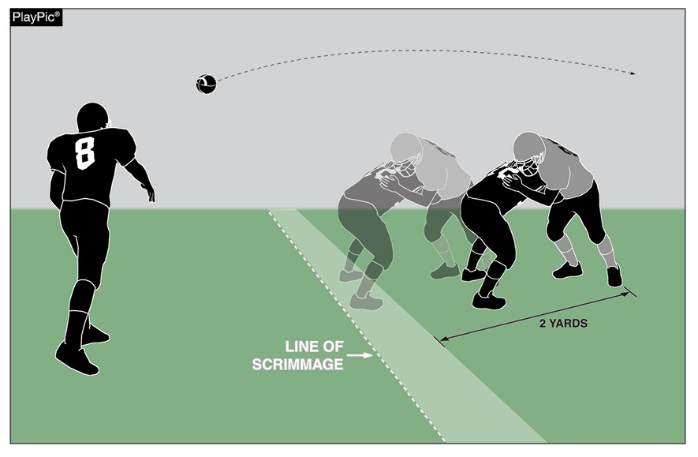
INELIGIBLE DOWNFIELD
Ineligible A players may not advance beyond the expanded neutral zone on a legal forward pass play before a legal forward pass that crosses the neutral zone is in flight. The neutral zone expands two yards behind the defensive line of scrimmage following the snap. When identifying A players who are illegally downfield it is important to make sure that the A player is clearly beyond the expanded neutral zone (2 yards) at the moment that the pass occurs.
Notes:
Ineligible Downfield (Point of Emphasis):
Some clarification was recently provided in identifying when an ineligible Team A player is illegally downfield on a pass play. By rule, ineligible Team A players may not advance beyond the expanded neutral zone on a legal forward pass play before a legal forward pass that crosses the neutral zone is in flight. The neutral zone expands 2 yards behind the defensive line of scrimmage following the snap. The position of the ineligible Team A player at the moment of the legal pass is the only factor in determining if the player is illegally downfield. When identifying Team A players who are illegally downfield, it is important to make sure that the Team A player is clearly beyond the expanded neutral zone (2 yards) at the moment that the pass is in flight. Players can travel multiple yards in a quick period of time. These players can be legally within the expanded neutral zone when the pass is thrown but beyond as the pass moves downfield. If B touches the pass in or behind the neutral zone, this restriction is terminated.

Slide 30
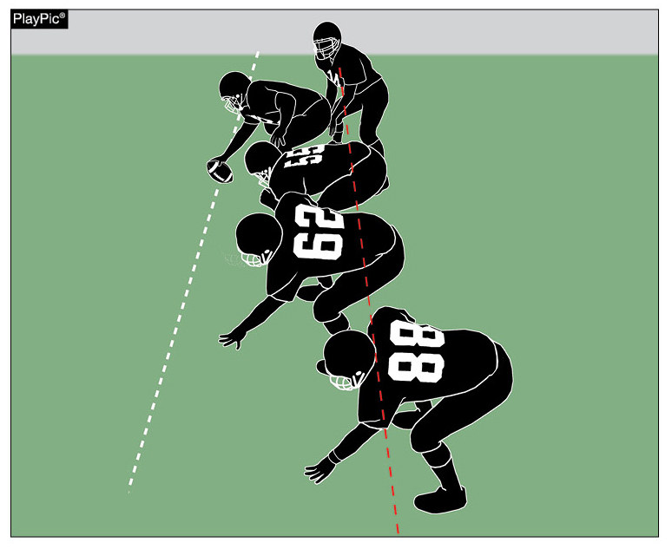
LINE OF SCRIMMAGE FORMATION
Only one player may not be on the line but still penetrate the vertical plane through the waistline of his nearest teammate who is on the line. This player (A) must be in position to receive a hand-to-hand snap, but does not have to actually receive it. By rule, he is the only player allowed to be positioned in “no man’s land” at the snap. All other players not on the line must be clearly positioned as backs. The player marked (B) is in an illegal position.
A
B
Notes:
Line of Scrimmage Formation (Point of Emphasis):
In order for the offensive team to have a legal scrimmage formation at the snap (assuming the numbering exception is not being used), at least five Team A players, numbered 50-79, must be on the line of scrimmage. Also, no more than four Team A players may be backs. Only one player may not be on the line but still penetrate the vertical plane through the waistline of his nearest teammate who is on the line. This player must be in position to receive a hand-to-hand snap, but does not have to actually receive it. By rule, he is the only player allowed to be positioned in “no man’s land” at the snap. All other players not on the line must be clearly positioned as backs.

Slide 31
2020-2021 nfhs football game officials manual

Slide 32
2020-2021 Nfhs football game officials manual REMINDERS
Game Officials Manual
2020 is a print year for the NFHS Football Game Officials Manual.
2020-2021 Game Officials Manual Points of Emphasis (See pages 91-93 of the 2020-2021 NFHS Football Game Officials Manual):
1. Clock Management Communication
2. Respectful Communication Between Coaches and Game Officials
3. Preventing Inequities Due to Illegal Substitution and/or Illegal Formation
4. Responsibility for Minimizing Risk in the Game
Notes:
Comment on Slide:
Reminders for 2020 from the NFHS Football Game Officials Manual Committee on the 2020-2021 NFHS Football Game Officials Manual and other items.
See comments on the slide.

Slide 33
2020-2021 Nfhs football game officials manual REMINDERS
Game Officials Manual
The Game Officials Manual Committee added and/or updated the following items for 2020-2021:
1. Added new NFHS General Instructions for Football Game and Play Clock Operators.
2. Changed NFHS Official Signal 23 to Disconcerting Act in the signal chart.
3. Updated the Pregame Conference Responsibilities for the Crew.
4. Game officials’ uniforms updated.
5. Strongly recommend that Line-to-Gain Crews be adults.
6. The referee should have the ball marked ready for play in three to five
seconds following the placement of the ball.
7. In five-person officiating crews, the line judge will now time the game if a visible game clock is not available.
Notes:
Comment on Slide:
Reminders for 2020 from the NFHS Football Game Officials Manual Committee on the 2020-2021 NFHS Football Game Officials Manual and other items.
See comments on the slide.

Slide 34
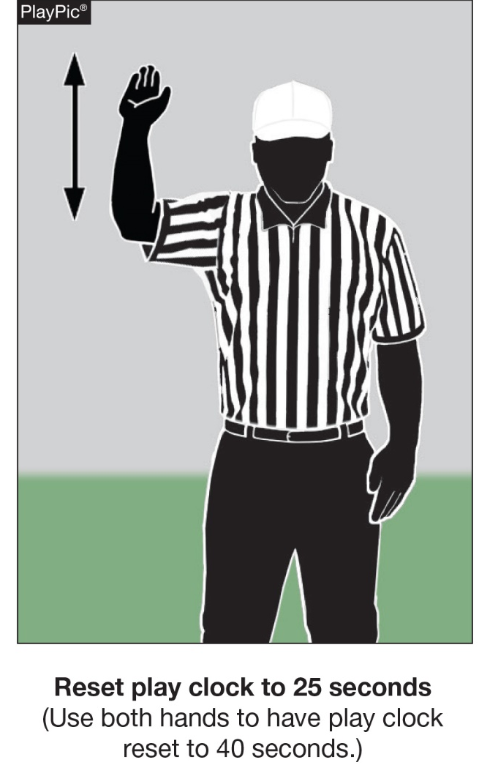
Reset Play Clock-Signal 17 (NEW)
NFHS Official Football Signals
Game Officials Manual
Notes:
Comment on Slide:
A new NFHS Official Signal for Reset Play Clock (Signal 17) was added to the signal chart.

Slide 35
2020-21 NFHS football information

Slide 36
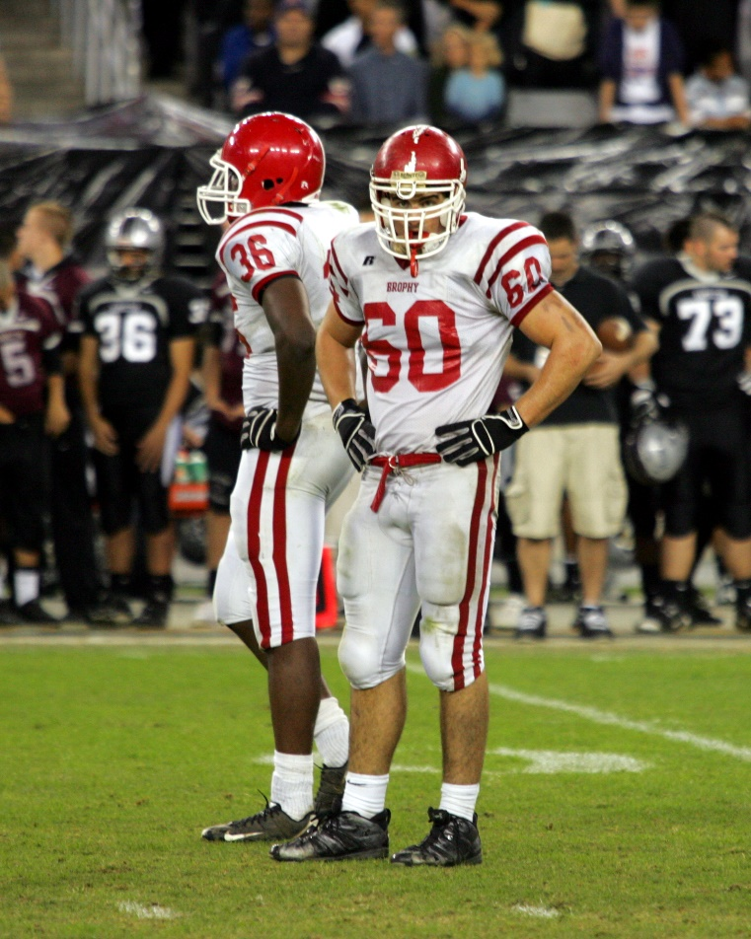
2021 nfhs football rule change proposal online form
Due:
November 1, 2020
Must be submitted to your state association office for approval.
Notes:
Comment on Slide:
ALL 2021 NFHS Football Rule Change Proposal Online Forms must first go through the state association office before it can be sent to the NFHS.
Only member state associations, football coaches and football game officials approved by the member state association, members of the NFHS Football Rules Committee and the NFHS can submit football rule change online proposal forms.
ALL 2021 NFHS Football Rule Change Online Proposal Forms must be submitted electronically online to the NFHS.

Slide 37
2020-21 nfhs football information
2020 Online NFHS Football Rules State Interpreters Meeting
  July 2, 2020
  4:30 p.m. (Eastern Time)
2020 Online Midseason NFHS Football Rules Webinar
  September 28, 2020
  2:00 p.m. (Eastern Time)
2021 NFHS Football Rule Change Proposal Form Due
  November 1, 2020
2021 NFHS Online Football Rules Committee Meeting
  January 10-12, 2021
Notes:
Comment on Slide:
2020-21 NFHS information with regards to football.

Slide 38

NFHS Rules Book as e-Books
E-books features:
  Searchable
  Highlight areas of interest
  Make notes
  Easy navigation
  Adjustable viewing size
  Immediate availability
  www.nfhs.org/ebooks for more information
Notes:
Comment on Slide:
Overview of NFHS Rules Books and Case Books as E-Books.
Cost is $6.99 each.
Download from iTunes and Amazon.

Slide 39

NFHS Rules App
Rules App features:
  Searchable
  Highlight notes
  Bookmarks
  Quizzes for all sports
  Easy navigation
  Immediate availability
  Free to paid members of the NFHS Coaches
  and Officials Associations
  www.nfhs.org/erules for more information
Notes:
Comment on Slide:
NFHS Rules App is free to download.
Each book subscription is $6.99.
NFHS Coaches and Officials Association paid members get all books for free.
100% states members get books for free in sports designated by their state.
For 2020-21 – Rules Apps for all NFHS rules books and case books available on iTunes and Google Play. Rules books and case books will be cross-linked. Searchable content.

Slide 40
Nfhs officials education

Slide 41

Notes:
Comment on Slide:
OFFICIALS EDUCATION
Every opportunity should be taken to improve upon officiating. Clinics, course work, observations, video review, association meetings should all be considered when attempting to improve one’s skills in officiating. The NFHS has provided opportunities for officials and prospective officials to take courses and to review video to support learning and developing officiating skills.
Sport-Specific Officiating courses are offered in several sports. They are ideal for new officials and those in the first few years of officiating. These courses introduce officials to the mechanics and techniques used in the sport and provide specific information on an area within that sport. Individuals can complete a course within 30-45 minutes. The cost of these courses is $10.00 to NFHS Officials Association members and $20 for non-members.
“Interscholastic Officiating” is a general course on sports officiating and it is free to members and cost $20 for non-members. This course provides an introduction to skills and concepts used as an official. Several topics are covered such as: basics of becoming and staying an official, science of officiating, art of officiating, how to combine these skills for successful officiating.
Video clips are made available to NFHS Officials Association members. The video is clipped on specific topics and provides the rules references as well as dialogue on the topic.
The courses and videos are offered at www.NFHSLearn.com .
Courses Available:
Officiating Football
Officiating Volleyball – Ball Handling
Officiating Volleyball – Alignment
Officiating Basketball
Officiating Basketball – Three-Person Mechanics
Soccer – Fouls and Misconduct
Soccer - Offside
Swimming and Diving
Officiating Wrestling
Umpiring Softball
Future Courses to be Considered:
Umpiring Baseball
Field Hockey
Track and Field
Umpiring Softball – Mechanics
Communication Among Officials and Coaches

Slide 42
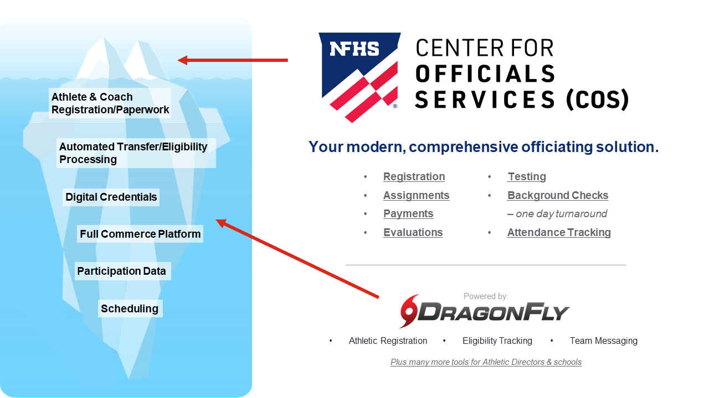
NFHS Center for Officials Services (COS)
Notes:
Comment on Slide:
Your Complete Solution for Officials Management and More:
Registration
Assignment
Payment
Testing
Background Checks
For More Information on the NFHS – Center for Officials Services (COS) Contact:
Davis Whitfield, NFHS, dwhitfield@nfhs.org
Karissa Niehoff, NFHS, kniehoff@nfhs.org
Also If You’re Interested in Eligibility and Monitoring Requirements Contact
the Folks at Dragonfly:
Kirk Miller, Dragonfly, kirk@dragonflyathletics.com
Brandon Wallace, Dragonfly, brandon@dragonflyathletics.com

Slide 43
Nfhs learning center

Slide 44

Notes:
Comment on Slide:
The NFHS Learning Center, accessed at NFHSLearn.com has over 70 online professional development courses for the entire interscholastic community, including coaches, administrators, officials, parents, students, and individuals within performing arts programs. The mission and purpose of the NFHS Learning Center is focused on growing professional development opportunities. Those opportunities include courses, but now also incorporate additional videos such as “The Parent Seat” and “Beyond The Scoreboard,” which are short videos created to show to parents at Parent Meetings or show during events. The NFHS Learning Center has delivered over 10,000,000 courses and looks to continue to educate and be a valuable resource for the entire interscholastic community. Learn more at NFHSLearn.com!

Slide 45
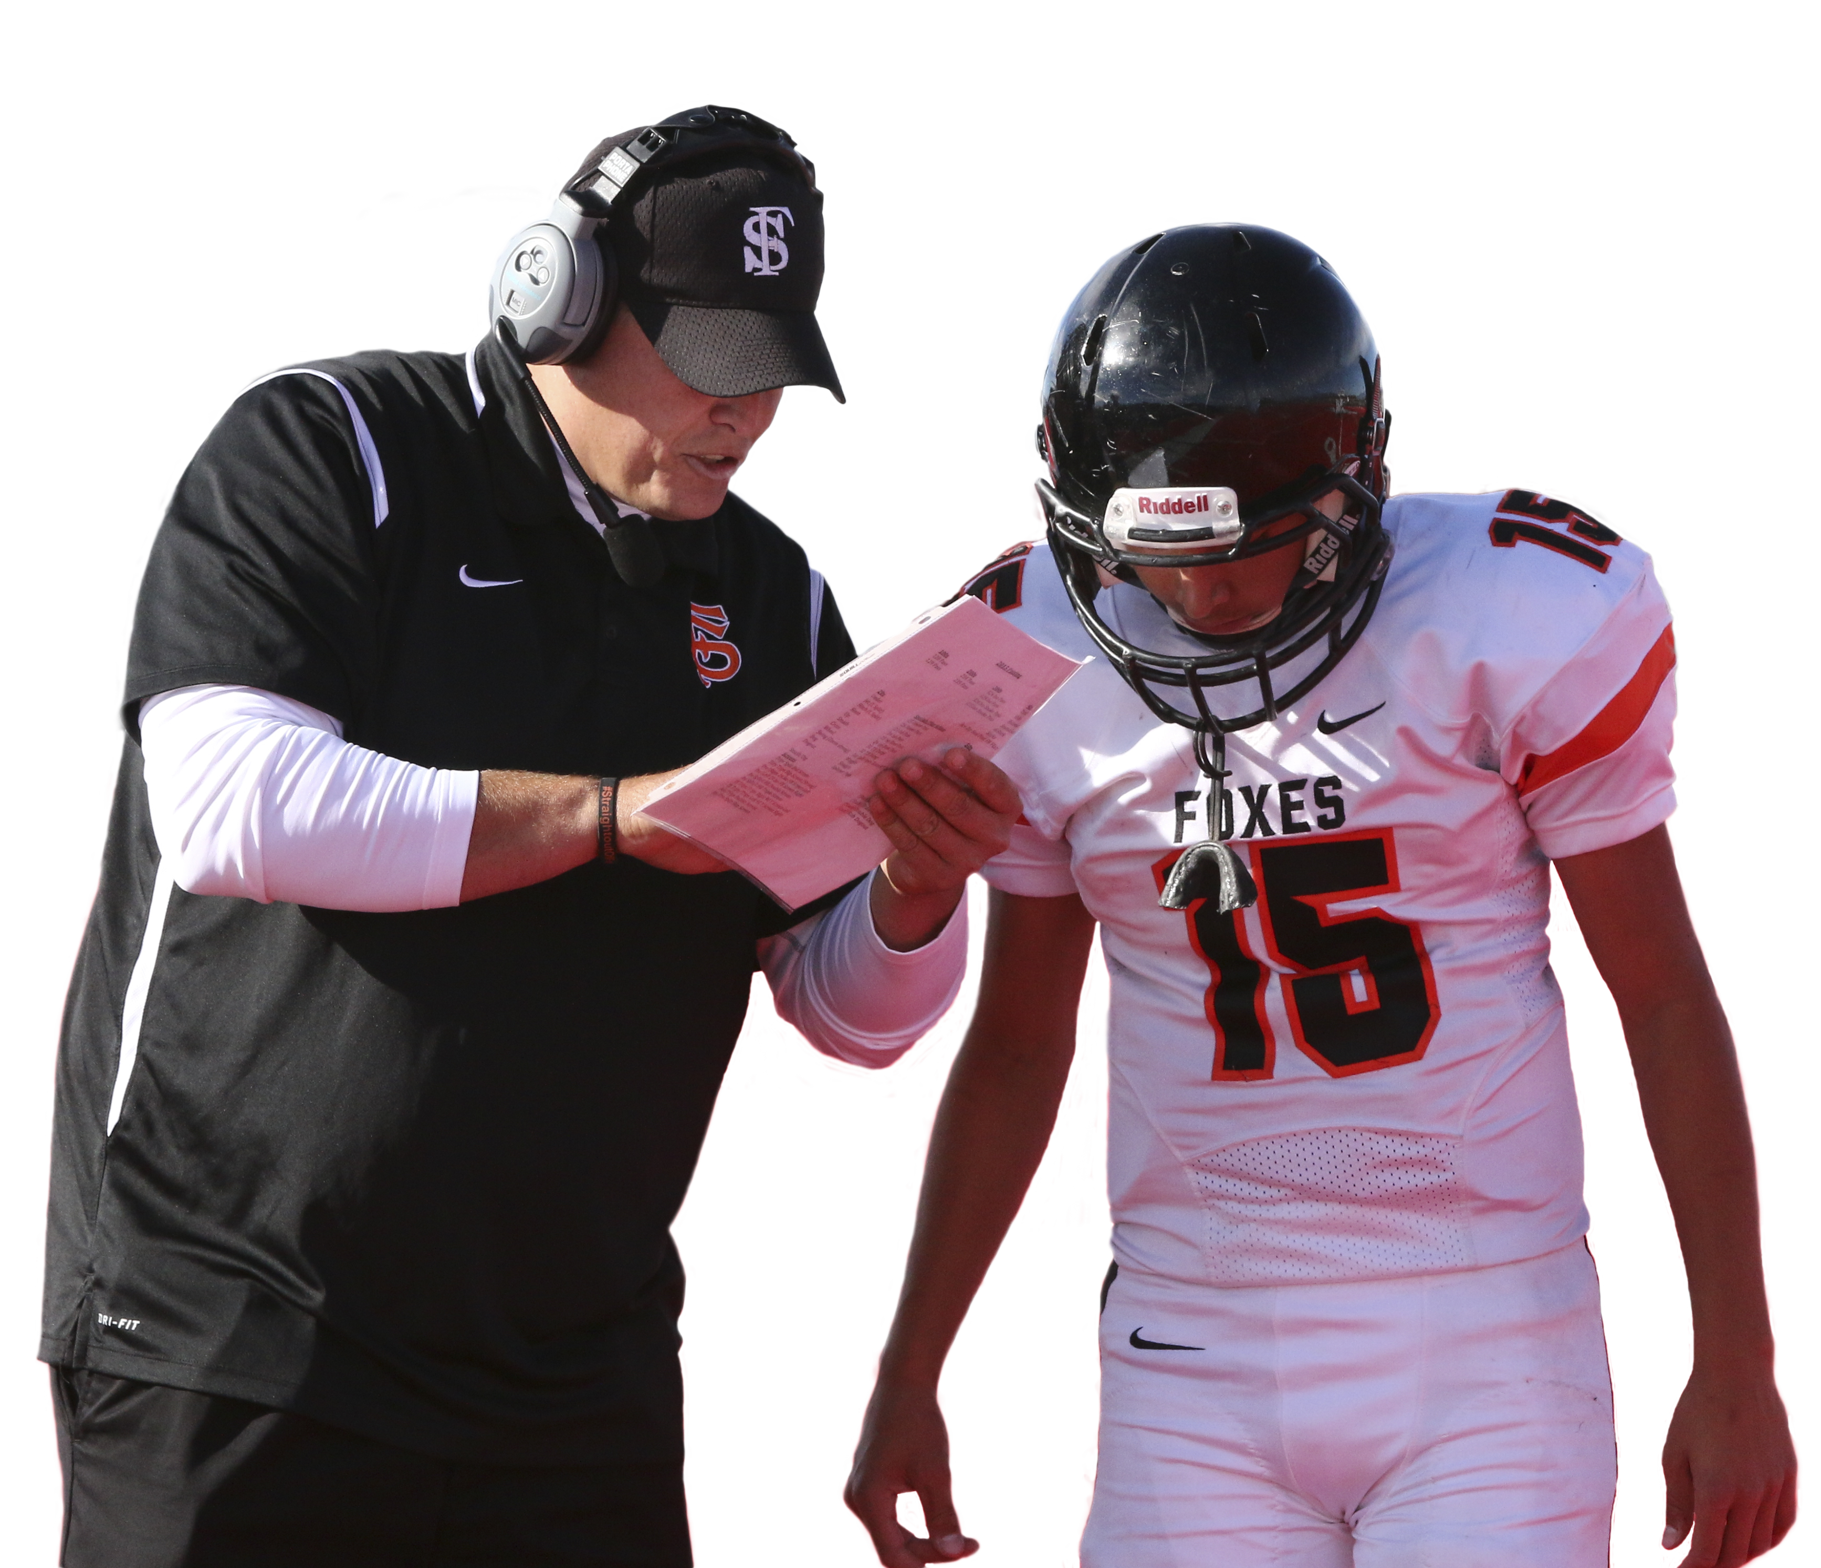

football Courses for coaches at the nfhs learning center
www.NFHSLearn.com
Coaching Football
Concussion in Sports (FREE!)
Concussion for Students (FREE!)
Heat Illness Prevention (FREE!)
Sudden Cardiac Arrest (FREE!)
Fundamentals of Coaching
Blocking and Defeating Blocks, Shoulder Tackling & Equipment Fitting
Notes:
Comment on Slide:
See all of the current 2020 Football Courses listed from the NFHS Learning Center.

Slide 46
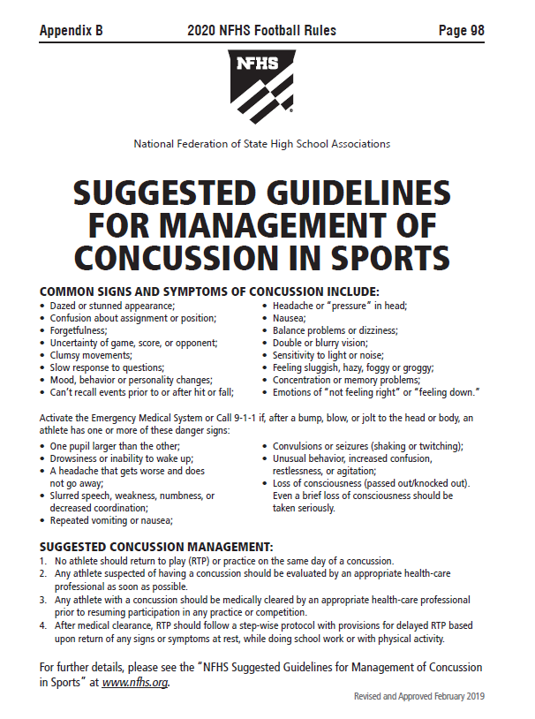
Nfhs suggested guidelines For management of concussion in sports
In the Appendix
in all of the
2020-21 NFHS
Rules Book
Notes:
Comment on Slide:
The “NFHS Suggested Guidelines for Management of Concussion” is in the Appendix in all of the 2020-21 NFHS Rules Books and was developed by the NFHS Sports Medicine Advisory Committee (SMAC).

Slide 47
Nfhs network

Slide 48
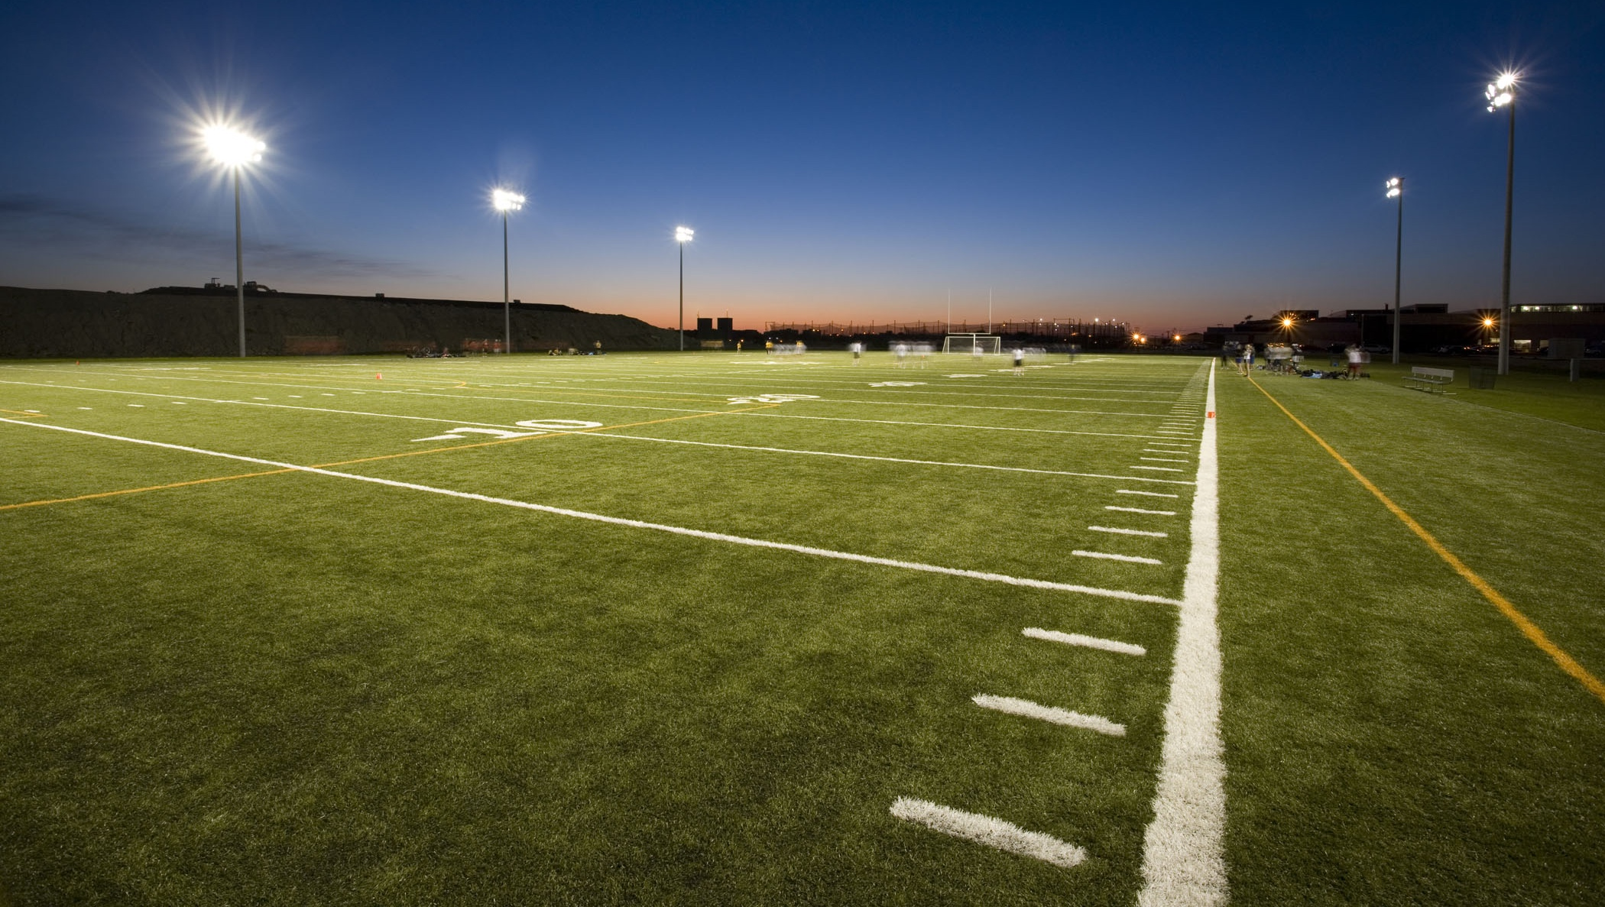

NFHS Network
By 2025, every high school sporting event in America will be streamed live.
The NFHS Network will be
THE DESTINATION for fans
to view these broadcasts.
27 Different Sports and Activities
www.NFHSnetwork.com
Notes:
Comment on Slide:
The NFHS Network is the leader in streaming Live and On Demand high school sports.
Partnered with the National Federation of State High School Associations, 45 high school state athletic/activities associations, and PlayOn! Sports, the NFHS Network is a joint venture created to provide fans with the ability to stream high school sports on any device, from wherever they are.
All NFHS Network events are available to watch online at www.NFHSnetwork.com and through the NFHS Network Live App for iOS and Android. Follow us on Facebook, Twitter, Instagram, and YouTube.
Watching high school sports and events has never been easier.
The NFHS Network’s goal to broadcast live all 2 million high school sporting events by 2025.
The NFHS Network covers 27 different regular season and postseason sports, as well as other high school activities, celebrating the accomplishments of students-athletes, student broadcasters, and high schools across the country.

Slide 49

Notes:
Comment on Slide:
The NFHS Network will broadcast over 150,000 live events this year. If your school is not a member of the NFHS Network School Broadcast Program, please contact us at Mark.Koski@NFHSnetwork.com

Slide 50

Thank You
National Federation of State High School Associations
PO Box 690 | Indianapolis, IN 46206
Phone: 317-972-6900 | Fax: 317.822.5700
www.nfhs.org | www.nfhslearn.com | www.nfhsnetwork.com

