Slide 1
2020-21 NFHS Volleyball
Rules PowerPoint
Rules Changes
Major Editorial Changes
Points of Emphasis

Slide 2

Sponsor Slide
remove this text and place artwork centered here
Notes:
The National Federation of State High School Associations is proud to have Sports Imports as the official volleyball partner of the NFHS.

Slide 3
National federation of state high school associations (NFHS)

Slide 4

National Federation of
State High School Associations
NFHS (located in Indianapolis, IN – Est. 1920):
  National leader and advocate for
  high school athletics and
  performing arts programs.
  Serves 51 state associations, 19,500
  high schools and 12 million student
  participants.
  Writes playing rules for 17 high school
  sports for boys and girls.
  Offers online education courses for high school coaches,
  officials, parents, students and others.
  Ensures that students can enjoy healthy participation, achievement and good sportsmanship in education-based athletics.
Notes:
The NFHS is the national leader and advocate for high school athletics and performing arts programs. Services of the NFHS reach more than 19,000 high schools and 12 million participants throughout the 8 NFHS sections across the U.S.
A significant responsibility of the NFHS is the commitment to writing quality playing rules for 17 high school sports for boys and girls, in addition to providing educational resources for high school coaches, officials, parents and students.
It is the vision of the NFHS to help prepare tomorrow’s leaders for the next level of life through the many program offerings in education-based athletics and activities.

Slide 5








NFHS Rules Review Committee
The NFHS Rules Review Committee is chaired by the chief operating officer and composed of all rules editors. After each committee concludes its deliberations and has adopted its recommended changes for the subsequent year, such revisions will be evaluated by the Rules Review Committee.
Davis Whitfield
Chief Operating Officer
Lindsey Atkinson
Girls Lacrosse and Volleyball
Bob Colgate
Football and Sports
Medicine
Sandy Searcy
Softball and Swimming & Diving
Elliot Hopkins
Baseball and Wrestling
Julie Cochran
Cross Country, Gymnastics, Field Hockey and
Track & Field
James Weaver
Boys and Spirit
Theresia Wynns
Basketball and Soccer
Dan Schuster
Ice Hockey
Notes:
All rules committee recommended rules changes are vetted through the NFHS Rules Review Committee before advancing to the NFHS Board of Directors for final action. The committee, as you see, is comprised of all NFHS Director of Sports and chaired by the NFHS Chief Operating Officer.

Slide 6

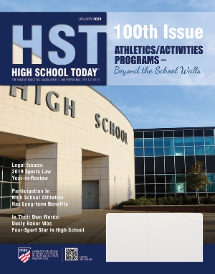
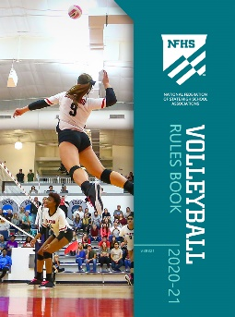

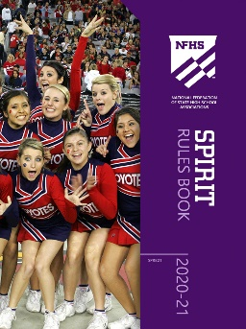
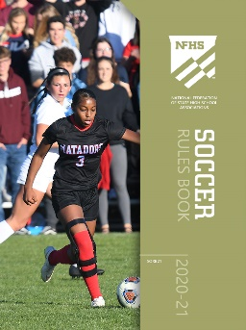

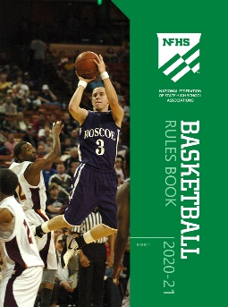




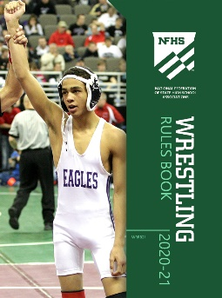
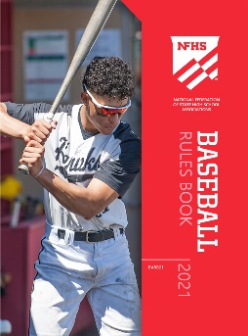
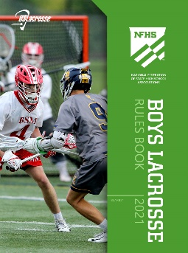
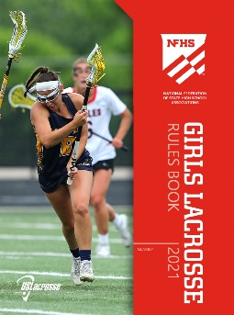
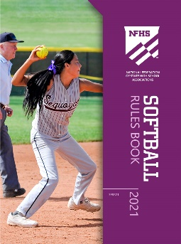

National Federation of
State High School Associations
The NFHS writes playing rules for 17 sports
for boys and girls at the high school level.
  Publishes 4 million pieces of materials annually.
Notes:
The NFHS writes playing rules for 17 sports, publishes High School Today (HST) along with several other key publications totaling over 4 million pieces annually.

Slide 7

NFHS Rules Book as e-Books
E-books features:
  Searchable
  Highlight areas of interest
  Make notes
  Easy navigation
  Adjustable viewing size
  Immediate availability
Notes:
The NFHS Rules and Case Book e-books are available for $6.99 each.

Slide 8
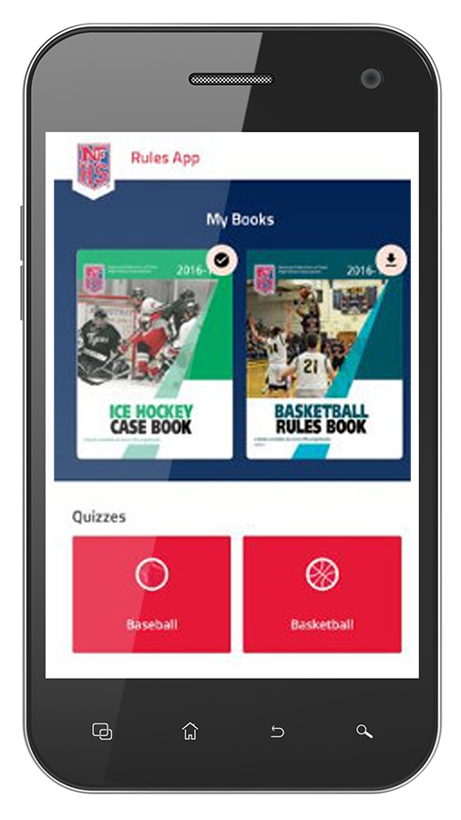
NEW NFHS Rules App
Rules App features:
  Searchable
  Highlight notes
  Bookmarks
  Quizzes for all sports
  Easy navigation
  Immediate availability
  Free to paid members of the NFHS Coaches
  and Officials Associations
  www.nfhs.org/erules for more information
Notes:
Rules app for all NFHS rules books and case books are available on iTunes and Google Play. Rules books and case books are cross-linked and enabled for searchable content.
App is free to download
Each book subscription is $6.99
NFHS Coaches and Officials Association paid members get all books for free
100% states members get books for free in sports designated by their state

Slide 9

Guidelines for Schools and state associations for consideration of accommodations
Notes:
To assist state associations in working with schools for the inclusion of students with disabilities the following guide prepared by the NFHS Task Force on the Inclusion of Students with Disabilities is being provided for your review.
Following these guidelines will assist in the individual student assessment by the student and the school.
When requesting a possible accommodation, coaches should work with their school and the state association as early as possible in the sport season.
Contest officials shall defer decisions on rule accommodations to the respective state association.
This information serves as a guide. Each state association may develop its own process.

Slide 10
2020-21 NFHS Volleyball
Rules Changes

Slide 11
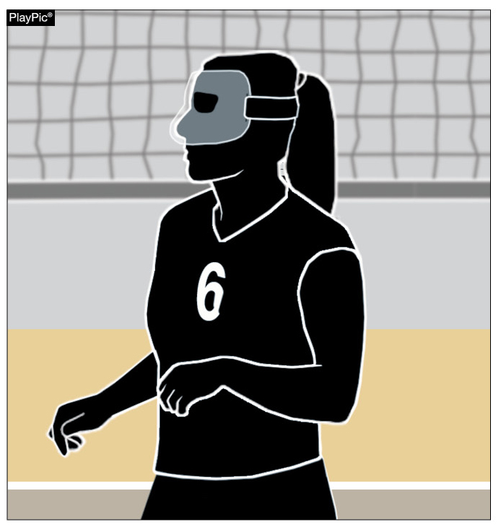
Protective face mask
4-1-4 (NEW)
Players may protect facial injuries by wearing a protective face mask.
The mask must be made of a hard material free of protrusions and molded to the face.
Notes:
Players may protect facial injuries by wearing a protective face mask.
The mask must be made of a hard material free of protrusions and molded to the face.
Rationale: Creates consistency with other NFHS rules codes and contributes to minimizing the risk of injury.

Slide 12
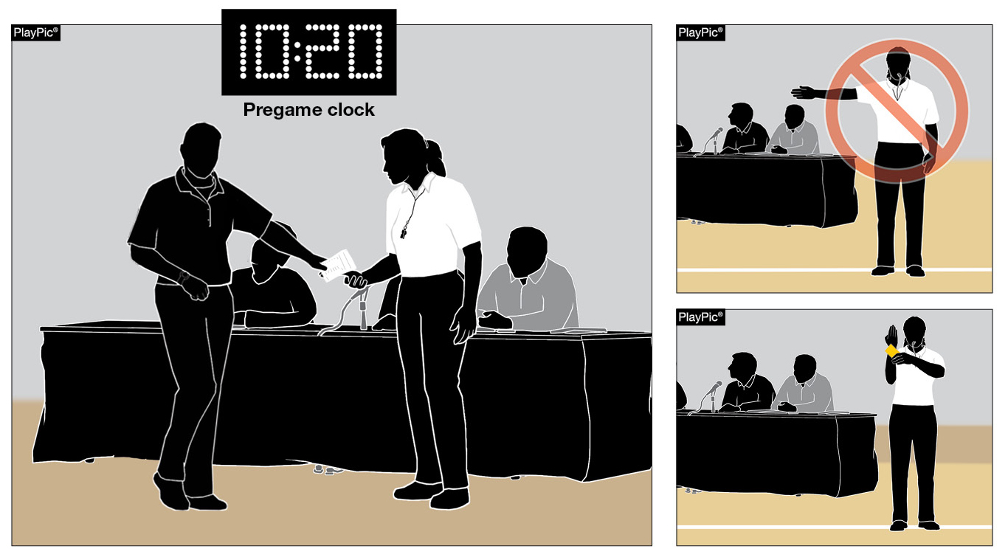
Roster submissions
7-1-1; 7-1-1 Penalties; 7-1-1 Penalties 2 (new); 9-9-1a (new); 10-3-7b
The penalty is no longer a loss of rally/point.
It is now an unnecessary delay (administrative yellow card) assessed at the start of the set.
When a team roster is not ready for submission during the prematch conference, but is provided before 10 minutes remain on the clock…
Notes:
When a team roster is not ready for submission during the prematch conference, but is provided before 10 minutes remain on the clock…
The penalty is no longer a loss of rally/point.
It is now an unnecessary delay (administrative yellow card) assessed at the start of the set.
Rationale: Creates an appropriate penalty progression for a late roster. Any corrections made to the roster after 10 minutes remain on the pregame clock still results in a loss of rally/point awarded to the opponent when the inaccuracy is discovered.
Note: Old 10-3-7b was deleted

Slide 13
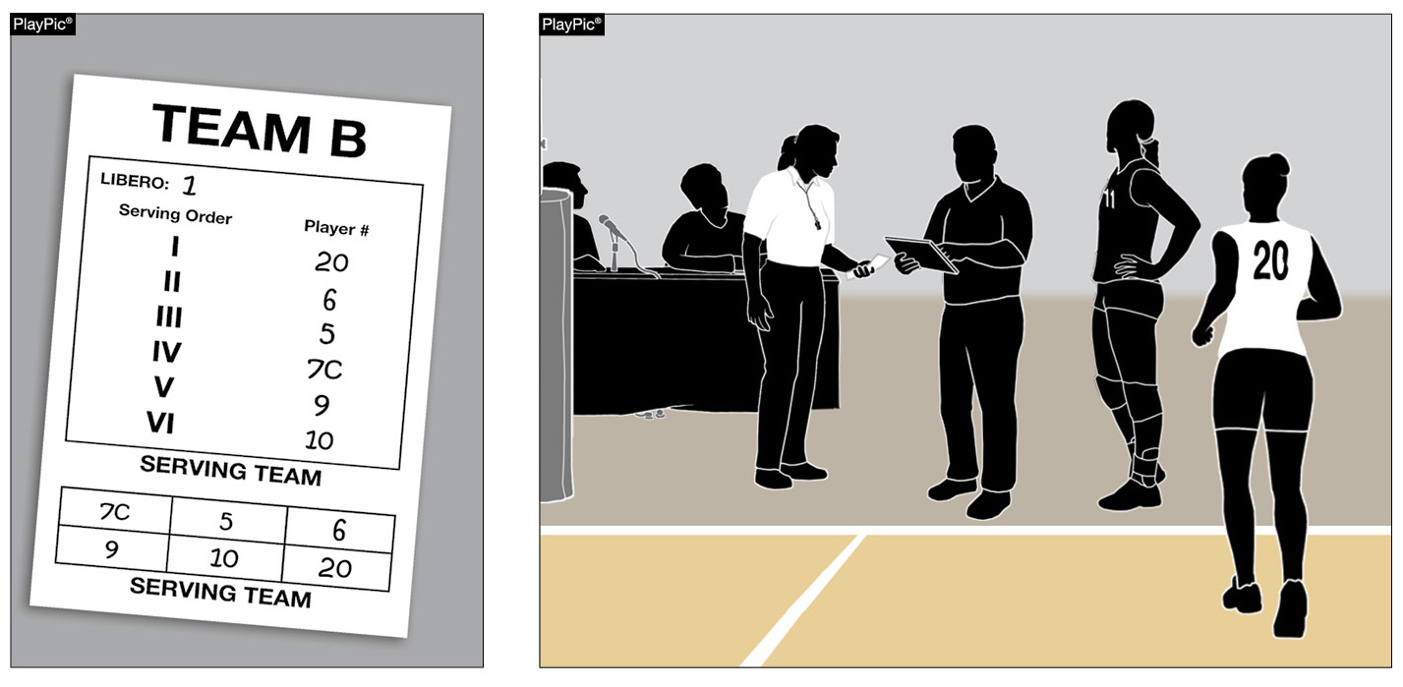
Correcting a submitted lineup
7-1-4a(1) & 7-1-4a(2) New
If a clerical error is made on the lineup by listing a libero number that no team member is wearing, the error shall be corrected without penalty.
Notes:
If a clerical error is made on the lineup by listing a libero number that no team member is wearing, the error shall be corrected without penalty.
Rationale: Creates consistency in allowing the correction of a clerical error (listing a number that no team member is wearing) on the lineup for a starting position and the libero position.

Slide 14
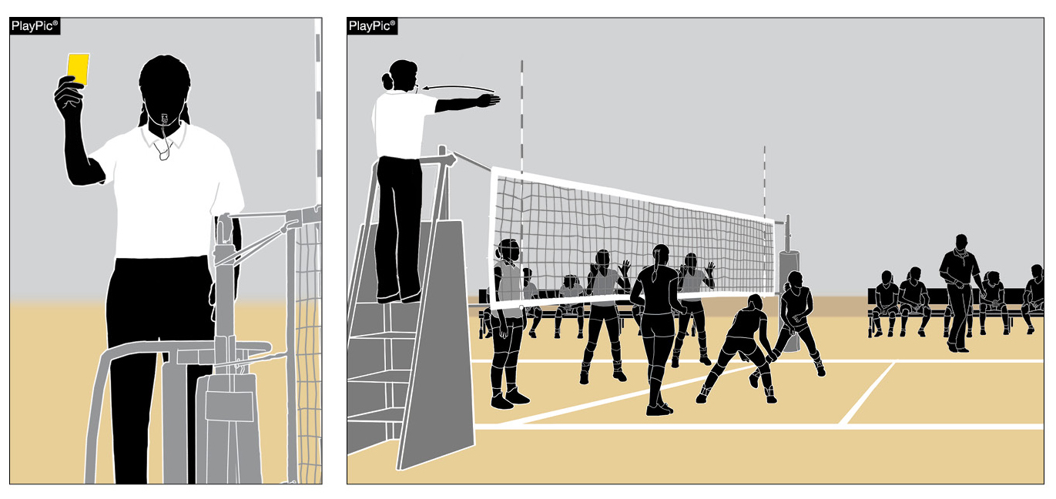
unsporting Yellow card penalty
12-2-6
When a yellow card is issued for unsporting conduct to the head coach, assistant coach(es) or team bench the head coach will no longer be required to remain seated.
If a red unsporting conduct card is issued to the head coach, assistant coach(es) or team bench, the head coach will be required to remain seated for the duration of the match.
Notes:
When a yellow card is issued for unsporting conduct to the head coach, assistant coach(es) or team bench the head coach will no longer be required to remain seated.
If a red unsporting conduct card is issued to the head coach, assistant coach(es) or team bench, the head coach will be required to remain seated for the duration of the match.
Rationale: Creates a penalty progression by allowing an official to warn a head coach with a yellow unsporting conduct card without requiring the coach to remain seated for the remainder of the match.

Slide 15
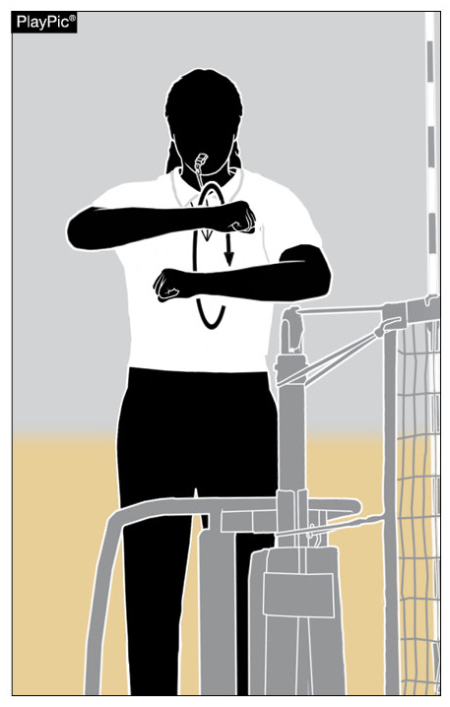
New substitution signal for referee
Signal #15
When a team requests a substitution, the official will administer two short whistles.
The official will rotate his/her forearms around each other with closed hands at shoulder height two times to signal the substitution.
Notes:
When a team requests a substitution, the official will administer two short whistles.
The official will rotate his/her forearms around each other with closed hands at shoulder height two times to signal the substitution.
Rationale: Aligns substitution mechanics with the current trends of the sport.

Slide 16
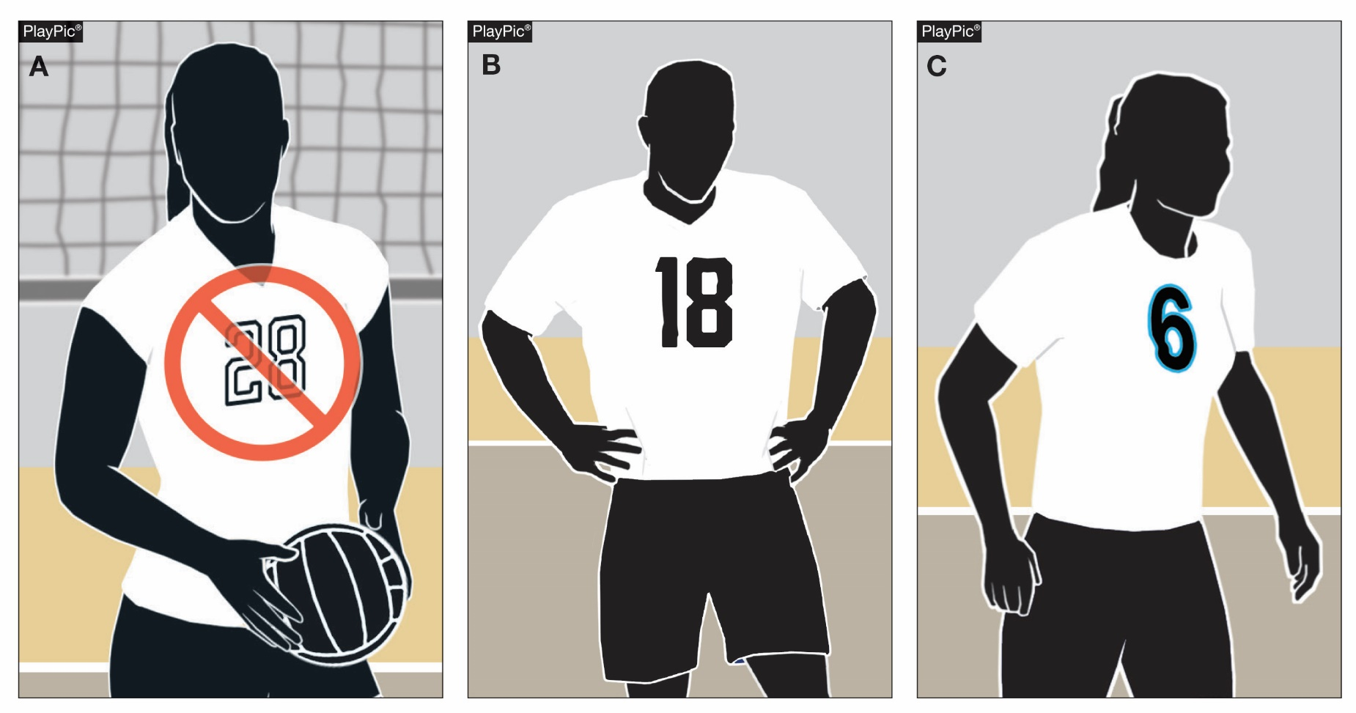
Rules Reminder: Legal uniform
4-2-4c
Illegal (2023)
Legal
Legal
Beginning with the 2023 season, the body of the uniform number must clearly contrast from the body of the uniform regardless of trim.
Notes:
Rules Reminder
This is a reminder that beginning with the 2023 season, the body of the uniform number must clearly contrast from the body of the uniform regardless of trim.
This will eliminate the allowance of trim to provide the only contrast between the body of the number and the uniform top. Trim will still be allowed (a contrasting border not to exceed ½ inch in width at its widest point).
All currently compliant uniform numbers will be compliant through the 2022-23 school year.
Rationale: Allows officials and scorers to easily identify uniform numbers.

Slide 17
2020-21 NFHS Volleyball
Editorial Changes

Slide 18
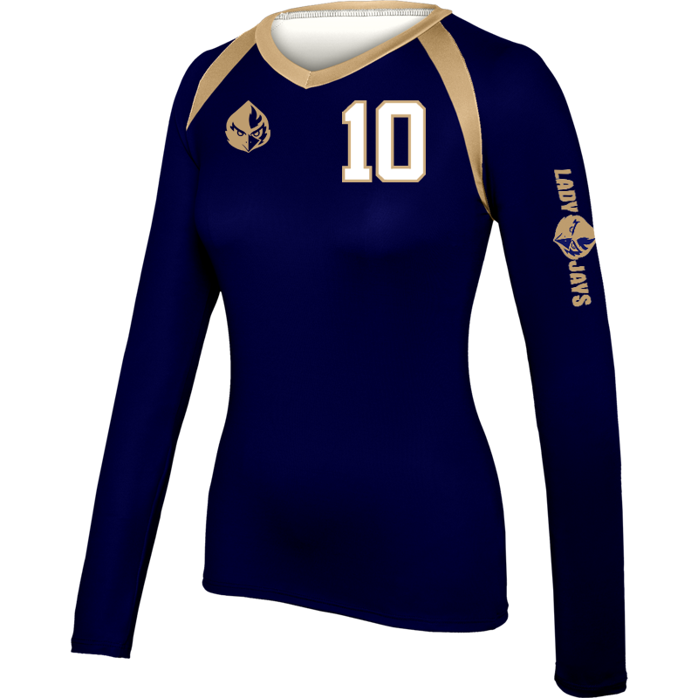
Uniforms
4-2-1e
Language referencing the size restrictions of mascots and/or school names placed on the uniform sleeve as part of the uniform requirements was removed.
School references are
permitted on the sleeve(s)
of the uniform top
without size restrictions.
Compliant
Notes:
Language referencing the size restrictions of mascots and/or school names placed on the uniform sleeve as part of the uniform requirements was removed.
School references are permitted on the sleeve(s) of the uniform top without size restrictions.

Slide 19
Exceptional Substitution
10-3-6b, 10-3-6c, 10-3-6 NOTE (new)
Reorganizes and clarifies the order of priority for an exceptional substitution for an injured/ill player aligning the language with Rule 10-4-3b.
Order of Priority:
By a teammate who has never played in the set or a player who has played in that position earlier in the set;
By any legal teammate on the bench (excluding the libero or libero replacement), regardless of previous position played;
By a libero if no other possible substitute exists.
  When no longer playing as a libero, that player must wear the same uniform as his/her teammates.
  The team will continue to play with no libero.
Notes:
Reorganizes and clarifies the order of priority for an exceptional substitution for an injured/ill player aligning the language with Rule 10-4-3b.
Order of Priority:
By a teammate who has never played in the set or a player who has played in that position earlier in the set;
By any legal teammate on the bench (excluding the libero or libero replacement), regardless of previous position played;
By a libero if no other possible substitute exists.
When no longer playing as a libero, that player must wear the same uniform as his/her teammates.
The team will continue to play with no libero.

Slide 20
Editorial Changes
5-4-3c(22) – Whistle and signal “end-of-set,” whistle and direct…
5-4-4b, c – Deleted repetitive information and combined items b. and c.
  New b. Following non deciding sets, after the first referee has confirmed the score of the set, he/she whistles and signals the teams to change courts. The team members proceed immediately to their new team benches. The players proceed counter clockwise along the sideline outside the standards, then directly to their new team benches. The timer begins timing the three-minute interval between sets with the first referee’s second whistle directing teams to their team benches.
  Re-letter remaining articles
Notes:
5-4-3c(22) – Added “whistle and” to more accurately describe the mechanics of the first referee while administering “end-of-set.”
5-4-4b,c – Deleted repetitive information and combined items b. and c. Re-lettered remaining articles.

Slide 21
Editorial Changes
5-5-3b(20) – …(five minutes when intermission is used)
7-1-2 – New formatting to align with 7-1-1 Roster:
  ART. 2 . . . Lineup:
  a. No later than…
  b. Thereafter, the written lineup…
9-7 PENALTIES 3 – For a multiple fault, only one penalty is assessed (loss of rally/point or a charged time-out).
9-9-1m – A libero or libero replacement…
Notes:
5-5-3b(20) – Added “if used” to correct an editorial error.
7-1-2 – New formatting to align with 7-1-1 Roster.
9-7 PENALTIES 3 – Deleted “or a charged time-out” as the language is no longer relevant.
9-9-1m – Added “libero replacement” to more accurately reflect this unnecessary delay.

Slide 22
Editorial Changes
12-2 Procedure for Unsporting Conduct Violations 1a, 2 (pgs. 50-51) –
1a. Whistle and hold the card(s) in the hand(s)…
2. …It is the responsibility of the first referee to immediately…whistle and administer any card(s)…
Card Procedures for Unsporting Conduct Violations (pg. 68) –
  First referee whistles and holds card in hand…
  First referee whistles and holds a card (head high)…
Unnecessary Delay Chart (NEW) (pg. 69) – New Chart illustrating the delay penalty progression.
Notes:
12-2 Procedure for Unsporting Conduct Violations 1a, 2 – Added “Whistle and” to more accurately describe the procedure for unsporting conduct violations.
Card Procedures for Unsporting Conduct Violations – Again added “whistle and” to more accurately describe the procedure for unsporting conduct violations.
Unnecessary Delay Chart – Added a new Unnecessary Delay Chart to illustrate the delay penalty progression.

Slide 23
2020-21 NFHS Volleyball
Points of Emphasis

Slide 24
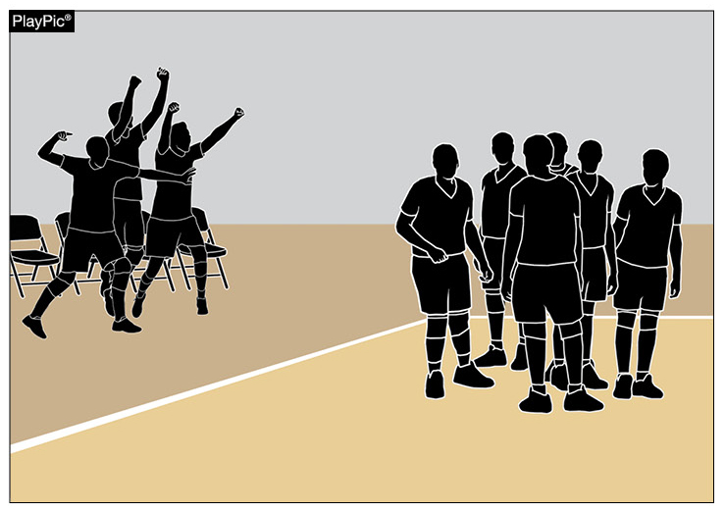
Bench Behavior/sportsmanship
Rule 12-2-7a allows bench personnel to, “Spontaneously react to an outstanding play by members of their own team.”
Team celebrations must be done in an appropriate, sporting manner.
The location and duration of these celebrations should not impede with the normal flow of the match.
Notes:
Rule 12-2-7a allows bench personnel to, “Spontaneously react to an outstanding play by members of their own team.”
Team celebrations must be done in an appropriate, sporting manner.
The location and duration of these celebrations should not impede with the normal flow of the match.

Slide 25
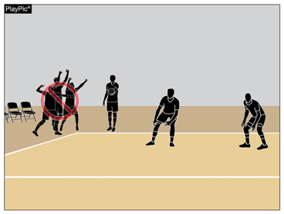
Bench Behavior/sportsmanship
Celebrations that continue after teams are ready for play and/or move outside of the bench area may be deemed excessive.
Excessive and disruptive reactions may result in an unsporting conduct penalty as described in Rule 12-2 PENALTIES.
Notes:
Celebrations that continue after teams are ready for play and/or move outside of the bench area may be deemed excessive.
Excessive and disruptive reactions may result in an unsporting conduct penalty as described in Rule 12-2 PENALTIES.

Slide 26
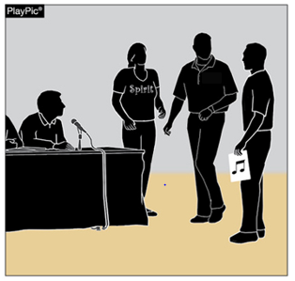
Management of non-team personnel
It is the responsibility of coaches to educate school administration and the school community as to the sportsmanship nuances of the game of volleyball. This should include:
  Appropriate times cheerleaders may or may not cheer and proper location to cheer,
  Appropriate comments, timing of announcements and good sportsmanship by PA announcers;
  Appropriate time for music and sound effects (1-8);
  Appropriate location and behavior of fans and mascots, etc.
Notes:
It is the responsibility of coaches to educate school administration and the school community as to the sportsmanship nuances of the game of volleyball. This should include:
Appropriate times cheerleaders may or may not cheer and proper location to cheer,
Appropriate comments, timing of announcements and good sportsmanship by PA announcers;
Appropriate time for music and sound effects (1-8);
Appropriate location and behavior of fans and mascots, etc.

Slide 27
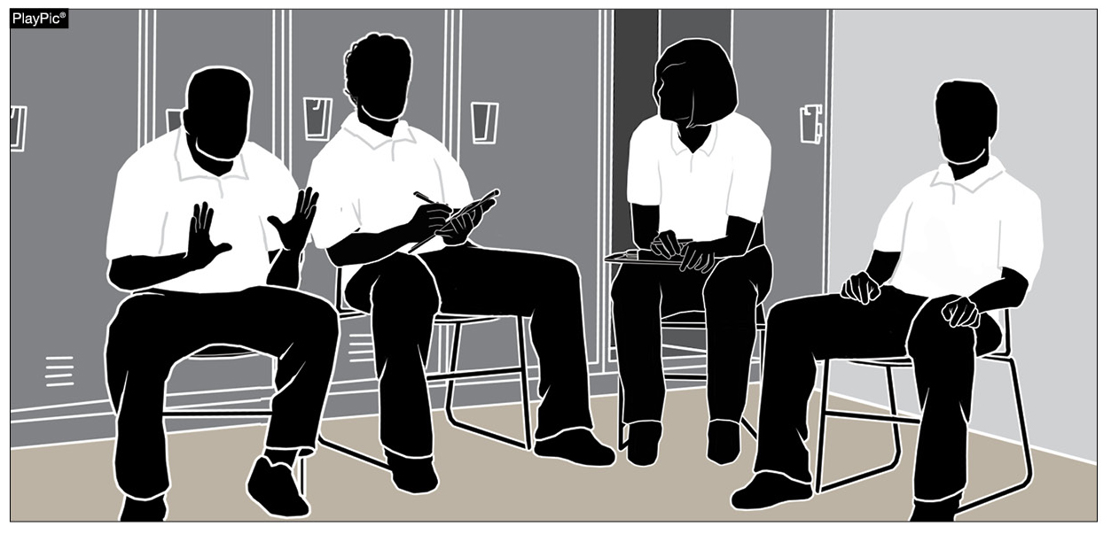
Officials’ communication
The first and second referees along with both line judges should participate in a pre-match conference to discuss the responsibilities of each crew member.
Crew members should be prepared to ask questions and the first referee prepared to answer them.
Topics of discussion should include:
  Clarifying the responsibilities and mechanics during penalty administration; and
  The review of informal signals.
Notes:
The first and second referees along with both line judges should participate in a pre-match conference to discuss the responsibilities of each crew member.
Crew members should be prepared to ask questions and the first referee prepared to answer them.
Topics of discussion should include:
Clarifying the responsibilities and mechanics during penalty administration; and
The review of informal signals.

Slide 28
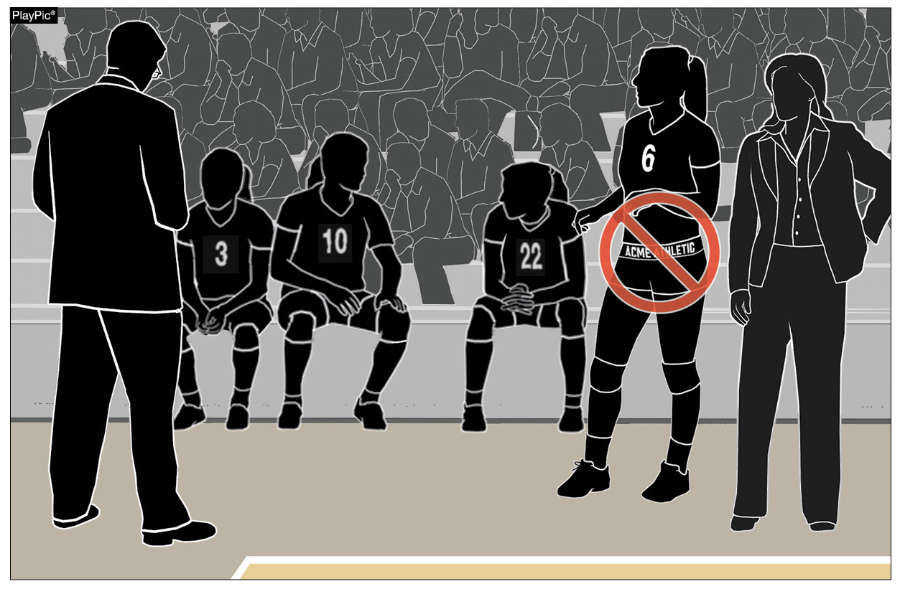
Uniform bottom compliance
It is the responsibility of the head coach to ensure that his/her players are properly equipped, which includes items purchased by the individual athlete.
Manufacturers are producing spandex marketed for volleyball with multiple large logos along the waistband. These bottoms, worn with uniform tops tucked or untucked, violate rule 4-2-1f.
Officials should enforce these uniform violations when they occur with the appropriate penalty (4-2 PENALTIES).
Notes:
It is the responsibility of the head coach to ensure that his/her players are properly equipped, which includes items purchased by the individual athlete.
Manufacturers are producing spandex marketed for volleyball with multiple large logos along the waistband. These bottoms, worn with uniform tops tucked or untucked, violate rule 4-2-1f.
Officials should enforce these uniform violations when they occur with the appropriate penalty (4-2 PENALTIES).

Slide 29
nfhs Officials association

Slide 30

Notes:
OFFICIALS EDUCATION
Every opportunity should be taken to improve upon officiating. Clinics, course work, observations, video review, association meetings should all be considered when attempting to improve one’s skills in officiating. The NFHS has provided opportunities for officials and prospective officials to take courses and to review video to support learning and developing officiating skills.
Sport-Specific Officiating courses are offered in several sports. They are ideal for new officials and those in the first few years of officiating. These courses introduce officials to the mechanics and techniques used in the sport and provide specific information on an area within that sport. Individuals can complete a course within 30-45 minutes. The cost of these courses is $10.00 to NFHS Officials Association members and $20 for non-members.
“Interscholastic Officiating” is a general course on sports officiating and it is free to members and cost $20 for non-members. This course provides an introduction to skills and concepts used as an official. Several topics are covered such as: basics of becoming and staying an official, science of officiating, art of officiating, how to combine these skills for successful officiating.
Video clips are made available to NFHS Officials Association members. The video is clipped on specific topics and provides the rules references as well as dialogue on the topic.
The courses and videos are offered at www.NFHSLearn.com .
Courses Available:
Officiating Football
Officiating Volleyball – Ball Handling
Officiating Volleyball – Alignment
Officiating Basketball
Officiating Basketball – Three-Person Mechanics
Soccer – Fouls and Misconduct
Soccer - Offside
Swimming and Diving
Officiating Wrestling
Umpiring Softball
Future Courses to be Considered:
Umpiring Baseball
Field Hockey
Track and Field
Umpiring Softball – Mechanics
Communication Among Officials and Coaches

Slide 31
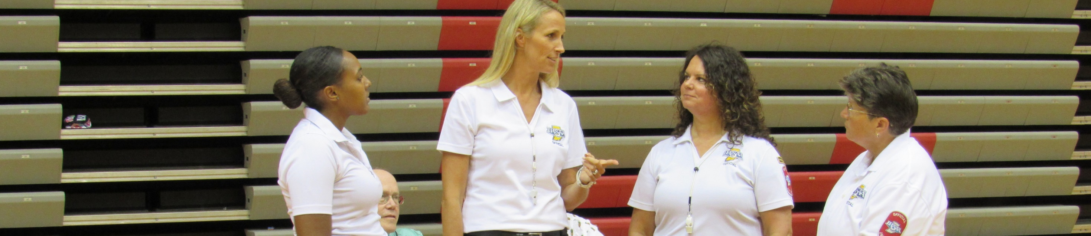

Officiating Volleyball: Alignment
Course Objectives
Units
Understand the rules governing alignment
Identify and explain the purposes of common serve and serve-receive positioning
Provide various techniques for recognizing illegal alignment
Explain officiating best practices during a game
Provide video demonstrations to help practice judging alignment
Rules Governing Alignment
Common Serve-Receive Positioning
Common Serving Team Positioning
Recognizing Illegal Alignment
“You Make the Call”
$20|$10 off with NFHS Officials Association membership
Available at NFHSlearn.com!
Notes:
The most recent officials’ education course produced by the NFHS is Officiating Volleyball: Alignment.
Course objectives include:
Understanding the rules governing alignment;
Identifying and explaining the purposes of common serve and serve-receive positioning;
Providing various techniques for recognizing illegal alignment;
Explaining officiating best practices during a game; and
Providing video demonstrations to help practice judging alignment.

Slide 32
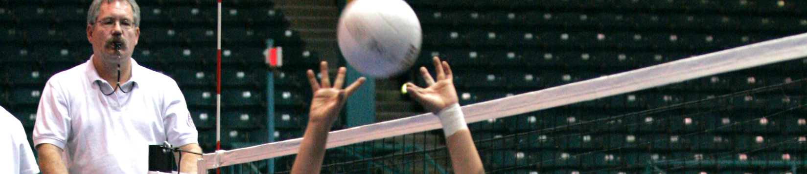
Officiating Volleyball: Ball Handling
Course Objectives
Units
Understand the basic rules of contact and the skills performed in a volleyball match
Identify and explain examples of illegal and legal contact
Practice making ball handling calls via video demonstrations
Create consistency in ball handling calls
Introduction to Ball Handling
Rules Governing Ball Handling
Techniques to Train the Eye
Variables and External Stimuli
Overview of Each Skill
$20|$10 off with NFHS Officials Association membership
Available at NFHSlearn.com!
Notes:
The first course in the Officiating Volleyball series is Officiating Volleyball: Ball Handling.
Course objectives include:
Understanding the basic rules of contact and the skills performed in a volleyball match;
Identifying and explaining examples of illegal and legal contact;
Practicing making ball handling calls via video demonstrations; and
Creating consistency in ball handling calls.

Slide 33
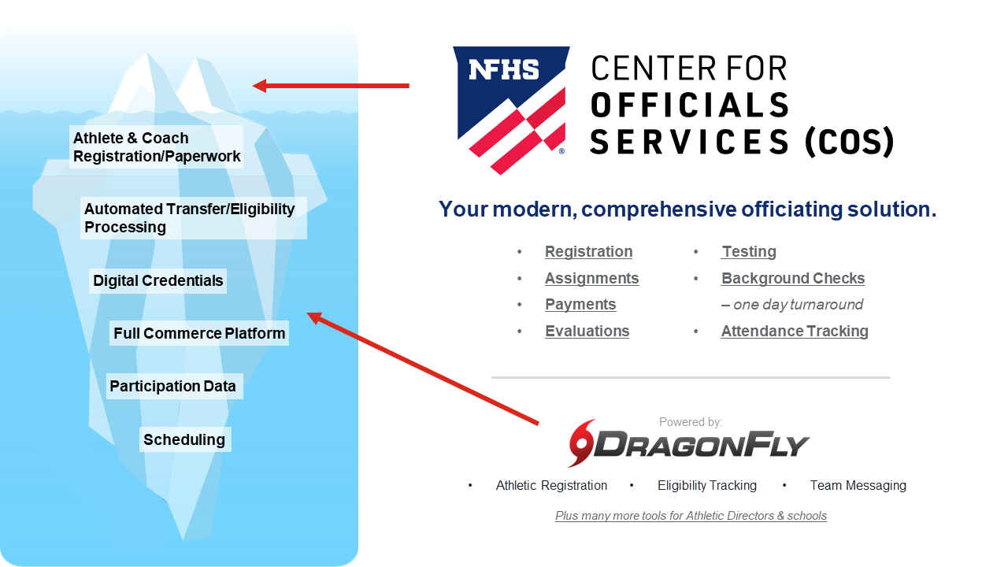
NFHS Center for Officials Services (COS)
Notes:
Your Complete Solution for Officials Management and More:
Registration
Assignment
Payment
Testing
Background Checks
For More Information on the NFHS – Center for Officials Services (COS) Contact:
Davis Whitfield, NFHS, dwhitfield@nfhs.org
Karissa Niehoff, NFHS, kniehoff@nfhs.org
Also If You’re Interested in Eligibility and Monitoring Requirements Contact
the Folks at Dragonfly:
Kirk Miller, Dragonfly, kirk@dragonflyathletics.com
Brandon Wallace, Dragonfly, brandon@dragonflyathletics.com

Slide 34
NFHS Learning Center

Slide 35

Notes:
The NFHS Learning Center, accessed at NFHSLearn.com, has over 70 online professional development courses for the entire interscholastic community, including coaches, administrators, officials, parents, students, and individuals within performing arts programs. The mission and purpose of the NFHS Learning Center is focused on growing professional development opportunities. Those opportunities include courses, but now also incorporate additional videos such as “The Parent Seat” and “Beyond The Scoreboard,” which are short videos created to show to parents at Parent Meetings or show during events. The NFHS Learning Center has delivered over 10,000,000 courses and looks to continue to educate and be a valuable resource for the entire interscholastic community. Learn more at NFHSLearn.com!

Slide 36
NFHS Network

Slide 37
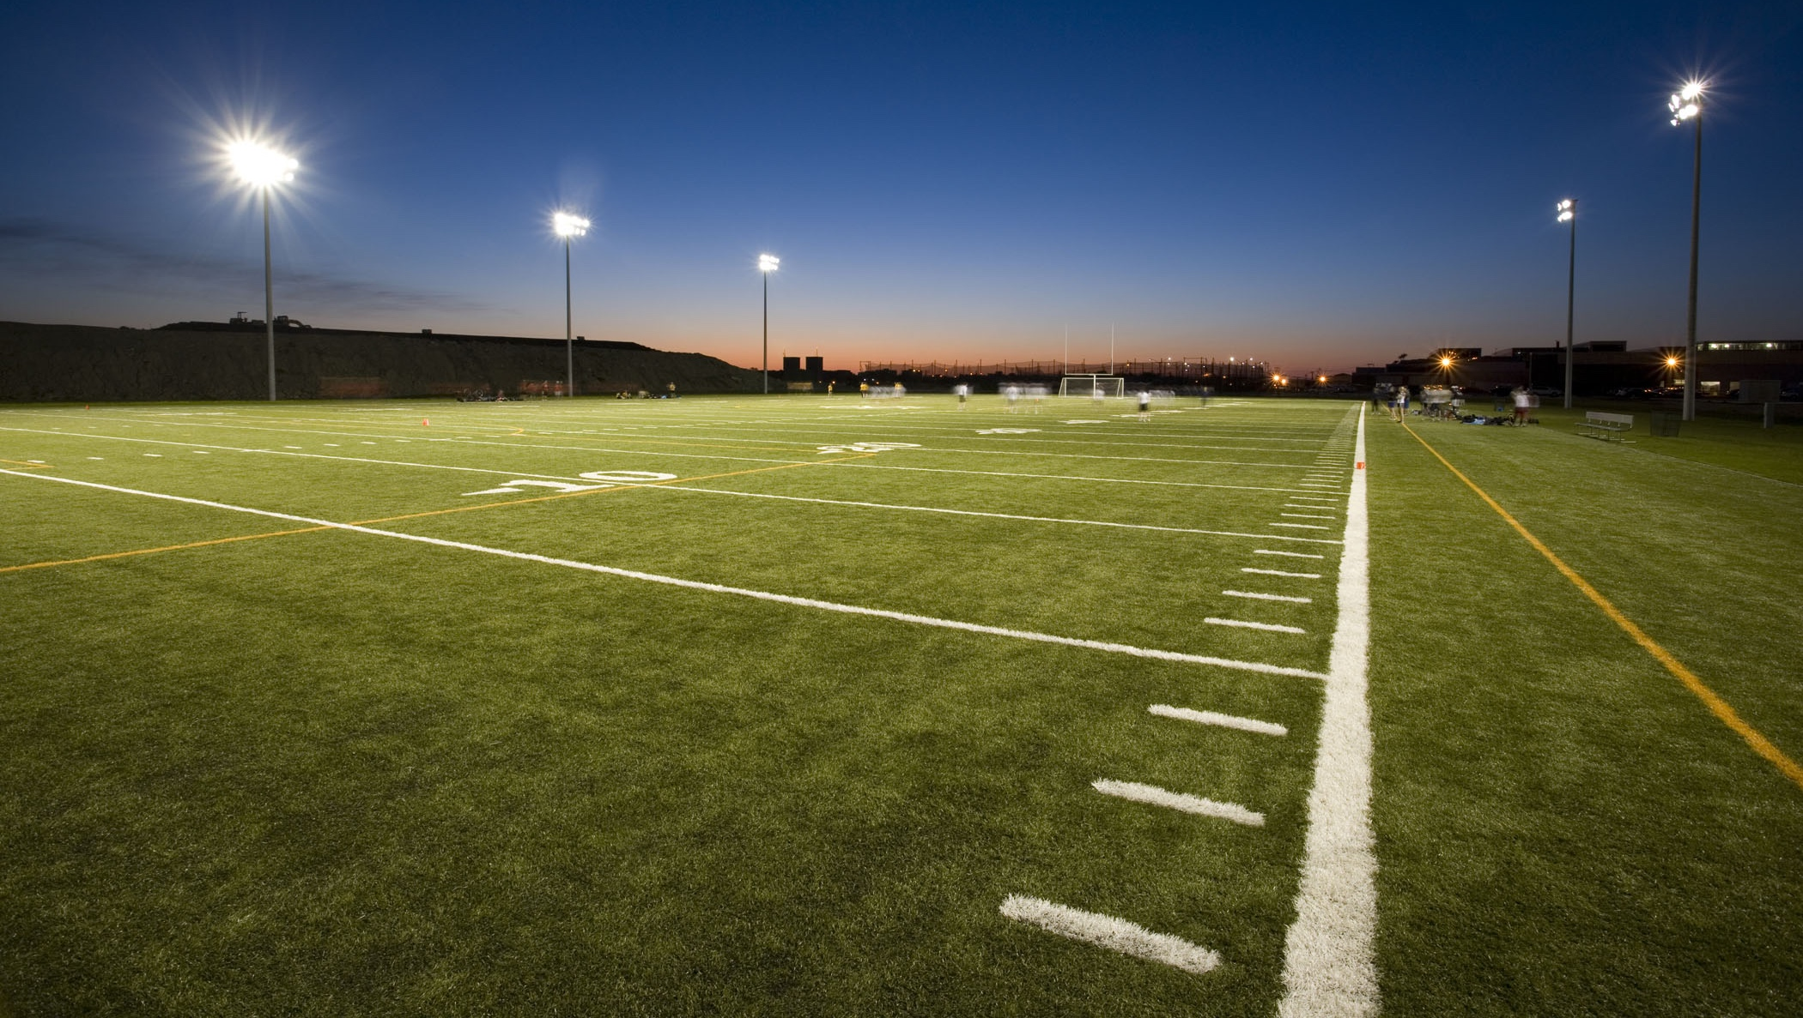

NFHS Network
By 2025, every high school sporting event in America will be streamed live.
The NFHS Network will be
THE DESTINATION for fans
to view these broadcasts.
27 Different Sports and Activities
www.NFHSnetwork.com
Notes:
The NFHS Network is the leader in streaming Live and On Demand high school sports.
Partnered with the National Federation of State High School Associations, 45 high school state athletic/activities associations, and PlayOn! Sports, the NFHS Network is a joint venture created to provide fans with the ability to stream high school sports on any device, from wherever they are.
All NFHS Network events are available to watch online at www.NFHSnetwork.com and through the NFHS Network Live App for iOS and Android. Follow us on Facebook, Twitter, Instagram, and YouTube.
Watching high school sports and events has never been easier.
The NFHS Network’s goal to broadcast live all 2 million high school sporting events by 2025.
The NFHS Network covers 27 different regular season and postseason sports, as well as other high school activities, celebrating the accomplishments of students-athletes, student broadcasters, and high schools across the country.

Slide 38

Notes:
The NFHS Network will broadcast over 150,000 live events this year. If your school is not a member of the NFHS Network School Broadcast Program, please contact us at Mark.Koski@NFHSnetwork.com

Slide 39

Thank You
National Federation of State High School Associations
PO Box 690 | Indianapolis, IN 46206
Phone: 317-972-6900 | Fax: 317.822.5700
www.nfhs.org | www.nfhslearn.com | www.nfhsnetwork.com

