Slide 1
2020-21 NFHS Swimming and diving Rules PowerPoint
Rules Changes
Major Editorial Changes
Points of Emphasis

Slide 2
National federation of state high school associations (NFHS)

Slide 3

National Federation of
State High School Associations
NFHS (located in Indianapolis, IN – Est. 1920):
  National leader and advocate for
  high school athletics and
  performing arts programs.
  Serves 51 state associations, 19,500
  high schools and 12 million student
  participants.
  Writes playing rules for 17 high school
  sports for boys and girls.
  Offers online education courses for high school coaches,
  officials, parents, students and others.
  Ensures that students have opportunity to enjoy healthy participation, achievement and good sportsmanship in education-based athletics.
Notes:
The NFHS is the national leader and advocate for high school athletics and performing arts programs. Services of the NFHS reach more than 19,000 high schools and 12 million participants throughout the 8 NFHS sections across the U.S.
A significant responsibility of the NFHS is the commitment to writing quality playing rules for 17 high school sports for boys and girls, in addition to providing educational resources for high school coaches, officials, parents and students.
It is the vision of the NFHS to help prepare tomorrow’s leaders for the next level of life through the many program offerings in education-based athletics and activities.

Slide 4








NFHS Rules Review Committee
The NFHS Rules Review Committee is chaired by the chief operating officer and composed of all rules editors. After each committee concludes its deliberations and has adopted its recommended changes for the subsequent year, such revisions will be evaluated by the Rules Review Committee.
Davis Whitfield
Chief Operating Officer
Lindsey Atkinson
Girls Lacrosse and Volleyball
Bob Colgate
Football and Sports
Medicine
Sandy Searcy
Softball, Swimming & Diving, and Water Polo
Elliot Hopkins
Baseball and Wrestling
Julie Cochran
Cross Country, Gymnastics, Field Hockey and
Track & Field
James Weaver
Boys Lacrosse and
Spirit
Theresia Wynns
Basketball and Soccer
Dan Schuster
Ice Hockey
Notes:
All committee recommended rules changes are vetted through the NFHS Rules Review Committee before advancing to the NFHS Board of Directors for final action. The committee is comprised of all NFHS Director of Sports and chaired by the NFHS Chief Operating Officer.

Slide 5


















National Federation of
State High School Associations
The NFHS writes playing rules for 17 sports
for boys and girls at the high school level.
  Publishes 4 million pieces of materials annually.
Notes:
The NFHS writes playing rules for 17 sports, publishes High School Today (HST) along with several other key publications totaling over 4 million pieces annually.

Slide 6

NFHS Rules Book as e-Books
E-books features:
  Searchable
  Highlight areas of interest
  Make notes
  Easy navigation
  Adjustable viewing size
  Immediate availability
Notes:
The NFHS Rules and Case Book e-books are available for $6.99 each.

Slide 7

NEW NFHS Rules App
Rules App features:
  Searchable
  Highlight notes
  Bookmarks
  Quizzes for all sports
  Easy navigation
  Immediate availability
  Free to paid members of the NFHS Coaches
  and Officials Associations
  www.nfhs.org/erules for more information
Notes:
Rules app for all NFHS rules books and case books are available on iTunes and Google Play. Rules books and case books are cross-linked and enabled for searchable content.
App is free to download.
Each book subscription is $6.99.
NFHS Coaches and Officials Association paid members get all books for free.
100% states members get books for free in sports designated by their state.

Slide 8

Guidelines for Schools and state associations for consideration of accommodations
Notes:
To assist state associations in working with schools for the inclusion of students with disabilities, the following guide prepared by the NFHS Task Force on the Inclusion of Students with Disabilities is being provided for your review.
Following these guidelines will assist in the individual student assessment by the student and the school.
When requesting a possible accommodation, coaches should work with their school and the state association as early as possible in the sport season.
Contest officials shall defer decisions on rule accommodations to the respective state association.
This information serves as a guide. Each state association may develop its own process.

Slide 9
2020 nfhs swimming and diving RULES CHANGES

Slide 10
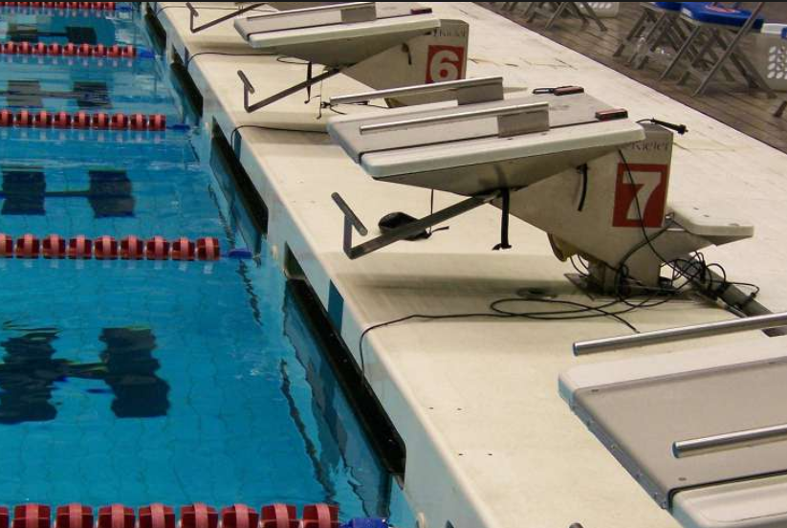
Parts of the pool
1-1-1
The end wall is the vertical portion of the pool, contiguous surface of the deck and overflow gutter, the front of the starting block or platform, or the touchpad at the end of the course.
Notes:
Rule 1-1-1: The end wall is the vertical portion of the pool, contiguous surface of the deck and overflow gutter, the front of the starting block or platform, or the touchpad at the end of the course.
Rationale: The additional language provides clarity on what constitutes the end wall. The 2019-20 rules book changed the definition of the finish of the race by permitting the swimmer to finish at the end wall versus the touchpad. That change necessitated a more concise definition of the end wall.

Slide 11
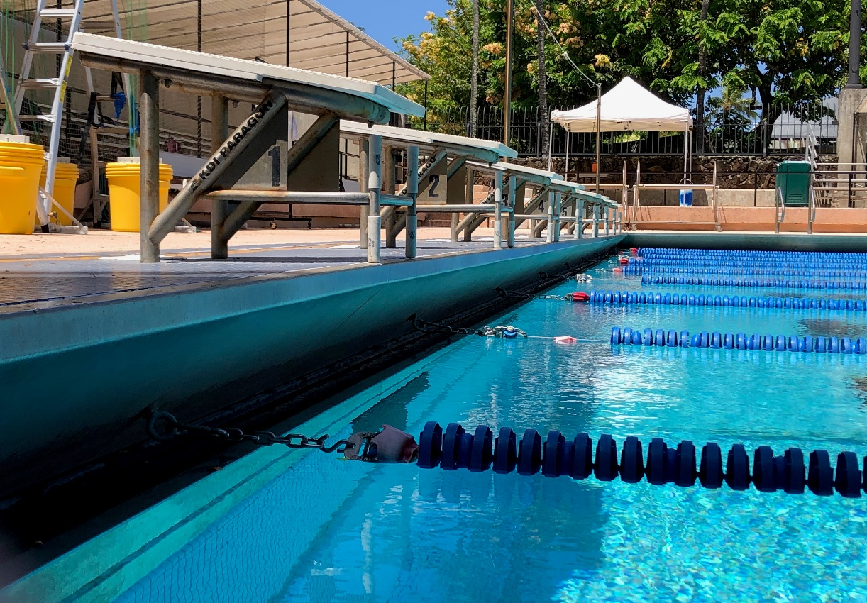
Parts of the pool
1-1-1
Open spaces on the side of the blocks or the open space of the gutter are not considered part of the end wall.
Notes:
Rule 1-1-1: Open spaces on the side of the blocks or the open space of the gutter are not considered part of the end wall.
Rationale: For the purpose of further clarifying the definition of the end all this slide indicates what should not be considered as part of the end wall. Timers should be instructed to stop the watch at the first point of contact by the swimmer with any structural portion of the pool at the end wall, whether or not touchpads are being used.

Slide 12
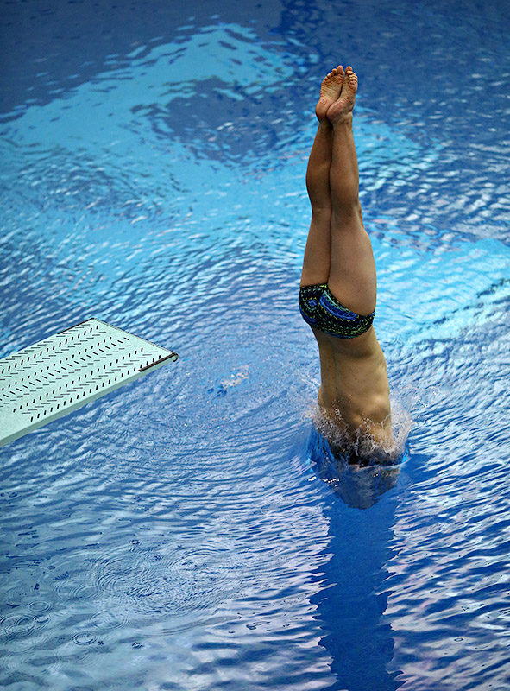
MEET MANAGEMENT
1-4-5, 1-4-6
  A dive round is the completion
  of one dive by each participant.
  A dive session is a series of dive
  rounds culminating in a break.
Notes:
Rule 1-4-5 A dive round is the completion of one dive by each participant.
Rule 1-4-6 A dive session is a series of dive rounds culminating in a break.
Note: The remaining articles have been renumbered.
Rationale: The definitions of a diving round and a diving session were added to clarify the differences between the terms which were currently used interchangeably in Rule 9. Diving sessions refer to preliminary rounds, semifinal rounds or final rounds during an 11-dive competition. After the end of each of these sessions, there is a natural break as scores are tabulated and cuts are made for the next session of competition. Meet management may choose to permit divers to warm up during these breaks.

Slide 13
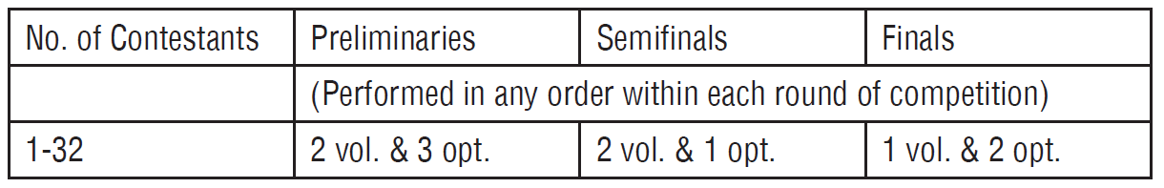
Other rules affected
9-2-1, 9-4-1d
  Practice dives are only permitted during specified warm-up times prior to each session.
  In championship meets, the dives to be performed during each session of championship competition are as follows:
Notes:
Rules affected by this change:
Rule 9-2-1: Practice dives are permitted during specified warm-up times.
Rule 9-4-1d: In championship meets, the dives to be performed during each session of championship competition are as follows:
Rationale: The Swimming and Diving Rules Committee wants to clarify that if meet management establishes diving warm-up protocol between diving sessions, this would be permissible and even encouraged. However, diving warm-up between sessions would be predicated on facility and time constraints and therefore, is not mandated.

Slide 14
Other rules affected
9-4-2, 9-4-4, 9-4-5
The number of qualifiers for each session of competition is the predetermined number of divers with the cumulative highest score for all rounds of competition.
After the preliminary session, the number of qualifiers shall be four more than the number of places to be scored.
After the semifinal session, the number of qualifiers shall be equal to the number of places to be scored.
Notes:
Rules affected by this change:
Rule 9-4-2 The number of qualifiers for each session of competition is the predetermined number of divers with the cumulative highest score for all rounds of competition.
Rule 9-4-4 After the preliminary session, the number of qualifiers shall be four more than the number of places to be scored.
Rule 9-4-5 After the semifinal session, the number of qualifiers shall be equal to the number of places to be scored.
Rationale: The edits clarify what constitutes preliminary sessions, semifinal sessions and final sessions during an 11-dive competition.

Slide 15
uniforms
3-3-3 note, 3-3-4c
NOTE: The FINA mark and/or individual barcode and/or the USA Swimming approved check-mark logo on certain suits designating that the suit has been approved for FINA and/or USA Swimming competition is not considered to be a second manufacturer's logo nor a form of advertising. Such suits with a FINA marking and/or check-mark, if otherwise legal, shall be legal for NFHS competition.
Notes:
Rule 3-3-3 NOTE: The FINA mark and/or individual barcode and/or the USA Swimming approved check-mark logo on certain suits designating that the suit has been approved for FINA and/or USA Swimming competition is not considered to be a second manufacturer's logo nor a form of advertising. Such suits with a FINA marking and/or check-mark, if otherwise legal, shall be legal for NFHS competition.
Rationale: USA swimming will be implementing a new rule on September 1, 2020 that does not permit 12-Under swimmers to wear technical suits at most swim meets. Some companies may submit a suit for approval by FINA that are not considered a technical suit, using it for marketing purposes. USA Swimming has developed a small check mark that will be placed next to the FINA logo so an official could see that the suit is legal to be worn by 12-Unders. This check mark will be positioned next to the FINA marking, and is not considered as a manufacturer’s logo or advertising.
Comments: This rule is a clarification of what the swimming community may see on suits this fall as a result of a rule change made by USA Swimming. A small check mark will be positioned next to the FINA marking on some suits and is not considered as an additional manufacturer’s logo or advertising.

Slide 16

uniforms
3-3-3 note, 3-3-4c
Suits with a FINA marking
and/or the USA Swimming
approved check-mark logo,
if otherwise legal,
shall be legal for NFHS
competition.
Notes:
Rule 3-3-4c: Suits with a FINA marking and/or the USA Swimming approved check-mark logo, if otherwise legal, shall be legal for NFHS competition.
Rationale: This check mark will be positioned next to the FINA marking, and is not considered as a manufacturer’s logo or advertising. These suits will be on the market for the 2020-21 seasons which mean coaches and officials may see the new mark on suits this fall.

Slide 17
Timing and judging
6-3-2
The official time is the time registered by touchpad, button(s) or stopwatch(es) when the swimmer completes the race. The order of finish shall be determined by integration of the official time for each lane.
Notes:
Rule 6-3-2: The official time is the time registered by touchpad, button(s) or stopwatch(es) when the swimmer completes the race. The order of finish shall be determined by integration of the official time for each lane.
Rationale: Since a legal finish can be accomplished by touching any part of the end wall, even if a touchpad is present, the result achieved by that legal touch must be regarded as the "official" time for the event. There is no rule foundation for the referee taking the pad time in preference to button/watch times. This rule change clarifies that other data points such as touchpad, buttons or stopwatches may need to be used by the referee to determine the swimmer’s time. A good rule of thumb is to remember the following:
The official time is determined when the first point of contact is:
1. Touchpad - that time shall be official;
2. Touchpad but a malfunction is determined - integrate backup time with results from other lanes;
3. End wall – utilize backup system and other available data points to verify backup system is accurate (order of finish, times in other lanes, etc.).

Slide 18
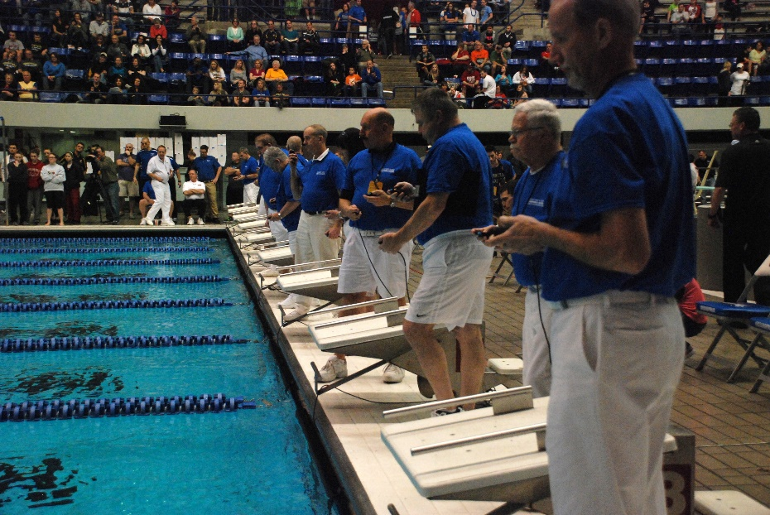
Timing and judging
6-3-4
The backup system shall be operative for all races but shall be used only for lanes in which the automatic equipment malfunctions
or time is not properly
recorded.
Notes:
Rule 6-3-4: The backup system shall be operative for all races but shall be used only for lanes in which the automatic equipment malfunctions or time is not properly recorded.
Rationale: The rule proposal more accurately describes the protocol for determining an official time when the competitor contacts the end wall and not the touchpad. The backup system, meaning backup buttons or stopwatches, may need to be used in situations where the swimmer does not activate the touchpad or the touchpad malfunctions. This phrase clarifies conditions when the swimmer does not touch the touchpad initially.

Slide 19
Diving contestants
9-3-3
Entries by Individuals - A diver officially becomes a participant when:
a. in championship meets, the official entry card/scoresheet
bearing that diver's first and last name, event and school
affiliation is submitted at the time and place specified by
the meet manager;
Notes:
Rule 9-3-3 - Entries by Individuals - A diver officially becomes a participant when:
a. in championship meets, the official entry card/scoresheet bearing that diver's first and last name, event and school affiliation is submitted at the time and place specified by the meet manager;
Rationale: Headings were added to Rules 9-3-3 and 9-3-5 to help delineate the two-step process for a diver participating in a championship meet. It is a two-step process of (1) entering the divers and swimmers into a culminating meet as part of a team entry submission, and (2) submitting the diving list/scoresheet at that time or a later time. Rule 9-3-3 defines how a diver is entered into the contest.
These headings and wording changes are simply clarifications of the process.

Slide 20
Diving contestants
9-3-5
Diving Scoresheets - Each diver shall submit a diving scoresheet, signed by both the contestant and the coach on the lines provided for those signatures, which includes the number, written description, position, degree of difficulty (with the number and degree of difficulty of the voluntary dive(s) circled or otherwise clearly identified), and order in which the dives will be attempted for all levels of the competition, preliminaries through finals.
Notes:
Rule 9-3-5: Diving Scoresheets – Each diver shall submit a diving scoresheet, signed by both the contestant and the coach on the lines provided for those signatures, which includes the number, written description, position, degree of difficulty (with the number and degree of difficulty of the voluntary dive(s) circled or otherwise clearly identified), and order in which the dives will be attempted for all levels of the competition, preliminaries through finals.
Rationale: The heading identifies and defines the protocol for submission of the diving scoresheet. The diving scoresheet is separate from the participant entry and continues to have its own deadline and penalties. Scoresheets are to be submitted at the time and place specified by the meet manager. These headings and wording changes are simply clarifications of the process.

Slide 21
2020 nfhs swimming and diving Major editorial CHANGES

Slide 22
timers
4-9-2
A head lane timer shall determine if the swimmer has touched the finish end (or touchpad if automatic timing/judging equipment is used) and, for the 500-yard/400-meter freestyle, shall keep a written tally of the number of laps completed by the swimmer in that lane.
Notes:
Rule 4-9-2: A head lane timer shall determine if the swimmer has touched the finish end (or touchpad if automatic timing/judging equipment is used) and, for the 500-yard/400-meter freestyle, shall keep a written tally of the number of laps completed by the swimmer in that lane.
Rationale: Language was removed from Rule 4-9-2 to reflect the change that was made in the 2019-20 season. The phrase "finish end or touchpad if automatic timing/judging equipment is used" indicates that the touchpad takes precedence, which is not an appropriate description of the finish of the race.

Slide 23
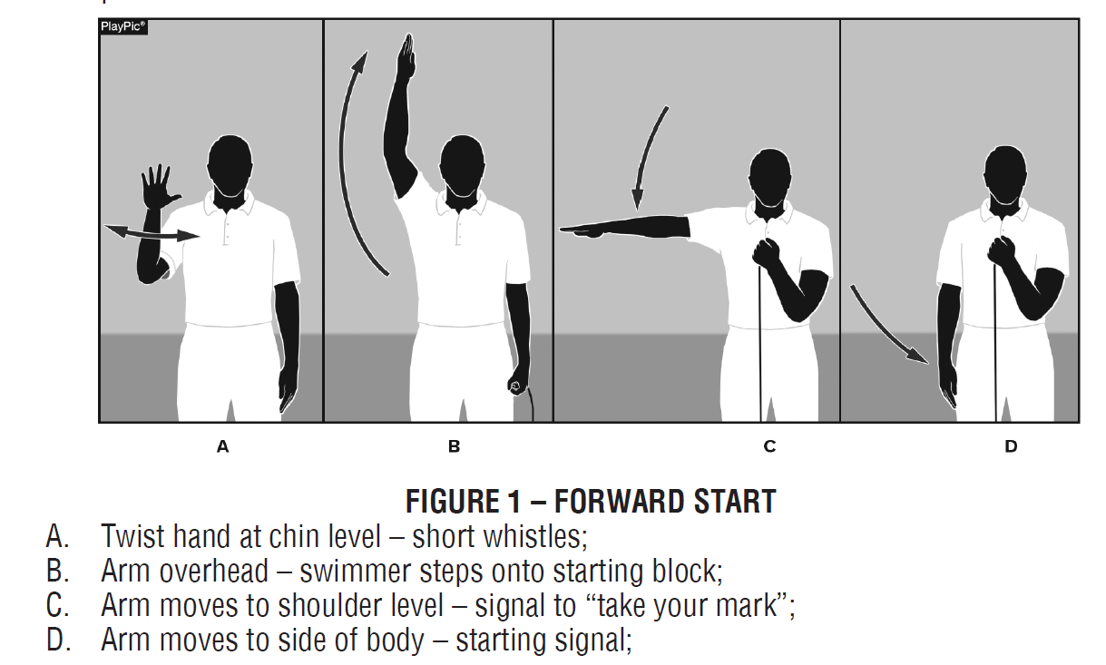
Guidelines for officiating swimmers with disabilities - appendix B
Notes:
Appendix B has been added to assist officials with signals for the. Hearing impaired The additional information was previously housed in the NFHS Swimming Officials Manual. This addition makes information more readily available. Included are updated images of officials signals for the forward and backstroke start as well as images for modified starting positions. These guidelines are provided to assist state associations in working with schools for the inclusion of students with disabilities.

Slide 24
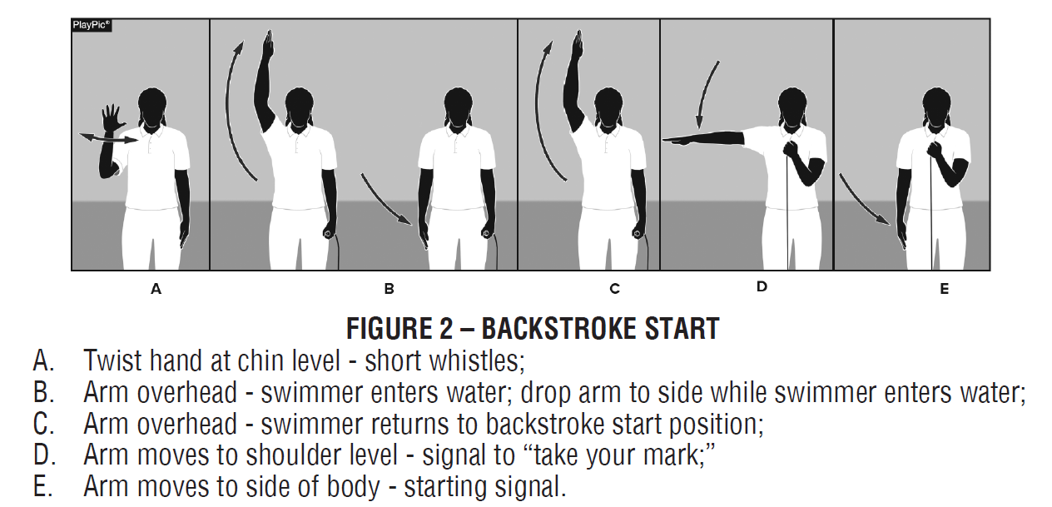
Guidelines for officiating swimmers with disabilities - appendix B
Notes:
Officials’ training prior to the start of the season should include review of these signals and procedures, and state associations may approve their use upon request without further authorization. Accommodations for students with special needs may be addressed through the rules and policies set forth by a variety of organizations, including Special Olympics, Disabled Sports USA, US Paralympics and USA Swimming. Contact information is provided in the beginning of the NFHS Swimming and Diving Rules Book. An accommodation may be permitted provided it does not fundamentally alter the sport, heighten risk or place opponents at a disadvantage.

Slide 25
2020 nfhs swimming and diving points of emphasis

Slide 26
Communication between the Referee and Table
Referee must establish a line of communication with timing system operator and meet management software operator.
Meet prior to the contest to discuss responsibilities:
starts and finishes;
number of laps completed;
entry limits;
discrepancies between touchpad and backup times;
Order of finish.
Notes:
Communication between the Referee and Table
The meet referee is the head official for all competition with responsibilities and duties that include oversight of all other meet officials listed in Rule 4. This role is especially critical in the areas of timing/judging, scoring and determination of results. It requires constant communication between the referee and the individuals responsible for those functions, especially the timing system operator and the meet management software operator. To ensure the meet progresses without unnecessary delays, the referee should be in constant communication with the table throughout the meet. The NFHS Swimming Officials Guidelines Manual lists several items to consider: Prior to the start of the contest the referee should meet with table personnel to review responsibilities related to starts, finishes, registration of the proper number of laps completed, entry limits and reporting any discrepancies between the touchpad times and backup times to the referee.

Slide 27
Establishing the Official Time
Legal finish - when first point of contact is:
  Touchpad - that time shall be official;
  Touchpad but a malfunction is determined - integrate backup time with results from other lanes;
  End wall – utilize backup system and other available data points to verify backup system is accurate (order of finish, times in other lanes, etc.).
Notes:
Establishing the Official Time
A legal finish requires the competitor to contact either the touchpad or the finish end wall (defined in Rule 1-1-1) according to the finish rules pertaining to the stroke being swum. This means that the initial point of contact with the end wall determines the final time for that lane as well as the final results for that heat. The referee must understand the tools that are available to determine that final time: order of finish determined by human finish judges/referee, touchpad, button, watch. When the referee determines that the swimmer's first point of contact at the finish of the race is:
a. the touchpad, that time shall be the official time;
b. the touchpad, but a difference of more than 0.3 seconds between the automatic time and backup time exists (indicates a potential malfunction). The referee determines that such malfunction has occurred, and the backup time for that lane
shall be integrated into the results from the other lanes to determine the official order of finish;
c. not the touchpad, the official time shall be the time registered by the backup system for that lane (semi-automatic button or manual watch). If other information supports the legitimacy of the human generated time (order of finish, times in
other lanes, etc.), that is the official time.
The referee is the head official and is responsible for making decisions on matters not specifically covered by the rules and can order that a race be re-swum when there is obvious unfairness, such as a lane line malfunction or a power outage. In the case of a timing malfunction, the referee is expected to utilize other information or data such as his/her order of finish, times on other lanes, etc., to verify the single data point (watch/button) is accurate. Referees have the authority to reject times that are clearly inaccurate and to determine placing without assigning a specific time to a swimmer.

Slide 28
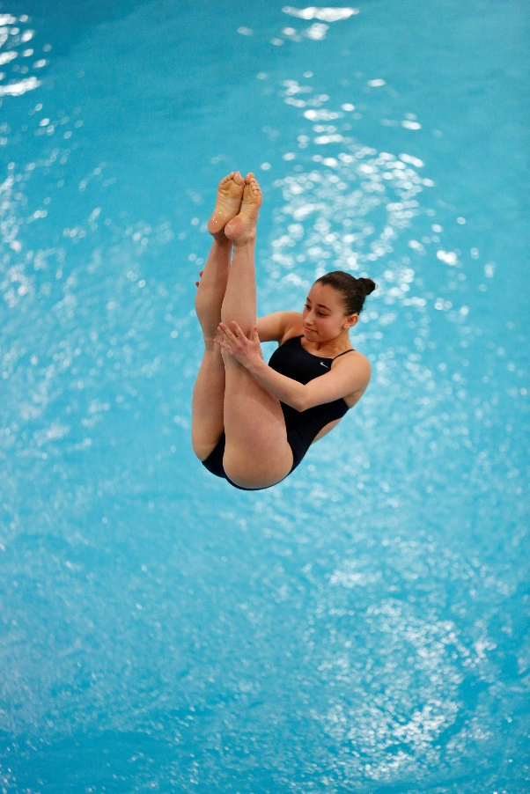
Diving Entries
Two-step process for a
championship meet:
  1. Entry as diving participant
  2. Submission of scoresheet
Notes:
Diving Entries
The diver entry process for championship meets continues to be a point of concern. Changes to Rules 9-3-3 and 9-3-5 clearly define what constitutes the official entry of a diver. The two-step process for championship meets consists of (1) entering the divers and swimmers into a culminating meet at a time specified by the meet manager (the team entry) and (2) submitting the dive list or scoresheet at a specified time and place. The referee will permit changes in the dive list until 60 minutes prior to the start of the diving competition. The penalty for not submitting a complete diving scoresheet at the specified time and place is disqualification. Divers must be included as part of the team entry to assure compliance with entry limitations (3-2-1); diving is one of the individual events of competition. The state association (or meet host) must publish the required procedure for diving entries for each championship-level meet.

Slide 29
Signals for Officiating Swimmers with Disabilities
Updated images of official signals;
Specific accommodations for visually and hearing impaired;
State associations may establish official training;
Accommodation questions can be addressed with NFHS.
Notes:
Signals for Officiating Swimmers with Disabilities
Updated images of official signals
Specific accommodations for visually and hearing impaired
State associations may establish official training
Accommodation questions can be addressed with NFHS
Language and officials signals regarding the inclusion of students with a disability now appear in the 2020-21 NFHS Swimming and Diving Rules Book in Appendix B. Included are updated images of officials signals for the forward and backstroke start. Specific accommodations for visually impaired and hearing-impaired competitors are also provided. These guidelines are provided to assist state associations in working with schools for the inclusion of students with disabilities. Officials’ training prior to the start of the season should include review of these signals and procedures, and state associations may approve their use upon request without further authorization. Accommodations for students with special needs may be addressed through the rules and policies set forth by a variety of organizations, including Special Olympics, Disabled Sports USA, US Paralympics and USA Swimming. An accommodation may be permitted provided it does not fundamentally alter the sport, heighten risk or place opponents at a disadvantage.

Slide 30
NFHS OFFICIALS Education

Slide 31

Notes:
OFFICIALS EDUCATION
Every opportunity should be taken to improve upon officiating. Clinics, course work, observations, video review, association meetings should all be considered when attempting to improve one’s skills in officiating. The NFHS has provided opportunities for officials and prospective officials to take courses and to review video to support learning and developing officiating skills.
Sport-Specific Officiating courses are offered in several sports. They are ideal for new officials and those in the first few years of officiating. These courses introduce officials to the mechanics and techniques used in the sport and provide specific information on an area within that sport. Individuals can complete a course within 30-45 minutes. The cost of these courses is $10.00 to NFHS Officials Association members and $20 for non-members.
“Interscholastic Officiating” is a general course on sports officiating and it is free to members and cost $20 for non-members. This course provides an introduction to skills and concepts used as an official. Several topics are covered such as: basics of becoming and staying an official, science of officiating, art of officiating, how to combine these skills for successful officiating.
Video clips are made available to NFHS Officials Association members. The video is clipped on specific topics and provides the rules references as well as dialogue on the topic.
The courses and videos are offered at www.NFHSLearn.com .
Courses Available:
Officiating Football
Officiating Volleyball – Ball Handling
Officiating Volleyball – Alignment
Officiating Basketball
Officiating Basketball – Three-Person Mechanics
Soccer – Fouls and Misconduct
Soccer - Offside
Officiating Swimming and Diving
Officiating Wrestling
Umpiring Softball
Future Courses to be Considered:
Umpiring Baseball
Field Hockey
Track and Field
Umpiring Softball – Mechanics
Communication Among Officials and Coaches

Slide 32
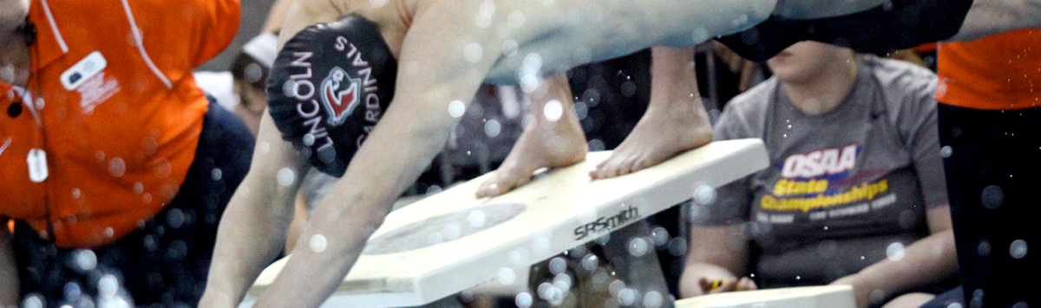



Officiating Swimming & Diving
Course Objectives
Units
Understand the roles of professionalism, rules knowledge, and communication and how they help ensure a fair meet.
Know how to consistently identify swimming violations in each type of event.
Learn the elements of a proper dive and how to score dives appropriately.
Elements of Professional Development
Officiating Swimming
Officiating Diving
Judging Practicum
Unlimited access to course for 1 year from the date of purchase
Approved by NFHS for 3 course clock hours
Notes:
Officiating Swimming and Diving is a course developed by the NFHS in conjunction with the National Interscholastic Swim Coaches Association (NISCA) and USA Diving. This course defines the elements of professional development and the fundamentals of officiating strokes and turns. The course also explores officiating and judging diving and provides a judging practicum that includes feedback of submitted scores. Officials may select either the swimming track, the diving track, or both, depending on rules required by their state association.
More:
- Unlimited access to course & resources for one year from date of purchase.
- Use as an elective to fulfill AIC or CIC certification requirements.

Slide 33
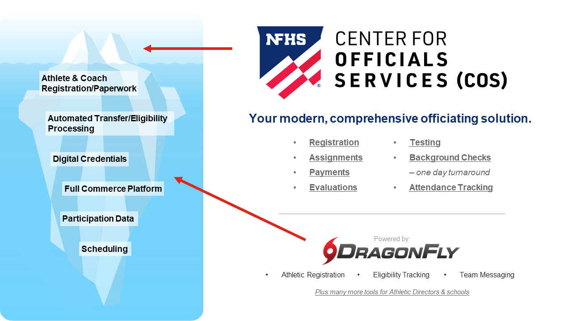
NFHS Center for Officials Services (COS)
ssearcy@nfhs.org
Notes:
Your Complete Solution for Officials Management and More:
Registration
Assignment
Payment
Testing
Background Checks
For More Information on the NFHS – Center for Officials Services (COS) Contact:
Davis Whitfield, NFHS, dwhitfield@nfhs.org
Karissa Niehoff, NFHS, kniehoff@nfhs.org
Also If You’re Interested in Eligibility and Monitoring Requirements Contact
the Folks at Dragonfly:
Kirk Miller, Dragonfly, kirk@dragonflyathletics.com
Brandon Wallace, Dragonfly, brandon@dragonflyathletics.com

Slide 34
NFHS Learning Center

Slide 35

Notes:
The NFHS Learning Center, accessed at NFHSLearn.com has over 70 online professional development courses for the entire interscholastic community, including coaches, administrators, officials, parents, students, and individuals within performing arts programs. The mission and purpose of the NFHS Learning Center is focused on growing professional development opportunities. Those opportunities include courses, but now also incorporate additional videos such as “The Parent Seat” and “Beyond The Scoreboard,” which are short videos created to show to parents at Parent Meetings or show during events. The NFHS Learning Center has delivered over 10,000,000 courses and looks to continue to educate and be a valuable resource for the entire interscholastic community. Learn more at NFHSLearn.com!

Slide 36
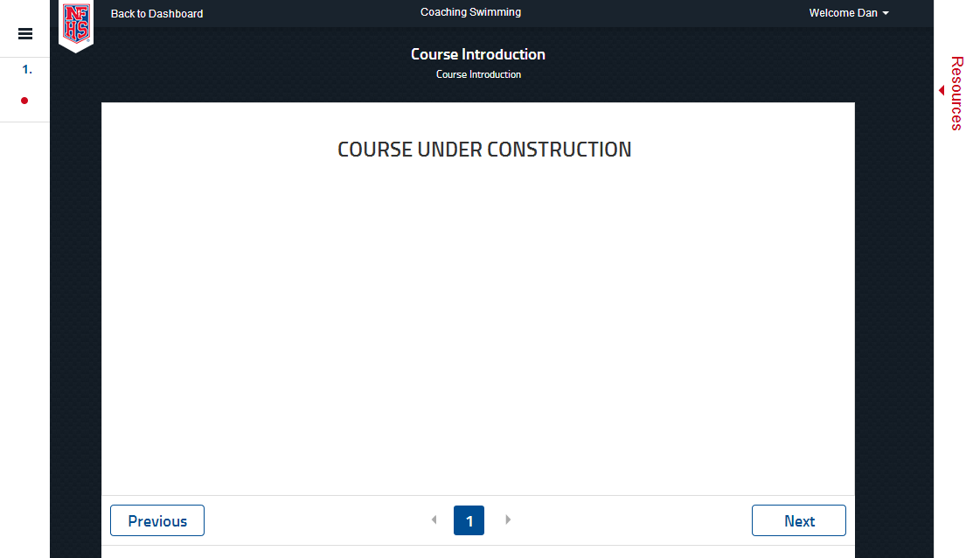
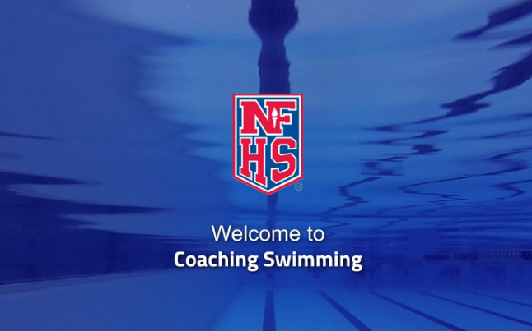

Coaching Swimming
Developed with NISCA
Notes:
The NFHS has partnered with the National Interscholastic Swim Coaches Association to present the online Coaching Swimming course. Go to www.nfhslearn.com to view the trailer, description and outline for this course. Encourage your coaches to sign-up today!

Slide 37
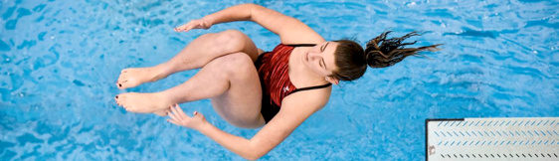
www.nfhslearn.com
Coaching Diving
Course Objectives
Units
Coaching Fundamentals: components of a dive, direction designations and position designations
Dryland: body positioning, drills, basic jumping skills and hurdle progressions
Forward and Backward Dives: feet-first entry, front fall-in, headfirst entry
Inward, Reverse and Twisting Skills: demonstrations and testing
Teaching Methodology
Fundamentals
Dryland Skills
Forward Skills
Backward Skills
Inward Skills
Reverse Skills
Twisting Skills
Notes:
Coaching Diving is a course developed by the NFHS in conjunction with the National Interscholastic Swim Coaches Association (NISCA) and USA Diving. This course teaches the fundamentals of becoming an effective diving coach. The course explores the different types of dives and the training required to execute the to the best of the diver’s ability.
More:
- Unlimited access to course & resources for one year from date of purchase.
- Use as an elective to fulfill AIC or CIC certification requirements.

Slide 38
NFHS Network

Slide 39


NFHS Network
By 2025, every high school sporting event in America will be streamed live.
The NFHS Network will be
THE DESTINATION for fans
to view these broadcasts.
27 Different Sports and Activities
www.NFHSnetwork.com
Notes:
The NFHS Network is the leader in streaming Live and On Demand high school sports.
Partnered with the National Federation of State High School Associations, 45 high school state athletic/activities associations, and PlayOn! Sports, the NFHS Network is a joint venture created to provide fans with the ability to stream high school sports on any device, from wherever they are.
All NFHS Network events are available to watch online at www.NFHSnetwork.com and through the NFHS Network Live App for iOS and Android. Follow us on Facebook, Twitter, Instagram, and YouTube.
Watching high school sports and events has never been easier.
The NFHS Network’s goal to broadcast live all 2 million high school sporting events by 2025.
The NFHS Network covers 27 different regular season and postseason sports, as well as other high school activities, celebrating the accomplishments of students-athletes, student broadcasters, and high schools across the country.

Slide 40

Notes:
The NFHS Network will broadcast over 150,000 live events this year. If your school is not a member of the NFHS Network School Broadcast Program, please contact us at Mark.Koski@NFHSnetwork.com

Slide 41
2020 nfhs swimming and diving resources

Slide 42

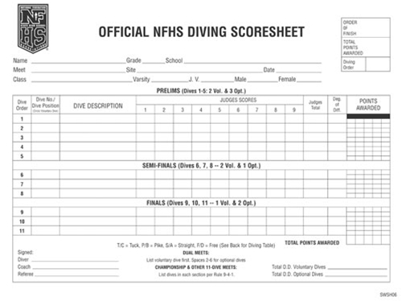
NFHS swimming and diving publications
The Rules Book, Scorebook and other swimming and diving materials can be ordered online at www.nfhs.com, or by calling 1-800-776-3462.
Notes:
The NFHS swimming and diving publications are available to order online or by using the toll-free number.

Slide 43

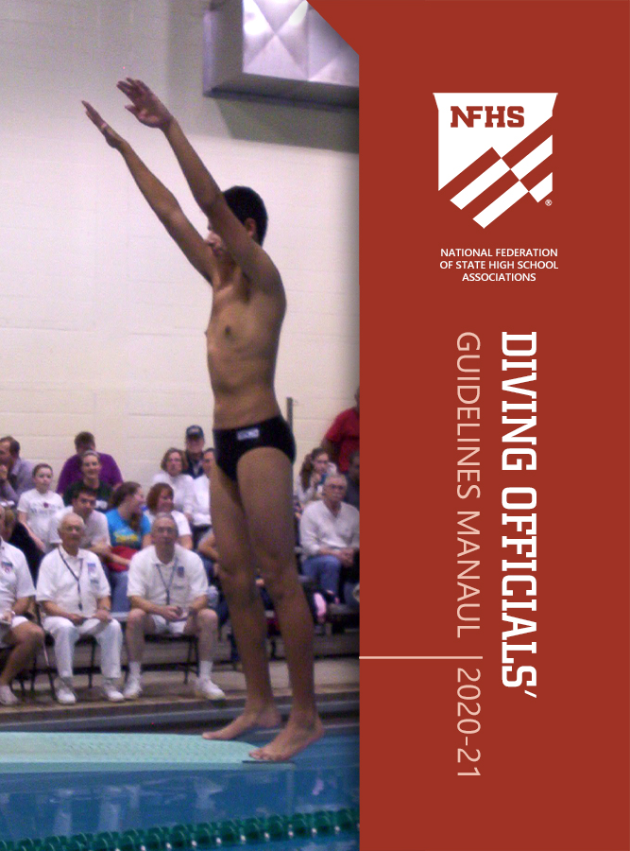
NFHS swimming and diving publications
The revised manuals will be available
July 1, 2020
Notes:
The NFHS Swimming Officials Guideline Manual and the Diving Officials Guidelines Manual will be available July 1 on the swimming and Diving page of www.nfhs.org. These documents are in word format so that state associations can tailor them to fit their specific needs.

Slide 44

Thank You
National Federation of State High School Associations
PO Box 690 | Indianapolis, IN 46206
Phone: 317-972-6900 | Fax: 317.822.5700
www.nfhs.org | www.nfhslearn.com | www.nfhsnetwork.com

