Slide 1
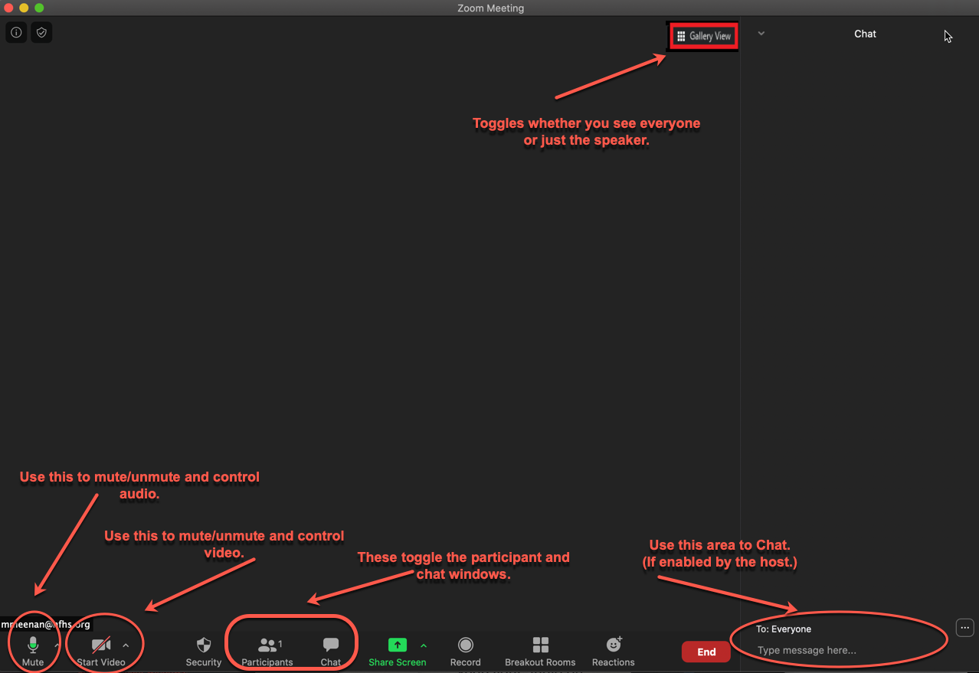
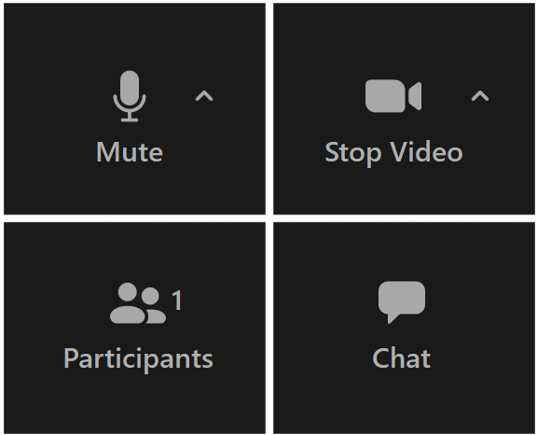
Please note the tips below as we wait for the meeting to begin…
Important:
Please keep your audio on mute unless speaking.
Notes:
PLEASE READ THE TIPS OFFERED FOR THE ZOOM MEETING

Slide 2
NFHS SOCCER Rules Power Point
2020-21
Notes:
2020-21 NFH SOCCER RULES POWER POINT

Slide 3
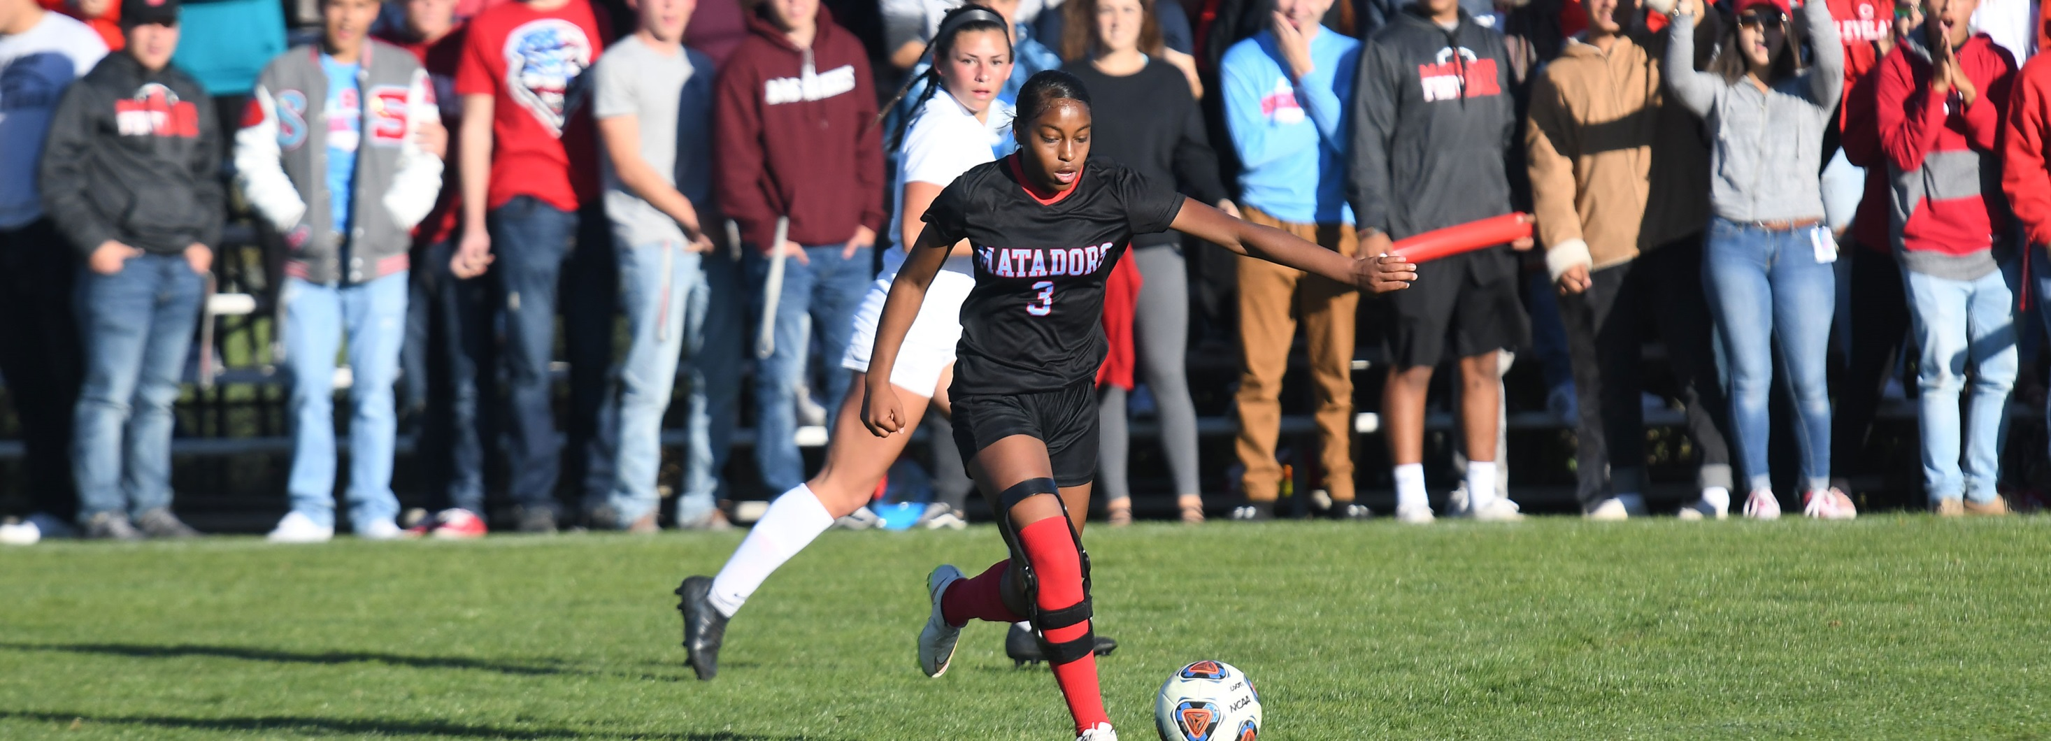
National federation of state high school associations (NFHS)
2020-21
Notes:
NATIONAL FEDERATOPM OF STATE HIGH SCHOOL ASSOCIATIONS (NFHS)

Slide 4

National Federation of
State High School Associations
NFHS (located in Indianapolis, IN – Est. 1920):
  National leader and advocate for
  high school athletics and
  performing arts programs.
  Serves 51 state associations, 19,500
  high schools and 12 million student
  participants.
  Writes playing rules for 17 high school
  sports for boys and girls.
  Offers online education courses for high school coaches,
  officials, parents, students and others.
  Ensures that students have opportunity to enjoy healthy participation, achievement and good sportsmanship in education-based athletics.
Notes:
National Federation of State High School Associations
NFHS (located in Indianapolis, IN – Est. 1920):
National leader and advocate for
high school athletics and
performing arts programs.
Serves 51 state associations, 19,500
high schools and 12 million student
participants.
Writes playing rules for 17 high school
sports for boys and girls.
Offers online education courses for high school coaches,
officials, parents, students and others.
Ensures that students have opportunity to enjoy healthy participation, achievement and good sportsmanship in education-based athletics

Slide 5









NFHS Rules Review Committee
The NFHS Rules Review Committee is chaired by the chief operating officer and composed of all rules editors. After each committee concludes its deliberations and has adopted its recommended changes for the subsequent year, such revisions will be evaluated by the Rules Review Committee.
Davis Whitfield
Chief Operating Officer
Lindsey Atkinson
Girls Lacrosse and Volleyball
Bob Colgate
Football and Sports
Medicine
Sandy Searcy
Softball, Swimming & Diving and Water Polo
Elliot Hopkins
Baseball and Wrestling
Julie Cochran
Cross Country, Gymnastics, Field Hockey and
Track & Field
James Weaver
Boys Lacrosse
and Spirit
Theresia Wynns
Basketball and Soccer
Dan Schuster
Ice Hockey
Notes:
NFHS RULE REVIEW COMMITTEE
The NFHS Rules Review Committee is chaired by the chief operating officer and composed of all rules editors. After each committee concludes its deliberations and has adopted its recommended changes for the subsequent year, such revisions will be evaluated by the Rules Review Committee.

Slide 6


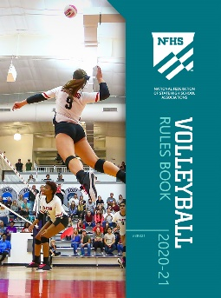


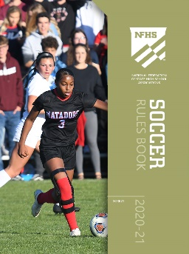

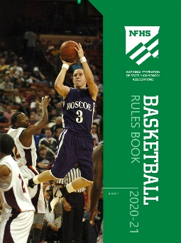

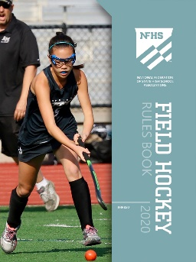




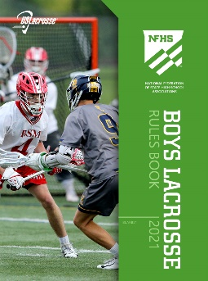
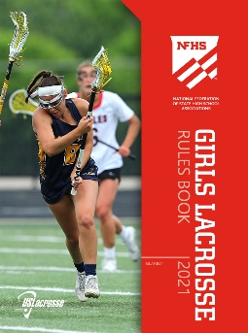

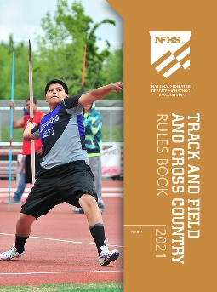
National Federation of
State High School Associations
The NFHS writes playing rules for 17 sports
for boys and girls at the high school level.
  Publishes 4 million pieces of materials annually.
Notes:
NATIONAL FEDERATION OF STATE HIGH SCHOOL ASSOCIATIONS
The NFHS writes playing rules for 17 sports for boys and girls at the high school level.
Publishes 4 million pieces of materials annually

Slide 7

NFHS Rules BookS as e-Books
E-books features:
  Searchable
  Highlight areas of interest
  Make notes
  Easy navigation
  Adjustable viewing size
  Immediate availability
Notes:
NFHS RULES BOOKS AS E-BOOKS
E-books features:
Searchable
Highlight areas of interest
Make notes
Easy navigation
Adjustable viewing size
Immediate availability

Slide 8
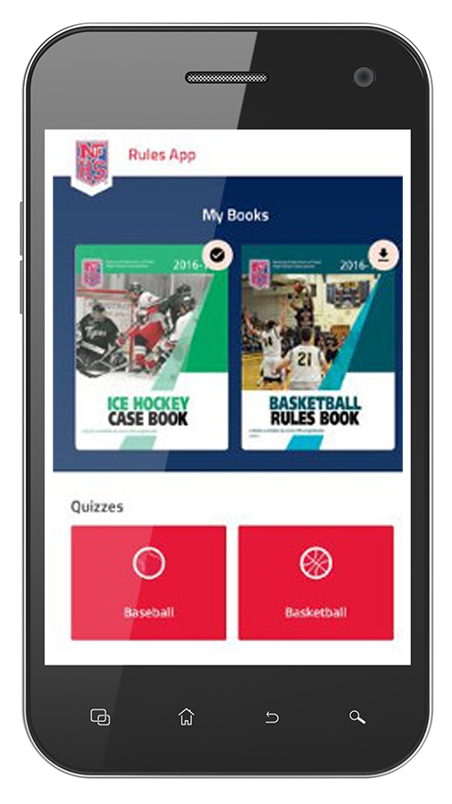
NEW NFHS Rules App
Rules App features:
  Searchable
  Highlight notes
  Bookmarks
  Quizzes for all sports
  Easy navigation
  Immediate availability
  Free to paid members of the NFHS Coaches
  and Officials Associations
  www.nfhs.org/erules for more information
Notes:
NFHS RULES APP
Rules App features:
Searchable
Highlight notes
Bookmarks
Quizzes for all sports
Easy navigation
Immediate availability
Free to paid members of the NFHS Coaches
and Officials Associations
www.nfhs.org/erules for more information

Slide 9

nfhs SOCCER RULES CHANGES
2020-21
Notes:
NFHS SOCCER RULES CHANGES

Slide 10
Rule 2-2-4 ball specifications
Art. 4…
If the ball becomes deflated during play, it is declared dead and the game is resumed by a drop ball at the spot where it was last played. If the ball becomes deflated within the goal area, then the ball is dropped subject to the provisions of Rule 9-2-2 and 9-2-3. Ball deflated during a penalty kick results in retaken kick.
Notes:
Rule 2-2-4 BALL SPECIFICATIONS
Art. 4…
If the ball becomes deflated during play, it is declared dead and the game is resumed by a drop ball at the spot where it was last played. If the ball becomes deflated within the goal area, then the ball is dropped subject to the provisions of Rule 9-2-2 and 9-2-3. Ball deflated during a penalty kick results in retaken kick.

Slide 11
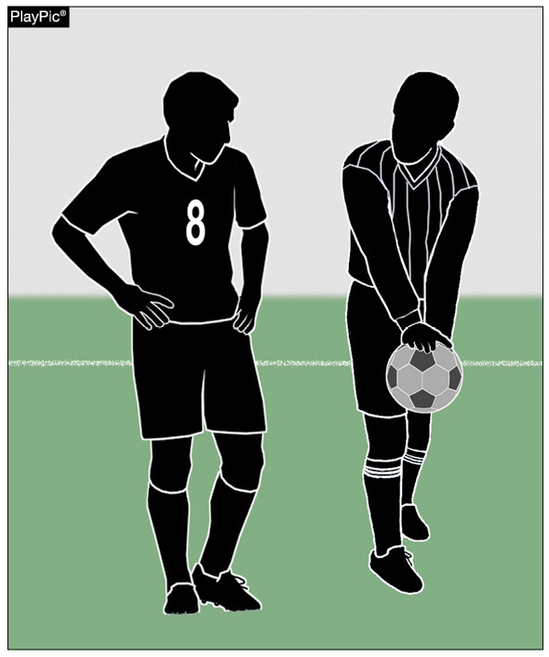
Rule 2-2-4
Deflated Ball
If the ball becomes deflated during play, it will be put into play with a drop ball to a player of the team last in possession at the spot where it was last played.
Notes:
RULE 2-2-4 DEFLATED BALL
If the ball becomes deflated during play, it will be put into play with a drop ball to a player of the team last in possession at the spot where it was last played.

Slide 12
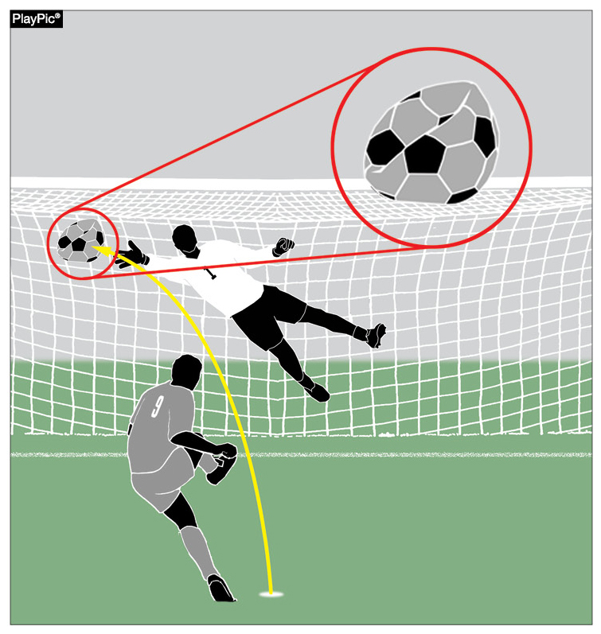
Rule 2-2-4
Deflated Ball
If ball becomes deflated during a penalty kick, the kick will be retaken.
Notes:
Rule 2-2-4 DEFLATED BALL
If ball becomes deflated during a penalty kick, the kick will be retaken.

Slide 13
Rule 4-1-1a required equipment uniform
The visiting team shall wear solid white jerseys and solid white socks, and the home team shall wear dark jerseys and socks (dark is defined as any color which contrasts with white).
Notes:
RULE 4-1-1a REQUIRED EQUIPMENT/TUCKED SHIRTS
The visiting team shall wear solid white jerseys and solid white socks, and the home team shall wear dark jerseys and socks (dark is defined as any color which contrasts with white).

Slide 14
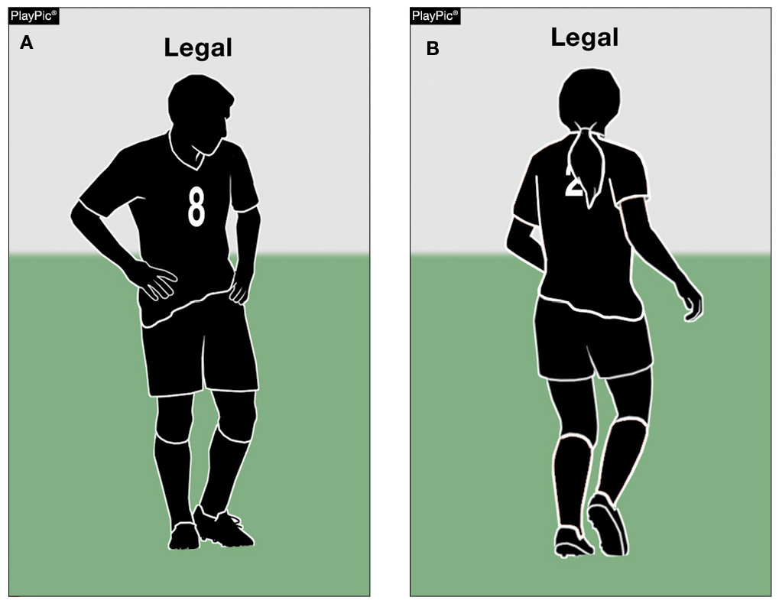
Rule 4-1-1A uniform
Players are no longer required to tuck in jerseys.
Notes:
RULE 4-1-1a TUCKED SHIRTS
Players are no longer required to tuck in jerseys.

Slide 15
Rule 4-2-7e, f other equipment delete
Art. 7…
A tooth and mouth protector (intraoral), if worn, shall:
e. not be completely white; and
f. not be completely clear.
SMAC no longer recommends the mouth protector meet these two criteria; dropping these two requirements bring soccer in line with the other sports that allow mouth guards.
Notes:
RULE 4-2-7e, f OTHER EQUIPMENT - DELETE
Art. 7…
A tooth and mouth protector (intraoral), if worn, shall:
e. not to be completely white; and
f. Not to be completely clear.
SMAC no longer recommends the mouth protector meet these two criteria; dropping these two requirements bring soccer in line with the other sports that allow mouth guards.

Slide 16
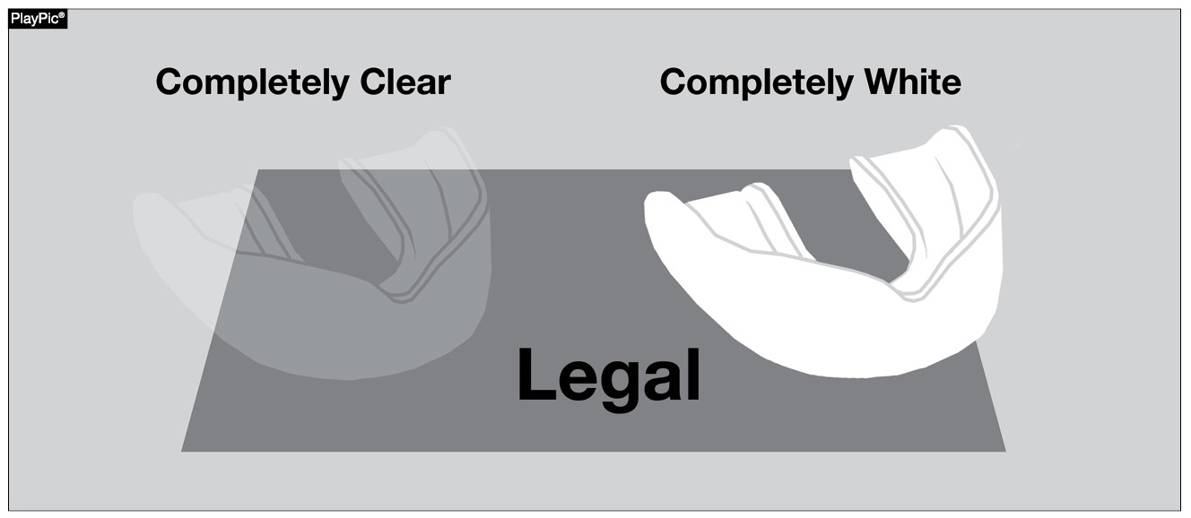
Rules 4-2-7E, F (DELETED) eQUIPMENT
Tooth and mouth protectors (intraoral), if worn, are no longer illegal if completely white or clear.
Notes:
Rules 4-2-7e, f EQUIPMENT
Tooth and mouth protectors (intraoral), if worn, are no longer illegal if completely white or clear.

Slide 17
Rule 9-1-1b ball in and out of play
The ball is out of play when:
a. it has completely crossed the goal line or touch line, whether on the ground or in the air;
b. the ball touches an official and remains on the field; and
1. a team starts a promising attack;
2. goes directly into the goal;
  3. possession changes
Notes:
RULE 9-1-1b
The ball is out of play when:
a. it has completely crossed the goal line or touch line, whether on the ground or in the air;
b. the ball touches an official and remains on the field; and
1. a team starts a promising attack;
2. goes directly into the goal;
3. possession changes

Slide 18
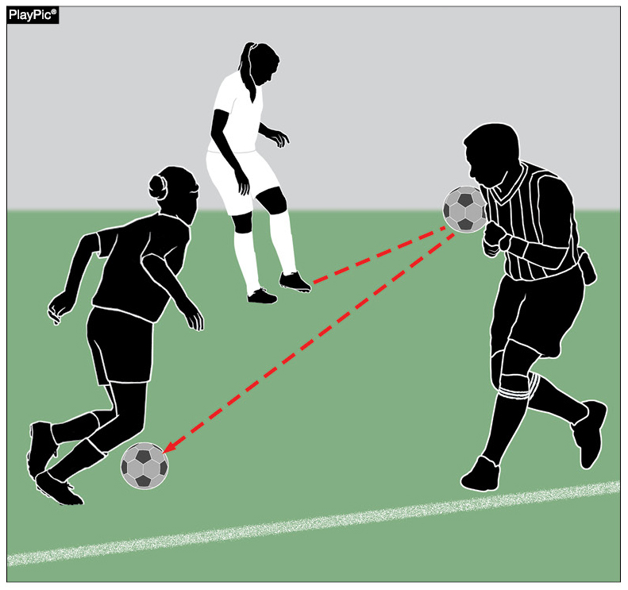
Rule 9-1-1B
Ball in or out of play
A team should not gain an advantage when the ball touches the referee and stays on the field, including when it goes to an opponent (as shown), goes into the goal or starts a promising attack.
Restart with a drop ball to a player of the team last in possession at the spot where it was last played.
Notes:
RULE 9-1-1b BALL IN AND OUT OF PLAY
A team should not gain an advantage when the ball touches the referee and stays on the field, including when it goes to an opponent (as shown), goes into the goal or starts a promising attack.
b. Restart with a drop ball to a player of the team last in possession at the spot where it was last played.

Slide 19
Rule 9-2-1 drop ball
ART. 1…The game is restarted with a drop ball:
a. when the ball is caused to go out-of-bounds by two opponents simultaneously;
b. when the ball becomes deflated; (2-2-4)
c. following a temporary suspension of play for an injury or unusual situation; (except as noted in 14-1-7) and the goalkeeper is not in possession of the ball.
d. when simultaneous fouls of the same degree occur by opponents; or
e. when the ball touches an official as per 9-1-1b.
Notes:
9-2-1 DROP BALL
ART. 1…The game is restarted with a drop ball:
a. when the ball is caused to go out-of-bounds by two opponents simultaneously;
b. when the ball becomes deflated; (2-2-4)
c. following a temporary suspension of play for an injury or unusual situation; (except as noted in 14-1-7) and the goalkeeper is not in possession of the ball.
d. when simultaneous fouls of the same degree occur by opponents; or
e. when the ball touches an official as per 9-1-1b.

Slide 20
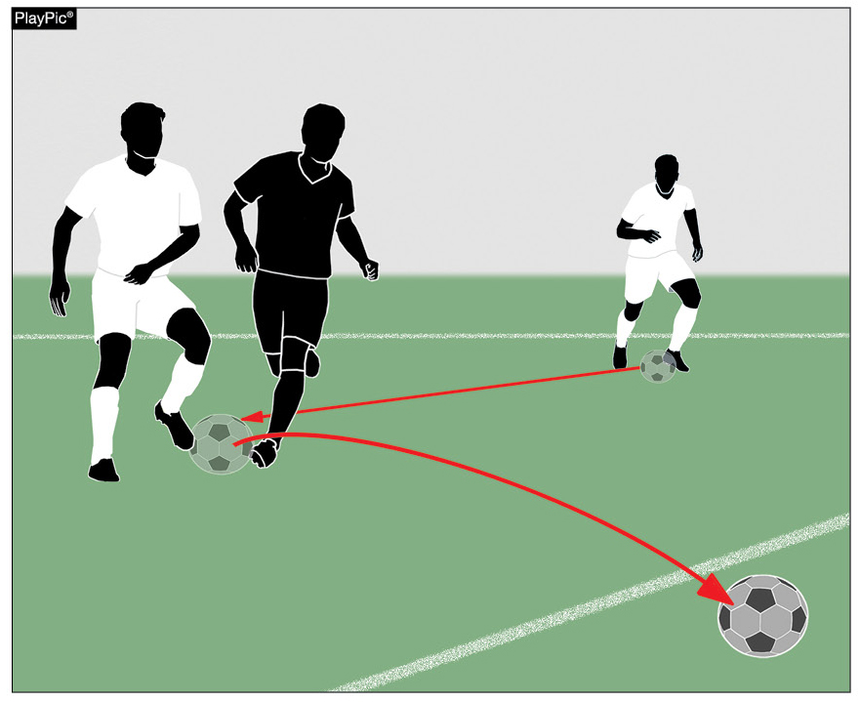
Rules 9-2-2, 9-2-3
Drop Ball
If the ball was caused to go out of bounds by two opponents simultaneously, the ball is dropped five yards inside the boundary line to one player of the team in possession of the ball prior to the simultaneous touch, unless this was in the goal area.
Notes:
RULES 9-2-2; 9-2-3 DROP BALL
If the ball was caused to go out of bounds by two opponents simultaneously, the ball is dropped five yards inside the boundary line to one player of the team in possession of the ball prior to the simultaneous touch, unless this was in the goal area.

Slide 21
Rule 9-2-3 drop ball
ART. 3…
The ball is dropped by an official from waist level to the ground. The referee drops the ball to one player of the team that last possessed the ball at the position where it was last touched by a player(s), an outside agent or match official. If when play was stopped, the ball was in the penalty area or the last touch, by either team, was in the penalty area, the ball is dropped to the defending team’s goalkeeper with all opposing players outside the penalty area. In all cases, all other players must remain at least 4 yards from the ball until it is in play.
Notes:
RULE 9-2-3 DROP BALL
ART. 3…
The ball is dropped by an official from waist level to the ground. The referee drops the ball to one player of the team that last possessed the ball at the position where it was last touched by a player(s), an outside agent or match official. If when play was stopped, the ball was in the penalty area or the last touch, by either team, was in the penalty area, the ball is dropped to the defending team’s goalkeeper with all opposing players outside the penalty area. In all cases, all other players must remain at least 4 yards from the ball until it is in play.

Slide 22
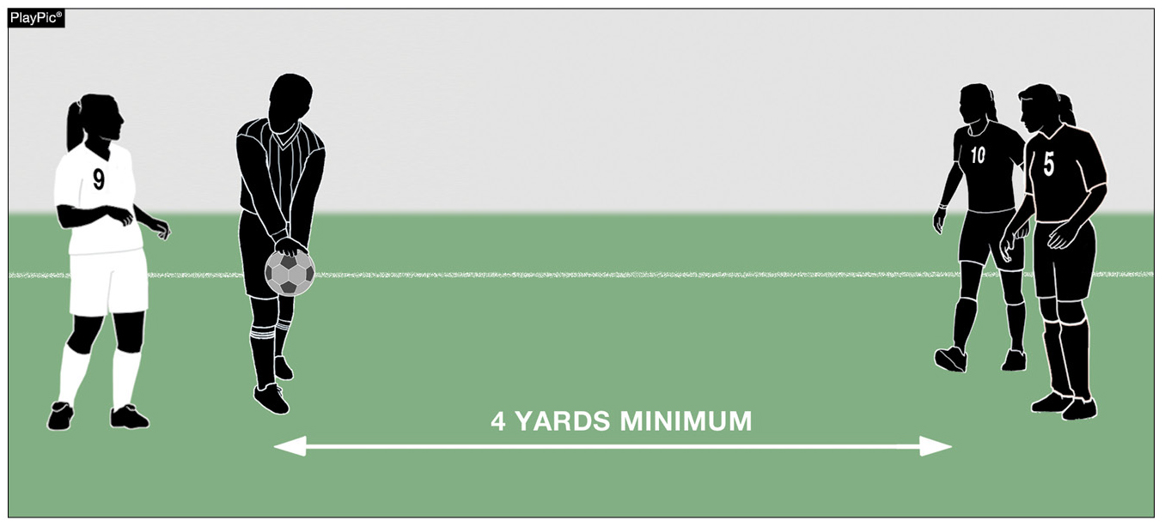
Rules 9-2-2, 9-2-3
Drop Ball
A drop ball goes to one player of the team that last possessed the ball. The ball is dropped where it was last touched by a player, an outside agent or match official unless the ball was in the penalty area or the last touch by either team was in the penalty area.
Notes:
Rules 9-2-2; 9-2-3
A drop ball goes to one player of the team that last possessed the ball. The ball is dropped where it was last touched by a player, an outside agent or match official unless the ball was in the penalty area or the last touch by either team was in the penalty area.

Slide 23
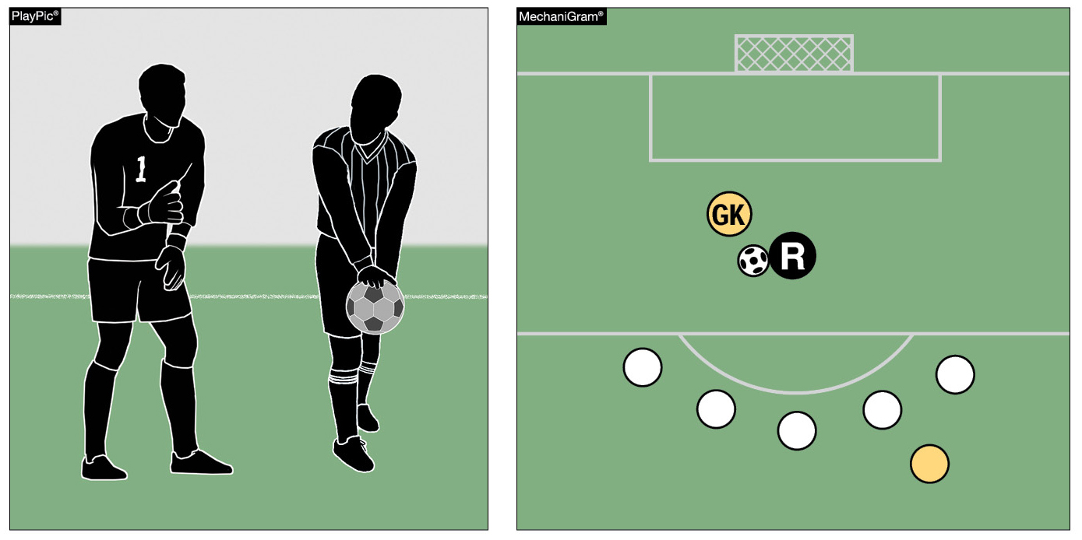
Rules 9-2-2, 9-2-3
Drop Ball
If the ball was in the penalty area or the last touch by either team was in the penalty area when play was stopped, the ball is dropped to the defending team’s goalkeeper. All opposing players must be outside the penalty area and all players must be at least four yards from the ball.
Notes:
RULES 9-2-2, 9-2-3 DROP BALL
If the ball was in the penalty area or the last touch by either team was in the penalty area when play was stopped, the ball is dropped to the defending team’s goalkeeper. All opposing players must be outside the penalty area and all players must be at least four yards from the ball.

Slide 24
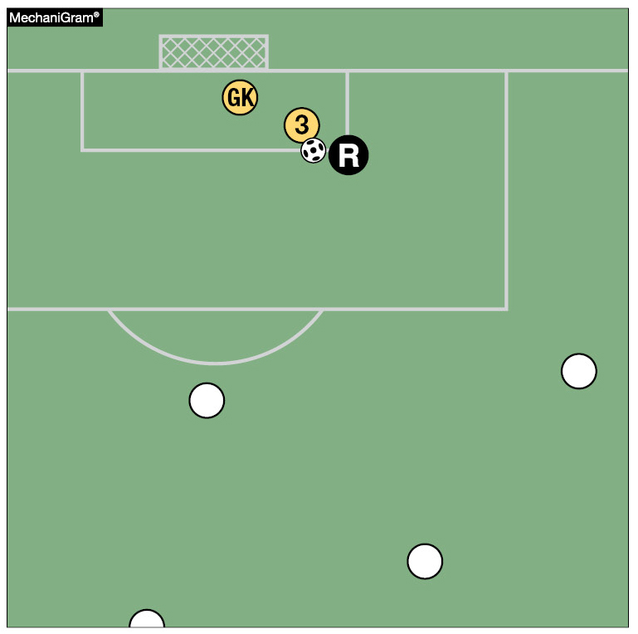
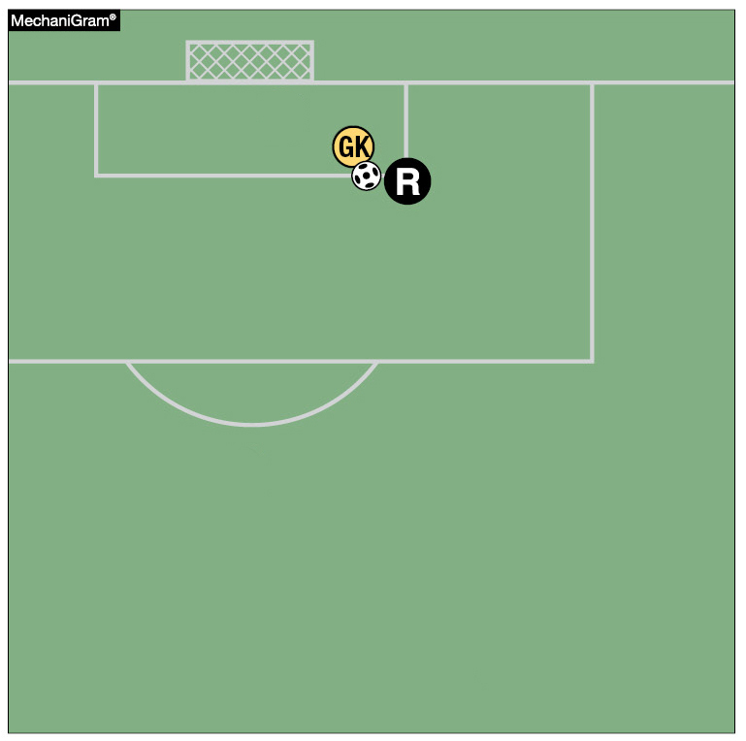
Rules 9-2-2, 9-2-3
Drop Ball
If the ball was in the goal area when play was stopped, it is dropped to the goalkeeper on that part of the goal-area line which runs parallel to the goal line nearest the location where the ball was when play was stopped.
Notes:
RULE 9-2-2; 9-2-3
If the ball was in the goal area when play was stopped, it is dropped to the goalkeeper on that part of the goal-area line which runs parallel to the goal line nearest the location where the ball was when play was stopped.

Slide 25
Rule 13-3-1 how taken – FREE KICK
ART. 1…
Players opposing the kicker shall be at least 10 yards from the ball until it is kicked, unless they are standing on their own goal line between the goal posts. If the free kick is awarded to the defending team in its penalty area, players opposing the kicker shall be outside the penalty area at least 10 yards from the ball and shall remain there until the ball is in play. Where 3 or more defending team players form a wall, all attacking team players must remain at least 1 yard from the wall until the ball is in play.
Notes:
RULE 13-3-1 HOW TAKEN – FREE KICK
ART. 1…
Players opposing the kicker shall be at least 10 yards from the ball until it is kicked, unless they are standing on their own goal line between the goal posts. If the free kick is awarded to the defending team in its penalty area, players opposing the kicker shall be outside the penalty area at least 10 yards from the ball and shall remain there until the ball is in play. Where 3 or more defending team players form a wall, all attacking team players must remain at least 1 yard from the wall until the ball is in play.

Slide 26
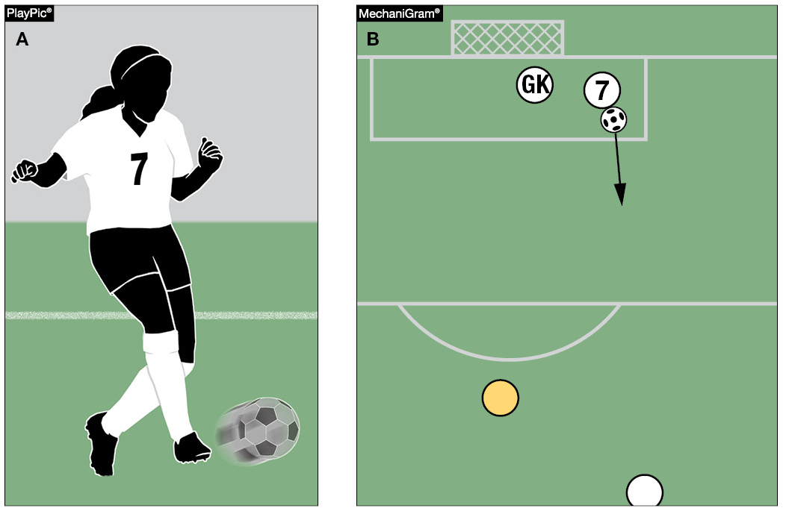
Rule 13-3-1
Free Kick — How taken
On a free kick taken from within a team’s penalty area, the ball is in play when it is kicked and moves (PlayPics A and B).
Notes:
RULE 13-3-1 HO TAKEN – FREE KICK
On a free kick taken from within a team’s penalty area, the ball is in play when it is kicked and moves (PlayPics A and B).

Slide 27
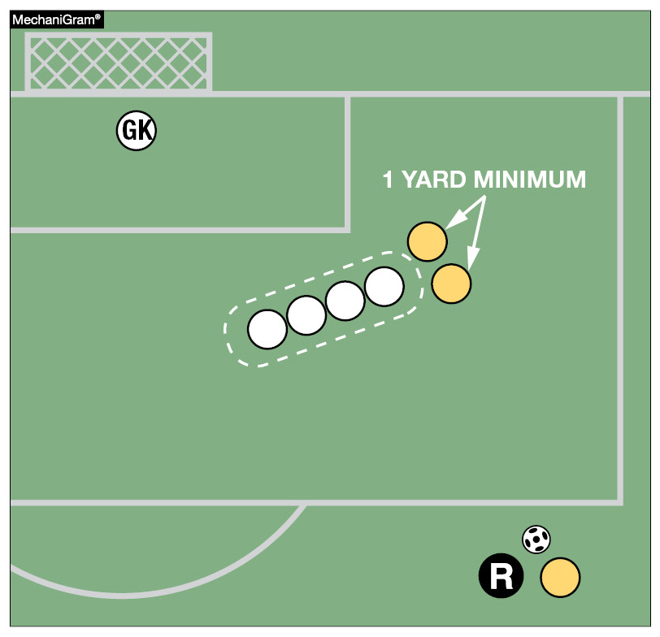
Rule 13-3-1
Free Kick — How taken
When three or more defending team players form a wall, all attacking team players must remain at least one yard from the wall until the ball is in play.
Notes:
13-3-1 HOW TAKEN- FREE KICK
When three or more defending team players form a wall, all attacking team players must remain at least one yard from the wall until the ball is in play.

Slide 28
Rule 13-3-2 how taken – FREE KICK
ART. 2…
The ball shall be kicked while it is stationary on the ground at the spot specified by the official. To be in play, the ball shall be moved in any direction. Failure to kick the ball as specified shall result in a rekick.
Notes:
RULE 13-3-2 HOW TAKEN – FREE KICK
ART. 2…
The ball shall be kicked while it is stationary on the ground at the spot specified by the official. To be in play, the ball shall be moved in any direction. Failure to kick the ball as specified shall result in a rekick.

Slide 29
Rule 13-3-4 new how taken – free kick
NEW ART. 4…
For indirect kicks, the referee shall signal an indirect kick (using Official NFHS Soccer Signals Rule 5-3-1b) by raising an arm above the head; this signal shall be maintained until the kick is taken and the ball touches another player or goes out of play. If the referee fails to signal the kick is indirect and the ball goes directly into the opponent's goal, the kick shall be retaken.
Notes:
RULE 13-3-4 (NEW) FREE KICK – HOW TAKEN
NEW ART. 4…
For indirect kicks, the referee shall signal an indirect kick (using Official NFHS Soccer Signals Rule 5-3-1b) by raising an arm above the head; this signal shall be maintained until the kick is taken and the ball touches another player or goes out of play. If the referee fails to signal the kick is indirect and the ball goes directly into the opponent's goal, the kick shall be retaken.

Slide 30
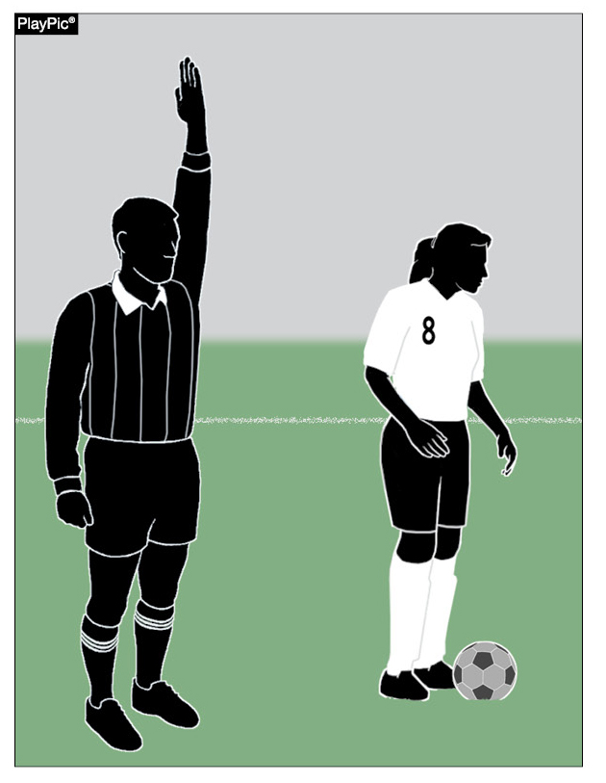
Rule 13-3-4
NEW - FREE KICK – HOW TAKEN
The referee must show and hold the indirect kick signal until the kick is taken and the ball is touched by any other player. Failure of the referee to correctly signal indirect free kick when the ball goes directly into the opponent’s goal results in a re-kick.
Notes:
RULE 13-3-4 FREE KICK - HOW TAKEN (NEW)
The referee must show and hold the indirect kick signal until the kick is taken and the ball is touched by any other player. Failure of the referee to correctly signal indirect free kick when the ball goes directly into the opponent’s goal results in a re-kick.

Slide 31
Rule 14-1-3 penalty kick
ART. 3…
The opposing goalkeeper shall stand with at least one foot on or in-line with the goal line, facing the kicker, between the goal posts, and shall not be touching the goal posts, crossbar, or nets, until the ball is kicked. Lateral or forward movement is allowed, but the goalkeeper is not permitted to come off the line with both feet until the ball is in play.
Notes:
RULE 14-1-3 PENALTY KICK
ART. 3…
The opposing goalkeeper shall stand with at least one foot on or in-line with the goal line, facing the kicker, between the goal posts, and shall not be touching the goal posts, crossbar, or nets, until the ball is kicked. Lateral or forward movement is allowed, but the goalkeeper is not permitted to come off the line with both feet until the ball is in play.

Slide 32
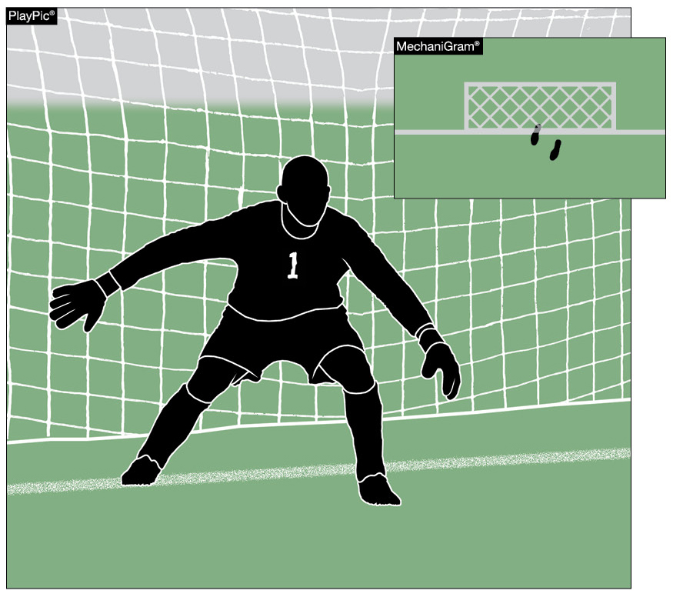
Rule 14-1-3
Penalty kick
The goalkeeper must stand with at least one foot on or in line with the goal line and shall not be touching the goal posts, cross bar or nets until the ball is kicked. While side to side movement is allowed, the goalkeeper is not allowed to leave the goal line with both feet until the ball is kicked and moves.
Notes:
RULE 14-1-3 PENALTY KICK
The goalkeeper must stand with at least one foot on or in line with the goal line and shall not be touching the goal posts, cross bar or nets until the ball is kicked. While side to side movement is allowed, the goalkeeper is not allowed to leave the goal line with both feet until the ball is kicked and moves.

Slide 33
Rule 16-1-2; Rule 16-1-3 goal kick
ART. 2…
Players opposing the kicker shall remain outside the penalty area until the ball is in play.
ART. 3…
Once spotted, the ball shall be kicked from the ground from any point within the goal area by a player of the defending team. The ball is in play when it is kicked and moves.
Notes:
RULE 16-1-2; 16-1-3 GOAL KICK
ART. 2…
Players opposing the kicker shall remain outside the penalty area until the ball is in play.
ART. 3…
Once spotted, the ball shall be kicked from the ground from any point within the goal area by a player of the defending team. The ball is in play when it is kicked and moves.

Slide 34
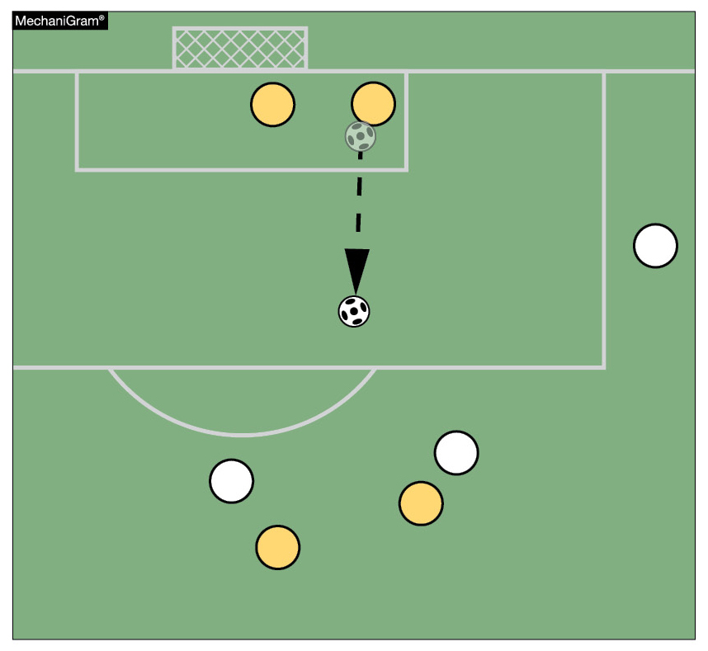
RuleS 16-1-2; 16-1-3
Goal Kick
Players opposing the kicker shall remain outside the penalty area until the ball is in play.
Once spotted on the ground and within the goal area for a goal kick, the ball is in play when it has been kicked and moves.
Notes:
RULES 16-1-2; 16-1-3 GOAL KICK
a. Players opposing the kicker shall remain outside the penalty area until the ball is in play.
b. Once spotted on the ground and within the goal area for a goal kick, the ball is in play when it has been kicked and moves.

Slide 35
Rule 16-1-4 goal kick
ART. 4…
After the goal kick is properly taken, the ball may be played by any player except the one who executes the goal kick. The kicker may not play the ball until it has been touched by another player.
Notes:
RULE 16-1-4 GOAL KICK
ART. 4…
After the goal kick is properly taken, the ball may be played by any player except the one who executes the goal kick. The kicker may not play the ball until it has been touched by another player.

Slide 36
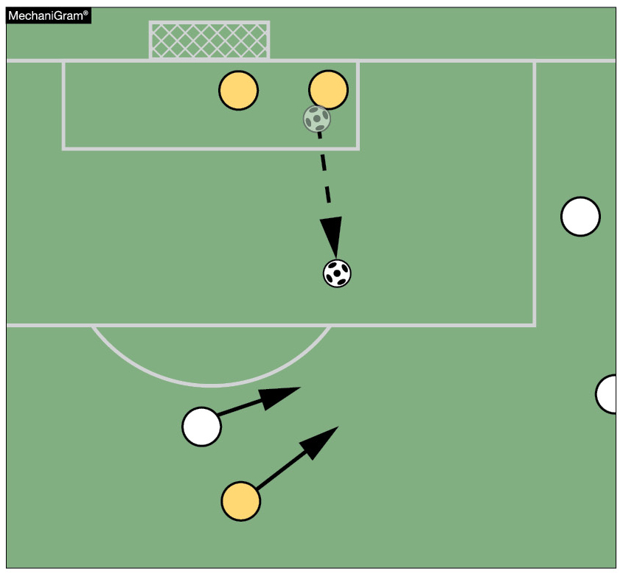
Rule 16-1-4
Goal Kick
Once the goal kick is properly taken (the ball is kicked and moves) it may be played by any player other than the kicker without having to leave the penalty area.
Notes:
RULE 16-1-4 GOAL KICK
Once the goal kick is properly taken (the ball is kicked and moves) it may be played by any player other than the kicker without having to leave the penalty area.

Slide 37
2020-21 nfhs SOCCER editiorial CHANGES
Notes:
2020-21 NFHS SOCCER EDITORIAL CHANGES

Slide 38
RuleS 12-5-1; 12-5-2 OBSTRUCTION
Obstruction is the deliberate act of a player, that moves into the path of an opponent to block, slow down or force a change in direction when the ball is not within playing distance. Being in the way of an opponent is not an offense and is different than moving into the way.
A player may legally place him/herself between opponents and the ball provided the ball is within playing distance. This player may legally be challenged from behind.
Notes:
RULES 12-5-1; 12-5-2 OBSTRUCTION
Obstruction is the deliberate act of a player, that moves into the path of an opponent to block, slow down or force a change in direction when the ball is not within playing distance. Being in the way of an opponent is not an offense and is different than moving into the way.
A player may legally place him/herself between opponents and the ball provided the ball is within playing distance. This player may legally be challenged from behind.

Slide 39
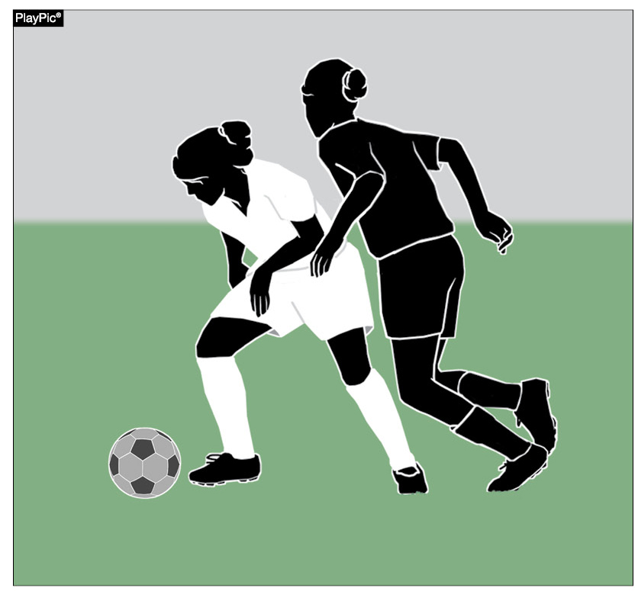
Rules 12-5-1, 12-5-2
Obstruction
The definition of obstruction has not been changed. The wording has been edited for clarity.
A player, within playing distance of the ball, may legally use his/her body to shield the ball from the opponent.
Notes:
RULES 12-5-1; 12-5-2 OBSTRUCTION
a. The definition of obstruction has not been changed. The wording has been edited for clarity.
b. A player, within playing distance of the ball, may legally use his/her body to shield the ball from the opponent.

Slide 40
12-5-2 situation new
A player dribbles the ball to a corner and while the ball is within playing distance, uses his/her body to block opponents from reaching the ball. Ruling: Legal as this is shielding.
Notes:
12-5-2 SITUATION (NEW)
A player dribbles the ball to a corner and while the ball is within playing distance, uses his/her body to block opponents from reaching the ball. Ruling: Legal as this is shielding.

Slide 41
Rule 12-8-2d, 4
SERIOUS FOUL PLAY
ART. 2d, 4…
Foul Play; disqualified: a player commits a foul inside the penalty area while not attempting to play the ball, denying the opponent an obvious goal-scoring opportunity, and the referee awards a penalty kick.
Notes:
RULE 12-8-2d, 4 SERIOUS FOUL PLAY
ART. 2d, 4…
Foul Play; disqualified: a player commits a foul inside the penalty area while not attempting to play the ball, denying the opponent an obvious goal-scoring opportunity, and the referee awards a penalty kick.

Slide 42
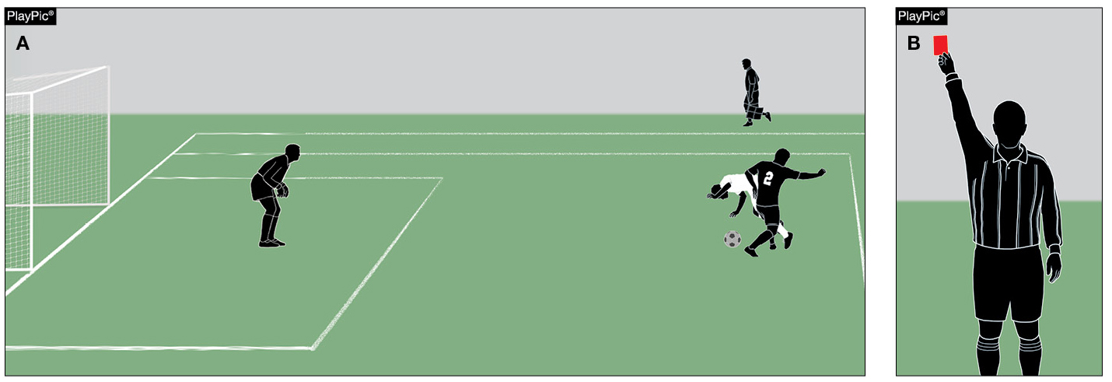
Rules 12-8-2d, 4
Serious foul play
Player B2 with no attempt to play the ball, fouls the attacking player A1 inside the penalty area denying an obvious goal-scoring opportunity (PlayPic A). The referee awards the opponents a penalty kick and issues a red card to B2 (PlayPic B).
Notes:
RULES 12-8-4d, 4 SERIOUS FOUL PLAY
Player B2 with no attempt to play the ball, fouls the attacking player A1 inside the penalty area denying an obvious goal-scoring opportunity (PlayPic A). The referee awards the opponents a penalty kick and issues a red card to B2 (PlayPic B).

Slide 43
Dual AND DOUBLE DUAL CORNER KICK officiating-system
When the ball is kicked from the right side, the lead official will take a position behind the ball and corner flag. When the ball is kicked, the official will observe the flight of the ball, and once it's determined that the ball will land in the field of play, the official can move inward along the goal line so as to better observe the actions of the players where the ball will land.
Notes:
DUAL AND DOUBLE DUAL CORNER KICK OFFICIATING SYSTEM
When the ball is kicked from the right side, the lead official will take a position behind the ball and corner flag. When the ball is kicked, the official will observe the flight of the ball, and once it's determined that the ball will land in the field of play, the official can move inward along the goal line so as to better observe the actions of the players where the ball will land.

Slide 44
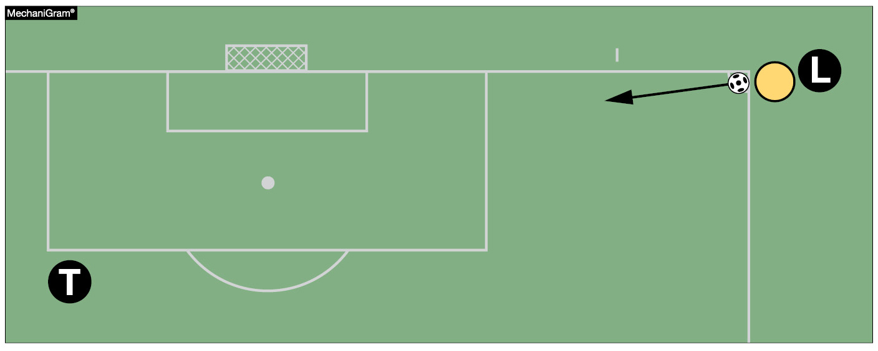
DUAL AND DOUBLE Dual-officiating system
On a corner kick from the right, the lead referee shall be in a position behind the ball and the corner flag so that he/she sees down the goal line, can follow the flight of the ball on the kick and observe the action of the players.
Notes:
DUAL AND DOUBLE DUAL OFFICIATING SYSTEM
On a corner kick from the right, the lead referee shall be in a position behind the ball and the corner flag so that he/she sees down the goal line, can follow the flight of the ball on the kick and observe the action of the players

Slide 45
Rule 1-1b; 7-1-1 MIDDLE SCHOOL
Moved all rules referencing junior high/middle school athletics to an Appendix near the end of the rules book.
Notes:
RULE 1-1 b; 7-1-1 MIDDLE SCHOOL
Moved all rules referencing junior high/middle school athletics to tan Appendix near the end of the rules book.

Slide 46

Moved all references to middle school athletics
All rules referencing junior high/middle school athletics have been moved to an Appendix near the end of the rules book so they can be found in one place.
Notes:
MOVED ALL REFERENCES TO MIDDLE SCHOOL ATHLETICS
All rules referencing junior high/middle school athletics have been moved to an Appendix near the end of the rules book so they can be found in one place.

Slide 47
2020-21 soccer pointS of emphasis
Notes:
2020-21 SOCCEER POINTS OF EMPHASIS

Slide 48
Correct Field Markings and Appropriate Uniform
It is important that games are played on fields marked in a consistent manner, and players wear uniforms according to NFHS rules. If a field is improperly marked and/or if a team wears an illegal uniform the referee shall contact the state association, who will work with school administrators to make appropriate changes. In addition, during pregame communication with school administration, game officials are also encouraged to communicate these corrective actions directly to administrators.
Notes:
CORRECT FIELD MARKINGS AND APPROPIRATE
It is important that games are played on fields marked in a consistent manner, and players wear uniforms according to NFHS rules. If a field is improperly marked and/or if a team wears an illegal uniform the referee shall contact the state association, who will work with school administrators to make appropriate changes. In addition, during pregame communication with school administration, game officials are also encouraged to communicate these corrective actions directly to administrators.

Slide 49
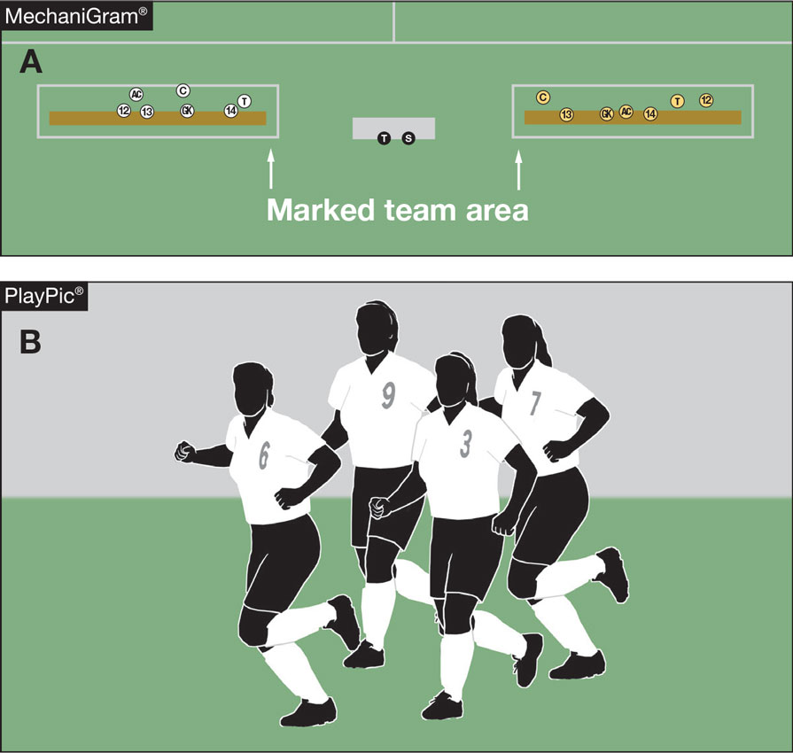
Correct field markings and appropriate uniform
Fields must be marked in a consistent manner (MechaniGram A), and players must wear uniforms according to NFHS rules (PlayPic B).
Referees should report to the school and the state office designee noncompliance on the part of field markings and inappropriate uniforms.
Illegal Home Team
Uniforms
Notes:
CORRECT FIELD MARKINGS AND APPROPRIATE UNIFORM
a. Fields must be marked in a consistent manner (MechaniGram A), and players must wear uniforms according to NFHS rules (PlayPic B).
b. Referees should report to the school and the state office designee noncompliance on the part of field markings and inappropriate uniforms.

Slide 50
Understanding the Difference Between Fair, Hard Play and a Foul
Soccer is a contact sport and understanding the differences between fair and hard play and a foul that is either reckless or serious is important to ensuring fair play and the safety of the players. When a player acts with disregard of the danger to, or consequences for, the opponent, he/she should be cautioned for reckless play. When a player uses disproportionate and unnecessary force against an opponent, he/she could be disqualified for serious foul play.
Notes:
UNDERSTANDING THE DIFFERENCE BETWEEN FIWR, HARD PLAY AND A FOUL
Soccer is a contact sport and understanding the differences between fair and hard play and a foul that is either reckless or serious is important to ensuring fair play and the safety of the players. When a player acts with disregard of the danger to, or consequences for, the opponent, he/she should be cautioned for reckless play. When a player uses disproportionate and unnecessary force against an opponent, he/she could be disqualified for serious foul play.

Slide 51
Understanding the Difference Between Fair, Hard Play and a Foul (con’t)
It is critical coaches teach players about their own safety and the safety of their opponents, and officials recognize the differences between reckless and serious and the corresponding penalties. Safety, fair play and sportsmanship should be emphasized in the pregame meeting. Communication between officials, coaches and captains should continue throughout a match, especially as the intensity increases. And when reckless or serious foul play occurs, officials should deal with the situation immediately – this kind of play should not tolerated.
Notes:
UNDERSTAND THE DIFFERENCES BETWEEN FAIR, HARD PLAY AND A FOUL (CONT.)
It is critical coaches teach players about their own safety and the safety of their opponents, and officials recognize the differences between reckless and serious and the corresponding penalties. Safety, fair play and sportsmanship should be emphasized in the pregame meeting. Communication between officials, coaches and captains should continue throughout a match, especially as the intensity increases. And when reckless or serious foul play occurs, officials should deal with the situation immediately – this kind of play should not tolerated.

Slide 52
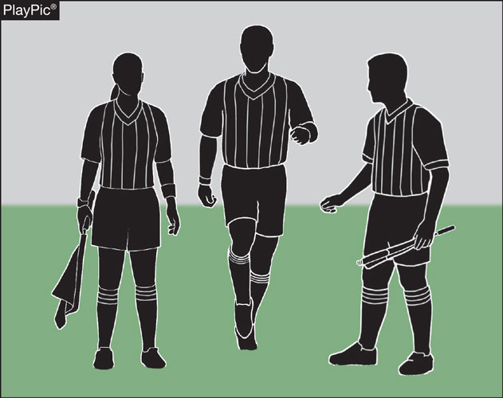
UNDERSTANDING THE DIFFERENCE BETWEEN FAIR, HARD PLAY AND A FOUL
Referees are encouraged to engage in continuing education to improve their ability to distinguish between fair play and fouls.
Notes:
UNDERSTANDING THE DIFFERENCE BETWEEN FAIR, HARD PLAY AND A FOUL
Referees are encouraged to engage in continuing education to improve their ability to distinguish between fair play and fouls.

Slide 53
Education-Based Soccer
High school athletics is education-based, and some mechanics of our game are intentionally different from other levels of soccer. The pregame meeting, for example, is a time for officials to communicate expectations to both coaches and captains. This REQUIRED meeting for both head coaches and captains should cover pertinent rules, sportsmanship, the coin toss, and properly and legally equipped players. This meeting is a purposeful start to an education-based interscholastic match
Notes:
EDUCATION-BASED SOCCER
High school athletics is education-based, and some mechanics of our game are intentionally different from other levels of soccer. The pregame meeting, for example, is a time for officials to communicate expectations to both coaches and captains. This REQUIRED meeting for both head coaches and captains should cover pertinent rules, sportsmanship, the coin toss, and properly and legally equipped players. This meeting is a purposeful start to an education-based interscholastic match

Slide 54
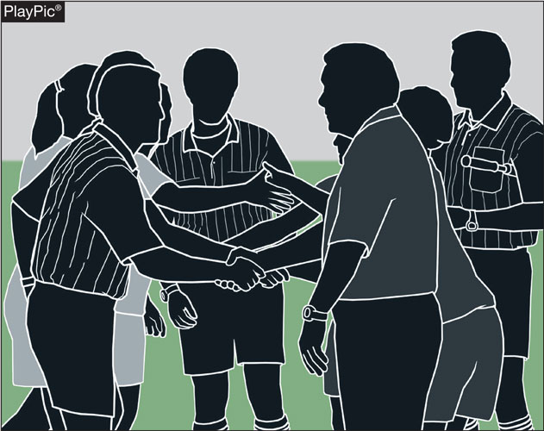
Education-based soccer
Mechanics of the NFHS high school soccer game may differ from those of other playing codes because of the need to teach. Coaches and referees should be teaching student-athletes in every phase of the competition in everything that is done.
Notes:
EDUCATION-BASED SOCCER
Mechanics of the NFHS high school soccer game may differ from those of other playing codes because of the need to teach. Coaches and referees should be teaching student-athletes in every phase of the competition in everything that is done.

Slide 55
NFHS OFFICIALS Education
2020-21
Notes:
NFHS OFFICIALS EDUCATION

Slide 56

Notes:
OFFICIALS EDUCATION
Every opportunity should be taken to improve upon officiating. Clinics, course work, observations, video review, association meetings should all be considered when attempting to improve one’s skills in officiating. The NFHS has provided opportunities for officials and prospective officials to take courses and to review video to support learning and developing officiating skills.
Sport-Specific Officiating courses are offered in several sports. They are ideal for new officials and those in the first few years of officiating. These courses introduce officials to the mechanics and techniques used in the sport and provide specific information on an area within that sport. Individuals can complete a course within 30-45 minutes. The cost of these courses is $10.00 to NFHS Officials Association members and $20 for non-members.
“Interscholastic Officiating” is a general course on sports officiating and it is free to members and cost $20 for non-members. This course provides an introduction to skills and concepts used as an official. Several topics are covered such as: basics of becoming and staying an official, science of officiating, art of officiating, how to combine these skills for successful officiating.
Video clips are made available to NFHS Officials Association members. The video is clipped on specific topics and provides the rules references as well as dialogue on the topic.
The courses and videos are offered at www.NFHSLearn.com .
Courses Available:
Officiating Football
Officiating Volleyball – Ball Handling
Officiating Volleyball – Alignment
Officiating Basketball
Officiating Basketball – Three-Person Mechanics
Soccer – Fouls and Misconduct
Soccer - Offside
Swimming and Diving
Officiating Wrestling
Umpiring Softball
Future Courses to be Considered:
Umpiring Baseball
Field Hockey
Track and Field
Umpiring Softball – Mechanics
Communication Among Officials and Coaches

Slide 57
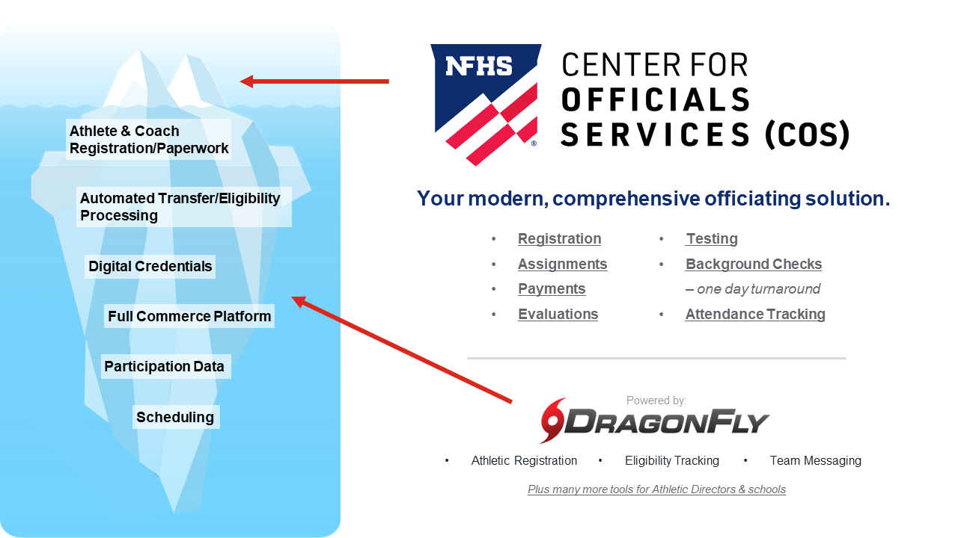
NFHS Center for Officials Services (COS)
Notes:
NFHS CENTER FOR OFFICIALS SERVICES (COS)
Your Complete Solution for Officials Management and More:
Registration
Assignment
Payment
Testing
Background Checks
For More Information on the NFHS – Center for Officials Services (COS) Contact:
Davis Whitfield, NFHS, dwhitfield@nfhs.org
Karissa Niehoff, NFHS, kniehoff@nfhs.org
Also If You’re Interested in Eligibility and Monitoring Requirements Contact
the Folks at Dragonfly:
Kirk Miller, Dragonfly, kirk@dragonflyathletics.com
Brandon Wallace, Dragonfly, brandon@dragonflyathletics.com

Slide 58
NFHS Learning Center
2020-21
Notes:
NFHS LEARNING CENTER

Slide 59

Notes:
The NFHS Learning Center, accessed at NFHSLearn.com has over 70 online professional development courses for the entire interscholastic community, including coaches, administrators, officials, parents, students, and individuals within performing arts programs. The mission and purpose of the NFHS Learning Center is focused on growing professional development opportunities. Those opportunities include courses, but now also incorporate additional videos such as “The Parent Seat” and “Beyond The Scoreboard,” which are short videos created to show to parents at Parent Meetings or show during events. The NFHS Learning Center has delivered over 10,000,000 courses and looks to continue to educate and be a valuable resource for the entire interscholastic community. Learn more at NFHSLearn.com!

Slide 60
NFHS Network
2020-21
Notes:
NFHS NETWORK

Slide 61


NFHS Network
By 2025, every high school sporting event in America will be streamed live.
The NFHS Network will be
THE DESTINATION for fans
to view these broadcasts.
27 Different Sports and Activities
www.NFHSnetwork.com
Notes:
The NFHS Network is the leader in streaming Live and On Demand high school sports.
Partnered with the National Federation of State High School Associations, 45 high school state athletic/activities associations, and PlayOn! Sports, the NFHS Network is a joint venture created to provide fans with the ability to stream high school sports on any device, from wherever they are.
All NFHS Network events are available to watch online at www.NFHSnetwork.com and through the NFHS Network Live App for iOS and Android. Follow us on Facebook, Twitter, Instagram, and YouTube.
Watching high school sports and events has never been easier.
The NFHS Network’s goal to broadcast live all 2 million high school sporting events by 2025.
The NFHS Network covers 27 different regular season and postseason sports, as well as other high school activities, celebrating the accomplishments of students-athletes, student broadcasters, and high schools across the country.

Slide 62

Notes:
The NFHS Network will broadcast over 150,000 live events this year. If your school is not a member of the NFHS Network School Broadcast Program, please contact us at Mark.Koski@NFHSnetwork.com

Slide 63

Thank You
National Federation of State High School Associations
PO Box 690 | Indianapolis, IN 46206
Phone: 317-972-6900 | Fax: 317.822.5700
www.nfhs.org | www.nfhslearn.com | www.nfhsnetwork.com
Notes:
THANK YOU.
National Federation of State High School Associations
PO Box 690 | Indianapolis, IN 46206
Phone: 317-972-6900 | Fax: 317.822.5700
www.nfhs.org | www.nfhslearn.com | www.nfhsnetwork.com

