Slide 1
2023 NFHS Rules Interpretation
Shawn Knight – NFHS Spirit Committee Chair
Shaunda Brown – NFHS Spirit Rules Interpreter

Slide 2

Thank you to our Spirit Partner Varsity

Slide 3
National federation of state high school associations (NFHS)

Slide 4

National Federation of
State High School Associations
NFHS (located in Indianapolis, IN – Est. 1920):
  National leader and advocate for
  high school athletics and
  performing arts programs.
  Serves 51 state associations, 19,500
  high schools and 12 million student
  participants.
  Writes playing rules for 17 high school
  sports for boys and girls.
  Offers online education courses for high school coaches,
  officials, parents, students and others.
  Ensures that students have opportunity to enjoy healthy participation, achievement and good sportsmanship in education-based athletics.

Slide 5






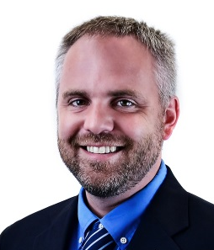

NFHS Rules Review Committee
The NFHS Rules Review Committee is chaired by the chief operating officer and composed of all rules editors. After each committee concludes its deliberations and has adopted its recommended changes for the subsequent year, such revisions will be evaluated by the Rules Review Committee.
Davis Whitfield
Chief Operating Officer
Lindsey Atkinson
Basketball, Girls Lacrosse and Volleyball
Bob Colgate
Football and Sports
Medicine
Sandy Searcy
Softball, Swimming & Diving and Water Polo
Elliot Hopkins
Baseball and Wrestling
Julie Cochran
Cross Country, Gymnastics, Field Hockey, Soccer and
Track & Field
James Weaver
Boys Lacrosse
and Spirit
Dan Schuster
Ice Hockey

Slide 6

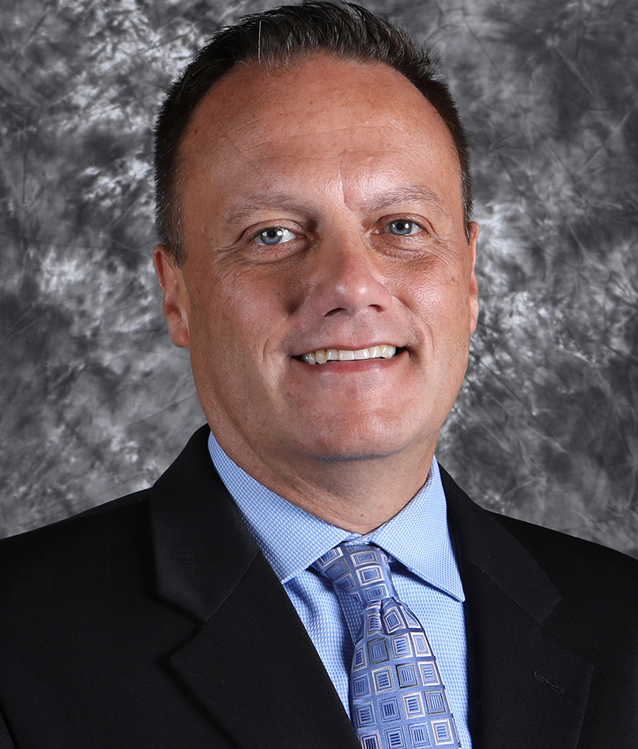

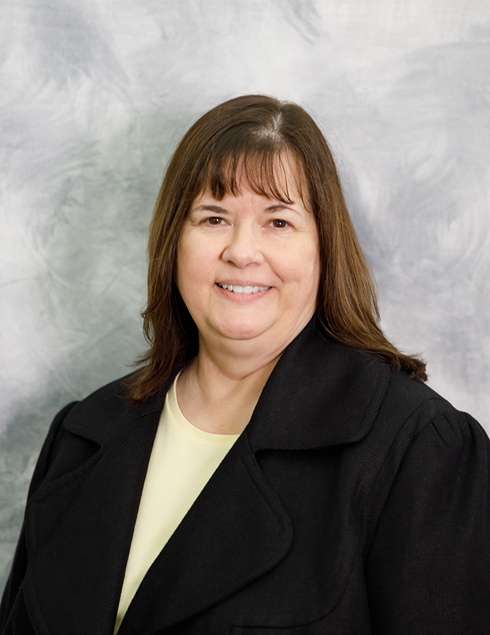
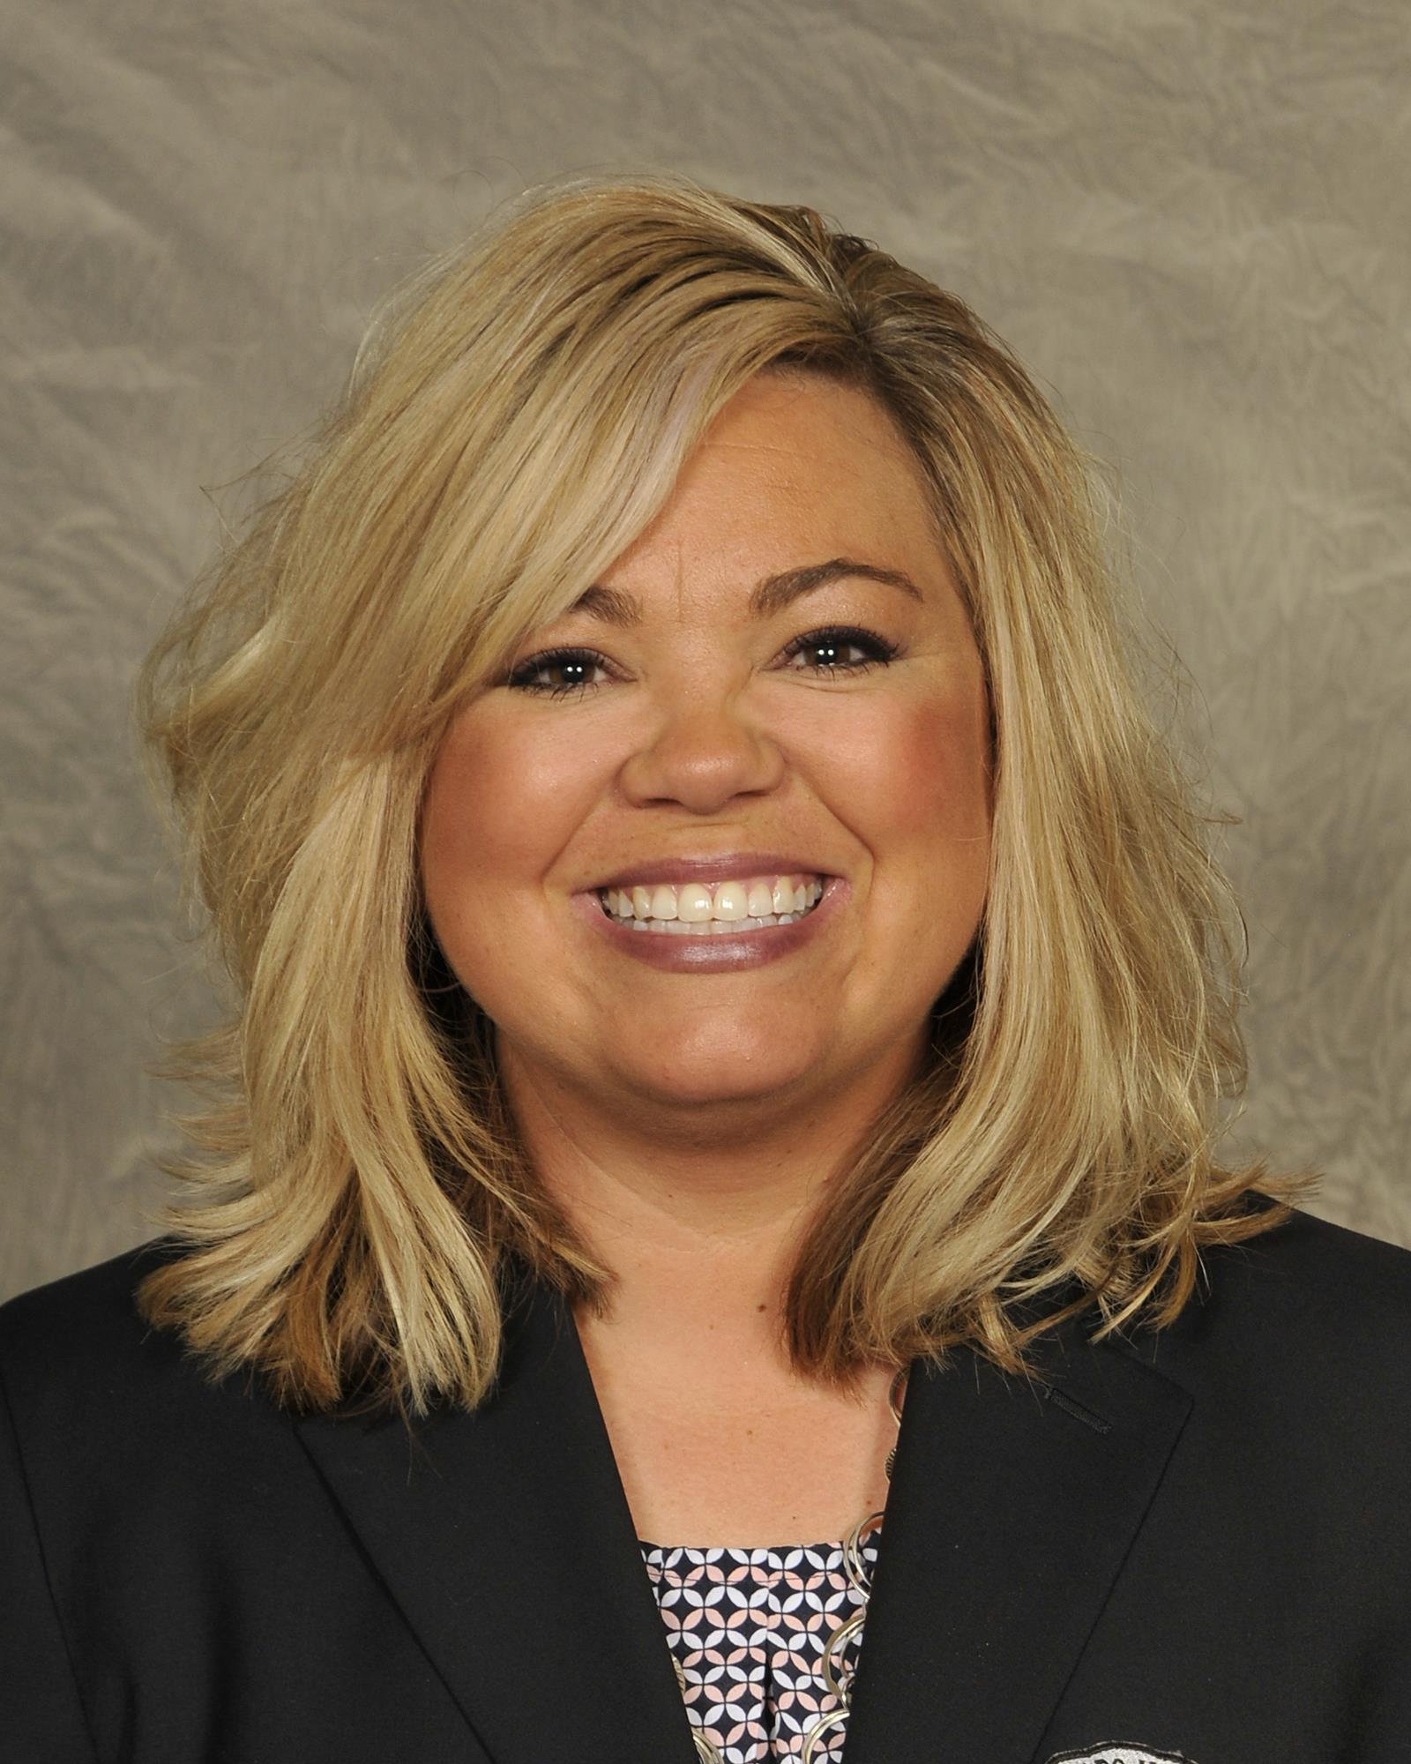

NFHS Rules Committee
Dr. James Weaver
NFHS Staff
Liaison
Shawn Knight
Virginia
Chairperson
Laurie Rothhaus
New Hampshire
Section 1
Butch Cope
Kentucky
Section 2
Penny Mitchell
Georgia
Section 3
Susie Knoblauch
Illinois
Section 4
Davine Davis
Missouri
Section 5
Jenn Roberts-Uhlig
Colorado
Section 6
Ashley Gronewold
Arizona
Section 7
Sandi Wagner
Alaska
Section 8
Shaunda Brown
NFHS Officials Association
Jim Lord
USA Cheer Representative

Slide 7







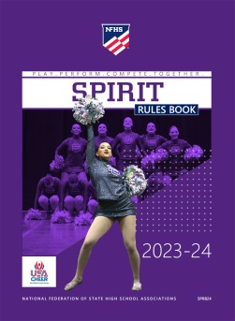





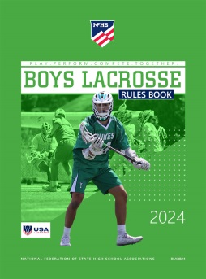
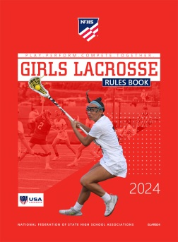



National Federation of
State High School Associations
The NFHS writes playing rules for 17 sports
for boys and girls at the high school level.
  Publishes 4 million pieces of materials annually.

Slide 8

NEW NFHS AllAccess – Website
AllAccess is the New NFHS Digital Publications Platform that includes:
  Rules Publications
  High School Today Magazine
  Policy Debate Quarterlies
  Other NFHS Digital Publications
Website organized for associations and individuals to assign books and manage purchases
Visit www.allaccess.nfhs.org

Slide 9
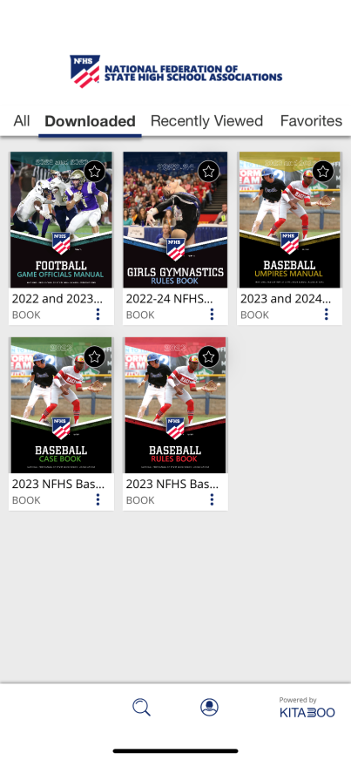


NEW NFHS AllAccess – Mobile App
Access Via Website or Mobile App:
View available publications for sale
View publications assigned to you
Download books for offline viewing
Read publications as an e-book
  Book features include:
    Table of contents
    Highlighting text
    Creating ‘sticky notes’ on pages
    Searching for terms
    Mark-up pen feature
    Viewing highlights and notes on data page
Available on App Store and Google Play

Slide 10
2023 Rules Changes

Slide 11
Rule 1 – Definitions
Hanging Stunt – A stunt in which a top person(s) is suspended by another top person who is in a shoulder stand.
Changed Pyramid to Stunt
Rationale: Diamond Heads and Whirlybirds are technically not pyramids, since they are not connected to other stunts. This change would clarify that they are subject to the restrictions dealing with Hanging Stunts.
Notes:
Rationale: Diamond Heads and Whirlybirds are technically not pyramids, since they are not connected to other stunts. This change would clarify that they are subject to the restrictions dealing with Hanging Stunts.

Slide 12
3-3-5d & E (NEW) Inversions
Bracer(s) with hand to hand/arm contact must be in a multi-based prep with a spotter and remain stationary.
New e. Non-arm bracer(s) must be at prep level or below. If in a prep or shoulder stand, the bracer(s) shall have two bases or a base and spotter.
Rationale: This change clarifies the requirement for a bracer that does not have hand to hand contact with the top person. As the inversion rule has evolved and the connection between the top person and the bracer has changed from two arms to one arm, there is a need for further clarification for bracers who do not have hand to hand contact with the flipping top person.

Slide 13
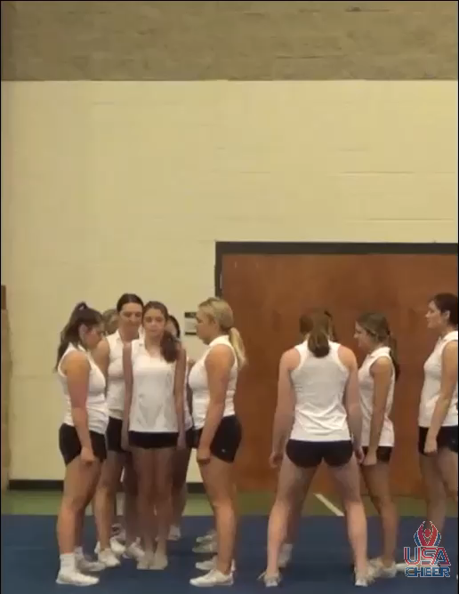

Slide 14
3-3-6a Inversions
Inversions may release to a non-inverted dismount, loading position or stunt at any level provided the following conditions are met:
Changed ½ and ¼ turns to: Top person completes no more than one twist.
The release goes to the original base(s).
There is a spotter.
Rationale: Allows for a consistent rule for the same twisting allowance for each type of landing.

Slide 15
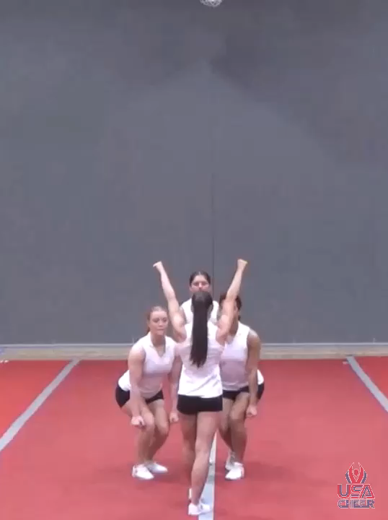

Slide 16
3-3-6b and 4-3-6b Inversions
In inversions where the base of support begins and remains below prep level, contact must be maintained between at least one base or spotter and the top person until the top person is no longer inverted or hands are on the performing surface.
Rationale: Would enable a wider variety of below prep level inversions to be performed legally, mirroring the language in prep level inversions. The change clarifies the rule that was changed in 2018.

Slide 17
3-4-5 non-release stunts
Updated language to align with the new definition of a hanging stunt.
Rationale: A true hanging pyramid would be subject to this rule just like an extension in a braced pyramid and would still require a spotter. The revised rule reflects the new definition of a hanging stunt.

Slide 18
3-5-4 Release Stunts/tosses
A toss caught in a non-inverted stunt by the original bases is permitted providing the following are met: The toss must not go significantly higher than the point of contact with the bases on the catch. A ball-up position is the only allowed body position during the release other than the landing position.
Rationale: Allows a toss to be caught in a horizontal or vertical stunt by the original bases while clarifying only a ball up position is allowed during the release of a toss caught in a non-inverted stunt.

Slide 19
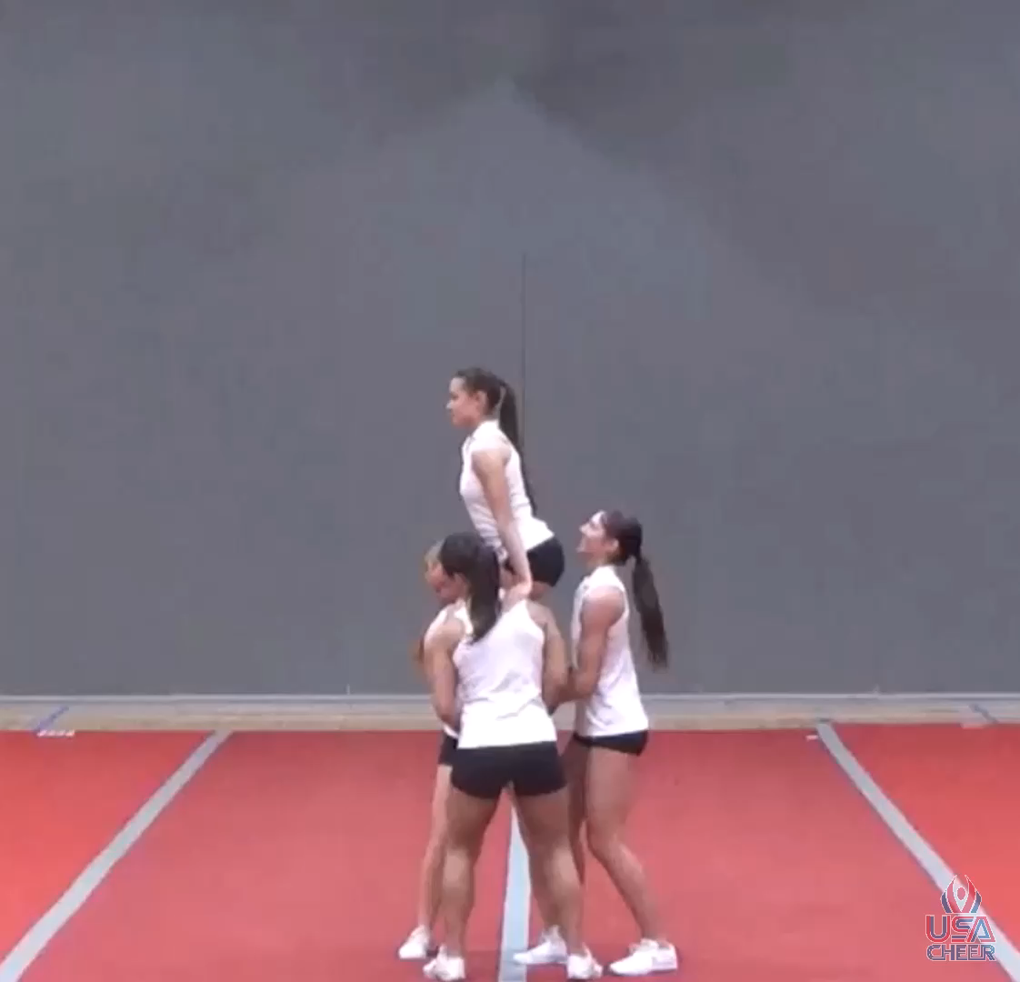

Slide 20
3-5-6 and 4-5-4 Release Stunts/Tosses
Reduced the number of bases from four (4) to three (3) for a helicopter
Rationale: Decreasing the number of tosser/catchers brings the personnel requirement in line with similar skills. Helicopters will continue to require a tosser/catcher to be in position to support the top person’s head and shoulders at the beginning and end of the skill.

Slide 21
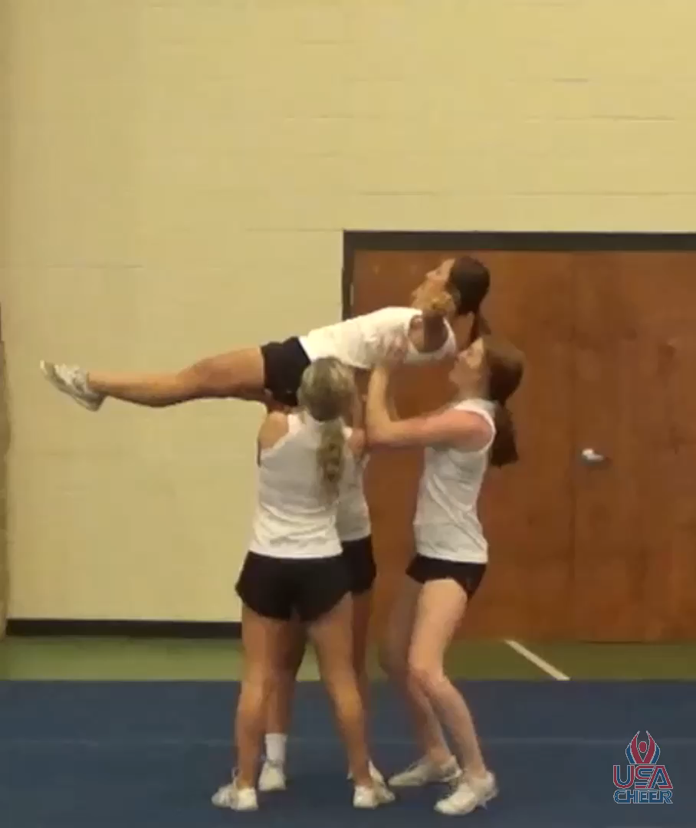

Slide 22
3-5-7 Release Stunts/Tosses
Deleted Article 7
Other Rules Affected:
  3-5-2f - The top person must not be in contact with another released top person
Rationale: 3-5-7a is unnecessary, as that is the normal rotation for a single base. 3-5-7b conflicts with popping from a cradle or flat back and performing a half twist to the prone position.

Slide 23
4-4-4 b and d Non-release stunts/lifts
A top person may be moved from a vertical position to a horizontal or cradle position provided all the following conditions are met:
  a. The top person maintains contact with at least one original base, post or spotter.
  b. At least two catchers and/or bases catch the upper body of the top person. and does not pass through an extended position.
  c. When the catchers are not the original bases, they remain close to the original bases and are in place prior to the movement to the horizontal position.
  d. When the catchers are not the original bases and the top person begins or passes through an extended overhead position, three catchers are in place.
Rationale: Allows for a skill in Dance that has been proven effective with minimal risk in a corresponding Cheer skill.

Slide 24
2023 points of emphasis

Slide 25
Copyright Compliance
Spirit coaches and schools should be conscientious and follow all U.S. Copyright Laws when incorporating music into your spirit programs. There are many companies that will assist in securing copyright compliance. Coaches should exercise due diligence to protect programs against costly fines and potential lawsuits when using copyrighted music. Be sure to take the NFHS Learn Course for Copyright Compliance for Cheer and Dance coaches at www.nfhslearn.com/copyright

Slide 26
Sportsmanship
Spirit participants should strive to boost school spirit; promote good sportsmanship; develop good, positive crowd involvement; and help student participants and spectators achieve the most worthwhile educational objectives of the interscholastic program. Spirit leaders can effectively neutralize negative environments at any interscholastic contests.

Slide 27
Performing surfaces
Performing surfaces and areas must be suitable for spirit activities. When utilizing mats during practices and games, consideration should be given to the total area necessary for the performance. Extra attention should be given to the difference in the performing surfaces if transitioning on and off the mat.

Slide 28
Risk Minimization
Jewelry, hands-free poms worn around the wrist and appropriate footwear continue to be areas of concern in both cheer and dance. As a reminder, jewelry and hands-free poms worn around the wrist are illegal during practice, performance and competitions. Dancers and cheerleaders must wear footwear that is appropriate for the activity as specified in the NFHS Spirit Rules Book.

Slide 29
NFHS OFFICIALS Education

Slide 30





OFFICIALS EDUCATION
Content remains free of charge
TEACHING
AIDS
RULES
CHANGES
DIAGRAMS
VIDEO
LIBRARY
OFFICIALS
COURSES
Notes:
Sport-Specific Officiating courses are offered in several sports. They are ideal for new officials and those in the first few years of officiating. These courses introduce officials to the mechanics and techniques used in the sport and provide specific information on an area within that sport. Individuals can complete a course within 30-45 minutes. These courses are free to all officials and prospective officials.
“Interscholastic Officiating” is a general course on sports officiating, and it is free to all officials and prospective officials. This course provides an introduction to skills and concepts used as an official. Several topics are covered such as: basics of becoming and staying an official, science of officiating, art of officiating, how to combine these skills for successful officiating.
Video clips are made available to NFHS Officials Association members. The video is clipped on specific topics and provides the rules references as well as dialogue on the topic.
The courses and videos are offered at www.NFHSLearn.com .
Courses Available:
Officiating Football
Officiating Volleyball – Ball Handling
Officiating Volleyball – Alignment
Officiating Volleyball – E-Whistle
Officiating Basketball
Officiating Basketball – Three-Person Mechanics
Officiating Basketball - Pre-Game Conference
Soccer – Fouls and Misconduct
Soccer – Offside
Soccer - Pre-Game Conference
Swimming and Diving
Officiating Wrestling
Umpiring Softball
Officiating Field Hockey
Officiating Track and Field
Future Courses to be Considered:
Umpiring Baseball
Umpiring Softball – 2 Person Mechanics
Communication Among Officials and Coaches

Slide 31



Future Developments:
Auto Assign
Mobil Assign
Customized Game and Travel Fees
Mass Update Capabilities
Integrated Playoff Financial Reporting
Improvements:
Invoicing
Updated Financial Reporting
Playoff and Tournament Bracketing
Eligibility Tracking Notifications
NFHS Learn Integration
Coming Fall 2023:
NFHS Exam Center
New Team App
New Form Builder
Year Two Accomplishments
16
194,810
$29M
States
Registering
Officials
Contests
Assigned
Payments
Sent to
Officials
100% FREE to your state as a NFHS-Member Benefit.
Notes:
NFHS CENTER FOR OFFICIALS SERVICES (COS)
Your Complete Solution for Officials Management and More:
Registration
Assignment
Payment
Testing
Background Checks
For More Information on the NFHS – Center for Officials Services (COS) Contact:
Dana Pappas, Director of Officiating Services, dpappas@nfhs.org
Also If You’re Interested in Eligibility and Monitoring Requirements Contact
the Folks at Dragonfly:
Kirk Miller, Dragonfly, kirk@dragonflyathletics.com
Brandon Wallace, Dragonfly, brandon@dragonflyathletics.com

Slide 32
NFHS Learning Center

Slide 33

Notes:
The NFHS Learning Center is the home to more than 90 online professional development courses for everyone within the interscholastic community - coaches, students, officials, parents, administrators, and individuals within performing arts programs. More than 60 courses are available for free.
The NFHS is an Accredited Institution and has delivered more than 15 million courses on its NFHS Learning Center platform since its inception in 2007. In receiving national accreditation by Cognia, the NFHS has upheld itself to rigorous standards that focus on productive learning environments, equitable resource allocation that meet the needs of learners, and effective leadership.
The NFHS Learning Center features its flagship coaching course, “Fundamentals of Coaching,” as well as several health and safety courses that have been completed by millions of individuals, such as “Concussion in Sports,” “Heat Illness Prevention,” “Sudden Cardiac Arrest” and “Protecting Students from Abuse.” The NFHS Learning Center offers several national credentials that can be earned by individuals who complete specific NFHS courses. Through the School Honor Roll Program, schools can earn a physical banner to hang in their school.
To learn more and start your professional development journey, please visit the NFHS Learning Center at NFHSLearn.com.

Slide 34
NFHS Network

Slide 35


NFHS Network
By 2025, every high school sporting event in America will be streamed live.
The NFHS Network will be
THE DESTINATION for fans
to view these broadcasts.
27 Different Sports and Activities
www.NFHSnetwork.com
Notes:
The NFHS Network is the leader in streaming Live and On Demand high school sports.
Partnered with the National Federation of State High School Associations, 45 high school state athletic/activities associations, and PlayOn! Sports, the NFHS Network is a joint venture created to provide fans with the ability to stream high school sports on any device, from wherever they are.
All NFHS Network events are available to watch online at www.NFHSnetwork.com and through the NFHS Network Live App for iOS and Android. Follow us on Facebook, Twitter, Instagram, and YouTube.
Watching high school sports and events has never been easier.
The NFHS Network’s goal to broadcast live all 2 million high school sporting events by 2025.
The NFHS Network covers 27 different regular season and postseason sports, as well as other high school activities, celebrating the accomplishments of students-athletes, student broadcasters, and high schools across the country.

Slide 36


Over 1 million events this year…
Notes:
The NFHS Network will broadcast over 150,000 live events this year. If your school is not a member of the NFHS Network School Broadcast Program, please contact us at Mark.Koski@NFHSnetwork.com

Slide 37

Thank You
National Federation of State High School Associations
PO Box 690 | Indianapolis, IN 46206
Phone: 317-972-6900 | Fax: 317.822.5700
www.nfhs.org | www.nfhslearn.com | www.nfhsnetwork.com

