Slide 1
2024 nfhs football rules powerpoint
Notes:
This PowerPoint presentation from the National Federation of State High School Associations (NFHS) covers the following:
2024 NFHS Football Rules Change-
2024 NFHS Football Editorial Changes-
2024 NFHS Football Points of Emphasis-
2024 NFHS Football Rules Reminders-
2024-25 NFHS Football Information-

Slide 2
NFHS

Slide 3

National Federation of
State High School Associations (NFHS)
NFHS (located in Indianapolis, IN – Est. 1920):
  National leader and advocate for
  high school athletics and
  performing arts programs.
  Serves 51 state associations, 19,500
  high schools and 12 million student
  participants.
  Writes playing rules for 17 high school
  sports for boys and girls.
  Offers online education courses for high school coaches,
  officials, parents, students and others.
  Ensures that students have opportunity to enjoy healthy participation, achievement and good sportsmanship in education-based athletics.
Notes:
Comment on Slide:
Overview of the NFHS.

Slide 4








NFHS Rules Review Committee
The NFHS Rules Review Committee is chaired by the chief operating officer and composed of all rules editors. After each committee concludes its deliberations and has adopted its recommended changes for the subsequent year, such revisions will be evaluated by the Rules Review Committee.
Davis Whitfield
Chief Operating Officer
Lindsey Atkinson
Basketball, Girls Lacrosse and Volleyball
Bob Colgate
Football and Sports
Medicine
Sandy Searcy
Softball, Swimming & Diving and Water Polo
Elliot Hopkins
Baseball and Wrestling
Julie Cochran
Cross Country, Gymnastics, Field Hockey, Soccer and
Track & Field
James Weaver
Boys Lacrosse
and Spirit
Dan Schuster
Ice Hockey
Notes:
Comment on Slide:
Overview of NFHS Rules Review Committee.

Slide 5




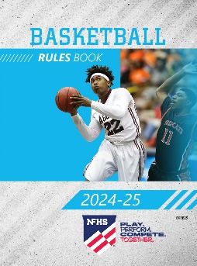
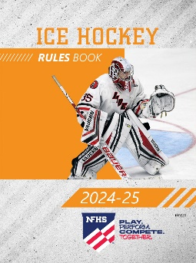
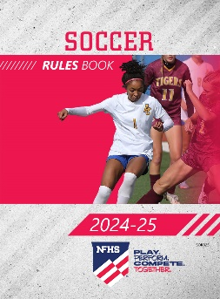
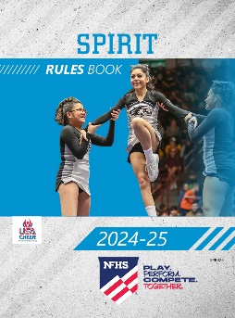
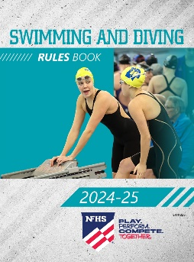

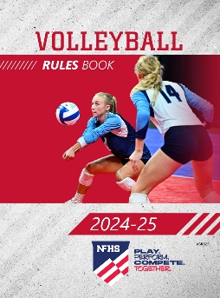
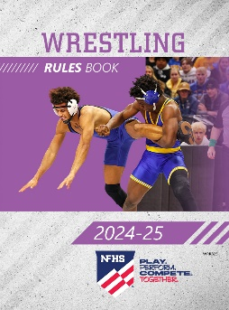
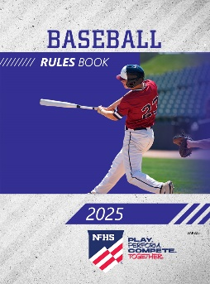
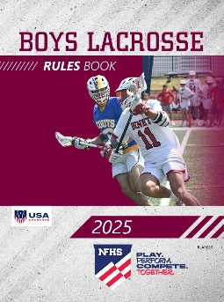
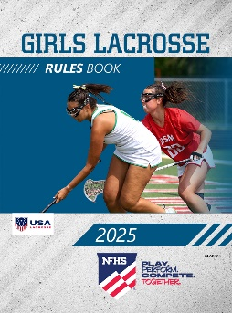
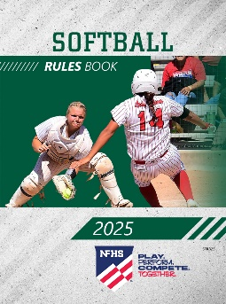
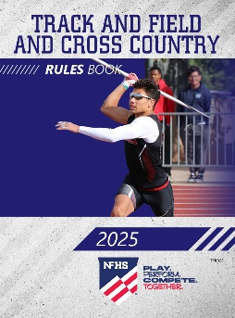
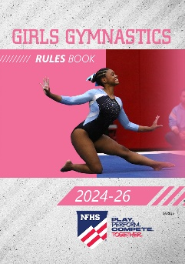
NFHS Publications
The NFHS writes playing rules for 17 sports
for boys and girls at the high school level.
  Publishes 4 million pieces of materials annually.
Notes:
Comment on Slide:
Overview of NFHS Rules Books and Publications.

Slide 6

NFHS AllAccess – Website
AllAccess is the NFHS Digital Publications Platform that includes:
  Rules Publications
  High School Today Magazine
  Policy Debate Quarterlies
  Other NFHS Digital Publications
Website organized for associations and individuals to assign books and manage purchases
Visit https://allaccess.nfhs.org
Notes:
Comment on Slide:
Overview of NFHS AllAccess - Website

Slide 7
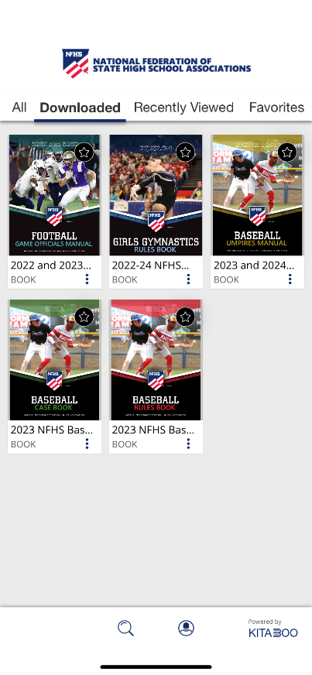


NFHS AllAccess – Mobile App
Access Via Website or Mobile App:
View available publications for sale
View publications assigned to you
Download books for offline viewing
Read publications as an e-book
Available on App Store and Google Play
Notes:
Comment on Slide:
Overview of NFHS AllAccess – Mobile App

Slide 8
2024 nfhs football rules change

Slide 9
Nfhs football rules
Each state high school association adopting these NFHS football rules is the sole and exclusive source of binding rules interpretations for contests involving its member schools. Any person having questions about the interpretation of NFHS football rules should contact the football rules interpreter designated by the respective state high school association.
The NFHS is the sole and exclusive source of model interpretations of NFHS football rules. State rules interpreters may contact the NFHS for model football rules interpretations. No other model football rules interpretations should be considered.
Notes:
Comment on Slide:
This statement appears at the bottom of page three in the 2024 NFHS Football Rules Book.

Slide 10
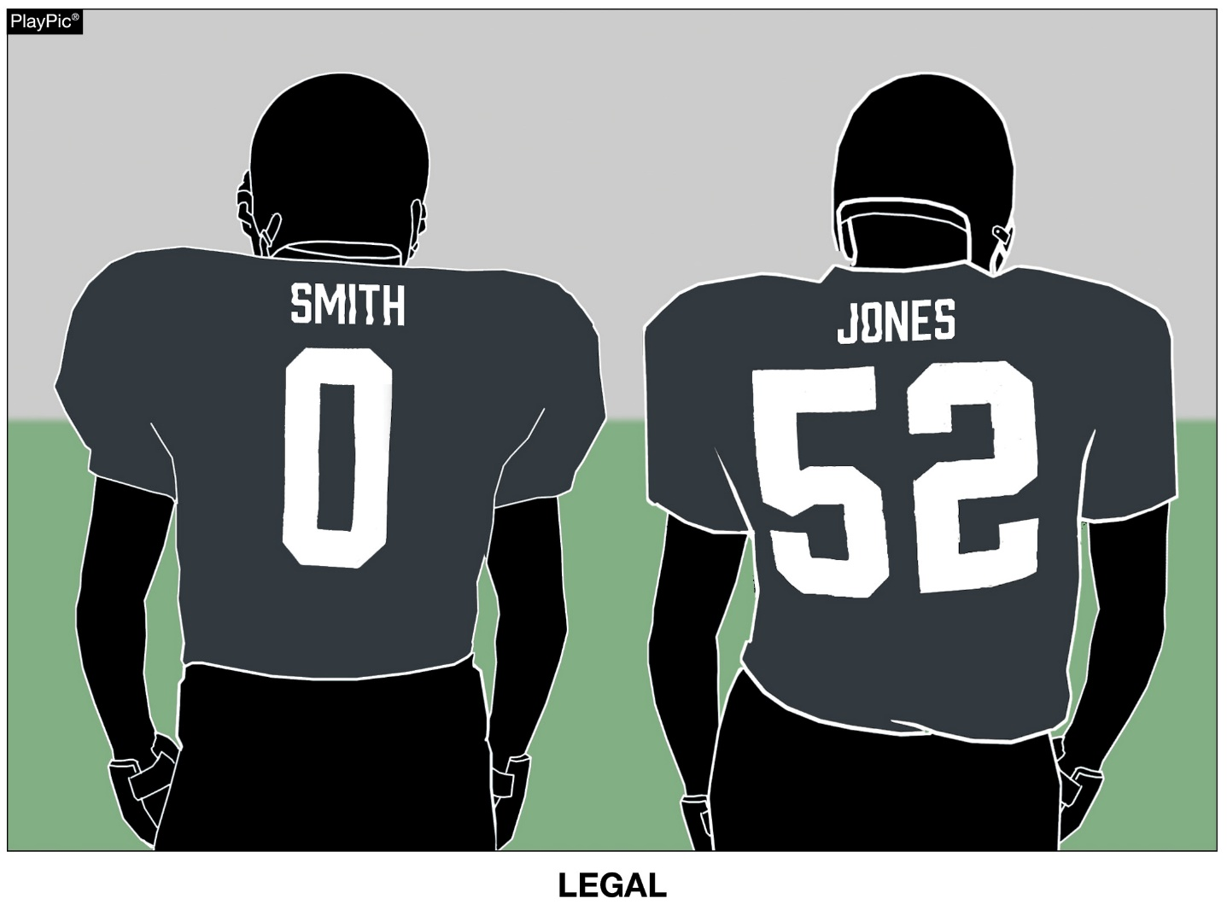
HOME jerseys rule 1-5-1b(3)
Jerseys of the home team shall all be the same dark color(s) that clearly contrasts to white.
Notes:
Rule Change:
RULE 1 – SECTION 5 PLAYER EQUIPMENT
ART. 1 . . . Mandatory equipment. Each player shall participate while wearing the following pieces of properly fitted equipment, which shall be professionally manufactured and not altered to decrease protection: …
b. Jersey: …
3. Players of the home team shall wear jerseys, unaltered from the manufacturer’s original design/production, that meet the following criteria:
(a) The body of the jersey (inside the shoulders, inclusive of the yoke of the jersey or the shoulders, below the collar, and to the bottom of the jersey) may not include white, except as stated below.
(b) The jerseys of the home team shall all be the same dark color(s) that clearly contrasts to white. If white appears in the body of the jersey of the home team, it may only appear: …
Rationale for Change: Clarified home team uniform requirement for each player. The jerseys of the home team shall all be the same dark color(s) that clearly contrasts with white.
Case Book: See SITUATION 9.8.1H

Slide 11
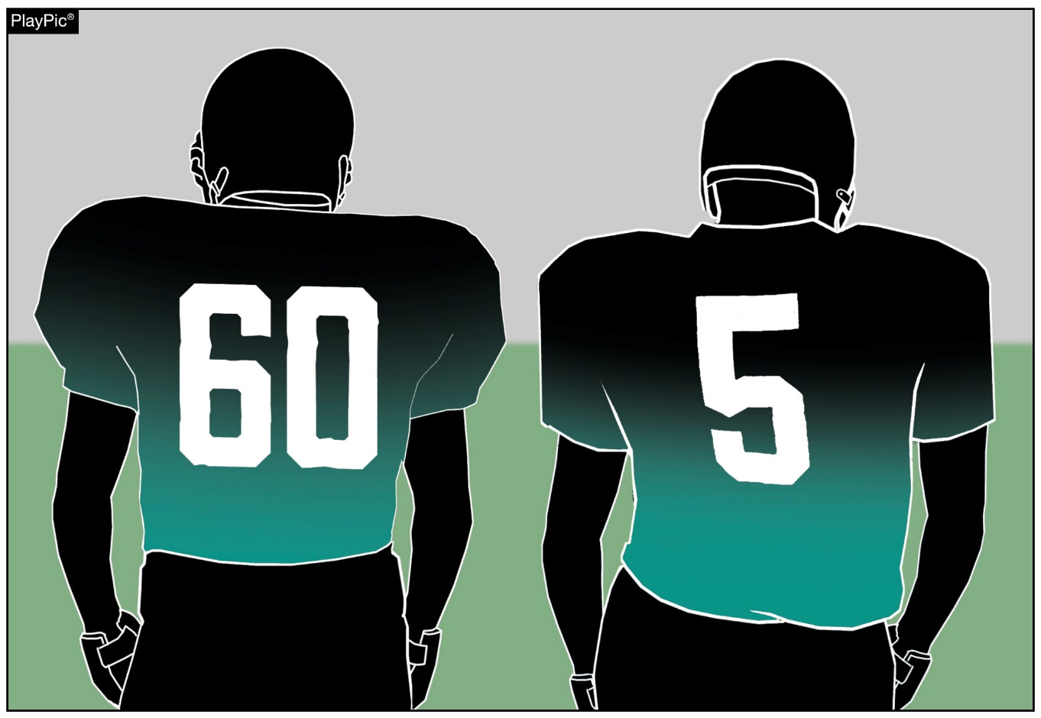
Home jerseys rule 1-5-1b(3)
These jerseys are legal because it is the same dark colors. All players on this home team shall wear the same dark colored jerseys in order to comply with the rule.
LEGAL
Notes:
Rule Change:
Comment on Slide:
See comments on slide.

Slide 12
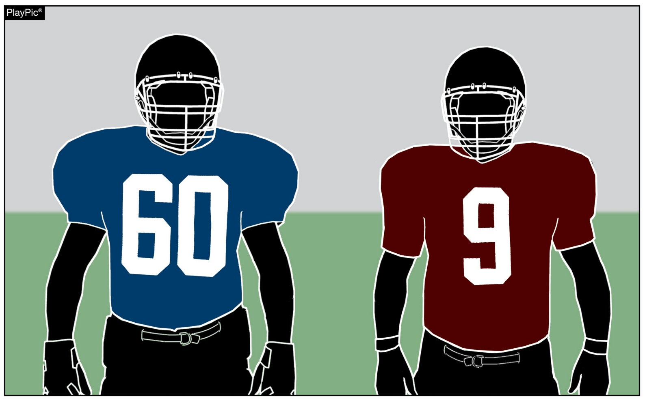
HOME jerseys rule 1-5-1b(3)
These jerseys of the home team are illegal because all members of the home team must wear the same dark color(s) that clearly contrasts to white.
ILLEGAL
Notes:
Rule Change:
Comment on Slide:
See comments on slide

Slide 13
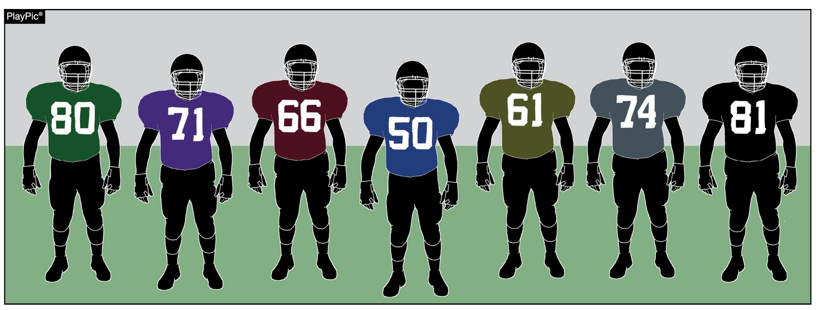
HOME jerseys rule 1-5-1b(3)
These jerseys of the home team are illegal because all members of the home team must wear the same dark color(s) that clearly contrasts to white.
Notes:
Rule Change:
Comment on Slide:
See comments on slide

Slide 14
2024 nfhs football editorial changes

Slide 15
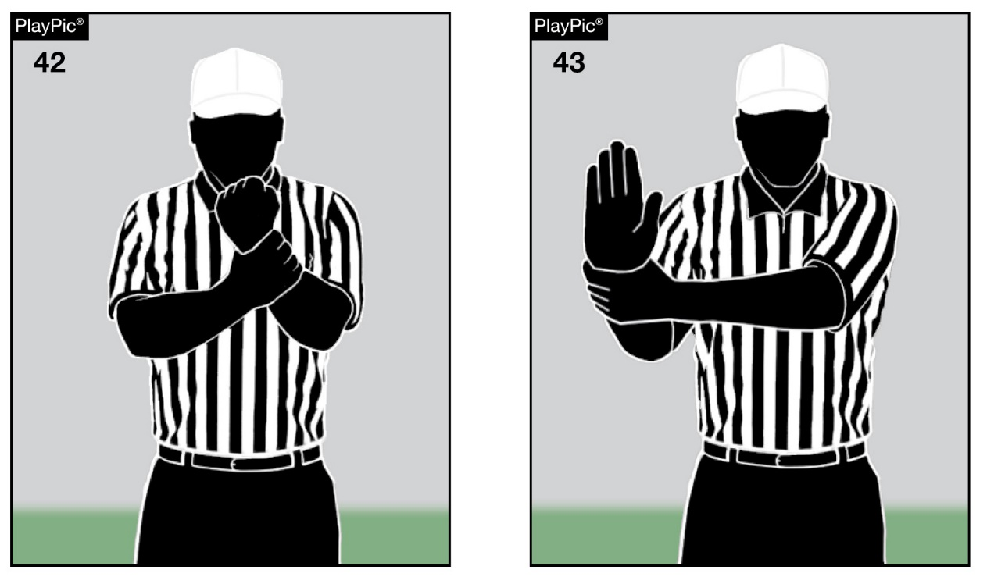
Signal chart
Signal 43 will be used to indicate illegal use of hands/arms as well as illegal block. Signal 42, formerly used for illegal use of hands/arms, will indicate holding only.
Notes:
Editorial Change:
Comment on Slide:
See comments on slide. Refer to the NFHS Official Football Signals on pages 96-97 of the 2024 NFHS Football Rules Book.

Slide 16
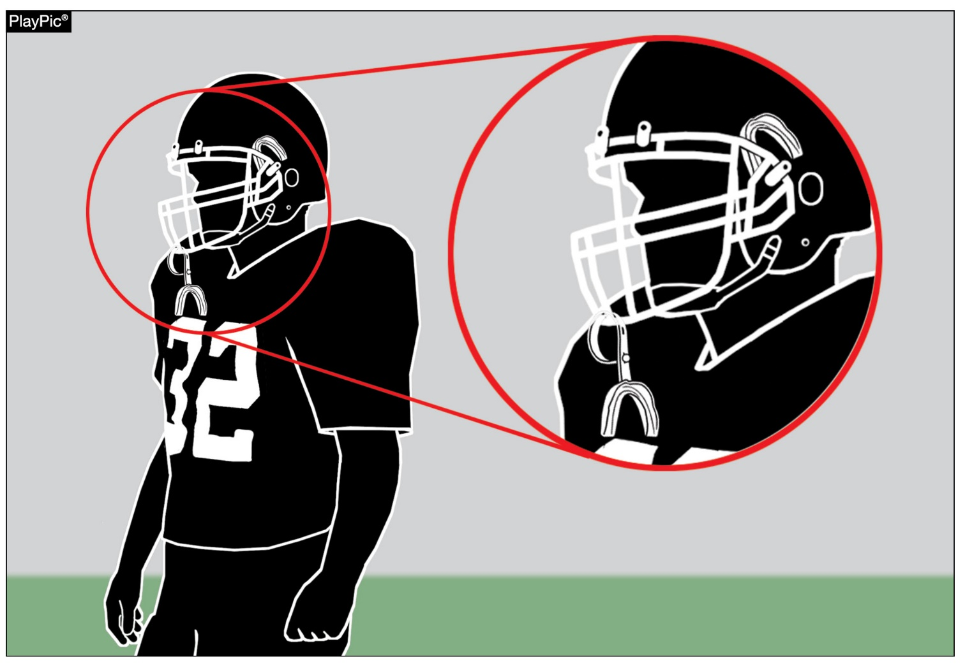
TOOTH AND MOUTH PROTECTOR
RULE 1-5-1d(5)a
Players may have only one tooth and mouth protector.
Notes:
Editorial Change:
RULE 1 – SECTION 5 PLAYER EQUIPMENT
ART. 1 . . . Mandatory equipment. Each player shall participate while wearing the following pieces of properly fitted equipment, which shall be professionally manufactured and not altered to decrease protection: …
d. Pads and Protective Equipment – The following pads and protective equipment are required of all players: …
5. (a) A single tooth and mouth protector (intraoral) which shall:
(1) include an occlusal (protecting and separating the biting surfaces) portion;
(2) include a labial (protecting the teeth and supporting structures) portion; and
(3) cover the posterior teeth with adequate thickness. …
Rationale for Change: Further clarified that players may have only one tooth and mouth protector. Players have increasingly been wearing one tooth and mouth protector attached to their face mask while simultaneously having one in their mouth unseen by game officials.
Case Book: See SITUATION 1.5.1C

Slide 17
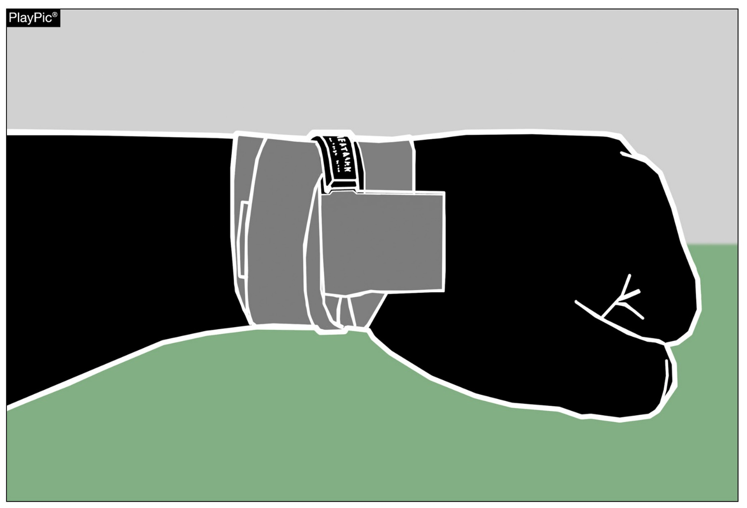
ILLEGAL EQUIPMENT
RULE 1-5-3c(6)
Religious medals and a medical alert such as the one shown in the PlayPic are not considered jewelry. Religious medals or other religious items must be taped to the body and worn under the uniform. A medical-alert indicator must be taped to the body and may be visible.
Notes:
Editorial Change:
RULE 1 – SECTION 5 PLAYER EQUIPMENT
ART. 3 . . . Illegal equipment. No player shall participate while wearing illegal equipment. This applies to any equipment, which in the opinion of the umpire is dangerous, confusing or inappropriate. Illegal equipment shall always include but is not limited to: …
c. The following Other Illegal Equipment: …
6. Jewelry. Religious medals and a medical-alert indicator are not considered jewelry. Religious medals or other religious items must be taped to the body and worn under the uniform. A medical-alert indicator must be taped to the body and may be visible. …
Rationale for Change: Further clarified and standardized rules language that has been approved by the NFHS Rules Review Committee for all 2024-25 NFHS Rules Books that still have jewelry rules.

Slide 18
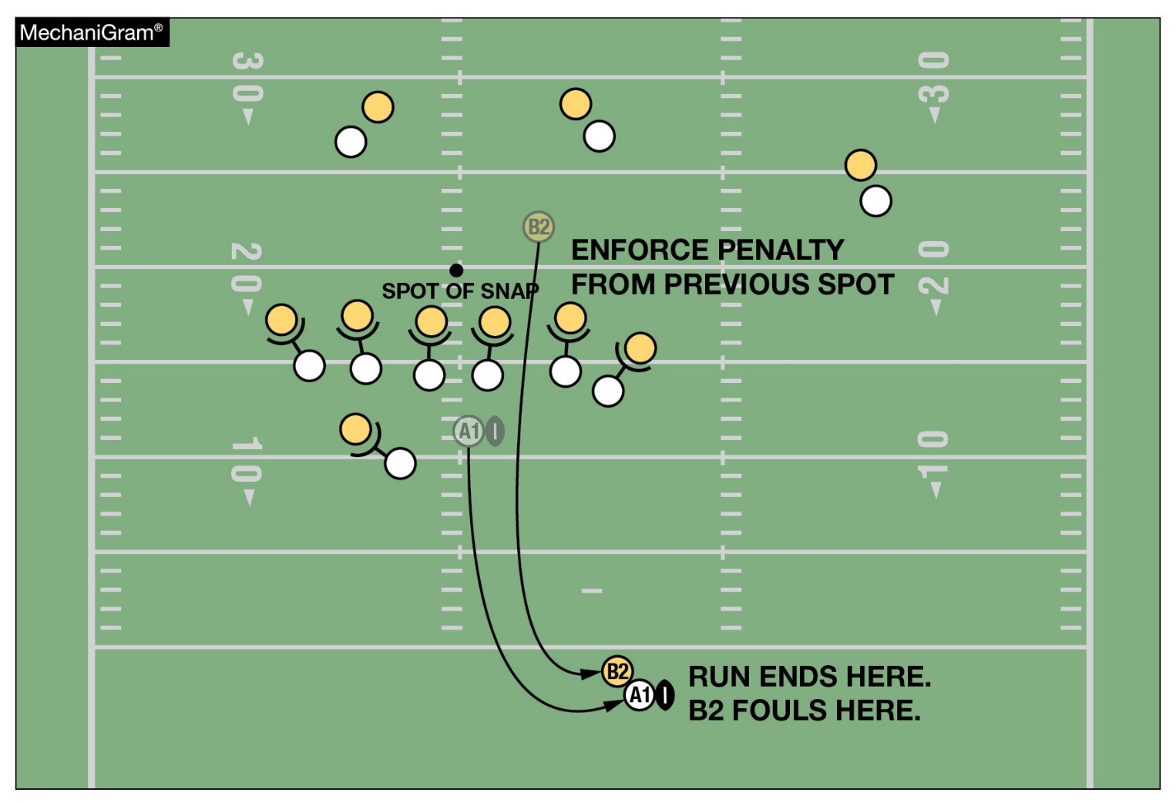
BASIC SPOTS
RULE 10-4-2d
The penalty for this foul is enforced from the previous spot. Under the old rule, the penalty would have been enforced from the goal line.
Notes:
Editorial Change:
Comment on Slide:
See comments on slide. Further clarified Basic Spots in Rule 10-4-2.

Slide 19
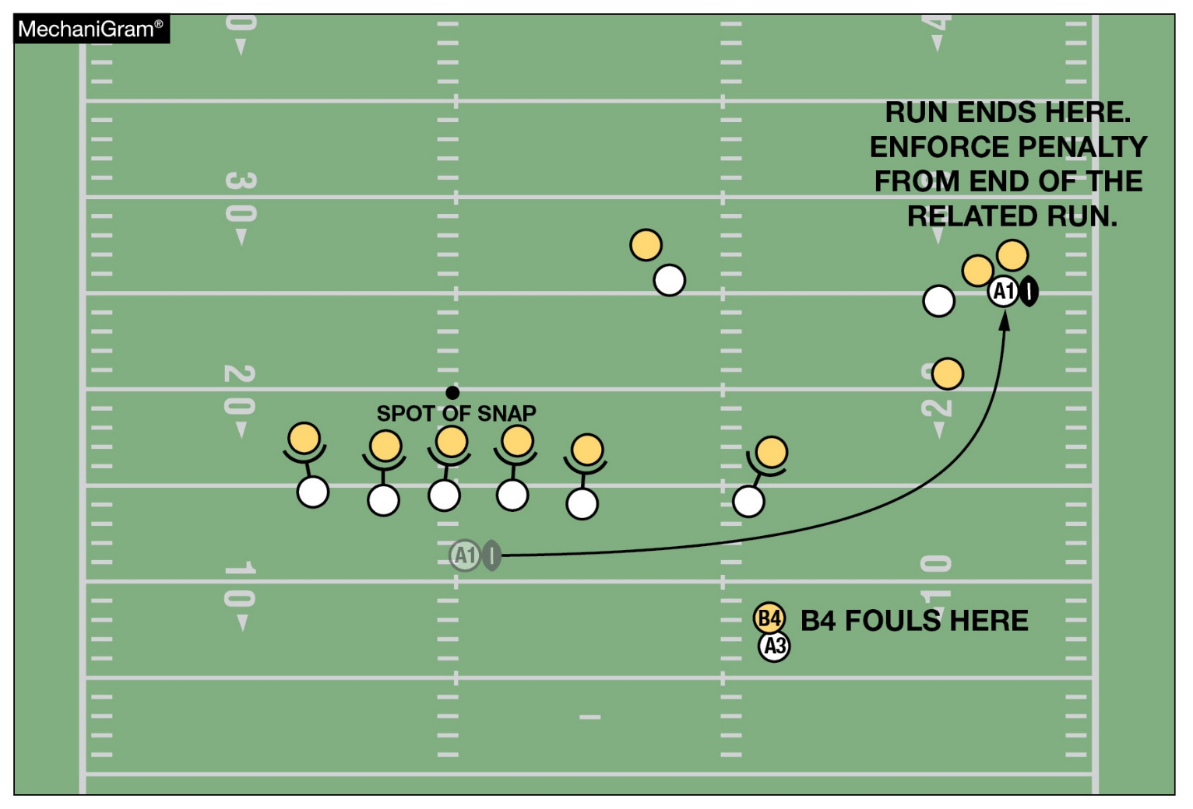
BASIC SPOTS
RULE 10-4-6a
The basic spot is the end of the run or related run for a foul by B when the run or related run ends beyond the line of scrimmage.
Notes:
Editorial Change:
Comment on Slide:
See comments on slide. Further clarified Basic Spots in Rule 10-4-6.

Slide 20
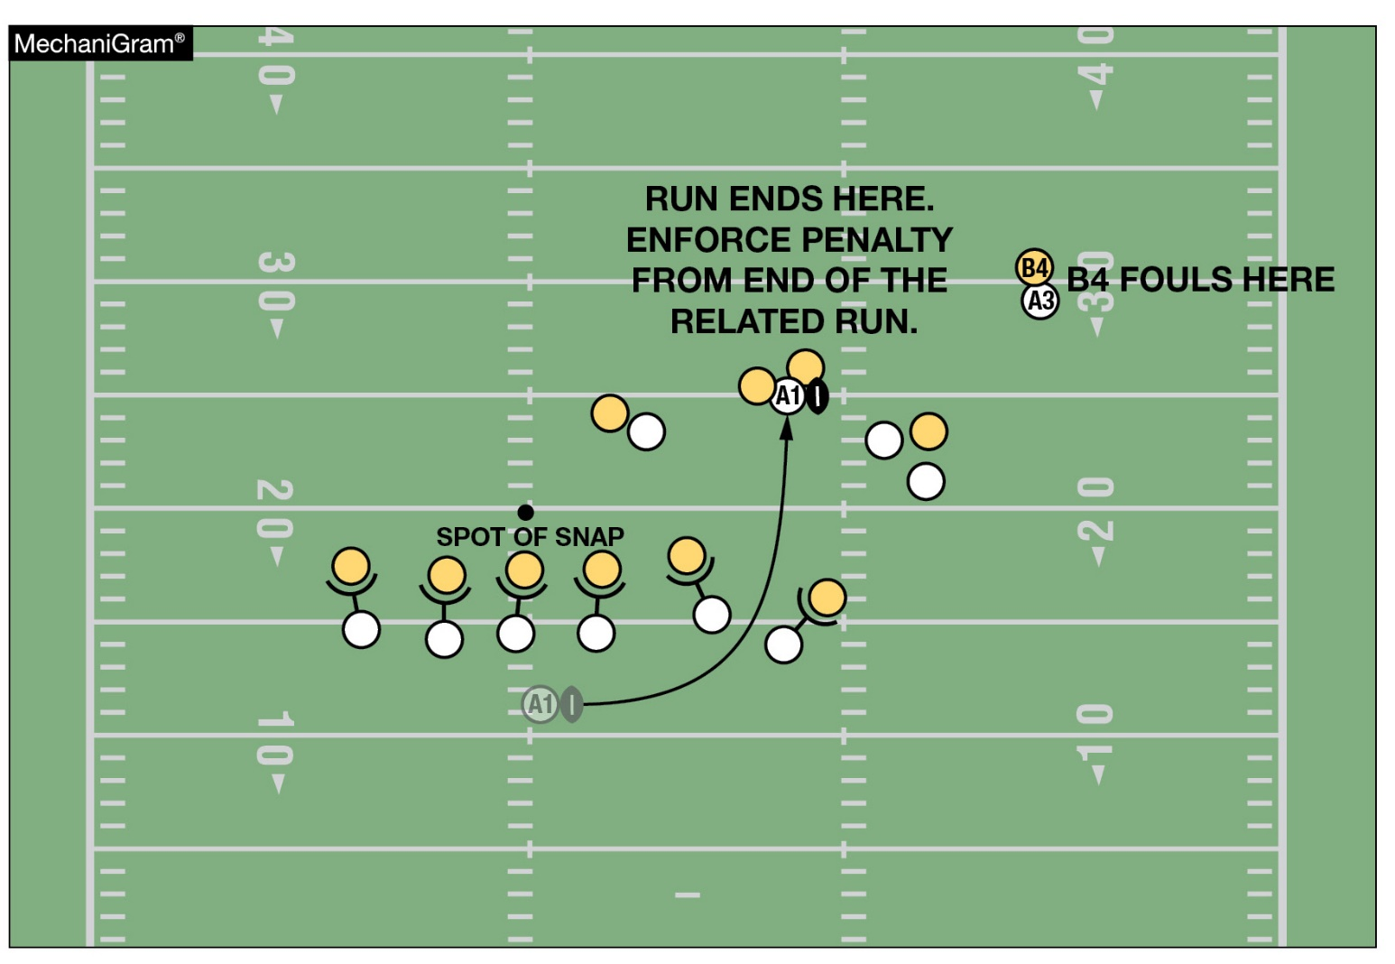
BASIC SPOTS
RULE 10-4-6a
The basic spot is the end of the run or related run when the run or related run ends beyond the line of scrimmage and the foul occurs in advance of the end of the run or related run.
Notes:
Editorial Change:
Comment on Slide:
See comments on slide. Further clarified Basic Spots in Rule 10-4-6.

Slide 21
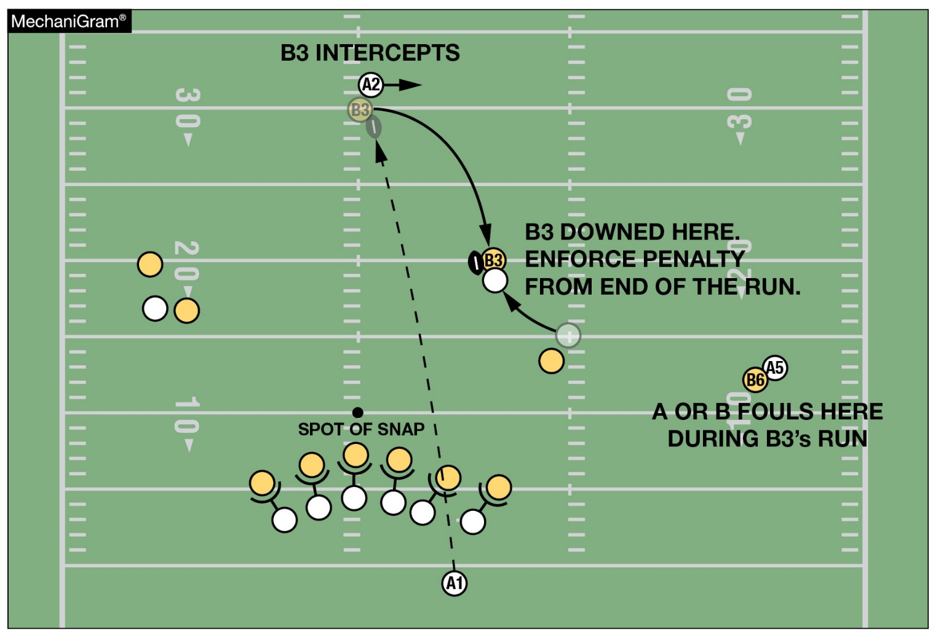
BASIC SPOTS
RULE 10-4-6b
The basic spot is the end of the run or related run for a foul that occurs beyond the end of the run or related run following a change of possession.
Notes:
Editorial Change:
Comment on Slide:
See comments on slide. Further clarified Basic Spots in Rule 10-4-6.

Slide 22
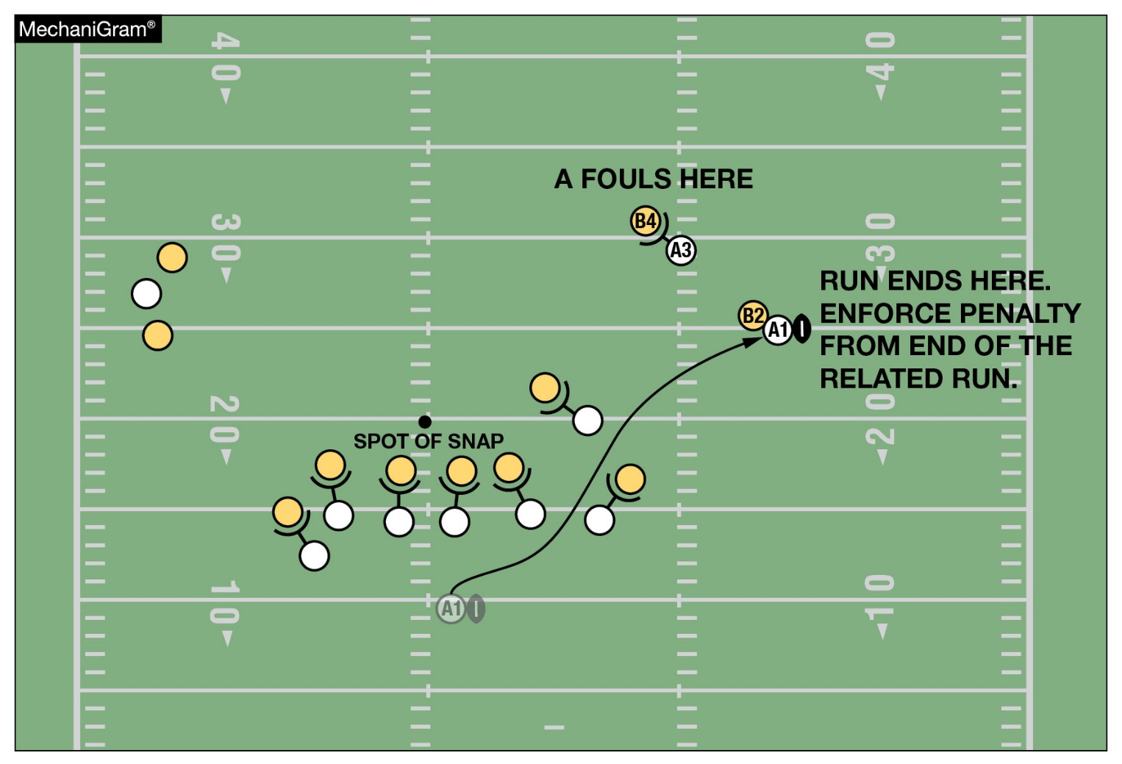
BASIC SPOTS
RULE 10-4-6c
The basic spot is the end of the run or related run for a foul by A that occurs beyond the line of scrimmage during a running play.
Notes:
Editorial Change:
Comment on Slide:
See comments on slide. Further clarified Basic Spots in Rule 10-4-6.

Slide 23
2024 Nfhs football editorial changes
Football Helmet Warning Statement | Added the words “is certified by the Safety Equipment Institute (SEI) to the” to the description of the NOCSAE standards process.
1-3-1b, 1-3-1i(5) | Added further clarification to the description on how the placement of the laces on the ball is measured when being produced and tested.
1-3-1g | Added the new 2024 format image for the NFHS Authenticating Mark.
1-5-1a(1) | Added new Figure 1-5-1a – NOCSAE Standard Logo for helmet.
1-5-1b(2), 1-5-1b(3) | Reformatted the jersey rules for clarification.
1-5-1c(5) | Noted that this rule on jersey numbers takes effect in 2024.
1-5-2b | Added new Figure 1-5-2b – NOCSAE Standard Logo for glove and SFIA Specification Logo for glove.
1-5-3b(6) | Added new Figure 1-5-3b(6) – NOCSAE Standard Logo for shin guard.
TABLE 1-7 (7) | Changed the rules reference in the Table for “Authorize the wearing of a commemorative/memorial patch.”
Notes:
Comment on Slide:
This slide lists the rules references and a brief description of the additional football editorial changes that were made to the 2024 NFHS Football Rules Book.

Slide 24
2024 Nfhs football editorial changes
1-8 | Further clarified State Association Accommodations.
2-8 | Split the definition on Encroachment up into two Articles and updated the rules references within the Rule.
2-32-16 | Added further clarification on when a player is no longer defenseless.
5-2-4 | Updated the rules reference within the Rule.
7-2 PENALTY | Deleted Art. 5d from the Illegal Numbering Penalty.
TABLE 7-5 | Added “or Related Run” to the Enforcement Spot for Illegal Forward Pass.
9-2 PENALTY | Changed the signal reference for “Illegal Use of Hands or Arms” to signal 43.
9-5-1g, 9-8-1j | Further clarified and standardized rules language that has been approved by the NFHS Rules Review Committee for all 2024-25 NFHS Rules Books on alcohol and tobacco.
9-8 PENALTY | Further clarified the responsibility of the head coach within the Penalty.
Notes:
Comment on Slide:
This slide lists the rules references and a brief description of the additional football editorial changes that were made to the 2024 NFHS Football Rules Book.

Slide 25
2024 Nfhs football editorial changes
10-3-1c, NOTE | Deleted letter c and the NOTE in the Rule under a “Loose-Ball Play Action.”
10-4 | Further clarified Basic Spot.
10-5 | Further clarified Special Enforcement Rules and deleted some Articles.
TABLE 10-4 | Revised TABLE 10-4.
PENALTY SUMMARY | Updated the signal references in LOSS of 10 YARDS for “Illegal Blocking,” “Runner Grasping a Teammate” and “Illegal Use of Hands or Arms” to signal 43.
Notes:
Comment on Slide:
This slide lists the rules references and a brief description of the additional football editorial changes that were made to the 2024 NFHS Football Rules Book.

Slide 26
2024 nfhs football rules reminders

Slide 27
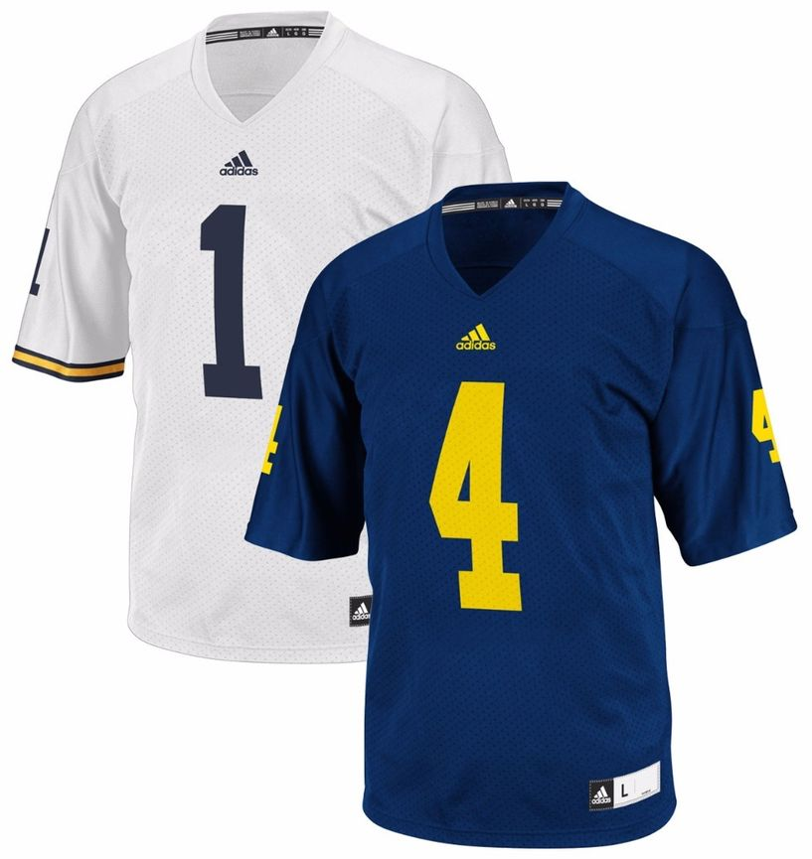
2024 - Football JERSEY numbers
RULES 1-5-1c; 1-5-1c(5)
Effective with the 2024 season, the entire body of the number (the continuous horizontal bars and vertical strokes) shall be a single solid color that clearly contrasts with the body color of the jersey.
Notes:
Rules Reminder:
Comment on Slide:
See comments on slide.

Slide 28

UNIFORM ADORNMENTS - TOWELS
Rule 1-5-3a(5)a 4, 5
It is legal for a player to have one moisture-absorbing solid-colored towel that has no more than one visible manufacturer's logo/trademark reference that does not exceed 2¼ square inches and does not exceed 2¼ inches in any dimension; and has no more than one school logo/trademark reference that does not exceed 2¼ square inches and does not exceed 2¼ inches in any dimension.
Towels do not have to be the same solid color for each player.
Notes:
Rules Reminder:
RULE 1 – SECTION 5 PLAYER EQUIPMENT
ART. 3 . . . Illegal equipment. No player shall participate while wearing illegal equipment. This applies to any equipment, which in the opinion of the umpire is dangerous, confusing or inappropriate. Illegal equipment shall always include but is not limited to:
a. The following items related to the Game Uniform: …
5. Uniform adornments, with the exception of:
(a) One moisture-absorbing solid-colored towel that:
(1) is not ball- or penalty flag-colored;
(2) is no less than 4 inches in width and 12 inches in length;
(3) is no greater than 18 inches in width and 36 inches in length;
(4) has no more than one visible manufacturer's logo/trademark reference that does not exceed 2¼ square inches and does not exceed 2¼ inches in any dimension; and
(5) has no more than one school logo/trademark reference that does not exceed 2¼ square inches and does not exceed 2¼ inches in any dimension. …
Rationale for Change:
2023 Rule Change - Player towels may contain one manufacturer’s logo and/or one school logo neither exceeding 2¼ square inches. Towels must be a solid color but now do not have to be the same solid color for each player. Towels may not be ball- or penalty-flag colored.
Case Book: See SITUATION 3.5.10L

Slide 29
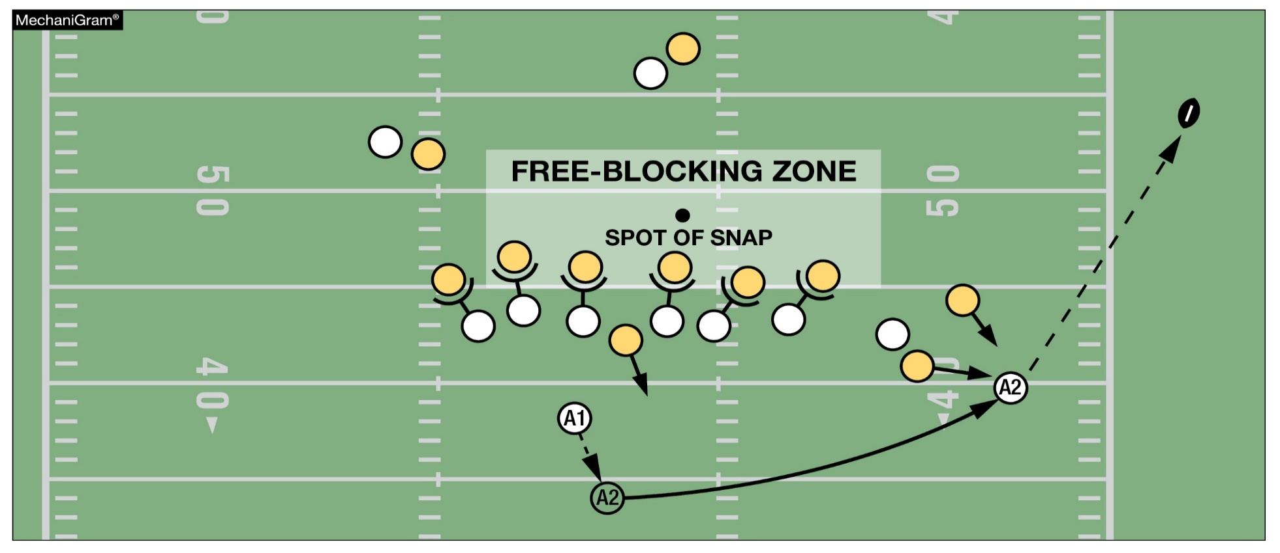
intentional grounding EXCEPTION
Rule 7-5-2d EXCEPTION 2a, c, TABLE 7-5-2 d EXCEPTION 2a, c, TABLE 7-5 (1) d EXCEPTION 2a, c
This is a foul for intentional grounding since A2 is the second player to possess the ball. Only the player who possessed the ball after the snap ends may take advantage of the intentional grounding exception.
Notes:
Rules Reminder:
RULE 7 – SECTION 5 FORWARD-PASS CLASSIFICATION
ART. 2 . . . An illegal forward pass is a foul. Illegal forward passes include:
a. A pass after team possession has changed during the down.
b. A pass from beyond the neutral zone.
c. A second and subsequent forward pass(es) thrown during a down.
d. A pass intentionally thrown into an area not occupied by an eligible offensive receiver, or thrown incomplete to save loss of yardage or to conserve time.
EXCEPTIONS:
1. It is legal for a player positioned directly behind the snapper to conserve time by intentionally throwing the ball forward to the ground immediately after receiving the snap that has neither been muffed nor touched the ground.
2. It is legal for a player to conserve yardage by intentionally throwing an incomplete forward pass if all of the following conditions are met:
a. The passer has possessed the ball beyond the lateral boundary of the free-blocking zone as established at the snap;
b. The pass reaches the neutral zone, including the extension beyond the sideline; and
c. The passer is the only player to possess the ball after the snap ends.
Rationale for Change:
2023 Rule Change - This change permits the exception for intentional grounding to the first and only player to possess the ball after the snap ends.
Case Book: See SITUATION 7.5.2D

Slide 30



NFHS Authenticating Mark update
Specifications
Do not use the NFHS Authenticating Mark without prior written approval from the NFHS
This mark is for use of licensees only.
Minimum size
  Inflatable Balls - 2 ½" (Football)
  On a ball, the NFHS logo may be smaller than manufacturer’s logo, but should be placed in proximity to the manufacturer’s name for easy identification. Allow enough space around the logo so it can be easily recognized as distinct and separate.
  Reproduce the logo only from the vector artwork provided here or on Direct Licensing Hub. Do not copy, scan art electronically or use as a template to redraw the symbol.
Note: If sizing or specifications do not work well in your particular design situation, contact K12 Licensing.
A current list of NFHS authenticated products can be found at www.nfhs.org, Resources, Authenticating Mark
Current Logos
New Logo
Notes:
Rules Reminder:
Comment on Slide:
See comments on slide. The NFHS has approved a new NFHS Authenticating Mark starting in 2024 on the ball.
Please see Rule 1-3-1g for the approved formats for the NFHS Authenticating Mark on the ball.

Slide 31



Football nfhs authenticating mark
Old Size
Current Size
OR
1.25”
2.5”
10.875”
10.875”
Notes:
Rules Reminder:
Comment on Slide:
See description on slide. The NFHS has approved a new NFHS Authenticating Mark starting in 2024 that has increased in size on the ball.
Please see Rule 1-3-1g for the approved formats for the NFHS Authenticating Mark on the ball.

Slide 32
2024 nfhs football points of emphasis

Slide 33
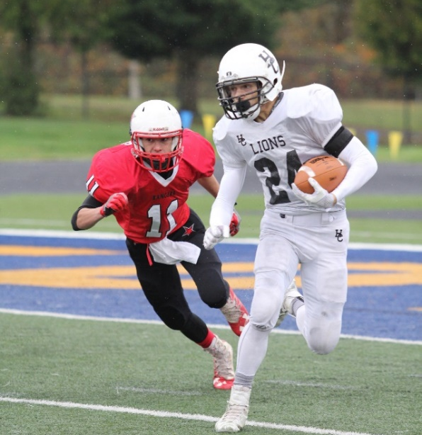
2024 nfhs football points of emphasis
Sportsmanship and Altercation Prevention
and Protocol
Player Equipment and Enforcement
3. Formations
Notes:
Comment on Slide:
The following football points of emphasis were selected by the NFHS Football Rules Committee for the 2024 high school football season. These three football points of emphasis need to be stressed to all coaches, game officials, players, parents, school administrators, appropriate health-care professionals and all others who have an interest in high school football.

Slide 34
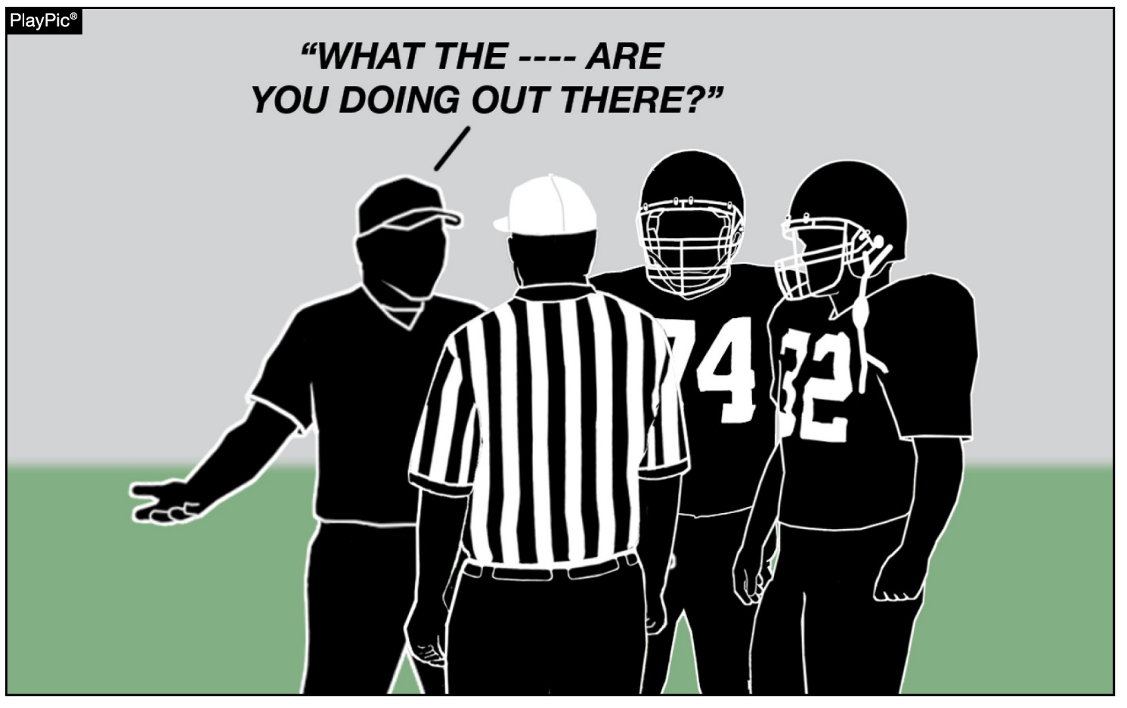
SPORTSMANSHIP and altercation prevention and protocol
Coaches must teach, promote, model and set clear standards of behavior for themselves, players and fans. Game officials must fairly and consistently enforce NFHS rules in all aspects related to unsporting behavior by coaches and participants. Everyone involved must clearly understand that education-based athletics is an extension of the classroom and is about more than just winning and losing.
Notes:
Sportsmanship and Altercation Prevention and Protocol (Point of Emphasis):
The National Federation of State High School Associations (NFHS), state associations, coaches and game officials across the country are concerned as unsporting behavior in education-based athletics continues to escalate across all sports. A commitment to a collaborative, working relationship to promote good sportsmanship and teach and enforce NFHS rules and state association expectations is paramount to continue to safely conduct the game.
Everyone associated with high school football has a role to play in creating a positive, sportsmanlike atmosphere at games. The NFHS must continue to address poor sporting behavior and promote the value of good sportsmanship. State associations must clearly set expectations in regard to unsportsmanlike behavior and enforce association rules regarding violations of those expectations. School administrators and coaches must teach, promote, model and set clear standards of behavior for themselves, players and fans. School administrators and coaches should also ensure that additional personnel on the sideline, outside the team box, adhere to set standards of sportsmanship. Game officials must fairly and consistently enforce NFHS rules in all aspects related to unsporting behavior by coaches and participants. Players and parents must model respect for coaches and game officials’ decisions, opponents and adhere to and promote the set expectations regarding sportsmanship.
Everyone involved must clearly understand that education-based athletics is an extension of the classroom and is about more than just winning and losing, getting scholarships and gaining accolades. Education-based athletics is about learning, and the conduct and actions of everyone involved should reflect this.
In order to prevent unsportsmanlike issues from escalating please consider the following preventive protocols.

Slide 35
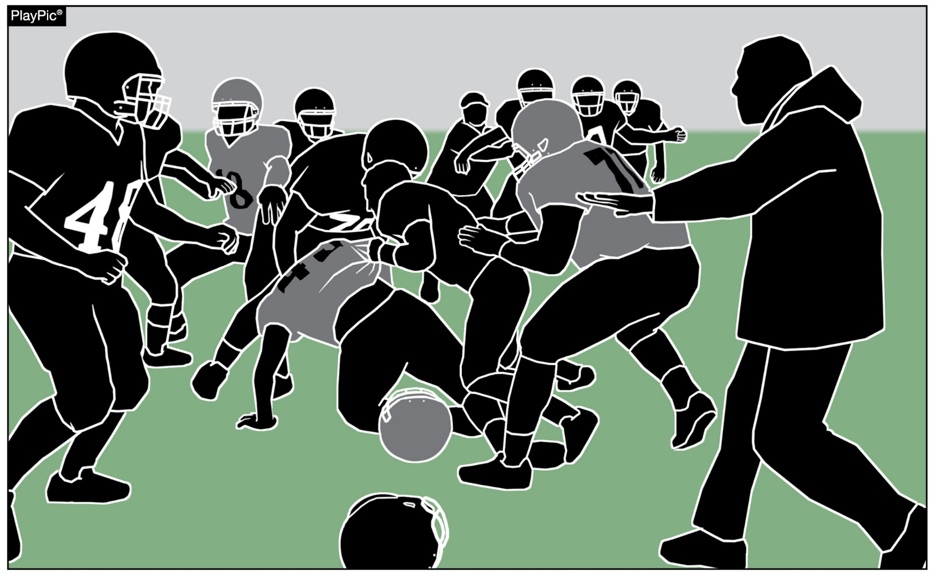
SPORTSMANSHIP and altercation prevention and protocol
Fights that escalate beyond the initial incident tend to do so because others run toward the fight. Coaches are urged to instruct their team and even practice what to do in case an altercation occurs.
Notes:
Sportsmanship and Altercation Prevention and Protocol (Point of Emphasis) - continued:
Fight or Altercation Protocol
Most fights end quickly. Fights that escalate beyond the initial incident tend to do so because others run toward the fight. Running toward a fight normally contributes to the escalation of the altercation.
1. Prepare before it happens. Make sure to instruct and even practice what to do in case an altercation occurs.
a. Assign specific coaches or administrators to run to the altercation to assist with breaking it up.
b. Assign specific coaches to immediately step off the sideline and turn their attention to keeping the players on the sideline.
c. Team members already on the field should distance themselves from the altercation.
d. Educate all participants about the penalties associated with fighting, leaving the team area, taunting, using offensive gestures, and other unsportsmanlike acts.
e. Instruct your video crew to continue to record or to start recording if an altercation occurs.
f. Know where security is stationed.
g. Keep all non-essential people off the sideline and preferably behind a fence or barrier.
2. If an altercation does occur, execute the above plan.
3. Once the participants are separated, keep them separated until play can safely resume or until administrators and game officials decide how to proceed.
4. Do not allow teams to simultaneously use the same exits or occupy the same areas following an altercation or chippy contest.

Slide 36
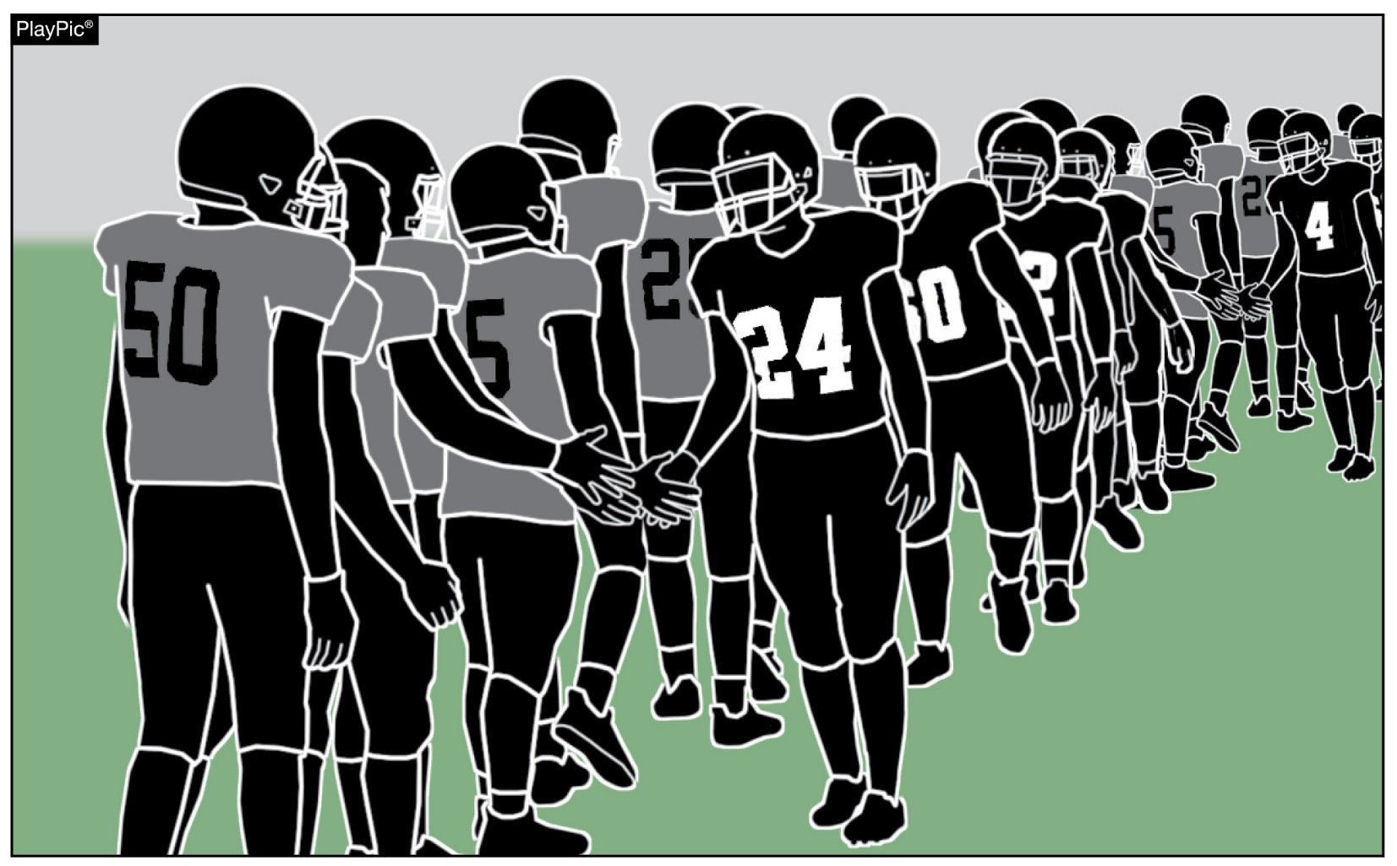
SPORTSMANSHIP and altercation prevention and protocol
Postgame handshake line protocol should be followed by both teams. Among the points, administrators and security from both schools should be stationed on the field in close proximity to the handshake line. One team should be on the right and the other team should be on the left. Players from one team should not be allowed to walk down both sides of the line.
Notes:
Sportsmanship and Altercation Prevention and Protocol (Point of Emphasis) - continued:
Handshake Line Protocol
1. Administrators/security from both schools should be stationed on the field in close proximity to the handshake line.
2. One team should be on the right and the other team should be on the left. Players from one team should not be allowed to walk down both sides of the line.
3. Absolutely no non-essential personnel should be allowed on the field or sidelines until both teams have reached a designated area after completion of the handshake line.
4. A coach or administrator should be stationed at the end of the handshake line to direct the players who have completed the line to a designated area on their end of the field. Do not allow the players to continue to the opposing sideline or to the other end of the field.
5. Have one or more coaches at the front of the line and one or more at the end of the line. Improving the current state of the game regarding the prevalence of unsporting behavior requires that everyone involved commit to addressing the issue. Civility, even in the midst of intense competition, matters.

Slide 37
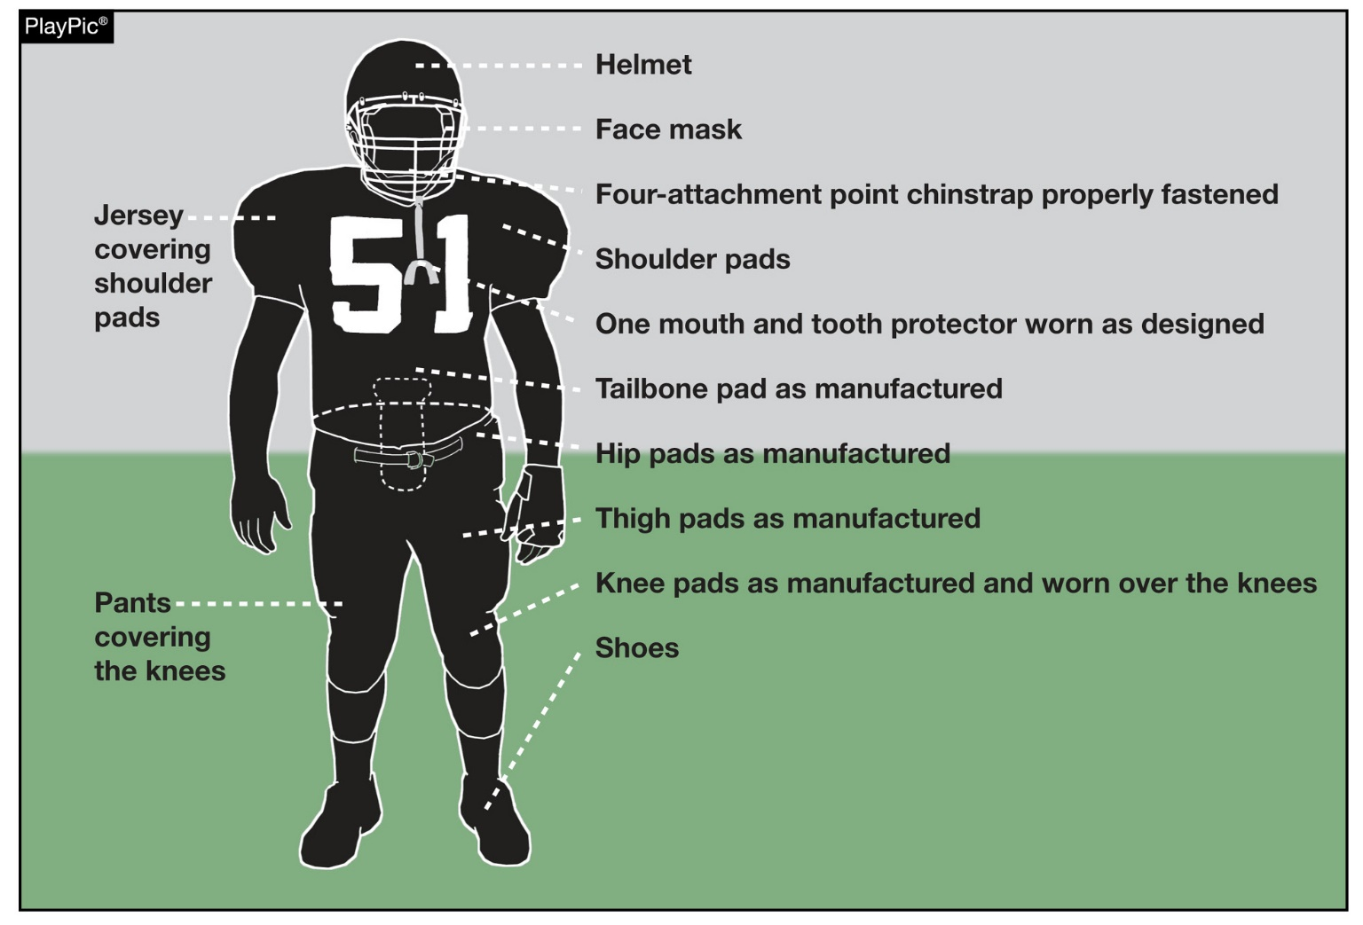
Player EQUIPMENT and enforcement
To support the safety of all participants, players must wear equipment and uniforms that are properly fitted and worn as intended by the manufacturer. Before starting each game, the head coach must verify that all players are properly and legally equipped.
Notes:
Player Equipment and Enforcement (Point of Emphasis):
To support the safety of all participants, players must wear equipment and uniforms that are properly fitted and worn as intended by the manufacturer. Before starting each game, the head coach must verify that all players are properly and legally equipped.
The use of knee pads is an area targeted for emphasis. Due to potential injury, it is essential that players only be allowed to participate if their pants and knee pads comply with the rules. Pants must completely cover the knees, and knee pads must be worn over the knee. In pregame duties, game officials should be watchful and proactive in addressing potential equipment, and more specifically, knee pad issues. Players often wear pants that slide up and expose the knee during movement. Game officials should communicate with coaches and/or players and ensure that only legally and properly equipped players are allowed to participate – noncompliance results in nonparticipation.
It is the shared responsibility of the coaches, players and game officials to closely monitor equipment issues and act in accordance with NFHS football playing rules on this subject. The specific areas of concern include the wearing of mandatory equipment by each player at all times while the ball is live, properly wearing any mandatory/legal equipment as intended by the manufacturer, and avoiding the use of any illegal equipment at any time by any player. It must be noted that NFHS Football Rules 3-5-10e and 9-8-1h directly address the correct enforcement for violations of these specific equipment rules. Coaches, game officials and players should work together and support the safety of all participants by ensuring that NFHS football equipment and uniform rules are followed.

Slide 38
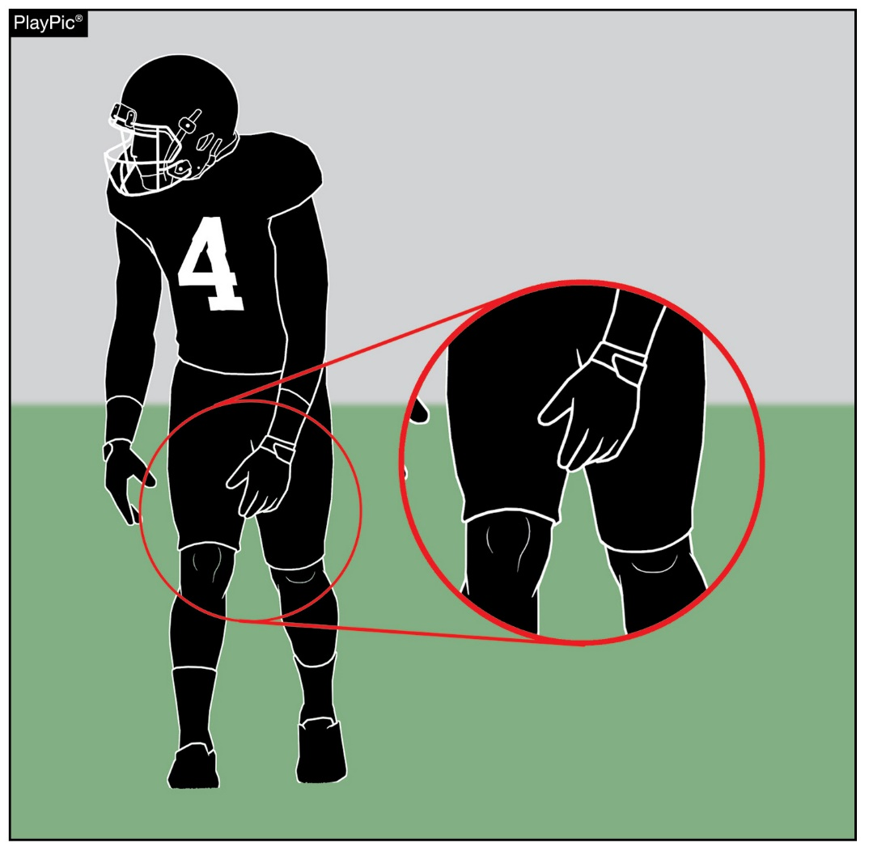
Player EQUIPMENT and enforcement
Due to potential injury, it is essential that players only be allowed to participate if their pants and knee pads comply with the rules. Pants must completely cover the knees, and knee pads must be worn over the knee. Game officials should be watchful and proactive in addressing potential equipment, and more specifically, knee pad issues.
Notes:
Player Equipment and Enforcement (Point of Emphasis) - continued:
Comment on Slide:
See comments on slide.

Slide 39
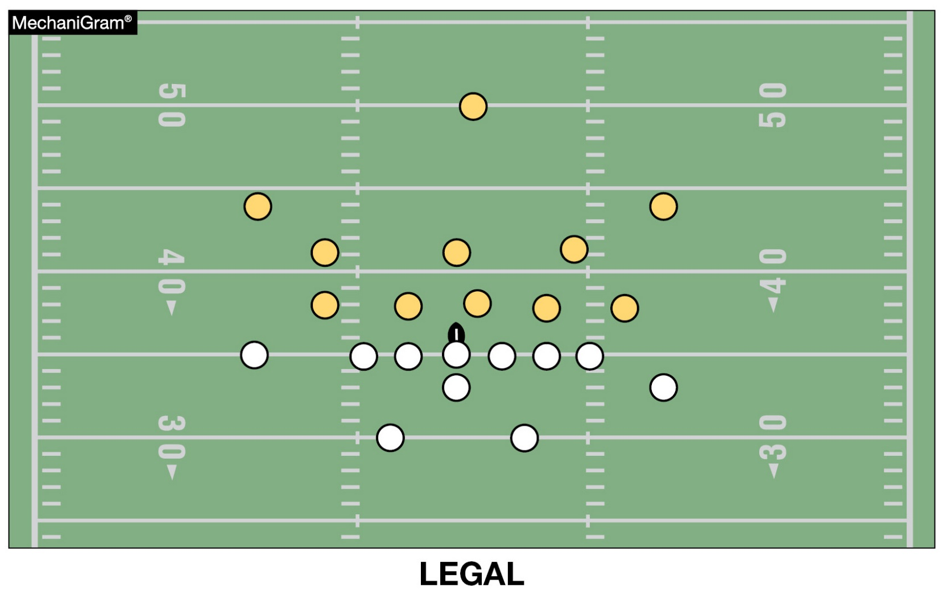
formations
A legal formation has no more than four players in the backfield. A back is any A player who has no part of his body breaking the
plane of an imaginary line drawn parallel to the line of scrimmage through the waist of the nearest teammate who is legally on the line, except for the player under the snapper, who is also considered a back.
Notes:
Formations (Point of Emphasis):
Over the past several years, there has been a considerable decline by many teams in their efforts to line up legally. There has also been a decrease by game officials with enforcement of illegal formations, especially involving offensive linemen. Linemen are legally on the line of scrimmage when they face their opponent’s goal line and have a head or foot breaking the imaginary plane through the waist of the snapper. It has become fairly common to see guards or tackles line up a yard or two off the ball to aid in pass blocking or pulling. Doing so provides a significant advantage for the offense and should be addressed at the first opportunity by coaches and game officials.
A back is an “A” player who has no part of his body breaking the plane of the waist of the nearest teammate who is on the line of scrimmage. Formations become illegal when backs are not clearly in the backfield. If an offensive player lines up by intersecting the waistline of the tackle, but not the center, Team A has committed an illegal formation foul because all Team A players must be a lineman or back. Receivers who wish to line up as a back should have “daylight” between the rear end of the nearest lineman and their nearest body part. Communicating with the line of scrimmage official on your side of the field is the best way to avoid a formation foul.

Slide 40
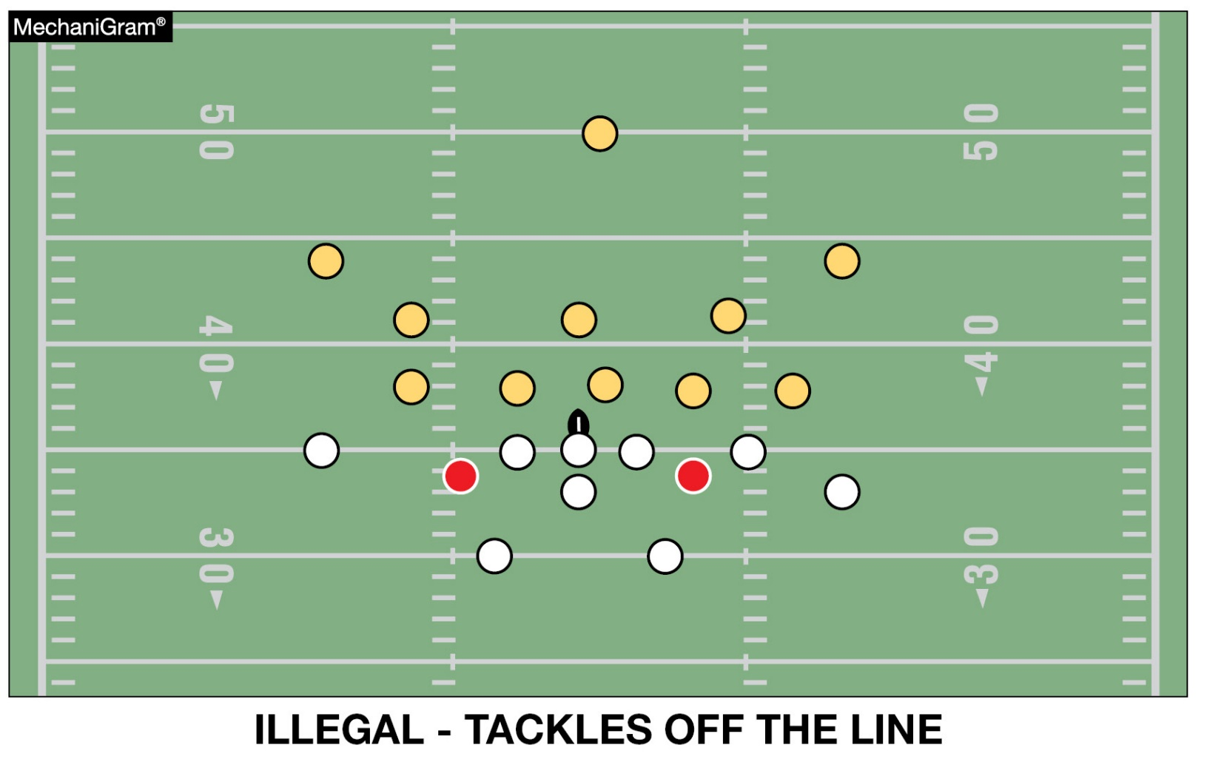
formationS
Linemen are legally on the line of scrimmage when they face their opponent’s goal line and have head or foot breaking the imaginary plane through the waist of the snapper. It has become fairly common to see guards or tackles line up a yard or two off the ball to aid in pass blocking or pulling.
Notes:
Formations (Point of Emphasis) - continued:
All coaches should spend time learning and periodically reviewing the current NFHS football playing rules so they can effectively communicate correct information on to their players. Someone on the coaching staff should be assigned to monitor player compliance and understanding of formation rules during practice and game play. Early and consistent communication between coaches, players and game officials will permit the game to proceed with less disruption to the flow.
Game officials should monitor pre-game warm-up and communicate (through coaches) to allow them to correct borderline or illegal formation issues they have observed. Once the contest begins, preventive officiating skills should be used at the earliest opportunity to allow coaches to make adjustments before formation issues become egregious. However, formations that clearly and obviously do not meet the specifications of NFHS Football Rules 2-32-3, 2-32-9 and 7-2 must be penalized as fouls without warning.

Slide 41
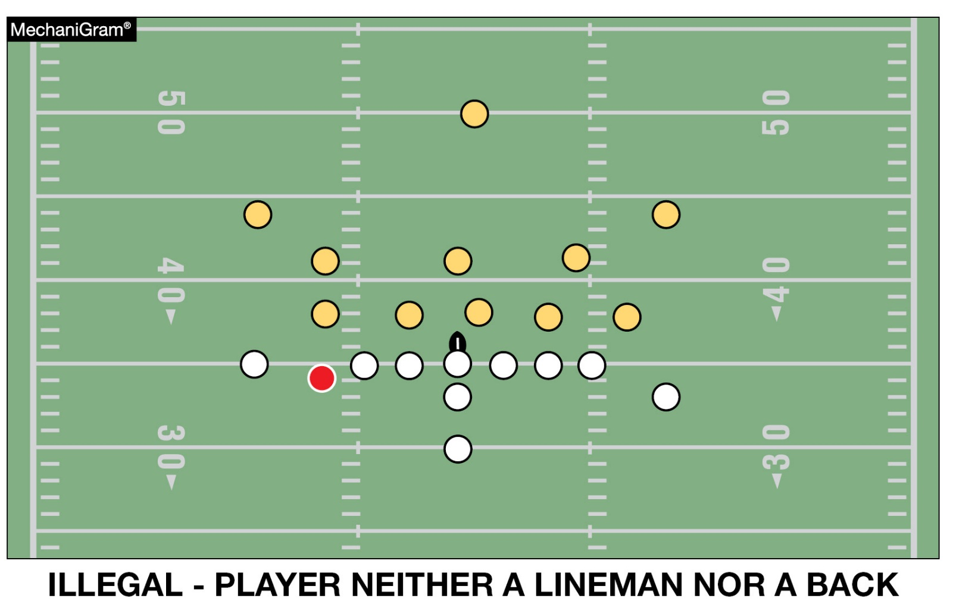
formationS
If an offensive player lines up by intersecting the waistline of the tackle, but not the center, Team A has committed an illegal formation foul because all Team A players must be a lineman or back. Receivers who wish to line up as a back should have “daylight” between the rear end of the nearest lineman and their nearest body part.
Notes:
Formations (Point of Emphasis) - continued:
Comment on Slide:
See comments on slide.

Slide 42
2024-25 nfhs football information

Slide 43

2025 nfhs football rule change proposal online form
Due:
November 1, 2024
Must be submitted to your state association office for approval.
Notes:
Comment on Slide:
ALL 2025 NFHS Football Rule Change Proposal Online Forms must first go through the state association office before it can be sent to the NFHS.
Only member state associations, football coaches and football game officials approved by the member state association, members of the NFHS Football Rules Committee and the NFHS can submit football rule change online proposal forms.
ALL 2025 NFHS Football Rule Change Online Proposal Forms must be submitted electronically online to the NFHS by November 1, 2024.

Slide 44
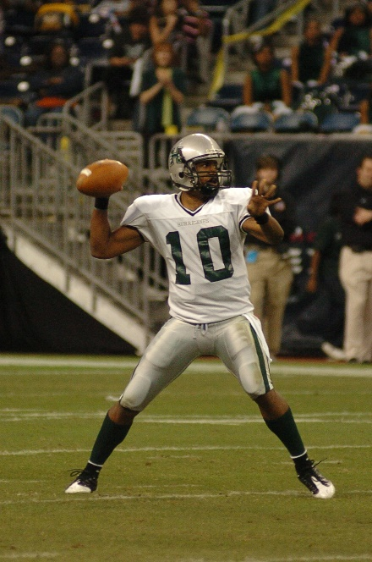
2024-25 nfhs football information
2024 In-Person NFHS Football Rules State Interpreters Meeting
  June 29, 2024 (NFHS Summer Meeting – Boston, MA)
  4:00 p.m. (Eastern Time)
2024 Online Mid-Season NFHS Football Rules Webinar
  September 23, 2024
  2:00 p.m. (Eastern Time)
2025 NFHS Football Rule Change Proposal Form Due
  November 1, 2024
2025 NFHS Football Rules Committee Meeting
  January 12-14, 2025
  Indianapolis, Indiana
Notes:
Comment on Slide:
2024-25 NFHS information with regards to football.

Slide 45
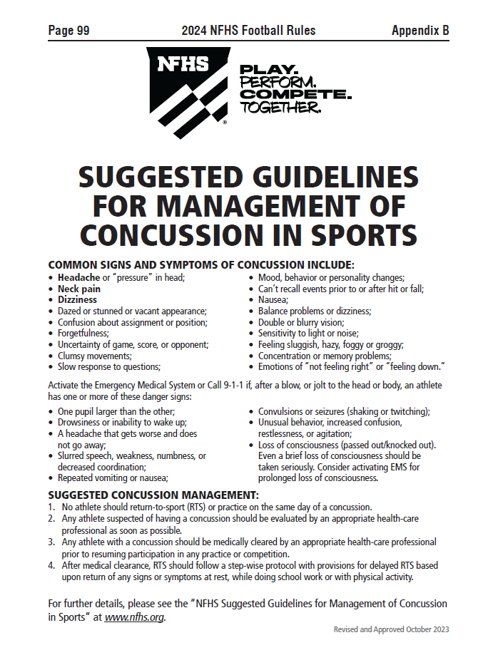
Nfhs suggested guidelines For management of concussion in sports
In the Appendix
in all of the
2024-25 NFHS
Rules Book
Notes:
Comment on Slide:
The “NFHS Suggested Guidelines for Management of Concussion” is in the Appendix in all of the 2024-25 NFHS Rules Books and was developed by the NFHS Sports Medicine Advisory Committee (SMAC).

Slide 46
Nfhs officials education

Slide 47

All things officiating in one place!
The all-in-one, cloud-based NFHS Center for Officials Services (COS) connects everyone associated with officiating. The COS handles registration, assignments, testing, payments, and a host of other features and integrations that consolidate all officiating needs into a single, modern solution. Free to all NFHS state associations, local associations, and assigner groups.
20+
Member States
300,000+
Officials
7,000+
Schools
Notes:
Comment on Slide:
See comments on slide.

Slide 48
COS Continued Improvements
Over 200 Updates and New Features in the Past 12 Months!
  COMING SOON
    Exam Center Improvements
    Streamlined Registrations and Onboarding
    Expanded Reporting Capabilities for States
    Event/Clinic Registration and Attendance Tracking
  Reciprocity
    In-State/Out-of-State
  Watch for Many More Updates from NFHS!
Notes:
Comment on Slide:
See comments on slide.

Slide 49
Nfhs learning center

Slide 50

Notes:
Comment on Slide:
The NFHS Learning Center is the home to more than 90 online professional development courses for everyone within the interscholastic community - coaches, students, officials, parents, administrators, and individuals within performing arts programs. More than 60 courses are available for free.
The NFHS is an Accredited Institution and has delivered more than 15 million courses on its NFHS Learning Center platform since its inception in 2007. In receiving national accreditation by Cognia, the NFHS has upheld itself to rigorous standards that focus on productive learning environments, equitable resource allocation that meet the needs of learners, and effective leadership.
The NFHS Learning Center features its flagship coaching course, “Fundamentals of Coaching,” as well as several health and safety courses that have been completed by millions of individuals, such as “Concussion in Sports,” “Heat Illness Prevention,” “Sudden Cardiac Arrest” and “Protecting Students from Abuse.” The NFHS Learning Center offers several national credentials that can be earned by individuals who complete specific NFHS courses. Through the School Honor Roll Program, schools can earn a physical banner to hang in their school.
To learn more and start your professional development journey, please visit the NFHS Learning Center at NFHSLearn.com.

Slide 51

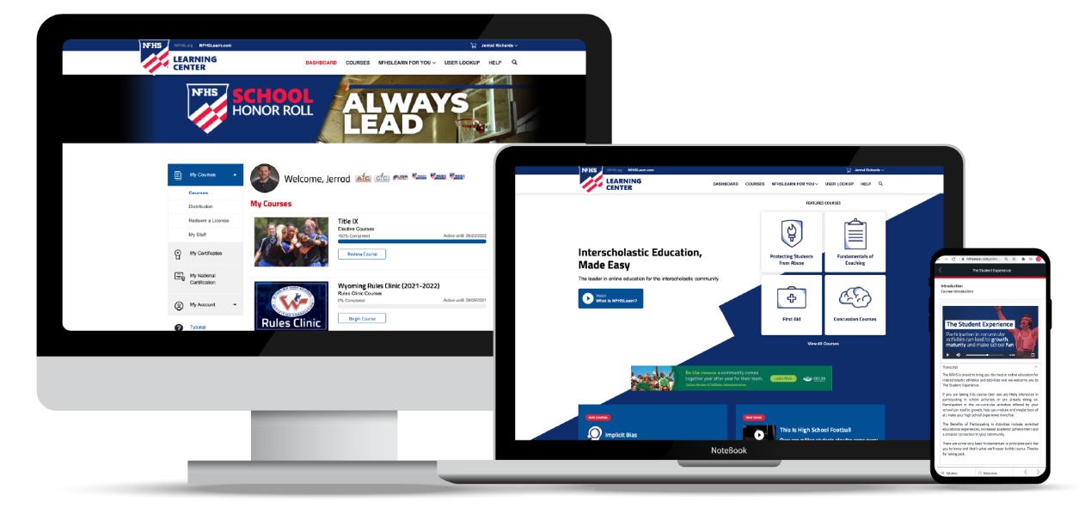
Over 21 million courses delivered!
Concussion in Sports – 7.2M+
Heat Illness Prevention – 2.2M+
Sudden Cardiac Arrest – 2.4M+
Concussion for Students – 1.2M+
The Collapsed Student (2020) – 67,550+
CPR & AED Training (2023) – 9,300+
Sportsmanship – 1M+
Fundamentals of Coaching – 928,000+
First Aid, Health and Safety – 418,000+
Bullying, Hazing and Inappropriate Behaviors – 425,000+
Student Mental Health and Suicide Prevention – 250,000+
Protecting Students from Abuse – 250,000+
Implicit Bias (2021) – 96,000+
Notes:
Comment on Slide:
See comments on slide.

Slide 52
NFHS Network

Slide 53


NFHS Network
By 2025, every high school sporting event in America will be streamed live.
The NFHS Network will be
THE DESTINATION for fans
to view these broadcasts.
27 Different Sports and Activities
www.NFHSnetwork.com
Notes:
Comment on Slide:
The NFHS Network is the leader in streaming Live and On Demand high school sports.
Partnered with the National Federation of State High School Associations, 45 high school state athletic/activities associations, and PlayOn! Sports, the NFHS Network is a joint venture created to provide fans with the ability to stream high school sports on any device, from wherever they are.
All NFHS Network events are available to watch online at www.NFHSnetwork.com and through the NFHS Network Live App for iOS and Android. Follow us on Facebook, Twitter, Instagram, and YouTube.
Watching high school sports and events has never been easier.
The NFHS Network’s goal to broadcast live all 2 million high school sporting events by 2025.
The NFHS Network covers 27 different regular season and postseason sports, as well as other high school activities, celebrating the accomplishments of students-athletes, student broadcasters, and high schools across the country.

Slide 54

Thank You
National Federation of State High School Associations
PO Box 690 | Indianapolis, IN 46206
Phone: 317-972-6900
www.nfhs.org | www.nfhslearn.com | www.nfhsnetwork.com

